Slide 1
Vision and Plans for Fermilab’s Next 10-20 Years
Lia Merminga
Snowmass Community Summer Study
University of Washington, Seattle
25 July 2022

Slide 2
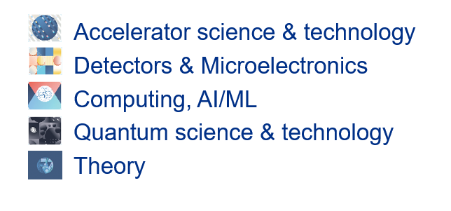
This is an exciting time for Particle Physics
Profound science questions and discovery potential
Significant advances in technology and other enabling drivers

Slide 3
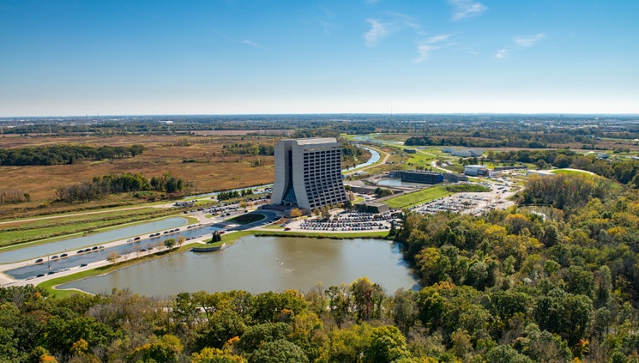
This is a defining moment for Fermilab
With the successful completion of LBNF/DUNE/PIP-II, Fermilab will become host to the first internationally conceived, constructed, and operated mega-science experiment on U.S. soil
US/Fermilab is universally acknowledged as the world leader in neutrino science
As it enters its next 50 years, Fermilab remains America's premier Particle Physics and Accelerator Laboratory, delivering groundbreaking science and technology innovation, underpinned by a world-class and diverse workforce, excellence in business and operations, a renewed and sustainable campus and strong and lasting regional, national and international partnerships

Slide 4
Over the next decade, Fermilab plans to:
Continuously deliver groundbreaking discovery science and technology innovation
Addressing the 2014 P5 science drivers and science priorities informed by the next P5 report
NOvA, SBN; LHC; Muon g-2; LSST-DESC, ….
Successfully complete the 2014 P5 plan, begin scientific exploitation consistent with P5 timeline
LBNF/DUNE; PIP-II; HL-LHC; Mu2e; CMB-S4
Host Lab for DUNE
In collaboration and coordination with the US community and international partners, ensure the success and impact of the new P5 strategic plan
Booster Replacement (BR), DUNE Phase II
Lay the groundwork for the next major facility onsite, as an international project, conceived and executed as a global endeavor
Pursue accelerator and detector R&D
BR, DUNE Phase II, FCC @CERN, next major facility @Fermilab
As sciences in their own right
Advance emerging science & technology capabilities → further enhancing lab’s core mission
Quantum Information Science & SQMS Center
Artificial Intelligence / Machine Learning
Microelectronics

Slide 5
Over the next decade, Fermilab also plans to:
Diversify and empower our workforce
Develop and execute a workforce and diversity strategic plan
Foster a culture of respect, inclusion, transparency, integrity and excellence that is essential to ground-breaking science
Partner with Chicagoland and nationwide colleges and universities, including minority serving institutions, to host upwards of 100s of students and advanced degree programs
Achieve excellence in business & operations, and renew our campus infrastructure with sustainability goals, integrated with science vision
Forge strong regional, national, international partnerships: with University of Chicago, Argonne, Universities Research Association and other national and international institutions
Launch a strategic plan for Fermilab’s next 20 years

Slide 6
Strategic Thrusts: Pillars of our vision for Fermilab
Deliver groundbreaking science and technology innovation
Building for Discovery: Project Execution
Diversify and empower our workforce
Transform business systems & operations, execute sustainable campus strategy integrated with science vision
Forge strong alliances with UChicago, ANL, URA and other national/international institutions
Develop Strategic Plan for Fermilab’s next 20 Years

Slide 7
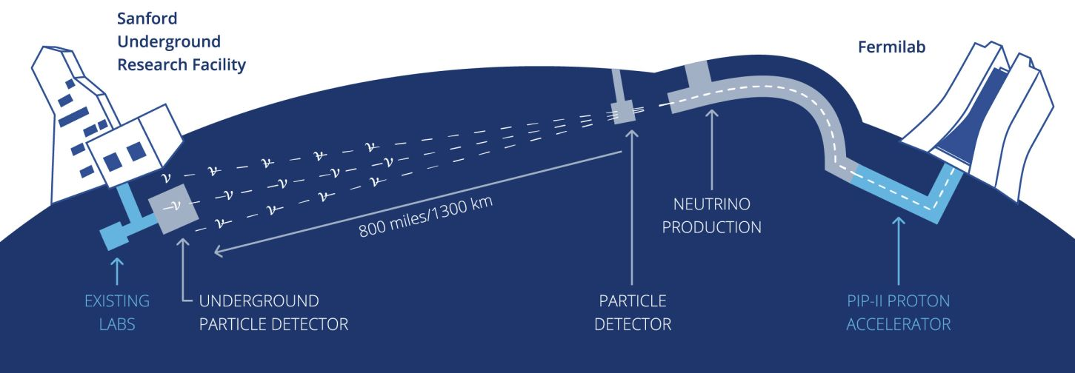
DUNE: The world’s most capable neutrino experiment, driven by LBNF and PIP-II
S&T
Delivering on LBNF/DUNE is Fermilab’s highest priority

Slide 8
Proton Improvement Plan – II (PIP-II)

Slide 9
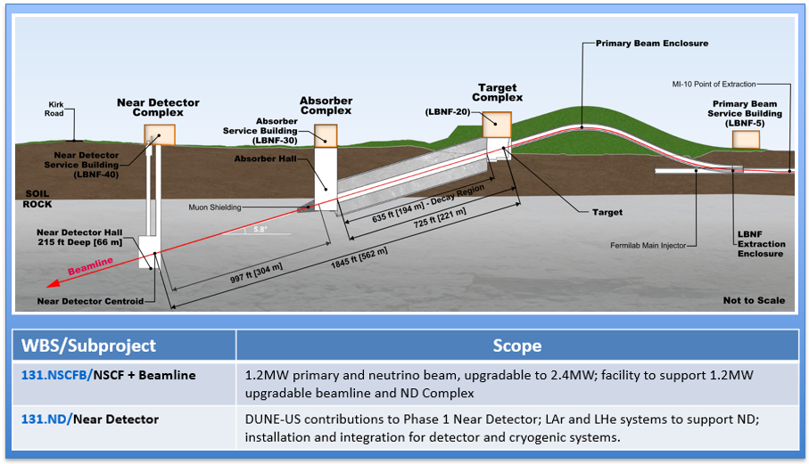
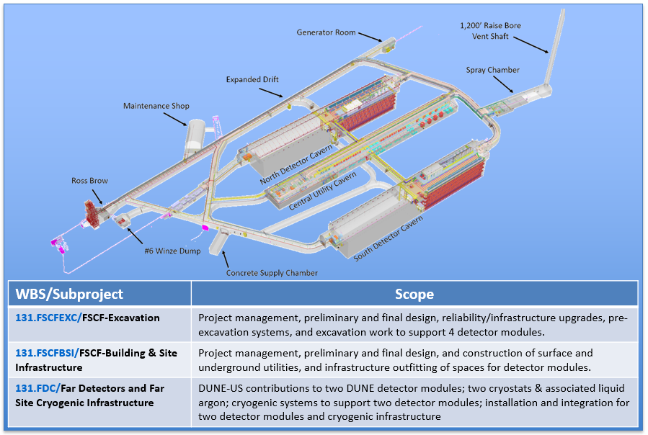
Near Site – Batavia, IL
LBNF/DUNE-US Project Scope
Far Site – SURF, Lead, SD
Over 50% of scope is at final design maturity

Slide 10
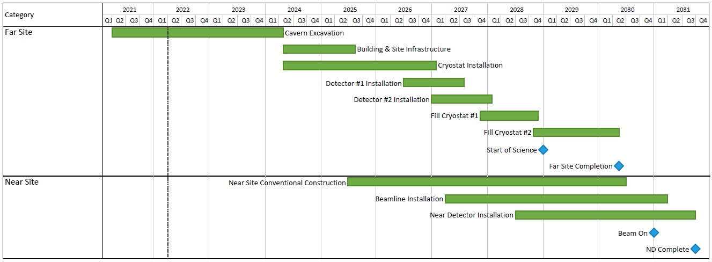
LBNF DUNE Summary Schedule

Slide 11
Definition of Phases
LBNF/DUNE-US Project + DUNE Int’l Project
Capability Description | Phase I | Phase II
Beamline
1.2MW (includes 2.4MW infrastructure) | X
2.4MW |  | X¹
Far Detectors
FD1 – 17 kton | X
FD2 – 17 kton | X
FD3 |  | X
FD4 |  | X
Near Detectors²
ND LAr | X
TMS | X
SAND | X
MCND (ND GAr) |  | X
Originally envisioned in the 2014 P5 plan
Phase I
Accomplished with PIP-II, LBNF/DUNE-US, and DUNE International Partners
Meets P5 minimum requirements to proceed by 2035 timeframe
Same project scope as proposed at CD-1R in July 2015
Phase II
Increased mass at Far Detector
More Capable Near Detector (MCND)
Increased beam power by Booster replacement
Note 1: requires upgrades to LBNF neutrino target and upgrades to Fermilab accelerator complex. The LBNF facility is built to support 2.4MW in Phase I. Note 2: Near Detector Subproject threshold scope provides “day 1” requirements to start the DUNE experiment

Slide 12
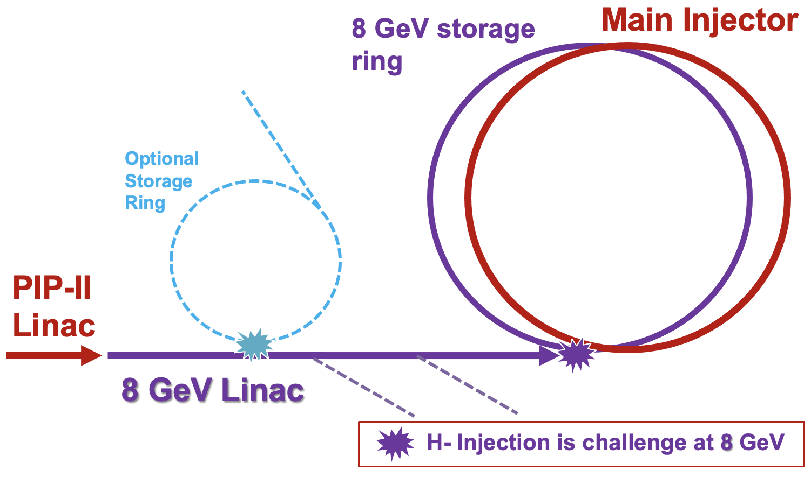
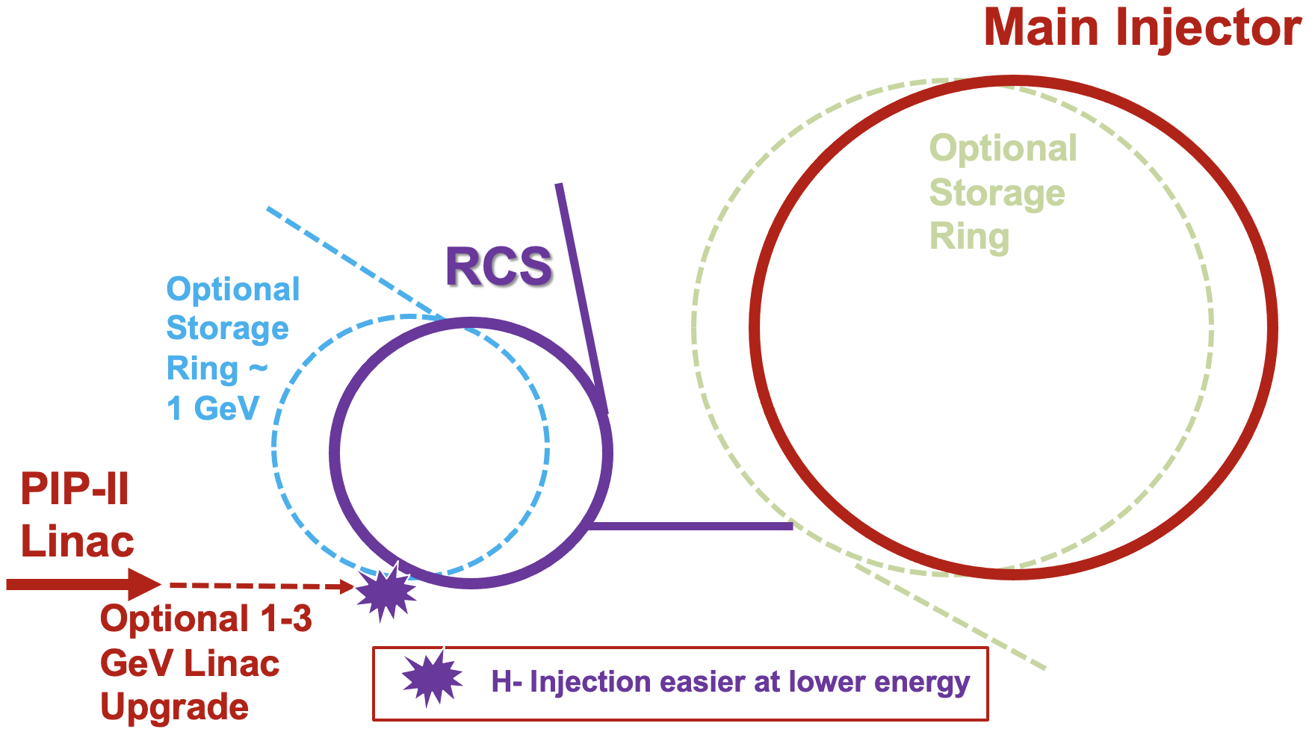
Booster Replacement
PIP-II provides a platform for extended physics program and future facility upgrades.
Booster replacement scenarios are developed informed by input from Snowmass/P5
Cost-effective and fastest path to increased power to 2.4MW for LBNF.
Capture options for additional medium and small-scale experiments.
Enable long-term vision.
Optional 1-3 GeV Linac Upgrade
H- Injection easier at lower energy

Slide 13
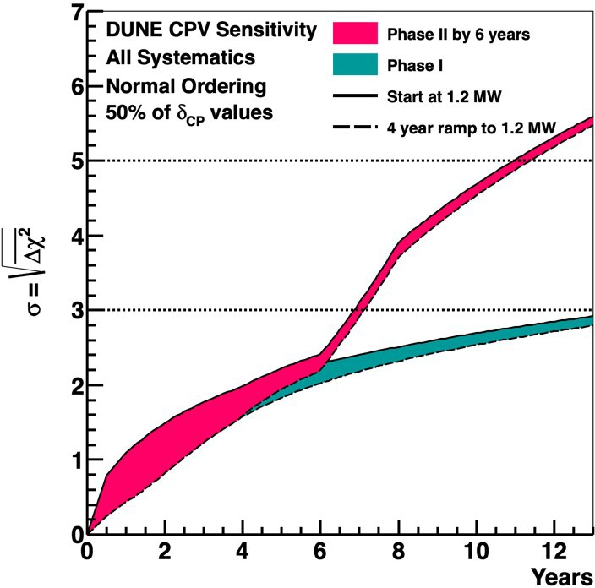
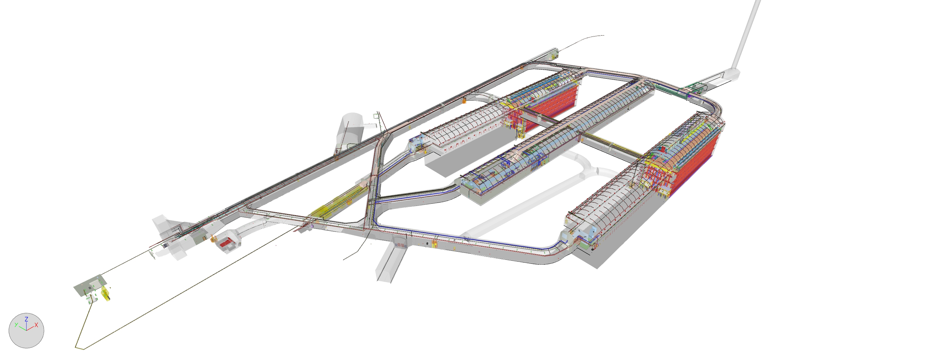
Far Detector Modules 3 and 4

Slide 14
Neutrino Science
Vision: US/Fermilab is universally acknowledged as the world leader in neutrino science for decades to come
 | FY22 | FY23 | FY24 | FY25 | FY26 | FY27 | FY28 | FY29 | FY30 | FY31 | FY32
NOvA
SBN
PIP-II
LBNF/DUNE
DUNE
BR
Operations
Operations
Construction
2040
Construction
Construction
2040
R&D

Slide 15
Collider Science
S&T
Vision: Fermilab continues to be the leading U.S. center for CMS and second leading center in the world after our partner CERN
CERN is our European sister laboratory and our strong partner in many areas
Major decadal goals
Maximize science from LHC Runs 2 and 3 data – ROC is back in Operations!
Execute HL-LHC AUP and CMS Detector Upgrade Projects
Advance R&D towards FCC @CERN
 | FY22 | FY23 | FY24 | FY25 | FY26 | FY27 | FY28 | FY29 | FY30 | FY31 | FY32
LHC
HL-LHC AUP
HL-LHC CMS
FCC @CERN
Future facility @ FNAL
Operations
Construction
Construction
2042
R&D / Prototyping
Physics studies / Pre-conceptual designs

Slide 16
Precision Science
S&T
Vision: Fermilab is a world center for accelerator-based Charged-lepton flavor violation (CLFV) and Dark Matter experiments, driven by intense particle beams and PIP-II/Booster Replacement
Major decadal goals
Muon g-2: Complete data production, analysis, theory to achieve 5σ
Complete Mu2e project and start science
Design and build Mu2e-II, other upgrades
 | FY22 | FY23 | FY24 | FY25 | FY26 | FY27 | FY28 | FY29 | FY30 | FY31 | FY32
Muon g-2
Mu2e
Mu2e-II
Operations/analysis
R&D
Construction
Operations
R&D
Construction

Slide 17
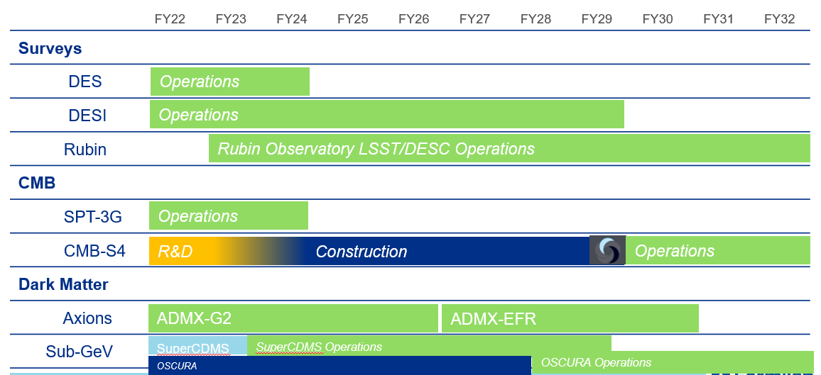
Cosmic Science
S&T
Vision: Fermilab is an essential partner in world-leading cosmic science experiments and is contributing innovative R&D efforts toward future dark energy, dark matter, and cosmic microwave background (CMB) experiments and a coordinated campaign of experiments seeking to directly detect and study the properties of dark matter particles in the laboratory.
Major Decadal Goals
Cosmic Surveys → Transition from DES to DESI, LSST
Cosmic Microwave Background → Grow: Major role in CMB-S4
Dark Matter Detection → Consolidate: G2, Axions, Sub-GeV

Slide 18
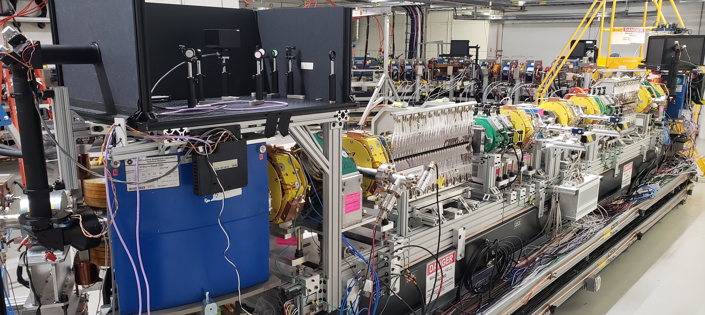
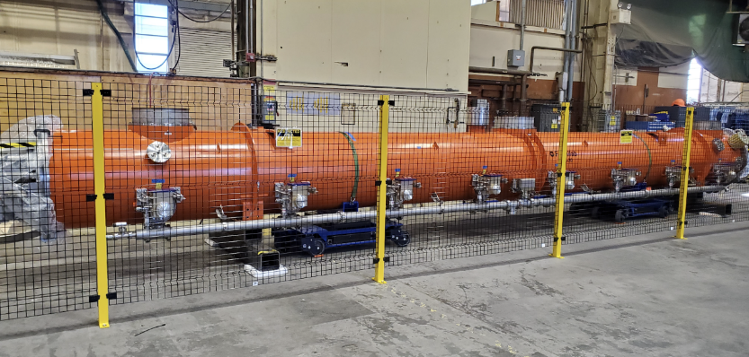
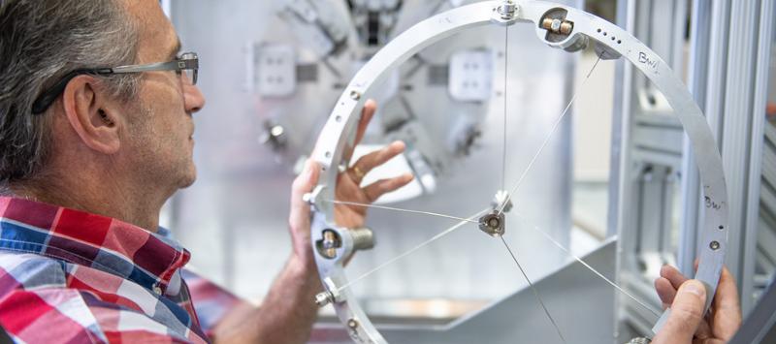
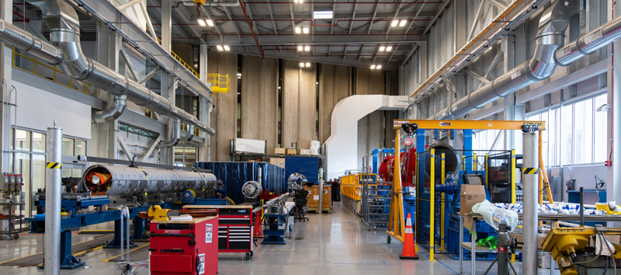
Accelerator Science & Technology
S&T
Vision: Fermilab is a world-leader in Accelerator Science and Technology R&D that enables the next generation of particle accelerators and advances the HEP and Office of Science mission. Fermilab is an essential partner of choice for future large-scale accelerators.
Major decadal goals:
Deliver 2.4 MW proton beam power to LBNF/DUNE
- Design, develop Booster Replacement
- Develop High Power Targetry capabilities
Advance R&D in high field magnets and Superconducting RF for FCC @CERN
Initiate physics studies and concepts towards next major facility on Fermilab site
Continue to advance accelerator science as science in its own right!
Continue to enable the mission of other Office of Science programs

Slide 19
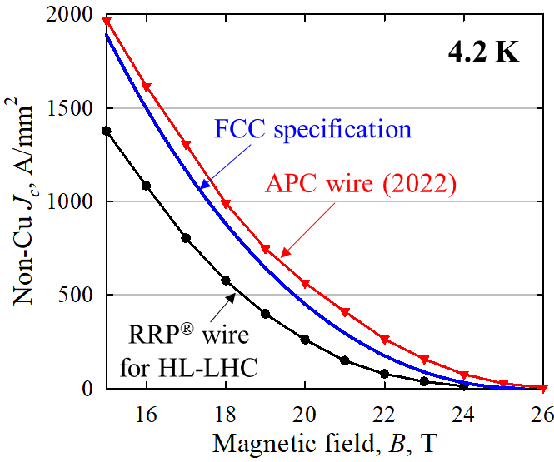
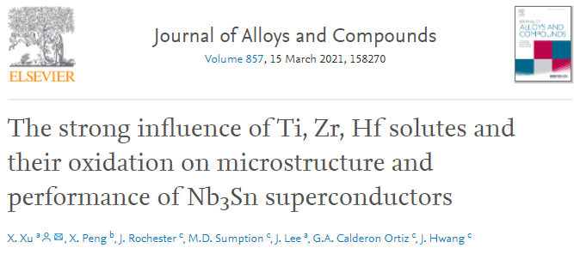
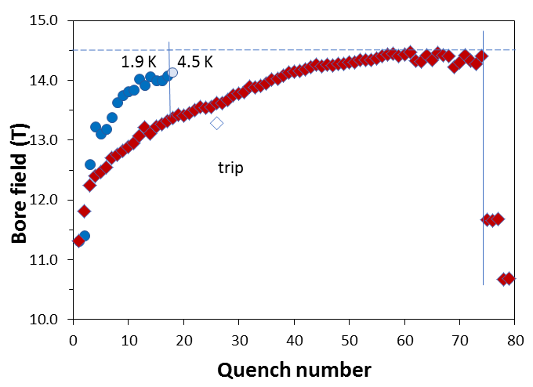
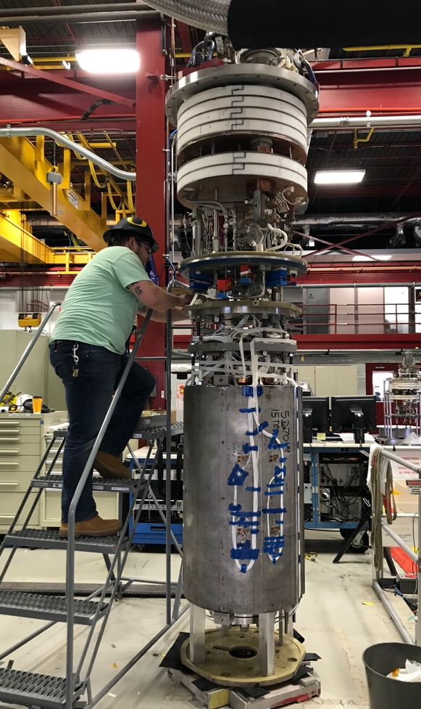
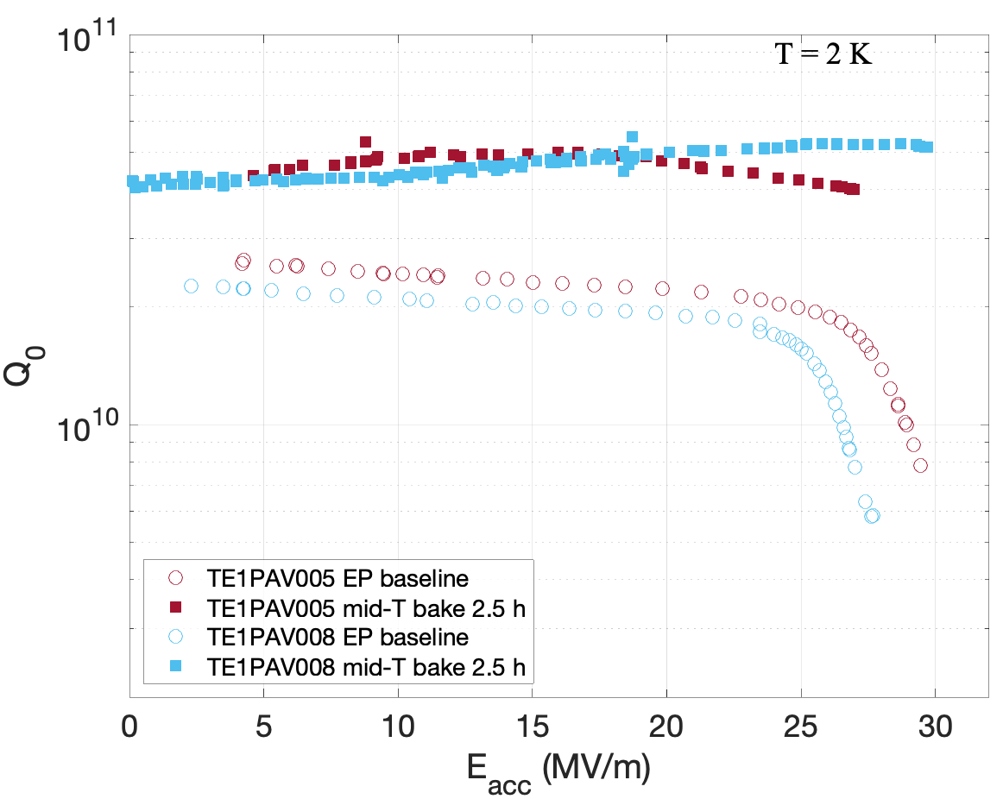
Fermilab Magnet and SRF Technology & FCC
Fermilab accelerator technology R&D programs are highly synergistic with ambitious goals of FCC-ee and FCC-hh
Fermilab magnet and SRF innovations can be leveraged for FCC:
Fermilab Nb₃Sn conductor with APCs exceeding FCC J_{c} spec for first time
TC1
TC2
“mid-T bake” for high Q₀ SRF cavities at medium fields
A. Zlobin at al.
World record 14.5 T Nb₃Sn dipole magnet

Slide 20
Emerging Science & Technology Capabilities
Quantum Information Science & SQMS
Artificial Intelligence / Machine Learning
Microelectronics

Slide 21
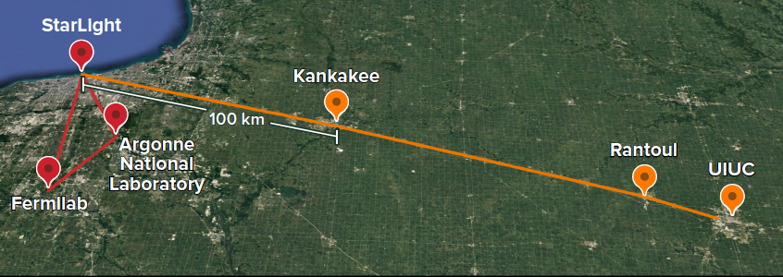
Quantum Information Science
S&T
Vision: Fermilab, together with Chicagoland partners, is a major US quantum center; hosts national facilities for Quantum Science, developing innovative approaches that enable HEP discovery.
Major decadal goals:
Execute SQMS Center decadal roadmap:
Utilizing SRF technology to develop record coherence for 3D cavities in quantum regime demonstrated at FNAL ~ 2 seconds → Quantum computer → Solving complex problems in HEP, CMP, medicine, climate, national security
Quantum Networks towards a Quantum Internet:
Fermilab together with Chicagoland and other collaborators to deploy a multi-node, multi-user metropolitan scale quantum network in the greater Chicago area → Urbana → ORNL
3. Deep Cryogenic electronics for utility-scale Quantum Computers

Slide 22
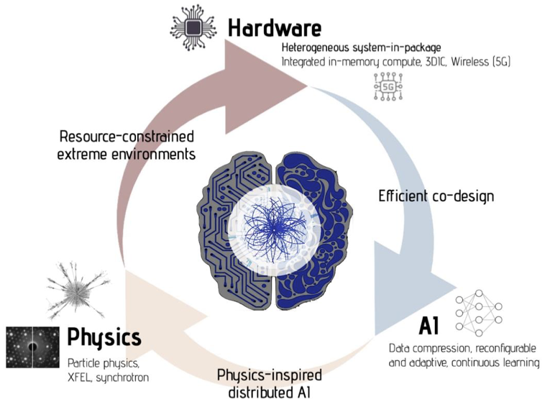
AI/ML to accelerate discovery science
Vision:
Develop powerful AI algorithms that are robust, interpretable, and explainable for reconstruction, simulation, and operations
Optimized accelerator and experimental facilities with real-time, continuous learning control
Build software and hardware infrastructure to support community AI computing needs including open data, benchmarks, and training
Advance world-leading capabilities in AI-on-chip for edge ML applications – strong connections with smart sensing, internet-of-things, and novel microelectronics
ML advances foster a diverse AI-ready workforce with strong multi-disciplinary teams and collaborations

Slide 23
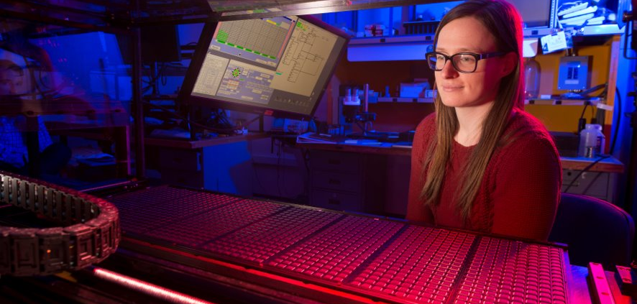
Microelectronics
Vision: Fermilab together with other national labs, academic and university partners establishes a major US Microelectronics Co-design center
Major decadal goals
Support the community for extreme environment microelectronic development
Enable lab-university-industry collaboration
Maintain and grow expertise in state-of-the art integrated circuit design and testing to enable precision science measurements
Develop smart detectors with integrated sensing-edge computing - communication
Engage with Industry on Heterogeneous Integration and Advanced packaging solutions
Leverage transformative technologies

Slide 24
Final Thoughts
Particle physics is global! The evolving international context remains essential
In this decade, Fermilab will complete the 2014 P5 strategic plan and follow the next P5 plan
DUNE Phase I will be realized, Phase II will be launched
Fermilab’s role for the HEP Community is an integral part of the Fermilab mission
as host of the USCMS and DUNE collaborations
as the nexus for US HEP, and the broader Snowmass Frontiers communities
as a resource for large-scale engineering, co-located expertise and capabilities, and intellectual vitality
as an International User Facility, dedicated to a diverse workforce and collaborative culture, and to enabling world-class scientific discovery

Slide 25
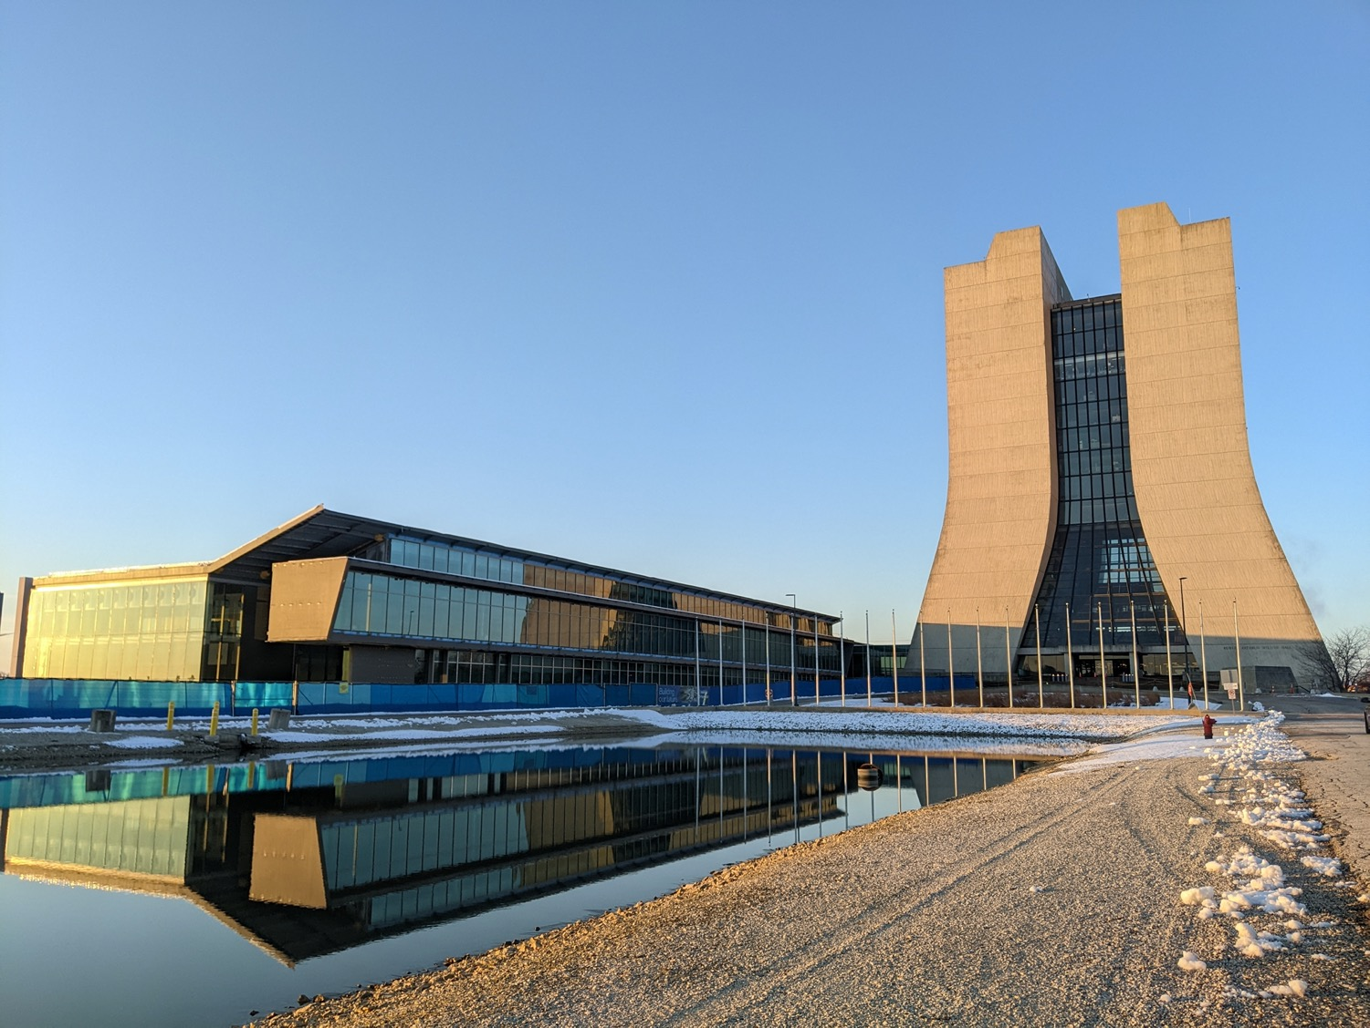
Thank you for your contributions to defining compelling future directions for our field!
Wilson Hall and IERC at dawn. The sloped roof on IERC is intended to mimic the curve of Wilson Hall rotated 90 degrees; this is especially evident when the image of IERC is doubled in the reflecting pond. Photo credit: Brian Rubik

