Slide 1
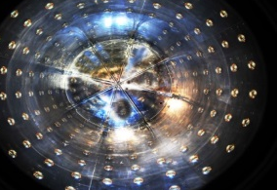
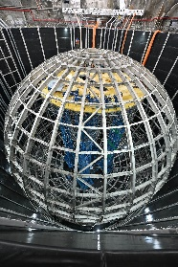
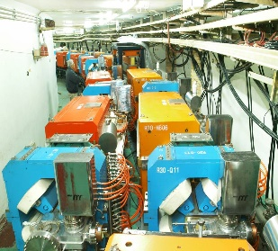
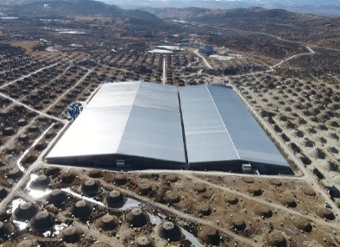
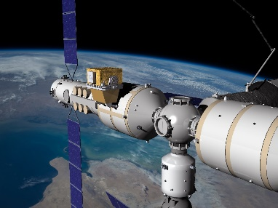
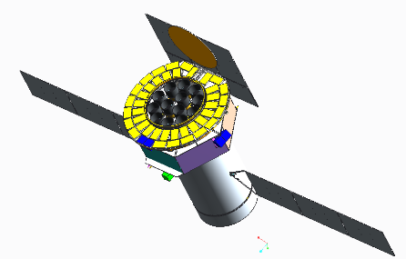
Plans of IHEP
Yifang Wang
Institute of High Energy Physics, Beijing
Snowmass, July 25, 2022

Slide 2


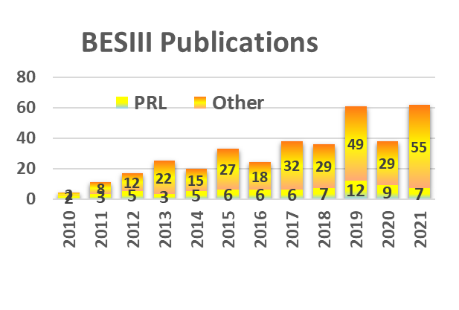
BEPCII/BESIII: 2009-2030
Fruitful physics results
Rich physics program requiring > 40 fb⁻¹, corresponding to ~15 yrs@curr. lumi.
Upgrade to be completed in 2024:
  Luminosity × ~3 ➔ squeeze the beam size by adding a new RF cavity per beam
  Replace the two SC quadrupole magnets near the IP to increase the maximum beam energy from 2.45 to 2.8 GeV ➔ for charmed baryons
Future physics program of BESIII

Slide 3
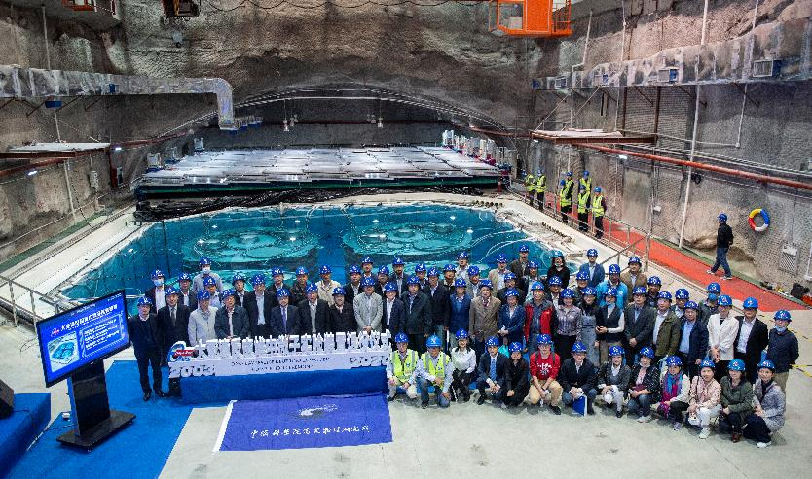
Daya Bay Experiment
Data taking terminated on Dec. 12, 2020
  Ceremony broadcasted online, 1.7 M viewers
  Detector decommissioning completed
Data analysis still in process:
  Final nGd results obtained: sin²2θ₁₃ precision ~ 2.8%
  Final nH and combined results will be released next year ➔ 2.6% ?

Slide 4
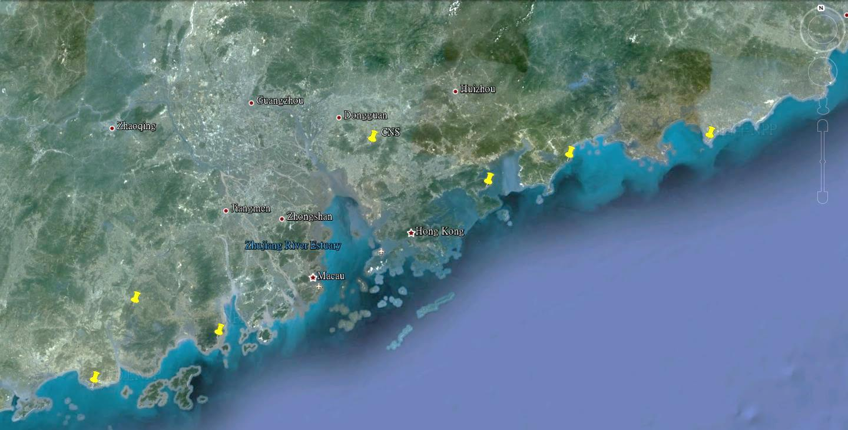
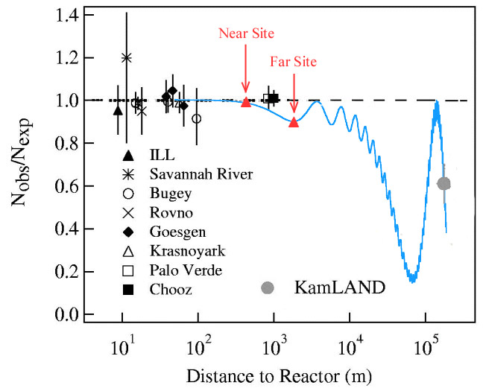

JUNO Experiment
A 20 kt liquid scintillator detector at ~53 km baseline from reactors for neutrino mass hierarchy, precision determination of oscillation parameters and astrophysics
Daya Bay
Overburden ~ 700 m
JUNO
Previous site candidate
Guang Zhou
2.5 h drive
Lufeng
NPP
Shen Zhen
Huizhou
NPP
Daya Bay NPP
Zhu Hai
Hong Kong
Macau
 | Target mass [t] | energy resolution
JUNO | 20,000 | 3% @ 1 MeV
Borexino | 300 | 5% @ 1 MeV
KamLAND | 1,000 | 6% @ 1 MeV
Daya Bay | 20 | 8% @ 1 MeV
53 km
53 km
Taishan
NPP
Yangjiang NPP

Slide 5
Physics of JUNO
Energy resolution of ~3%@1 MeV leads to a sensitivity of NMO at 3σ@ ~6 yrs*26.6 GW
Atmospheric neutrinos contribute another ~ 0.7~1.4 σ @ ~6 yrs
Most of neutrino oscillation parameters can be improved to a sub-percent level
Solar, supernova and geoneutrinos
 | Current (PDG2020) | JUNO (100 d) | JUNO (6 y)
Δm²₃₁ Δm²₃₂ | 1.3% | 0.8% | 0.2%
Δm²₂₁ | 2.4% | 1.0% | 0.3%
sin²θ₁₂ | 4.2% | 1.9% | 0.5
sin²θ₁₃ | 3.2% | 47.9% | 12.1%
high stat. if burst SN ν nearby
high prob. to discover diffused SN ν

Slide 6
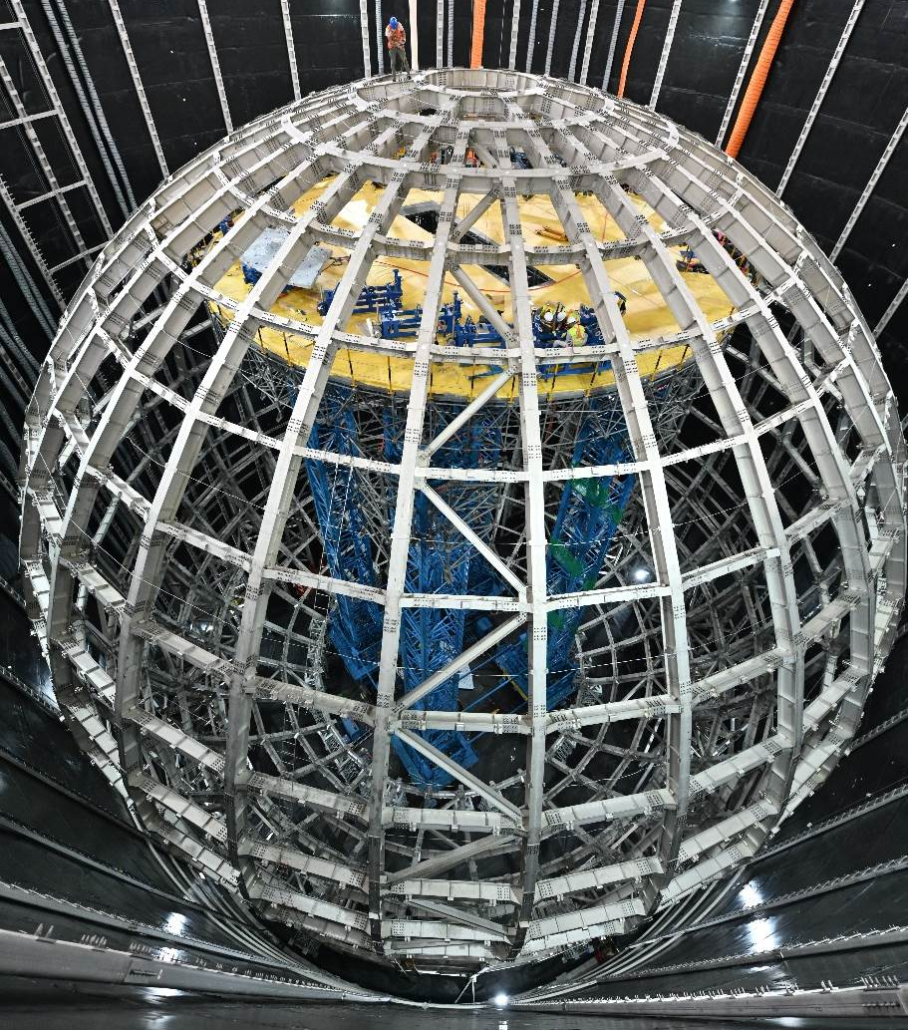
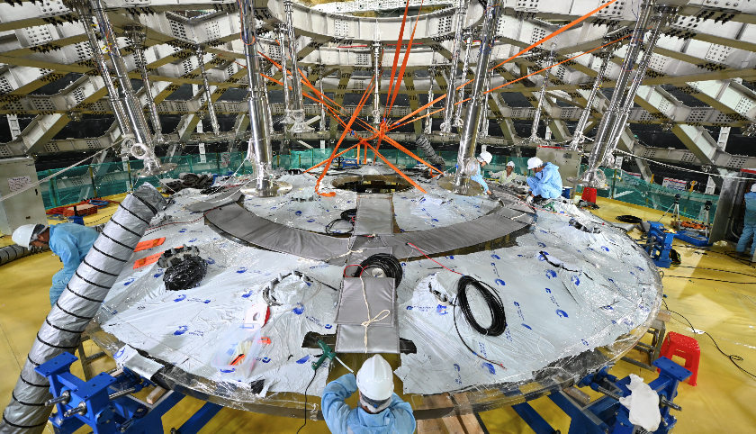
Construction of JUNO
Civil construction mostly finished
Components mostly produced, including a new type of high efficiency 20” MCP-PMTs
SS structure completed, acrylic sphere bonding in progress
PMT installation will start in a few months, LS Filling will start next year
High energy resolution(3%@1MeV) and cleanness(10⁻¹⁷ g/g) seems realizable

Slide 7
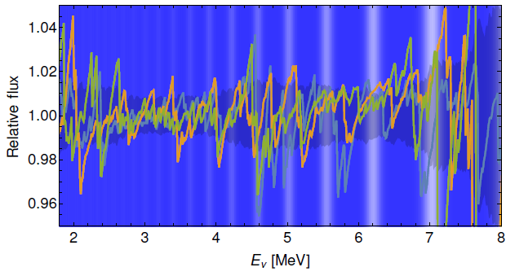
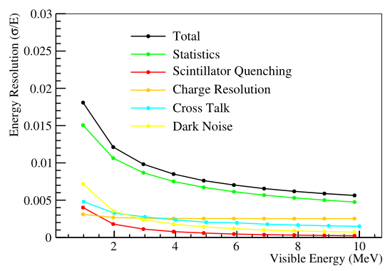
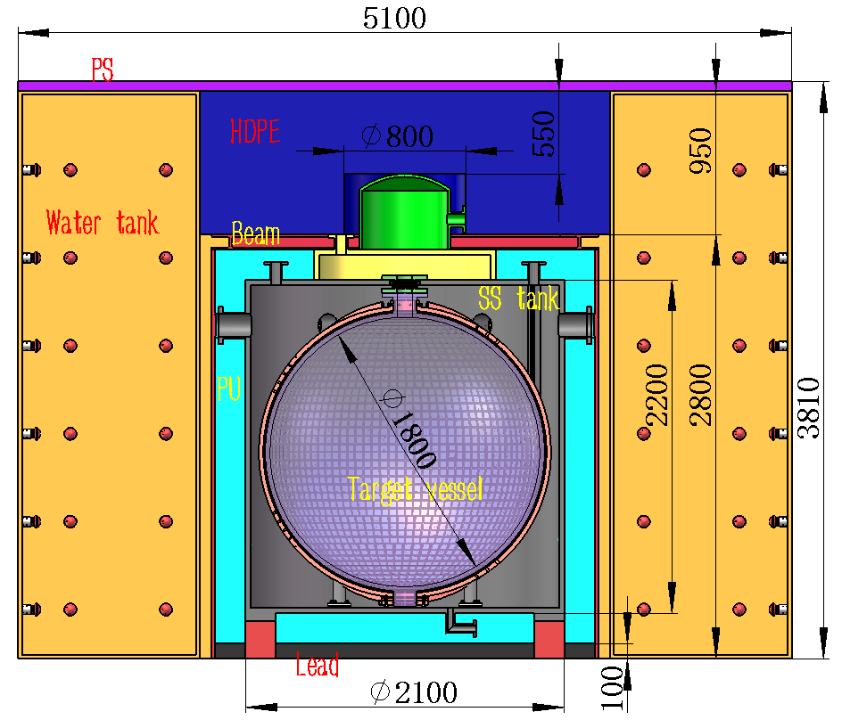
JUNO-TAO: a LS detector at -50℃
A high precise neutrino detector located at the Taishan Nuclear Power Plant, ~30m from a 4.6GW reactor core
  A reference neutrino spectrum to improve MH and constrain uncertainties(arXiv:2005.08745)
  Sterile neutrino searches
  Nuclear data
Highest possible energy resolution ~ 1.5%/√E:
  Large area SiPM:
    PDE > 50%, >90% coverage, 10 m²
    4500 p.e./MeV ➔ × 3 JUNO;
  Operate at -50℃ to reduce SiPM dark noise by 3 orders of magnitude to 100 Hz/mm²
  Gadolinium-doped liquid scintillator working at -50℃ ➔ a new recipe
~2000 IBD/day with ~2% bkg
To be operational in 2023
Expected energy resolution

Slide 8
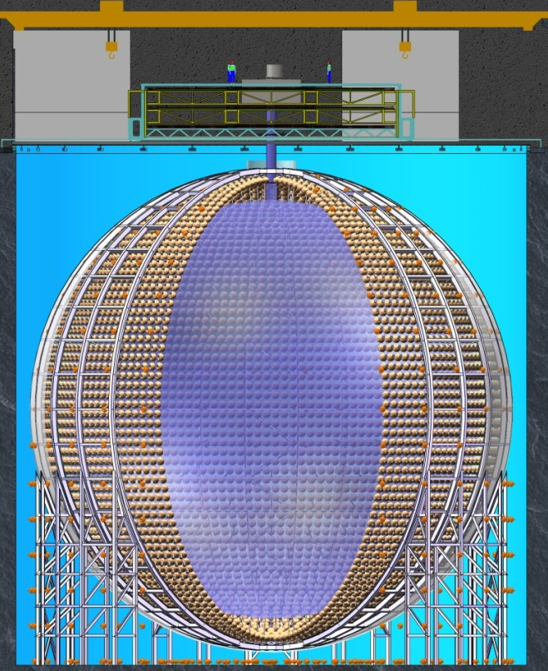
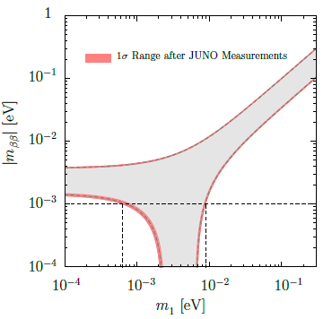
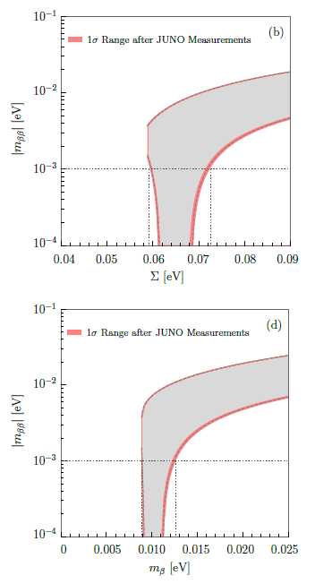
JUNO-ββ
In 10-20 years from now, oscillation will be mostly understood
0ν ββ decay will be the next focus point:
  Dirac-Majorana nature and the absolute ν mass
J. Cao et al., arXiv:1908.08355
 | Isotope | Mass(t) | <m_{ββ}>,meV
KamLAND-Zen | ¹³⁶Xe | 0.8 | 36-156
EXO-200 | ¹³⁶Xe | 0.2 | 93-286
nEXO | ¹³⁶Xe | 5 | 7-22
Cupid-1T | ¹⁰⁰Mo | 1 | 4-7
Legend-1000 | ⁷⁶Ge | 1 | 10-40
SNO+ | ¹³⁰Te | 8 | 19-46
JUNO-ββ | ¹³⁶Xe | 50 | 4-12
 | ¹³⁰Te | 100-200 | 2-6 ？
Load ¹³⁶Xe or ¹³⁰Te into the LS of JUNO: good self-shielding, resolution, etc.
Zhao et al., arXiv: 1610.07143, CPC 41（2017）5

Slide 9

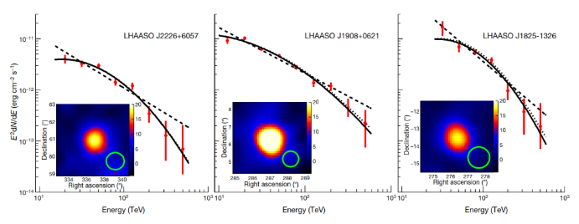
Cosmic-Rays and γ-astronomy
⎯ Large High Altitude Air Shower Observatory(LHAASO)
World largest air shower array(with e, μ, water Č detectors and Č telescope) for the high energy γ-astronomy and cosmic-ray physics
Construction just completed and interesting results obtained:
    Highest γ-rays from the Milky Way： 1.4 PeV
    many γ-ray sources up to ~1 PeV identified → PeVatrons in Milky Way
  Future:
    Large Array of Cherenkov Telescopes（LACT）
Sichuan, 4410m above the sea

Slide 10
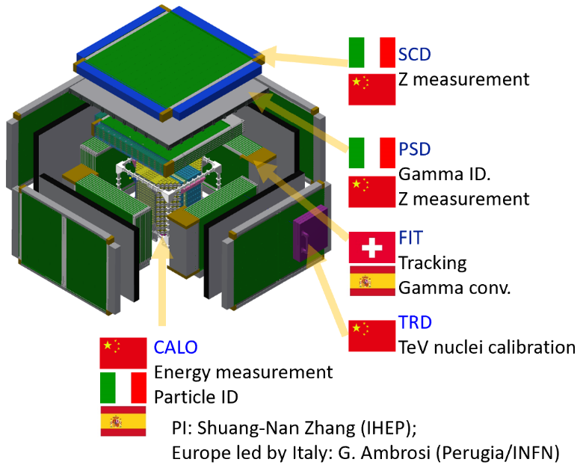




Future Space Programs
A 3D crystal calorimeter for ×10 acceptance and ×10 higher energy on board of the Chinese Space Station, to be launched in ~2027
  dark matter search
  Precise cosmic ray spectrum and composition to calibrate LHAASO
  Gamma-ray sky survey
Large international collaboration
Enhanced X-ray Timing and Polarimetry as the next generation x-ray satellite for
  Neutron stars, black holes, etc to study Extreme gravity, magnetism, density, etc.
Cutting-edge technology
  Large eff. Area (~3.5 m²@6 keV)
  High spectral resolution (<180 eV@6 keV)
  Polarimetry
Large international collaboration
HERD
eXTP

Slide 11
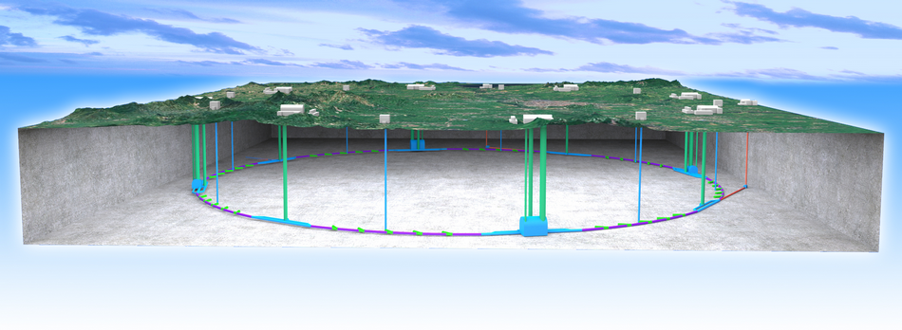
CEPC ⎯ A Higgs Factory
The idea of a Circular e+e- Collider(CEPC) followed by a possible Super proton-proton collider(SPPC) was proposed in Sep. 2012, and quickly gained the momentum in IHEP and in the world
  Looking for Hints@e⁺e⁻ Collider ➔ If yes, direct search@PP collider
  The tunnel can be re-used for pp, AA, ep colliders up to ~ 100 TeV ➔ compatibility study needed now
The idea was firstly reported at the Fermilab Higgs Factory workshop in Oct. 2012

Slide 12
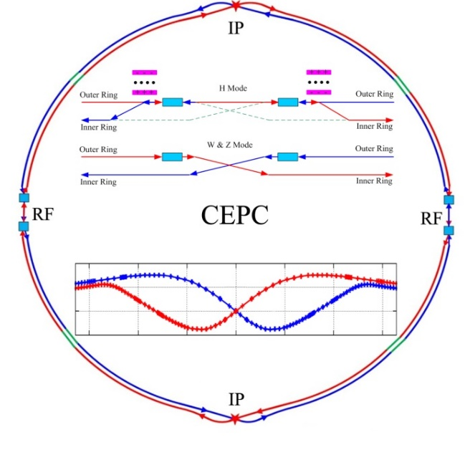
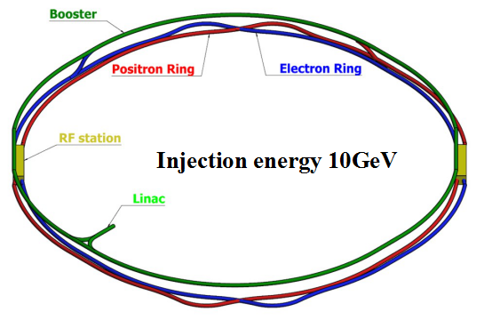
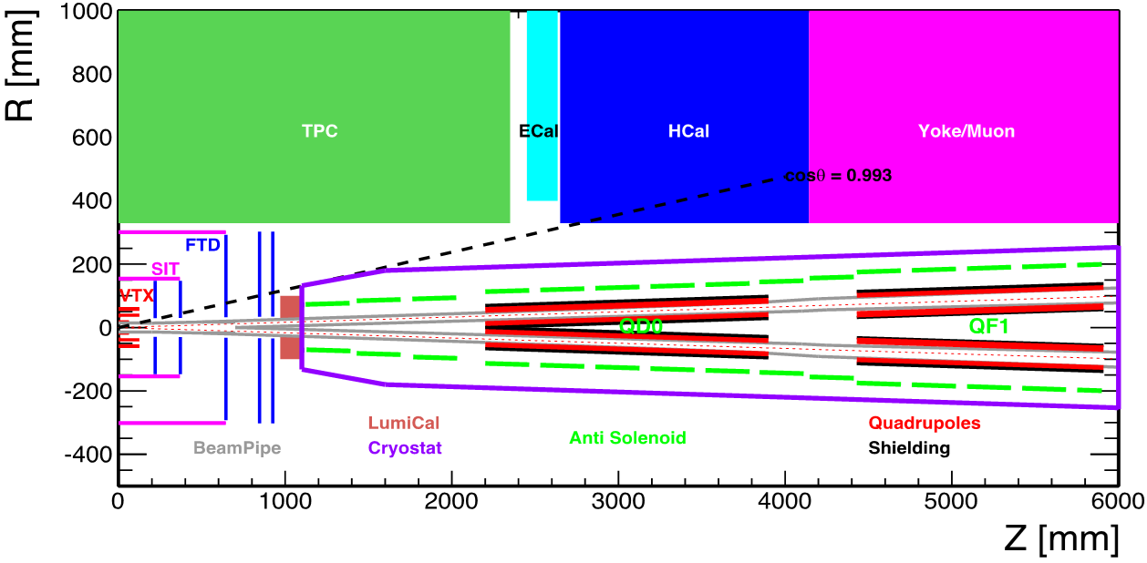
CEPC Layout
H
W and Z
Collider ring (100km)
Booster ring (100km)
Baseline: 100 km, 30 MW; Upgradable to 50 MW, High Lumi Z, ttbar;
Compatible to pp collider

Slide 13
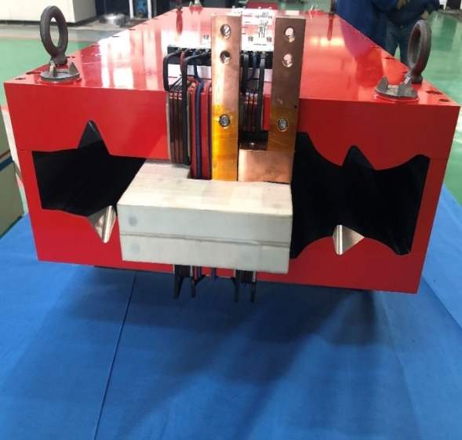
Design and R&D Efforts
650MHz
Strong support from MoST, CAS and NSFC, at a total funding level of > 40 M $
CDR completed, TDR to be completed soon
Key technology R&D:
  SRF cavities
  High efficiency Klystrons
  Plasma wake-field accelerator for the injector
  Iron-based HTc superconducting tech.
  Magnets, vacuum pipes, beam diagnostics, polarized electron gun, positron source, …
  Silicon pixel chips, gas chambers, calorimeters, …
1.3GHz
magnets
Klystrons
IBS coils

Slide 14
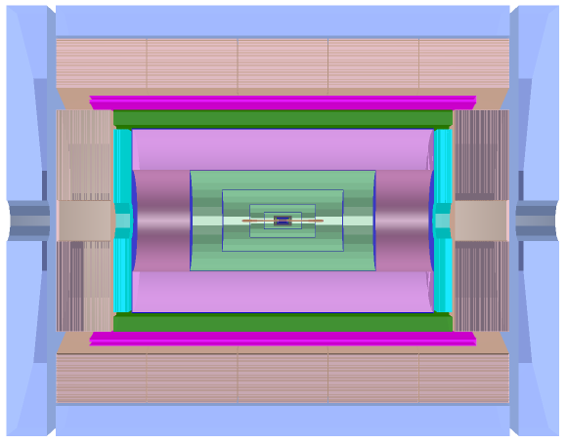
New Detector Design and R&D
Advantage: Higher sampling ratio for better energy resolution
Challenges: Light yield, transparency, mass production.
Solenoid Magnet (3T / 2T )
Scint Glass/Steel
PFA HCAL
Advantage: HCAL absorbers act as the return yoke.
Challenges: thin enough magnet not to affect the jet resolution; stability
Transverse Crystal bar ECAL
Advantage: better e/γ enegy resolution, 2D readout with timing with 3D capabilitirs for PFA
Challenges: ambiguity of showers if too close; high energy π⁰ reconstruction
A Drift chamber optimized for PID
Advantage: improve Si tracking, good PID
Challenges: suitable for high event rate; good dN/dx for sufficient PID power
Muon+Yoke
Si Tracker
Si Vertex

Slide 15
Ideal Schedule

Slide 16
Project Status
Continuing the design and R&D efforts in the next few years, developing the engineering design report for government approval
Strengthening international collaborations, in particular with other Higgs factory proponents
Actively working with CAS to prepare the proposal to MoST for the “China initiated large science projects”
Under the guidance of CAS, developing a roadmap and an executable program of large science projects for the 15th 5-year plan
  Evaluate proposals based on science, technology and feasibility at international contest
  For the first time to have an International Advisory Committee to help
  Finalize the report by mid 2023, and then approach to the NCDR with the help of CAS
Continue to develop and build international collaborations for detectors
Hopefully to start the civil construction in the next 5-years plan(2025-2030)

Slide 17
International Projects
KEK
  BELLEII(IHEP+Univ.s)
  COMET(IHEP+Univ.s)
  SuperK (Tsinghua)
CERN & Europe
  Prototype of the HL-LHC CCT magnet delivered to CERN, tested OK(IHEP)
  All experiments and upgrade at LHC: ATLAS, CMS, LHCb and ALICE (many)
  PANDA(IHEP+IMP+Univ.s)
  Darkside(IHEP)
US
  EXO/nEXO(IHEP), LBNF(IHEP)
  GlueX(IHEP)
  AMS and its upgrade(IHEP+Shangdong+Univ.s)

Slide 18
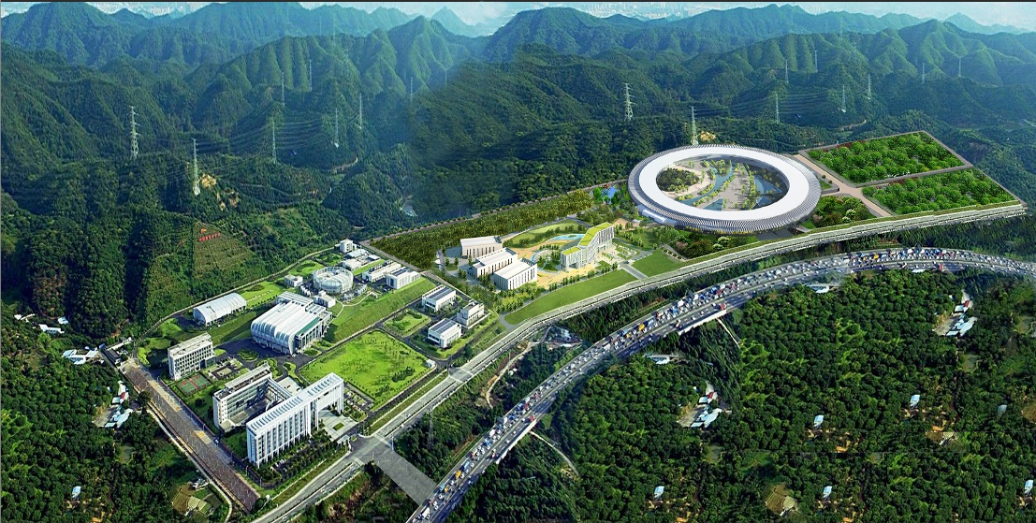
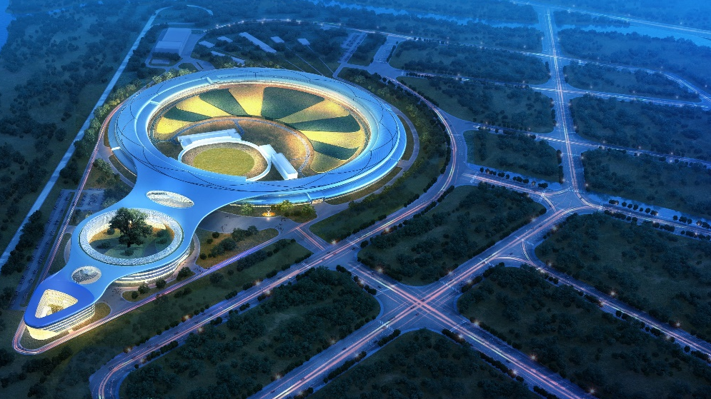
Other Projects
China Spallation Neutron Source(CSNS) in our Dongguan Campus operational since 2018 at 100 kW beam power
Upgrade to 500 kW with 10 more beam lines will start soon
High Energy Photon Sources(HEPS) in Huairou, north of Beijing is under construction, to be operational in 2025
  6 GeV, 0.036nm·rad emittance, 1260m Circumference,
  Brilliance: >10²²phs/s/mm²/mrad²/0.1BW
SAPS
CSNS

