Slide 1

KEK, High Energy Accelerator
Research Organization
Particle Physics Program in Japan
July 25, 2022
Snowmass Meeting in Seattle
M.Yamauchi
KEK

Slide 2
Outline
Outline
Neutrino program: T2K and beyond
The μ program at J-PARC
SuperKEKB and Belle II
ILC: Efforts to realize it
LiteBIRD, astro-particle physics at KEK
Application of superconducting RF technology to industry
Summary and Conclusions
HyperKamiokande
SuperKEKB/Belle II
ILC

Slide 3
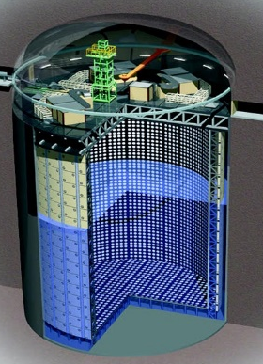
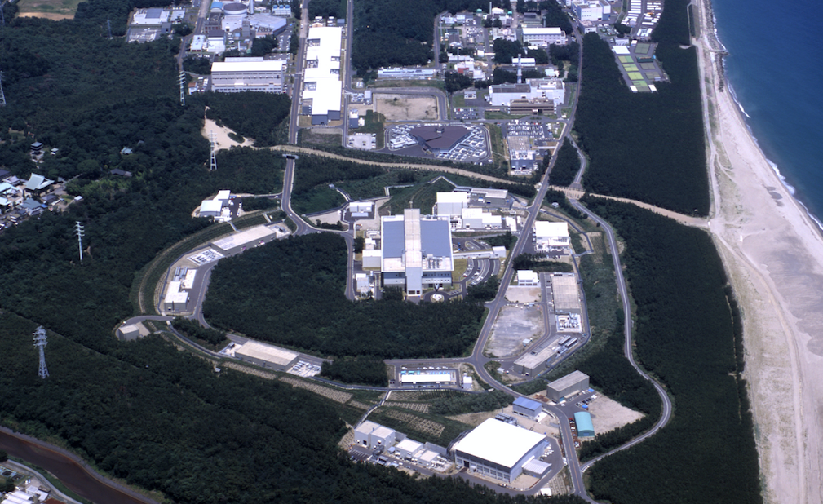

















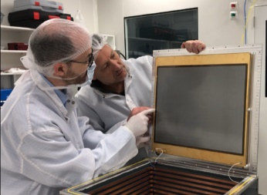
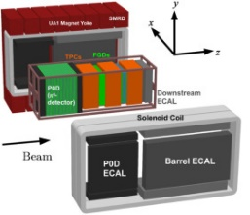
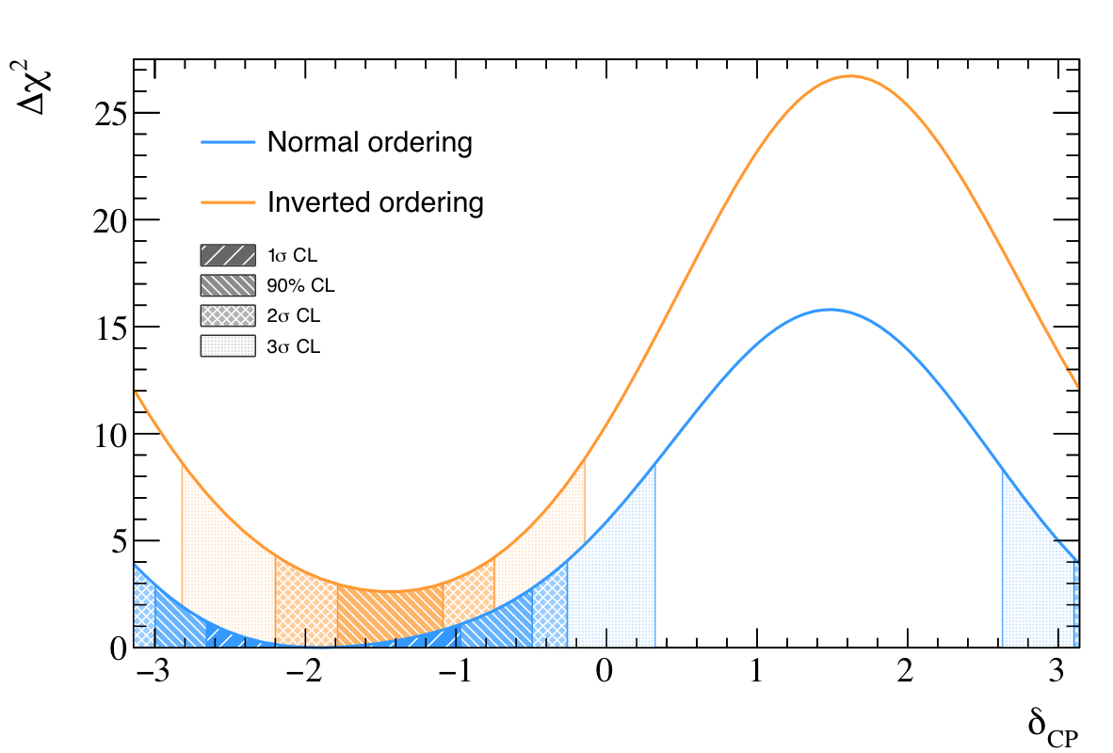
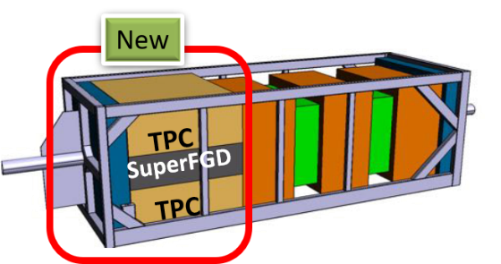
T2K: Long baseline neutrino oscillation experiment
Search for lepton CP violation
HA TPC
~470 members, 74 Institutes, 13 countries
3D neutrino detector
Precise measurement with doubled data by ~2026 is expected.
First constraint on lepton CP asymmetry has been obtained.
High power neutrino beam; ~520kW (achieved)
→ Intensity upgrade up to 1.3MW
& Near-detector upgrade are on going.

Slide 4
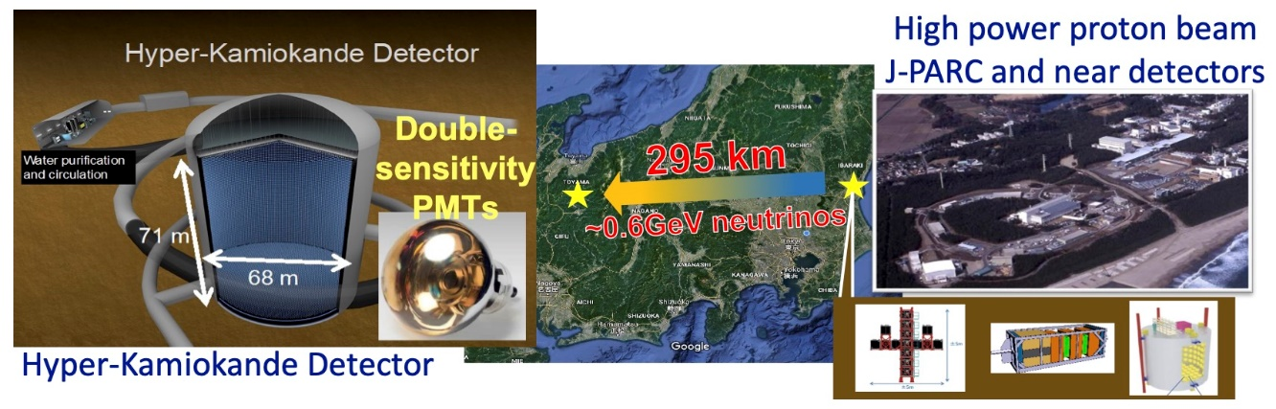


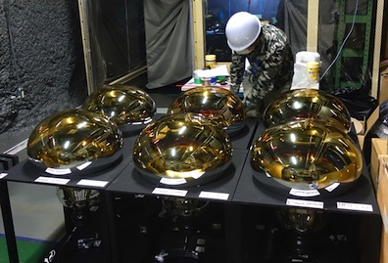
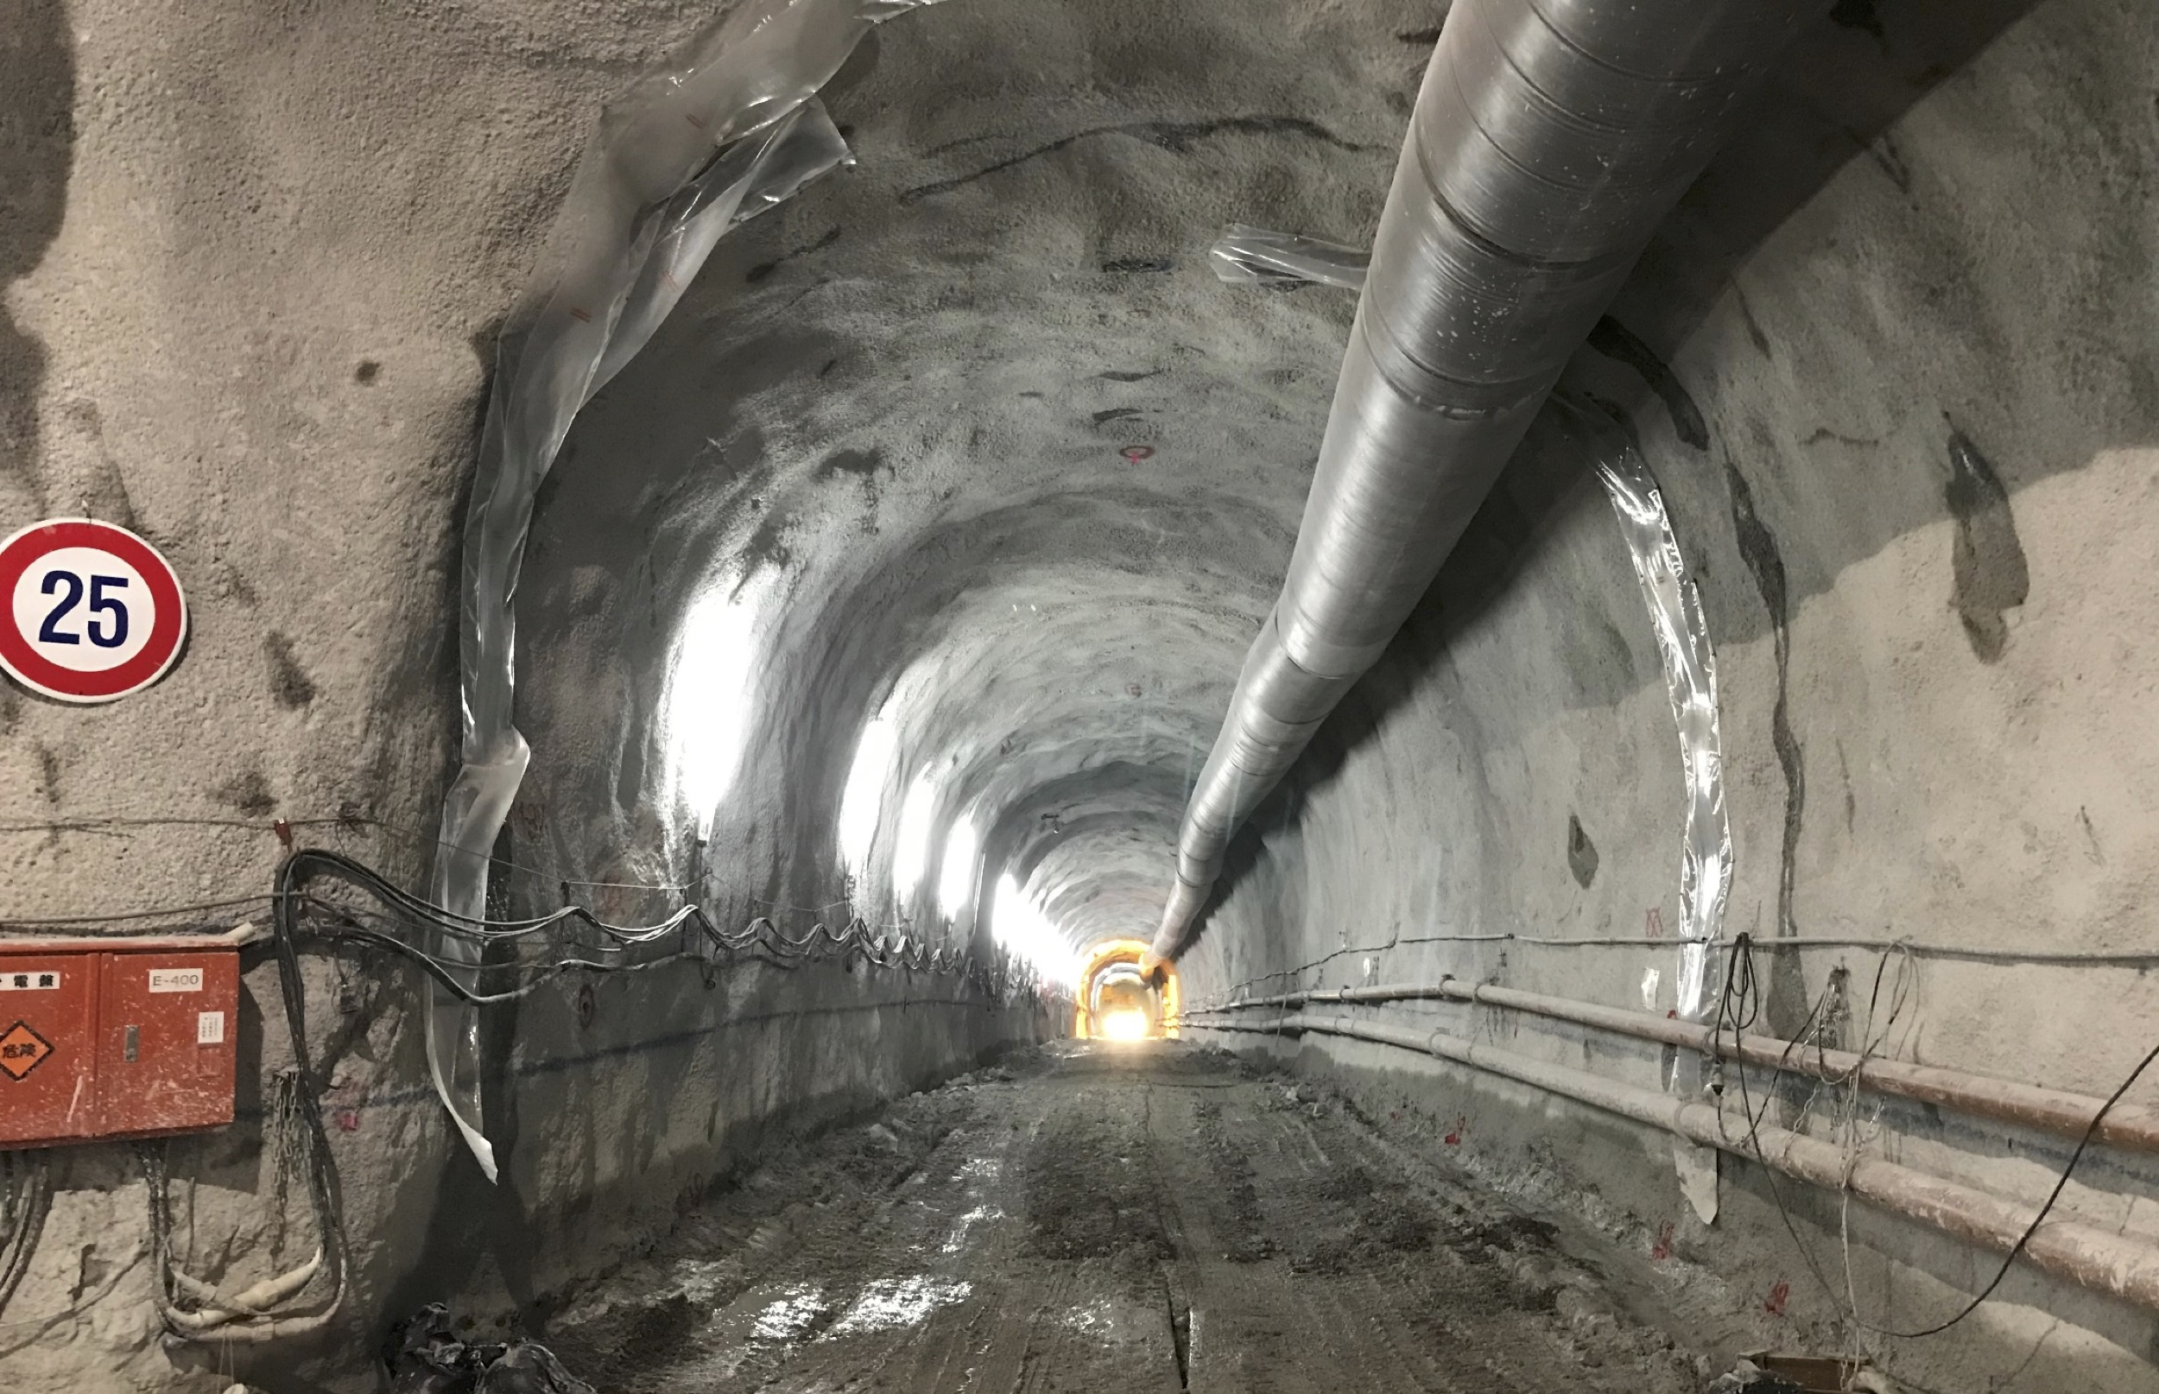

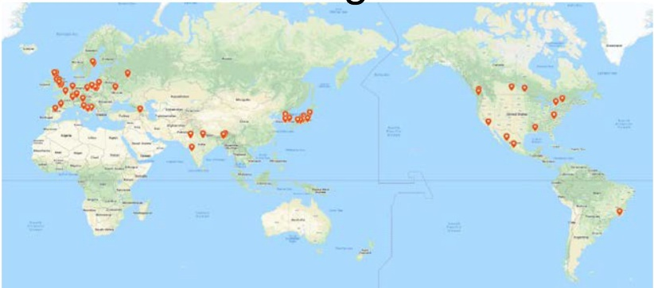
Hyper-Kamiokande (HK) by U. Tokyo and KEK
Project
  190kt-FV Hyper-Kamiokande Detector (UT)
  Upgrade of J-PARC to 1.3MW (KEK)
Physics goals
  CPV in neutrino sector
  Search for proton decay
  Atm-nu, solar-nu and supernova nu
International project hosted by U.Tokyo & KEK
Funding approved and construction started in 2020
  Preparation of cavern excavation, production of PMTs started
  J-PARC upgrade on-going
Aiming to start operation in 2027.
Beamline facility and
component upgrade
Delivered PMT for HK
Access tunnel excavated
~500 members
from 20 countries

Slide 5
KEK’s role in HyperKamiokande program

Slide 6
J-PARC upgrade for HyperKamiokande

Slide 7
Neutrino beamline upgrade

Slide 8
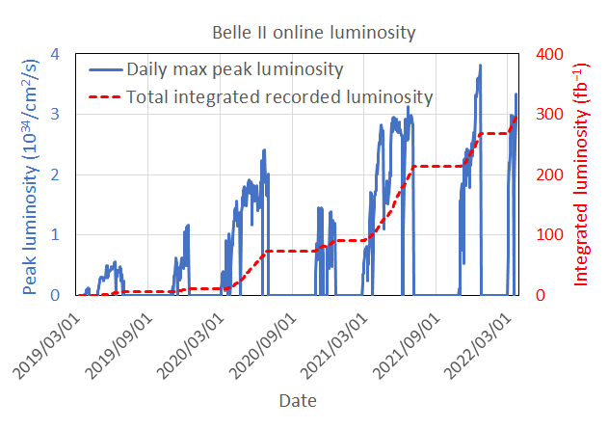
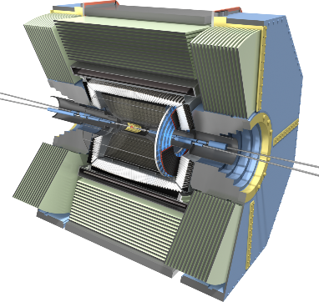

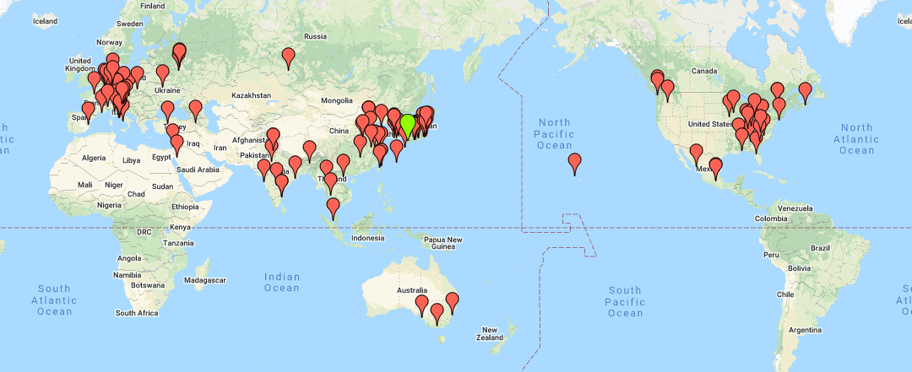
SuperKEKB and Belle II
e⁻(2.6A)
SuperKEKB
3km circ.
e⁺(3.6A)
Belle II
Damping ring for low emittance positron
injection
L_{peak}=4.7x10³⁴/cm²/s
ʃ L dt = 475fb⁻¹
Belle II
Asymmetric e⁺e⁻ collider at ϒ(4s) with target L=6x10³⁵/cm²/s
~10¹¹ B, D and τ measured with vertex reconstruction and PID
Physics run started March 2019.
Belle II collaboration consists of 1100 physicists from 26 countries.
8

Slide 9
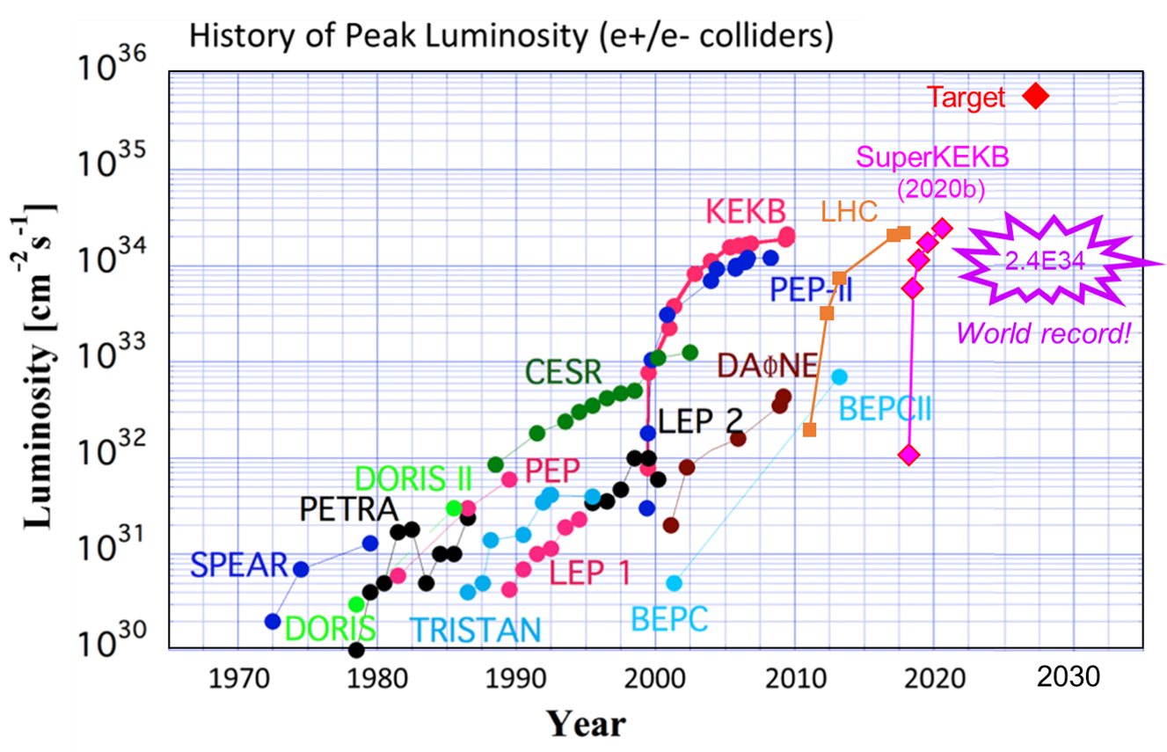
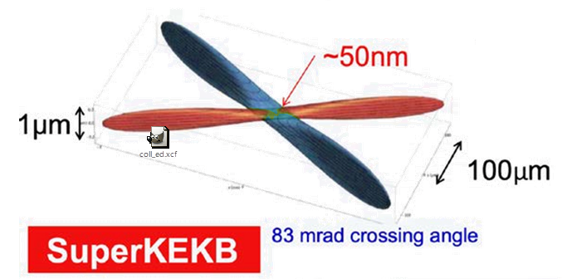
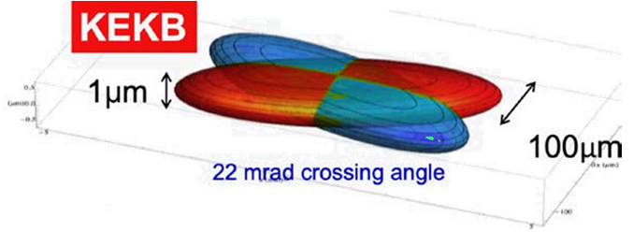
Luminosity strategy at SuperKEKB
Nano-beam collisions
Machine improvement in July 2022 – September 2023
Replacing the beam collimators with the one that are highly resistant to the beam and less likely to cause beam instability
Improved radiation shield to Belle II detector
Increasing the diameter of the beam pipe at the injection point
Improving pulse-by-pulse beam control of the injection linac
L ~ 2.4 x 10³⁵/cm²/s will be achieved after careful machine tuning.

Slide 10
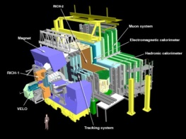
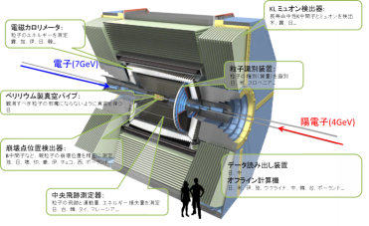
Physics at Belle II
>>analyses LHCb is good at
>>analyses Belle II is good at
SUSY, charged Higgs
Model-indep. NP
Inclusive analysis
LHCb@CERN
B → K*ll
b→ s/d γ
Belle II
Bs, Λ_{b}
Model-indep. NP
b→ u l ν
A(K π)
Bs →μμ
LUV
Neutral particles (γ, ν K_{S} etc.) in the final state
new CPV
b→sqq
B→ K_{S} π⁰ γ
SUSY, Charged Higgs
new CPV
B→h ν ν , τ ν
B→D* τν
B→D⁰ τν
D⁰ CPV
Charged Higgs
Right-handed weak interaction
LUV
tau
τ→μγ
Charged Higgs
LFV

Slide 11
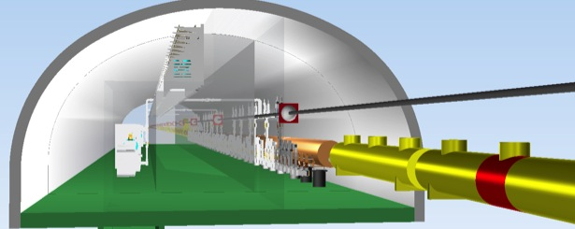
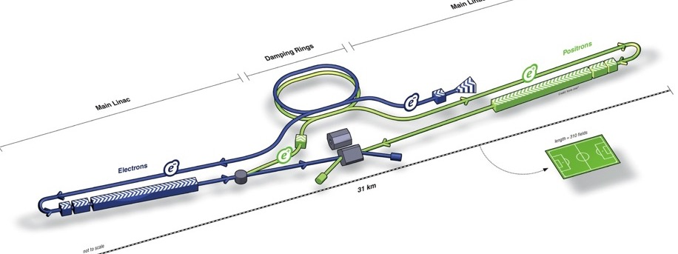
International Linear Collider
RF Distribution
ILC has been developed by the international HEP community and supported by European strategy, US P5, etc. Its design has been conducted by the initiative of ICFA.
Cryomodules
RF Power Source
e- Source
Damping Ring
e+ Main Linac
Item | Parameters
C.M. Energy | 500 GeV
Length | 31 km
Luminosity | 1.8 x10³⁴ cm⁻²s⁻¹
Repetition | 5 Hz
Beam Pulse Period | 0.73 ms
Beam Current | 5.8 mA (in pulse)
Beam size (y) at FF | 5.9 nm
SRF Cavity G. Q₀ | 31.5 MV/m Q₀ = 1x10 ¹⁰
250GeV
20km
e+ Source
20 km
e- Main Linac
Key Technologies
Nano-beam Technology
SRF Accelerating Technology

Slide 12
ILC Promotion Scheme in Japan
Five-party meeting (Mar. 2021 - )
ILC-Japan (May 2021 - )
ILC Federation of Diet Members
MEXT
Physicists
Industrial sector
Candidate site
Spokesperson: Shoji Asai
(U. Tokyo)
Executive board
Taskforces
Working groups
KEK
Productive discussions of possible solutions to the problems to realize ILC by all the stakeholders
Organize activities of the Japanese physics community to realize the ILC.
Outcome of the meeting so far
  It was agreed that the physics community will report on the progress made over the past three years.
  It was recommended to MEXT to hold a meeting of experts to evaluate this report and the Pre-lab proposal by the IDT.
  It was also at this meeting that MEXT was recommended to exchange views with the governments of US and European countries.
Activities of ILC-Japan
  We focused on providing good input to the ILC Advisory Panel at MEXT.
  ILC communications
  Activities to deepen the understanding of ILC by scientists in other fields

Slide 13
Recent history of ILC
The ICFA established the IDT in August 2020 to realize the ILC in multiple-stages, and in June 2021 the IDT published the report on overall design of the Pre-lab and 18 work packages to be implemented there. At the same time, the Japanese physics community submitted a report to MEXT on the progress of the ILC over the past three years.
MEXT set up an ILC Advisory Panel to evaluate these reports, and published a recommendation in February 2022.
  The panel recognizes the academic significance of particle physics research and the importance of the research field, including that of a Higgs factory, and understands the value of international collaborative research. However, the panel found that it is still premature to proceed into the ILC Pre-lab phase, which is coupled with an expression of interest to host the ILC by Japan as desired by the research community proposing the project.
  The panel recommends that the development of the key technology for the next-generation accelerator such as ILC should continue by further strengthening the international collaboration among institutes and laboratories, shelving the question of hosting the ILC.
  For realizing a very large project such as the ILC, cultivating a framework where the related countries can exchange information on their situations and discuss required steps would be important.

Slide 14
Plan in the next years
Create a new international collaborative framework to implement the most urgent work packages.
  We believe that it is highly likely that the budget for this will be approved in Japan in JFY2023.
  Detailed R&D plan is being elaborated in the IDT-WG2.
  We are about to start discussions with related laboratories to exchange MOU’s between the laboratories.
An International Expert Panel will be set up by IDT to deepen discussions in two or three stages, and then, hold meetings to explain the progress to the representatives of the relevant governments. With this as a starting point, we will encourage intergovernmental discussions on the ILC.
  At least one meeting attended by the government representatives will be held by the end of this year.

Slide 15
Longer term scenario of ILC
IDT phase
Pre-lab phase
Construction phase
Physics experiment
Aug. 2020
IDT
IDT
Pre-lab
ILC construction
by ILC Lab.
Experiment
at ILC
International
Development
Team under ICFA
Pre-lab organized
by MoU’S among
the relevant labs.
ILC lab. based on
the Governmental
agreement
Joint R&D
Int. Expert Panel
+ governmental
discussions

Slide 16
Summary and Conclusions
Particle physics program at KEK
  Long baseline neutrino program at J-PARC/SuperKamiokande
  Flavor physics at J-PARC: K_{L} and μ
  High precision measurements of B, D and τ decays with SuperKEKB/Belle II
  >100 Japanese physicists are involved in ATLAS. KEK takes a role of supporting them.
KEK is also working on next step in (astro-)particle physics.
  Upgrade of J-PARC MR for HyperKamiokande
  Contribution to HL-LHC and the ATLAS upgrade
  LiteBIRD to test cosmic inflation and quantum gravity
We are committed to play a leading role in realizing ILC.
  Create a new international collaborative framework to implement the most urgent work packages in advance.
  An International Expert Panel will be set up by IDT to deepen discussions in two or three stages, and then, hold meetings to explain the progress to the representatives of the relevant governments.

