Slide 1
Accelerator Frontier Panel 2 Enabling Accelerator Technologies
https://snowmass21.org/accelerator/start
Community Summer Study – Seattle, July 25, 2022
Stephen Gourlay, Tor Raubenheimer, and
Vladimir Shiltsev
(Snowmass’21 AF Conveners)

Slide 2
To Enable Future Accelerators
Three main components:
To enable the near- to medium-term future:
1. A National Future Collider R&D Program
To enable the medium- and long-term future:
2. General Accelerator R&D (GARD)
3. Accelerator and Test facilities

Slide 3
Accelerator Frontier “Message”
On Colliders: We need an integrated future collider R&D program to engage in the design and to coordinate the development of the next generation collider projects:
To address in an integrated fashion the technical challenges of promising future collider concepts that are not covered by the existing General Accelerator R&D (GARD) program.
To enable synergistic U.S. engagement in ongoing global efforts (e.g., FCC, ILC, IMCC)
To develop collider concepts and proposals for options feasible to be hosted in the U.S. (e.g., CCC, HELEN, Muon Collider, etc)

Slide 4
Accelerator Frontier “Message”
On R&D: We have an ongoing R&D program aimed at fundamental beam physics and long-term accelerator concepts and technologies (RF, magnets, beam physics, advanced concepts, targets & sources, etc):
All these items have broad applicability across future accelerators with ideas generated by Universities and labs
R&D is key to enable facilities for neutrinos, rare processes and colliders

Slide 5
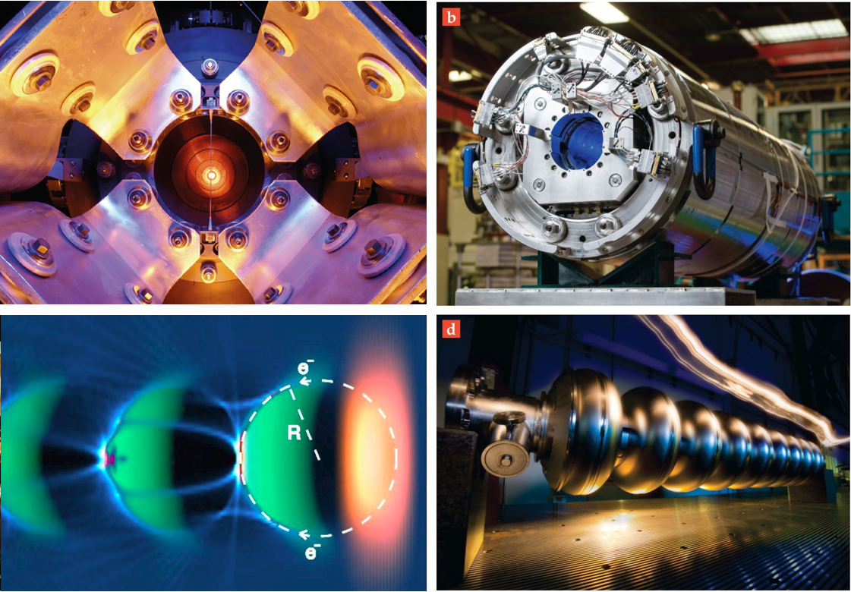
Sources and Multi-MW targets: - intense e⁺ sources - 2.4 MW for PIP-III - 4-8 MW for a muon collider
Accelerator R&D: Next Decade
Magnets for
Colliders and RCSs:
- 16T dipoles
- 40T solenoids - 1000 T/s fast
cycling ones
…coordinated
with US MDP
Accelerator & Beam Physics
High intensity/brightness beams acceleration and control
High performance computer modeling and AI/ML approaches
Design integration and optimization, incl energy efficiency
Wakefields: - collider quality beams
- efficient drivers and staging
- close coordination with Int’l (Euro Roadmap, EUPRAXIA,..)
SC/NC RF: - 70-120 MV/m C³
- 70 MV/m TW SRF
- new materials
- high Q₀
- efficient RF sources

Slide 6
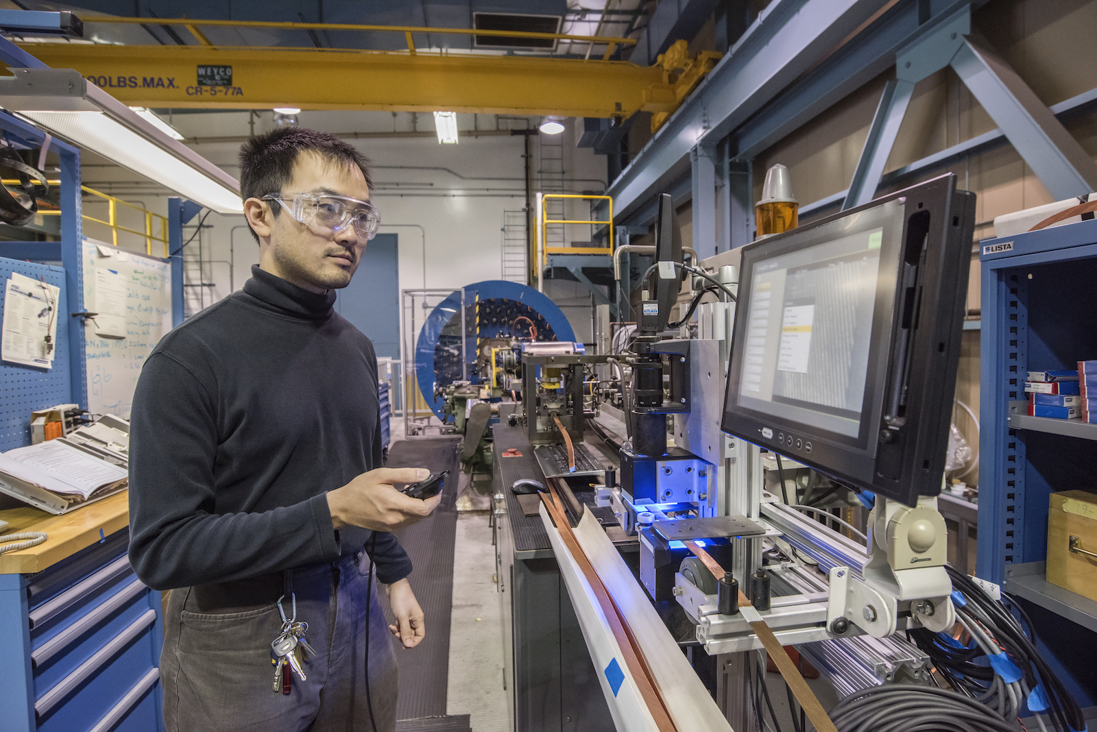
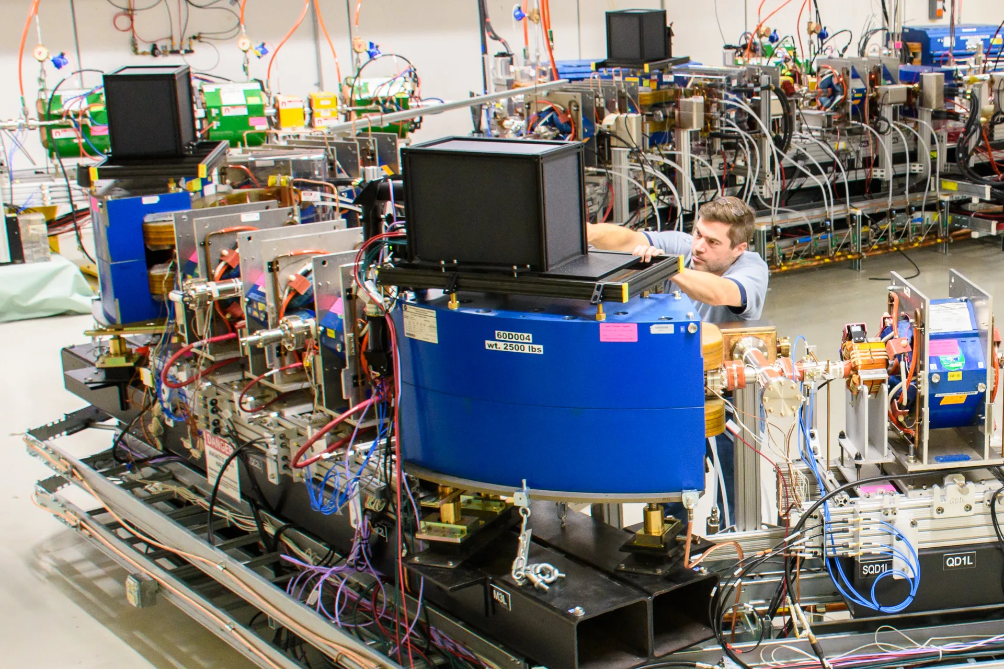
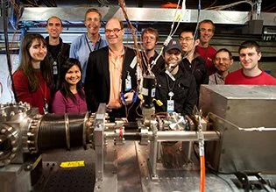
Accelerator and Test Facilities
Enable technology progress and beam research
SRF and SC Magnet Tests
Beam Physics Facilities
BNL
FNAL
LBNL
SLAC
Cornell
FNAL
BNL
ANL
CMT, Berkely,
IOTA ring, Fermilab
Wakefield/Plasma Studies
MISSING PIECE!
Facility for multi-MW beam targetry R&D and testing
SLAC
LBNL
UT-Austin
ANL
UCLA
FACET-II, SLAC,

Slide 7
Back up slides

Slide 8
Accelerator Frontier “Message” #5
#5 Accelerator development should be part of P5: Planning for accelerators should be aligned with the strategic planning for particle physics and should be part of the P5 prioritization process.

Slide 9
AF “Message” on Facilities (2)
in the area of future colliders - several approaches are identified as both promising and potentially feasible, and call for further exploration and support: in the Higgs/EW sector – in addition to the ILC, there is growing support for the FCCee at CERN and somewhat more advanced linear colliders in the US, such as C3 and HELEN;
in the energy frontier, the discovery machines such as O(10 TeV c.m.e.) muon colliders have rapidly gained significant momentum:
to be in a position for making choices and decisions on collider projects viable for construction in the 2040s and beyond at the time of the next Snowmass/P5, these concepts should be explored technically and documented in pre-CDR level reports by the end of this decade.

Slide 10
AF “Message” on Facilities (3)
Given that the U.S. HEP accelerator R&D portfolio presently contains no collider-specific scope we support proposal to establish the U.S. national integrated R&D program on future colliders in the DOE Office of High Energy Physics (OHEP) to carry-out technology R&D and accelerator design for future collider concepts:
to address in an integrated fashion the technical challenges of promising future collider concepts, particularly those aspects of accelerator design, technology, and beam physics that are not covered by the existing General Accelerator R&D (GARD) program.
to enable synergistic U.S. engagement in ongoing global efforts (e.g., FCC, ILC, IMCC)
to develop collider concepts and proposals for options feasible to be hosted in the U.S. (e.g., CCC, HELEN, Muon Collider, etc)

Slide 11
AF R&D “Message” re: Technology
Accelerator Technologies define cost per TeV and cost per MW, as well as performance limits (luminosity, power) → R&D is a must.
Targets and Sources (AF7-T&S):
Clearly set priorities for the next years – advanced neutrino target designs to secure operation at 2.4 MW beam power level (LBNF)
Next step : 4-8 MW target concepts/R&D for a future Muon Collider
Sources: high power high brightness e+ sources for future circular and LCs (incl. polarized)

Slide 12
AF R&D “Message” re: RF
The only way to get particles accelerated – RF systems need drastic reduction in cost and improvement in performance to support HEP aspirations (eg multi-TeV colliders)
Priorities for the next decade (AF7-RF):
Improve cavity performance (gradient, Q₀~e11)
Bring new materials like Nb3Sn to the level of Nb and beyond
Better (more efficient, eg TW or CCC) structure designs, tunable RF for RCSs
Effort on ERL – coordinate with EIC and European roadmap

Slide 13
AF R&D “Message” re: Magnets
Serious investment in both US, Europe, Japan, and, since recently, China. Impressive progress but long timeline.
Priorities for the next decade (AF7-MAG):
Explore Nb3Sn limit (16 T magnets, improve conductors) – FCChh and MuC, in mind
Toward HTS magnets for MuC (30 T solenoids)
Strong need in cost efficient fast ramping magnets (1000’s T/s) for RCSs and MuCollider
Coordinate US effort (MDP) with Europe (CERN)

Slide 14
AF R&D “Message” re: WFA
Advanced Accelerator Concepts (AF6) show great progress in research (LPA/BPA FELs, record Gs, etc), but collider requirements are much more demanding… esp. now when EF calls for 15 TeV cme lepton colliders
“It is expected that a plasma-based collider can only become available for particle physics experiments beyond 2050” (European strategy, 2021)
In the US, next steps needed:
establish coherent self-consistent parameter set of a WFA-based 15 TeV LC;
experimental studies/facilities focused on beam quality and power efficiency

Slide 15
Accelerator Frontier “Message”
#1 We have a broad array of accelerator technologies and expertise to design and construct prioritized HEP accelerator projects: short-term, mid-term and long-term.
#2 We an ongoing R&D program aimed at fundamental beam physics and long-term level of accelerator concepts and technologies (SRF. SC magnets, Beam physics, etc)
#3 We need an integrated future collider R&D program to engage in the design and coordinate the development of the next generation collider projects.
Given that the U.S. HEP accelerator R&D portfolio presently contains no collider-specific scope we support proposal to establish the U.S. national integrated R&D program on future colliders in the DOE Office of High Energy Physics (OHEP) to carry-out technology R&D and accelerator design for future collider concepts:
to address in an integrated fashion the technical challenges of promising future collider concepts, particularly those aspects of accelerator design, technology, and beam physics that are not covered by the existing General Accelerator R&D (GARD) program.
to enable synergistic U.S. engagement in ongoing global efforts (e.g., FCC, ILC, IMCC)
to develop collider concepts and proposals for options feasible to be hosted in the U.S. (e.g., CCC, HELEN, Muon Collider, etc)
A multi-MW beam power upgrade of the Fermilab accelerator complex is the highest priority for the neutrino program in the 2030s
corresponding accelerator technology and beam physics studies are needed to identify the most cost- and power-efficient solutions that could be timely implemented leading to breakthrough results of the DUNE neutrino program;
2. several beam facilities for axion and DM searches are shown to have great potential for construction in the 2030s in terms of scientific output, cost and timeline
incl. PAR (1 GeV, 100 kW PIP-II Accumulator Ring)

Slide 16
Accelerator Frontier “Ask”
Next generation accelerators and colliders for discovery science push accelerator science towards ultimate performance with unprecedented beam energy, intensity, and brightness. Reduction of power consumption is one of the main challenges of future colliders. Long-term fundamental accelerator and beam physics research and development in Accelerator and Beam Physics is essential to meet these needs.
The above items call for a substantial increase in corresponding R&D support, augmented with other measures to make the US competitive in education and attraction of accelerator talent, such as:
creating an undergraduate level recruiting program structured to draw in women and underrepresented minorities (URM) that could be coordinated with the USPAS.
re-establish a program of beam physics research on general collider related topics towards future e+e− colliders and muon colliders
strengthen and expand capabilities of the US accelerator beam test facilities to maintain their competitiveness with respect to worldwide capabilities

Slide 17
From the ITF Report Draft: Tables 1-3, 5
 | CME (TeV) | Lumi per IP (10^34) | Years, pre-project R&D | Years to 1st physics | Cost range (2021 B$) | Electric Power (MW)
FCCee-0.24 | 0.24 | 8.5 | 0-2 | 13-18 | 12-18 | 280
ILC-0.25 | 0.25 | 2.7 | 0-2 | <12 | 7-12 | 140
CLIC-0.38 | 0.38 | 2.3 | 0-2 | 13-18 | 7-12 | 110
HELEN-0.25 | 0.25 | 1.4 | 5-10 | 13-18 | 7-12 | 110
CCC-0.25 | 0.25 | 1.3 | 3-5 | 13-18 | 7-12 | 150
MC-Higgs | 0.13 | 0.01 | >10 | 19-24 | 4-7 | ~200
CLIC-3 | 3 | 5.9 | 3-5 | 19-24 | 18-30 | ~550
ILC-3 | 3 | 6.1 | 5-10 | 19-24 | 18-30 | ~400
MC-3 | 3 | 2.3 | >10 | 19-24 | 7-12 | ~230
MC-FNAL | 6-10 | 20 | >10 | 19-24 | 12-18 | O(300)
MC-IMCC | 10-14 | 20 | >10 | >25 | 12-18 | O(300)
FCChh-100 | 100 | 30 | >10 | >25 | 30-50 | ~560

