Slide 1
Snowmass’21: Accelerator Frontier “Message” on Colliders (for XF:EF-AF)
https://snowmass21.org/accelerator/start
Community Summer Study – Seattle, July 22, 2022
Stephen Gourlay, Tor Raubenheimer, and
Vladimir Shiltsev
(Snowmass’21 AF Conveners)

Slide 2
From the ITF Report Draft: Tables 1-3, 5
 | CME (TeV) | Lumi per IP (10^34) | Years, pre-project R&D | Years to 1st physics | Cost range (2021 B$) | Electric Power (MW)
FCCee-0.24 | 0.24 | 8.5 | 0-2 | 13-18 | 12-18 | 280
ILC-0.25 | 0.25 | 2.7 | 0-2 | <12 | 7-12 | 140
CLIC-0.38 | 0.38 | 2.3 | 0-2 | 13-18 | 7-12 | 110
HELEN-0.25 | 0.25 | 1.4 | 5-10 | 13-18 | 7-12 | 110
CCC-0.25 | 0.25 | 1.3 | 3-5 | 13-18 | 7-12 | 150
CERC(ERL) | 0.24 | 78 | 5-10 | 19-24 | 12-30 | 90
CLIC-3 | 3 | 5.9 | 3-5 | 19-24 | 18-30 | ~550
ILC-3 | 3 | 6.1 | 5-10 | 19-24 | 18-30 | ~400
MC-3 | 3 | 2.3 | >10 | 19-24 | 7-12 | ~230
MC-FNAL | 6-10 | 20 | >10 | 19-24 | 12-18 | O(300)
MC-IMCC | 10-14 | 20 | >10 | >25 | 12-18 | O(300)
FCChh-100 | 100 | 30 | >10 | >25 | 30-50 | ~560

Slide 3
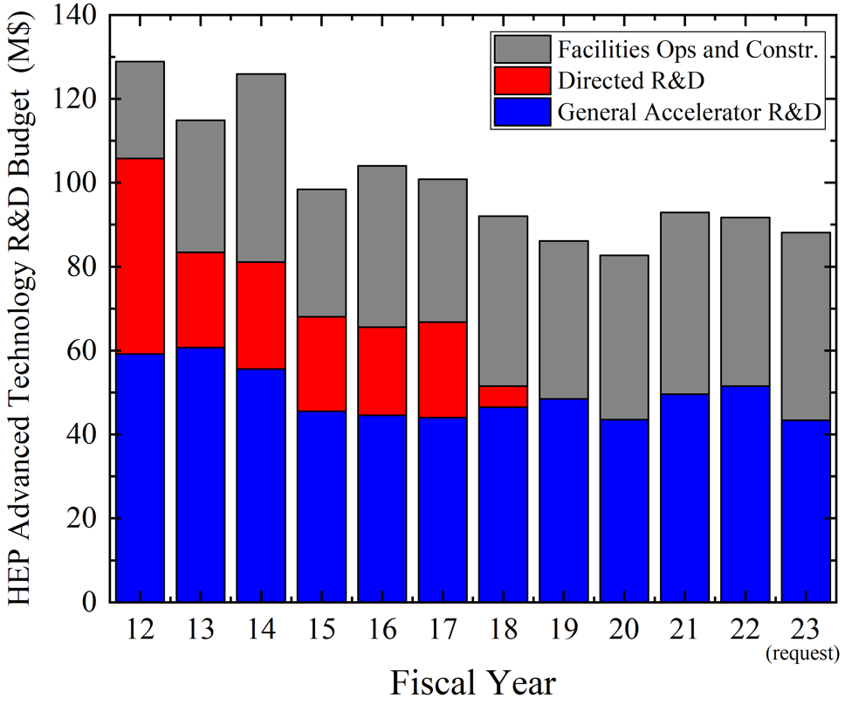
Future Colliders R&D Program - Initiative
Completed:
US ILC
US LARP (LHC)
US MAP (Muon)
Accel. Test Facilities
Proposed
for FY24-30:
Future Colliders
.......
Integrated program:
FCCee, ILC,
C^3, HELEN,
Muon Collider, etc
In US and abroad
Design and R&D
https://arxiv.org/abs/2207.06213

Slide 4
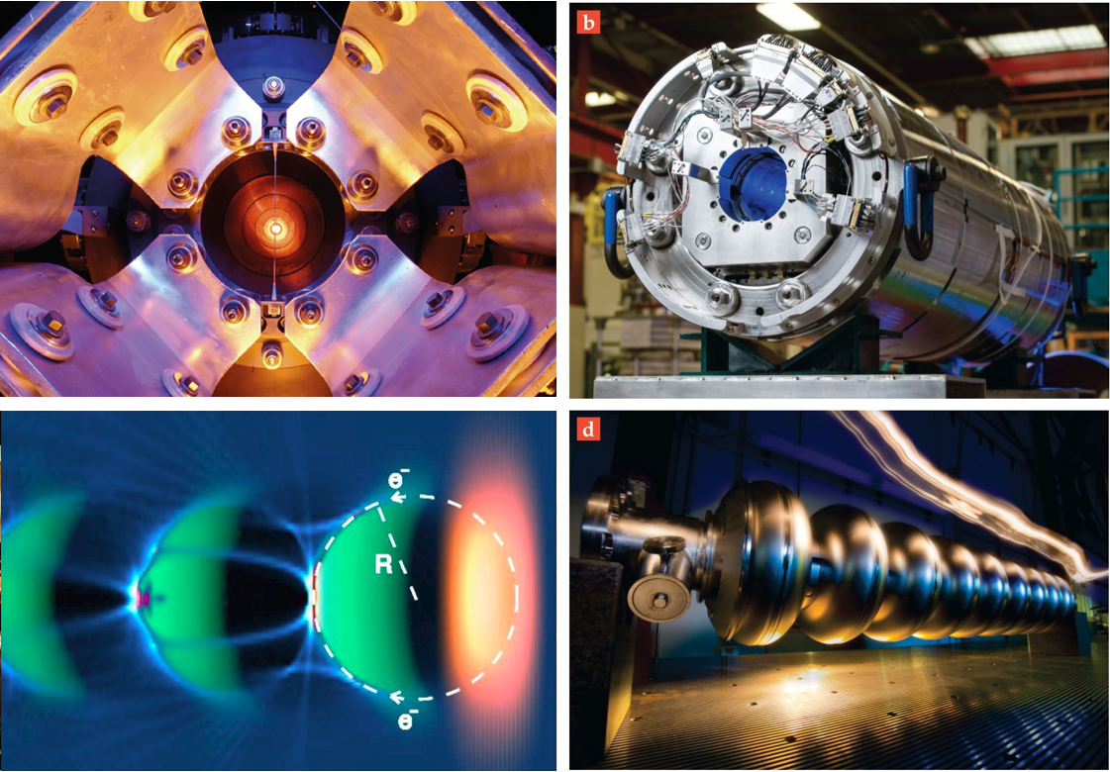
Multi-MW targets: - 2.4 MW for PIP-III - 4-8 MW for muon collider
Accelerator R&D: Next Decade
Magnets for
colliders and RCSs: - 16T dipoles
- 40T solenoids - 1000 T/s fast
cycling ones
…coordinated
with US MDP
Accelerator & Beam Physics
High intensity/brightness beams acceleration and control
High performance computer modeling and AI/ML approaches
Design integration and optimization, incl energy efficiency
Wakefields: - collider quality beams
- efficient drivers and staging
- close coordination with Int’l (Euro Roadmap, EUPRAXIA,..)
SC/NC RF: - 70-120 MV/m C³
- 70 MV/m TW SRF
new materials, high Q₀
efficient RF sources

Slide 5
Facilities
#1: We have a broad array of accelerator technologies and expertise to design and construct prioritized HEP accelerator projects (NF- 2.4MW, RPF-PAR, EF – spectrum of design options). Expect P5 to tell us “what”.
#2: We need an integrated future collider R&D program (a directed R&D program in the OHEP) to engage in the design and to coordinate the development of next generation collider projects such as: FCCee, CCC/HELEN, multi-TeV Muon Collider.

Slide 6
Accelerator R&D and Workforce
#3 (while key to all facilities) OHEP funding for accelerator R&D dropped from ~130 M$/yr to ~90M$/yr (incl. accelerator test facilities ops and construction) – that has to be reverted to support RF, magnets, targets and sources, advanced acceleration concepts and beam physics/AI/ML.
#4: Increase grants to Universities for accelerator R&D and enhance recruiting (esp. int’l students) and support the US PAS

Slide 7
Accelerators to be topic of P5
#5 Accelerator development should be part of P5: Planning for HEP accelerators should be aligned with the strategic planning for particle physics and should be part of the P5 prioritization process.

Slide 8
Back up slides

