Slide 1
Update on ProtoDUNE-SP Simulation
Wenqiang Gu (BNL)
On behalf of the Simulation Task Force

Slide 2
Updates since the collaboration meeting
Refactored Larg4
Custom physics list
TPC simulation
Diffusion study, dE/dx
Data validation of the field response
Optical detector simulation
CRT simulation
Available since dunetpc v08_33_00

Slide 3
Refactored Larg4 (by David Rivera)
Benchmarks
A common Corsika cosmic event
OpDet , CRT not included
Refactored Geant4 is slightly better in memory and time
“QGSP_BERT_HP” physics list

Slide 4
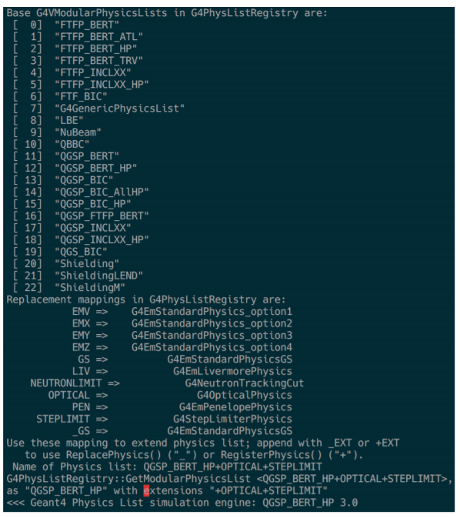
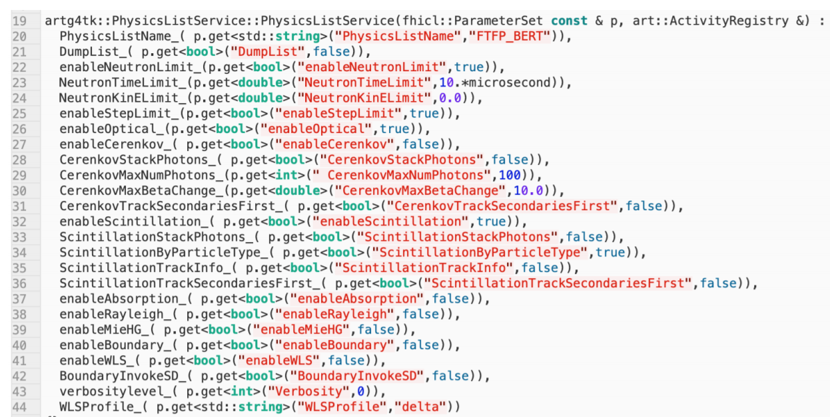
Extensible physics list
Extensible physics list factory
Reference physics lists + EM options + user cuts (neutron tracking cuts, stepLimiter, etc.)
Configurable (fhicl) options in physics list service

Slide 5
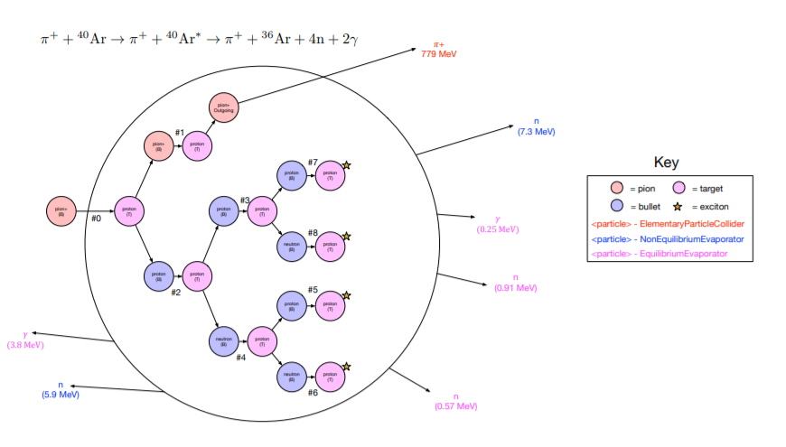
Customized Bertini cascade model
Requested by the pion quasi-elastic scattering analysis
Pion interaction in the nucleus described by the Bertini cascade model
Now the internal type from cascade model is also available to user
Exposed by the customized Bertini model
$π^{+}$ example

Slide 6
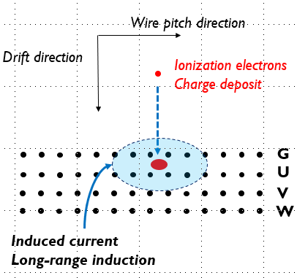
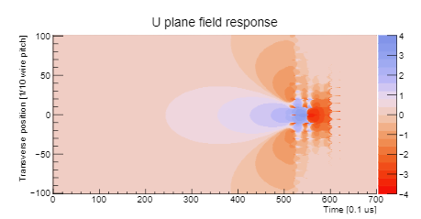
WireCell TPC simulation (by Wenqiang)
D_{T}
D_{L}
<SimEnegyDeposit>
* x, y, z, t, # of e
Electronics response
Preamp shaping
AC coupling
Noise
Digitizer
Ionized electron absorption (lifetime in LAr)
Gaussian random diffusion (longitudinal/transverse) $σ^{2}$= 2Dt
Fluctuation in electron absorption
More reading: DUNE collaboration meeting, May 2019

Slide 7
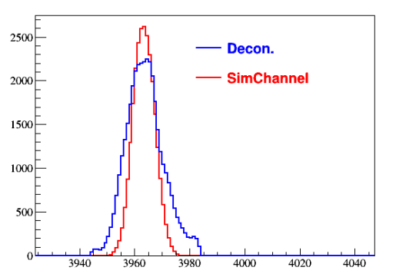
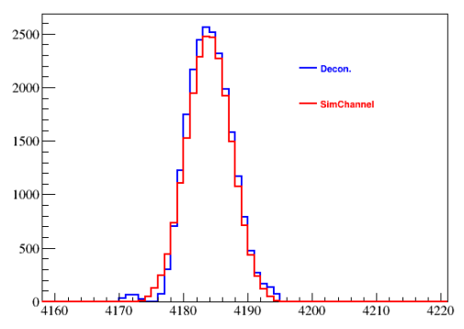
Wire-Cell TPC simulation
Ticks
Decon. charge
Ch#140
Channel
Ticks
SimChannel aligned with deconvolved charge signal
(optional) additional smearing in SimChannel to sufficiently cover signal
works as a truth tagging

Slide 8
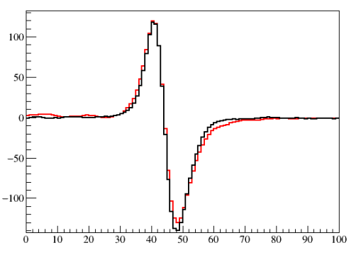
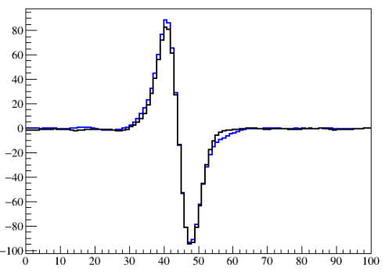
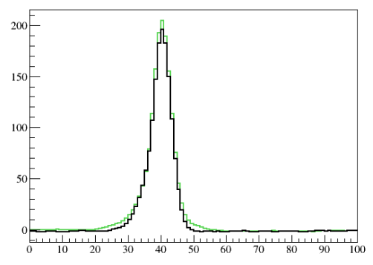
Average waveform from cosmic: data vs. MC
An anode-piercing cosmic track
MC (black)
U plane
MC (black)
V plane
MC (black)
W plane
Good agreement!
Previous result using a cathode-piercing cosmic track
D_{L} issue? 
Field response? (induced current vs speed)

Slide 9
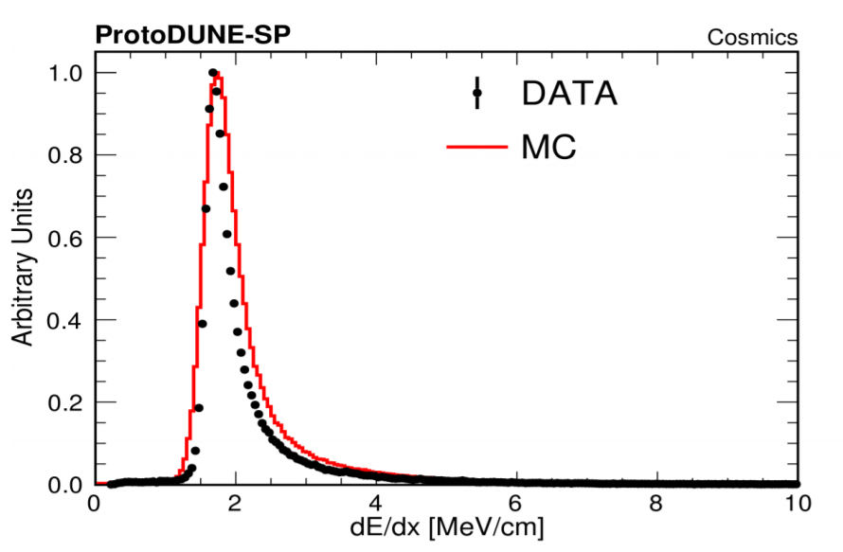
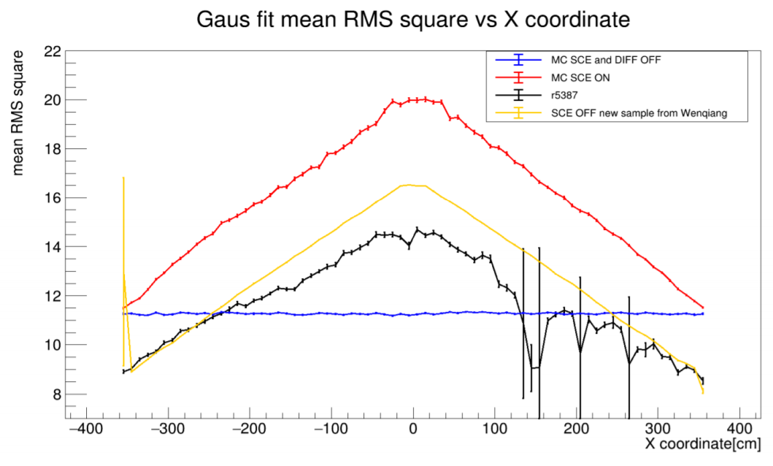
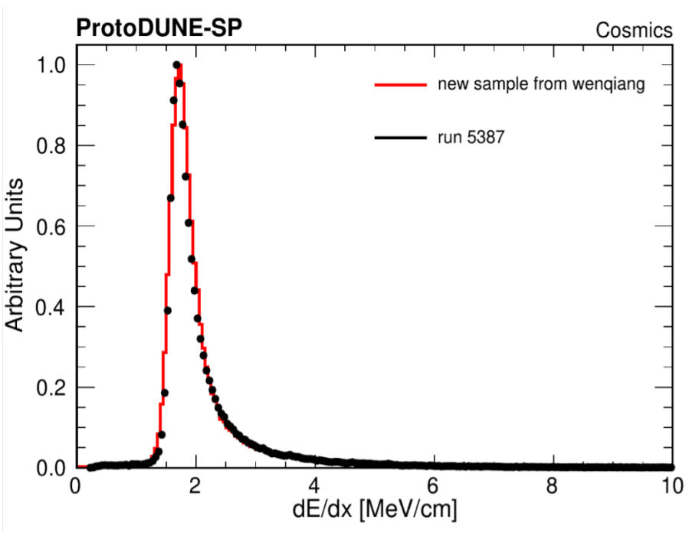
Diffusion Analysis (by Ajib)
The MC sample with the new TPC simulation seems to be promising!
New MC sample

Slide 10
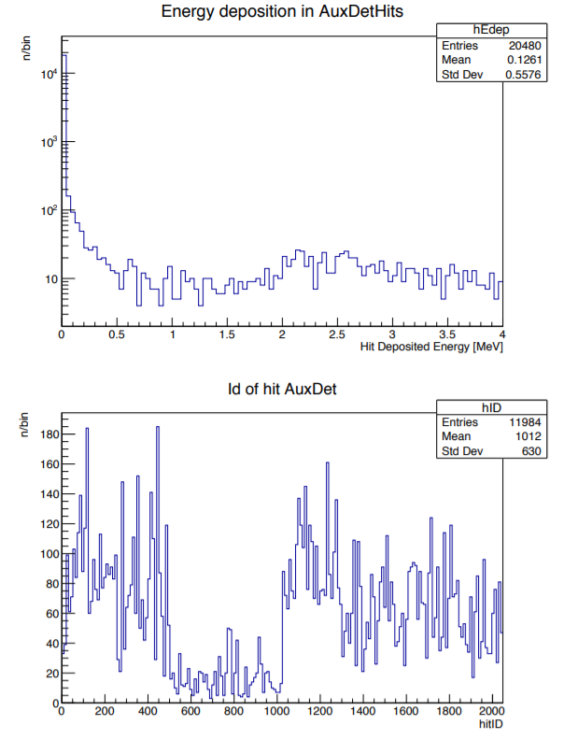
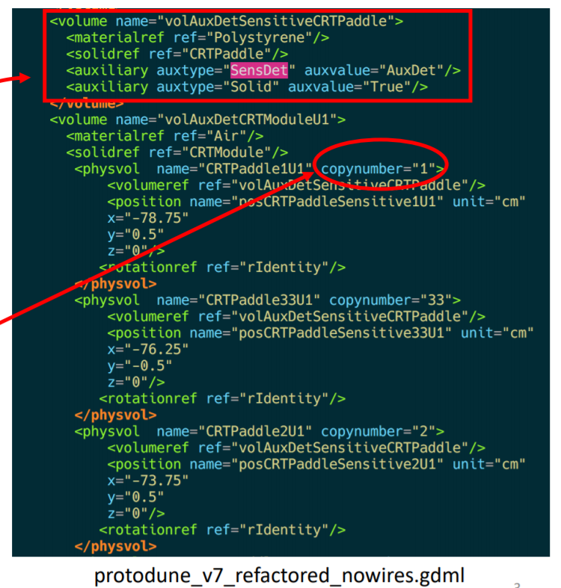
Refactored CRT simulation (David, Richie)
Set CRT paddle as “sensitive” and assign unique copy #
Check the AuxDetHits from simulation

Slide 11
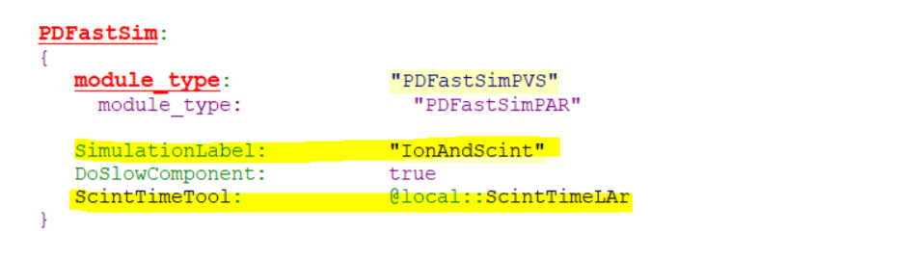
OpDet simulation (by Muve)
Redefined constructor to avoid the redundant info in fast/slow light
New tool (ScintTimeLAr) to control the scintillation time constant
Updates from many feature branches!
Available since larsoft v08_33_00
dunetpc @ feature/wgu_refact lardataobj @ feature/muve_pdsim_refactor larsim @ feature/muve_pdsim_refactor larg4 @ feature/muve_pdsim_refactor larwirecell @ feature/muve_pdsim_refactor @ feature/wgu_refact

Slide 12
To-do list
Larg4
Document the custom physics list and make it available to people
TPC simulation
Understand the small difference (data vs. MC) in the field response
Improve the simulation in diffusion and dE/dx
CRT simulation
Implement AuxDetSimChannel object
Data validation, consistency check with the legacy simulation
OpDet simulation
Validate the pulse shape

Slide 13
Summary
The refactored framework is almost finished
Some additional work
e.g., field respose, CRT, physics list, OpDet pulse shape
The updated TPC simulation gives a better agreement in dE/dx

