Slide 1
Booster Absorber Preliminary Thermal Analysis
Jesse Batko
Preliminary Design Review
20 November 2019

Slide 2
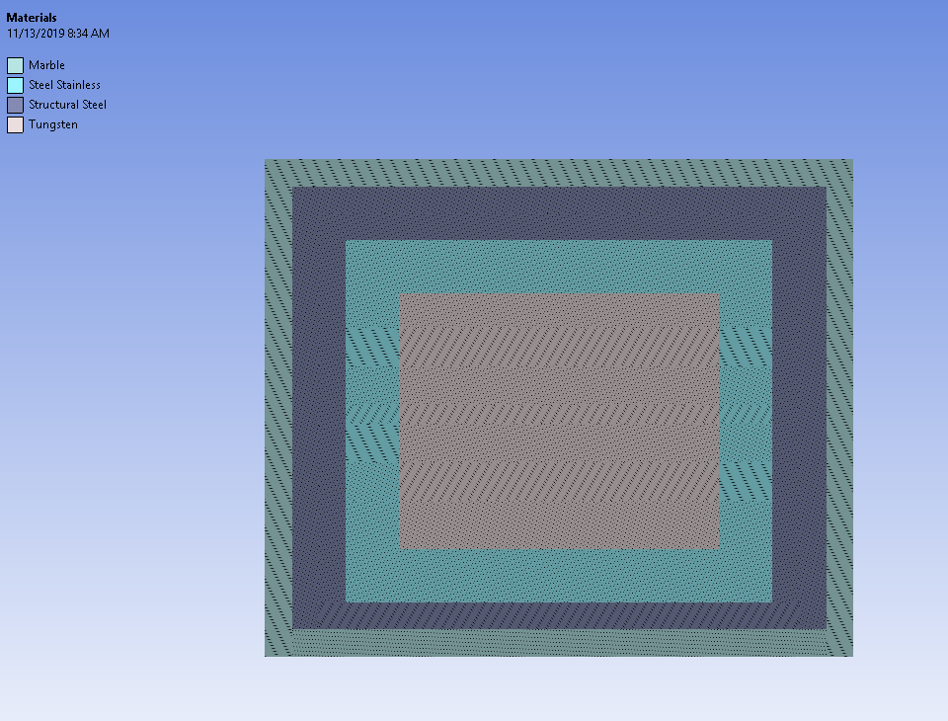
Overview- Three Simulations
Tungsten Block with SS cover, Outer steel and marble shielding at 200W
SS steel core with marble exterior at 200 W (includes looking at blocks of SS [2a] vs a single SS piece [2b]).
Stainless steel with marble exterior at 30W beam power
1
2a,2b&3

Slide 3
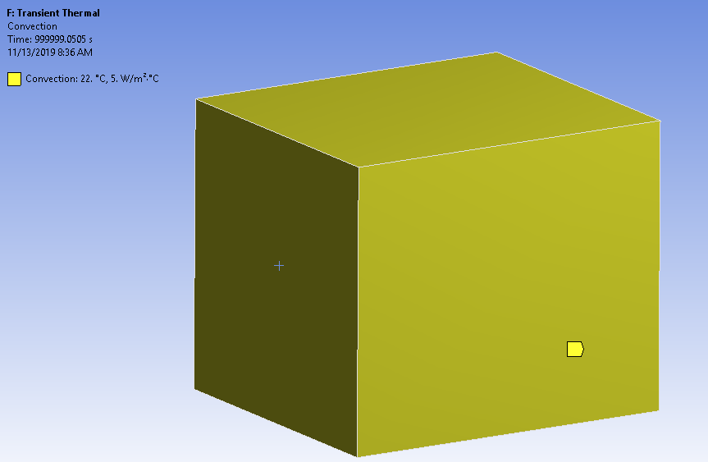
Convection
Convection was assigned to the outer surface of the marble cover. The value given (5 W/m^2 C) is equivalent to stagnant air at 22 degrees Celsius.

Slide 4
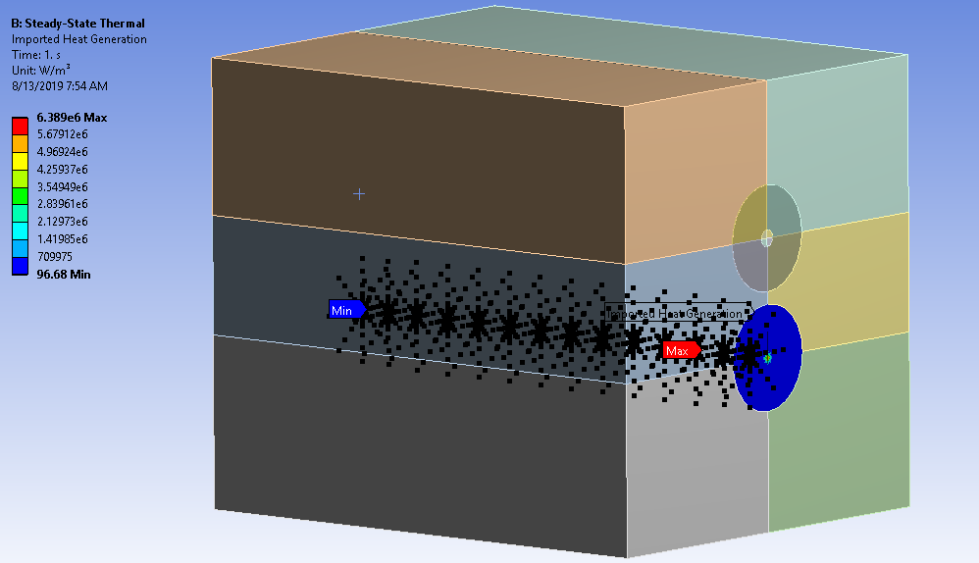
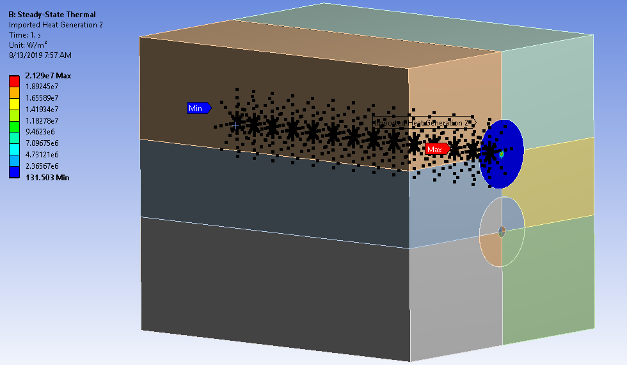
Beam Mapping
Both top and bottom beam path interactions were mapped with energy deposition given by MARS simulations
For the 30W simulation, the top beam mapping was suppressed.

Slide 5
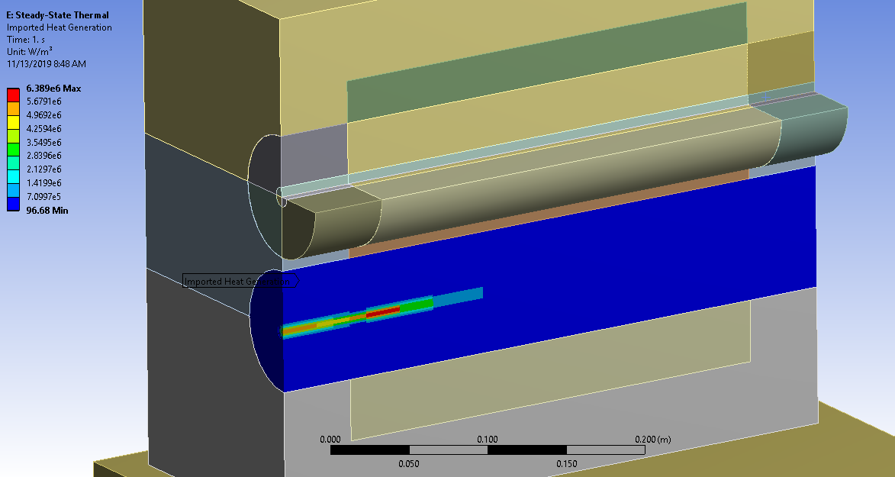
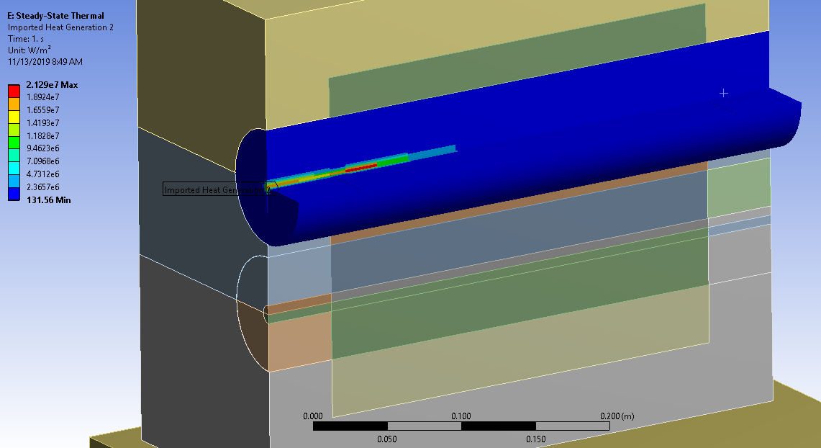
Beam Mapping- Section View

Slide 6
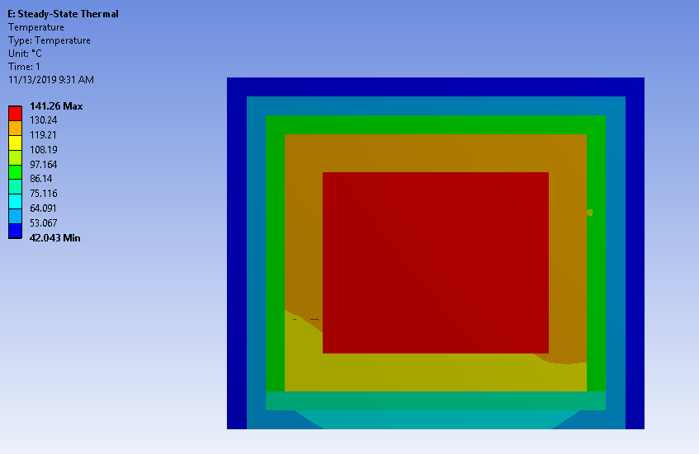
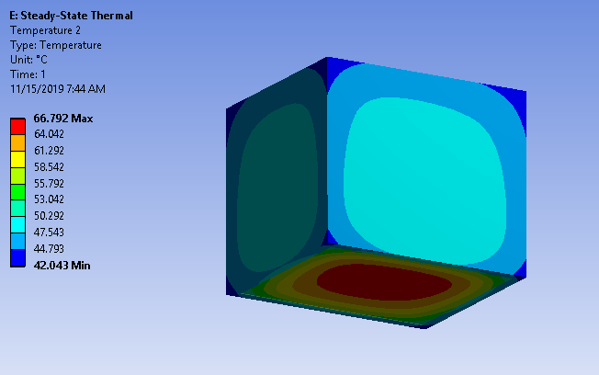
Results of Simulation 1- Steady State
Max temp- 141.26 degrees C in the tungsten core
Max temp of outside marble face- 48 degrees C on the sides and top, 67 degrees C on the bottom

Slide 7
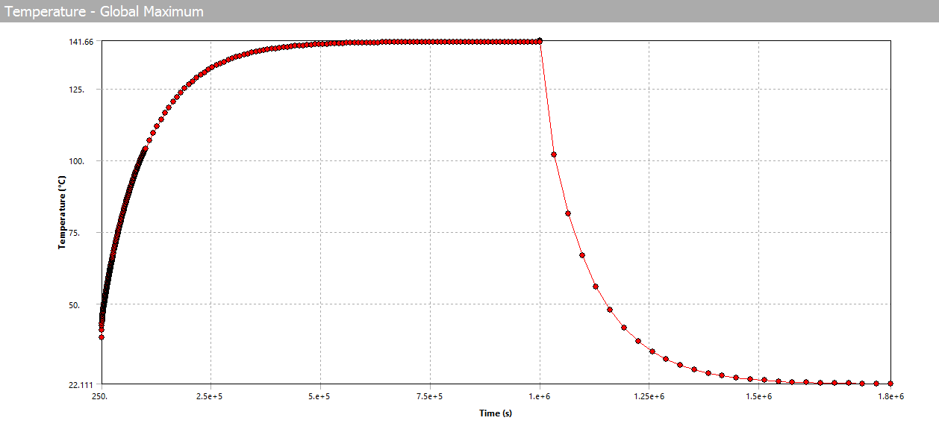
Results of simulation 1- Transient Thermal
Time it takes to get to steady state: about 631,000 seconds.
Time it take to cool down to room temp: 544,000 seconds.
Temp rise during individual beam pulses after reaching steady state: .4 degrees C

Slide 8
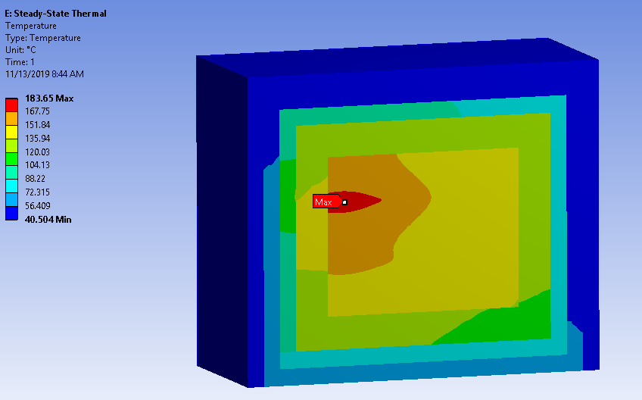
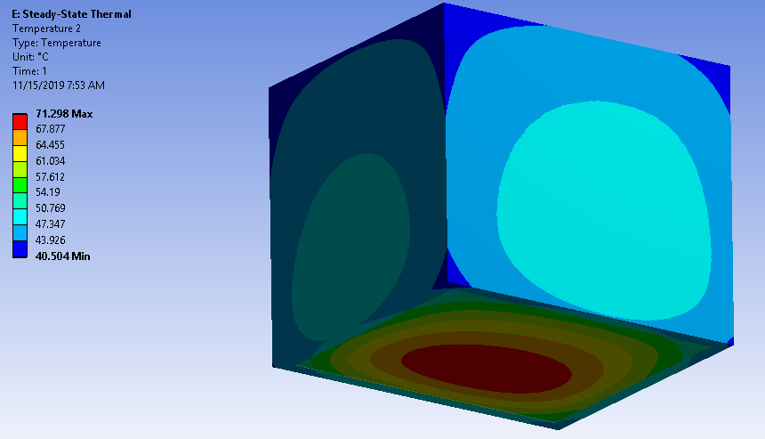
Results of Simulation 2a- Steady State
Max temp of outside marble face- 49 degrees C on the sides and top, 72 degrees C on the bottom
Max temp- 183.65 degrees C

Slide 9
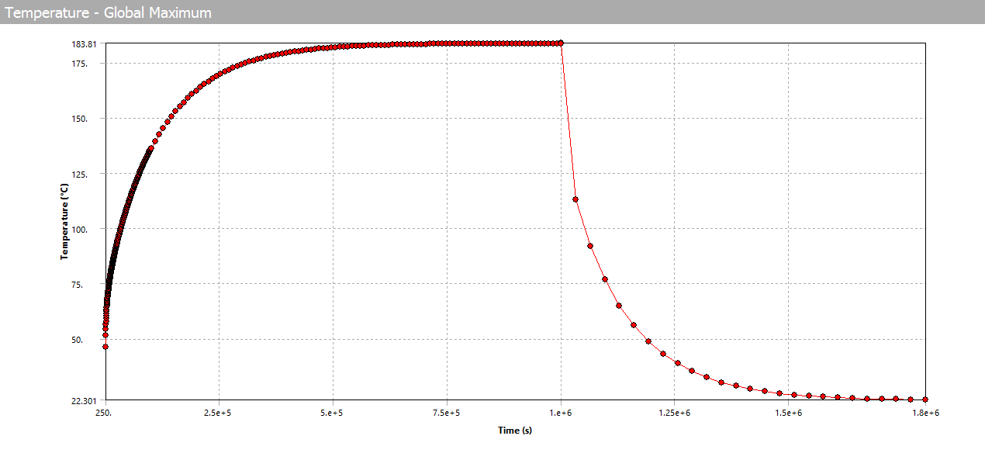
Results of simulation 2a- Transient Thermal
Time it takes to get to steady state: about 640,000 seconds.
Time it take to cool down to room temp: 640,000
Temp rise during individual beam pulses after reaching steady state: .20 degrees C
Not sure why there is a dip in temperature during pulse

Slide 10
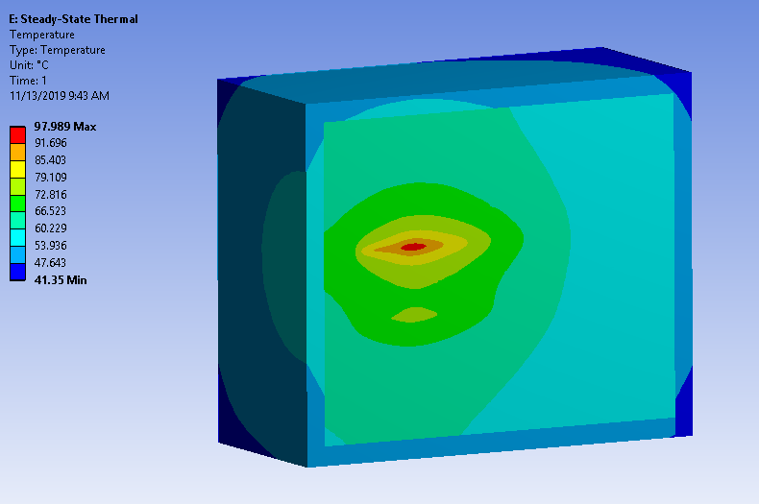
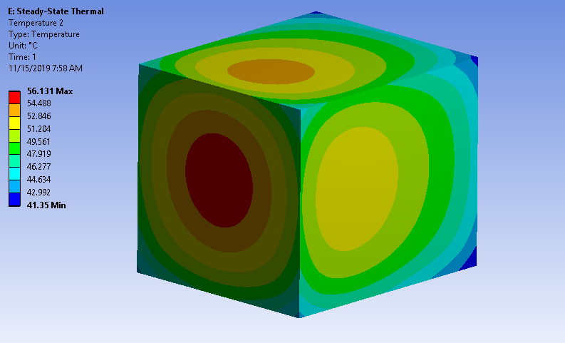
Results of Simulation 2b- Steady State
Max temp- 98 degrees C
Max temp of outside marble face- 53 degrees C on the sides, top and bottom, 57 degrees C on the beam face

Slide 11
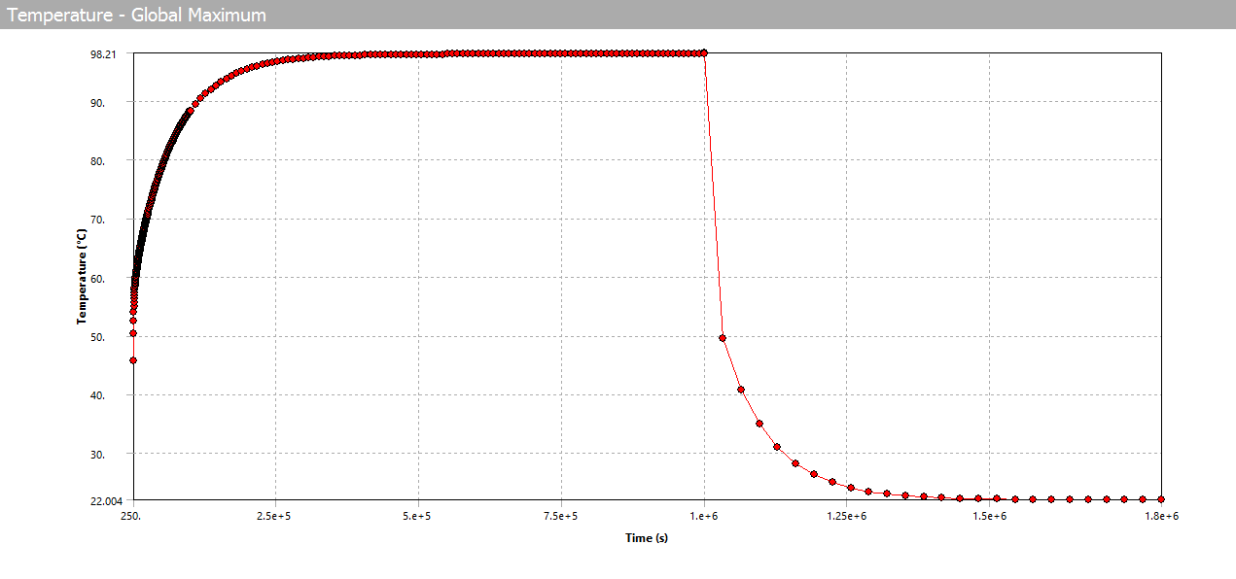
Results of simulation 2b- Transient Thermal
Time it takes to get to steady state: about 280,000 seconds.
Time it take to cool down to room temp: 320,000 seconds.
Temp rise during individual beam pulses after reaching steady state: .22 degrees C
Not sure why there is a dip in temperature during pulse

Slide 12
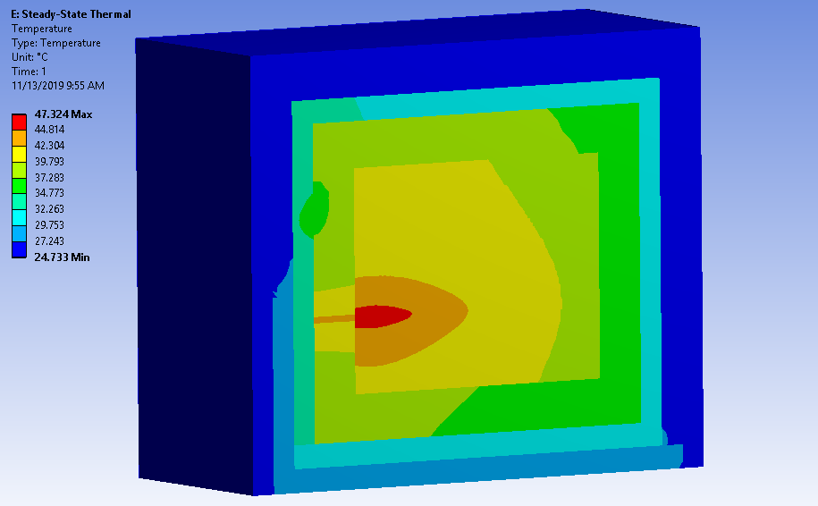
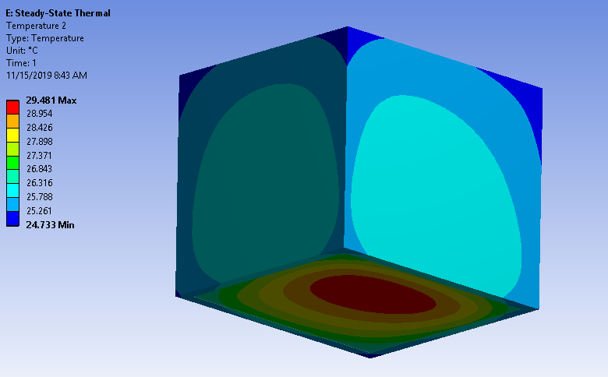
Results of Simulation 3- Steady State
Max temp of Stainless Steel- 48 degrees C
Max temp of outside marble face- 26 degrees C on the sides and top, 30 degrees C on the bottom

Slide 13
Results of simulation 3- Transient Thermal
Time it takes to get to steady state: about 487,000 seconds.
Time it take to cool down to room temp: 384,000 seconds.
Temp rise during individual beam pulses after reaching steady state: .04 degrees C
Not sure why there is a dip in temperature during pulse

Slide 14
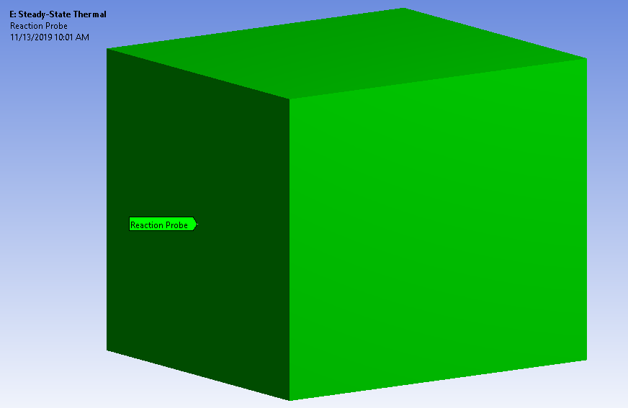
Total power management
1&2a,2b
3

Slide 15
Summary
 | Sim 1 | Sim 2a | Sim 2b | Sim 3
Max temp | 141.24 C | 184 C | 98 C | 48 C
Power management | 204.66 W | 204.66 W | 204.66 W | 30.4 W
Time to steady state | 631,000 s | 640,000 s | 280,000 s | 487,000 s
Time to cooldown | 544,000 s | 640,000 s | 320,000 s | 384,000 s
Temp jump per pulse | .4 C | .2 C | .22 C | .04 C
Max temp of marble face | 67 C | 72 C | 57 C | 30 C

Slide 16
Conclusion
Annealing Temp of Stainless Steel: ~1040 C
Oxidizing Temp of Stainless Steel: >900 C
Annealing Temp of Tungsten: ~800 C
Oxidizing Temp of Tungsten: ~ as low as 400 C*
*- http://lup.lub.lu.se/luur/download?func=downloadFile&recordOId=4025324&fileOId=4025329
A solid piece of stainless steel performs 53% better than blocks stacked together. This is due to the blocks having an imperfect interface.
In reality, there will be two opening in the marble for the beam to go into. This will increase convection to the inner material.
Regardless if the core is stainless or tungsten, heat dissipation is 200 W or 30 W, no active cooling is necessary.

