Slide 1
Answers to Questions
TPC Electronics Consortium
6 February 2020

Slide 2
System (i)
Question: Are there some reliability data about the LDOs to be used on the FEMB?
Discussed in the presentation on the front-end motherboard earlier today (Jack Fried)
Do not expect any degradation over lifetime of DUNE (Texas Instruments TSP74201)

Slide 3
System (ii)
Question: Are there plans to monitor the output voltage of the LDOs during operation?
This is something we have considered, but in the end decided against it
The best thing would be multiplexing the voltage rails from the LDOs on the FEMB to an 8-bit ADC inside COLDATA
There is plenty of room inside the silicon (chip size limited by the number of pads)
Decided against this in order not to compromise the COLDATA schedule
Cable plant prevents us from adding external monitor (would still require multiplexer on the FEMB)
Could monitor the 1.1V / 1.8 V using the analog monitor on LArASIC, but this would not work for a 2.5 V supply

Slide 4
System (iii)
What is the requirement for timing synchronization across the different chips and components in the system? For both CRYO and COLDATA, what is the method for synchronizing the system clocks? How will synchronization be monitored? How are phase issues associated with frequency multiplication or division handled, to ensure that the correct phase is always obtained? What is the sensitivity of internal PLLs to voltage and temperature? How will differences in path length (cable lengths primarily) be accounted for?

Slide 5
Timing Synchronization (i)
There is a basic difference between DUNE and a collider experiment
We do not have a hardware trigger, there is no need to have the entire detector sample the data at the same time or frequency
The photon detector will sample the data at a much higher rate than the TPC electronics (signal duration is different)
Each system is read out by waveform digitizers sampling at different frequencies (we reorder the TPC data into waveforms inside the DAQ)
The important thing is that the time stamp of each sample are consistent between different detector elements
DUNE timing system provides us with a 62.5 MHz clock endpoint on the WIB with a in sync / out of sync flag
If this endpoint is out of sync, the timing system will automatically reset the link
From the end point onward it is the responsibility of the TPC electronics to handle the timing
Sample all the TPC wires at the same time (within O(ns))

Slide 6
Timing Synchronization (ii)
Once the DUNE clock is distributed to the WIB, how do we ensure that all the 512 wires connected to it are all sampled at the same time ?
A) LArASIC + ColdADC + COLDATA
Next slides (Dave)
B) CRYO
Aldo and Dionisio will discuss this tomorrow morning

Slide 7
Cable length (i)
How will differences in path length (cable lengths primarily) be accounted for ?
In principle cables come in two lengths (9 m and 23 m / upper and lower APA)
In ProtoDUNE we had timing corrections in the FPGA of the warm interface board that had been pre-determined based on the measured cable length
We would prefer to measure the cable length in situ
This requires a small modification in COLDATA (presented yesterday by Jim Hoff)
For CRYO this is simply the transit time of signals, no modification required inside the chip, just need a timing measurement in the FPGA
Need a FEMB dependent offset in the WIB, to be determined once, represents an offset between “the clock has arrived on the WIB” and “the waveform of the wire signal has been sampled”

Slide 8
Cable length (ii)
Difference in cable length between various APAs
Given the readout architecture we just need to ensure that all the TPC wires are sampled at the same time.
Data transmitted to the WIB is derandomized and transformed into time ordered samples for each wire with fixed (and equal) time stamps
To ensure that all the wires are sampled at the same time (and that the time is know) we need to correct for
Difference in cable length between the FEMBs and the warm electronics
Difference between arrival of FastCommand (3 ASIC solution) or Clock (CRYO) and actual sampling of signal waveform
This time is known: O(ns) for LArASIC, ~xx ns for CRYO, it is the same for all the channels in the detector
COLDATA+LArASIC: propagation time of the signal in the chips
CRYO: propagation time of the signal in the chips (mm cycles of the 56 MHz clock)

Slide 9
Cable length (ii)
Difference in cable length between various APAs
Given the readout architecture we just need to ensure that all the TPC wires are sampled at the same time.
Data transmitted to the WIB is derandomized and transformed into time ordered samples for each wire with fixed (and equal) time stamps
To ensure that all the wires are sampled at the same time (and that the time is know) we need to correct for
Difference in cable length between the FEMBs and the warm electronics
Difference between arrival of FastCommand (3 ASIC solution) or Clock (CRYO) and actual sampling of signal waveform
This time is known: O(ns) for LArASIC, ~xx ns for CRYO, it is the same for all the channels in the detector
COLDATA+LArASIC: propagation time of the signal in the chips
CRYO: propagation time of the signal in the chips (mm cycles of the 56 MHz clock)

Slide 10
Number of dies / Boiling
Question: For CRYO, what is the expected final die size? How many devices total? For LARASIC/CALDADC/COLDATA, what are the 3 die sizes, and how many devices are expected to be in each? In the case of the latter, does the 3-chip solution reduce the tendency for the boiling of LAr, since the power density is generally lower? Has this been measured?

Slide 11
Number of dies / wafers
CRYO dimensions: 6.774 x 8.948 mm
LArASIC: expected to grow from 6.0 * 5.7 mm to 7.0 * 6.2 mm (Nara, this morning)
ColdADC: expected to grow from 6.86 mm x 7.61 mm to 6.86 x 7.73 mm (align scribe lines with COLDATA)
COLDATA: 7.73 x 7.73 mm (no changes planned)
Technologies
LArASIC: TSMC 180 nm (via MOSIS)
ColdADC / COLDATA: TSMC 65 nm (via IMEC)
CRYO: TSMC 130 nm (via MOSIS)

Slide 12
Number of chips / detector (i)
LArASIC and ColdADC: 8 per FEMB, 3k FEMB, 24k chips before yields
COLDATA and CRYO: 2 per FEMB, 6k chips
Yield assumptions (Marco’s presentation)
Populate FEMBs for 152 APAs (2 spare APAs) per detector, 3,040 FEMBs
Produce 10% spares FEMBs: 3,340 i.e. 26,720 LArASIC/ColdADC + 6,680 COLDATA / 6,680 CRYO
Assume 90% from dicing/packaging/warm testing, 95% from cold testing (based on LArASIC, fixed….)
Overall yield 85% (ColdADC is higher with limited statistics)

Slide 13
Number of chips / detector (i)
LArASIC and ColdADC: 8 per FEMB, 3k FEMB, 24k chips before yields
COLDATA and CRYO: 2 per FEMB, 6k chips
Discussions of yields / required number of wafers in Marco’s presentation this afternoon
Need 2 batches per detector for ColdADC/COLDATA and LArASIC
Need 2 batches per detector for CRYO
Can accommodate lower yields
If yield is high we may need only 1 batch for 2nd detector in some cases

Slide 14
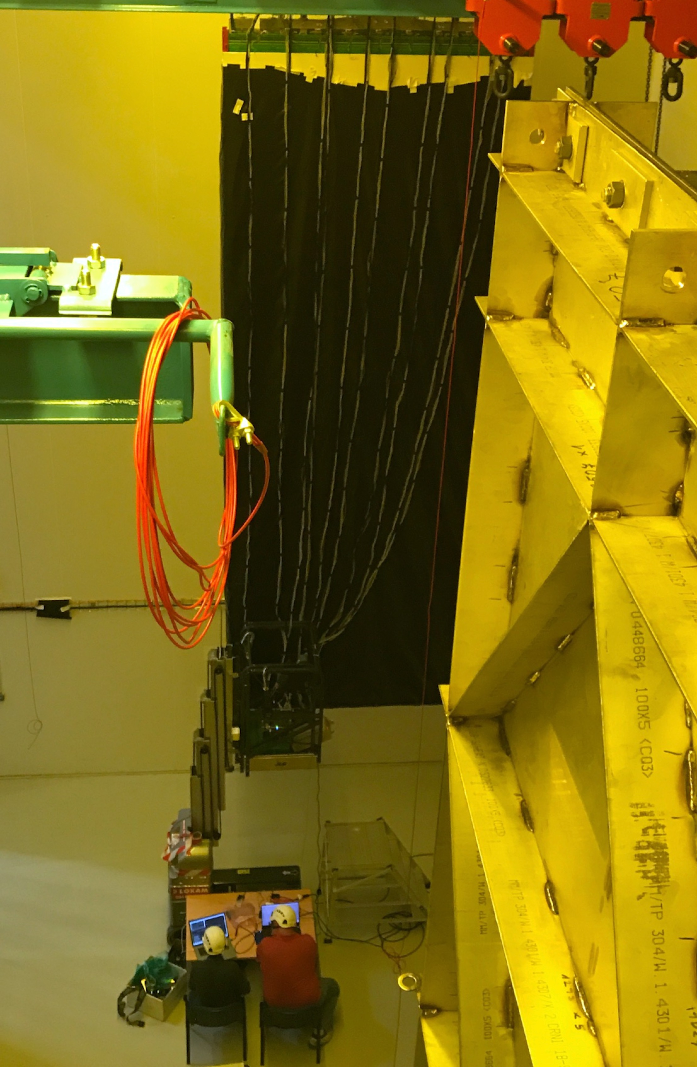
Boiling
We have FEMBs mounted on the head tube of the upper and lower APAs
The two APAs are identical and are connected via the foot tube
The FEMBs are attached to the head tube of the APA The FEMBs for the upper APA are immersed in 10-20 cm of LAr
The FEMBs for the lower APA are immersed in 12.5 m of LAr

Slide 15
Boiling
Boiling from the FEMBs mounted on the upper APA is not an issue, it is just a load on the cryogenic plant to be taken into account
Boiling from the FEMBs mounted on the lower APA could be a serious problem
If there is no boiling or if there is boiling but the bubbles have a very short lifetime (i.e. the gas recondensates immediately), this is not a problem
If there is boiling and the bubbles travel into the drift region, this could lead to discharges in the gas that could result in damage to the FE electronics
This is a problem we have taken very seriously

Slide 16
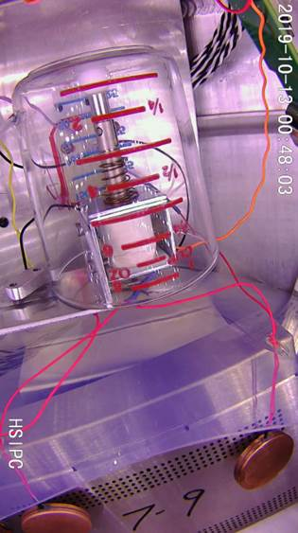
Does the Electronics cause LAr to boil ?
Built test stand where we can measure LAr boiling as a function of pressure
As soon as the CE boxes are immersed in more than 1.4 m of LAr boiling stops
At a depth of 12 m no bubbles with 120 W of power (40 kW/m² power density)
FEMBs: 4-6.5 W (factor 20 safety)
If bubbles form (reduced pressure or increased heat load) they do not travel far and recondense without traveling far
Very large safety factor from the point of view of total heat load
At least factor 2 safety in terms of power density (CRYO)
Repeat tests with actual FEMB prototypes (with/without heat spreader in the case of CRYO)

