Slide 1


Modified FEMB for the CRYO ASIC
Jeff Kleyner, Kurtis Nishimura, Gary Varner
University of Hawaii
In close collaboration with SLAC
DUNE TPC Electronics Review
February 6, 2020

Slide 2
Reminder of CRYO Architecture
CRYO integrates LDOs, preamps, filters, ADCs, encoded data output into a single ASIC.
Significantly reduces number of components required on the FEMB.
Increases density near ASIC for chip-on-board.
*from Angelo’s slides yesterday.

Slide 3
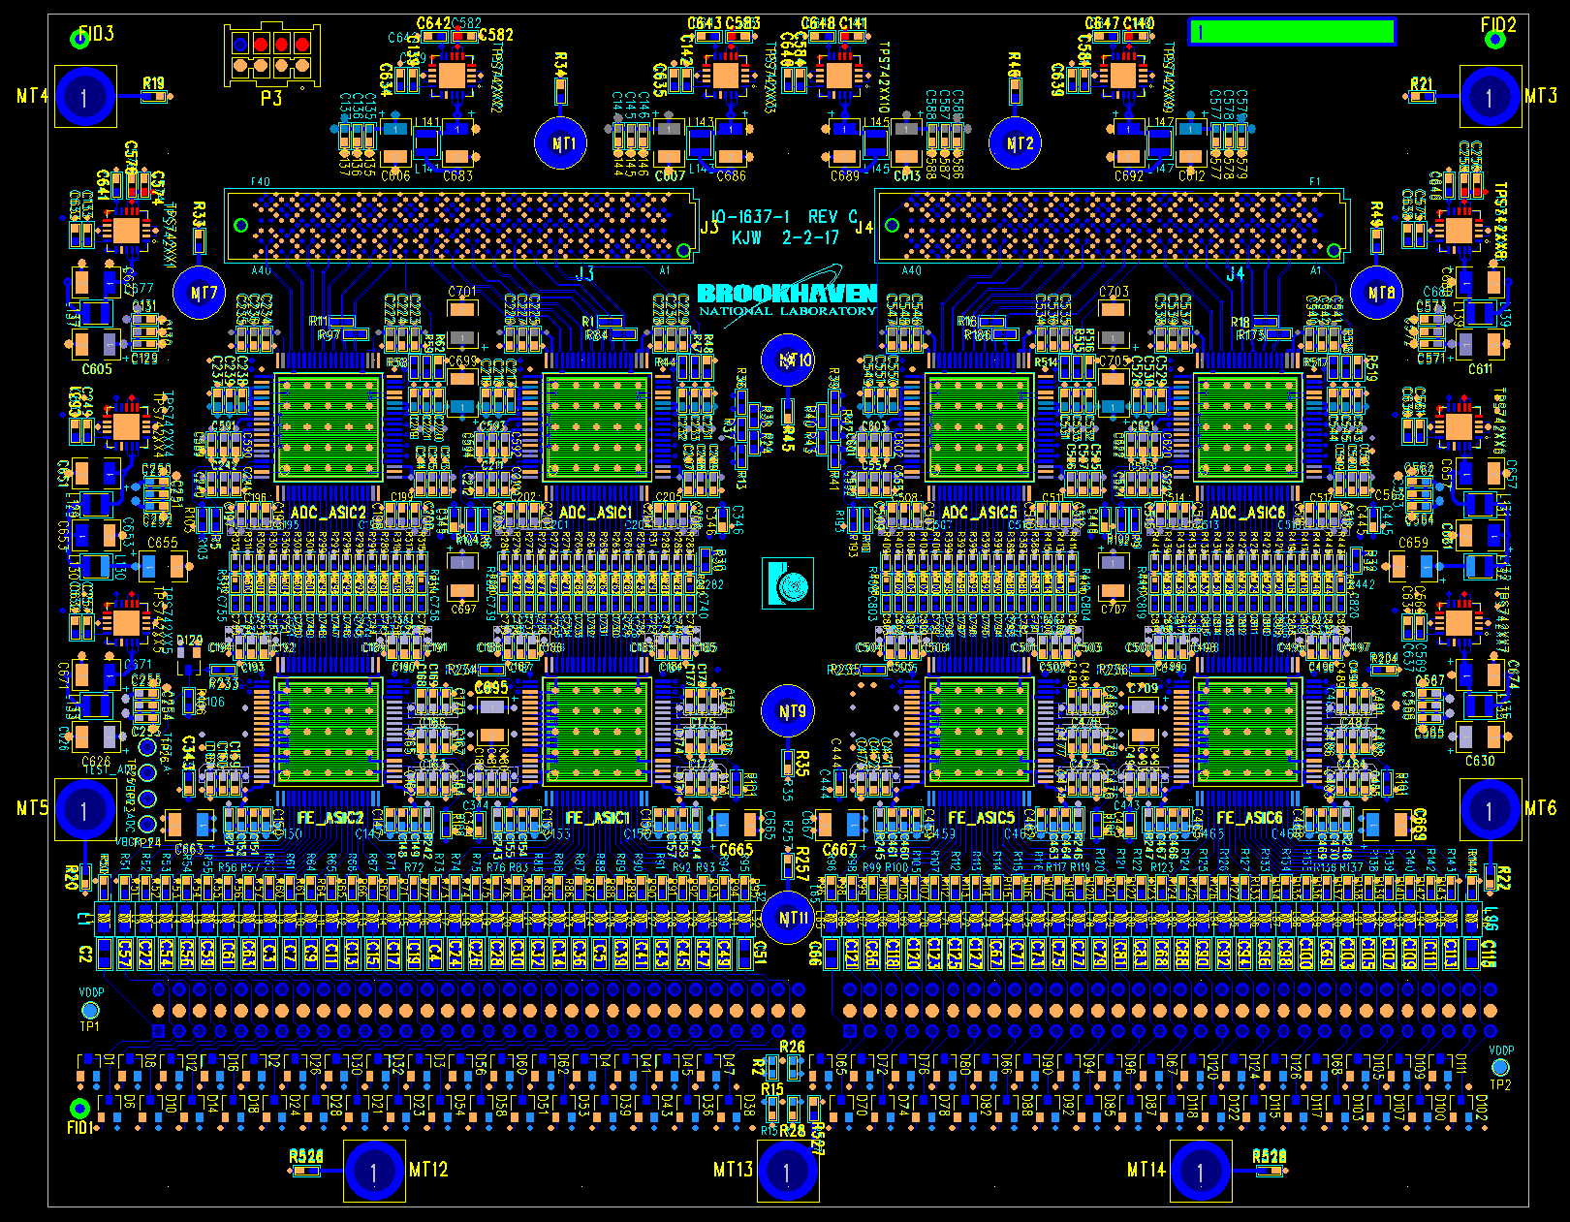
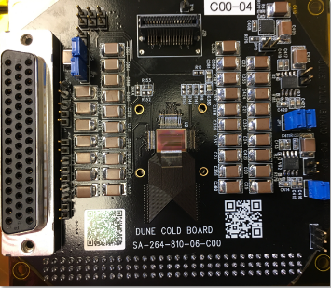
CRYO FEMB Design Strategy
Original BNL FEMB Layout
Original FEMB adopted as
starting point to get proper
form factor, mounting holes,
system connections, etc.
No mezzanine cards since
digital functionality is all
on-chip.
Parts of schematic involving
CRYO drawn directly from
SLAC CRYO cold test boards.
Layout is being guided by
experience from the SLAC
design (e.g., layout fixes adopted
after first cold test board noise
experience).
SLAC CRYO
Cold
Test Board

Slide 4
CRYO FEMB – Power Options
Available by alternative loading options:
Alternate 1:
  CRYO LDOs enabled.
  Raw power supplies directly to supply CRYO LDOs (not default option but may be interesting to test if we can supply 2.5 V raw power).
Alternate 2:
  CRYO LDOs disabled.
  Raw power to LDOs that generate required CRYO internal voltages.
Analog
Analog 2.5 V LDO
Analog
CRYO
On-Chip LDOs
(~3 V)
Digital
Digital 2.5 V LDO
Digital
Default loading option:
  CRYO LDOs enabled.
  Raw power supplies separate digital and analog 2.5 V LDOs, which supply CRYO LDOs.
*All options use separate analog/digital power.
** Only one of two CRYO ASICs shown.

Slide 5
CRYO FEMB – Power Options
Available by alternative loading options:
Alternate 1:
  CRYO LDOs enabled.
  Raw power supplies directly to supply CRYO LDOs (not default option but may be interesting to test if we can supply 2.5 V raw power).
Alternate 2:
  CRYO LDOs disabled.
  Raw power to LDOs that generate required CRYO internal voltages.
Analog
CRYO
On-Chip LDOs
(2.5 V)
Digital
(2.5 V)
Default loading option:
  CRYO LDOs enabled.
  Raw power supplies separate digital and analog 2.5 V LDOs, which supply CRYO LDOs.
*All options use separate analog/digital power.
** Only one of two CRYO ASICs shown.

Slide 6
CRYO FEMB – Power Options
Analog
Analog 2 V LDO
Available by alternative loading options:
Alternate 1:
  CRYO LDOs enabled.
  Raw power supplies directly to supply CRYO LDOs (not default option but may be interesting to test if we can supply 2.5 V raw power).
Alternate 2:
  CRYO LDOs disabled.
  Raw power to LDOs that generate required CRYO internal voltages.
CRYO
Digital
Digital 2 V LDO
Digital 1 V LDO
Default loading option:
  CRYO LDOs enabled.
  Raw power supplies separate digital and analog 2.5 V LDOs, which supply CRYO LDOs.
*All options use separate analog/digital power.
** Only one of two CRYO ASICs shown.

Slide 7
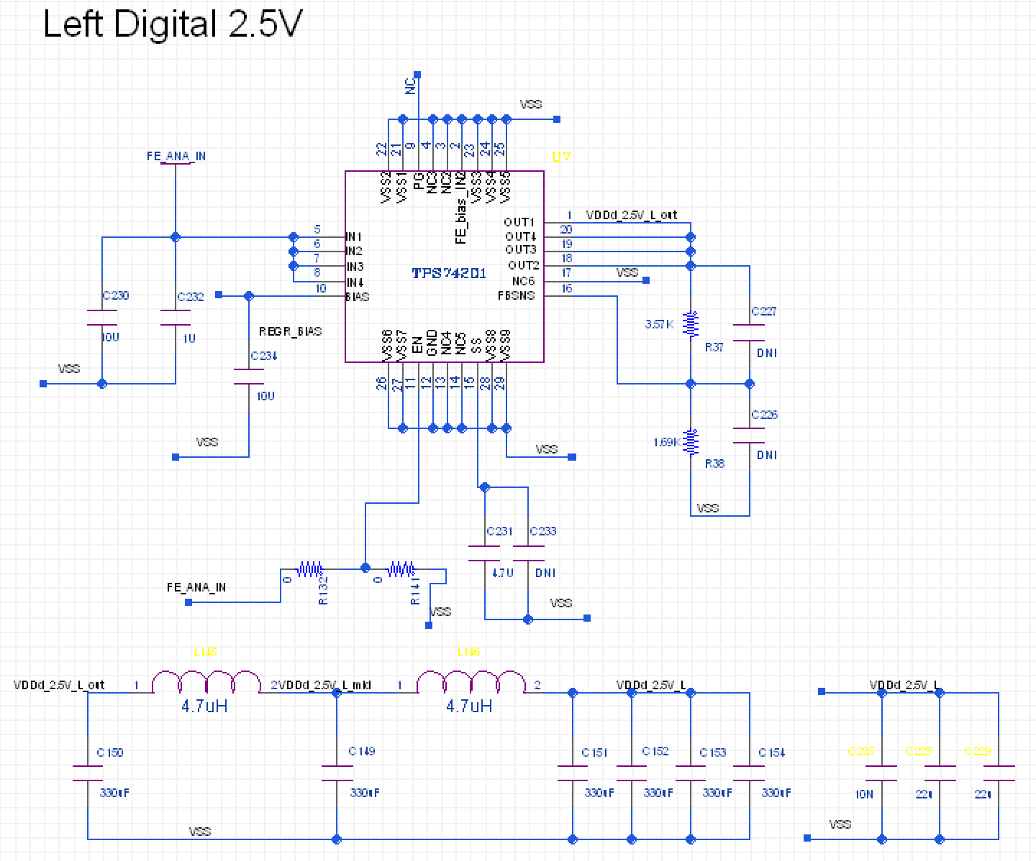
CRYO FEMB Components
Generally using same components as BNL FEMB to ensure compatibility with cold operation.
For example, same LDOs (TPS74201) and filtering circuits as original BNL FEMB.

Slide 8
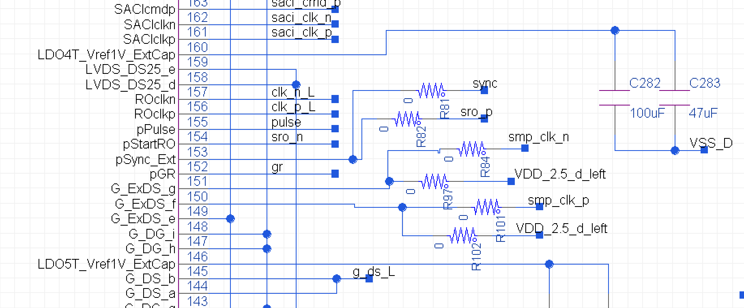
CRYO FEMB – ASIC Variants
DUNE and nEXO variants have different pinouts.
  Changes are limited to just a few pins.
Both are supported by same FEMB using different loading options.
This will allow first bring up of the FEMB without needing to wait for nEXO CRYO ASICs.

Slide 9
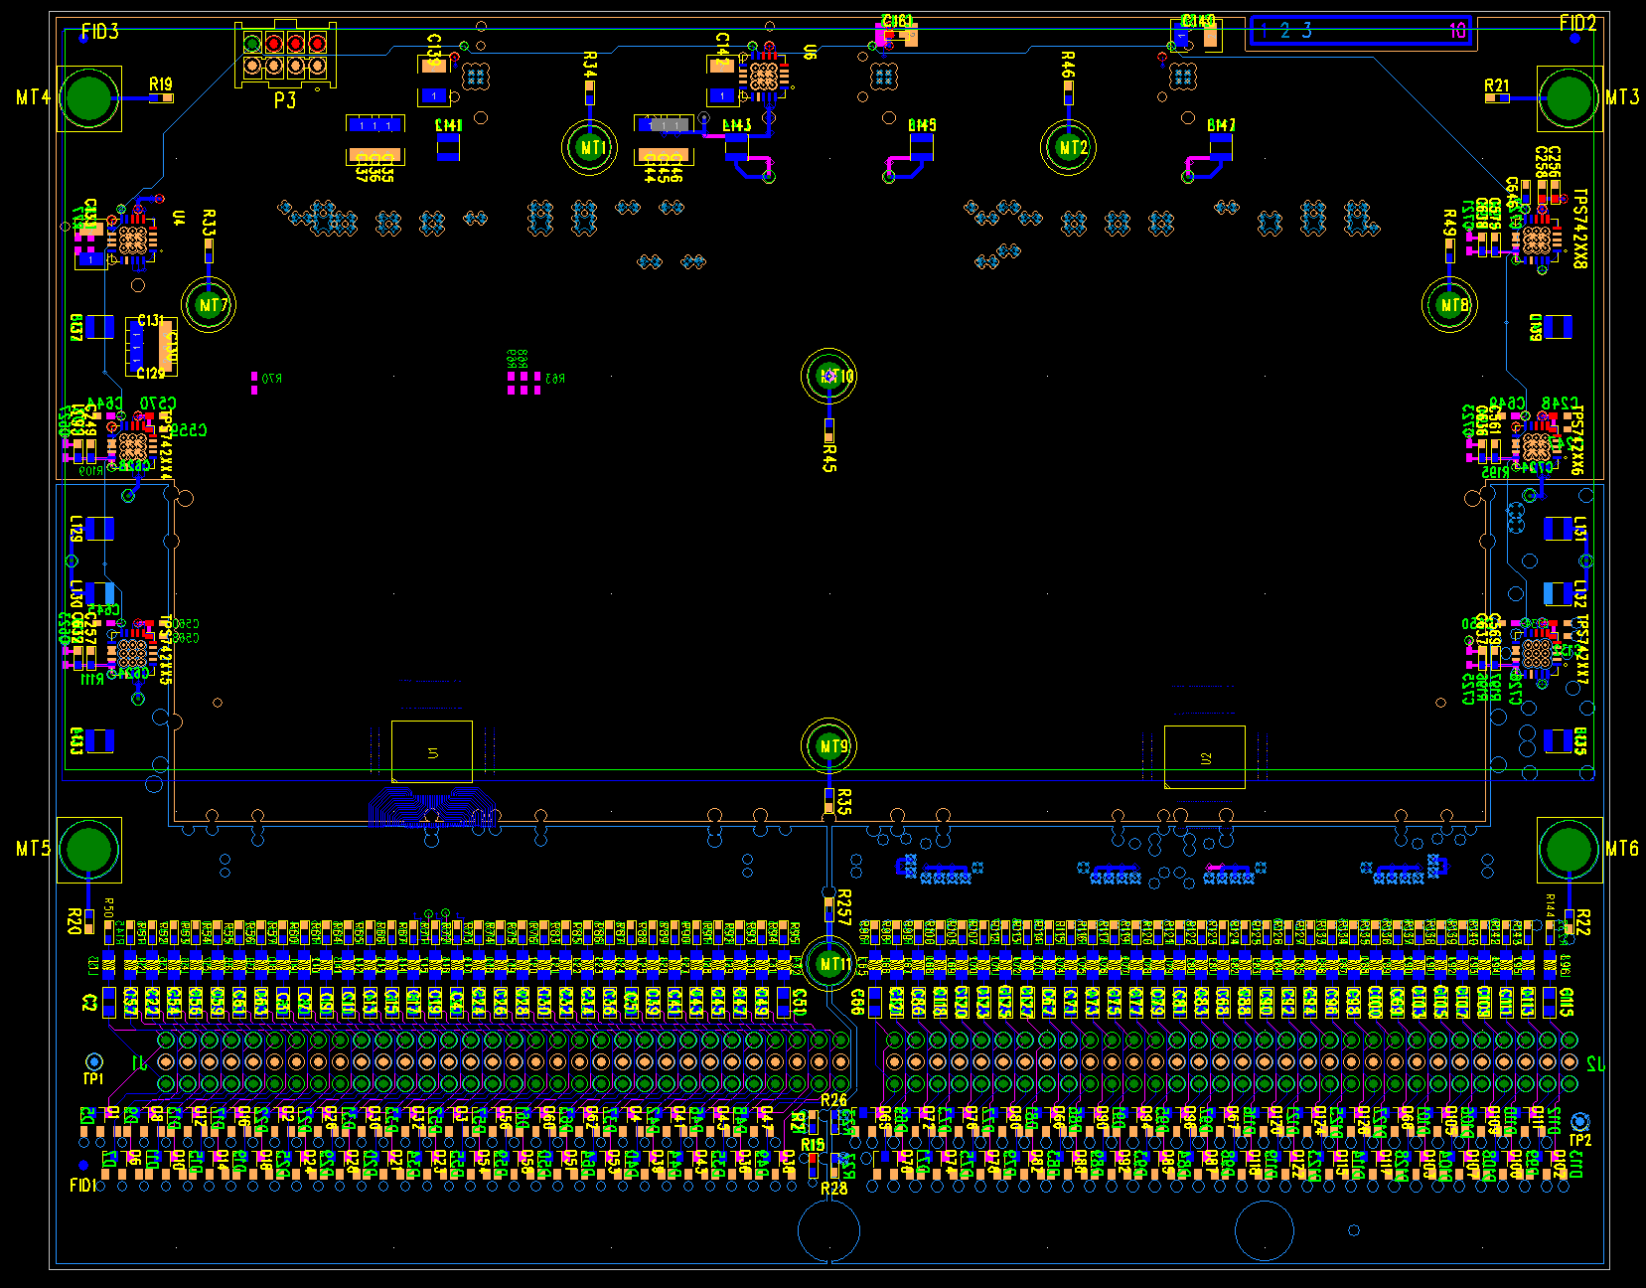
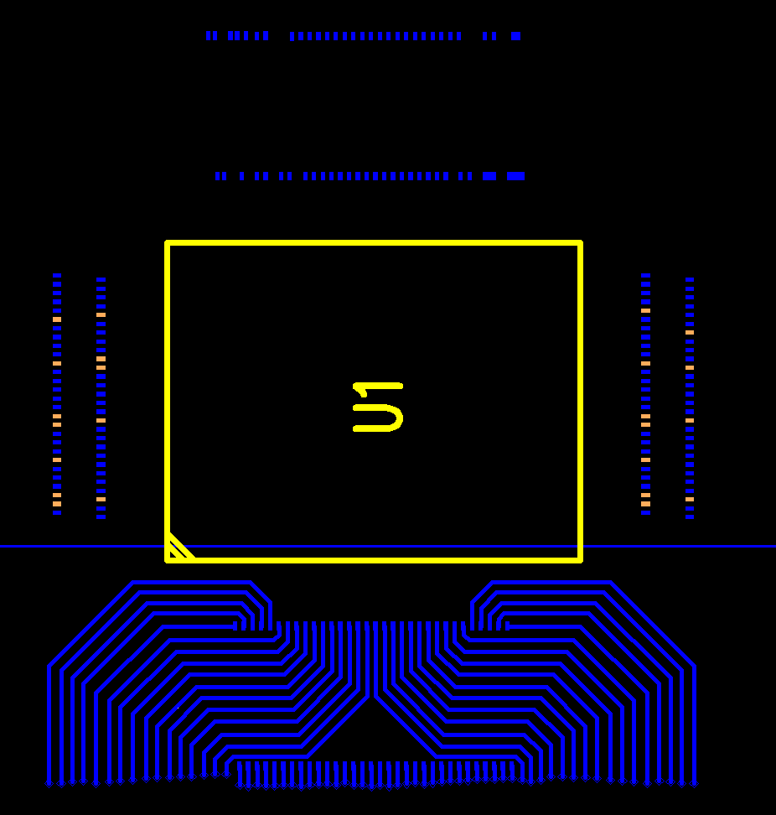
Initial Placement (in progress)
Analog inputs fanned in as on SLAC test board.
CoB leaves plenty of room for filtering capacitors.
Careful w/ power planes per SLAC experience.
Adopt connectors used by current ColdADC+FPGA FEMB.
➔ Need careful final checks on pinouts with new WIB.

Slide 10
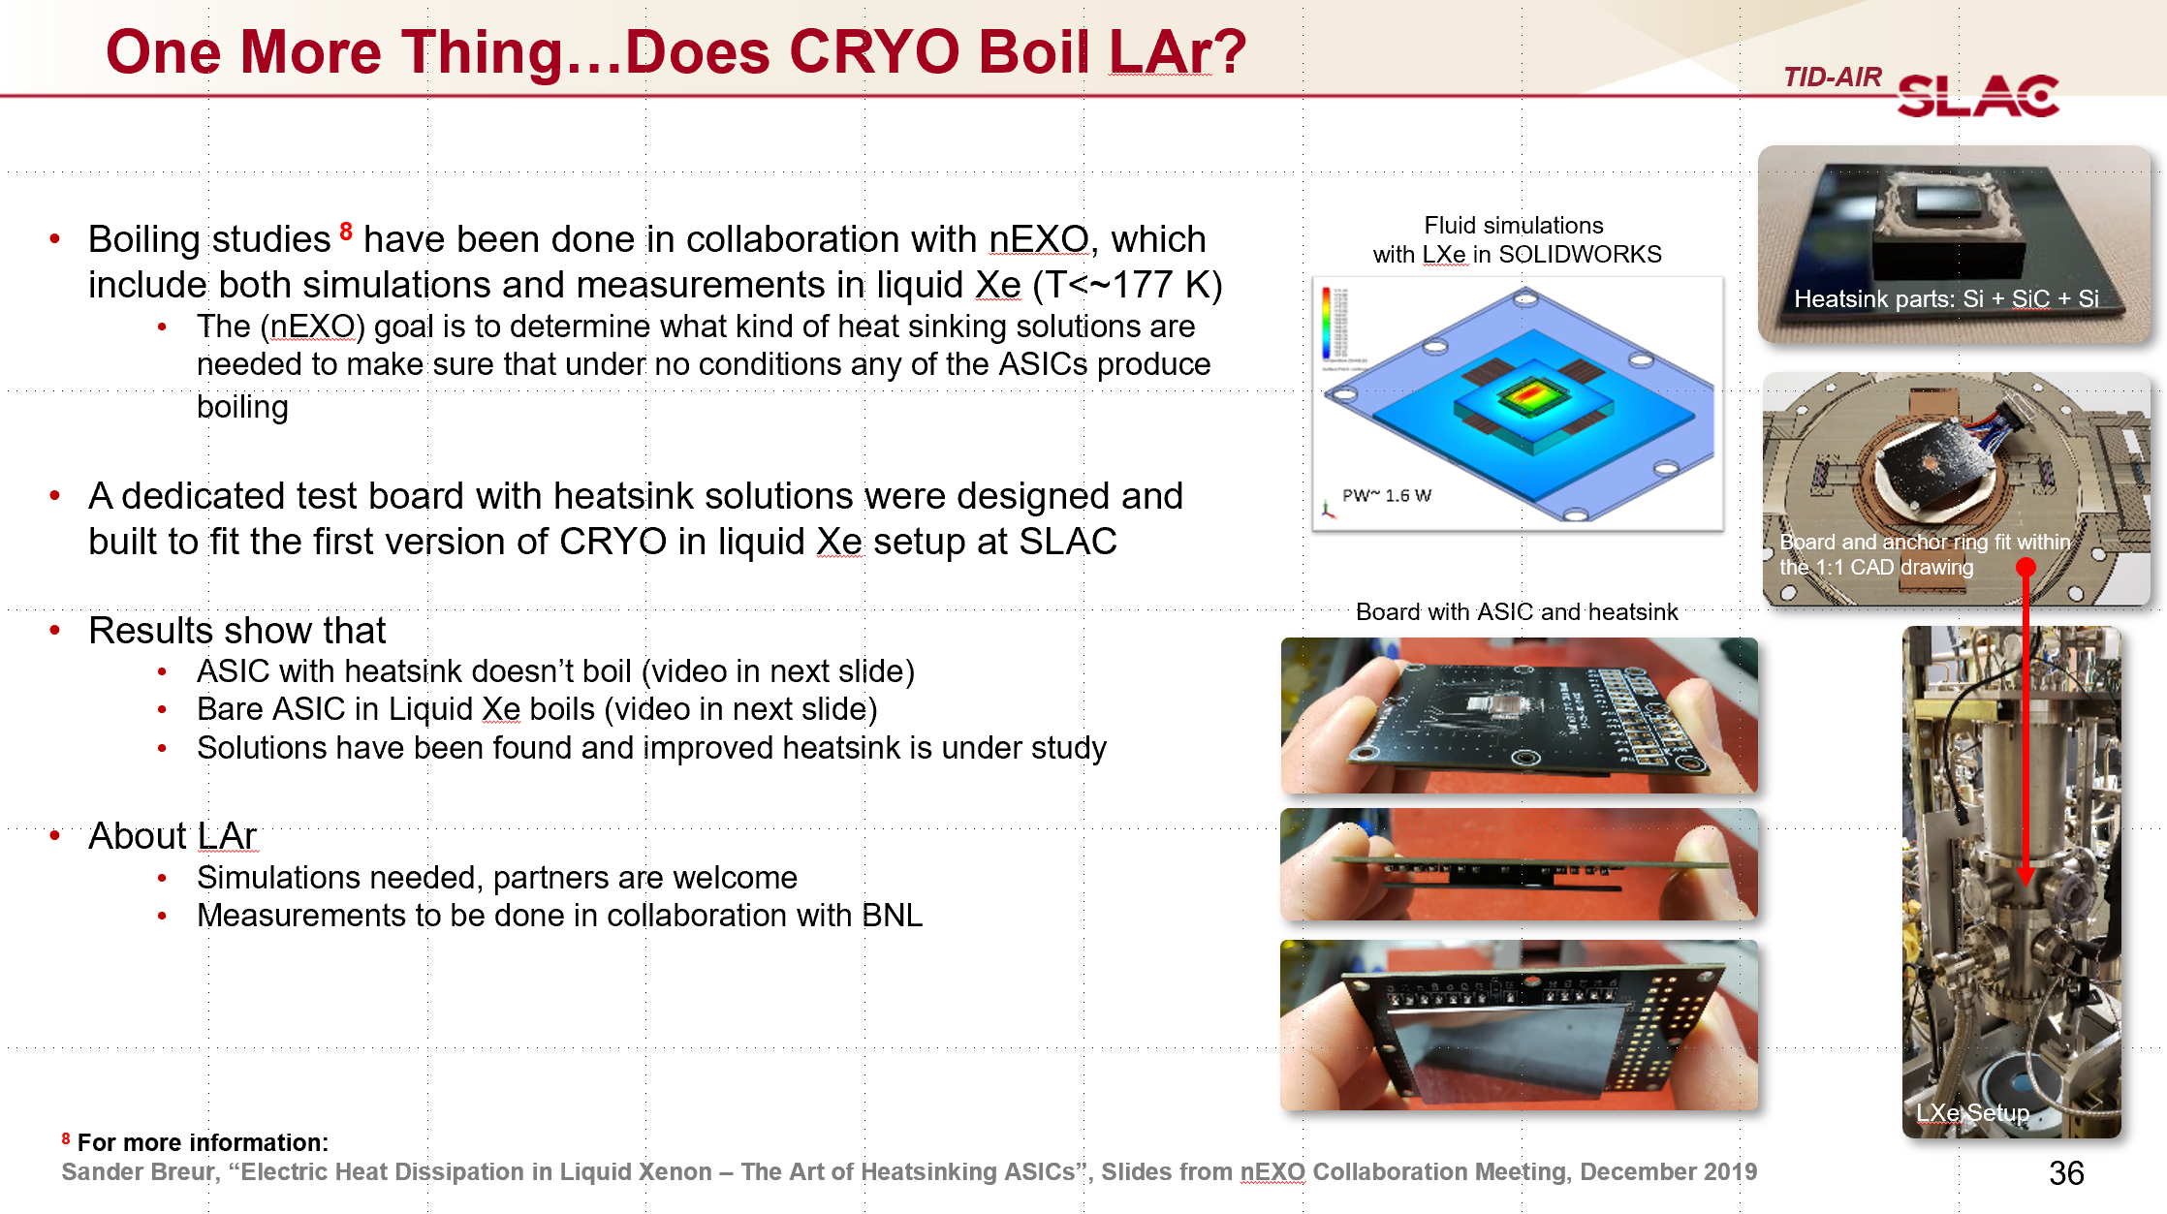
Chip on Board
ASICs will be epoxied and wire bonded directly
to PCB (no package) – cover to protect bonds.
As mentioned yesterday in Aldo’s talk, there
has been some concern as to whether we might
get boiling of LAr.
Revisions of the FEMB could leave cutouts or holes to accommodate thermal sinks / heat spreaders.
Starting simple on first revision, can revisit in future.

Slide 11
Other Logistics – Wirebonding
For wire bonding, want a workflow that gives reproducible results to those obtained by SLAC on their independent testing…
  Coordinating wire bonding of ASICs with SLAC.
  Will use same wire bonding vendor as used for SLAC tests (UH has also worked with them for other projects).
  ASICs will be epoxied to the FEMB at SLAC and sent to the vendor from there.

Slide 12
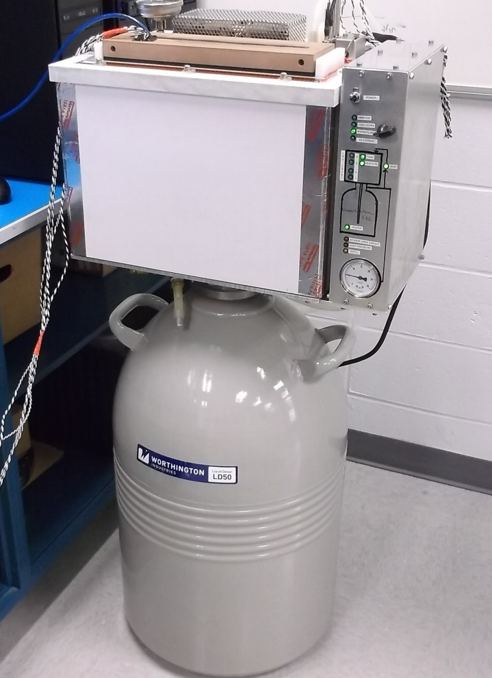
Test Plans
Plan to break out required ASIC interface signals to an evaluation board, to avoid requiring full WIB interface for FEMB bringup and test.
Straightforward to adapt firmware from SLAC to implement ASIC control (SACI) and readout.
WIB firmware/interfaces ultimately required
before July testing.
Cold tests can be conducted with MSU CTS
system.
System is already operating at SLAC.
Arrangements also underway to get another
CTS system and proper training for its use at UH.

Slide 13
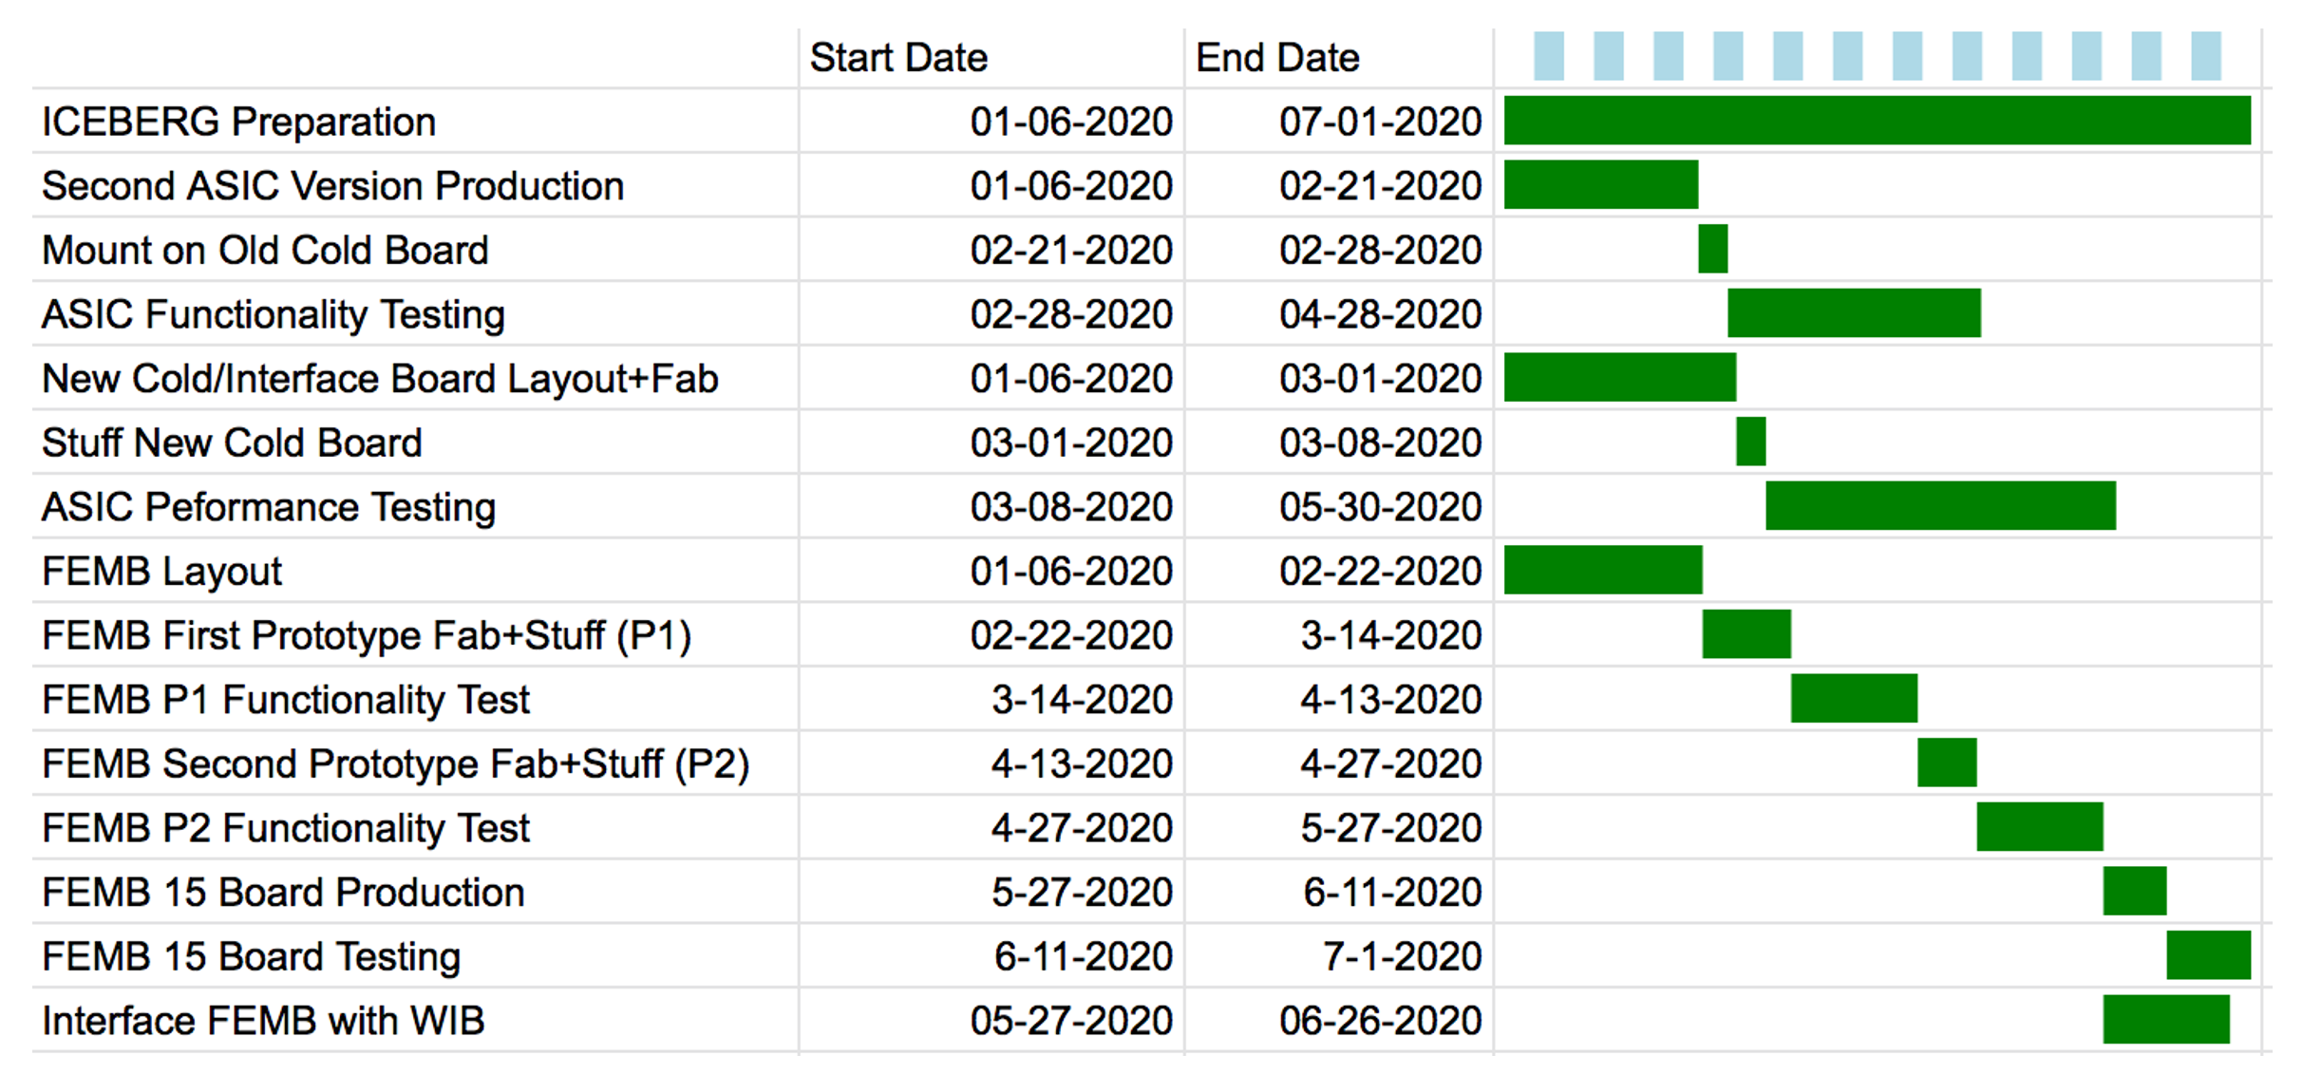
Summary of Status, Plans
Schematics for first rev of CRYO FEMB are tentatively complete.
  Have undergone review cycles with SLAC, some important issues identified, corrected.
  Can still make modifications if something urgent is found or requested.
Placement and layout are now under way ➔ targeting fab of 1st version late Feb.
Design accommodates both versions of the ASIC:
  Will likely use first ASIC revision for initial tests.
  Test functionality in standalone testing (evaluation board interfaces to bring up ASIC).
Bringing up CTS at Hawaii to facilitate cold testing of CRYO FEMBs.
Option to revise design based on results of Hawaii or SLAC testing before producing run of 15 FEMBs for ICEBERG.

