Slide 1
CRYO: A Waveform Digitizer/Serializer for TPC Experiments
DUNE TPC Electronics Review
CERN - Geneva, Switzerland, 5th – 7th February, 2020
Questions and Answers
Feb 7th, 2020

Slide 2
THANKS
We thank the reviewers and audience for their valuable comments and inputs during the review session of CRYO.
Next slides address most of the questions in regards to specific cells that implement the ASIC and upcoming measurement results.
A more detailed document with supporting material will be released next week for your review.

Slide 3
What Will Not Be Answered Today (but will be next week)
We have received 24 questions. 20 will be addressed today. Due to need for extra work and internal consultation with SLAC team, 4 will remain pending:
2. Could we get specs & simulations for the PSRR? Although the transit freq ft is very high wrt filter bandwidth it looks like the high frequency PSRR might be a problem: the input stage uses a single ended folded cascade with a PMOS input transistor which is not optimal for PSRR at high frequency. It would be good to see the PSRR figures without the internal LDOs and with the LDOs on
Note from Angelo:
We think there is a misunderstanding. We don’t have a folded cascode. We have used this amplifier configuration numerous times (again implementation details we don’t share thus are not up for discussion but I will discuss this with Jan privately). The chain is pseudo differential to the supply which is also something we used multiple times achieving noises as low as 8 electrons.
What we will provide are simulation results of the PSRR of the full frontend chain up to the sample and hold with and without the LDO.
18.What is the sensitivity of internal PLLs to voltage and temperature?
23. What is the transitional behavior of the LDOs? For example when clock is switched on/off.

Slide 4
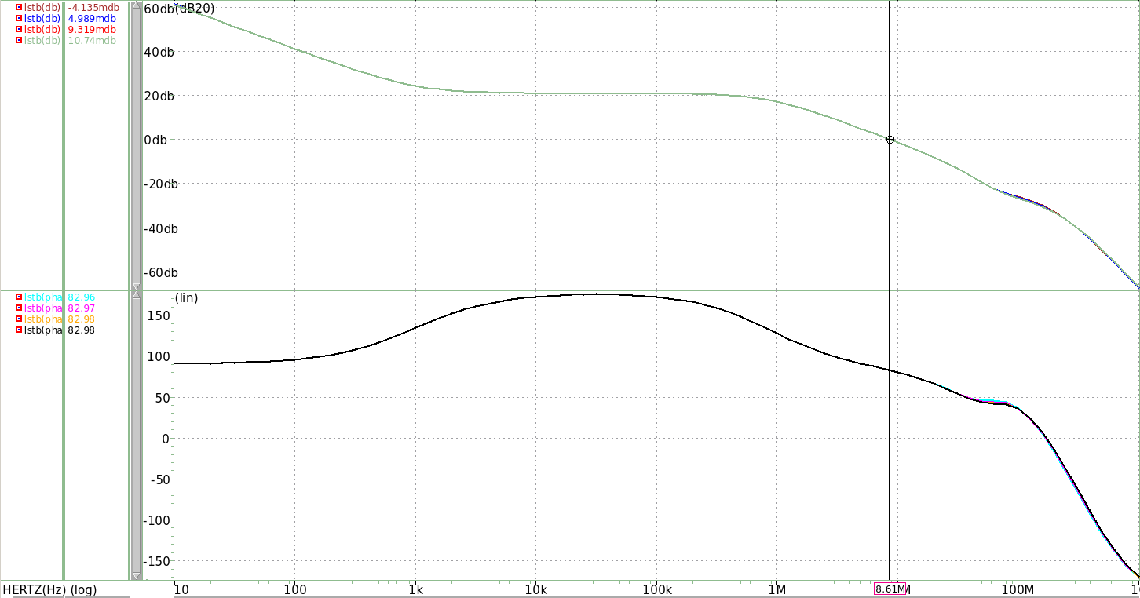
Preamplifier
Could we get specs & simulations for the phase margin (PM)?
A: Simulation results shows the loop stability analysis (LSTB) of the main preamplifier at different peaking times. The gain is set at 3.0X and temperature is -186C. Phase margin in all cases is >80°
Loop Gain
Tp [us] | PM [°] | f [MHz]
0.6 | 83.0 | 8.61
1.2 | 83.0 | 8.61
2.4 | 83.0 | 8.62
3.6 | 83.0 | 8.62
Magnitude [dB20]
Phase [°]
Frequency [Hz]

Slide 5
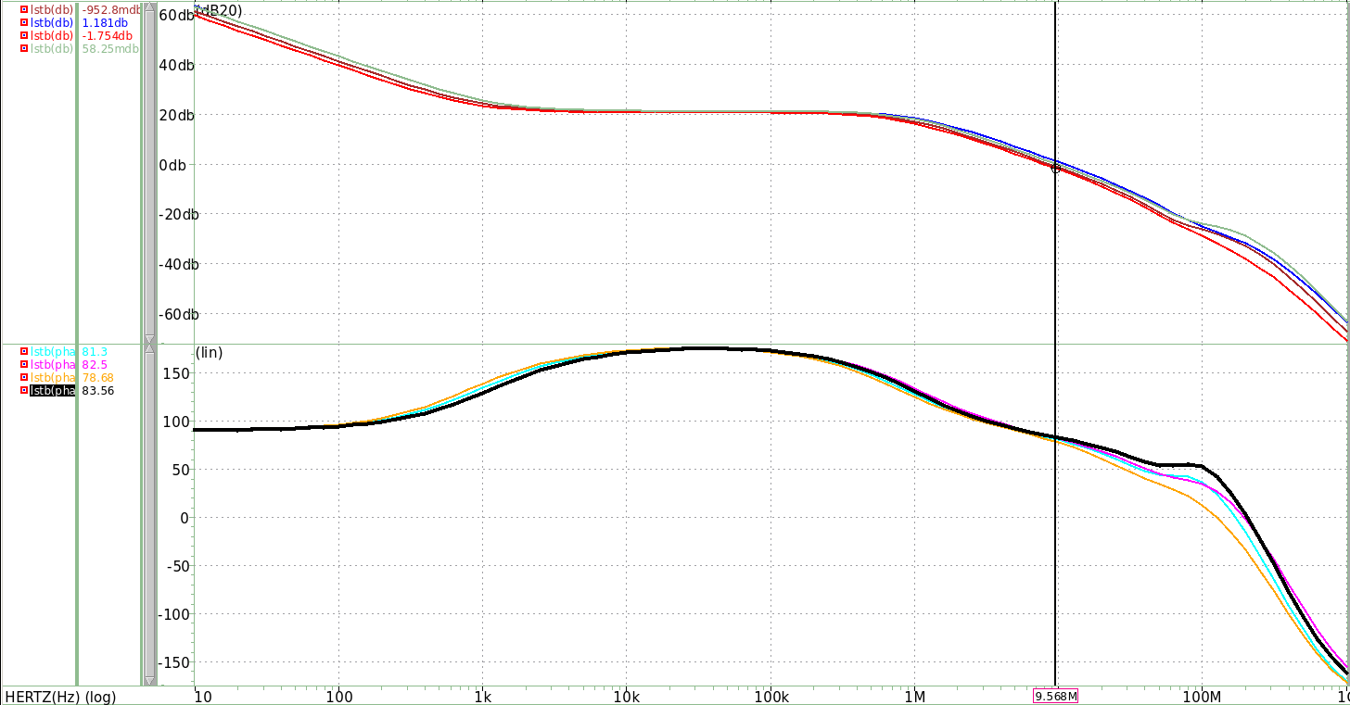
Preamplifier
Could we get specs & simulations for the phase margin (PM)?
A: Simulation results shows the loop stability analysis (LSTB) of the main preamplifier at different gain settings. The peaking time is set at 1.2us and temperature is -186C. Phase margin in all cases is >80°
Loop Gain
Gain | PM [°] | f [MHz]
1.0x | 82.4 | 7.89
1.5x | 80.4 | 10.8
3.0x | 83.0 | 8.62
6.0x | 83.5 | 9.63
Magnitude [dB20]
Phase [°]
Frequency [Hz]

Slide 6
LDO
Could we get PM of LDOs for nominal decoupling caps (including bonding connections)?
A:
Simulations reported below corresponds to the low noise LDO (supply of analog section) and are across temperature. The output of the LDO drives 2 external capacitors of 100uF (including parasitics related to the capacitor) and model of wire bonding. The Load current is 40mA.​
Loop Stability/Noise/PSRR
Temp | I_{Load} | RMS noise @100 KHz | PM | A_{dc} (dB) | PSRR @ 1MHz | PSRR @ 158 MHz
DUNE | 40mA | 0.15uV | >90 | 45 | -92 dB | -44 dB
nEXO | 40mA | 1.50uV | >90 | 40 | -93 dB | -44 dB
Room | 40mA | 2.70uV | >90 | 30 | -93 dB | -45 dB

Slide 7
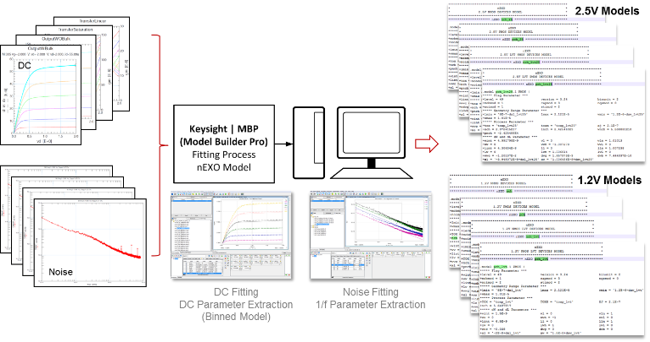
Cryogenic models
Low temperature models are extracted for nominal parameter - can we see simulations for corners & mismatch?
A:
The parameter extraction of our current models was done by using advance fitting tools from Keysight Technologies based on the DC and Noise characterization of 2.0V/1.0V devices at target temperatures (-113°C for nEXO, -186°C for DUNE). The cryogenic characterization was performed at SLAC using our dedicated test bench setup.
Our cold models take into account corners by adapting the same process variations of the model card from foundry.
Our cold models do not support Monte Carlo analysis. Monte Carlo simulations were done using the models of the foundry at room temperature and -40°C.

Slide 8
Testing
Testing has been done for the inputs loaded with discrete caps. When can there be measurements made with the chip connected to the APA wires (which cannot be properly modelled with a single capacitor)?
A:
CRYO will be tested on the ICEBERG Test TPC and/or APA 7 in the ProtoDUNE Cold Box. We plan to be ready for this test, using the nEXO version of CRYO, on July 1 of this year. A subsequent test using the third CRYO version could be done in late 2020, or early 2021. See Mark's talk for more details. ​

Slide 9
Testing
Are there additional evidences that the discrepancy between simulation and noise for bare chip is coming from the board design and not from the internal design of the power/ground grid (resistance of the connection for the input transistor etc) and possibly a bad PSRR?
A:
We know that there is still supply noise coupling that we couldn’t remove from the cold board but we expect improvements with the new version of cold board.
Cold models might be optimistic and they could be the cause of excess noise observed in measurements. This is the first time using them and therefore validation is still in progress. Measurement results with second prototype at nEXO temperature will give us more insight about this aspect.
With model card of the foundry at room temperature and with channel disconnected from the cold board (no wirebond) there is a good agreement between measurements and simulations (factor of 1.1X times).

Slide 10
Cross talk measurements
When is it planned to have measurements and simulations on cross talk?
A:
We plan to enlist the help of DUNE collaborators for detailed studies such as this. Michigan State is interested in looking at the analog front-end, which should include cross-talk studies. We are in discussions with MSU and Hawaii to determine the best way to build test stands outside of SLAC. Outside testing should start about April 1.

Slide 11
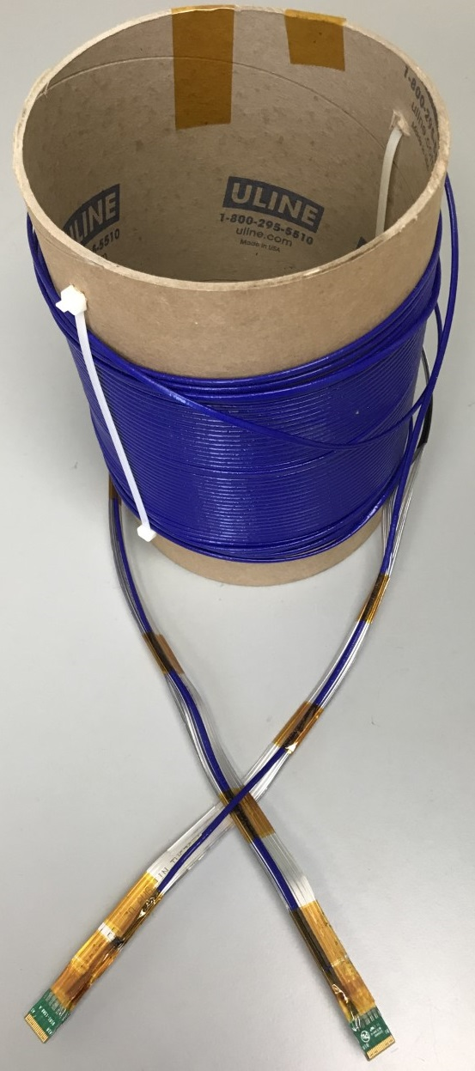
Test with long cable
When is it planned to have a measurement of the output link with a 25-m cable? Is there a design ready for implementing pre-emphasis if needed?
A:
SLAC received the 25m cable from Fermilab in late January. We are working setting up a dewar to submerge the cable. Expect to have the test done by the end of February.
We have designed pre-emphasis circuits in other family of ASICs. If results with long cable demand for this module we can implement it inside CRYO and optimize the cell to operate at cold temperatures.
  CRYO has already reserved SACI bit controls to adjust settings.

Slide 12
Clock domains of CRYO
Could we get more information about the clock domains in the chip and the functioning of the output link?
A:
Channel 0
Channel 2
Channel 4
Channel 28
Channel 1
Channel 3
Channel 8
2MHz
(2MSPS)
ADC 0
ADC 1
ADC 2
ADC 7
112MHz
(8MSPS)
12b
12b
12b
12b
Clock Distribution
PLL
(448MHz)
Multiplexer
64MHz
12b
Clock at 56MHz*
HDL
defined
latches
Encoder
(12b/14b)
64MHz
14b
*Completely synchronous operation. Can also operate with a 62.5MHz clock resulting in 2.2MSPS operation per channel
Clock at 56MHz*
Serializer
448MHz
896Mbps DDR
To LVDS Tx

Slide 13
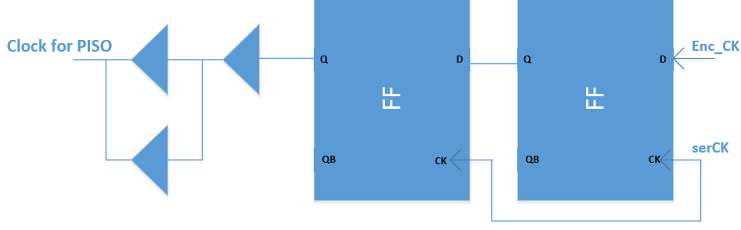
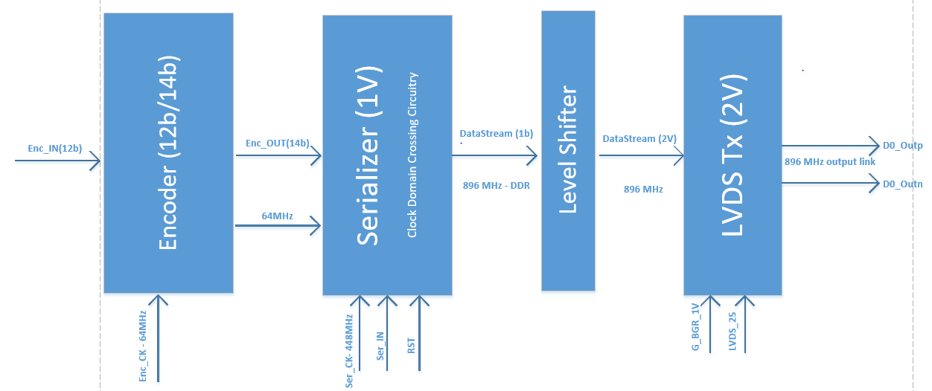
Clock domains of CRYO
Could we get more information about the clock domains in the chip and the functioning of the output link?
A:
CDC

Slide 14
Testing
Can we see the measurements similar to the top left plot of slide 21 of the presentation on CRYO measurements (full chain) but zoomed to see precisely the baseline when all ADCs are working and when only one ADC is active ?
A:
On slide 21 we were showing functionality tests, which in this case was assessed by looking at the waveform in the GUI.
We will look into our dataset of measurements and find one example that was taken under the same conditions and report the pulse as well as the requested zoom.

Slide 15
Power supplies inside CRYO
Can we see how the power domains are organized?
A:
2.0V
Analog FE
2.0V
Analog
2.0V
Digital
1.0V
Digital
2.0V
Digital (LVDS)
2.0V
Analog
1.0V
Digital (PLL)

Slide 16
Initialization sequence
Can we see how is reset applied/distributed (+ any power-up sequence)?
A:
For power up sequence:
Global reset is always issued at the beginning of operation.
SACI configures all ASIC registers.
  Including.
    Enable the PLL.
    Reset clock generation logic.
SampClkEn signal.
  After PLL is stable, SampClkEn signal control the exact moment when the internal clocks start
  This enables precise control of sampling and hold moment.
  Associated with DUNE fast command structures it allows to synchronize the ASICs to +/- 56MHz clock pulse.
  Associated with DUNE fast command structures it is possible to compensate for different cable propagation delay (top, bottom) by issuing the SampClkEn “earlier” in the time cycle.
Start of Readout signals.
  Synchronize the ASIC data transmission at the sample level.
  Associated with internal 8MHz clock (analog sample and hold clock).

Slide 17
Testing
Do you have verification plans ? What is the status? Is it simulated flat spice or mixed-mode or ...?
A: All our simulations were performed using Spice netlist including digital cells implementing CRYO. The same applies for top-level simulations.

Slide 18
Model card
A warning: there is a bug in the TSMC130 Bsim3 noise models; underestimation of thermal noise towards weak inversion up to 50% (weak), OK for strong; solution to go to Spice2 level -> as a results overestimation of gamma factor (always 2/3) and consequently the noise (noimod=2 -> noimod=3 in scs file; thermal model is described by SPICE2 and the flicker model is still in BSIM3V3)
A:
We do really appreciate the comments and inputs about the model. We will certainly do a double check on our end. We usually bias or input transistor in moderate inversion and we have not noted in other designs significant discrepancies between simulation and results.

Slide 19
Synchronization
What is the requirement for timing synchronization across the different chips and components in the system? For both CRYO and COLDATA, what is the method for synchronizing the system clocks?
A: The synchronization is under control of the WIB FPGA, as proposed in the block diagram.

Slide 20
Synchronization
How will synchronization be monitored?
A: Phases can be monitored using the proposed technique.

Slide 21
Synchronization
How are phase issues associated with frequency multiplication or division handled, to ensure that the correct phase is always obtained?
A: Slide 29 shows the relationship of the backend clock 112MHz, the control signal sampClkEn and how they are used to create the sampling clock, where the phase of the sampling clock is controlled by the moment where the sampClkEn transitions low to high, which is in phase with the 56MHz (controlled by the FPGA).

Slide 22
Synchronization
How will differences in path length (cable lengths primarily) be accounted for?
A: Answered in Marco's PDR_ASICs_FEMB_20200206.ppt from yesterday.
The difference in cable lengths can be compensated by adjusting the sampClkEn transition moment at the FPGA in such a way that they instant of time when this control signals arrive to the ASIC is the same.
Sampling cycle time @ FPGA
Sampling cycle time @ ASIC
504ns*(N)
504ns*(N)
long cable
SamClkiEn
Short cable
SamClkiEn
504ns*(N+1)
504ns*(N+1)
Short and long cable SamClkiEn
Represents the sampling time

Slide 23
From The presentation “CRYO: A Waveform Digitizer/Serializer for TPC Experiments
Design Changes for Next Version”

Slide 24
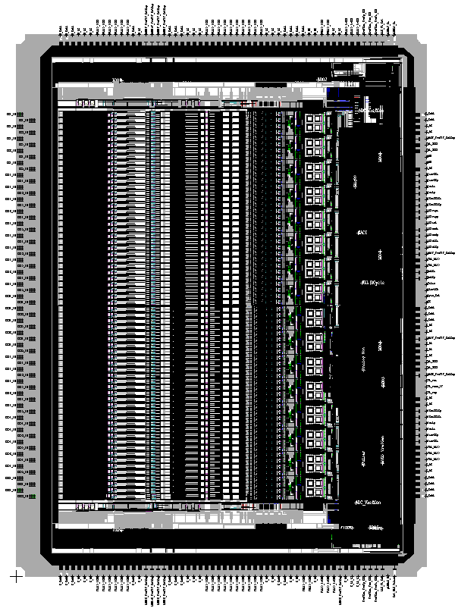
Die size and number of devices
For CRYO, what is the expected final die size? How many devices total?
A: Die size of CRYO is 6774um x 8948um, including pad frame. This size will not change.
6774um
8948um

Slide 25
PLL
All the tests performed till now were with an external clock. What is the performance with internal PLL?
A:
The PLL was one of the last building block to be tested and optimized. Therefore we only made full chain measurements with the external clock. We expect the results to improve when we test the ASIC with it since the PLL, besides generating the 448MHz frequency, also helps to reduce the clock jitter.
More as we test the next version

Slide 26
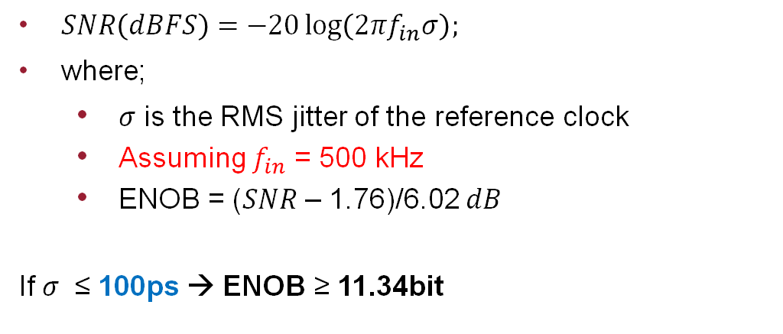
Clock quality
The clock is distributed through 24-m long cables. Which clock quality is required for the chip to operate correctly?
A: The formula below is used to estimate the jitter requirements of the ADC clock. Jitter specifications for input clock requires further investigation and understanding using the 24-m long cable.
$SNR\left(dBFS\right)=−20\log\left(2πf_{in}σ\right);$
where;
  $σ$ is the RMS jitter of the reference clock
  Assuming $f_{in}$ = 500 kHz
  ENOB = ($SNR$ – 1.76)/6.02 $dB$
If $σ$ ≤ 100ps → ENOB ≥ 11.34bit

Slide 27
LDO
Do you also see the “ledge effect” as the design is very similar to LARASIC?
A: We don’t know how similar the design are. We are familiar with the typical structure De Geronimo designed but we have modified it in particular in the section related to biasing the reset system. In our implementation we don’t see a ledge effect.

