Slide 1
CRYO: A Waveform Digitizer/Serializer for TPC Experiments
DUNE TPC Electronics Review
CERN - Geneva, Switzerland, 5th – 7th February, 2020
Measurement Results From the 1st Prototype
Feb 5th, 2020
A. Pena Perez, A. Gupta, D. Doering, P. Tsang, M. Convery, A. Dragone*
(*dragone@slac.stanford.edu)

Slide 2
Few points about our testing
CRYO is a System-on-Chip (SoC) waveform digitizer and serializer optimized as a charge readout circuit for TPC experiments working at cryogenic temperature
The testing and characterization of CRYO has been done at the SLAC using a dedicated cryogenic test bench setup that involves the CTS system provided by Michigan State
The testing was aimed to assess both the functionality of all internal blocks as well as their performance
  The functionality test was carry out to evaluate that all building blocks were active and operational at the target temperatures: room (27C⁰) and cold (i.e. LN @ -193⁰C)
  The performance test was conducted at subsystem levels where key building cells were tested together for relevant performance metrics
Examples of subsystems tested across temperatures include: the analog front-end channel, ADC section, digital back-end, SACI, among others. Also, the entire ASIC performance (referred here as a full-chain) has been evaluated as well
Next sections describe and discuss the measurement results obtained from the first prototype version of CRYO

Slide 3
OUTLINE
CRYO Specifications
Test Bench for Characterization
Functionality Test
CRYO performance
Summary and Next Steps

Slide 4
CRYO Specifications
TPC Experiment | DUNE
CMOS process | 130nm
Supply voltage | 2.5V (2.0V, 1.0V internal)
Input capacitance | ~ 220pF
Anti-aliasing filter | 5th order Bessel architecture
Peaking times | 0.6us, 1.2us, 2.4us, 3.6us
Gain settings | 6.0X (28.6mV/fC) | 3.0X (14.3mV/fC) | 1.5X (7.1mV/fC) | 1.0X (4.8mV/fC)
Max. input charge | 50fC | 100fC | 200fC | 300fC
Noise | ~500e- @ 3.0X and 1.2us
Resolution | 12 bit
INL and DNL | ±1LSB
Sampling frequency | 2MSPS
Temperature | 87K (-186ºC)

Slide 5
OUTLINE
CRYO Specifications
Test Bench for Characterization
Functionality Test
CRYO performance
Summary and Next Steps

Slide 6
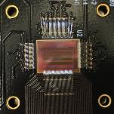
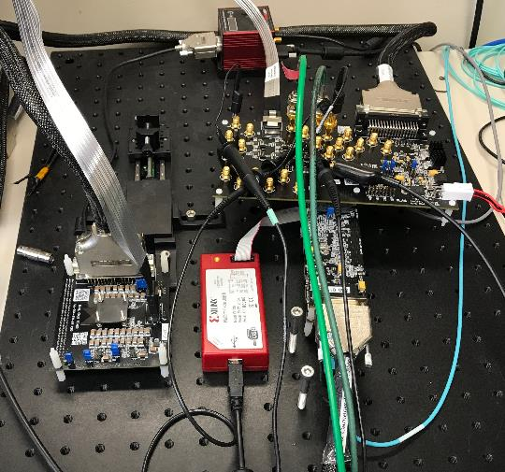
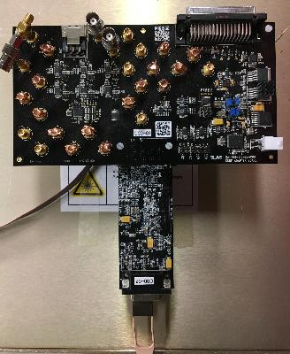
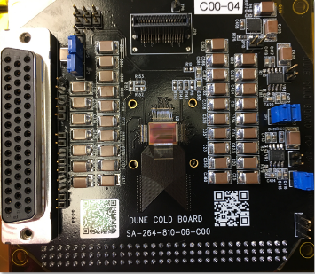
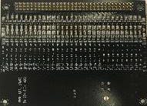
Test Bench for Characterization (I)
Data Acquisition Setup
Our Testing Boards
CRYO is wire bonded to the board
High-Speed
Cable
ePixHR
Boards
Cold Board
Holds ASIC and external LDOs
Interface (or Adapter) Board
Drives the cold board
Loading Board
Holds passives that model
DUNE wires (Cdet)
Daughter board that attaches to cold board

Slide 7
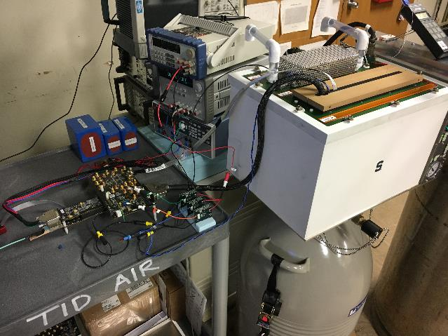
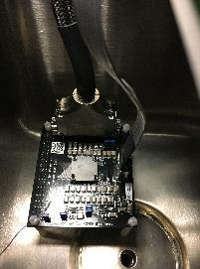
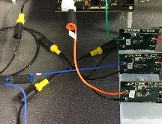
Test Bench for Characterization (I)
Full Test Bench Setup
  Agilent 3631A supplies ePixHR boards (6.0V)
  Precision 9130 supplies LT1963 LDO demo boards (6.0V)
  LT1963 LDO Demo boards generate the following supplies:
    1.8V and 3.3V required by interface board
    2.5V required by cold board
  Cold board is placed inside the CTS during measurements at room and cold temp
  GND of supplies follow a star configuration
Precision 9130
Agilent 3631A
Cold board inside CTS
Interface
Board
ePixHR Boards
LT1963
LDO Demo Boards
GND
(Star Config.)

Slide 8
OUTLINE
CRYO Specifications
Test Bench for Characterization
Functionality Test
CRYO performance
Summary and Next Steps

Slide 9
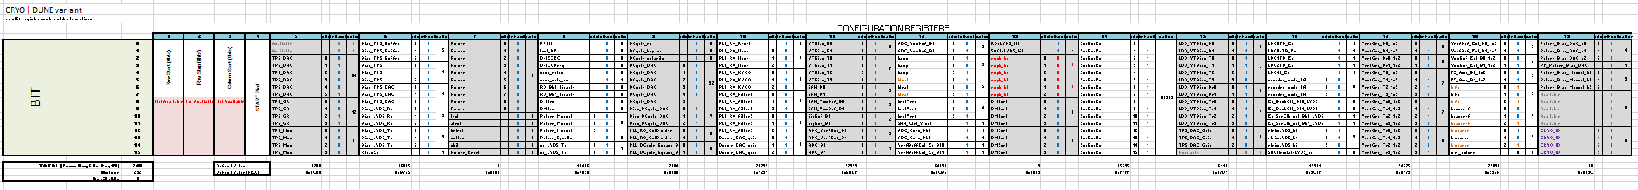
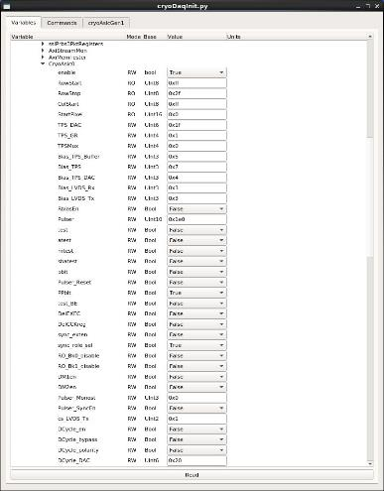
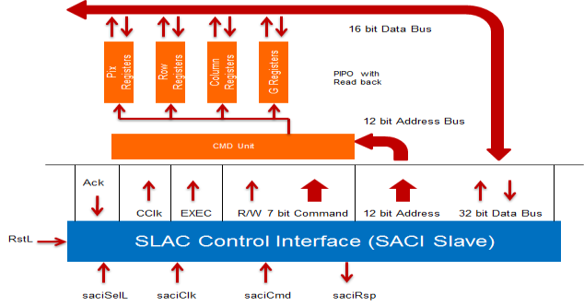
Functionality Test – SACI
  SLAC ASIC Control Interface (SACI)
Snapshot of internal registers
GUI interface with SACI registers
Check List – Verified (Room & Cold)
Communication SACI-FPGA
Drive SACI through GUI interface (right picture)
4 control signals of SACI (saciClk, saciCmd, saciRsp)
Write/read 19 (16 bit) global registers
Change in real time settings and operation modes of building blocks
Configuration files to run ASIC across temperatures

Slide 10
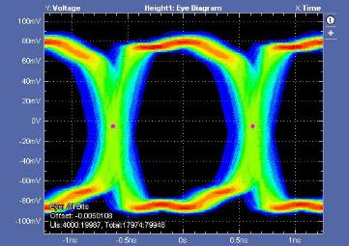
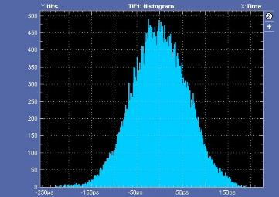
Functionality Test – Clock Domains
  Clock Domains
Check List – Verified (Room & Cold)
LVDS receivers (RXs) and transmitters (TXs) running at nominal speed (448MHz)
SACI control signals of LVDS modules
Master clock at 56MHz (PLL enabled)
Master clock at 224MHz and 448MHz (PLL disabled)
Data output stream at nominal 448Mbps DDR (896MHz)
Data synchronization CRYO-FPGA
Sampling rate of front-end channel at 2MSPS
Sampling rate of SAR ADCs at 8MSPS
Clock frequencies of back-end modules (DMUX, Encoder and Serializer)
PLL typical response
(measured jitter ~ 60ps)
Eye Diagram
Histogram
Histogram

Slide 11
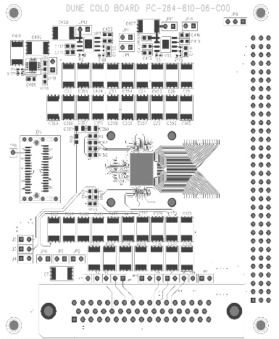
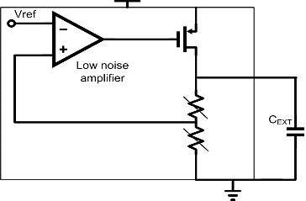

Functionality Test – Analog and Digital LDOs (I)
On-Chip Supply Regulation
Check List – Verified (Room & Cold)
2.5V nominal supply of cold board (red dots in figure) ²
Control of analog and digital LDO outputs through SACI bit controls
Control of reference voltage of analog and digital LDOs through SACI bit controls
Adjustment of analog LDO outputs at 2.0V (blue dots in figure) ²
Adjustment of digital LDO outputs at 2.0V and 1.0V (blue dots in figure) ²
Adjustment of reference voltage of all LDOs at 1.0V (green dots in figure) ²
² Voltages were measured directly at the external filter capacitors of cold board
2.5V Supply
Layout of cold board
LDO Outputs
LDO 1V Vref
CRYO
Low noise
amplifier
Low power
amplifier
LDO1
LDO2

Slide 12
Functionality Test – Analog and Digital LDOs (II)
On-Chip Supply Regulation
Examples of measured LDO voltages ²
LDO | CRYO Section | Domain | Expected | Measured
 |  |  |  | Room | Cold
LDO0T | Supply of front-end channels (top BANK) | Analog | 2.0V | 2.037V | 2.059V
LOD0B | Supply of front-end channels (bottom BANK) | Analog | 2.0V | 2.026V | 2.043V
LDO0rB | Supply of ADC reference voltage generation | Analog | 2.0V | 1.943V | 2.076V
LDO3T | Supply of full back-end (top BANK) | Digital | 1.0V | 1.043V | 1.029V
LDO4 | Supply of LVDS modules | Digital | 2.0V | 2.049V | 2.041V
LDO5 | Supply of SACI and PLL | Digital | 1.0V | 1.046V | 1.030V
² Voltages were measured directly at the external filter capacitors of cold board
Low noise
amplifier
Low power
amplifier
LDO1
LDO2

Slide 13
Functionality Test – ADC Reference Voltages (I)
ADC Reference Voltages
Check List – Verified (Room & Cold)
Control of positive reference voltage (Vrefp) of ADC through SACI bit controls
Control of common-mode reference voltage (Vcm) of ADC through SACI bit controls
Control of negative reference voltage (Vrefn) of ADC through SACI bit controls
Adjustment of positive reference voltages at 1.8V (purple dots in figure) ³
Adjustment of common-mode reference voltages at 1.0V (yellow dots in figure) ³
Adjustment of negative reference voltages at 0.2V (green dots in figure) ³
³ Voltages were measured directly at the external filter capacitors
of cold board
1.8V Vrefp
Layout of cold board
1.0V Vcm
0.2V Vrefn
CRYO

Slide 14
Functionality Test – ADC Reference Voltages (II)
On-Chip Supply Regulation
Examples of measured ADC reference voltages ³
Reference | CRYO Section | Domain | Expected | Measured
 |  |  |  | Room | Cold
Vrefp_bk0 | 1.8V positive ADC ref. voltage (top BANK) | Analog | 1.8V | 1.793V
Vcm_bk0 | 1.0V common-mode ADC ref. voltage (top BANK) | Analog | 1.0V | 0.988V
Vrefn_bk0 | 0.2V negative ADC ref. voltage (top BANK) | Analog | 0.2V | 0.201V
Vrefp_bk1 | 1.8V positive ADC ref. voltage (top BANK) | Analog | 1.8V |  | 1.797V
Vcm_bk1 | 1.0V common-mode ADC ref. voltage (top BANK) | Analog | 1.0V |  | 0.997V
Vrefn_bk1 | 0.2V negative ADC ref. voltage (top BANK) | Analog | 0.2V |  | 0.208V
³ Voltages were measured directly at the external filter capacitors of cold board

Slide 15
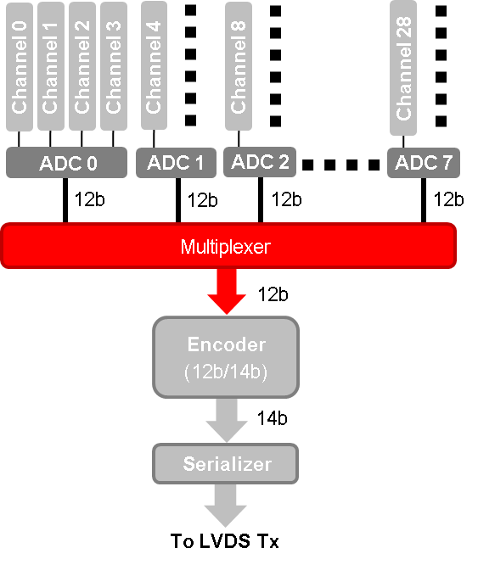

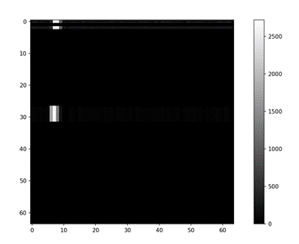

Functionality Test – Ghost Effect on Digital Back-End
Ghost Effect Issue
  Issue
  Digital MUX of back-end showed an issue during verification
  Set of latches that samples the 12 bit data of ADCs were not strong enough to properly drive switches of digital MUX
  This poor driving capability corrupts data of adjacent latches causing a “ghost effect”
  Solution
  Issue was understood and reproduced in simulations. Making strong buffering at output of latches solves the problem
  Focused Ion Beam (FIB) was performed into the digital MUX to disable it and allow us to test performance
    Only 12 bit data of one ADC is active per BANK
    Only 8 channels can be tested through the chain of digital back-end
Measurement of corrupted
data due to “ghost effect”
Good CHs
Ghost
Strong
Weak

Slide 16
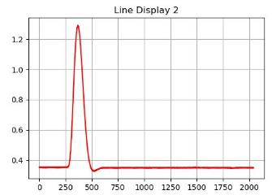
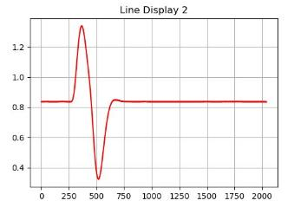
Functionality Test – Response of Front-End Channel
Front-End Channel
Check List – Verified (Room & Cold)
4 gain settings of preamplifier
4 peaking time configurations of Bessel filter
Baseline selection (collection and induction)
Global and local trimming of baseline
Test mode and masking mode
Channel response through analog monitor ⁴
Charge injection using internal Pulser
⁴ Single channel is connected to the analog monitor to prevent bus contingency
Examples of front-end channel response from analog monitor
Pulse response (collection)
Pulse response (induction)
Simplified block diagram

Slide 17
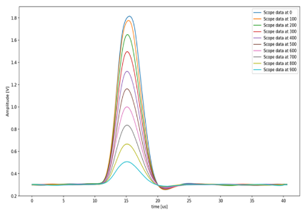
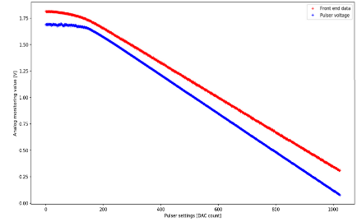
Functionality Test – Analog Monitor
Analog Monitor at Room temperature
Response at different Pulser levels
Check List – Verified (Room & Cold)
Bias and gain settings of SE buffer
Bias and gain settings of S2D output stage
Input signal selection of analog MUX
16 available monitoring signals (see table below)
MUX | Signal | Room & Cold
0 | om_Bk0 - Front-end outputs top BANK | ✔
1 | om_Bk1 - Front-end outputs bot BANK | ✔
2 | PLL_R0_Vctrl | ✔
3 | testline | ✔
4 | testref | ✔
5 | DCycle_Average | ✔
6 | DCycle_AverageTrgt | ✔
7 | DCycle_Vctrl | ✔
8 | ADC_Vrefp_Buff_Mon_Bk1 | ✔
9 | ADC_Vcm_Buff_Mon_Bk1 | ✔
10 | ADC_Vrefn_Buff_Mon_Bk1 | ✔
11 | SAH_Vcm_Buff_Mon_Bk1 | ✔
12-13 | G_DS | ✔
14-15 | VDS_3Bk0 | ✔
Linearity test of front-end

Slide 18
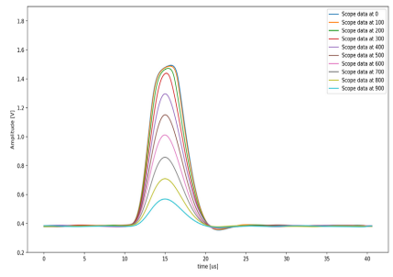
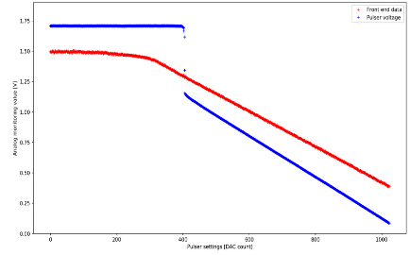
Functionality Test – Analog Monitor
Analog Monitor at Cold Temperature
Response at different Pulser levels
  Issue
  The analog monitor showed a saturation problem during verification at cold temperature
  This monitor is implemented by an analog multiplexer, an intermediate single-ended buffer and a differential output stage
  The single-ended buffer was the cause of the saturation
  Secondary issue since it does not affect the signal chain
  Solution
  Issue was understood and reproduced in simulations
  An improved rail-to-rail input stage on the buffer solved the problem
Linearity test of front-end

Slide 19
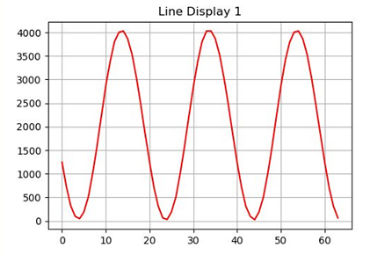
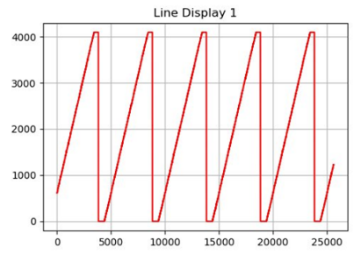
Functionality Test – ADC Section
ADC Section
Check List – Verified (Room & Cold)
ADC reference voltages
Test mode configuration to provide external signals (i.e. sinewave, ramp and constant values)
Bias setting adjustment of ADC section⁵ through SACI
⁵ ADC section is implemented by the following active cells: sample and hold (SAH), ADC signal driver, ADC reference buffers and the SAR ADC
Response of the ADC section with different input signals
Sinewave signal
Ramp signal
Simplified block diagram

Slide 20
Functionality Test – CRYO Full-Chain (I)
Full-Chain
Check List – Verified (Room & Cold)
On-chip supply regulation (analog and digital LDOs)
Internal Pulser system
Front-end channel in test mode and connected to analog monitor
Full ADC section
Full digital back-end
LVDS RXs and TXs
Target 2MSPS rate per channel
Analog monitor enabled
Full control of CRYO through SACI
Simplified block diagram

Slide 21
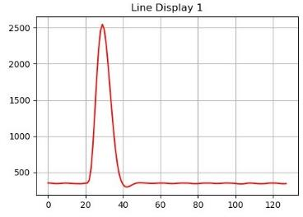
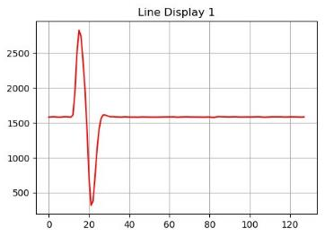
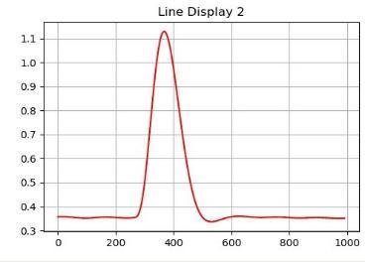
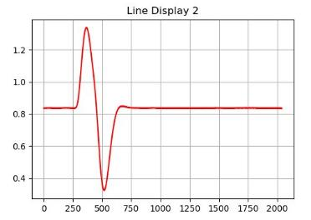
Functionality Test – CRYO Full-Chain (II)
Full-Chain
Pulse response (collection)
Pulse response (induction)
Full Chain
ADU Vs Samples
Cold temperature
Ext. Clk at 448MHz
3.6us peaking time
Gain = 3.0X
Cold temperature
Ext. Clk at 224MHz
3.6us peaking time
Gain = 3.0X
Analog Monitor
Voltage Vs Samples
Simplified block diagram

Slide 22
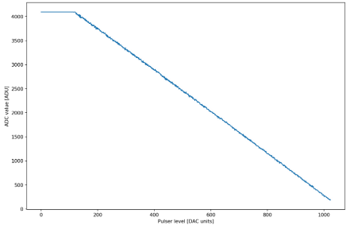
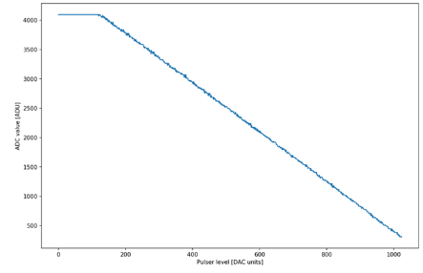
Functionality Test – CRYO Full-Chain (III)
Linearity Test of the Full-Chain
  Settings
  Charge injected using the internal pulser
  CRYO running at 448MHz ext. clock
  Collection mode
  3.6us peaking time
  Gain = 3.0X
Linearity test across temperatures
Room Temp (26.5⁰C)
Cold Temp (-193⁰C)
ADC value (Full Chain) [ADU]
ADC value (Full Chain) [ADU]
Pulser Code [DAC counts]
Pulser Code [DAC counts]
Simplified block diagram

Slide 23
OUTLINE
CRYO Specifications
Test Bench for Characterization
Functionality Test
CRYO performance
Summary and Next Steps

Slide 24
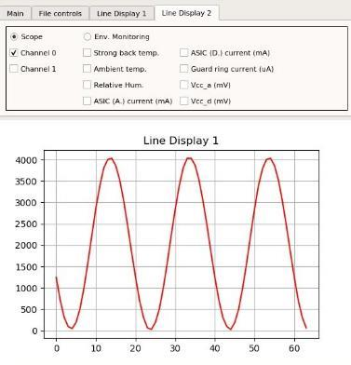
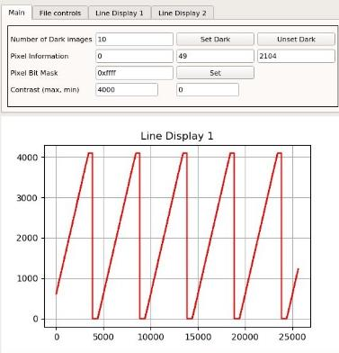
CRYO Performance – ADC Section (I)
  Dynamic and Static Characterization
Sinewave - ENOB
Ramp - Linearity
  Settings
  Cold temperature (i.e. LN @ -193)
  Target 2MSPS rate
  Test mode (front-end disconnected)
  External test signal provided by a 20 bit DAC
  Digital multiplexer disabled (FIB option)

Slide 25
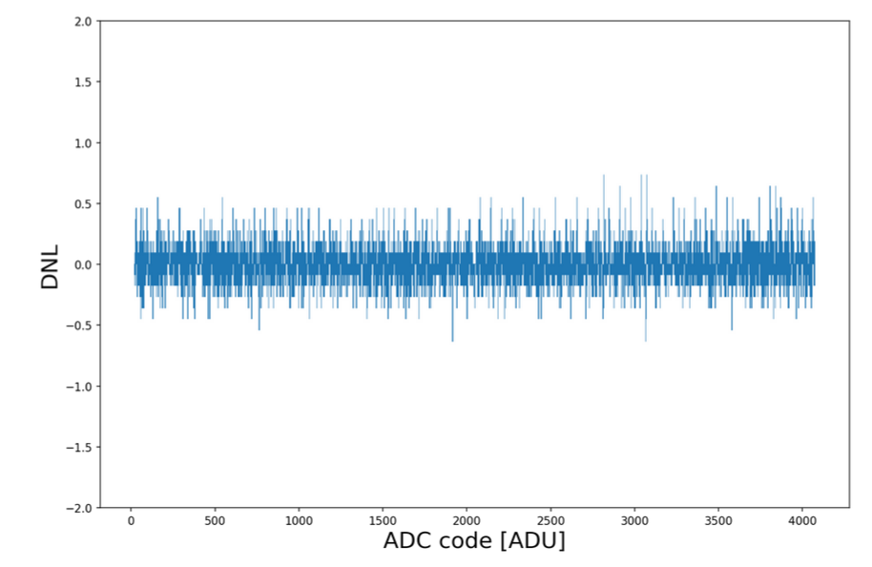
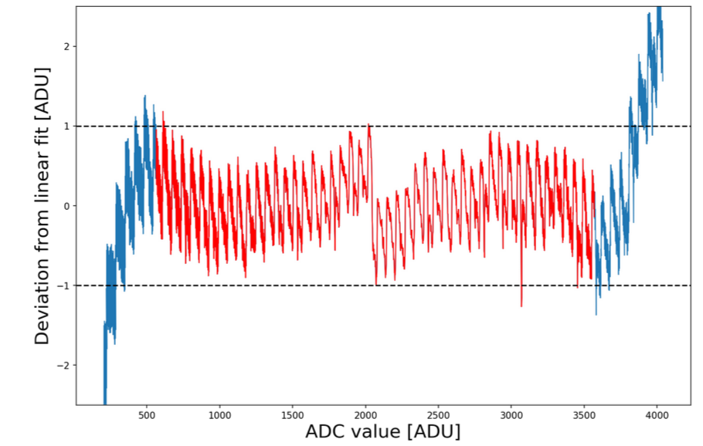
CRYO Performance – ADC Section (II)
  Static Characterization
DNL
Deviation from Linear Fit
+0.74 LSB
-0.58 LSB
3008 Counts
(564 ADU → 3572 ADU)

Slide 26

CRYO Performance – ADC Section (III)
  Dynamic Characterization
ADC counts
Voltage
Correction Factor ⁶
ENOB | ENOB Correction Factor ⁶
9.1 bit | 10.1 bit
⁶ Based on:
MT-003 Tutorial, Analog Devices

Slide 27
CRYO Performance – ADC Section Summary
Parameter | Cold |  | Min Req. | Note
Usable dynamic range | ~3200 counts |  | 3000 counts | Pass
DNL | +0.74 | -0.58 | ±1LSB | Pass
INL | +1.0 | -1.27 | ±1LSB | Pass* with exception of 1 code
ENOB | 10.1 bit (10.6 bit static) |  | 11.0 bit | Understood*
*Given the information extracted from the tests, an optimized version of the ADC was implemented in the second prototype of CRYO to improve the ENOB and linearity (more in next talk)

Slide 28
CRYO Performance – Full Chain (I)
  Full-Chain Performance
Full chain performance has been assessed in terms of noise level and involves all critical subsystems of the signal path
The 2.0V supply of CRYO is regulated by the on-chip LDOs, which are supplied from a single 2.5V power supply
  Noise measurements have been conducted at room and cold (i.e. LN @ -193⁰C) by considering the following scenarios for performance characterization:
    Input of the front-end channel is disconnected physically from the cold board (no wire bonding connection)
    Input of the front-end channel is wire bonded to the cold board but without any external load capacitance
    Front-end is loaded with external capacitance using a dedicated “loading board”, which emulates wires from DUNE experiment
  Noise measurements are compared against the results expected from simulations

Slide 29
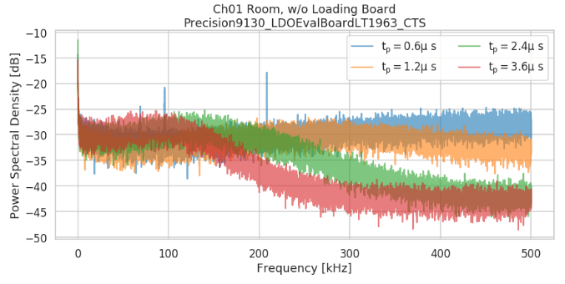
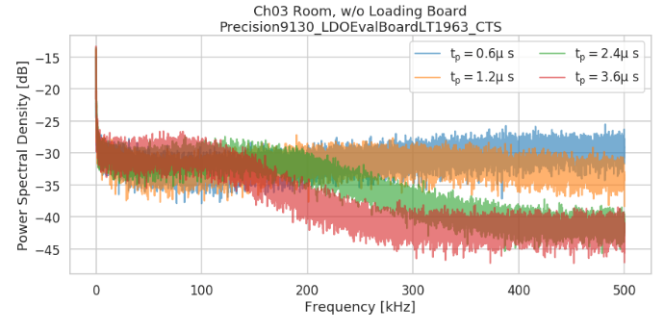
CRYO Performance – Full Chain (II)
  ENC at Different Peaking Times – No Load Capacitance (Cdet)
  FE Settings: Gain 3X, Room Temp
ENC [e-] – Without Load Board
CH01
Without Load Board
Tp [us] | Measured ⁶ |  | Simulations
 | CH01 | CH03
 | Wire bonded (No Cdet) | Without Wire bonding | No Cdet
0.6 | 623 | 514 | 387
1.2 | 457 | 422 | 308
2.4 | 374 | 319 | 267
3.6 | 292 | 272 | 265
Without load board ENC of CH01 is about ~x1.6 times bigger than expected from simulations
  Broadband noise is coupled to the input channel through power planes of the cold board (more in next slides)
  New version of cold board layout is being implemented to eliminate undesired couplings
On the other hand, ENC of CH03 (without wirebonding) is very close to simulations (~x1.1 times bigger)
CH03
Without Wire Bonding
⁶ ENC is calculated by subtracting the noise contribution of the ADC section at room (ENC = 220e-)

Slide 30
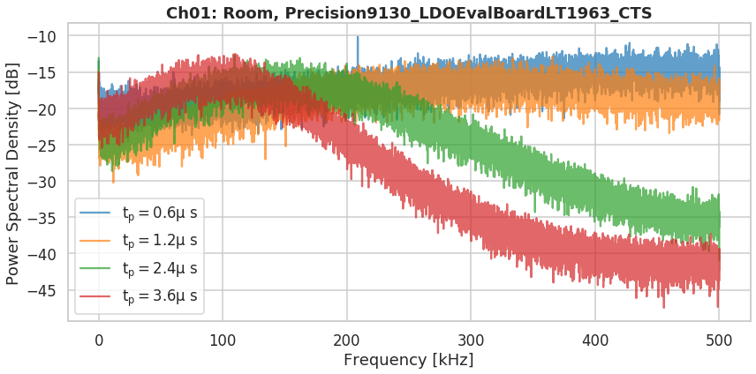
CRYO Performance – Full Chain (III)
  ENC at Different Peaking Times – Channel is Loaded
  FE Settings: Gain 3X, Room Temp
CH01 ENC [e-] – With Cdet
Tp [us] | Measured | Simulations
 | CH01
 | With Cdet | With Cdet
0.6 | 2900 | 1.5k
1.2 | 2170 | 1.1k
2.4 | 1630 | 861
3.6 | 1410 | 783
With loading board attached (Cdet) ENC of CH01 is about ~x1.6 bigger than expected from simulations due to broadband noise coupled into the FE inputs
    The new cold board layout is aimed to eliminate undesired couplings

Slide 31
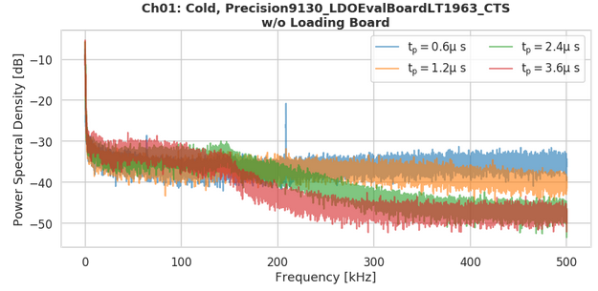
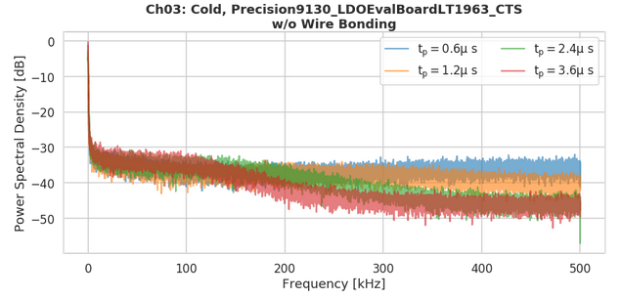
CRYO Performance – Full Chain (IV)
  ENC at Different Peaking Times – No Load Capacitance (Cdet)
  FE Settings: Gain 3X, Cold Temp
ENC [e-] – Without Load Board
Tp [us] | Measured ⁷ |  | Simulations
 | CH01 | CH03
 | Wire bonded (No Cdet) | Without Wire bonding | No Cdet
0.6 | 428 | 365 | 205
1.2 | 391 | 310 | 177
2.4 | 363 | 281 | 158
3.6 | 337 | 254 | 152
CH01
Without Load Board
As expected, front-end channel noise is lower at cold temp compared to the case at room temp
Without load board ENC of CH01 is about ~x2.1 times bigger than expected from simulations
    Broadband noise is coupled to the input channel through power planes of the cold board
ENC of CH03 (without wirebonding) is close to simulations (~x1.6 times bigger)
CH03
Without Wire Bonding
⁷ ENC is calculated by subtracting the noise contribution of the ADC section at cold (ENC = 200e-)

Slide 32
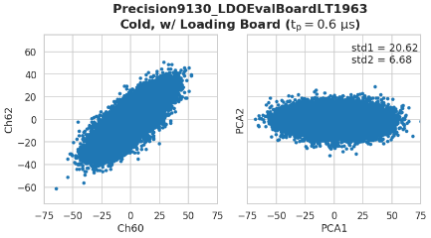
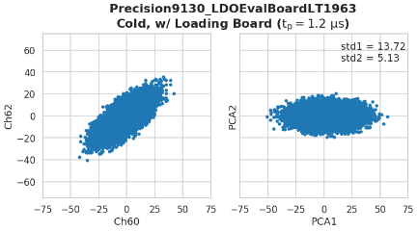
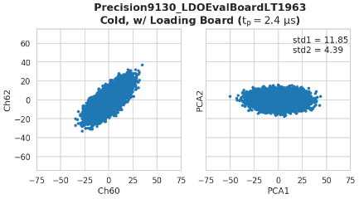
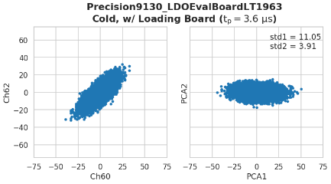
CRYO Performance – Full Chain (V)
  Correlation Plots (CH60 Vs CH62) – Channel is Loaded
  FE Settings: Gain 3X, Different Peaking Times, Cold Temp
Tp = 0.6us
Tp = 1.2us
ENC [e-] – With Load Board
Tp [us] | Uncorrelated ENC | Simulations
 | With Cdet | With Cdet
0.6 | 1240 | 589
1.2 | 880 | 495
2.4 | 731 | 425
3.6 | 635 | 395
Tp = 2.4us
Tp = 3.6us
Due to broadband noise coupled into the input channel, the estimated ENC with load capacitance was ~2.0X times bigger than expected from simulations
Simplified uncorrelated analysis was done between two different channels (Ch60 and CH62) to estimate the uncorrelated noise of the front-end channel
  At this stage uncorrelated ENC is ~x1.6 times bigger than expected from simulations
  We believe that solving the board issues should give us better results. To be demonstrated.
  Note this is the first time we use this cold models so it is possible that further optimization is needed

Slide 33
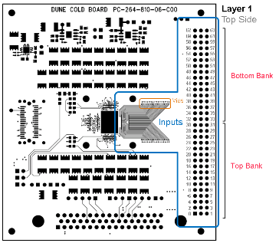
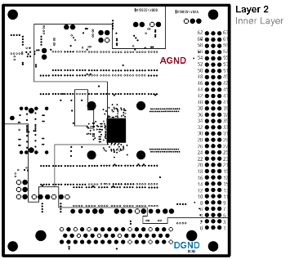
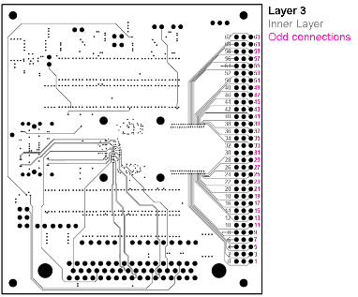
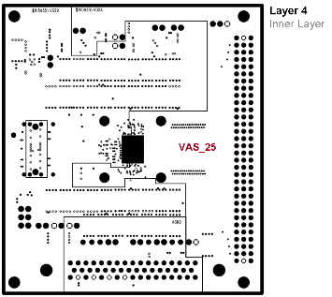
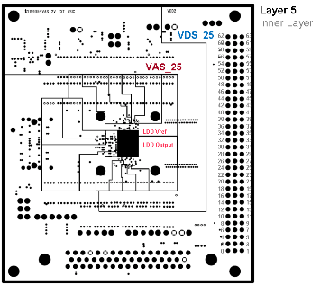
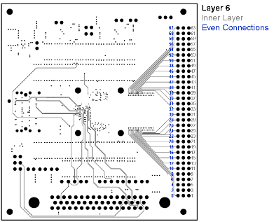


CRYO Performance – Cold Board Layout Layers
Broad band couplings to the inputs of the ASIC and the LDOs external planes through PCB traces of cold board
  Planes of supply and ground are on top and underneath the input traces of the ASIC
  New test board is under development with improved layout to eliminate undesired couplings

Slide 34
OUTLINE
CRYO Specifications
Test Bench for Characterization
Functionality Test
CRYO performance
Summary and Next Steps

Slide 35
Summary and Next Steps
First version of CRYO showed very good results as key building blocks were functional at first chip iteration and most performance are met
  ASIC configuration through SACI
  On chip supply regulation
  Reference generation of ADC
  Data communication (CRYO-FPGA)
  LVDS TXs and RXs operation
  Analog front-end and back-end operation
  Full chain and ADC operation
Discovered a couple of issues during the test validation. All of them have been fully understood and fixed on the second prototype of CRYO (more in next talk)
  “Ghost effect” in the digital back-end.
  Saturation issue in the analog monitor operating at cold temperature
In terms of performance the ADC achieved a linearity within ±1LSB at the target dynamic range. Similarly, the achieved resolution was 10.1 bit which was close to specification
  Given the information extracted from the tests, an optimized version of the ADC was implemented in the second prototype of CRYO to improve the ENOB and linearity (more in next talk)
Noise performance characterization of the front-end channel was measured on the full chain of CRYO and the measured ENC was slightly higher than expected from simulations, but this is also largely understood (more characterization with new boards is required as well as measurements on the second prototype)
  Noise is coupled to the input channel through power planes of the cold board, however, a new test board layout is being implemented to eliminate undesired couplings and improve the noise performance
Measurements with 25m long cable received recently from Fermilab will be conducted soon

Slide 36







One More Thing…Does CRYO Boil LAr?
Boiling studies ⁸ have been done in collaboration with nEXO, which include both simulations and measurements in liquid Xe (T<~177 K)
  The (nEXO) goal is to determine what kind of heat sinking solutions are needed to make sure that under no conditions any of the ASICs produce boiling
A dedicated test board with heatsink solutions were designed and built to fit the first version of CRYO in liquid Xe setup at SLAC
Results show that
  ASIC with heatsink doesn’t boil (video in next slide)
  Bare ASIC in Liquid Xe boils (video in next slide)
  Solutions have been found and improved heatsink is under study
About LAr
  Simulations needed, partners are welcome
  Measurements to be done in collaboration with BNL
Fluid simulations
with LXe in SOLIDWORKS
Heatsink parts: Si + SiC + Si
Board and anchor ring fit within the 1:1 CAD drawing
Board with ASIC and heatsink
LXe Setup
⁸ For more information:
Sander Breur, “Electric Heat Dissipation in Liquid Xenon – The Art of Heatsinking ASICs”, Slides from nEXO Collaboration Meeting, December 2019

Slide 37



ASIC Chip
FR4 Board
Si Mesa
SiC Pillar
Si Heat Sink
View
View
ASIC + Heatsink
Success: No bubbles
Power ASIC: ~ 1.6 W
T_LXE: ~ 165K
P_LXE ~ 1 bar

Slide 38


ASIC Chip
FR4 Board
View
View
Bare ASIC
It boils
Power ASIC: ~ 0.5 W
T_LXE: ~ 165K
P_LXE ~ 1 bar

