Slide 1
CRYO Testing Plan
Mark Convery
February 5, 2020

Slide 2
Introduction
Want to be ready for a system test in ICEBERG or ProtoDUNE Cold Box by July 1 (and the other one a short time later)
nEXO version is well matched to ICEBERG C_{det} , but not bad for ProtoDUNE Cold Box
Between now and then need:
Second ASIC version tests
New Cold Board
CRYO FEMB
Interface with WIB
…..
Provide all other needed info for ASIC down-select in ~Feb 2021
Third ASIC version to be submitted ~July

Slide 3
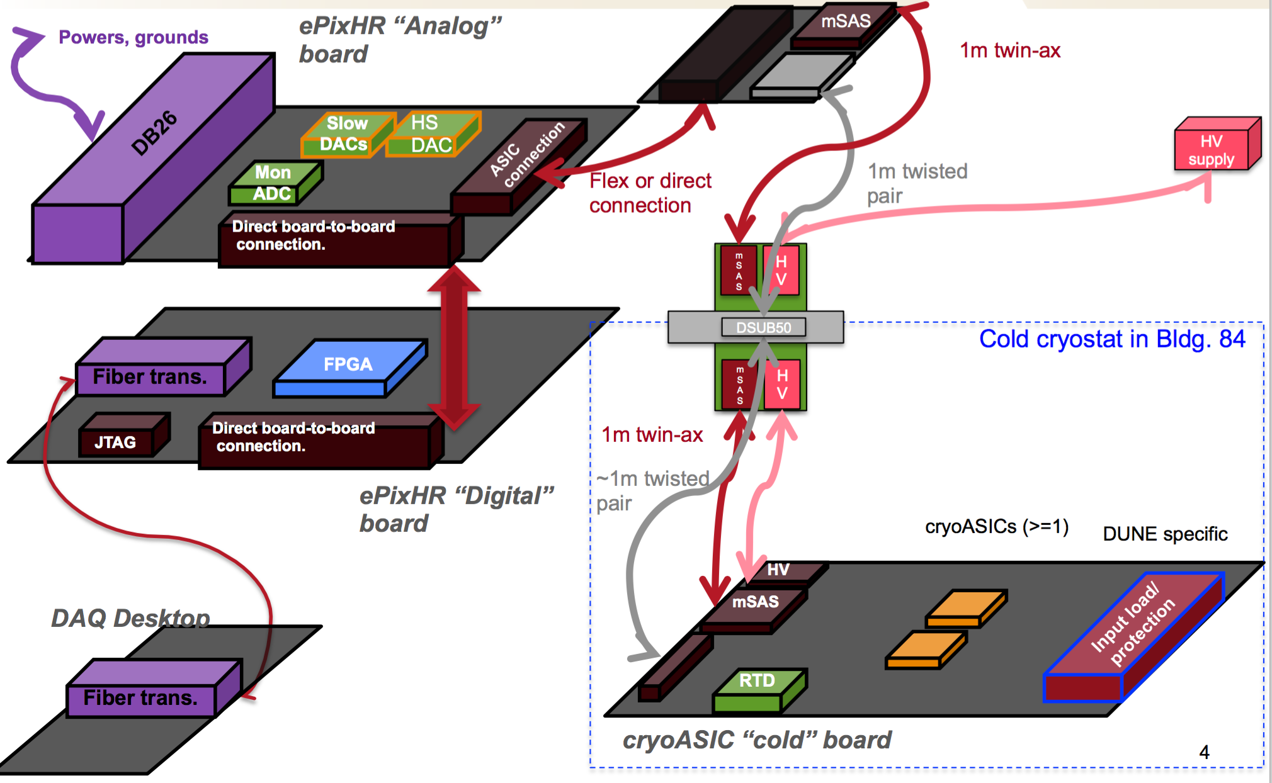
Bench Test Setup
Interface
Board

Slide 4
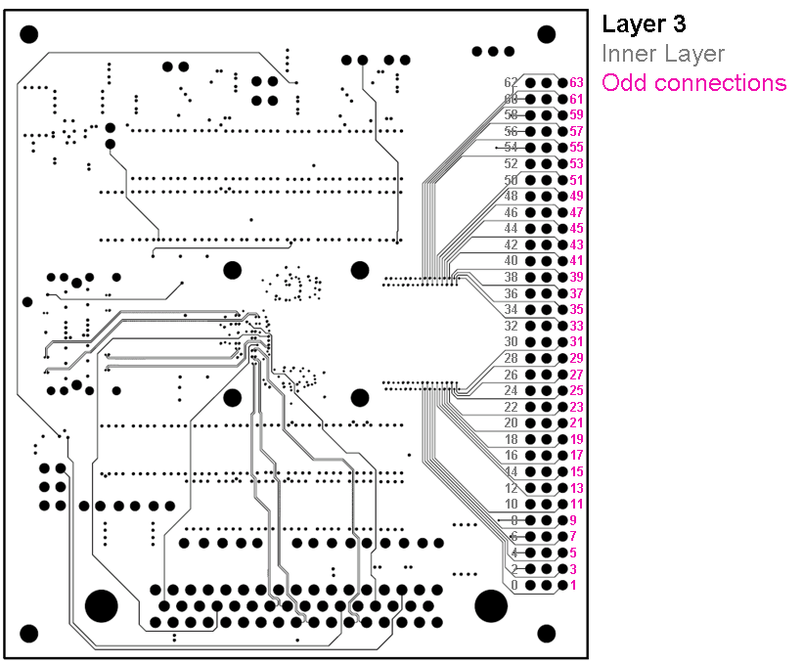
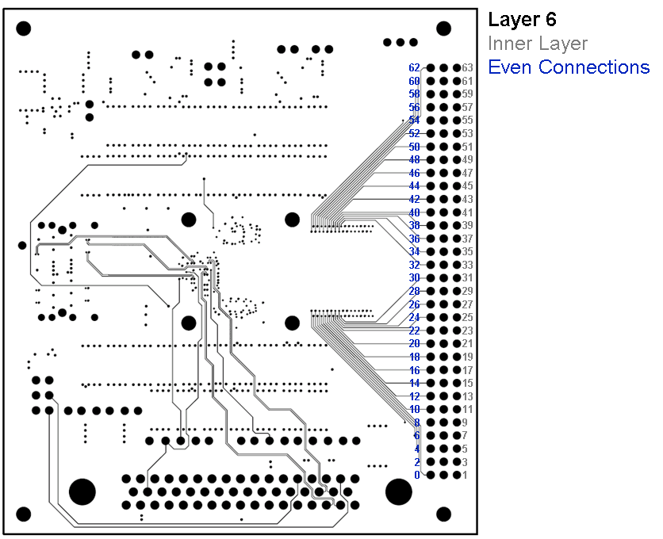
Problems Observed with Bench Testing Setup
Board interferences and noise coupling in each channel followed clear pattern
Odd channels much different from even
Traced to issue on cold board where signal traces were close to power planes
Also revealed 160kHz noise in external LDO (solved changing LDOs)
Cold board currently in layout
Interface board schematic nearly completed (simple change)
New cold board to alleviate these problems now in layout
Can accommodate new and old ASICs through loading options
Also need minor changes to interface board – schematic near completion

Slide 5
ASIC/FEMB Production Schedule
Goals
Be ready for ICEBERG (or ProtoDUNE Cold Box) test in July
Have all needed info for down-select (Feb. 2022)
Second ASIC version submitted: Dec. 1, 2019
Almost identical pin-out to first version
Expected to be received: Feb. 21
For first functionality tests, use old cold board
New cold and interface boards expected: Mar. 1
Complete bench tests with new boards: May 30
Need to get a sense of yield
Third ASIC version submitted ~July (DUNE optimized)
FEMB Schedule
Can accommodate new or old ASICs via loading options
Out for Fab: Feb. 22
Back from Fab: Mar. 7
First Prototype Stuffed (use old ASIC initially): Mar. 14
Decision point in April on whether a second version needed
June 11: Produce ~15 FEMBs with new ASIC (need 10 good ones for ICEBERG or Cold Box)
Likely will not pre-test ASICs – assuming high yield

Slide 6
ASIC/FEMB Testing Schedule
March – May: Tests of new ASIC on new cold board
Use existing ePIX setup – at SLAC
Functionality March, April
Performance May
Also plan to send to MSU for detailed analog testing
March, April: Functionality Tests of FEMB with old ASIC
Use Xilinx eval board for interface – at Hawaii
May: Functionality Tests of FEMB with new ASIC
Use Xilinx eval board – at Hawaii
Focused on functionality, interface – not performance
Decide if FEMB changes needed
June: Interface FEMB with WIB (could start earlier if WIB available)
July: Ready for ICEBERG test
September: Third version ASICs received
ProtoDUNE Cold Box Test
Use existing FEMBs, or consider using third ASIC version?
Accelerated lifetime testing

Slide 7
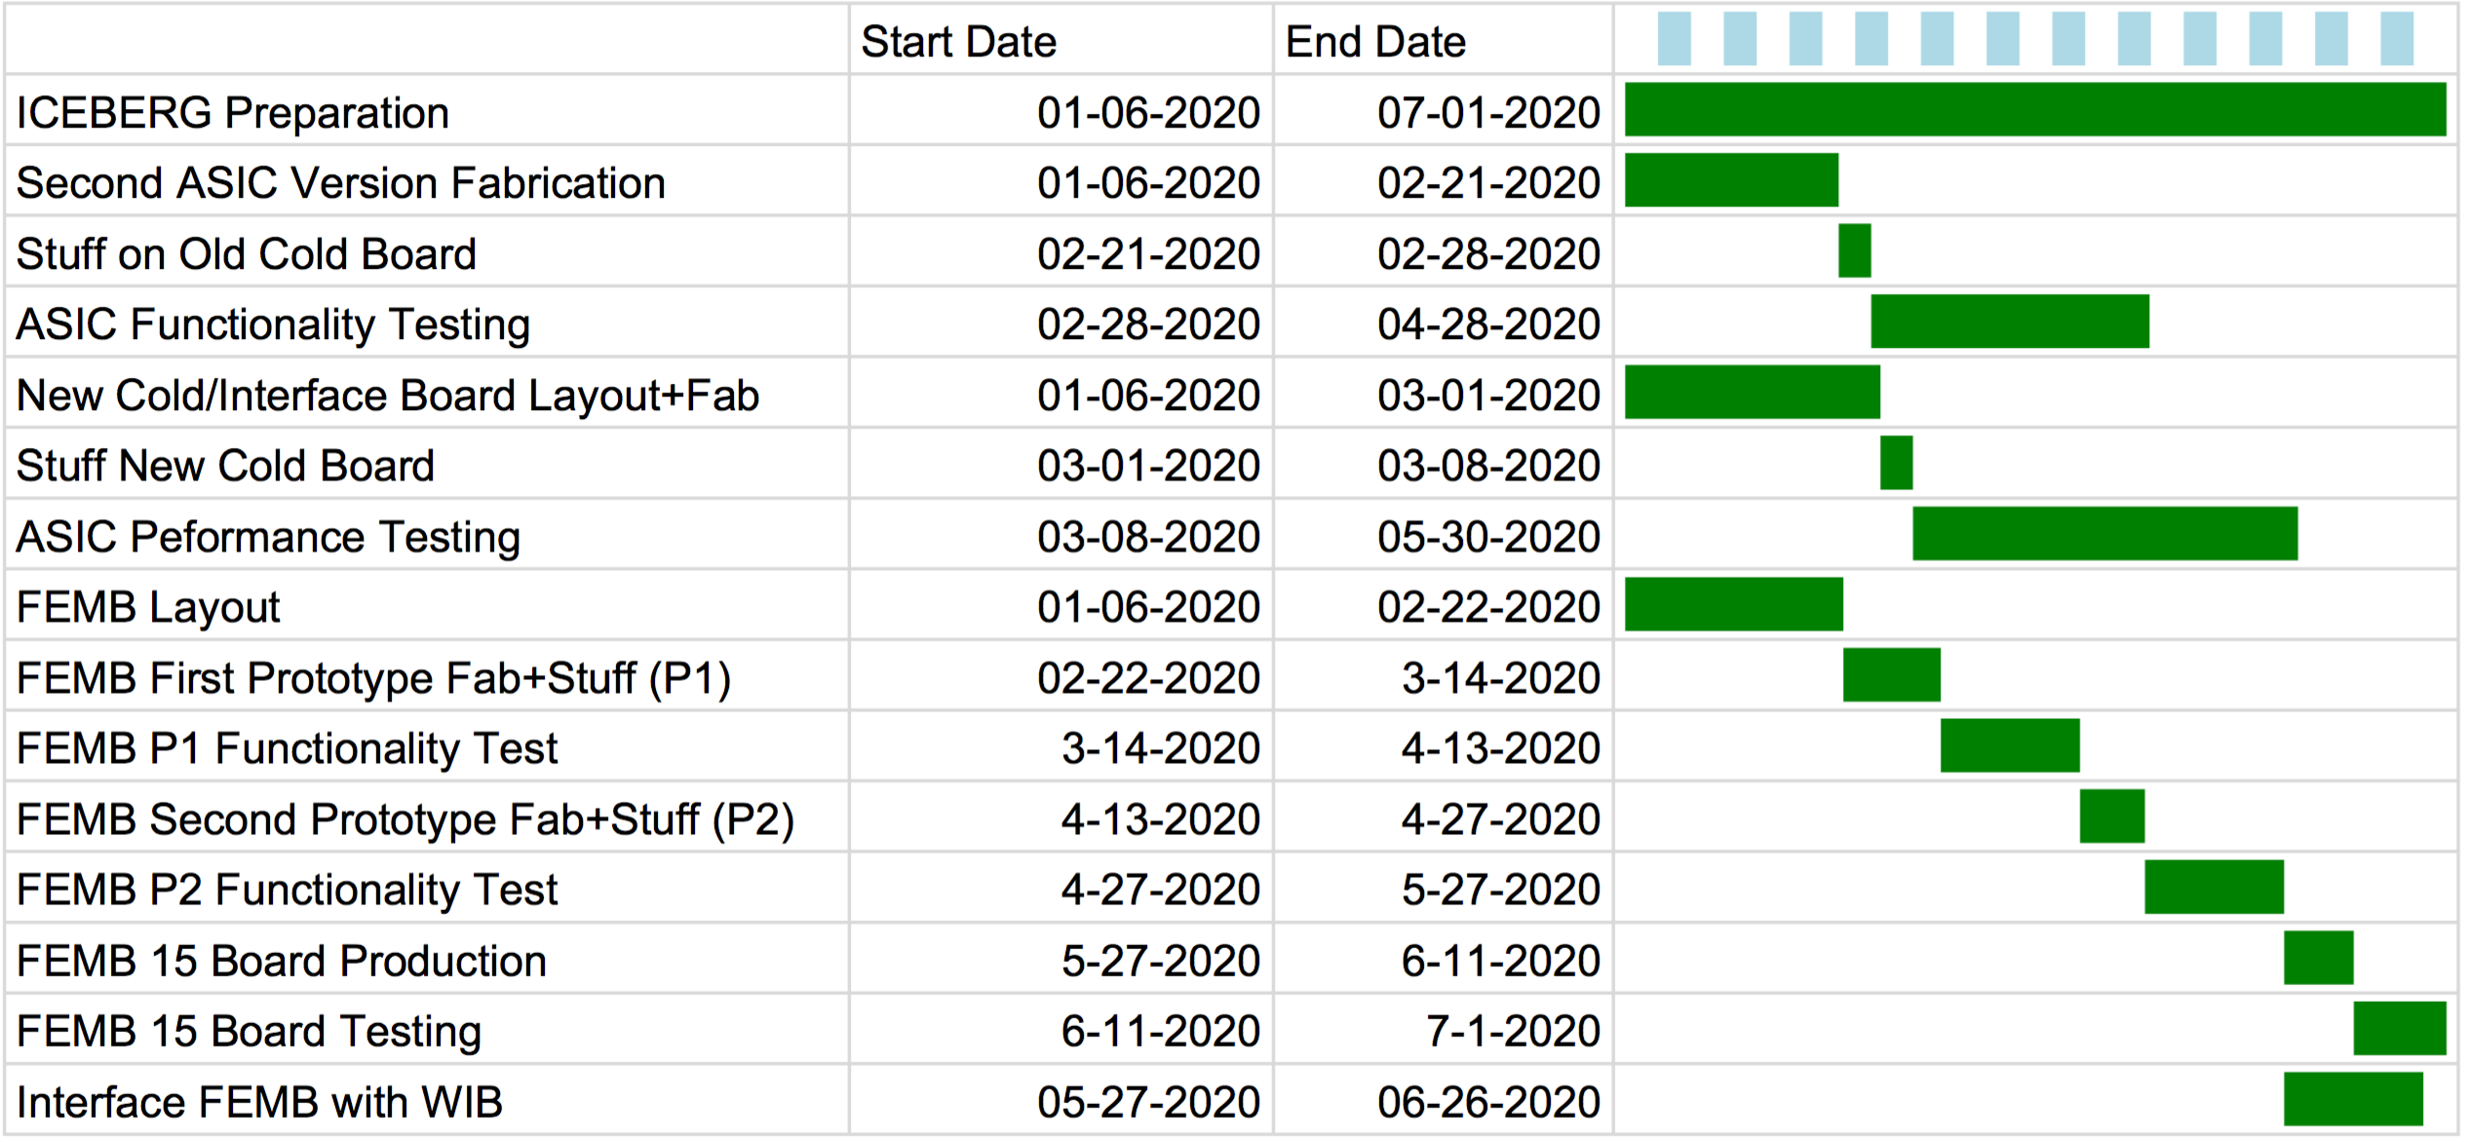
ASIC/FEMB Production/Testing

Slide 8
After System tests with NEXO version CRYO
Submission of new DUNE version
Need results from bench test to be as complete as possible
Some overlap between testing and design humanpower (Aldo)
Aim for submission date: July 2020
Perhaps can advance if testing goes smoothly and/or can offload some testing to physicists
Chips received ~September 2020
Bench performance tests needed
Time for system test?
Long-term lifetime accelerated aging test
Need to disable internal LDOs to allow elevated voltage test
Probably also need elevated voltage test of LDOs themselves

