Slide 1
CRYO: A Waveform Digitizer/Serializer for TPC Experiments
DUNE TPC Electronics Review
CERN - Geneva, Switzerland, 5th – 7th February, 2020
Design Changes for Next Version
Feb 5th, 2020
A. Pena Perez, A. Gupta, D. Doering, P. Tsang, M. Convery, A. Dragone*
(*dragone@slac.stanford.edu)

Slide 2
About the new CRYO version
A new version of CRYO has been developed and submitted during the fall last year (2019)
This version is aimed to meet the noise specifications of the nEXO experiment and addresses the issues observed during the characterization of the first iteration
As described in the following sections, the new modifications and improvements include:
  Resized front-end preamplifier to meet noise specifications at the target Cdet (40pF)
  Improved noise contribution of baseline holder
  Modified digital back-end to eliminate “ghost effect” observed on the first iteration
  Optimized capacitor array of the ADC to improve ENOB and linearity performance
  Improved analog monitor module with input/output rail-to-rail operation to fix saturation at cold temperature
  Mode for low power operation on the ADC section to achieve ~20% overall power reduction. This feature can be enabled or disabled using SACI interface
  Improved synchronization scheme to latch CRYO with both the external master clock and the external enable signal to stream data out (Start-of-Readout)
The new chip is expected to be back mid-February

Slide 3
OUTLINE
Comparison of CRYO Specifications
Modifications and Improvements
  Front-End Channel
  Ghost Effect Mitigation
  ADC Optimization
  Improved Analog Monitor
  Power Breakdown
  Synchronization Scheme

Slide 4
Comparison of CRYO Specifications
TPC Experiment | DUNE |  |  |  | nEXO
CMOS process | 130nm |  |  |  | 130nm
Supply voltage | 2.5V (2V, 1V internal) |  |  |  | 2.5V (2V, 1V internal)
Input capacitance | ~ 220pF |  |  |  | ~ 40pF
Anti-aliasing filter | 5th order Bessel architecture |  |  |  | 5th order Bessel architecture
Peaking times | 0.6us, 1.2us, 2.4us, 3.6us |  |  |  | 0.6us, 1.2us, 2.4us, 3.6us
Gain settings | 6.0X (28.6mV/fC) | 3.0X (14.3mV/fC) | 1.5X (7.1mV/fC) | 1.0X (4.8mV/fC) | 6.0X (57.2mV/fC) | 3.0X (28.6mV/fC) | 1.5X (14.3mV/fC) | 1.0X (9.6mV/fC)
Max. input charge | 50fC | 100fC | 200fC | 300fC | 25fC | 50fC | 100fC | 150fC
Noise | ~500e- @ 3.0X and 1.2us |  |  |  | ~200e- @ 3.0X and 1.2us
Resolution | 12 bit |  |  |  | 12 bit
INL and DNL | ±1LSB |  |  |  | ±1LSB
Sampling frequency | 2MSPS |  |  |  | 2MSPS
Temperature | 87K (-186ºC) |  |  |  | 160K (-113ºC)

Slide 5
Simulation methodology
CRYO has been designed under different simulation conditions to verify functionally and performance on all critical blocks implementing the ASIC
The evaluation takes into account PVT variations and advance analysis such as noise in AC and transient; Monte Carlo mismatch, etc; and they have been applied to both schematic level and extracted view (PEX) of layout
Digital flow implements co-simulation integrating ASIC firmware, FPGA firmware and software
  The simulation environment includes Vivado, VCS and python based tools
In the following a subset of simulation results considered during the design of CRYO are reported
Simulation conditions for the various sections | Schematic | PEX view
Supply voltage variation | ✔ | ✔
Temperature: Room, nEXO and DUNE | ✔ | ✔
Corners: SS, FF, FS, SF | ✔ | ✔
Clock speed | ✔ | ✔
Monte Carlo mismatch | ✔ | ✔
AC Noise Analysis | ✔ | ✔
DC analysis | ✔ | ✔
Transient | ✔ | ✔
Trannoise | ✔ | ✔
Top level simulations | ✔

Slide 6
OUTLINE
Comparison of CRYO Specifications
Modifications and Improvements
  Front-End Channel
  Ghost Effect Mitigation
  ADC Optimization
  Improved Analog Monitor
  Power Breakdown
  Synchronization Scheme

Slide 7
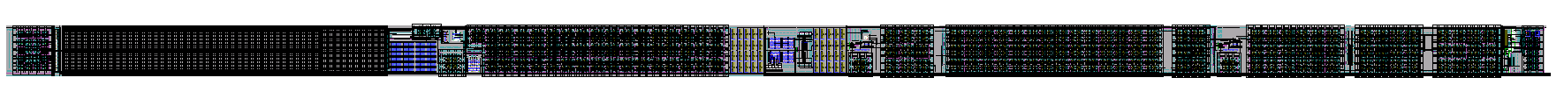
Front-End Channel
  Modifications
  Although the preamplifier of the front-end has been resized to meet noise specifications of the nEXO experiment simulations reported here were done at -186ºC
  Also, additional improvement in terms of noise was done in the baseline holder
  The layout of the nEXO channel follows the same footprint as the DUNE variant
DUNE Variant (Current Version)
Preamplifier
nEXO Variant (New Version)
Preamplifier

Slide 8
Front-End Channel – Collection Mode
  Simulation Conditions
  Baseline of the front-end channel is set to collection mode
  Plots show the ENC (left) and transient response (right) across different peaking times
  The analog LDO supplies the channel and temperature is -186ºC
  For this case the detector capacitance is 40pF with input charge of 25fC and gain of 6.0X

Slide 9
Front-End Channel – Induction Mode
  Simulation Conditions
  Baseline of the front-end channel is set to middle range (induction mode)
  Plots show the ENC (left) and transient response (right) across different peaking times
  The analog LDO supplies the channel and temperature is -186ºC
  The detector capacitance is 40pF with dual polarity input charge of ±12.5fC and gain of 6.0X

Slide 10
Front-End Channel – nEXO vs DUNE with Cdet = 220pF
  Simulation Conditions
  The ENC comparison between the DUNE preamp an the nEXO preamp is shown in the left plot
  Notice that for the given input charge (100fC), the gain of the nEXO variant is 1.5X whereas for DUNE is 3.0X
  Right plot shows the ENC of the DUNE front-end channel when it benefits from the revised baseline holder. This yields slightly noise improvement compared to the nEXO variant
  In both plots the detector capacitance is 220pF and temperature is -186ºC. Channels are supplied by LDO
1.5X (100fC)
3.0X (100fC)

Slide 11
Front-End Channel – ENC Vs Cdet
  Simulation Conditions
  The plot shows the ENC vs Cdet of the nEXO front-end channel across different peaking times
  Detector capacitance ranges from 0pF to 250pF and input charge is 25fC
  The channel is set in collection mode with gain setting of 6.0X
  The supply is provided by the LDO

Slide 12
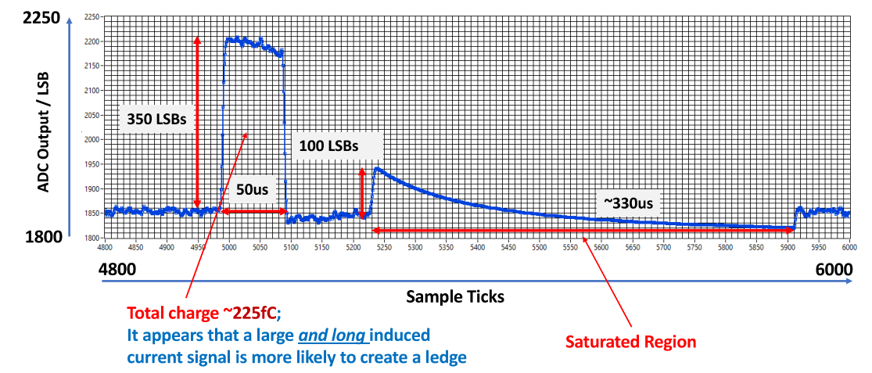
Front-End Channel – Saturation Response
Characteristic shape of “Ledge Effect” was observed in LArASIC when front-end channel is saturated with a large amount of charge
DUNE management asked us to perform this simulation on all versions
Transient simulations were done in the CRYO front-end channel using similar saturation conditions in collection and induction mode and across corners to evaluate this behavior
Image taken from:
Hucheng Chen, et. al.,
Study of the “Ledge” Effect in ProtoDUNE Readout

Slide 13
Front-End Channel – Saturation Response
Transient simulation conditions
Applied large input charge (Qin = 250fC) with pulse duration of 50us
Corners (SS,TT, FF) at different peaking times and gain set to 6.0X
Temperature is -186⁰C
Monte Carlo mismatch at -40C using model card ¹
Results show that the “Ledge affect” is not observed in both modes collection and induction
Corners (SS, TT, FF)
4 Tps | -186⁰C
Monte Carlo Mismatch | Corners
4 Tps | -40⁰C
Corners (SS, TT, FF)
4 Tps | -186⁰C
Monte Carlo Mismatch | Corners
4 Tps | -40⁰C
¹ Our current cryogenic models do not support Monte Carlo analysis

Slide 14
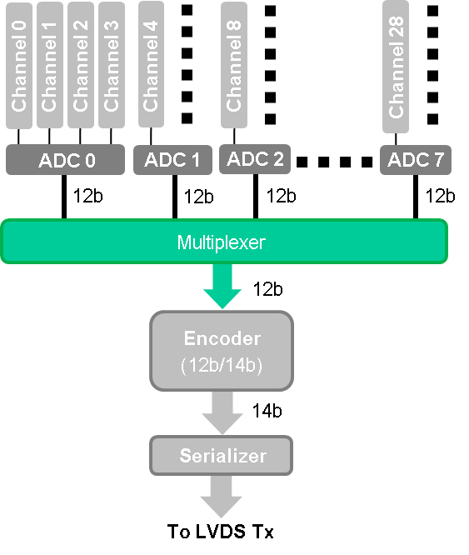
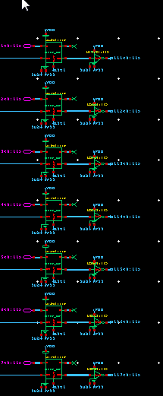
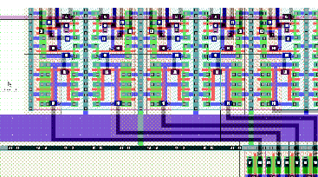
Digital Back-End – “Ghost Effect” Solution
  “Ghost effect” observed during the evaluation of the first version of CRYO was fully understood
  This issue was reproduced in simulations using extracted view (PEX) of the layout of the digital back-end
    PEX view involved the digital MUX, encoder, serializer and LVDS TX modules
  The poor driving capability of set of latches implementing the digital MUX was the main reason of this issue
  The second prototype fixes this problem by properly buffering the output of latches
  Special care was taking into account during the layout implementation of this section

Slide 15
Digital Back-End – Test Bench
Examples of Input Signals
  Simulations across PVT, corners and clock speed were performed to ensure that this problem was not present in the second version of CRYO
  Different test signals in 12 bit format were applied at the inputs of digital MUX. Some examples include constant values and dynamic signals such as ramps and sine waves using the ADC
  A dedicated Python script deserialized and decodified the data output stream of the LVDS TX to be then compared against the input signal
  Next figures shows the example of two different cases:
    Constant values in all inputs (i.e. IN0 = 1, IN 1= 2, etc)
    Zero value at inputs from IN0 to IN6 and half sinewave on IN7 using the ADC
ADC
IN1
1
IN2
2
IN3
3
IN4
4
IN5
5
IN6
6
IN7
7
IN8
8
12b
12b
12b
12b
12b
12b
12b
12b
Multiplexer
12b
Encoder
(12b/14b)
EQUAL
14b
Serializer
LVDS TX
Python
Stream
Deserializer
Decoder

Slide 16
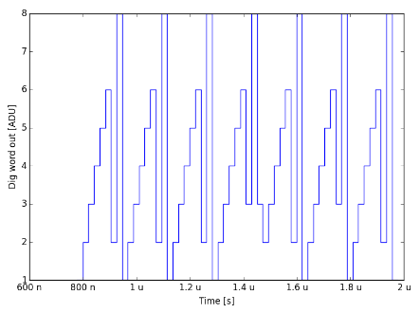
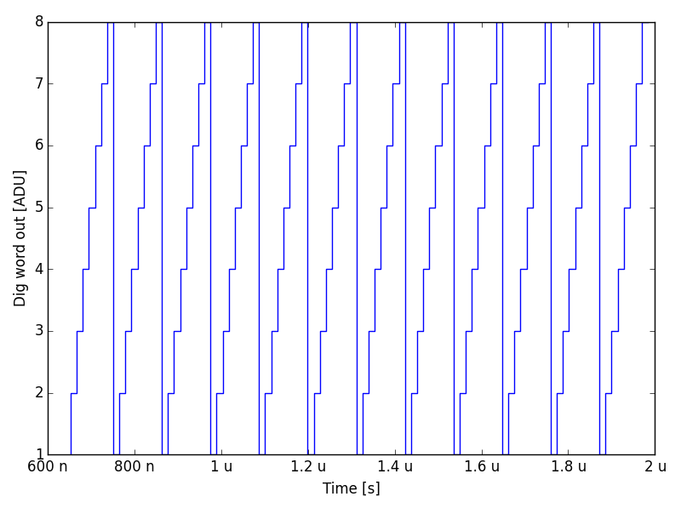
Digital Back-End – Test Bench
Simulation results at -186⁰C
Examples of Input Signals
ADC
Corrupted Data
IN1
1
IN2
2
IN3
3
IN4
4
IN5
5
IN6
6
IN7
7
IN8
8
12b
12b
12b
12b
12b
12b
12b
12b
Multiplexer
12b
Notice that last latches of DMUX failed as they need to drive longer connections due to layout placement
Encoder
(12b/14b)
EQUAL
Correct Data
(After Fix)
14b
Serializer
LVDS TX
Python
Stream
Deserializer
Decoder

Slide 17
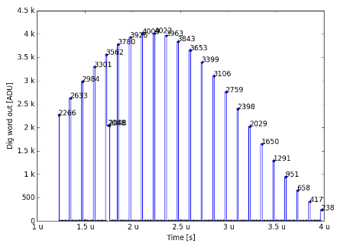
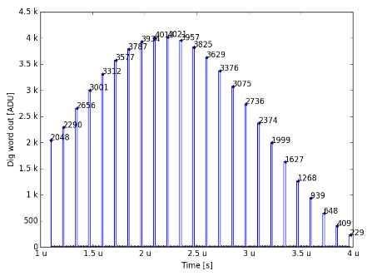
Digital Back-End – Test Bench
Simulation results at -186⁰C
Examples of Input Signals
ADC
Corrupted Data
IN1
0
IN2
0
IN3
0
IN4
0
IN5
0
IN6
0
IN7
0
IN8
-
12b
12b
12b
12b
12b
12b
12b
12b
Multiplexer
12b
Encoder
(12b/14b)
EQUAL
Correct Data
(After Fix)
14b
Serializer
LVDS TX
Python
Stream
Deserializer
Decoder

Slide 18
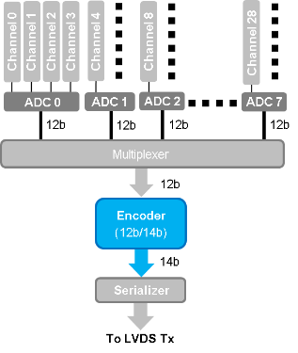
Digital Back-End – Test Patterns
  The back-end module of CRYO has built-in pattern generators specially intended for testing and debugging
  Different modes, controlled by SACI, were implemented to bypass cells and generate unique data patterns
  Although few of these patterns did not work properly on the first iteration, they do not have any impact on the signal chain and functionally of CRYO
  The new version fixed the bugs found in the first iteration
Test modes of digital back-end
Mode | Pattern | Description
0 | N/A – ADC data | ADC data → DMUX → Encoder → Serializer → LVDS TX (Full chain of digital back-end)
1 | Patt1: 0xA’s ↔ 0x5’s | Patt1 → Encoder → Serializer → LVDS TX
2 | Patt2: 000’s ↔ 111’s | Patt2 → Encoder → Serializer → LVDS TX
3 | Patt3: Ramp | Patt3 → Encoder → Serializer → LVDS TX
4 | N/A – ADC data | ADC data → DMUX → Serializer → LVDS TX
5 | Patt1: 0xA’s ↔ 0x5’s | Serializer/LVDS TX
6 | Patt2: 000’s ↔ 111’s | Serializer/LVDS TX
7 | Patt3: Ramp | Serializer/LVDS TX

Slide 19
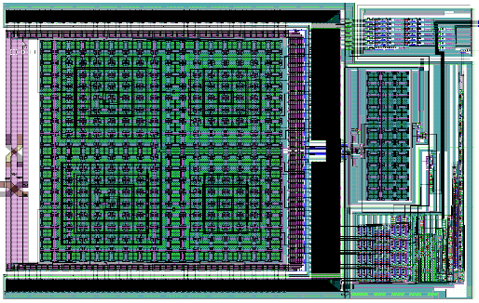
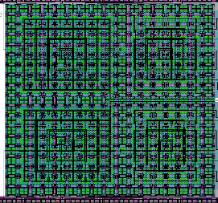
ADC Optimization
  Optimization on the capacitor array (I)
  The optimization was aimed to improve both resolution (ENOB) and linearity performance of the ADC
  These optimization was performed on the capacitor array of the ADC, which is based on a binary weighted split capacitor DAC implemented by MSB and LSB section
  Due to routing of interconnections, critical parasitic capacitors that impact performance were carefully identified from the extracted view (PEX) of the layout
  Given the results we pushed the minimum parasitic cap considered for extraction down to < 0.001fF

Slide 20
ADC Optimization
  Optimization on the capacitor array (II)
  These critical parasitics appeared in parallel to the main capacitors of the array; from top plates to ground in the MSB and LSB sections and in cross-coupling around the bridge capacitor
  The error introduced by those parasitics was substantially minimized by properly trimming the routing of interconnections
  After optimizations, the parasitic caps in parallel to the main capacitor array followed a binary weighted arrangement with mismatch error <0.01%; the crossed coupling capacitor was removed and parasitics with respect to ground were reduced by more than 50%
OPT

Slide 21
ADC Optimization – ENOB
ENOB Optimized PEX
Temperatures | Transient | Transient + Noise Noise BW: 10 kHz – 10 GHz
Room | 11.66 bit | 11.38 bit
nEXO (-113ºC) | 11.67 bit | 11.42 bit
DUNE (-186ºC) | 11.71 bit | 11.43 bit
Temperature = -186⁰C
FFT = 1024
Fin = 242.187kHz
Fs = 8MHz
Simulations were done using PEX views of the ADC
Without any optimization the simulated ENOB is in good agreement with measurement results (~10 bits)
After optimization the ADC achieved an ENOB = ~11.40 bits (transient + noise) across temperatures

Slide 22
ADC Optimization – Linearity
Linearity Test of ADC
Sinewave method was used in simulations to evaluate static performance (INL/DNL)
It uses a slow sinewave input signal (i.e. ~ 30kHz) with long number of periods to exercise all codes (i.e. 127 with FFT = 32768)
Results show the performance of the optimized PEX view of the ADC
DNL and INL are within ±1LSB
Transition around middle range in INL plot is reduced after optimization
Transition

Slide 23
Improved Analog Monitor Module
  Saturation issue observed during the evaluation of the analog monitor at cold temperature was fully understood
  The issue was reproduced in simulations using our cryogenic models
  This module is implemented by an analog multiplexer followed by an intermediate single-ended buffer and a differential output stage
  The limited input range of the single-ended buffer was the cause of the saturation
  The second version of CRYO addresses this problem with an improved rail-to-rail input stage on the buffer
  Simulations at -186⁰C were performed to ensure that this problem was not present in the new revision
  Also, new analog signals are available for debugging and testing
New monitor input signals
Input | MUX | Description
5 | Ana_Mon_Cal | External signal used for calibration of the analog monitor
6 | G_bgr_1V | Reference voltage of LVDS modules
12 | LDO1_Bk1_Mon | Output of analog LDO1 - Supply of ADC section (Bottom BANK)
13 | LDO2_Bk1_Mon | Output of digital LDO2 - Supply of SAR logic and 2V level shifters (Bottom BANK)

Slide 24
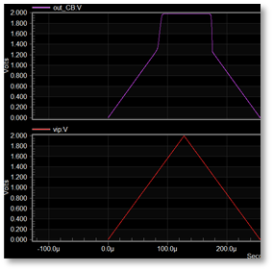
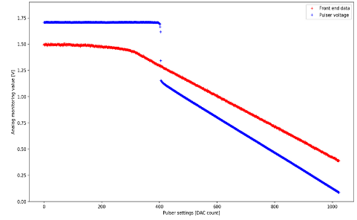
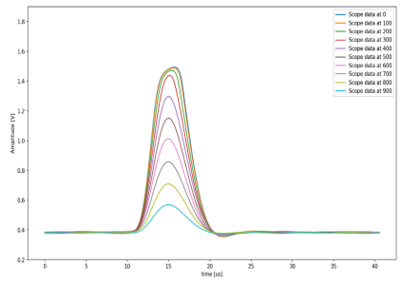
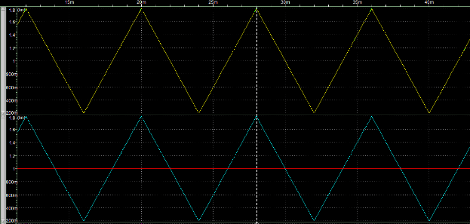
Improved Analog Monitor Module
Simulation results at -186⁰C
Measurement Results
Simulations
Linearity test of front-end
Response at different Pulser levels
Output
Input
Analog monitor output after improved input range of buffer stage
Input
Output

Slide 25
Power Breakdown
Second version of CRYO implements a power scaling technique
ADC section benefits from this feature and it can be enabled or disabled through SACI interface
Simulations show an overall power reduction of ~24%, which yields ~19.8mW/channel
This feature is implemented by adjusting dynamically the quiescent current of the ADC signal driver
  During sampling the driver delivers the necessary current to pre-charge the capacitor array of the ADC
  During conversion the current reduction is enabled since the driver is not required by the ADC
CRYO ASIC v0.1
Total Power | 1.68 W | 2.5V
Power/Channel | 26 mW
CRYO ASIC v0.2
Total Power | 1.27 W | 2.5V
Power/Channel | 19.8 mW
Power Scaling ON
nEXO Preamp

Slide 26
Synchronization Scheme – External Enable Signals
Upon DUNE management request, new version of CRYO implements new external enable signals to sync with:
  Internal clock generation
  Streaming data mode
Sampling Clock Enable (SampClkEn) allows the user to control the sampling time of the ASIC based on the master clock
Start-of-Readout (SRO) allows the user to control when to streaming out valid data
WIB firmware controls the ASIC synchronization.
Master Clk
SampClkEn
SRO

Slide 27
Synchronization Scheme – Clocking & Control at WIB
CRYO working with DUNE clock
Crossing the clock domains
  WIB generates 56MHz clock
  Monitors and align clock phases
Sampling is controllable
  SampClkEn controls the sampling time
  SRO controls the transmission
Running CRYO at DUNE clock
  Sampling of 2.2MSPS per channel
DUNE
timing
Timing logic
“uniform phase aligned counter & commands (new commands: SR0En, SHClkEn, samplingCycleSync)”
DUNE
CLOCK
Trigger logic
62.5MHz
clock
domain
Sampling Cycle Timing
Phase
monitor
FIFO
56MHz
56MHz
clock
domain
SampCLKEn
SR0_{56MHz}
Data de-serializer
CRYO

Slide 28
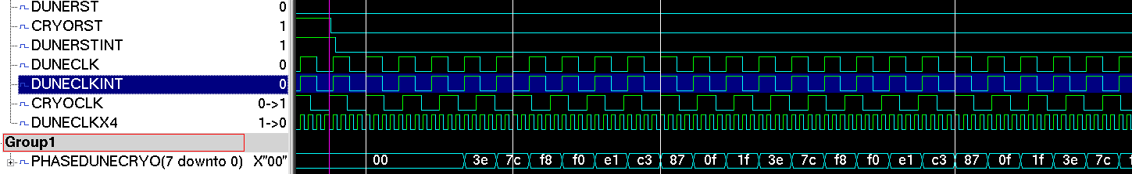
Synchronization Scheme – Clock Gen. and Monitor
CRYO with DUNE clock
Clock is generated internally
  Using integer option 55.5MHz clock
DUNE clock is the reference time
  CRYO clock is “data” for the phase monitor
Every 9 DUNE cycles the phase repeats
USE phase to issue fast commands to CRYO
DUNE
CLOCK
Phase
DATA
ISERDESE3
DDR
MMCM
D
1000/18~56MHZ
62.5*16=
1000MHz
CLK
1000/4=250MHz
CLKDIV
1000/16=62.5MHz
in phase
in phase

Slide 29
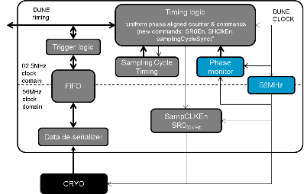
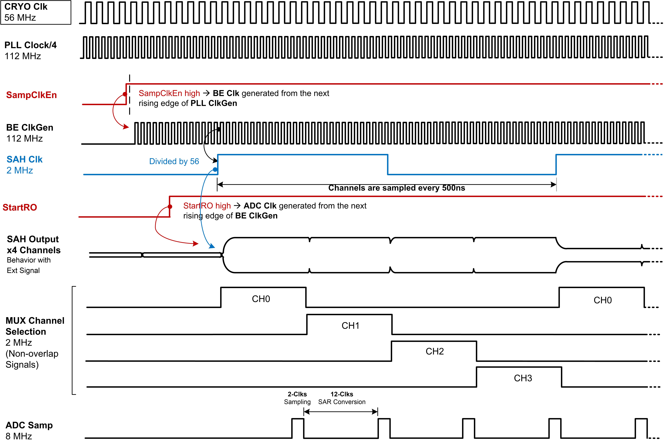
Synchronization Scheme – sampClkEn Controls Sampling
CRYO clock can be generated from the DUNE clock deterministically at the WIB level
Phase relations are predictable and can be used to control CRYO through sampClkEn defined by the user
CRYO internal clocks respond to the sampClkEn signal enabling the user to define the sampling instant

Slide 30
Acknowledgments
SLAC ASIC Team
Aseem Gupta
Camillo Tamma
Lorenzo Rota
Bojan Markovic
Savino Petrignani
Pietro Caragiulo
Umanath Kumar
Xiaobin Xu
Faisal Abu-Nimeh
Hussein Ali
Aldo Pena Perez
Angelo Dragone
SLAC DAQ Team
Ryan Herbst
Dionisio Doering
Ben Reese
Larry Ruckman
Maciej Kwiatkowski
Mark Freytag
Thung Pan
Lupe Salgado
SLAC Sensor Team
Chris Kenney
Chu-En Chang
SLAC DUNE Team
Hirohisa Tanaka
Mark Convery
Patrick Tsang
SLAC nEXO Team
Peter Rowson
Bob Conley
Sander Braun
Brian Mong
CRYO Collaborators Team
Kurtis Nishimura
Rick Van Berg
Gary Varner
Carl Bromberg
Dean Shooltz

