Slide 1


Cold ADC – Review of Design
Carl Grace (on behalf of Cold ADC Design Team)
crgrace@lbl.gov
February 5, 2020
DUNE TPC Electronic Review
CERN

Slide 2
Introduction
Cold ADC is a 16-channel, 12-bit, 2 MS/s Digitizer ASIC for the DUNE Far Detector
Designed by joint team from LBNL, FNAL, and BNL
Cold ADC uses a conservative, industry-standard design with digital self-calibration
Besides functionality and reliability, design goal is low-noise operation
Design contains significant features for risk mitigation and observability

Slide 3
Chip Top-Level

Slide 4
Technology Choices
ASIC implemented in 65 nm CMOS technology
  leverages existing FNAL cold models
  facilitates potential future integration with COLDATA
Design follows conservative guidelines developed by BNL
  power supplies reduced by 10%
  minimum device length increased by 50%
Analog blocks implemented with thick-oxide devices and high supply
  Relaxes noise requirements
  Simplifies interface with LArASIC
ASIC implemented using a digital-on-top design style

Slide 5
Design Risk Mitigation
BLOCK | WORK-AROUND
Buffer | Bypass (directly connect LArASIC to ADC)
ADC Reference Buffers | Bypass (use external references)
Bandgap Reference | Bypass (use CMOS-based reference, external BGR, or external references)
Bias Currents | Highly adjustable to improve settling or reduce power at cold (for instance)
Calibration Algorithm | Calibrate off-line and load gain estimates into register file
Correction Logic | Use uncalibrated (traditional) ADC output (expect about 10-bit linearity in this case)
Digital Interface to COLDATA | Route ADC data through SSO (can still evaluate ADC performance)
Configuration Interface | Read and Write with either I2C or UART
ADC Gain Boosting | Include gain booster kill switch

Slide 6
Cold ADC Power Partitioning
*
Separating clean analog supplies from supplies with dynamic currents key to achieving low-noise performance
Supply | Blocks
2.25 V Analog | Amplifiers, references, comparator preamp
2.25 V Digital | Analog Switches, Comparator Latch, ADC Stage Logic
1.1 V Digital | All synthesized digital logic
2.25 V I/O | ESD Ring and LVDS drivers

Slide 7
Cold ADC Functional Block Diagram

Slide 8
ADC Top Level
Pipelined ADC
ADC block diagram
ADC stage transfer characteristic
Pipelined ADC capable of about 10-bits or so of raw accuracy (limited by cap mismatch and op amp finite gain)
Key point: gain errors don’t inherently cause nonlinearity. It appears only when assumed gain (i.e. the stage radix) is wrong.

Slide 9
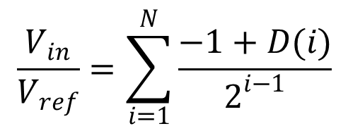
Calibration Concept
$$\frac{V_{in}}{V_{ref}}=\sum_{i=1}^{N}{\frac{−1+D(i)}{2^{i−1}}}$$
Size of jump = actual stage gain
Need to measure this…
Ideally stage gain exact power of 2, it that case we can simply concatenate bits to generate output code
Deviations from 2 → nonlinearity

Slide 10
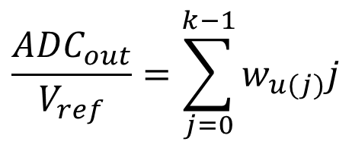
Calibration Concept (cont.)
Use proven Karanicolas - Soenen algorithm → converts unknown radix (depends on component matching and finite open-loop gain) to base-2
Technique based on fact that missing codes in ADC transfer characteristic can be corrected as long as all decision levels present
Set input to decision level, force decision 1 & 0, drive difference to 0
Decision | Weight | Measurement
0 | w0 | S1-S0
1 | 0 | N/A
2 | w2 | S2-S3
$$\frac{{ADC}_{out}}{V_{ref}}=\sum_{j=0}^{k−1}{w_{u(j)}j}$$

Slide 11
Back-to-Front Calibration
Pseudocode:
for STAGE (max downto 0) do
Measure decision levels (S0, S1, S2, S3);
Calculate stage weights (w0, w2);
Write stage weights (w0, w2) to Register File;
Next STAGE;
end

Slide 12
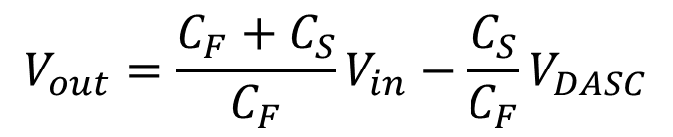
ADC Stage
Conceptual block diagram of ADC Stage
$$V_{out}=\frac{C_{F}+C_{S}}{C_{F}}V_{in}−\frac{C_{S}}{C_{F}}V_{DASC}$$
Capable of about 10-bits or so of raw accuracy (limited by cap mismatch and op amp finite gain)

Slide 13
Stage MDAC
V_{calp} and V_{caln} are decision levels generated internal to the stage

Slide 14
MDAC Op amp
Fully differential folded-cascode opamp
with gain-boosting
Gain = 86 dB
GBW = 177 MHz
PM = 75 degrees

Slide 15
Switched-Capacitor Comparator
Comparator samples signal and threshold in opposite clock phases
Difference between them is latched and drives MDAC
Offset is critical issue as errors larger than Vthresh/4 cannot be corrected by the calibration

Slide 16
Key Analog Requirement, Offset
Offset Tolerance
Assume +/- 1.5 V differential reference
b
=
0
b
=
1
b
=
2
V
R
1st stage eff. bits | Offset Tolerance | Tolerance in mV
1 | +/- V_{R}/4 | 375
2 | +/- V_{R}/8 | 187.5
3 | +/- V_{R}/16 | 93.75
4 | +/- V_{R}/32 | 46.875
V
o
V
R
/
2
V
i
0
-
V
R
/
2
As much as 4X worse matching for offset may be expected at cold
-
V
R
-
V
R
/
4
V
R
/
4
V
R
Stage overrange means lost analog information (in this case, decision levels) that cannot be recovered using calibration → MUST AVOID

Slide 17
Comparator Core
Balanced latch minimizes dynamic mismatch current

Slide 18
Input Buffer
3 operating modes:
  Fully differential
  Converts from single-ended to differential
  Bypassed (and powered down) – used with potential differential-output LArASIC
Noise of the buffer adds directly to the input, so must be significantly below total noise
Converting to differential gives gain of 2

Slide 19
Input Buffer

Slide 20
Sample-and-Hold (SHA)
The Sample-and-Hold amplifier (SHA) has 2 operating modes:
  Fully differential
  Converts from single-ended to differential (in case input buffer is bypassed)
Samples at 2 MS/s but requires fast settling (< 30 ns) to prepare for ADC sampling

Slide 21
SHA Array
Sample-and-Hold (SHA) Array multiplexes 8 LArASIC inputs down to a single ADC sampling at 16 MS/s (for effect channel sampling rate of 2 MS/s

Slide 22
SHA
These switches determine overall linearity
Switched-capacitor SHA uses standard design based on charge redistribution. Besides sampling, the SHA shifts common-mode voltage from input buffer to ADC

Slide 23

Reference Buffers
Reference Buffers drive ADC reference voltages
Reference voltages need to settle to better than about 0.25 LSB between samples (define settling time here as 1/3 clock period @ 20 MS/s for margin)
Need Low Noise
Noise in reference directly couples to input of ADC
ideal Pipelined ADC
transfer function. Digital output is the ratio of the input to the reference, not the input itself!
$$\frac{V_{in}}{V_{ref}}=\sum_{i=1}^{N}{\frac{−1+D(i)}{2^{i−1}}}$$

Slide 24
Reference Buffers (cont.)
10 Ω resistors help settling for switched capacitor load

Slide 25
Reference Buffers (cont.)
Class A/B Opamp used in reference buffers

Slide 26
Configurable Bias System

Slide 27
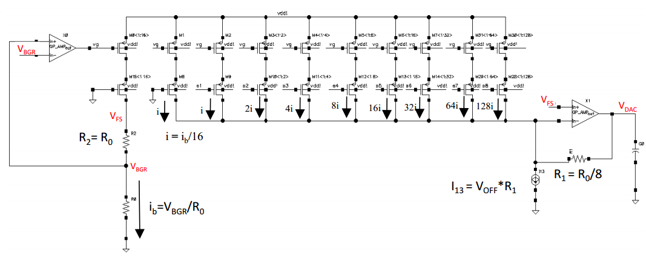
8-bit Reference DAC
Nominal ref:
Bandgap based
CMOS ref:
R-2R based

Slide 28
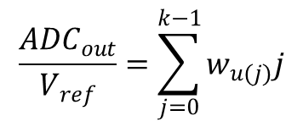
Calibration Hardware
Calibrate up to seven stages in Cold ADC
$$\frac{{ADC}_{out}}{V_{ref}}=\sum_{j=0}^{k−1}{w_{u(j)}j}$$

Slide 29
Calibration Hardware (cont.)
Digital calibration Engine. One for each ADC.

Slide 30
Digital Data Formatter
Conservative digital interface to COLDATA
  16-bit data from 2 ADCs sent out via 8 LVDS output ports
  Each ADC word organized as 4 nibbles and interface operates at 64 Mb/s
  One bit per clock (SDR) for robustness
T = “Top” ADC
B = “Bottom” ADC

Slide 31
Clock Domain Crossing
Solution: ADC bits are resampled and then handed off to core.
In case of metastability, handoff can be phase offset 180 degrees

Slide 32
Control Interface - UART
Cold ADC includes both an I2C and a UART-based interface for redundancy (both worked fine)
Custom byte-oriented UART interacts directly with register file to read and write calibration data and configuration bits
1 MHz UART data is oversampled 16X by Cold ADC giving extremely conservative design with very low risk

Slide 33
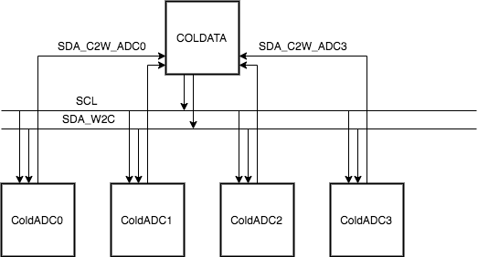
Control Interface – I2C
COLDATA communicates with FEMB using “I2C-like” protocol so COLDATA <-> Cold ADC communication with same protocol is a natural choice
*
Robust version of I2C for long-term operation in cold temperature
Independent cold-to-warm and warm-to-cold connections
CMOS logic levels

Slide 34
Chip Configuration
Memory-mapped configuration bits and calibration data
Can be accessed using either I2C (preferred) or UART
Chip ID established via bonding option

Slide 35
Configuration Logic Memory Map
Bit | [7] | [6] | [5] | [4:1] | [0]
Contents | Config Flag | Which ADC | Which Weight | Stage Address | Which Byte
Address Range (Hex) | Content
FF-80 | Configuration bits
7F-7E | ADC1 Offset
7D-60 | ADC1, W2
5F-5E | ADC1 Gain
5D-40 | ADC1, W0
3F-3E | ADC0 Offset
3D-20 | ADC0, W2
1F-1E | ADC0 Gain
1D-00 | ADC0, W0
Configuration bits fully defined in Cold ADC datasheet

Slide 36
Calibration Register File
Register File
Register File stores all calibration weights. Externally readable and writeable.

Slide 37
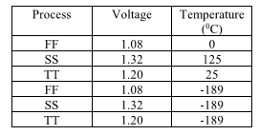
Digital-On-Top Design Methodology
cal_unit in an ADC is an independent digital block
  Verified the functionality on the post place and routed netlist along with SDF back annotation
Top level integration consists of placement of analog macro along with the digital read out logic
  Integrated using cadence automatic place and route tools
  Verified the post place and routed netlist of the full chip along with SDF back annotation
  During full chip verification Verilog-AMS models for the analog macro has been included
  Full chain primary input to primary output of the chip as been verified
The digital configuration and readout logic at the top level is immersed in deep n-well
Custom digital standard cell library (~225 cells)
  Channel length changed from 65nm → 90nm
  Enough number of cells for digital logic implementation
Spectre models at LAr temperature are developed with in the DUNE collaboration
Timing libraries are characterized using Liberate tool for following corners
For the next version of Cold ADC, digital supply will be 1.1V

Slide 38
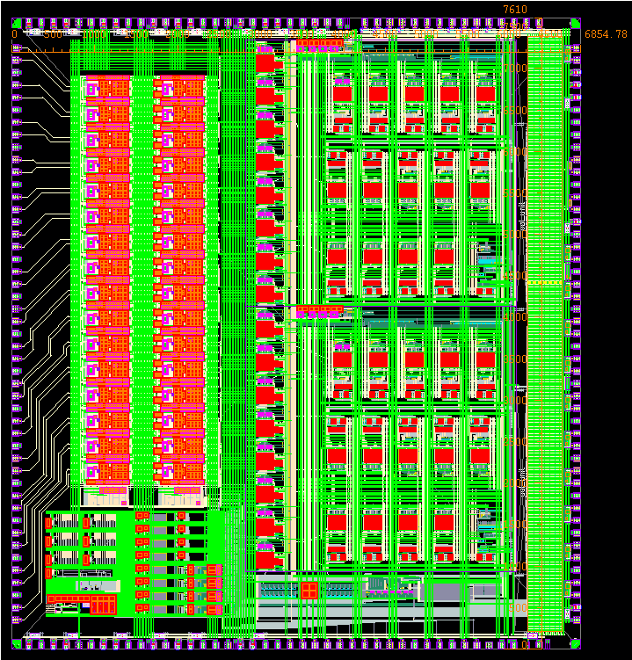
Digital-On-Top Design Methodology
65nm process, 9 metal stack
Chip size : 6860 µm x 7610 µm
Full design flow, density filling, physical verification (DRC, LVS) cycle takes ~24hrs
AP metal was not used for routing except wire bonding pads
ADC0
BUFFER
DIGTAL READOUT
ADC1
BIAS REF
Analog Macro

Slide 39
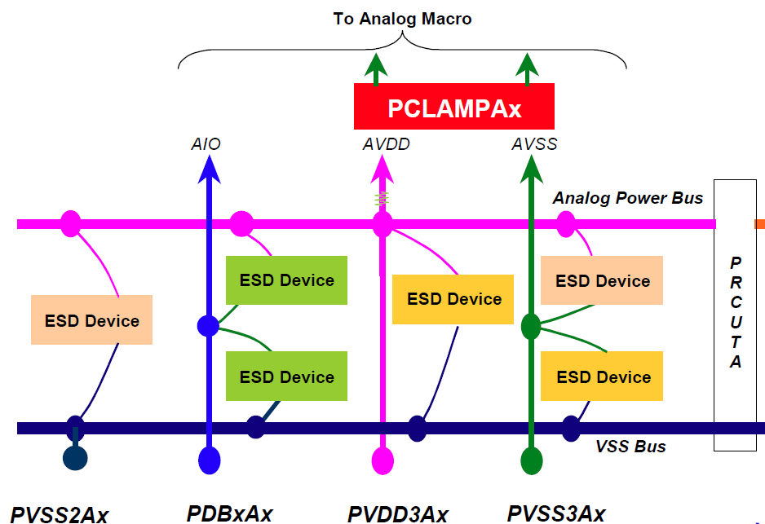
ESD Strategy
ESD protection rings in padring
*
Scheme used for Cold ADC:
Analog (2.25V)
Digital (2.25V)
Core (1.1V)
I/Os (2.25V)
C
PDBxA
PVDD3A
PVSS2A
PVSS2A
PDBxA
PVDD3A
PVSS3A
PVSS2AC
PDBxAC
PVDD3AC
PVSS3AC
PVSS2A
PDBxA
PVDD3A
PVSS3A
General remarks:
ESD strategy follows TSMC’s guidelines (same scheme used in COLDATA)
PADs are from TSMC’s standard library
One uninterrupted VSS for ESD in padring
For each power domain, active RC-clamp protection cells are used between VDD-VSS.
Signal pads only have passive diode protection to VDD/VSS (PDBx)

Slide 40
Contributors to Cold ADC Design
ASIC Designers
Advisors
Mietek Dabrowski
Yuan Mei
Emerson Vernon
Gabriella Carini
Hucheng Chen
BNL
Davide Braga
Jim Huff
Sandeep Miryala*
David Christian
Grzegorz Deputch*
FNAL
Dario Gnani
Carl Grace
Tarun Prakash
Heather Richardson
Dan Dwyer
Cheng-Ju Lin
Kam-Bui Luk
LBNL
*Now at BNL

Slide 41



UNIVERSITY OF
CALIFORNIA

Slide 42
Backup

Slide 43
Common-Mode Feedback
Conservative CMFB gives symmetric output loading → reduced CM offset in exchange for larger CMFB load

Slide 44
Stage ADSC
A | B | MSB | LSB | X | Y | Z
0 | 0 | 0 | 0 | 0 | 1 | 0
0 | 1 | 0 | 1 | 0 | 0 | 1
1 | 1 | 1 | 0 | 1 | 0 | 0
Stage Logic Truth Table
VTHRESH{P/N} equal to V_{calp} and V_{caln}

Slide 45
MDAC Op amp Gainboosters
P-channel GB
N-channel GB

Slide 46
CMOS Reference (current ref)
Adjust reference current using trim and monitor output
CMOS reference

