Slide 1
COLDADC Schedule David Christian

Slide 2
COLDADC Redesign Team
Redesign will be done mostly by the same designers responsible for the first prototype.
General Responsibilities:
BNL: Input Buffers, Bandgap Reference Block, Digital Synthesis & PnR (Sandeep Miryala is now at BNL)
LBL: SHA, MUX, & pipeline ADCs
Fermilab: Digital backend logic, Power On Reset, pad ring, final integration and verification.

Slide 3
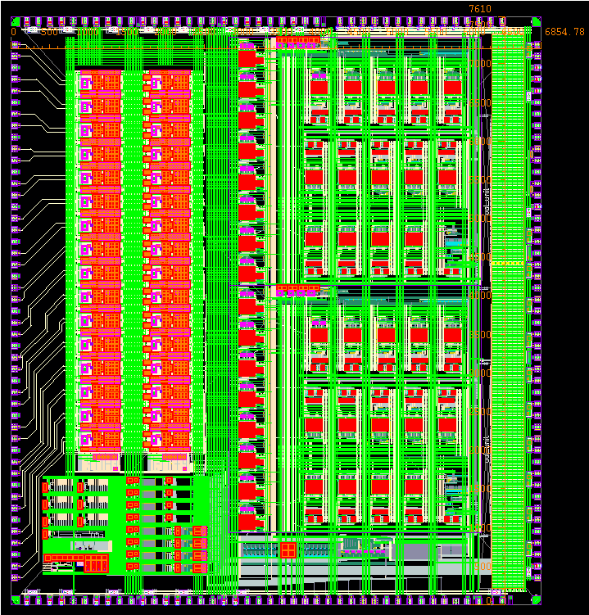
COLDADC Floor Plan
Vertical size of ASIC will be increased by 120 microns, but floor plan will be modified only very slightly.
Pads on the left and right will not be moved; input routing will remain as is.
A small number of debug outputs will be removed (top and bottom).
The Power On Reset circuit will be added on the bottom right hand side.
No other modification will change the size of a circuit block
ADC0
BUFFER
DIGTAL READOUT
ADC1
BIAS REF

Slide 4
Status
BNL
Input buffers are done.
Bandgap reference fix is understood, simulated at the schematic level, layout still needs modification.
RTL synthesis & PnR can start now.
LBL
Changes in digital logic (autocalibration & overrange protection) are understood, RTL modification is next.
After RTL synthesis & PnR, LBL will place digital logic into analog block(s)
Pipeline ADC: design of improved OpAmp is done; layout and post-layout simulation is next.
Changes to MUX are minor; layout is next.
Last step before full-chip integration is mixed-mode simulation including layout parasitics.

Slide 5
FNAL
Modification to backend logic (reset state machine and MUX sequencing)
RTL has been written and simulated; next step is PnR.
Power On Reset
POR from COLDATA will be used.
Layout needs minor modification (one of the existing pads will be used for disable input)
Verification
Christian Gingu will do much of the verification (working with direction from Jim Hoff)
Final Assembly
Davide Braga and Sandeep Miryala (BNL) will do the final assembly, DRC, LVS checking, etc.

Slide 6
Schedule: Submission Date = April 22 (11 weeks from today)
Week | Analog Design & Simulation | Analog Layout | Write & Synthesize RTL; Verify | Full Chip PnR | Final Assembly & Verification
1
2
3
4
5
6
7
8
9
10
11

