Slide 1
COLDATAP3
Modifications for the next chip
Jim Hoff

Slide 2
Introduction
COLDATAP2 was extremely successful.
If anyone has any doubts about the merits of the Universal Verification Methodology, this should put them to rest. It takes a LOT of effort, but it is worth it in the end.
One slight modification to the PLL block is recommended. The system works perfectly at the expected operating temperature, but at room temperature, there is one small problem.
One bug to the I2C relay managed to slip through because of the way we chose to Verify. As bugs go, it is probably a gnat. It won’t kill, but it does annoy.
All other changes are requested minor modifications to the specification.

Slide 3
The PLL Problem
Xiaoran can give a better explanation of this if requested, but, for now…
The PLL, Serializer and Line Driver were required to work at 1.1 volts at both room temperature and cryogenic temperature. The PLL met the specification at cryogenic temperature, but it could only work at close to 1.2 volts at room temperature.
Given the temperature-dependence of resistance, the initial assumption was that there was too much IR-drop in the power and ground nets within the PLL-section.
Upon further examination, it seems that IR-drop was the proximate cause, but it also led to a reduction in gm within the voltage-controlled oscillator.
Consequently, the fix involves decreasing the IR-drop within the power and ground nets by increasing grid widths and increasing the redundancy of via structures. At the same time, prudence dictates increasing the widths of transistors in the voltage-controlled oscillator.

Slide 4
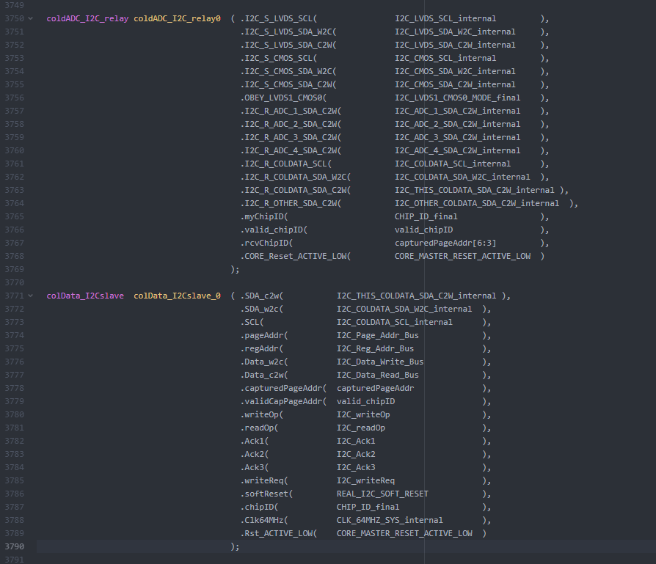
The I2C Gnat (bug)
capturedPageAddr
To the right, you will note SystemVerilog code that connects the I2C slave module to the I2C relay module.
Within COLDATA, I2C signals must be relayed to the subordinate COLDADC chips and also to the COLDATA on the bottom of the FEMB if you are the COLDATA on the top of the FEMB. This is the job of colData_I2C_relay.
valid_chipID

Slide 5
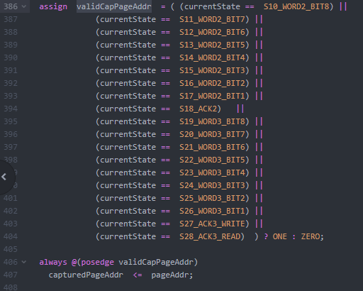
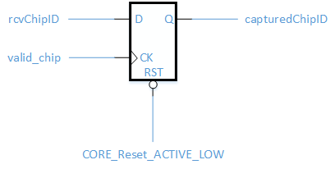
The I2C Gnat
In colData_I2Cslave
In colData_I2C_relay

Slide 6
The I2C Gnat
Unfortunately, this means that at any given time the capturedChipID within the I2C relay is the capturedChipID from the *last* I2C transaction.
Within the I2C relay, capturedChipID tells the relay which Serial Data Output to return to the I2C Master.
More unfortunately, for reasons of thoroughness, all I2C writes during simulations were writes followed immediately by reads. I thought I was being so clever. However, this meant that the last I2C address was always correct.
This shows that no matter how good UVM is, you still can get caught with a bad test.
This fix is very simple. The flip-flop in the I2C slave needs to be eliminated and UVM tests need to be added that don’t follow writes immediately with reads.

Slide 7
Requested Change #1: The Timestamp
The timestamp of COLDATAP2 is shown to the right. It is very straightforward. It is an 8-bit counter that simply counts 2MHz clock periods.
What is desired in the future is that the timestamp be expanded to 15-bits and count 64MHz clock periods.
A 16th bit will be reserved to be activated when a LARASIC Test Pulse is activated.

Slide 8
Requested Change #2: EFUSE User Interface
COLDATA intends to incorporate the CERN/IMEC/TSMC EFUSE IP Module for the purpose of uniquely identifying chips so that each one can be cataloged and so it can be known which chips are TOP or BOTTOM on the FEMB and which chips are on which FEMBs.
COLDATAP2 successfully incorporated an EFUSE module as a test, but we were unsatisfied with how complex it was to use the module. In order to even read the data, some signals needed to be high, others low and still others needed to change state.
In COLDATAP3, we will match the EFUSE module to a state machine activated by one of our fast commands so that, to the user, the EFUSE signals are simply available for use. EFUSE bits will be written during QC, after the chip passes acceptance tests.

Slide 9
Requested Change #3: The Frames
COLDATAP2
COLDATAP3
Successfully implemented 4 frame types – Frame Dummy, Frame-12, Frame-14 and Frame-15. These are not all necessary for the experiment.
Each frame began with a unique 8b10b control character.
1 byte of time stamp
Trailers combined K.28.5 with K.28.1
Frame-15 will be eliminated.
K.28.1 will be added at the start of all frames (start of frame becomes two bytes long)
2 bytes of time stamp
Trailers will only contain K.28.5
From a design perspective, these are all simplifications. It will take longer to modify the UVM testbench than it will to modify the design

Slide 10
Requested Change #4: Measurement of WIB Delay
A request was made to add a means of measuring the cable delay time between the WIB and FEMB.
COLDATA has many spare Fast Commands (specifically FastAct Commands).
In a manner identical to switching the COLDATA into LARASIC Inject mode, we would use a FastAct Command to switch the chip into a MEASURE_DELAY mode. This mode would timeout after a set period of time.
During the MEASURE_DELAY mode, the SDA_w2c would be relayed back to the SDA_c2w line. The time difference between an incoming and an outgoing pulse measured at the I2C Master provides the solution to the request.

Slide 11
Conclusions
COLDATAP2 can be considered a first-silicon success.
The UVM testbench was successful in uncovering a significant number of bugs.
There are 2 minor known problems and their solutions are simple and obvious.
There are 4 requests for modification for future versions. Again, the solutions are quite straightforward.

