Slide 1
COLDATA Design and Performance
David Christian

Slide 2
Outline
COLDATA Functionality
Design Methodology
Design Verification
Testing

Slide 3
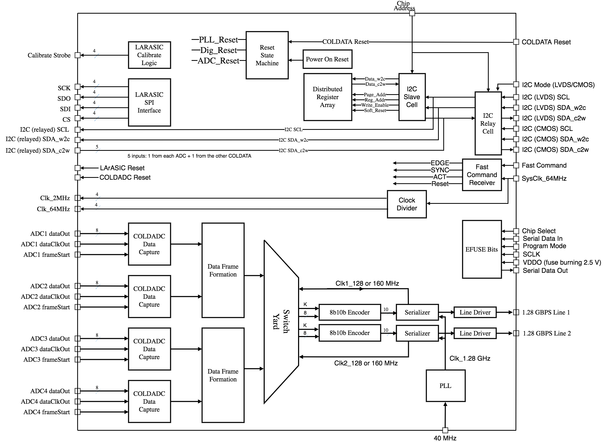
COLDATA ASIC Designers
Fermilab:
Jim Hoff
Davide Braga
Sandeep Miryala
SMU:
Xiaoran Wang
Ping Gui
SMU Block

Slide 4
COLDATA Functions
Configure and control 4 COLDADCs and 4 LArASICs
Accept data from 4 COLDADCs
Format ADC data (truncate to 12 or 14 bits) & pack into an array of 8-bit words
Combine packed arrays from pairs of ADCs into 2 output data frames
Encode the output data using 8b10b
Drive the output data to a WIB at 1.28 Gbps

Slide 5
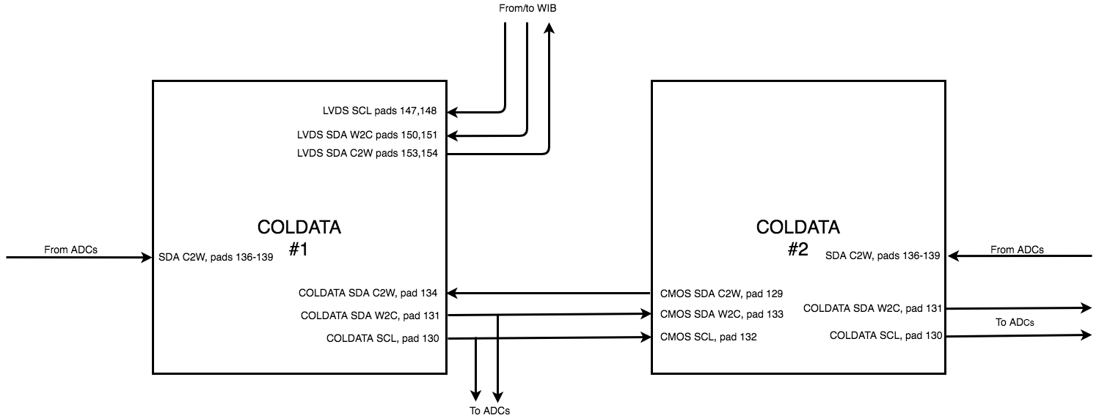
DUNE I2C
COLDATA uses an I2C-like protocol for control communications, with differences and simplifications implemented because the WIB and COLDATA are connected only by long cables.
LVDS signaling is used between COLDATA and the WIB
    Three lines are used rather than 2 (SCL, SDA_W2C, SDA_C2W)
  COLDATA relays I2C commands to other chips (ADCs, 2nd COLDATA) on the FEMB and relays responses from the other chips to the WIB.
CMOS signaling is used for I2C on the FEMB

Slide 6
Fast Commands
Fast Commands provide a way to control when a command to COLDATA is executed.
Fast commands are formatted as DC-balanced 8-bit words:
    WIB changes bits on 64 MHz clock rising edges, COLDATA latches bits on 64 MHz clock falling edges.
Code | Command | Comment
1111_0000 | Alert | Defines word boundary
1010_1010 | Idle
1110_0001 | Edge | Move edge of 2 MHz clock to next rising edge of 64 MHz clock
1110_0010 | Sync | Zero time stamp on next rising edge of 64 MHz
1110_0100 | Act | Perform action specified by ACT I2C register
1110_1000 | Reset | Reset COLDATA

Slide 7
PLL
Developed by SMU group, proven in 2 test chips
    PLL Test chip (2016) with multiple designs submitted by SMU
    CDP1 (2017) included single-path PLL (FNAL/SMU COLDATA test chip)
  For COLDATA, minimum length transistors were replaced with transistors with 90 nm long channels, and the circuit was simulated with a lower voltage rail (1.1V instead of 1.2V)
  Produces a 2.56 GHz clock (original plan was for a single 2.56 Gbps link)
  A single 1.28 GHz clock is provided to the two serializers
Notes:
PFD = Phase & Frequency Detector
LPF = Low Pass Filter
VCO = Voltage Controlled Oscillator

Slide 8
LArASIC Control
Serial Programming Interface (SPI)
    Used to configure LArASIC
    Includes programmable clock speed
    Included in CDP1
    Every SPI sequence for a LArASIC is issued twice & the pattern read back (the second time) is compared to the pattern sent. An error bit is set in one of the status registers if the two differ.
LArASIC Reset
    Active low CMOS signal
    Reset duration is programmable.
Test Pulse Control
    Periodic calibrations will be done using test pulses injected into LArASIC
    Fast Act command used to start and stop calibrations
    Registers control delay before first pulse as well as width and frequency of pulses

Slide 9
Data Capture and Frame Formation (step 1)
16-bit ADC data is transmitted on 4 lines at 64 MHz
    4 clock cycles to transmit 1 channel of data; 8 channels transmitted sequentially (32 cycles for all data latched at a given time = one ADC sample period)
    2 MHz clock in Data Capture blocks constructed from dataClkOut & frameStart
  16-bit data from a single ADC is truncated and packed into 8-bit words. A checksum is added, and data & checksum from a second ADC is appended.

Slide 10
Frame Formation (step 2) and 8b10b Encoding
The switchyard selects data from the frame formation block (12-bit format, for instance), adds the current timestamp, an identifying header, and a trailer to yield a 64-word frame.
At this point, another bit is associated with each 8-bit word to indicate which words are data are which are control characters.
A FIFO is used to cross from the 2 MHz clock domain to the serializer clock domain and 9-bit data (K+8) is shifted into the 8b10b encoder block using the serializer clock.
The encoder block keeps track of the running disparity and uses 2 lookup tables (one for each running disparity) to do the 8b10b encoding.
    If 8b10b encoding is bypassed, 8 bits of “raw data” are output, along with a 11 for control characters and 00 for data.
    The encoding block can also ignore the ADC data and output
      The sync word only (with or without 8b10b encoding)
      PRBS-7
      PRBS-15

Slide 11
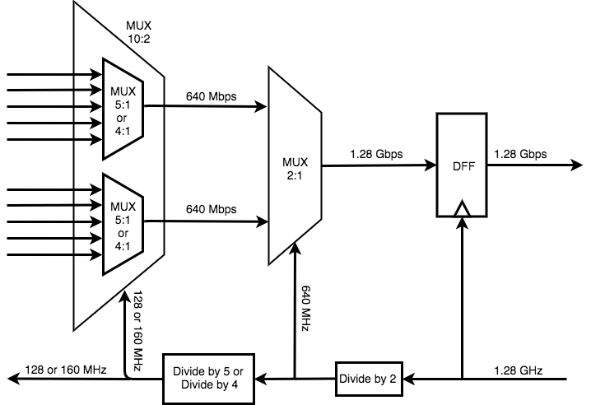
Serializer
The serializer uses a 2-stage multiplexer to combine either 10 bits input at 128 MHz or 8 bits input at 160 MHz to a serial stream of bits at 1.28 Gbps.
The 8-bit mode is included only for debugging purposes.

Slide 12
Line Driver
The 1.28 Gbps hybrid-mode line driver is designed with current-mode transmitter equalization and voltage-mode pre-emphasis to drive 25-35 meter long twin-axial cables. The current-mode transmitter equalization circuit uses a finite impulse response (FIR) filter to distort the data pulse and compensate for the large frequency-dependent signal loss over a long twinax cable with low dynamic power consumption. The voltage-mode main driver and pre-emphasis circuit uses source-series-terminated (SST) output stages to provide a large output voltage swing and low static power consumption.
The line-driver is highly programmable and can also be operated in a pure current-mode or a pure voltage-mode.

Slide 13
EFUSE Bits
COLDATA includes 32 bits of non-volatile memory that can be “written” by burning fuse links and can be copied to registers than are accessible via the I2C interface. These bits can be used to assign a serial number to each COLDATA ASIC.
    EFUSE circuit block was provided by CERN Foundry Services and has been used in a number of other chips.
    Somewhat awkward to use in the current prototype, because two external pads must be biased correctly and a third must make a logical transition before EFUSE bits can be transferred to I2C registers (more in Jim Hoff’s talk).

Slide 14
Resets
The COLDATA reset starts a state machine (clocked by 64 MHz)
    The PLL reset is released first
    After a wait period during which the PLL locks, the core logic reset is released
  A power-on reset circuit (driven by VDDcore) is included so that COLDATA comes up in a well defined state after a power cycle.
  The POR includes a Schmitt trigger for hysteresis and a test pad (slightly inside the pad ring) that can be used to disable the POR (never used).
  Duration of POR depends on temperature and on the VDD rise time.
    Minimum (room temp) = 240 microseconds
    Minimum (cold) = 1.1 milliseconds

Slide 15
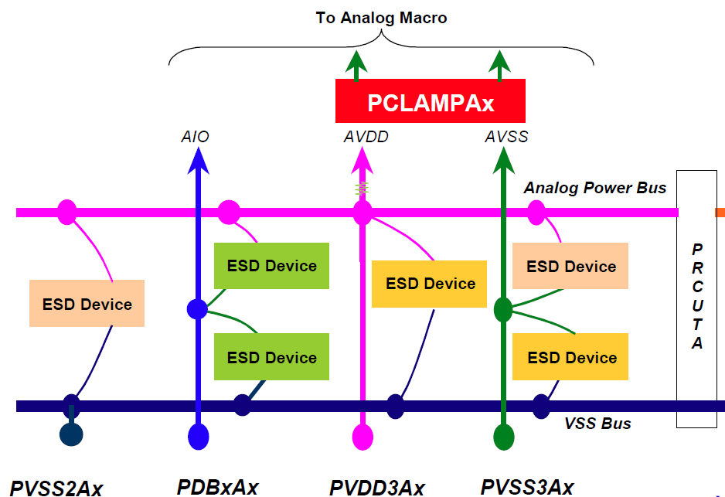
Power Domains & Pad Ring
ESD strategy follows TSMC’s guidelines
PADs are from TSMC’s standard library: tpan65lpnv2od3
One uninterrupted VSS for ESD in pad ring
For each power domain, active RC-clamp protection cells are used between VDD-VSS.
Signal pads only have passive diode protection to VDD/VSS (PDBx)
ESD protection rings in padring
A single common VSS
LArASIC Digital (1.8V)
SMU Analog (1.1V)
SMU Digital (1.1V)
Core (1.1V)
I/Os (2.25V)
PCLAMPA
PCLAMPAC
PCLAMPAC
PCLAMPAC
PCLAMPA
PDBxA
PVDD3A
PVSS2A
PDBxAC
PVDD3AC
PVSS2AC
PDBxAC
PVDD3AC
PVSS2AC
PDBxAC
PVDD3AC
PVSS2AC
PDBxA
PVDD3A
PVSS2A

Slide 16
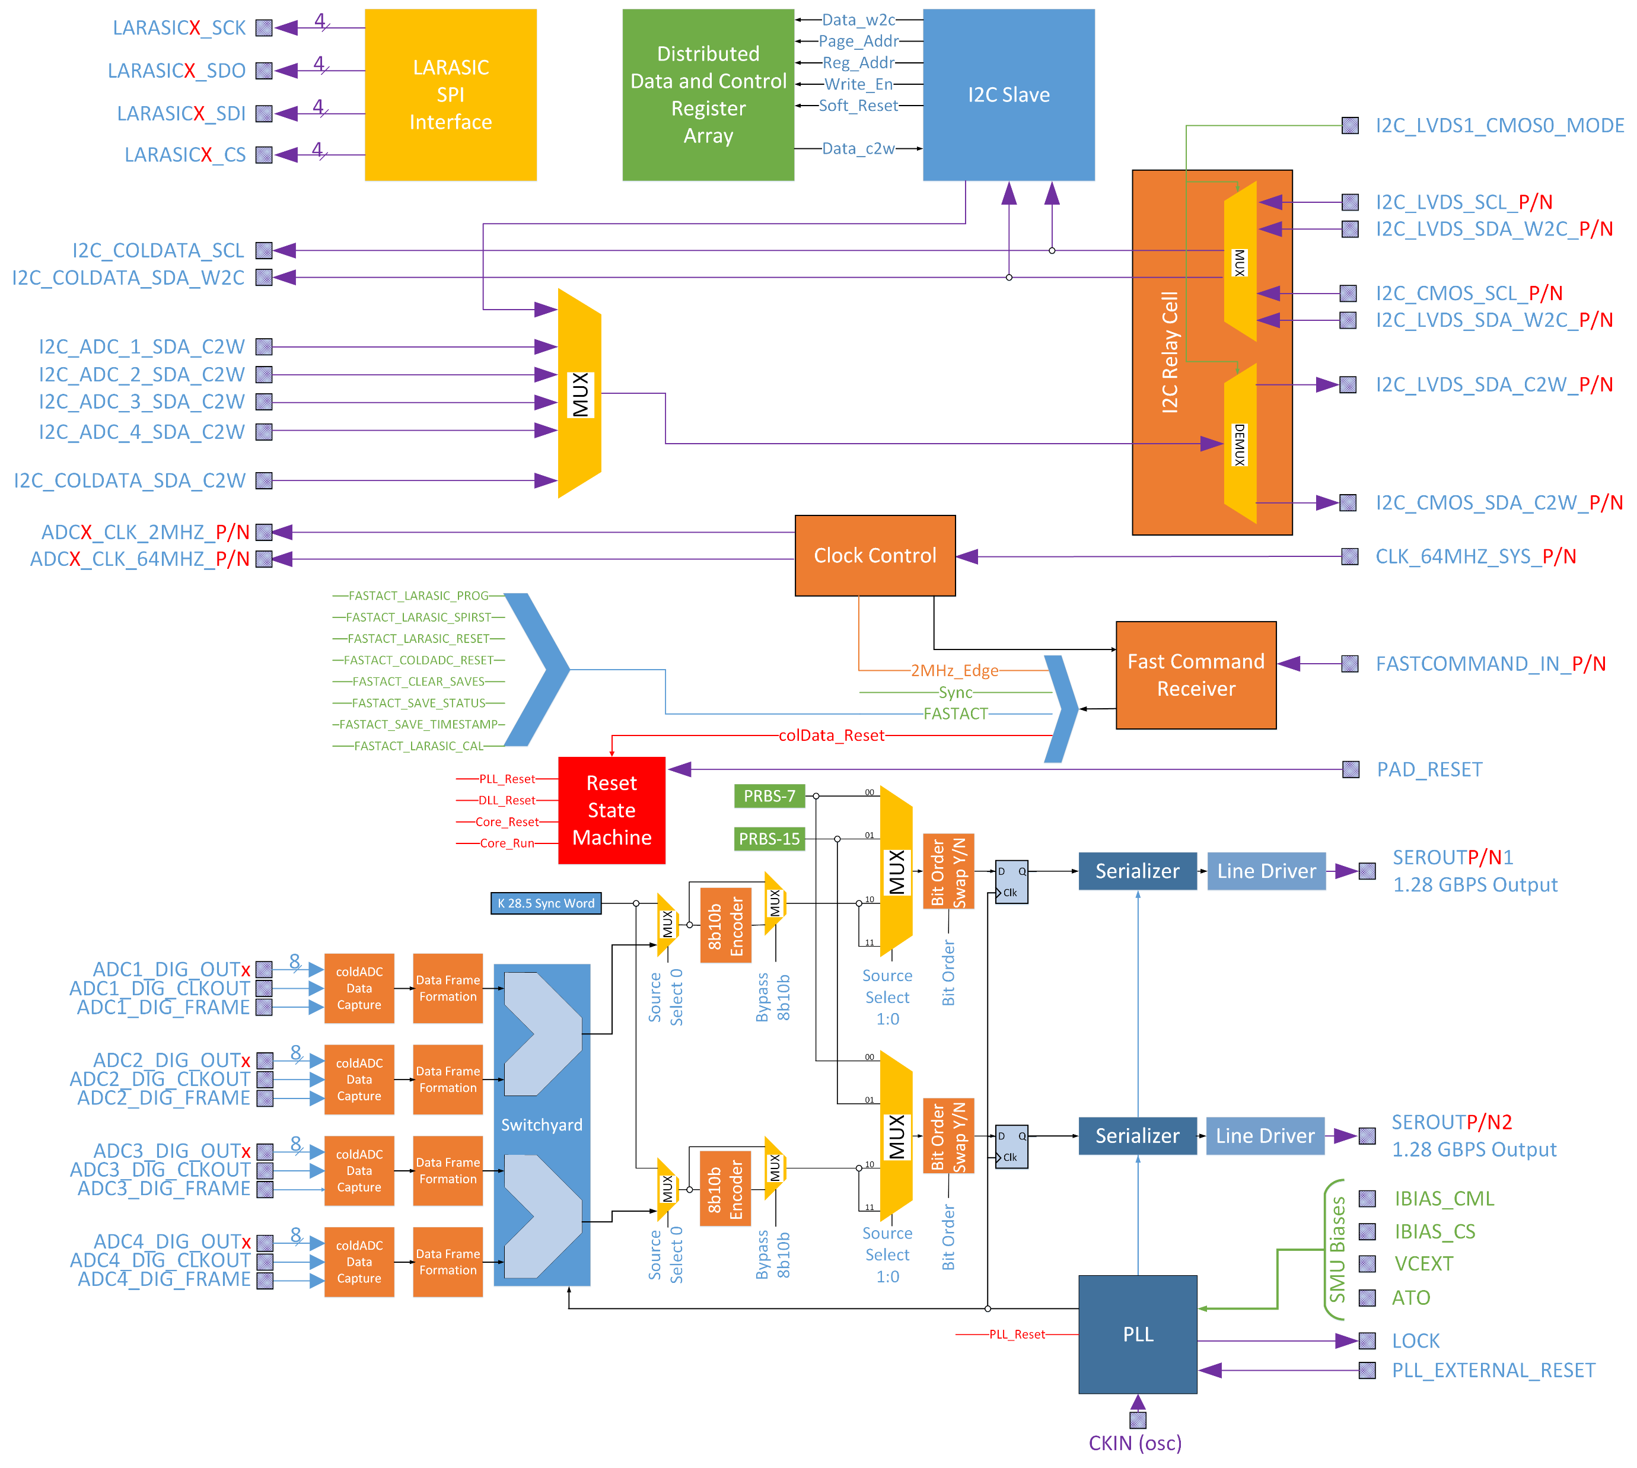
Digital-On-Top Design Methodology (slides from Jim Hoff)
Step 1
Begin with the block diagram.

Slide 17
Step 2:
We then separate out the SMU PLL, Serializer, and Line driver because they are pseudo-analog and will be designed via full-custom techniques using Virtuoso. This section includes its own pads. Eventually, an abstract will be created from this design for incorporation into the final PNR as a black box.
A simple behavioral model is created for COLDATA simulation

Slide 18
Step 3:
We then separate out all the IOs by functionality, origin or destination, type (e.g. CMOS, LVDS, etc) and power domain.
“Fake” modules of these IOs, at first, contain just simple behavioral models of the IO process (e.g. data driving, data reception, conversion from single ended to differential, etc.) Eventually, these fake modules contain anything necessary to ensure the functionality of the drivers and receivers (e.g. bias lines, unique power rails, etc.)
Some of these modules, like the SMU section, require full-custom design techniques and incorporation as black boxes.

Slide 19
Step 4:
This allows for the creation of a single module “COLDATAP2” (the outermost gold block) that instantiates these created IO and pseudo-analog modules (which is essential for the digital-on-top methodology) but allows the designer the freedom to model the functionality expressed in the green polygon.
The interfaces and the pinouts are defined at the beginning and are immediately made SACRED. No designer can change an interface or a pinout without the expressed approval of all other designers.

Slide 20
Advantages of Digital-On-Top Flow
The result is a set of modules that everyone (design, verification and PnR) are all working with and towards.
Testbenches for behavioral-level, gate-level and SDF-level simulations are, for all intents and purposes, identical.
Modifications necessary for PnR (like adding nodes for ESD protection or PAD-level power rails) are very simple and localized within the COLDATAP2 module. Their addition makes no change to the design effort or the verification effort.

Slide 21
Synthesis of Digital Logic and Place and Route
A custom library of standard cells (with minimum L = 90 nm) is used.
    Library originally created at U. Penn. & verified at Fermilab
    Timing characterization done at Fermilab using Cadence Liberate and SPICE models created by Logix (using measurements from a test chip)
      Includes corners for cryogenic temperature
      Updated in early 2019 to include lower voltage corners (1.0 V)
  Cadence Innovus is used for synthesis & PnR
    Pad ring and SMU block are laid out by hand
    Innovus does the rest

Slide 22
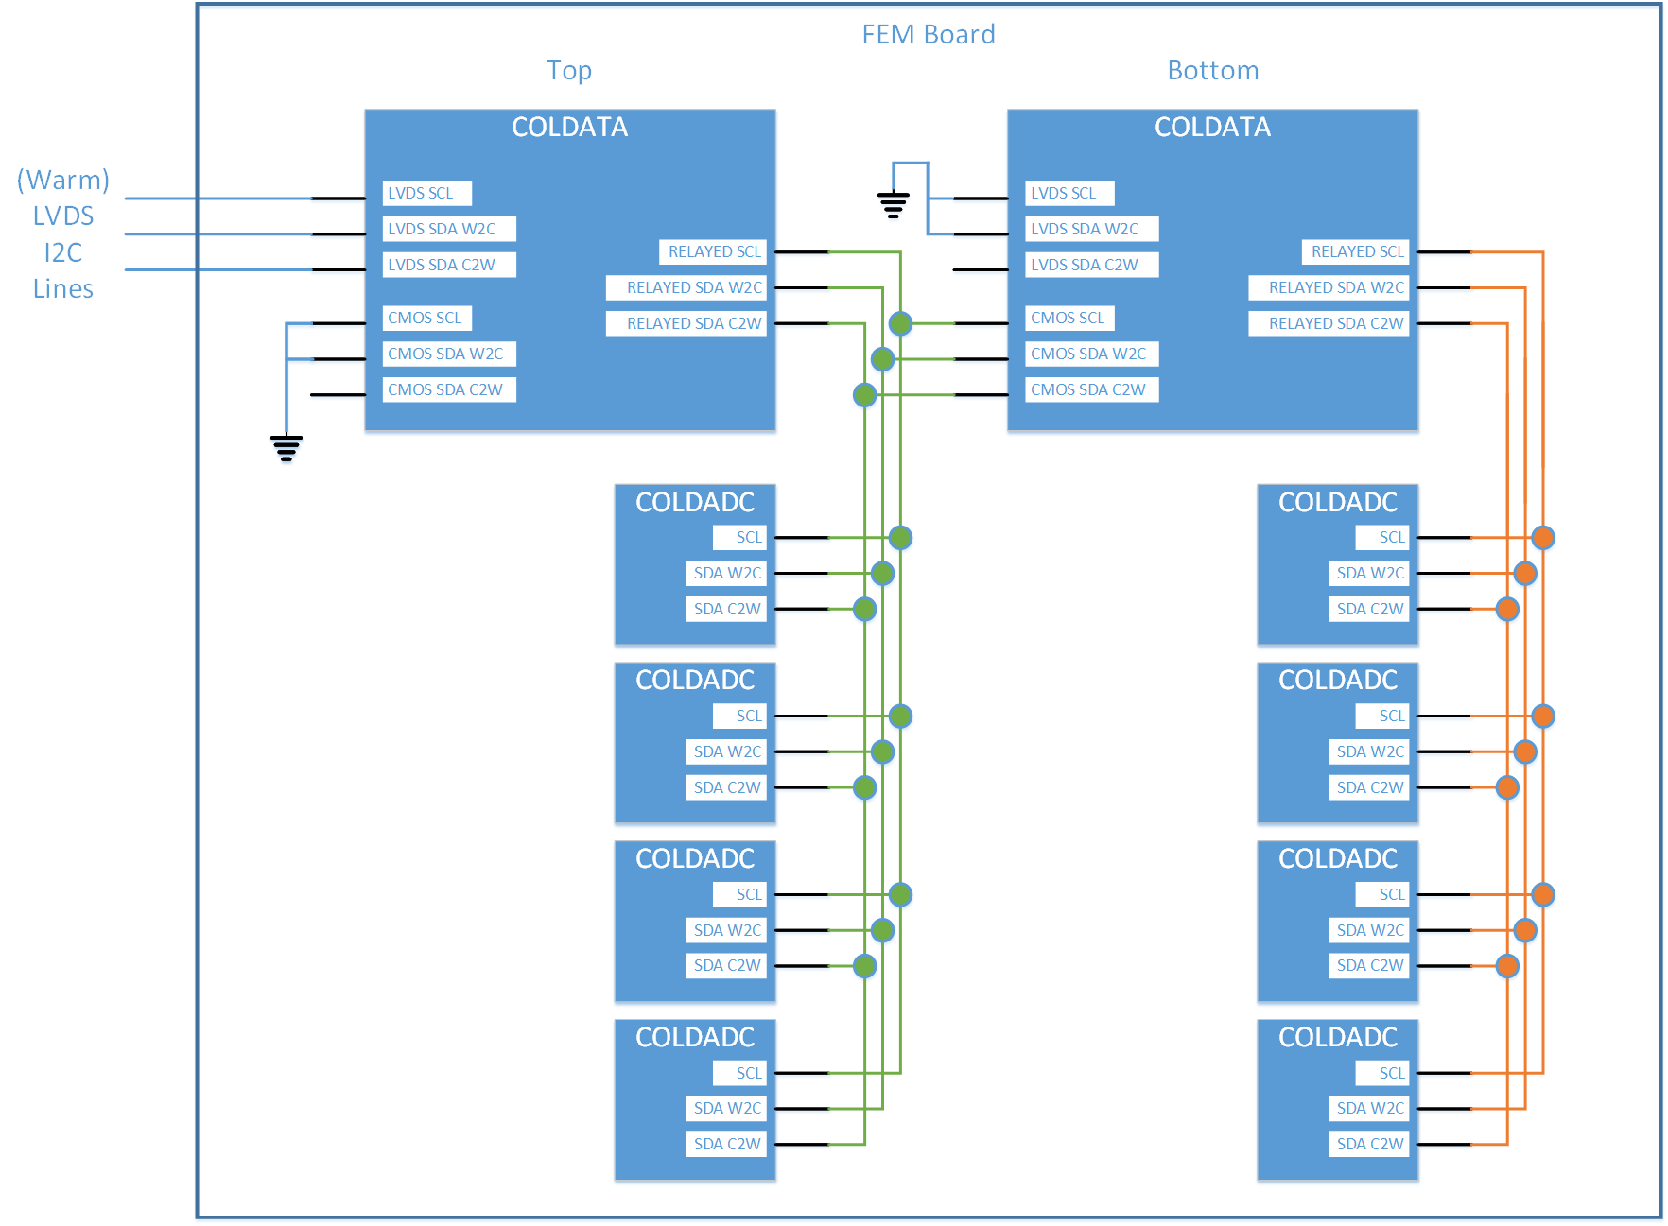
Verification: System Verilog/UVM
Step 1: A test bench was created to resemble a FEMB. It includes two COLDATAs (one Top one Bottom) and their four subordinate COLDADCs.
The COLDADC blocks use Verilog code from the COLDADC design.

Slide 23
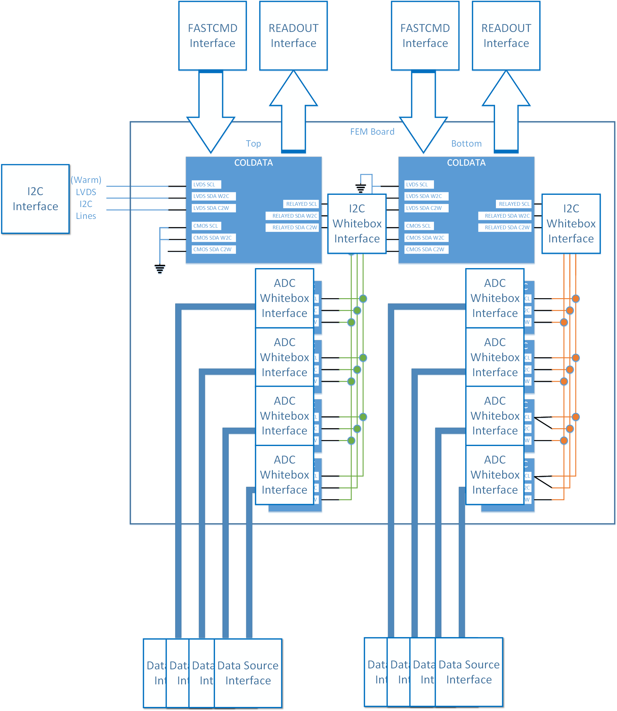
Step 2
On this is placed a series of interfaces to a UVM Hierarchy.
The I2C interface behaves like an I2C Master
The I2C Whitebox interfaces wiretap the sets of relayed I2C signals
The Data Source Interfaces drop random data into a model of the coldADC
The ADC Whitebox Interfaces record the outputs from the ADC that are driven to their COLDATA chips.
The FASTCMD Interface acts like the source of fast commands from the warm
Not shown is an interface that records the clock outputs to the ADCs and interfaces to the LARASICs

Slide 24
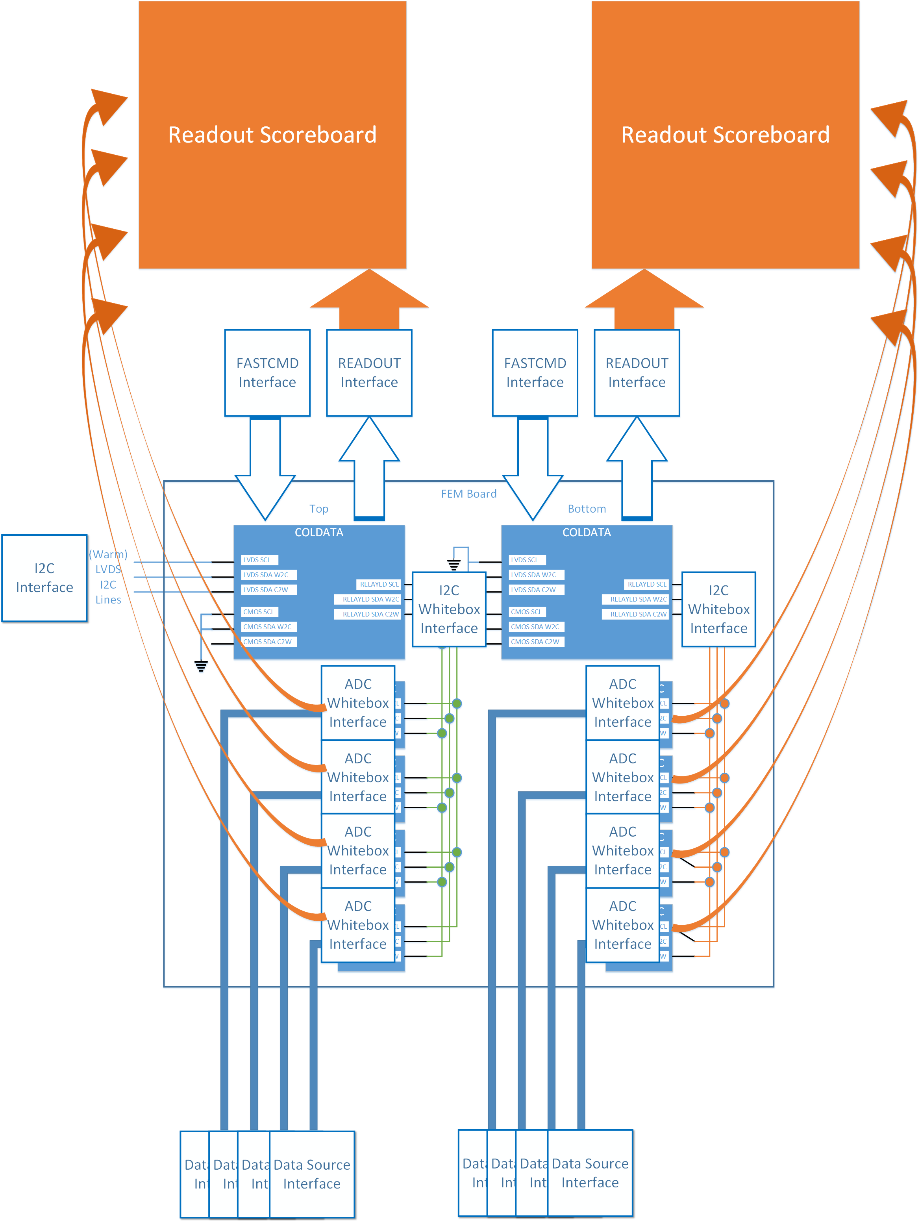
Step 3
Scoreboards record the outputs of the ADC and the chip outputs to make sure they are all correct.

Slide 25
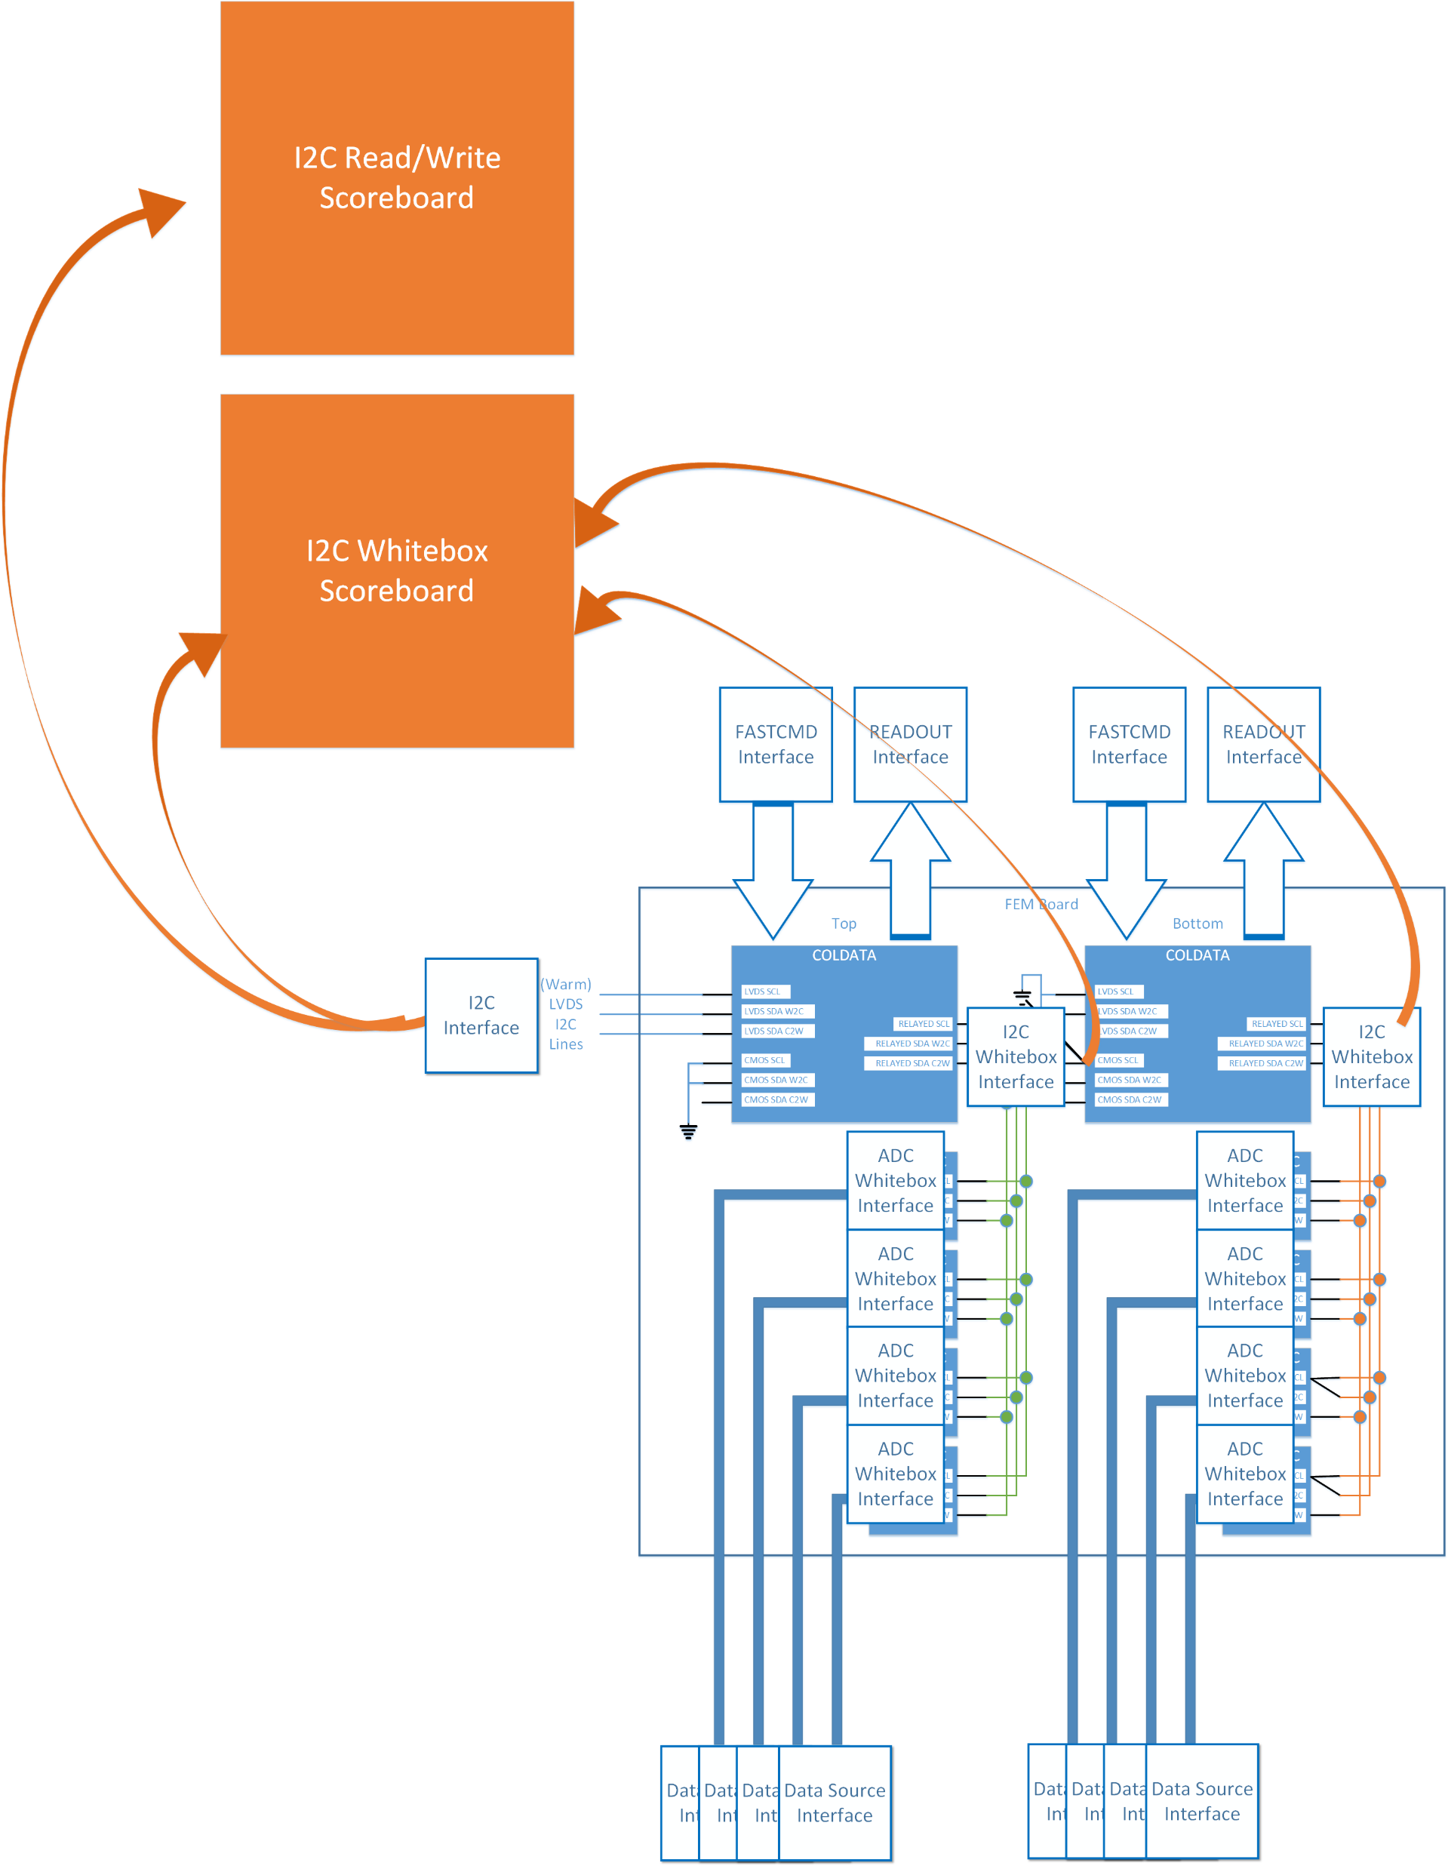
Step 3b: There are two types of I2C scoreboards
The I2C Whitebox Scoreboard confirms that the once and twice relayed signals from the Warm are transmitted correctly to the entire chip.
The I2C Read/Write Scoreboard verifies that writes followed by reads to the same register reveal that the original data was successfully written to the register. Curiously, one of the few errors on COLDATA can be traced to this. During testing it was noticed that a read from one chip followed by a read from a second chip would result in erroneous data. Because we always write and then read, we never noticed that there was an extra, unwanted flip-flop used to capture a valid chipID in the I2C relay.

Slide 26
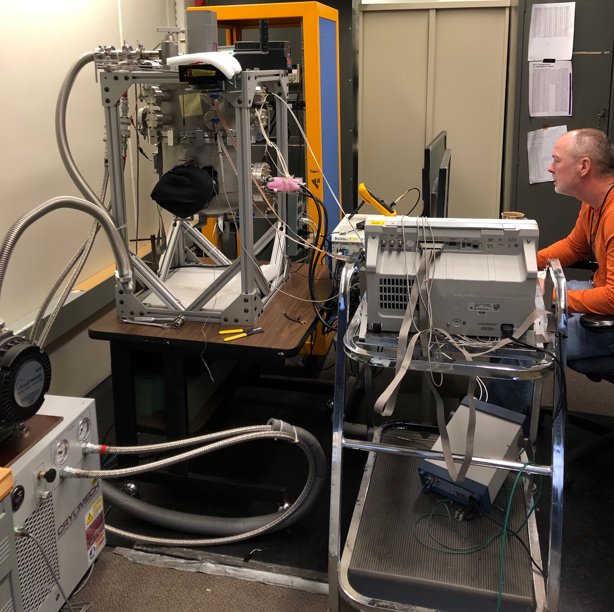
Testing: Cryocooler
Vacuum vessel + Cryomech PT-60
PT-60 = Closed-loop helium compressor + cold head
    Cools a copper cold-plate inside the vacuum vessel
    RTD & 75 Watt heater mounted on the cold-plate are used to maintain the set-to temperature (60 K – 250 K)
Vacuum vessel has 2 large penetrations and 12 small penetrations
    Typically, one large penetration is used as an inspection port & the other as a feedthrough for ribbon cables
    The small ports allow a variety of other signal feedthroughs.

Slide 27
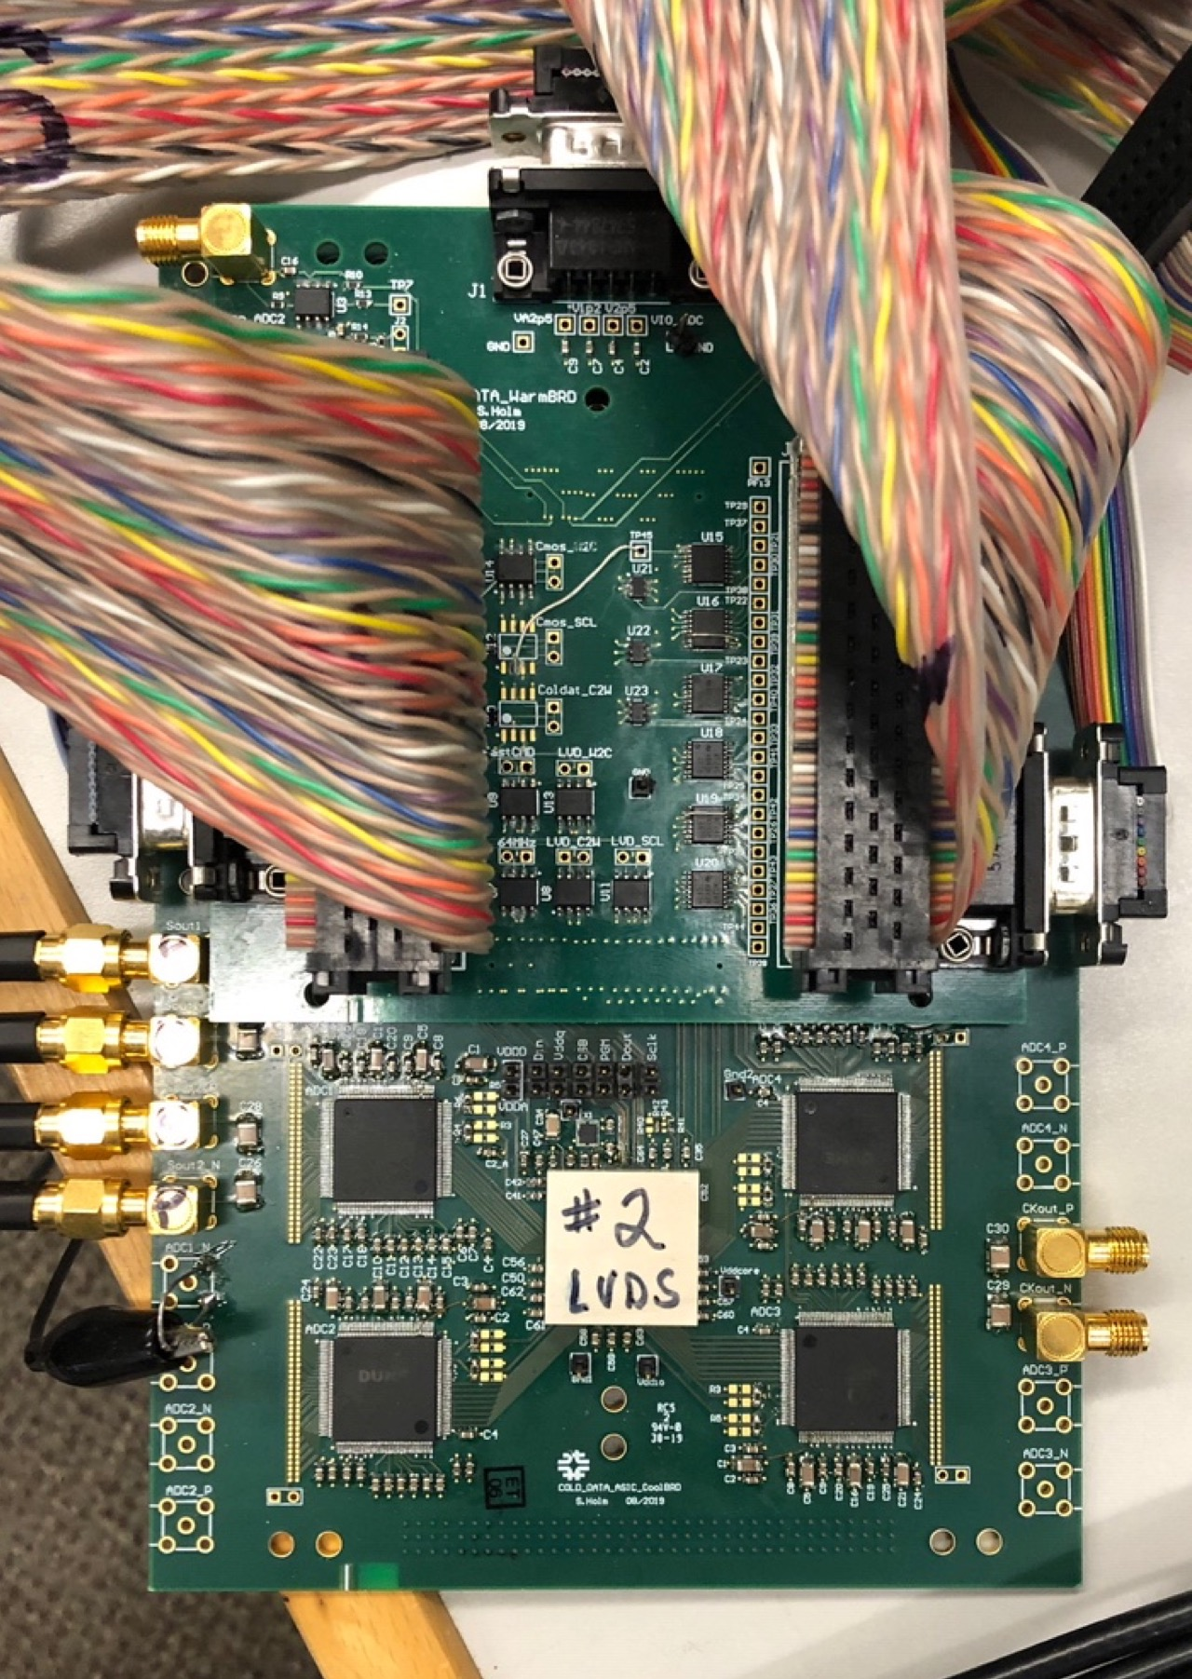
Test Hardware
Two test PCBs
    Cold board mounted on copper cold-plate
    Warm board mounted as mezzanine on the cold board
    RTDs measure temp on each
Cold board includes
    COLDATA (wire bonded to PCB)
    4 COLDADCs (PLCCs)
NI FPGA module & PS modules
Tektronix DSA 724004C (33 GHz analog bandwidth, 100 Gsps)

Slide 28
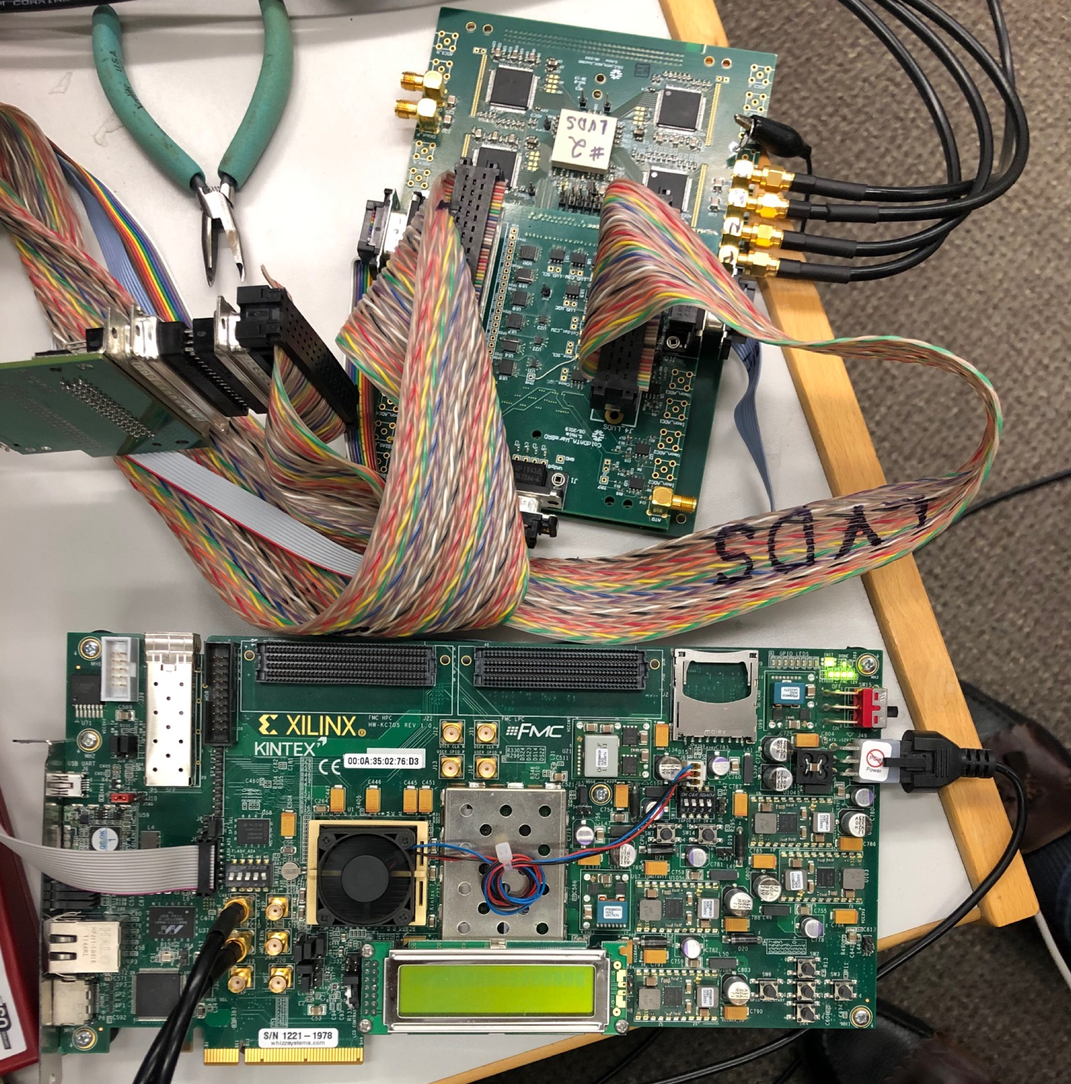
Test Hardware
Cold tests of long cables done using LN2
Bit error rate test done using Xilinx KC705 evaluation kit (USB connection to NI PC)

Slide 29
Functional tests
Clock Divider | 2 MHz clock is produced
I2C Communications | All I2C blocks operate as intended except when the first command to a chip address is a read command. All COLDATA registers and attached ADC registers can be written and read. COLDATA responds as intended to all control registers.
Power On Reset | Operates as designed; registers are initialized with expected default values.
Fast Command Receiver | All commands are interpreted correctly and the appropriate action is performed.
PLL | Fails to lock with VDDA=1.1V at room temperature. Operates properly at 1.2V. Operates as designed when cold.
ADC Data Path | All circuit blocks operate as designed. All output options have been verified. 8b10b encoding reverses bit order, so R3(page1) must be set to 0x2B in normal operation (default value is 0x28).

Slide 30
ADC and LArASIC Control
ADC control verified by examining test points on cold board & observing ADC behavior
LArASIC control functions verified by examining test points

Slide 31
Output Data Format
Verified first using the Tektronix DSA 724004C
    Verified all output options
      Sync pattern
      PRBS-7 & PRBS-15
      All data frame types
        Including data from ADCs
      With/without 8b10b
      10-bit and 8-bit output
Next, a Xilinx KC705 evaluation kit was used to confirm the format of the data frames (thanks to Jamieson Olsen for the KC705 and microcode to receive data frames).

Slide 32
Problems Discovered
I2C Relay
    All I2C registers can be written and read, but if the first command sent to a chip is a read command, the response from COLDATA is “0x5A.” For instance, if one writes a register in the COLDATA and then tries to read a register in one of the COLDADCs, the read is unsuccessful. If one issues the read again, the correct response is returned. The problem has been located in the Verilog of the I2C Relay Cell and it will be fixed for the next submission.
PLL at room temperature
    The PLL will not lock at room temperature if VDDA is set to 1.1 V (as planned). The PLL does lock at room temperature if VDDA is raised to ~1.17 V. The PLL locks as expected at liquid argon temperature. This problem is caused by insufficient current flowing through the VCO at room temperature. After extensive simulation we have settled on two changes which will be made for the next submission.

Slide 33
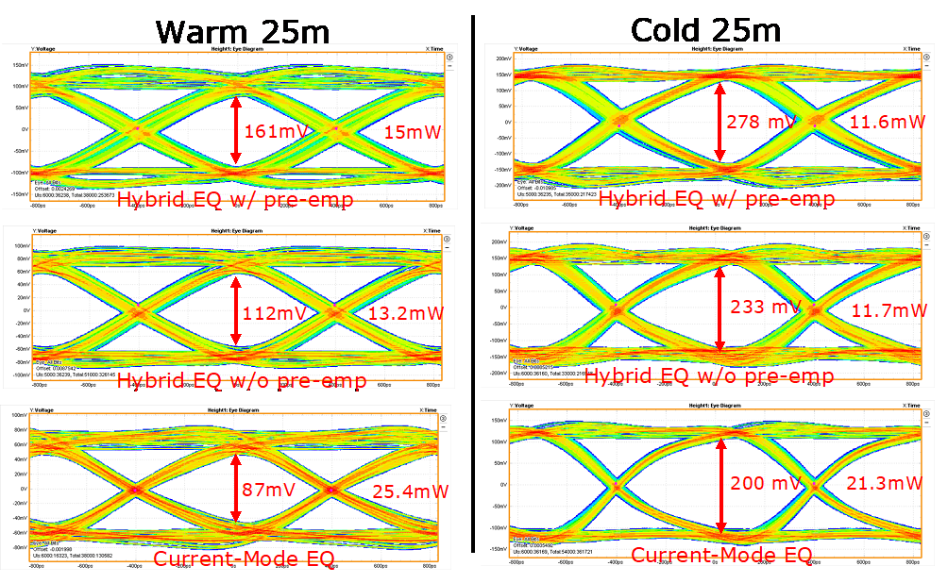
Optimal settings for PLL & Line Drivers
Optimal PLL settings were determined by monitoring the PLL test outputs (including the recovered clock) using the high speed oscilloscope.
The high speed scope was also used to create eye diagrams to determine optimal line driver settings.

Slide 34
Bit Error Rate
PRBS-15 used for BER measurement (should be worse than data frames because it is less well DC balanced than 8b10b encoded data)
Output connection: PCB to 2 short SMA cables to spool w/25 m Samtec twinax to 2 short SMA cables to KC705.
Test performed at room temperature (much less signal degradation when cable is cold).
    COLDATA line drivers configured to optimally drive 25m warm twinax.
PRBS-15 recognized by firmware provided with evaluation kit.
    Evaluation software run on NI PC (USB connection from PC to KC705) displays # of bits received, # of errors, etc.

Slide 35
BER Test Result
Proper operation verified:
    PRBS-7 recognized when PRBS-7 is output
    PRBS-15 recognized when PRBS-15 is output
    Neither recognized if bit order is reversed
    Errors counted when one of two SMA cable connections is loosened
Test run for ~3 weeks:
    2.38 E15 bits received, 0 errors.
    BER < 10⁻¹⁵ (90% confidence level)

Slide 36
Summary
COLDATAP2 was a very successful prototype.
We have a high degree of confidence that next prototype will satisfy all DUNE requirements.

Slide 37
Backup Slides

Slide 38
ESD Protection Cells (C in name indicates core = 1.2V)
Local VDD
Local VDD
PVSS2A=PVSS2AC
signal in
PDBxA=PDBxAC
VSSESD in
VSSESD
VSSESD
Local VDD
PVSS3A=PVSS3AC
VSS in
VSSESD

