Slide 1
Gianpaolo Carosi
January 25th, 2021

Slide 2

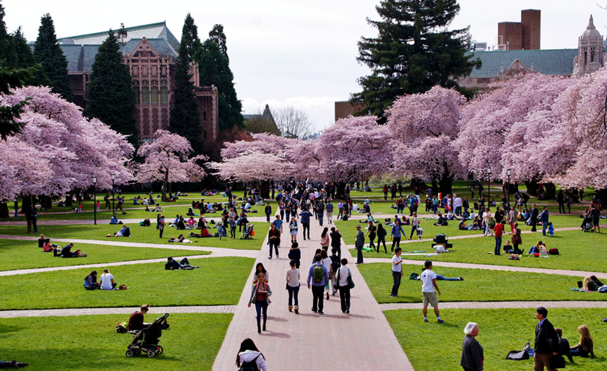

Welcome
Axions are a compelling dark matter candidate with a vibrant and growing community
Workshop Goals:
Explore the current status of the axion field
  Theoretical developments
  Astrophysical limits
  Status of current experimental efforts
  New Concepts
Sponsored by generous contribution from the Heising-Simons Foundation
Originally planned for in-person workshop at the University of Washington in March 2020 (derailed due to Covid-19). Switched to online format
UW in spring is great. Another experience ruined by Covid-19!

Slide 3


Meeting Logistics
Help available any time during the workshop hours
Assistance with logging into Zoom, accessing Indico site, uploading talks, etc
University of Washington Staff available to help
Email: beyond_gen_2@uw.edu
Phone: 1-206-543-4082
Workshop Schedule on Indico: https://indico.fnal.gov/event/22434/
** All times posted on the website are Pacific Standard Time Zone**
Morning sessions (7-10 am PST) and Afternoon (4-7 pm PST)
Note: No afternoon session on Tuesday & Wed morning goes to 11 am PST
Thursday afternoon: Whitepaper discussion and writing (look towards Snowmass restarting)
Zoom used for all the meeting:
https://washington.zoom.us/j/98926070010?pwd=Y21DeEdaQlNzb0U5Rlp3UVR5d3NOQT09
Meeting ID: 989 2606 0010
Passcode: 915860

Slide 4
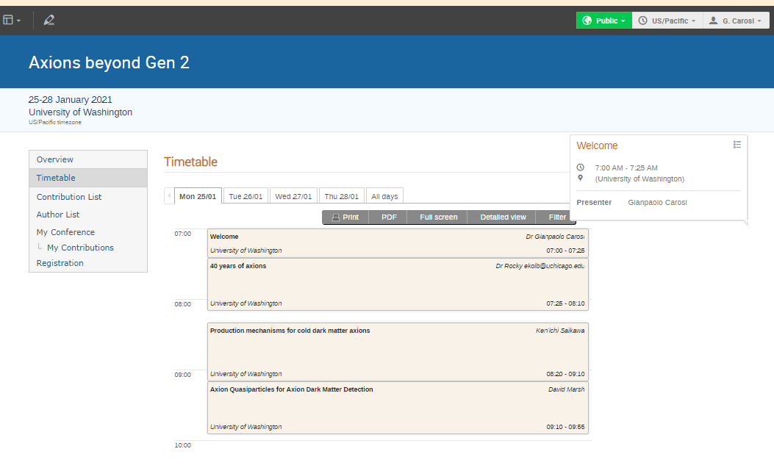
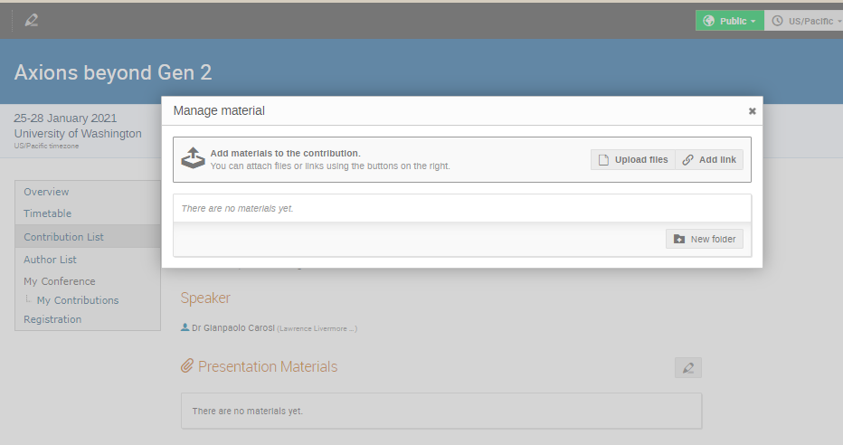
Meeting Logistics: Schedule and Talk Uploading
Workshop Schedule on Indico: https://indico.fnal.gov/event/22434/
Please upload your talk ahead of time (directly or by emailing it to beyondgen2@uw.edu)
Talks will be recorded and uploaded after each session.
Please let us know ahead of time if you would prefer your talk not to be recorded.
Click “Contribution Details” in Timetable
Click “Upload Files” in the “Manage material” section of your talk

Slide 5
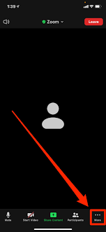
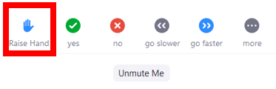
Meeting Etiquette
Would like to preserve the “Workshop” like spirit (lots of discussion)
Talks are between 25-30 min with 20-15 min of discussion
Each session has a moderator.
Please make sure your line is muted unless called upon during discussion (trying to minimize cross-talk)
Please use the chat feature to add questions during the talk.
At the end of the talk the Moderator will read the questions.
  For follow up questions please use “raise hand” feature of Zoom and wait until the Moderator calls you
Please keep all comments and discussions on topic
Any offensive comments or images will result in the attendee being dropped immediately!

Slide 6
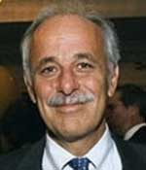
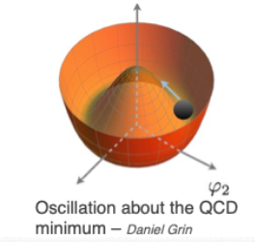
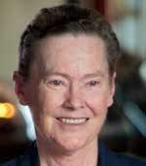
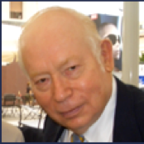

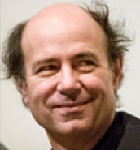
Who ordered the axion?
Why the neutron doesn’t have a measurable electric dipole
Peccei & Quinn: Postulated new U(1) symmetry that would be spontaneously broken.
Weinberg & Wilczek: A new Goldstone boson (dubbed the axion)
Remnant axion vacuum expectation nulls QCD CP violation.
Only free parameter: Symmetry breaking scale (f_{a})
“Invisible Axion”: f_{a} >> Weak Scale (dark matter candidate)
Two general classes of models
  KSVZ [Kim (1979), Shifman, Vainshtein, Sakharov (1980)]:
    Couples to leptons
  DFSZ [Dine, Fischler, Srednicki (1981), Zhitnitsky (1980)]
    Couples to quarks & leptons
Pierre Sikivie’s initial papers on a detection strategy began the search in earnest!
Roberto Peccei
1942-2020
Helen Quinn
Steven Weinberg
Pierre Sikivie
Frank Wilczek

Slide 7
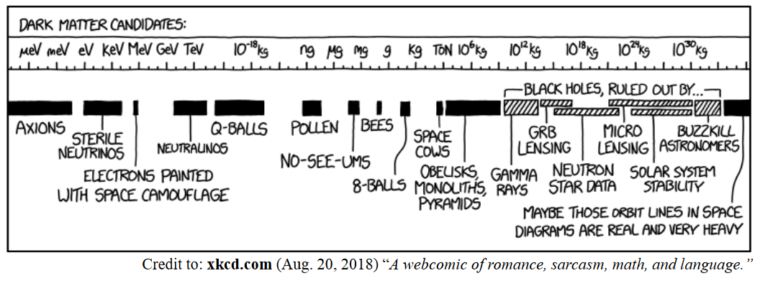
A Dark Matter Candidate like no other

Slide 8
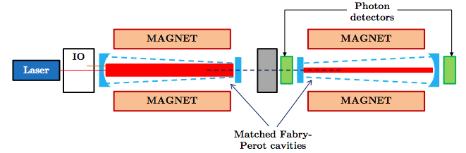
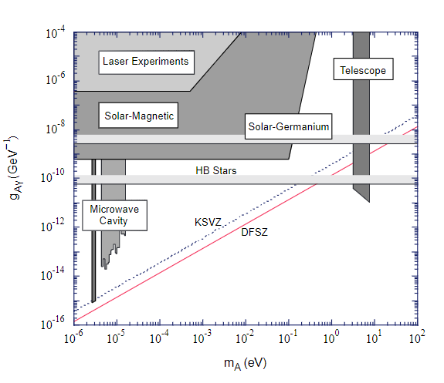
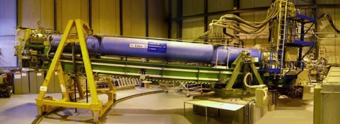
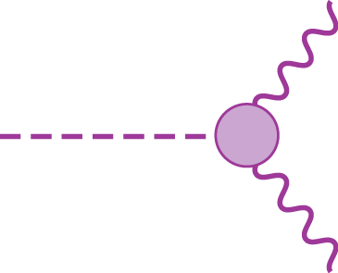
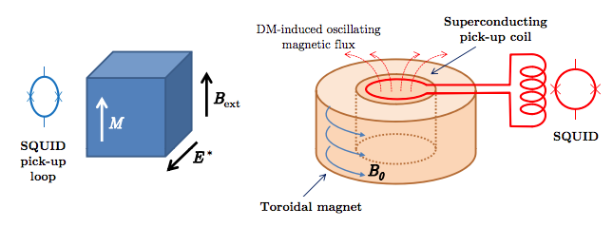
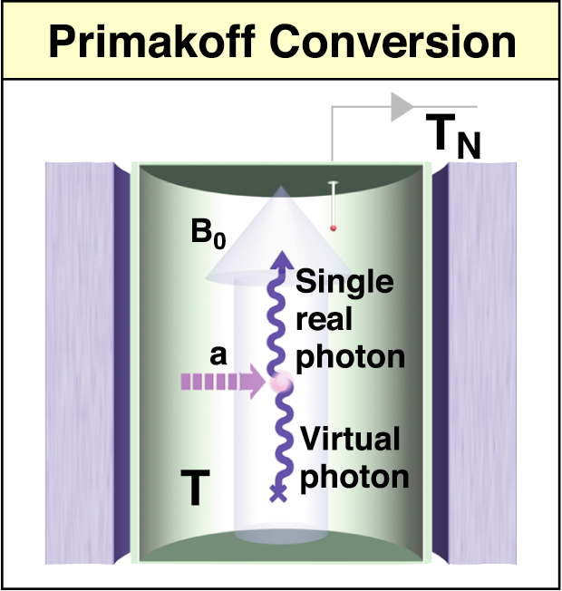
Variety of experiments proposed
Laboratory Experiments: Lasers (light shining through walls) & 5th force experiments
Particle Data Group: 2000
Solar Axions
axion
X-ray
CAST
QCD Axion
g_{agg}
Axions from Dark Matter (Haloscopes, NMR, etc)

Slide 9
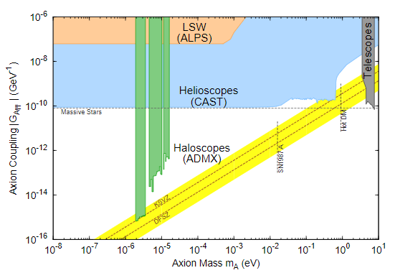
Variety of experiments proposed
Laboratory Experiments: Lasers (light shining through walls) & 5th force experiments
Particle Data Group: 2014
Solar Axions
axion
X-ray
CAST
QCD Axion
g_{agg}
Axions from Dark Matter (Haloscopes, NMR, etc)

Slide 10
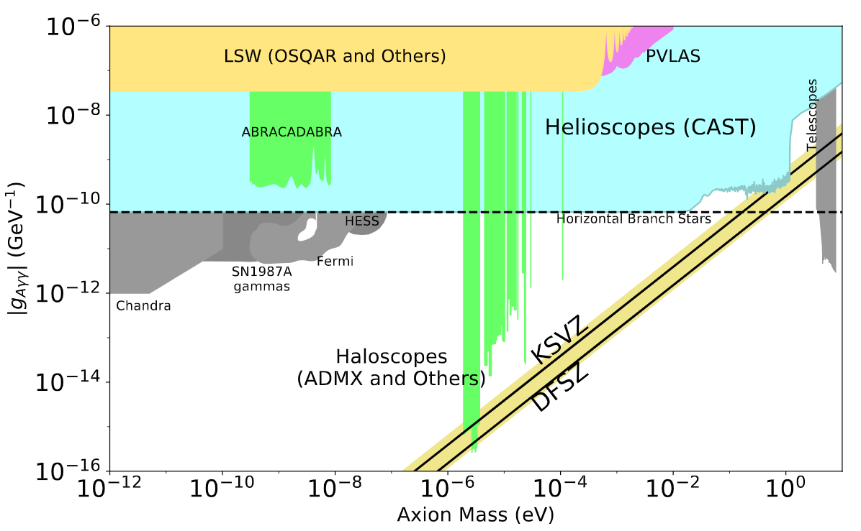
Variety of experiments proposed
Laboratory Experiments: Lasers (light shining through walls) & 5th force experiments
Particle Data Group: 2019
Solar Axions
axion
X-ray
QCD Axion
CAST
Plenty of open parameter space
g_{agg}
Axions from Dark Matter (Haloscopes, NMR, etc)

Slide 11
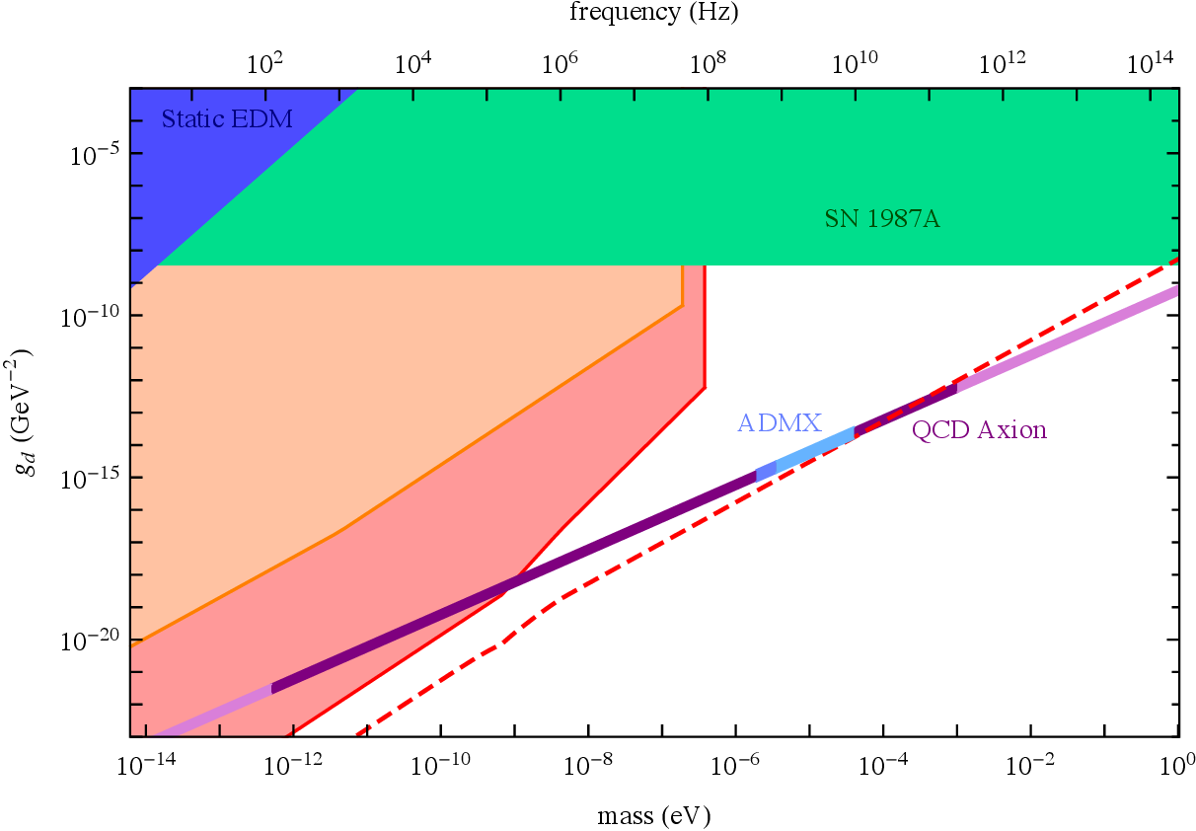
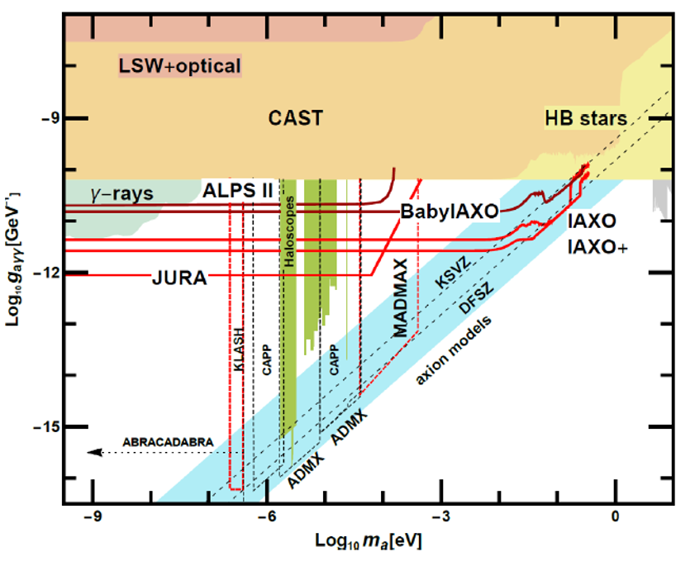
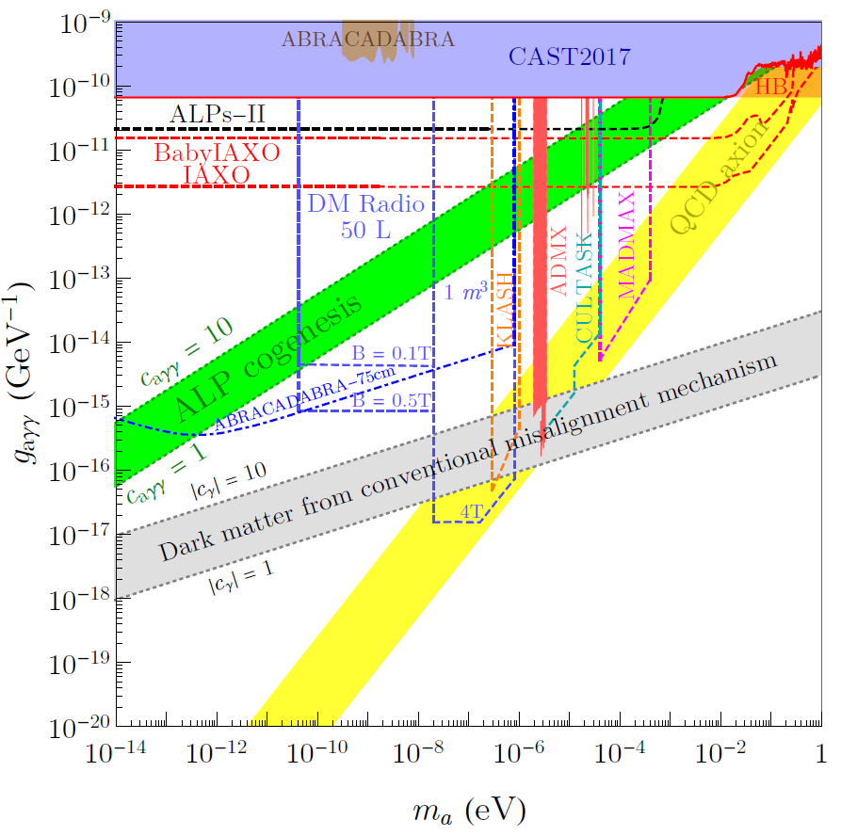
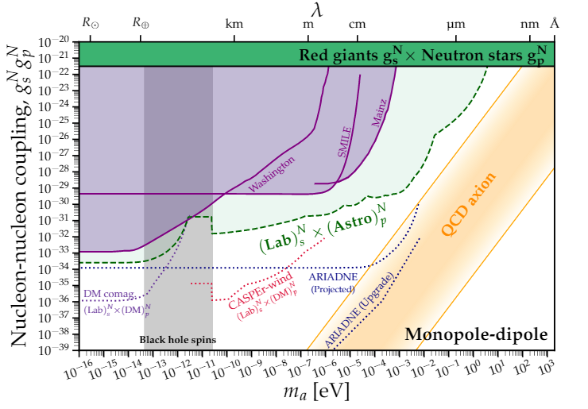
New ideas are rapidly being generated and prototyped
Bright future for axion research!
Please stay for the Whitepaper writing discussion on Thursday afternoon.

Slide 12
Gianpaolo Carosi
January 25th, 2021

