Slide 1
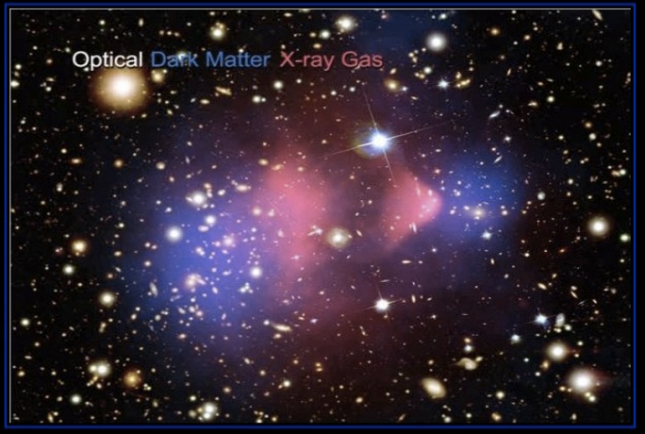
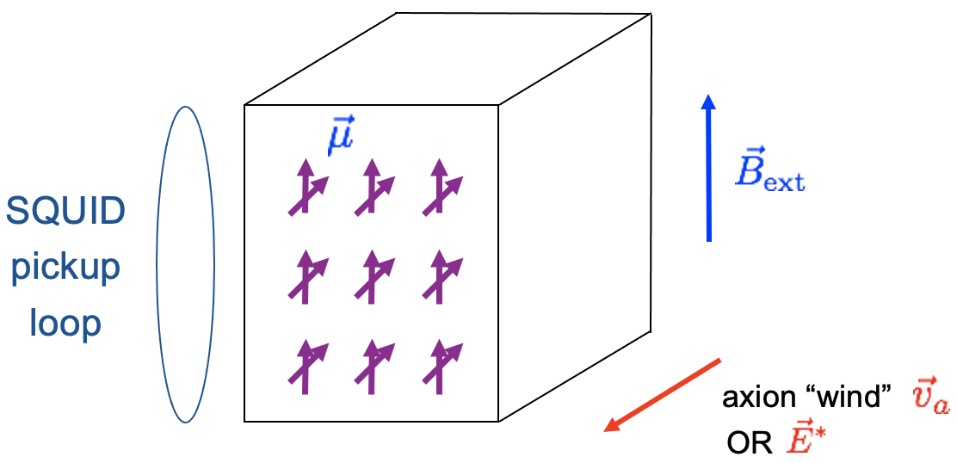
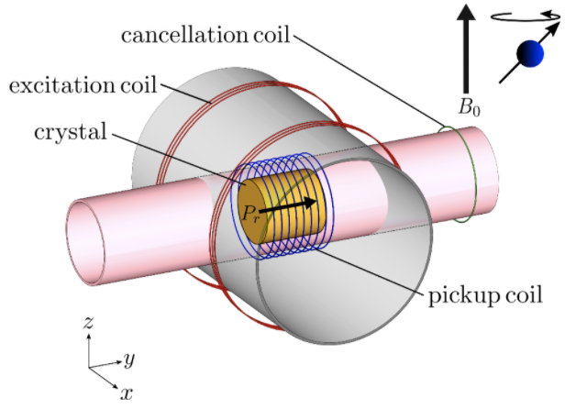
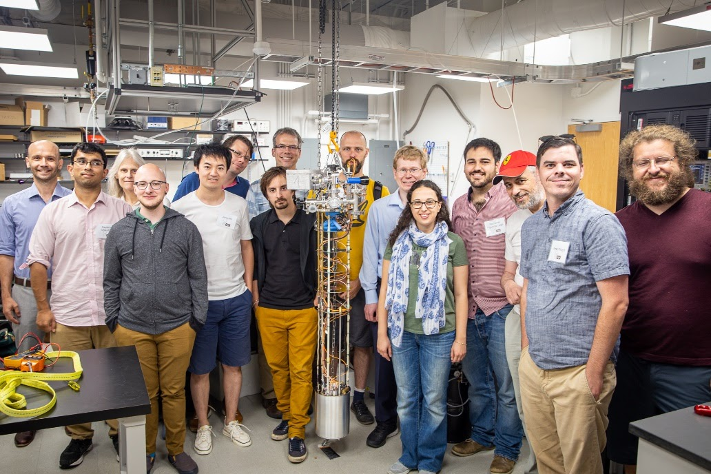
Cosmic Axion Spin-Precession Experiment(s)
For the CASPEr collaboration: Dmitry Budker
Helmholtz Institute, Johannes Gutenberg University, Mainz;
Department of Physics, UC Berkeley

Slide 2
How to search for Axions (ALPs) ?
Axion (ALP) Interactions
Gravity
+
Gauge Fields
Fermions
axion field amplitude
symmetry breaking scale
nEDM, HfF⁺,…
CASPEr-E
GNOME, QUAX, nEDM, comag,…
CASPEr-grad
Most Searches,
DM radio
2
Notes:
Concentrate on the electric and gradient couplings

Slide 3
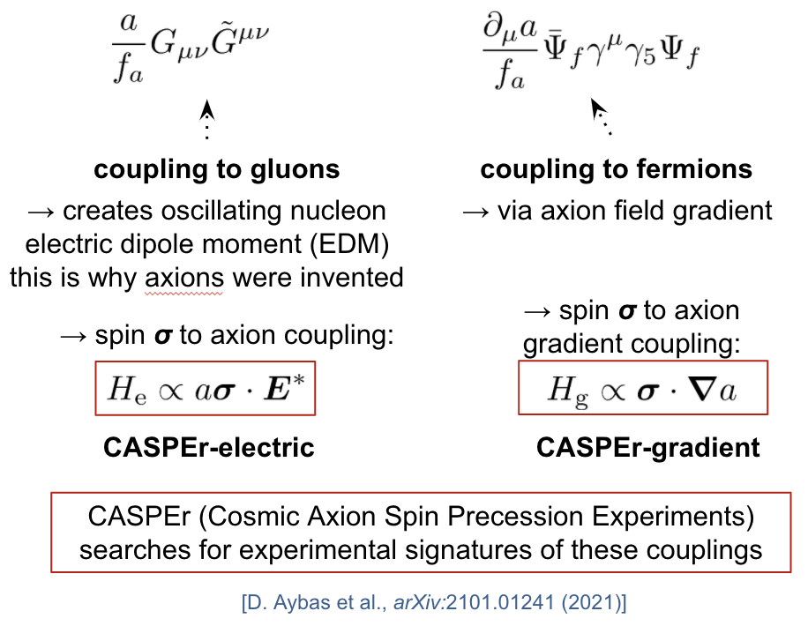
Nonrelativistic forms
A. Sushkov

Slide 4
CASPEr Experiments
CASPEr-E
(also grad)
Boston
High-field
Low-field
ZULF
CASPEr-grad
(also E ?)
Mainz
Comagnetometer
Sidebands
Related Experiments
Maser
Spin Amplifier
Hefei
Also: GNOME, WRESL, SHAFT, …
4
Notes:
Results! Name the PI and when the results were/will be published

Slide 5
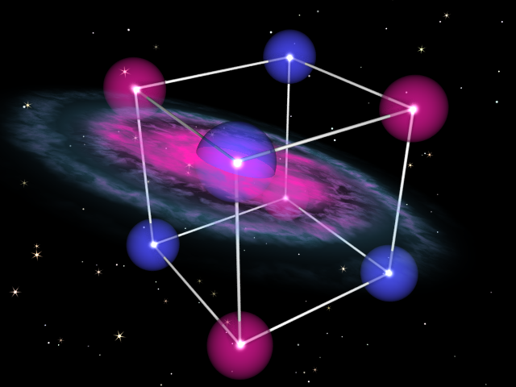
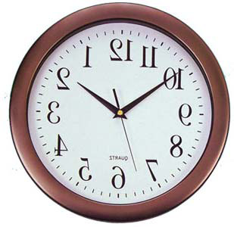
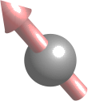
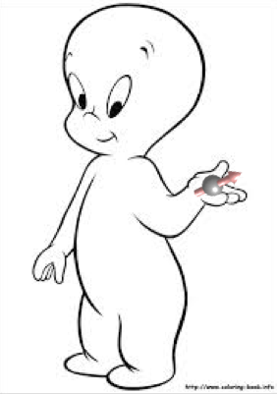
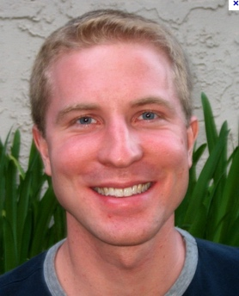
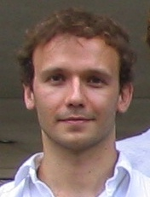
CASPEr
ADMX
10² Hz
10⁴ Hz
10⁶ Hz
10⁸ Hz
10¹⁰ Hz
10¹² Hz
axion mass (frequency)
Cosmic Axion Spin Precession Experiment (CASPEr)
Proposal:
Peter Graham
Surjeet Rajendran
Alex Sushkov
Micah Ledbetter
Dmitry Budker
PRD 88 (2013) arXiv:1306.6088,
PRX (2014) arxXiv:1306.6089,
PRD 84 (2011) arXiv:1101.2691

Slide 6
Nuclear Magnetic Resonance (NMR)
Resonance:

Slide 7
CASPEr
Inductive or
SQUID
pickup
loop
axion gradient
OR
Larmor frequency = axion mass ➔ resonant enhancement
SQUID measures resulting transverse magnetization
Example materials: liquid ¹²⁹Xe, ferroelectric PbTiO3
Notes:
Two ways to search for axions: CASPEr Electric and CASPEr Wind
CASPEr-E: Boston; CASPEr-grads: Mainz; R&D: Berkeley

Slide 8
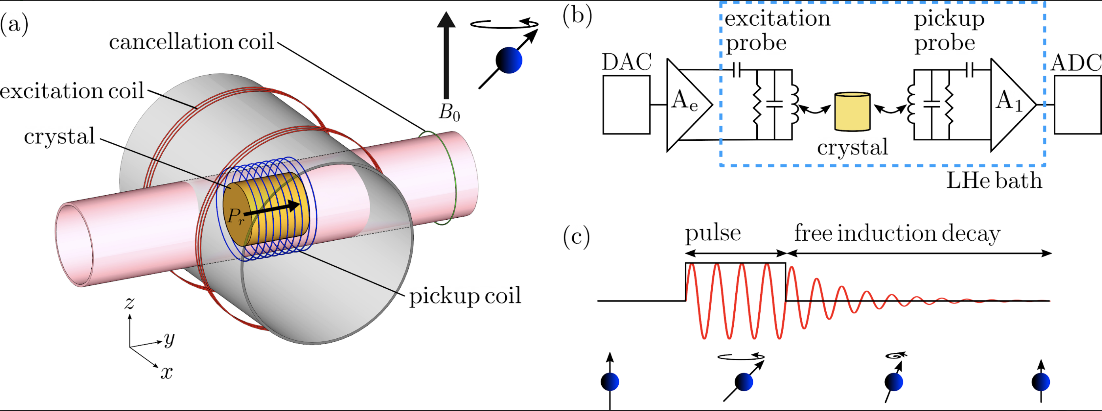
CASPEr-Boston
Deniz Aybas, et al., arXiv:2101.01241 (2021)

Slide 9
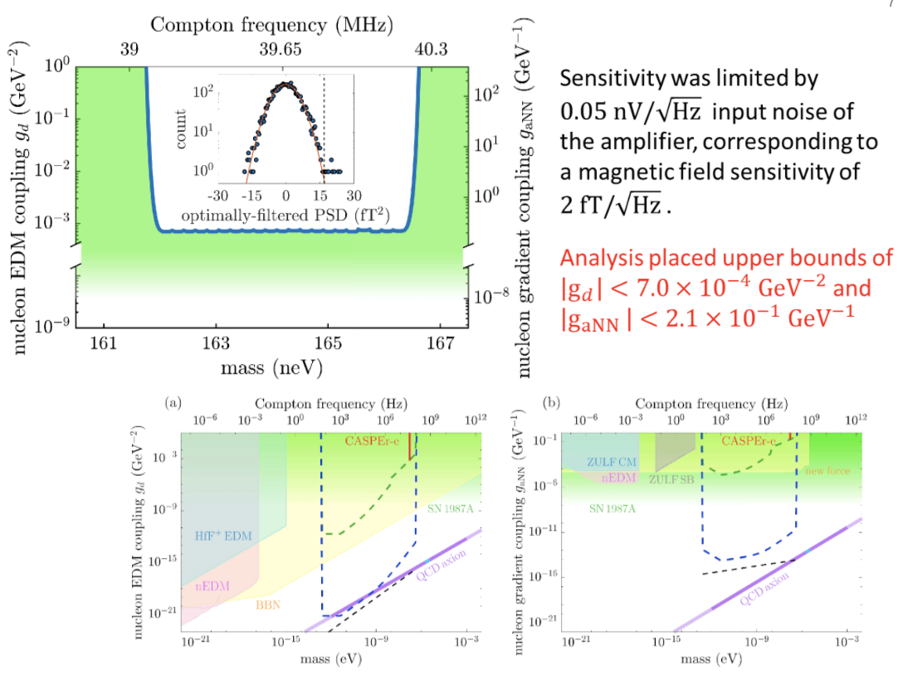
CASPEr-Boston
Deniz Aybas, et al., arXiv:2101.01241 (2021)

Slide 10
CASPEr-Boston
Gen 3 : Big Sample + Hyperpolarization !
A. Sushkov

Slide 11
CASPEr-Mainz: NMR based ALP-search program
First results (2019):
Antoine Garcon et al, Sci. Adv. 2019 5: eaax4539 arXiv:1902.04644;
Teng Wu et al, Phys. Rev. Lett. 122, 191302 (2019); arXiv:1901.10843
Low-frequency results should be taken with !caution!

Slide 12
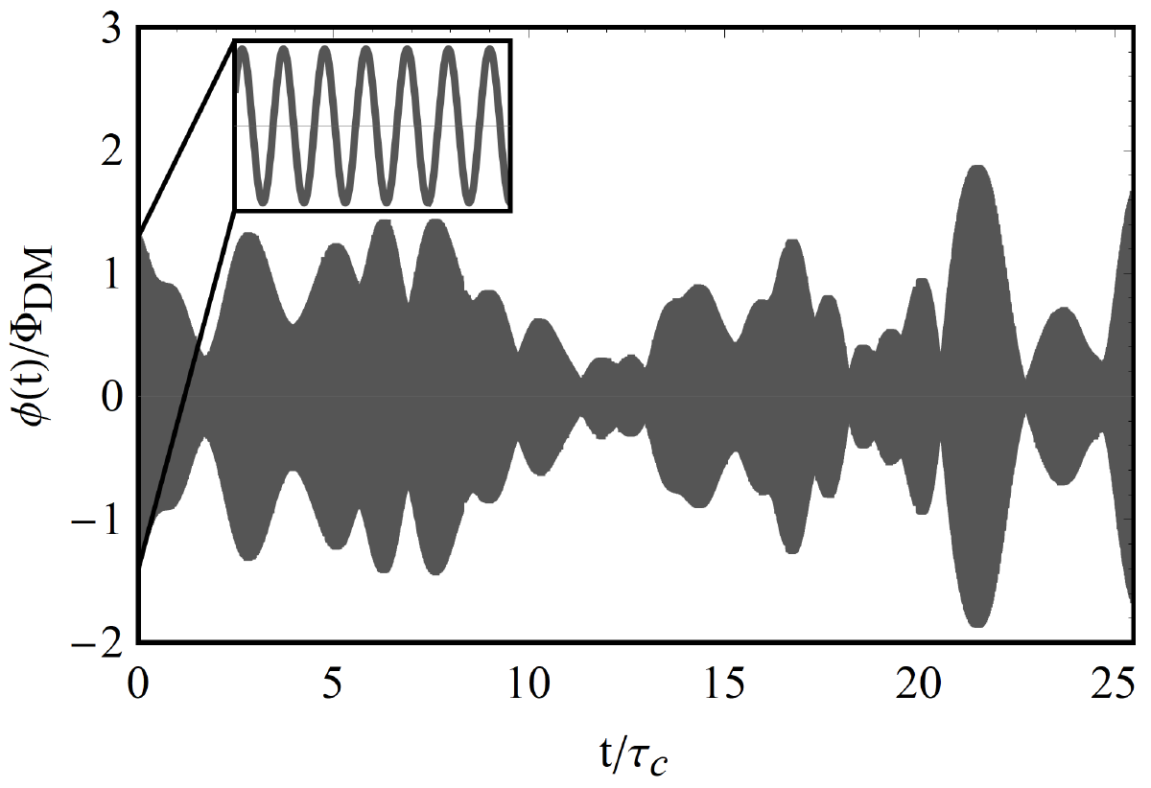
Gary P. Centers, et.al., Stochastic amplitude fluctuations of bosonic dark matter and revised constraints on linear couplings, arXiv:1905.13650 (2019)

Slide 13
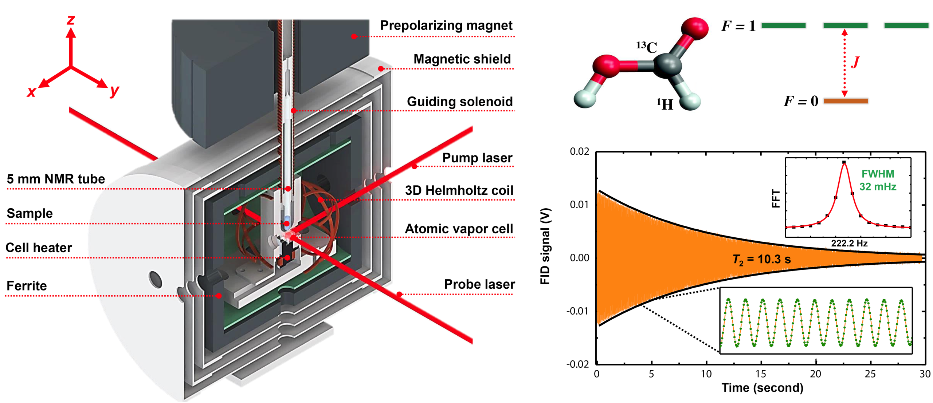
Zero-field NMR

Slide 15
John Blanchard
Antoine Garcon

Slide 18
ZULF-comagnetometer
Recent strong limits (not CASPEr):
I. M. Bloch, Y. Hochberg et al (2020)
comagnetometer analysis
Jiang Min et al (2021)
spin amplifier

Slide 19
CASPEr: NMR based ALP-search program
Higher frequencies: data runs start in 2021 (virus permitting)!
Cryogenics magnet; B < 0.15 T (<1.6 MHz for ¹²⁹Xe)

Slide 20
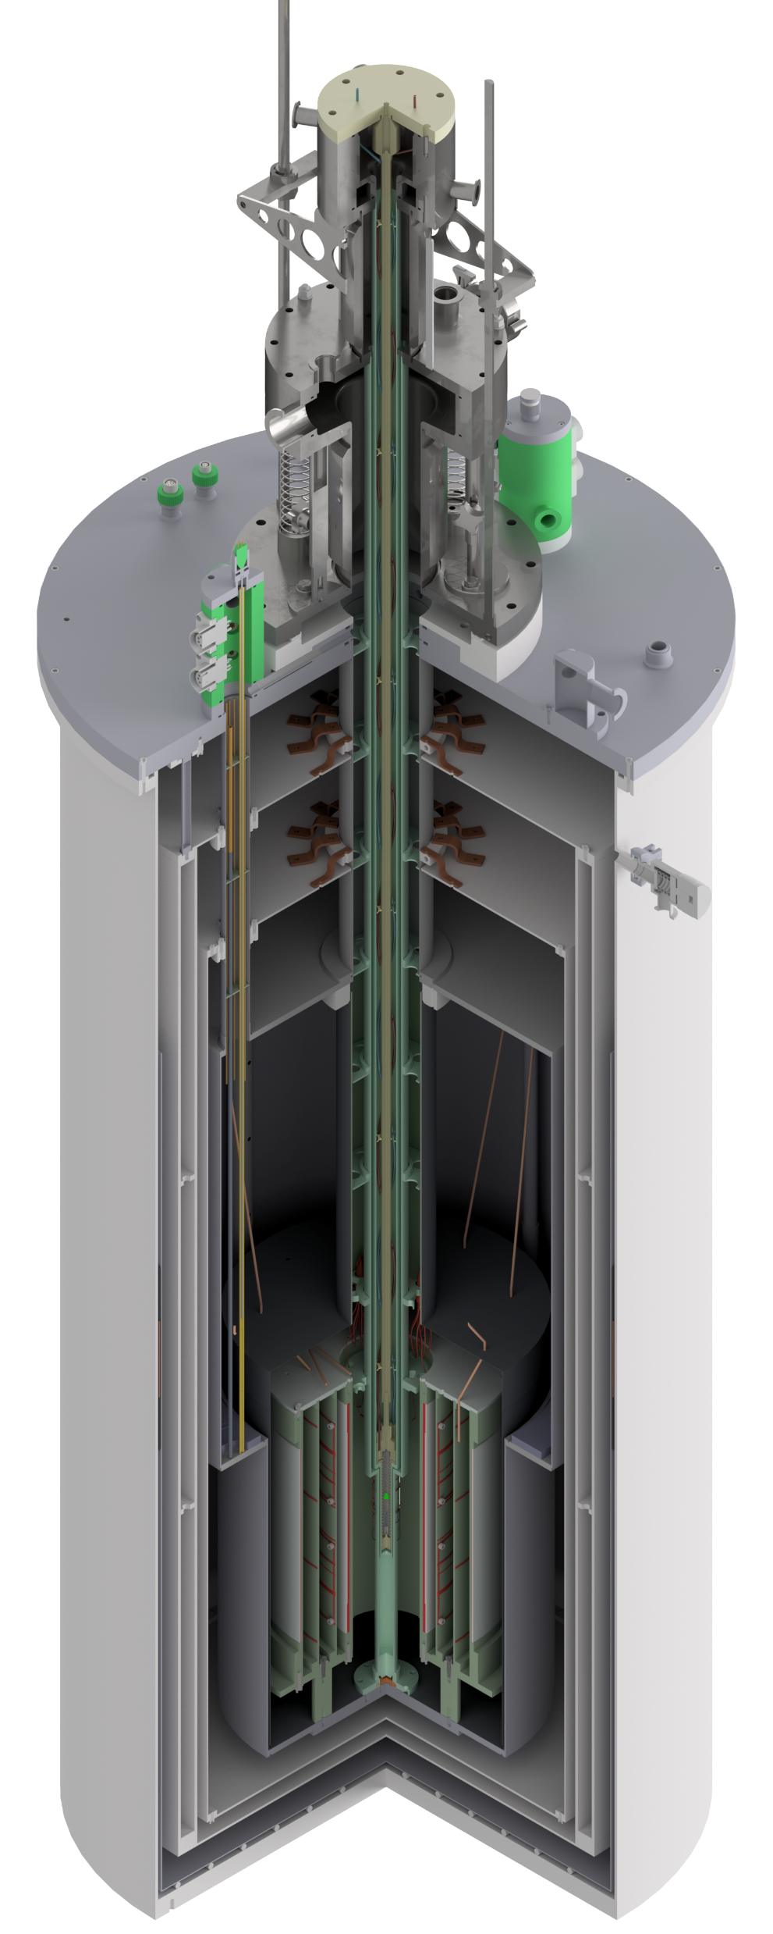
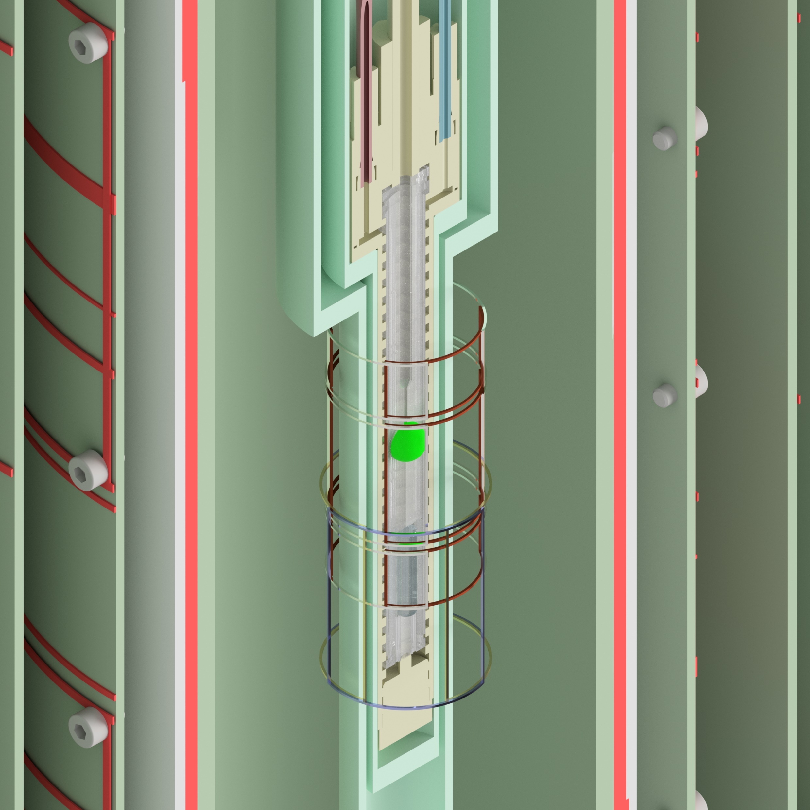
CASPEr-wind setup
Cryogenics Lt.
0.1 T (1 kG) superconducting
Cold, wet bore
Active shield
Superconducting shield
H. Bekker

Slide 21
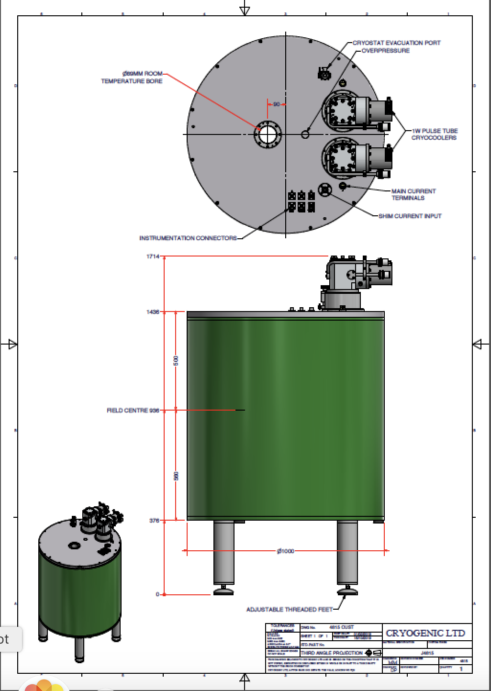
CASPEr: NMR based ALP-search program
Even higher frequencies are in the plan (~2 years):
Cryogenics magnet; B < 14.1 T (166 MHz for ¹²⁹Xe)

Slide 22
A short story for the remaining time…

Slide 23
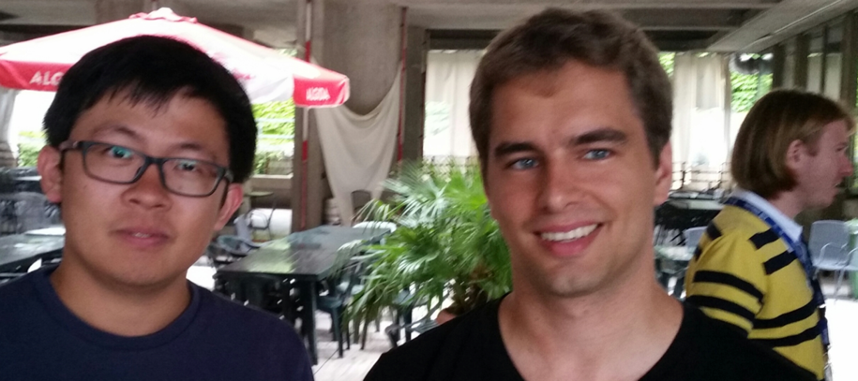
Dilaton DM ?
Notes:
The presence of the dilaton field causes oscillation of \alpha at a frequency equal to the mass of the dilaton

Slide 24
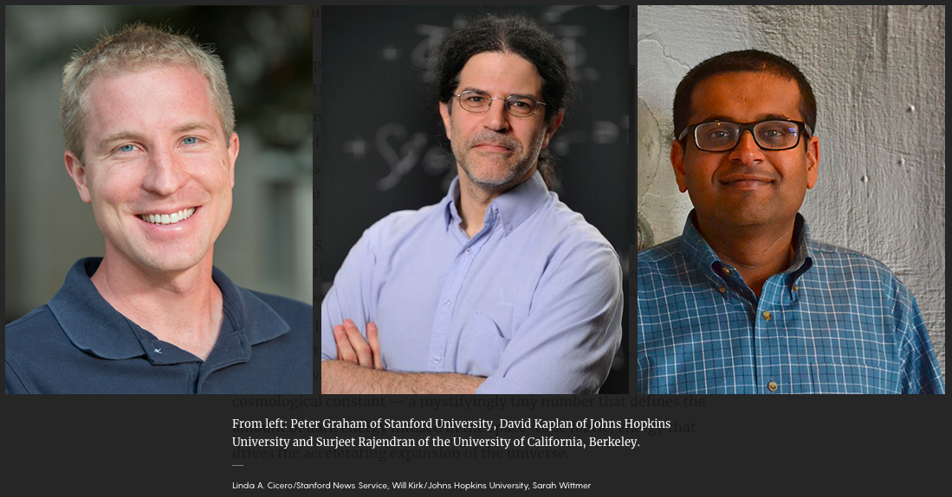
Relaxions in the dark
Gilad Perez
Weizmann Institute

Slide 25
relaxion
♦ Relaxion => solves hierarchy and strong CP problems
Graham, Kaplan & Rajendran (15); Hook,Marques-Tavares; Gupta, Komargodski, Perez & Ubaldi (16);
Davidi, Gupta, Perez, Redigolo & Shalit; Gupta; Nelson & Prescod-Weinstein (17)
♦ Axion-like particle but mixes with the Higgs => has scalar interactions
Flacke, Frugiuele, Fuchs, Gupta & Perez; Choi & Im (16)
♦ Minimal model provides viable axion-like dark matter (DM);
for:
$${10}^{−10}eV≲m_{φ≡relax}≲{10}^{−3}eV$$
Banerjee, Kim & Perez (18)
♦ DM can form stars & halos around Earth \w large over densities
Relaxion stars and their detection via atomic physics
Abhishek Banerjee, Dmitry Budker, Joshua Eby, Hyungjin Kim & Gilad Perez
COMMUNICATIONS PHYSICS (2020) 3:1 arXiv:1902.08212

Slide 26
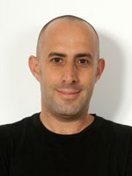
Fast changing “constants” ?
Jun Ye et al: cavity-clock comparison
Even faster: A “weekend” experiment @ Mainz ?
Dr. Dionysis Antypas Oleg Tretiak Prof. Roee Ozeri Antoine Garcon Helmholtz Institute, JGU Mainz HIM, JGU Mainz Weizmann Institute HIM, JGU Mainz

Slide 27
FAST OSCILLATING SCALAR DM Weekend Relaxion Search Laboratory

Slide 29
Cs D2 line (852 nm)
D. Antypas et al, PHYSICAL REVIEW LETTERS 123, 141102 (2019); arXiv:1905.02968
* Sensitive to variation of 𝛂 and m_{e}

Slide 30
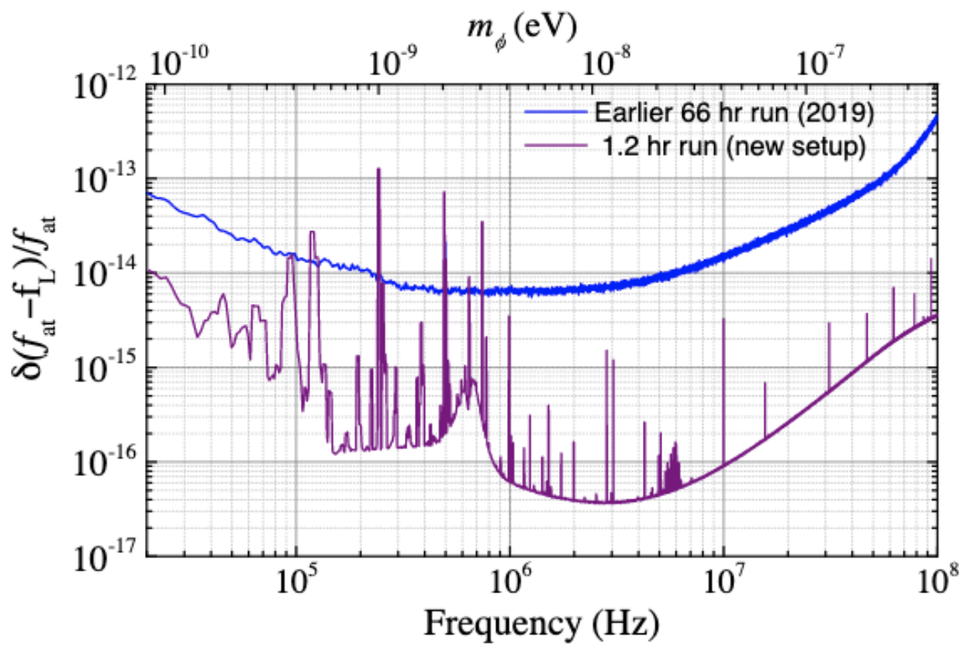
WReSL – 2 D. Antypas, et al, arXiv:2012.01519 (2020) to appear in QST
Projection: 10⁻¹⁸ (Cs)
WReSL-molecules
with S. Schiller group
Sensitive to oscill. of
nuclear mass

Slide 31
Fast Variation of Fundamental “Constants”
Dionysios Antypas, Dmitry Budker, Victor V. Flambaum, Mikhail G. Kozlov, Gilad Perez, and Jun Ye,
ANNALEN DER PHYSIK 2020, 1900566; arXiv:1912.01335
Old thinking: only dimensionless constants may vary
New thinking: m_{e} /< m_{e} >; 𝛂/< 𝛂 >, ... are OK
Origin of apparent variations: bosonic fields
BSM (and BBSM) physics is tricky!

Slide 32
Summary
Results from CASPEr-Boston & CASPEr-Mainz
Constraints on EDM & gradient couplings
Spin-offs!
-------
WReSL: reaching $δν/ν\sim$10⁻¹⁸

