Slide 1
Run-2C Upgrade Plans
Shekhar Mishra et al.
11/11/2019

Slide 2
Things to do
Inserting snorkel tube in condenser
Installation of 20 micron disks in the Inside LAr filter
Attaching new 20 micron filter and mole sieve on condenser return,
Its power supply and controls
Installation of new heater and RTD in the Inside LAr filter,
Its power supply and controls
Regeneration of Filter
Installation on filter on Top plate
Electrical commissioning of the Filter on the Top Plate before CE is attached.
Testing of FEMB received from BNL
Installation of FEMB on TPC
Testing of TPC with CE
Move TPC in the Cryostat
Database all items in ICEBERG

Slide 3
Condenser Port on Cryostat

Slide 4
Bottom of Condenser
Tube needs to go to 2/3 of the height of the condenser

Slide 5
Condenser Assembly
Decision was made to insert a clean fish tape from the instrumentation opening at the top of the condenser and pull a long Teflon tube, size to be determined by Katherine in a day, through the top. It will reinserted back in with Spiders to hold the tube vertically in place. (All needed parts should be ordered by end of Tuesday 11/12/19)

Slide 6
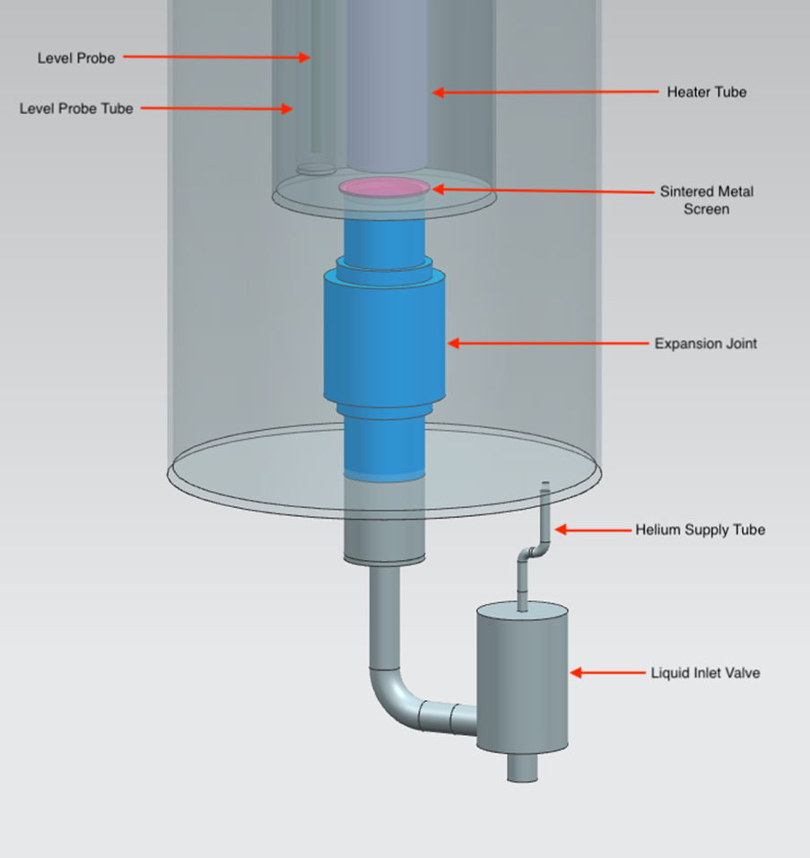
Replacement of Sintered Metal Disks
Written down plan/procedure for the Machine shop by 11/19/2019
Sintered Metal Disks will be delivered to Fermilab on 11/22/2019
Cut open at Machine Shop on 11/22/2019
Weld back on 11/25/2019
Fill media on 11/26/2019
Start regeneration on 11/27/209
MicroBooNE regeneration attachment should be ready by 11/22/2019

Slide 7
Regeneration of Filter
Schematic of what is needed to attach ICEBERG Filter to MicroBooNE system
Need Drawings: (Techs cannot do the work till we have drawings)
Fabricating two spool pieces that will connect the inlet and outlet of the Iceberg internal filter to the existing MicroBooNe regen set up
Making an adapter to connect the Iceberg RTDs to the existing RTD wiring (going to the MicroBooNe PLC)
Removing the Iceberg internal filter from PAB (crane usage)
Transporting the Iceberg internal filter to MicroBooNe
Lowering the Iceberg internal filter into the MicroBooNe pit (crane usage)
Connecting the Iceberg internal filter RTDs, inlet spool piece, and outlet spool piece
Regeneration of the Filter at MicroBooNe
Transporting the Iceberg internal filter to PAB

Slide 8
Electrical Reviews
ICEBERG Internal Filter
Fire-rod purchased is Watlow 2089-2941
There are details to it installation (electrical and mechanical) that must me followed
https://internal.dunescience.org/iceberg/localincludes/Internal-Filter/FIREROD-product-guide-6-25.pdf
Connection port at the cryostat (Need understand)
DC Power Supply (150 Volts, 16 Amps) and
Control Specification (Specification and operation)
Write down a requirements, specification, construction and operation document of Heater and RTDs. (Mechanical and Electrical: Trevor and Katherine):
Molecular Sieve (will only operate with LAr in cryostat)
Electrical connections
DC Power Supply (150 V and 5 Amps)
Control specification
Write down a requirements, specification, construction and operation document of Heater. (Mechanical and Electrical: Trevor and Katherine)

Slide 9
Heater Configuration

Slide 10
RTD Installation
We would do the following for the RTDs.
All existing RTDs and wires should be removed from the cryostat.
Trevor should produce an electrical schematic for the new RTD to cryogenic controls.
All new RTDs to be individually assembled with G10 backing with its final wire and connection to cryogenic controls.
Each individual RTD will be immersed in LN2 bath in CTS to calibrate its reading.
Installed RTD in the cryostat with reasonable known vertical position and electrical connection checked.

Slide 11
Filter Electrically ready
CE will be removed from the TPC for Electrical commissioning of the Filter
Once we certify that there is no current flowing out of filter CE will be attached.

Slide 12
Photon Detector
Photon Detector will not be part of the Run 2C at the start.
Full Photon Detector has to go through an electrical review
Photon Detector will get pulled out of the TPC for inspection before RUN 2C starts.
2 MPOD Units
2 channels, 48 volts
2 channels, 2.5 volt (DUNE)
1 PL506

Slide 13
Database
Trevor will provide all the ICEBERG data links being stored in Seeq to Bill.
Bill will include them in EPICS.
Alan has some derived quantity in Seeq, this should be stored in EPICS.
Purity Monitor MPOD units needs to be edited in EPICS.
Shekhar will work with Bill to ensure that the names of these data is clear.

