Slide 1
Photon Library Investigations
Leon Mualem

Slide 2
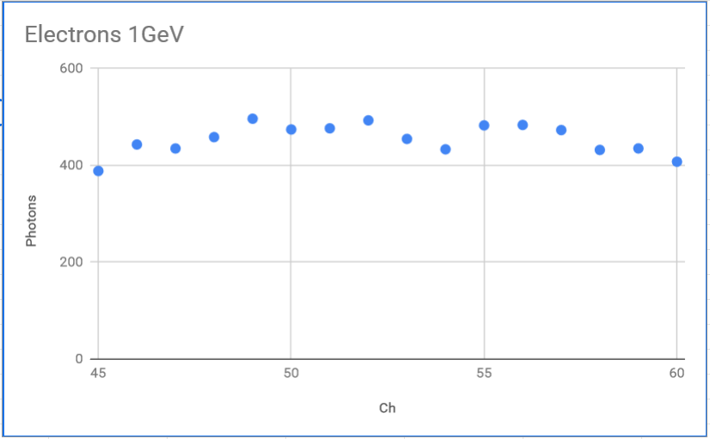
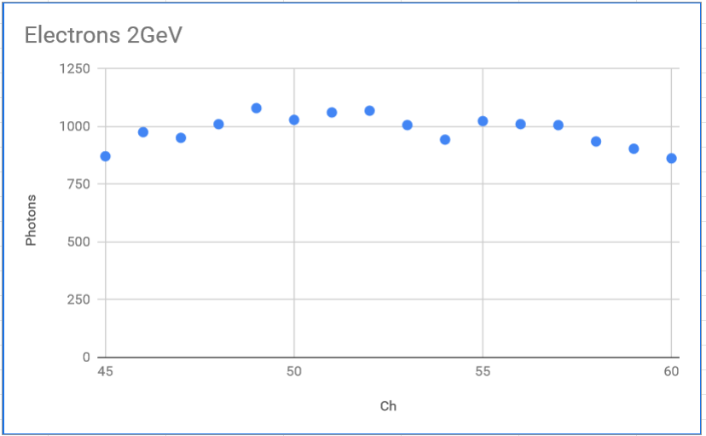
Motivation
Curious about the large fluctuation of “landing photons” from the simulation
Did not appear statistical (to me), should be smooth for distant shower at the cathode
Persisted with “double” statistics, combining 250,000 and 200,000 photon/voxel library generation
Persisted with tripling number of electron events, from about 1000 to 3000 (Laura)
Fluctuations are the same in 1GeV and 2GeV electrons (plots at right)
Must come from the Photon Library

Slide 3
Photon Library
Root Tree of “Visibilities” – Library used is Protodunev7_90cm_250000
Each entry in the tree contains (VoxelID, OpChannel, Visibility)
Visibility is fraction of simulated photons that would propagate to the sensitive area of an “OpChannel” for the simulated detector parameters (geometry, Rayleigh scattering length, attenuation length, ….)
OpChannel is smallest distinct signal element (Bar, or Arapuca Cell)
VoxelID is the encoded position: xIndex+(yVoxels*(yIndex+zVoxels*zIndex)
Library parameters
# voxels: 2352000 (140 x 120 x 140) (X x Y x Z)
Voxel size: 5.55 cm x 6.25 cm x 6.13 cm
Each Voxel has up to 90 visibilities in the tree

Slide 4
Photon Library
Coordinate system in voxel index is at upstream lower corner
Some landmarks:
Beam-side APA at Xindex=4
Cathode plane at Xindex=63
DAQ-side APA at Xindex=123
APA 3 PDs run from about Z=15 to Z=43
Library parameters
# voxels: 2352000 (140 x 120 x 140) (X x Y x Z)
Voxel size: 5.55 cm x 6.25 cm x 6.13 cm
DAQ Side
Beam Side
Beam Pipe
0 Y Index 120
140 X Index 0
0 Z Index 140

Slide 5
Some numbers for the problem
Moliere radius in LAr is 9cm (Wikipedia)
Radiation Length - X₀ is 14cm in LAr
9 voxels along the shower should contain 90% of the shower energy
1GeV electron has average range ${70g}/{cm2}$ or about 50cm $\frac{{70g}/{cm2}}{{1.4g}/{cm3}}$
Restrict range to ~first APA or less for investigations
From NIST CSDA, so expect straggling in this range (https://www.nist.gov/pml/stopping-power-range-tables-electrons-protons-and-helium-ions)
Executive summary: Showers are small and narrow, hit about 100-200 voxels in ~3x3 core along z

Slide 6
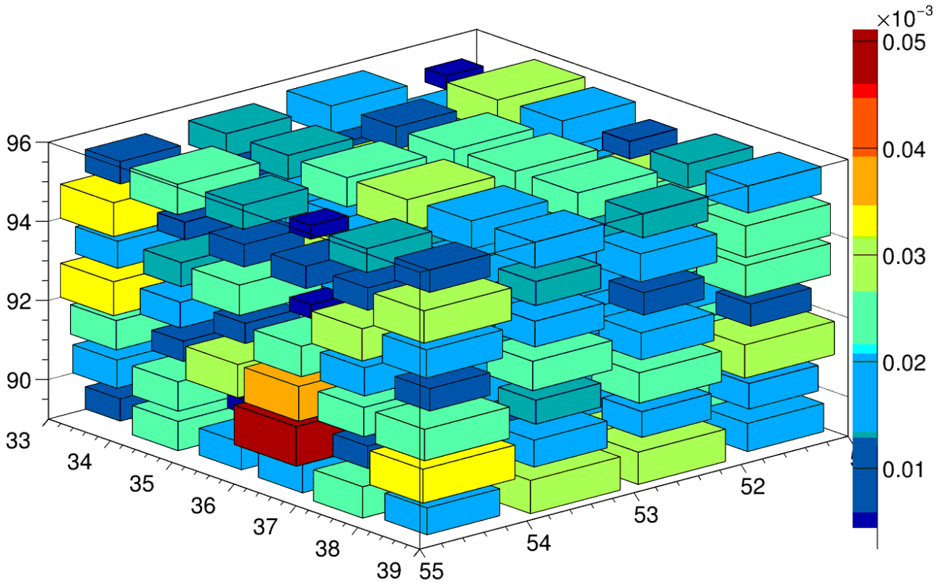
Visibility visualized
Visibility of 100 voxels for Channel 57
5 by 5 by 4 box near cathode approx. opposite detector
HUGE variation
Factor of 3-5

Slide 7
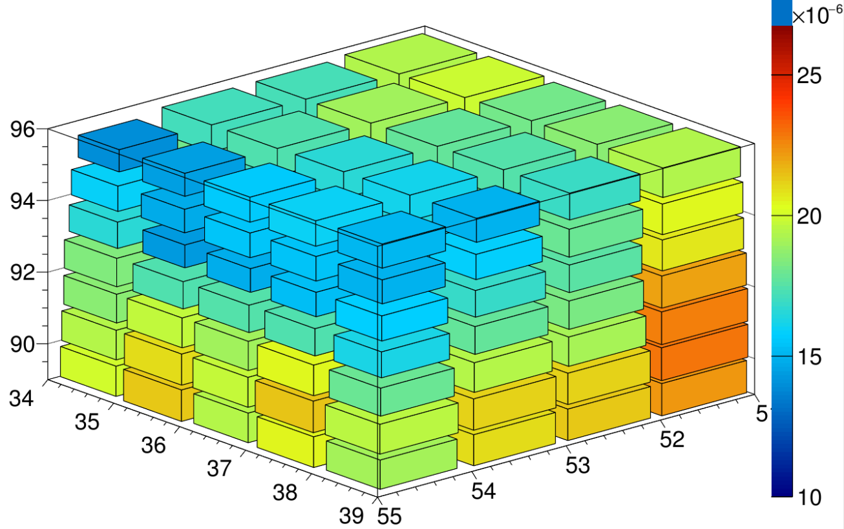
Visibility visualized
STARTING FROM AVERAGED MAP
Visibility of 140 voxels for Channel 57
5 by 5 by 4 box near cathode approx. opposite detector
Small variation
Smooth gradient

Slide 8
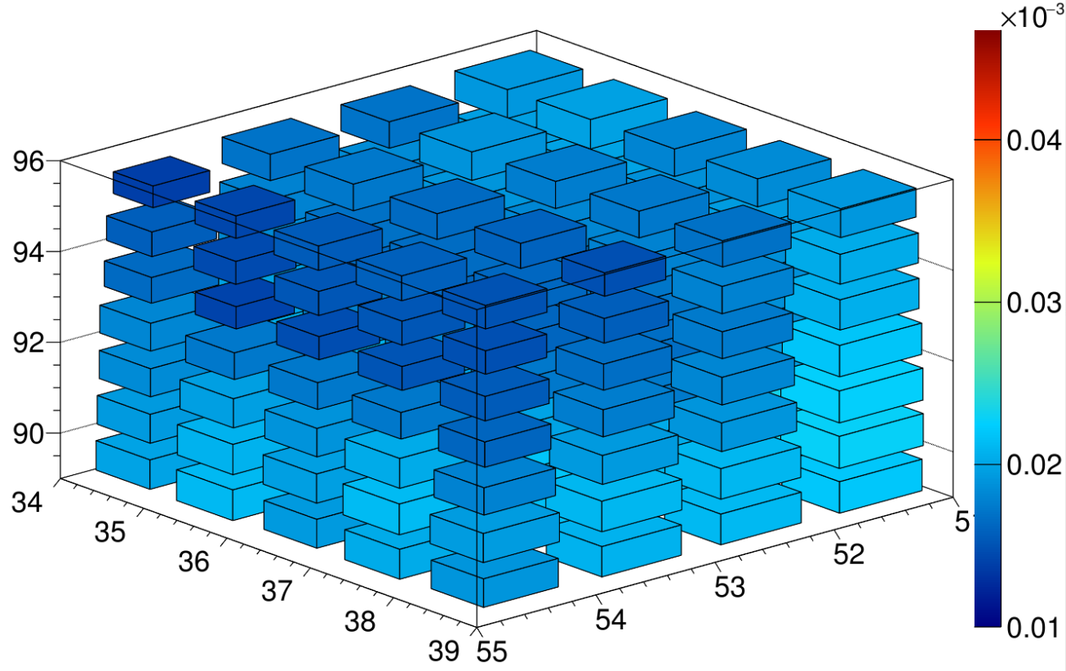
Visibility visualized
STARTING FROM AVERAGED MAP
Visibility of 140 voxels for Channel 57
5 by 5 by 4 box near cathode approx. opposite detector
Small variation
Smooth gradient

Slide 9
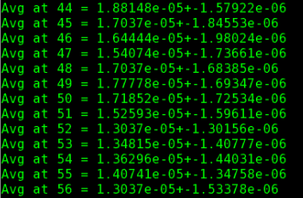
Calculate mean and RMS from a cube at each Z
Step along Z and find mean and RMS OpChannel 57 for each 27 voxel box
Table to the right shows for a particular set of z positions near the cathode, as seen in previous slides
Shown is error in the mean, RMS/sqrt(27)

Slide 10
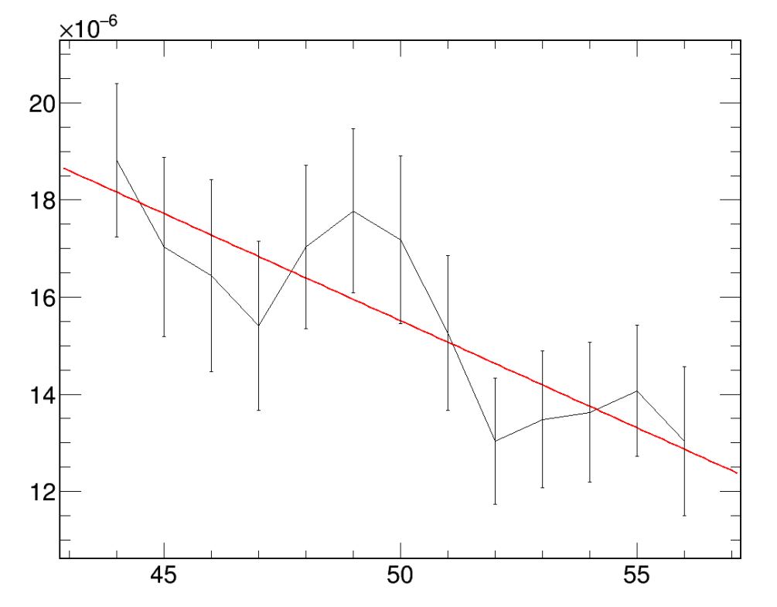
Plot Mean/RMS Visibility along z
Plot values from table on previous slide
Fit a line to points
About 25% error in slope still with 27 points averaged

Slide 11
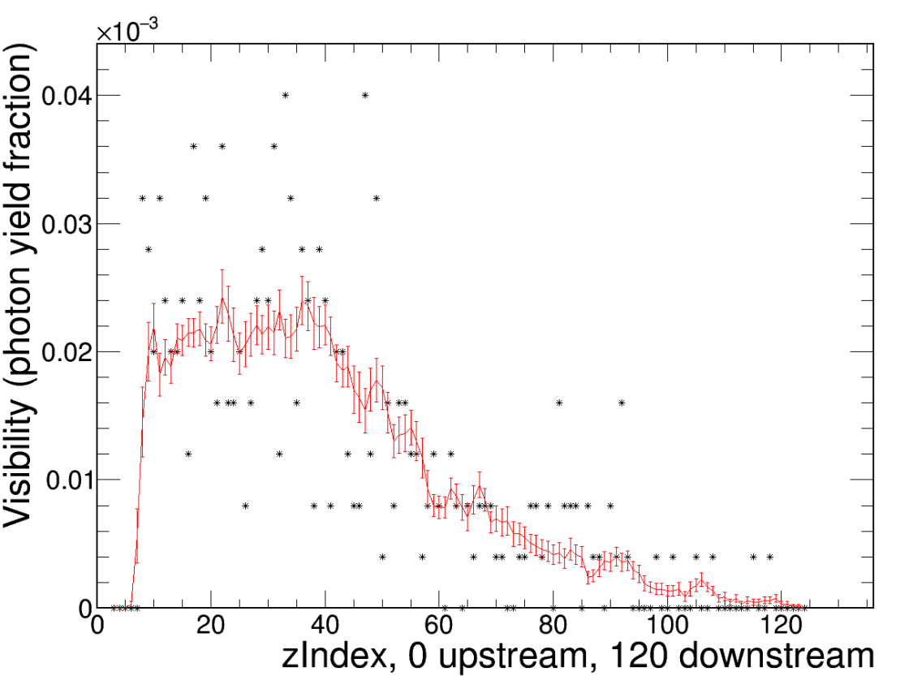
Plot Mean/RMS Visibility along z at x=59,y=60
Red points/line show visibility averaged over 27 neighbors in a cube
Black points show actual Visibility values in Photon Library that would be used for calculating photon landing
Channel 57, near upstream end of Arapuca module

Slide 12
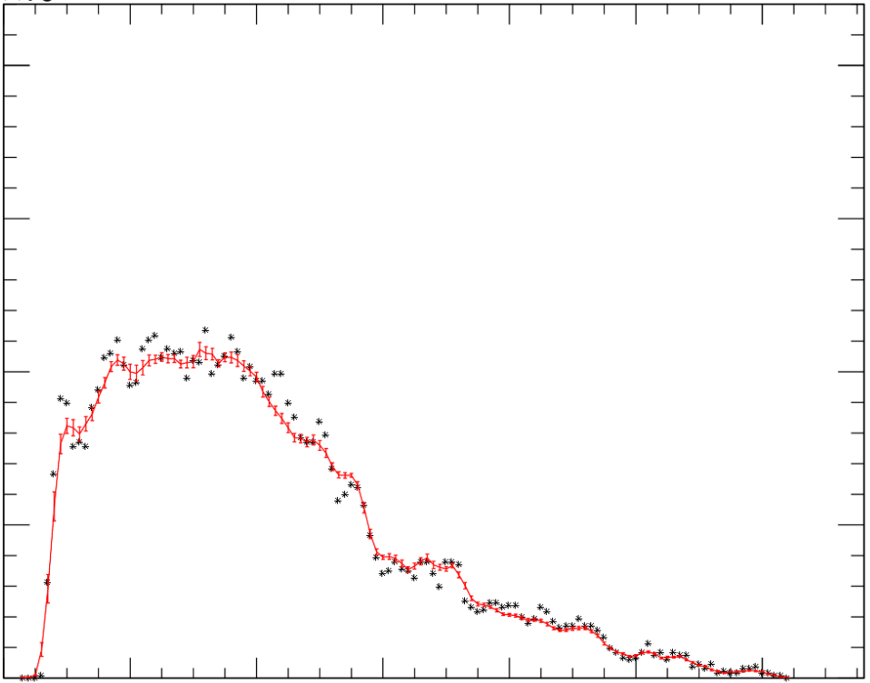
Plot Mean/RMS Visibility along z at x=59,y=60
STARTING FROM AVERAGED MAP
Red points/line show visibility averaged over 27 neighbors in a cube
Black points show actual Visibility values in Photon Library that would be used for calculating photon landing
Channel 57, near upstream end of Arapuca module

Slide 13
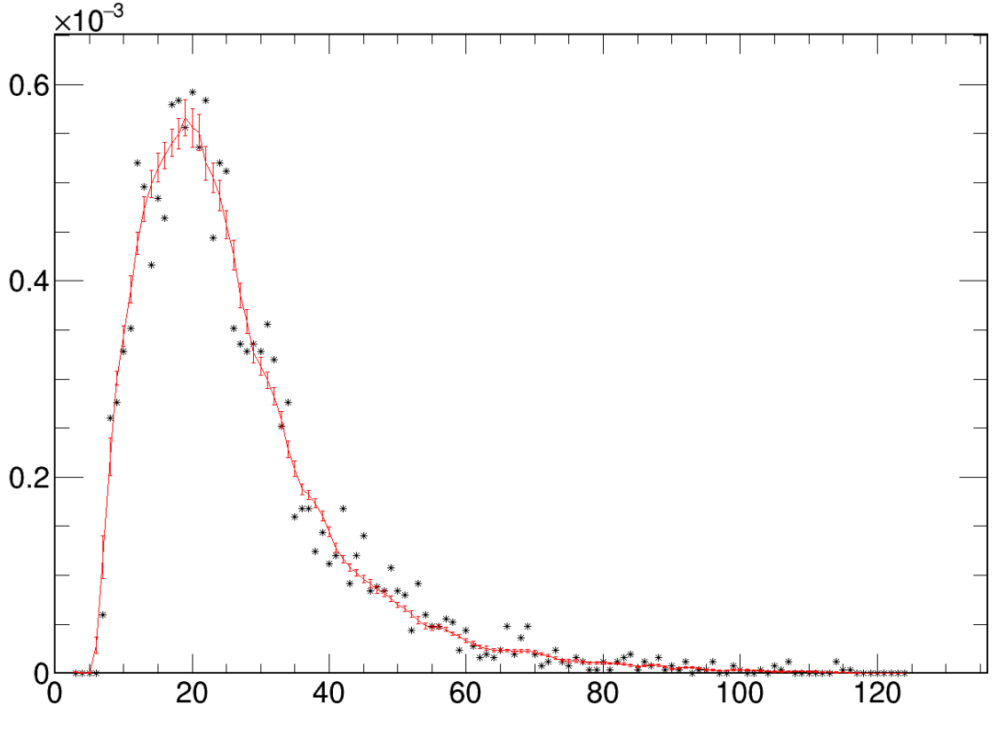
Plot Mean/RMS Visibility along z at x=16,y=60
Red points/line show visibility averaged over 27 neighbors in a cube
Black points show actual Visibility values in Photon Library that would be used for calculating photon landing
Channel 57, near upstream end of Arapuca module

Slide 14
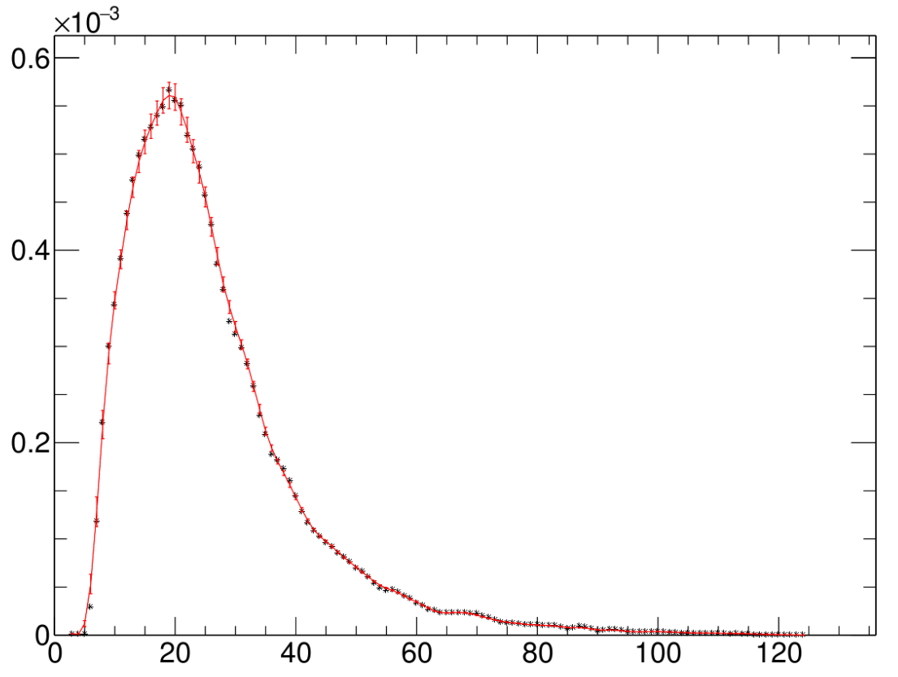
Plot Mean/RMS Visibility along z at x=16,y=60
STARTING FROM AVERAGED MAP
Red points/line show visibility averaged over 27 neighbors in a cube
Black points show actual Visibility values in Photon Library that would be used for calculating photon landing
Channel 57, near upstream end of Arapuca module

Slide 15
Conclusions
Photon library showed far too much variation
Smoothed the library
Averaging 27 voxels
Bars will have smaller fluctuations, since they have larger area, but still likely require averaging or other smoothing techniques
Used current merged library (missing OpChan==0)
Took care to average at array boundaries, so edges are less than 27
Did NOT take any care with boundaries like cathode/anode
Should be good to run, except for OpChan 0, should be quickly/easily remedied

Slide 16
Backup – other checks of visibility

Slide 17
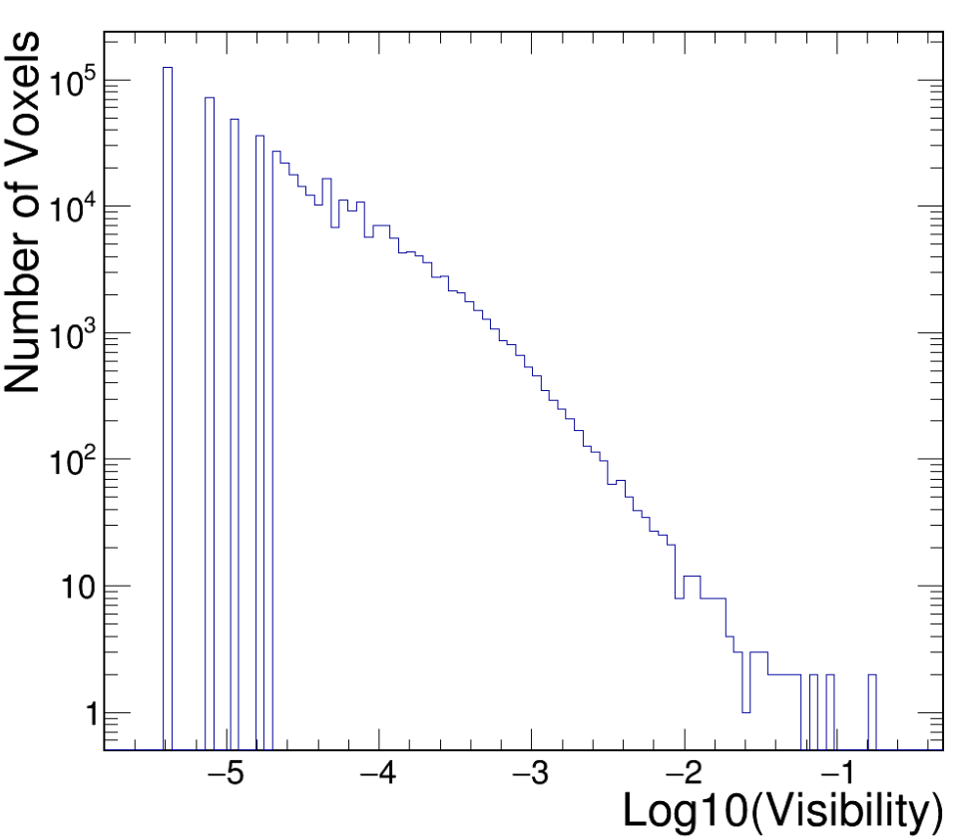
Visibility for one channel
Visibility for one Arapuca channel
(Log10(Vis) so you can see it all)
Lower right corner from the few voxels that are right in front of the window
Upper left, very frequent, but very low visibility voxels.
Quantized steps are from voxels that had 1,2,3,4,… photons that hit the window
One MIP would deposit about 20MeV in a voxel. That should yield about 500,000 photons. (50,000 photons at -1 and 1 photon at -4.7)

Slide 18
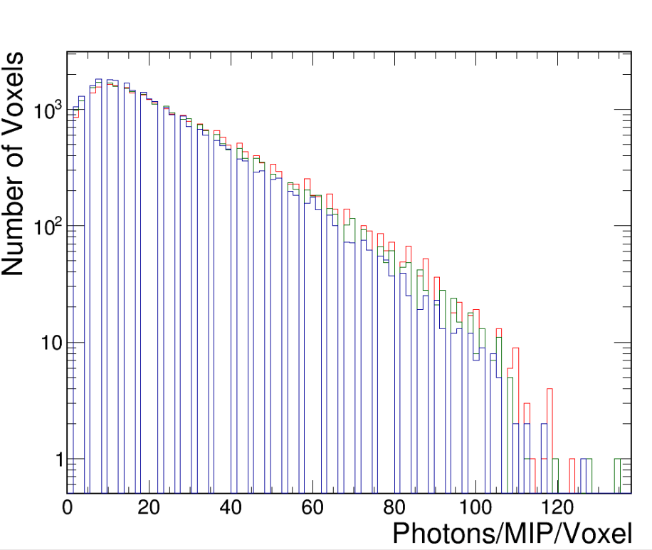
Photons/voxel/mip for voxels near the beam
Box is within 32 (of 59) voxels to the cathode, 20 voxels wide, (60-80) out of 108 in height and in the first 50 of 140 voxels in Z. This is meant to be neighborhood of electron beam events.
32000 Voxels in the box
For 3 channels, 57,58,59 (R,G,B)
Each cell gets ~400 photons/GeV from the simulation

Slide 19
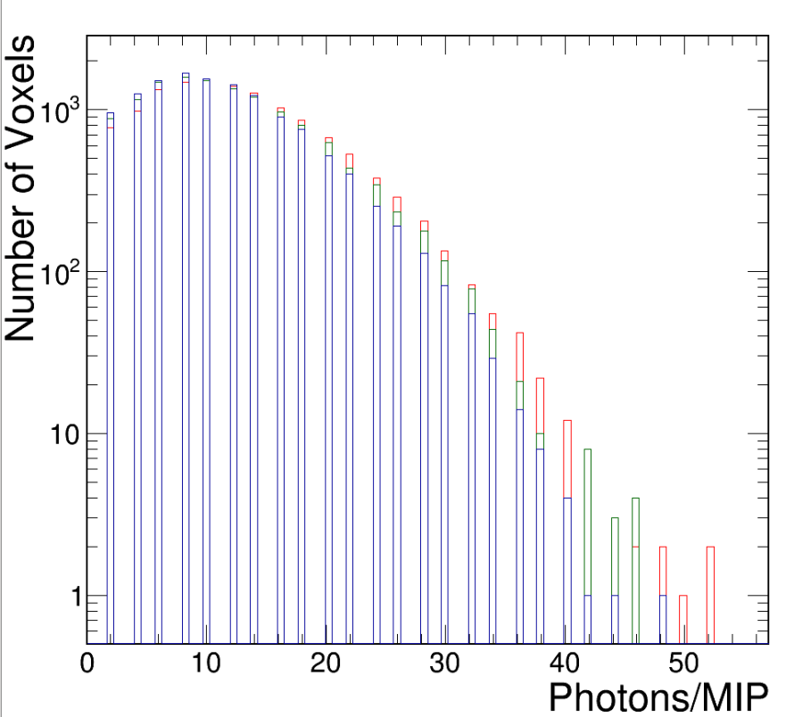
Photons/voxel/mip even closer to beam
Box is within 16 (of 59) voxels to the cathode, 20 voxels wide, (60-80) out of 108 in height and in the first 50 of 140 voxels in Z. This is meant to be neighborhood of electron beam events.
16000 voxels in the box
For 3 channels, 57,58,59 (R,G,B)
Each cell gets ~400 photons/GeV from the simulation

Slide 20
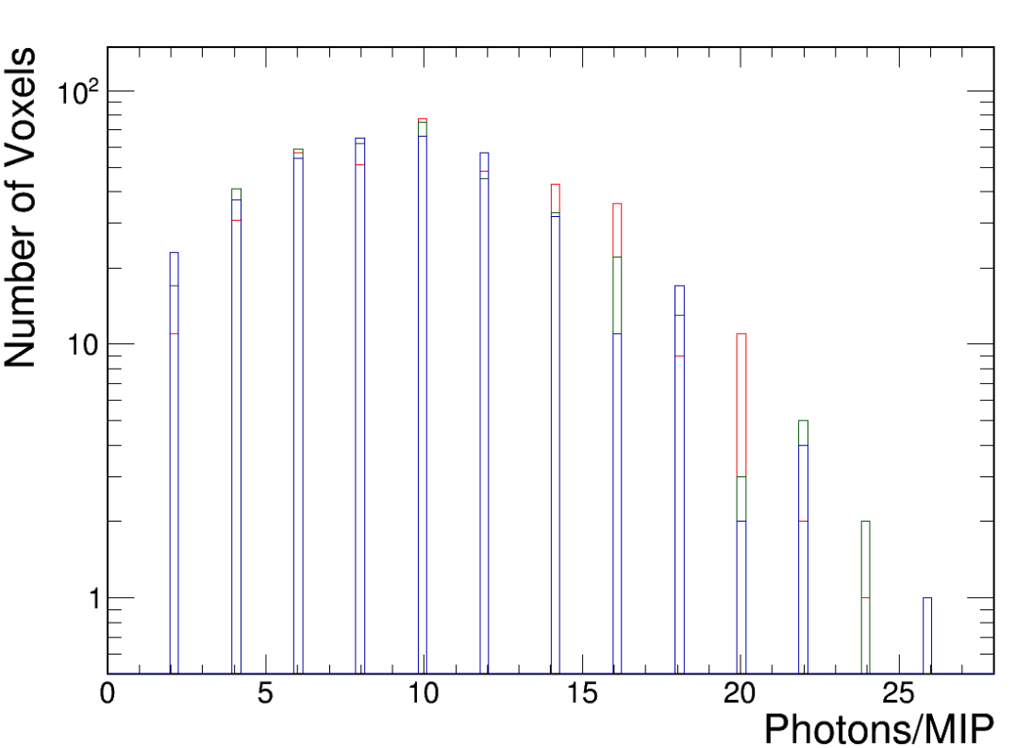
Photons/voxel/mip in a line parallel to cathode
Box is 5 away, +-1 (of 59) voxels to the cathode, 3 voxels tall, (59-61) out of 108 in height and in the first 50 of 140 voxels in Z. This is meant to be neighborhood of electron beam events.
450 voxels in the box
~80 Voxels/channel that are 0,
not shown (most probably outside)
For 3 channels, 57,58,59 (R,G,B)
Each cell gets ~400 photons/GeV from the simulation

Slide 21
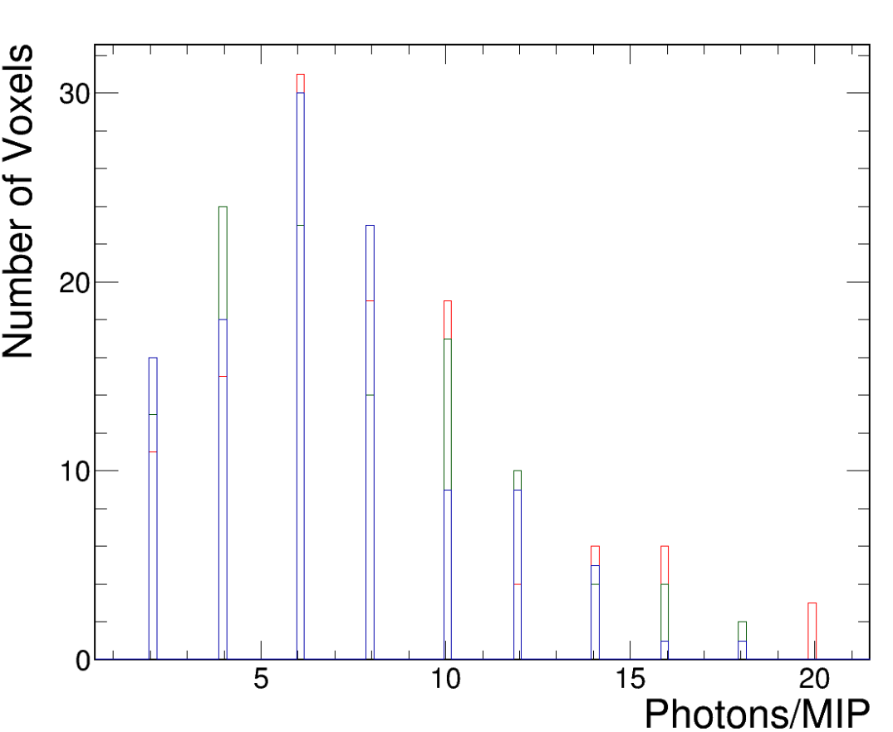
Photons/voxel/mip in a very small box
Box is 5 away, +-1 (of 59) voxels to the cathode, 3 voxels tall, (59-61) out of 108 in height and in the first 25+-6 of 140 voxels in Z. This is meant to be neighborhood of electron beam events.
117 voxels in the box
~5 Voxels/channel that are 0,
not shown
For 3 channels, 57,58,59 (R,G,B)
Each cell gets ~400 photons/GeV from the simulation
Spread about factor of 3?

Slide 22
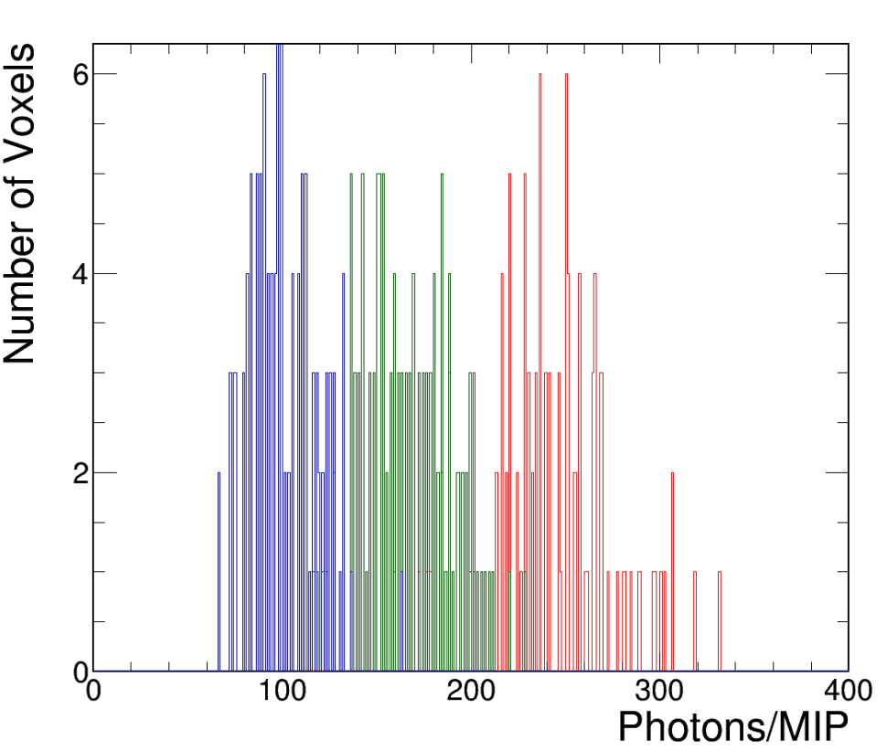
Photons/voxel/mip for a few bar channels
Box is 5 away, +-1 (of 59) voxels to the cathode, 3 voxels tall, (59-61) out of 108 in height and in the first 25+-6 of 140 voxels in Z. This is meant to be neighborhood of electron beam events.
117 voxels in the box
For 3 bars channels, 87,88,89 (R,G,B)
Each cell gets ~??? photons/GeV from the simulation
Spread ~30%

Slide 23
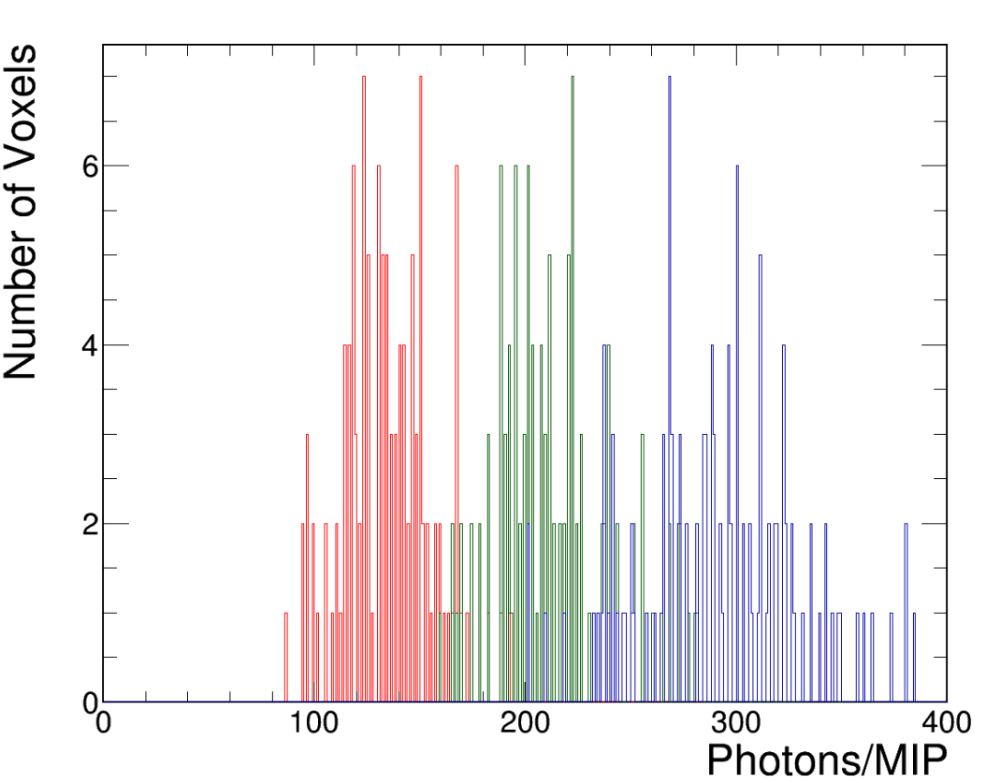
Photons/voxel/mip
Number of voxels in a box
Box is 5 away, +-1 (of 59) voxels to the cathode, 3 voxels tall, (59-61) out of 108 in height and in the first 25+-6 of 140 voxels in Z. This is meant to be neighborhood of electron beam events.
117 voxels in the box
For 3 bars channels, 81,82,83 (R,G,B)
Each cell gets ~??? photons/GeV from the simulation
Spread ~30%

