Slide 1
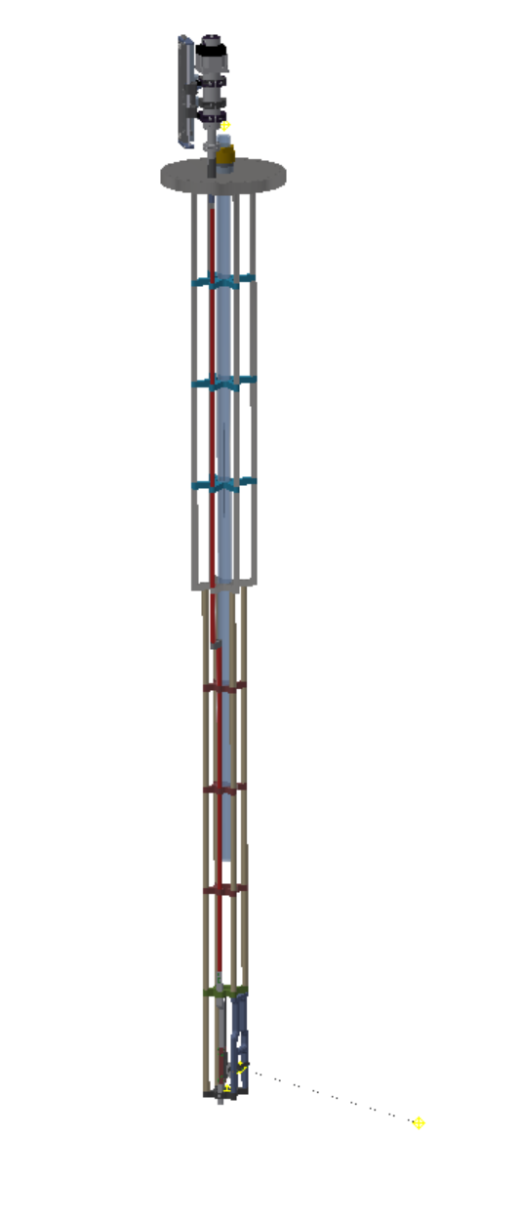
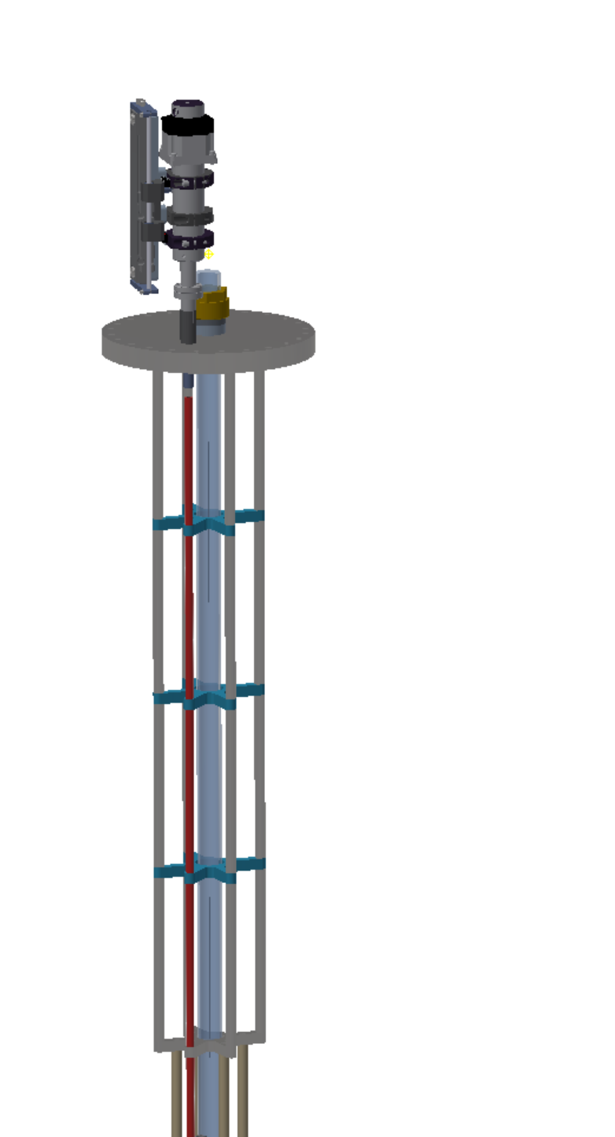
Placeholder Laser Periscope Insert
Actual ProtoDUNE insert is about 1m longer
Propose to change warm structure components material to stainless steel
Elasticity modulus ~200GPa vs 4 to 14GPa for Peek or Torlon
Less expensive
2.2m

Slide 2
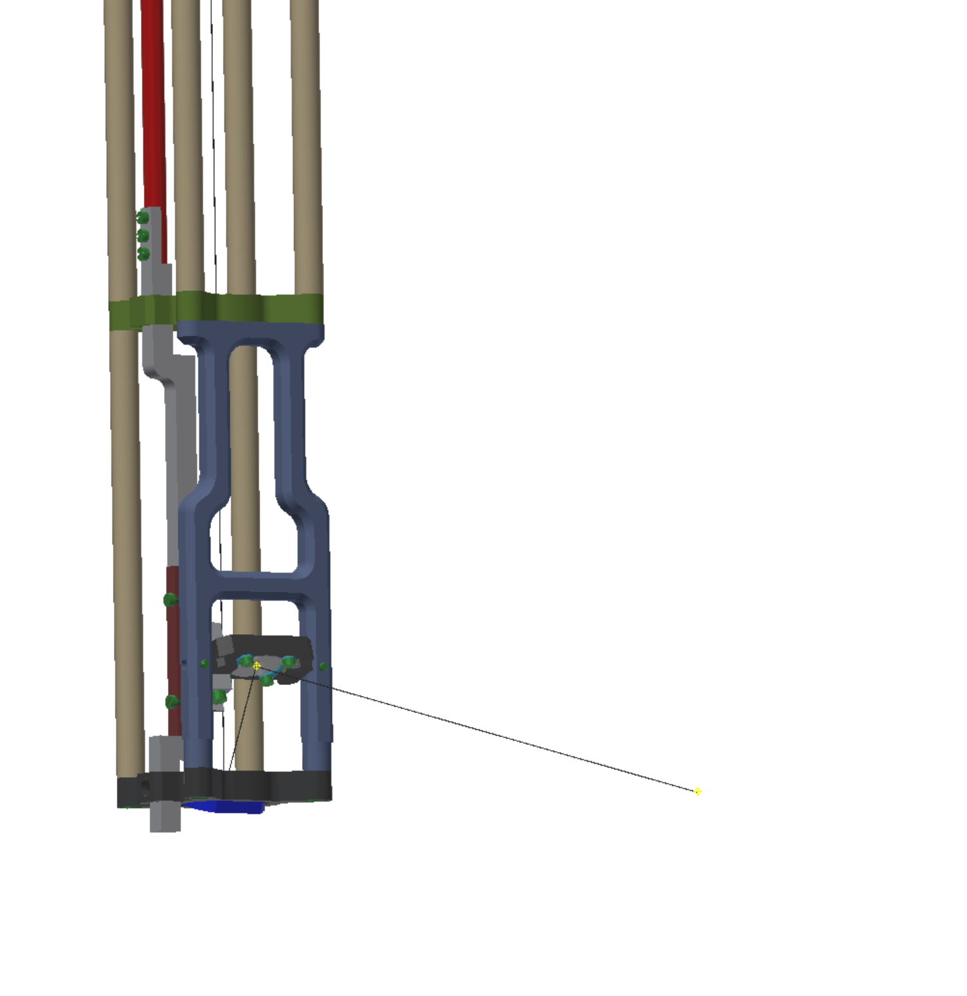
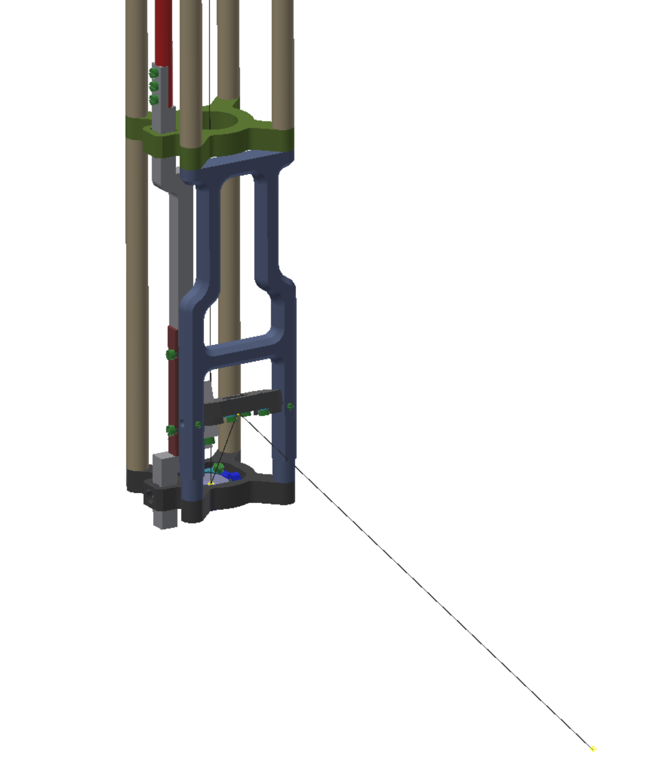

Slide 3
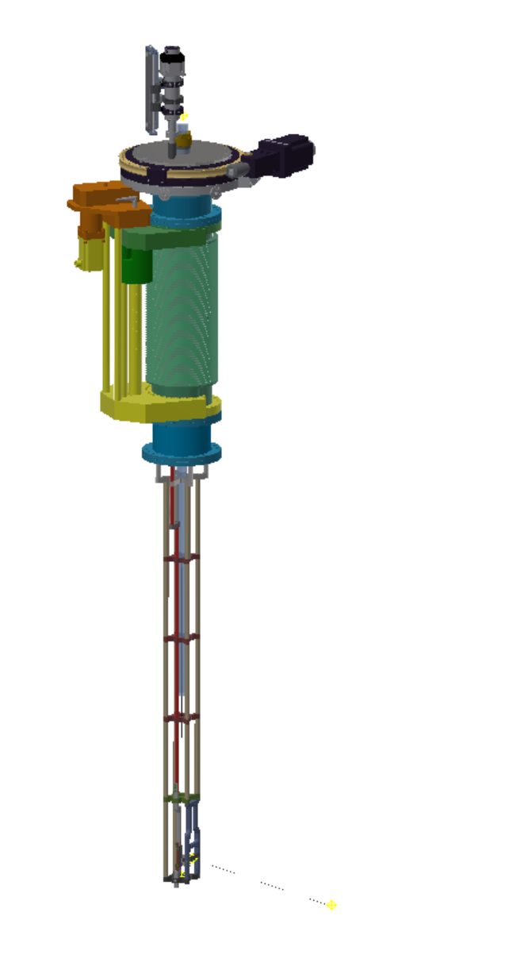
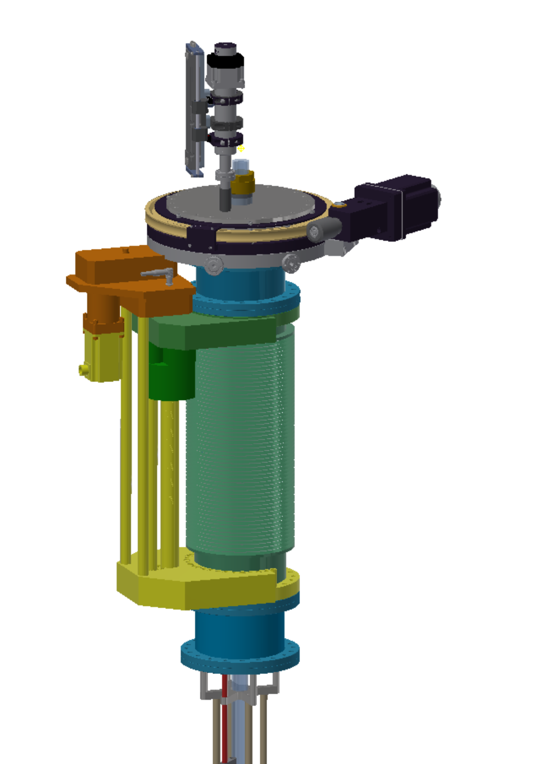
Rotation Stage – 10” version shown. Propose to go to 8” version
Linear translation stage – 300mm stroke, shown in retracted position
8” CF Adapter nipple

Slide 4
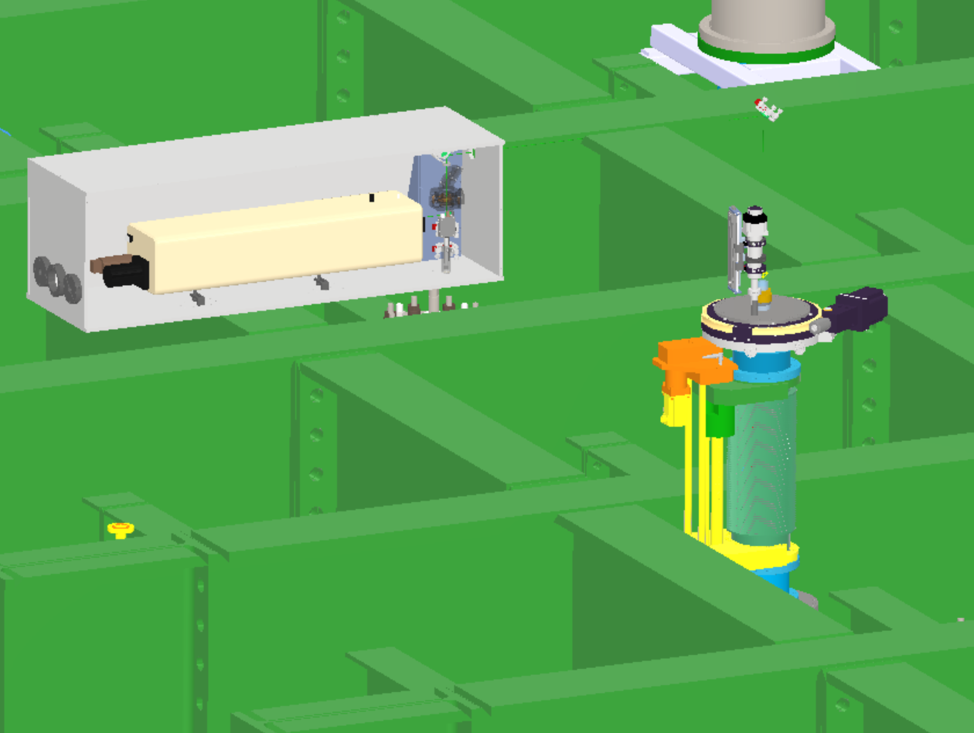
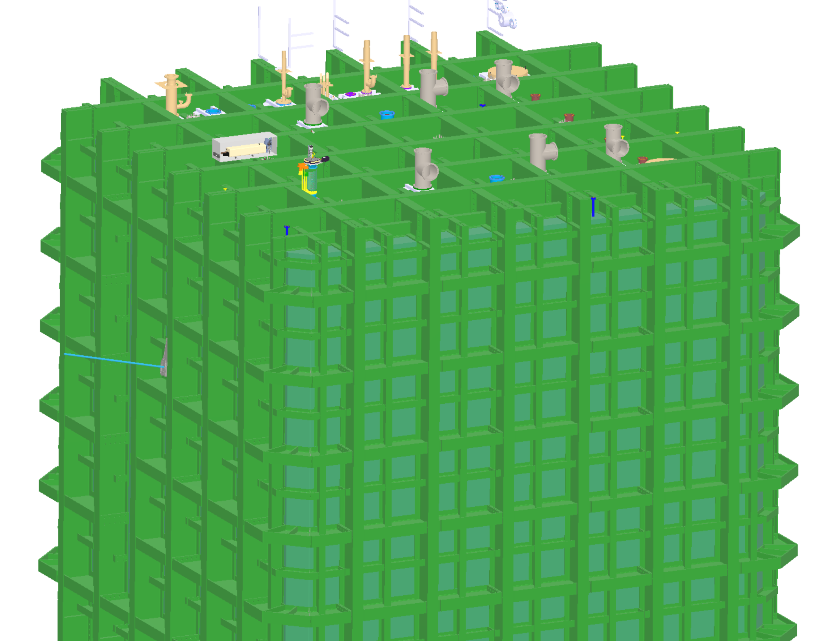
Laser Periscope

Slide 5
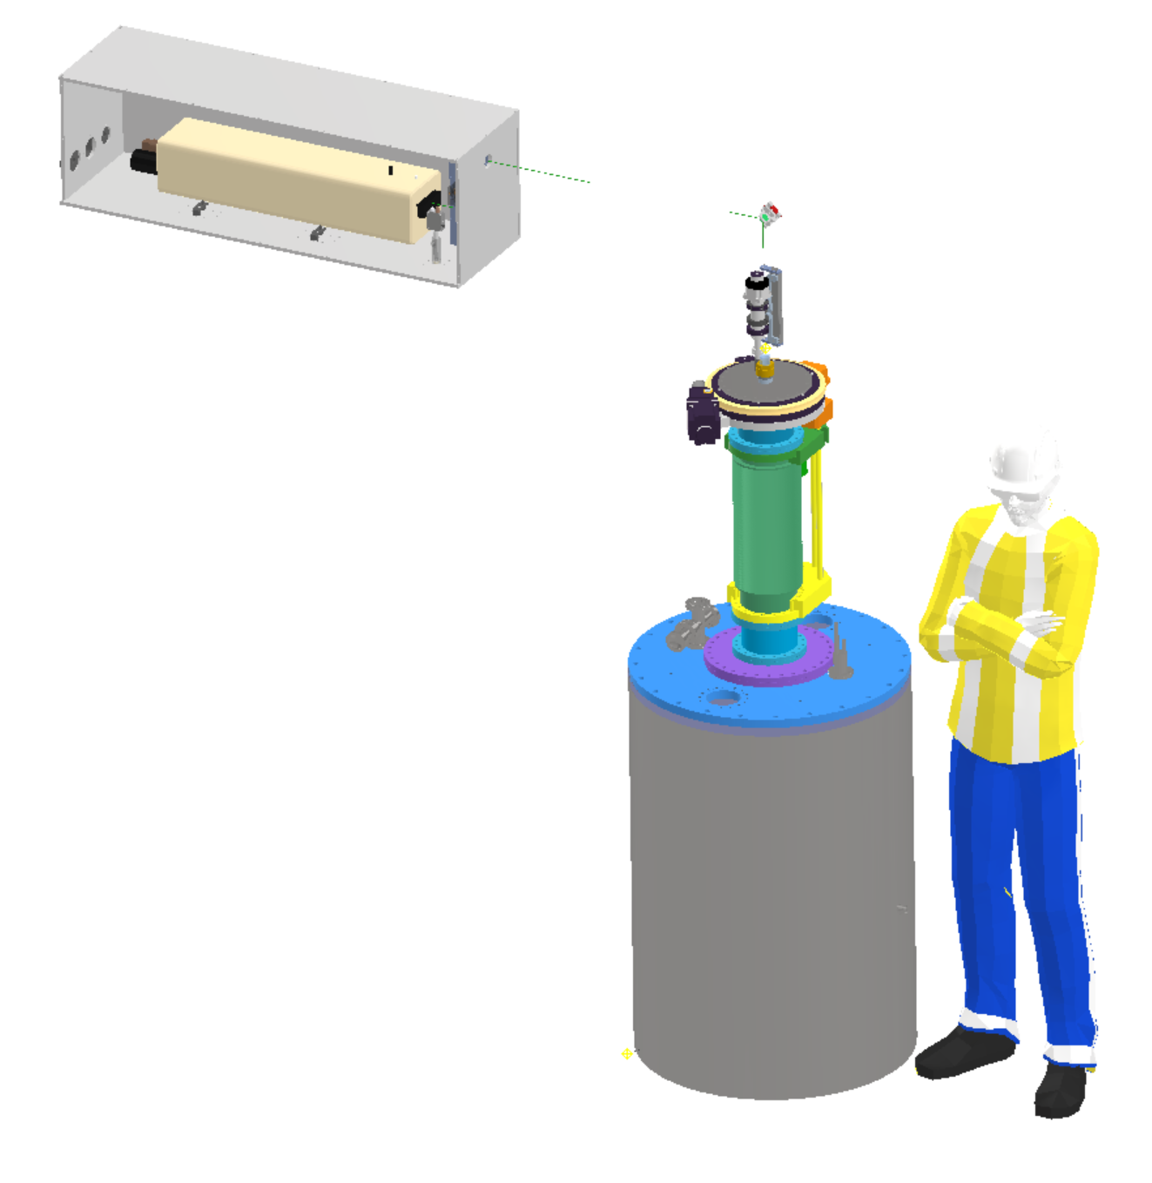
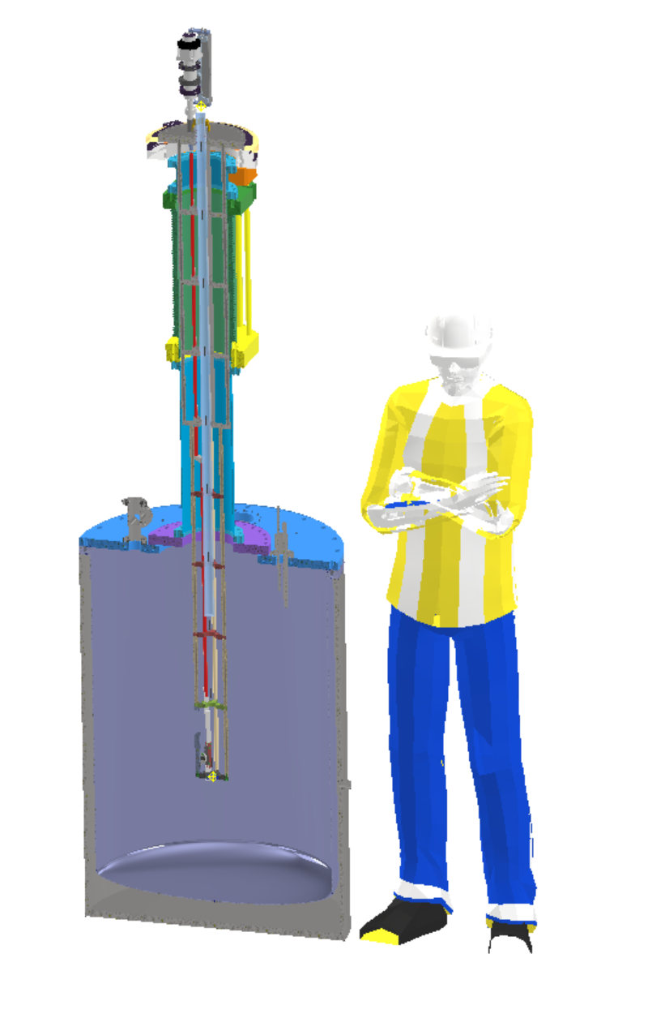
Possible Test setup at LANL
Mirror
Class IV Laser, top shown 2.5m above floor
2.25m
NMSU Vacuum Insulated Dewar ø760mm x 1130 mm high

