Slide 1
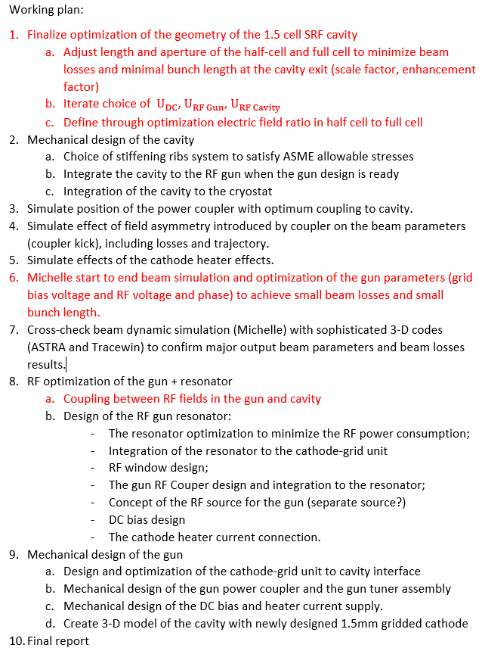

Slide 2
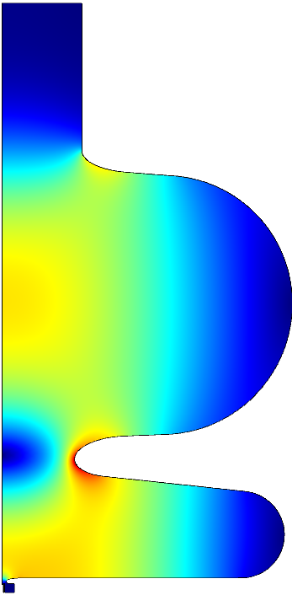
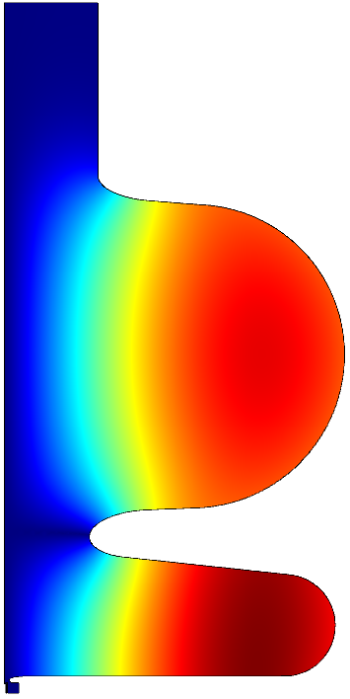
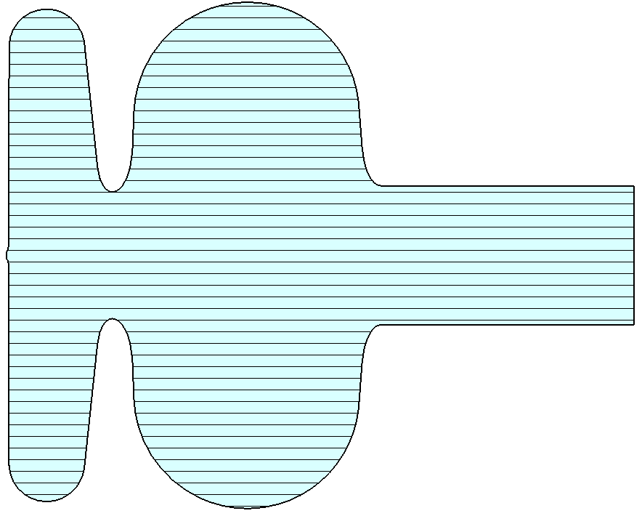
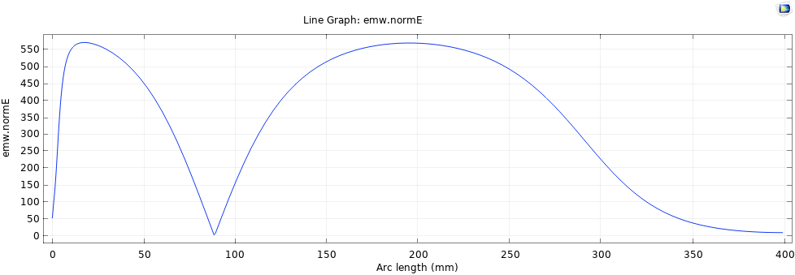
Cavity RF design
H-Field
55%
45%
Ø = 100 mm
Ø = 110 mm
$L_{1}$ = 83.6 mm
$L_{2}$ = 212 mm
Scale 0.35
β = 0.92
$P_{loss}$=$V^{2}R_{s}/$(R/Q)∙G
V = 1.6 MeV ${ P}_{loss}$ [W] ~ 0.073*$R_{s}$[nΩ]
R/Q, Ω | G, Ω | $E_{s}$, MV/m | $H_{s}$, mT
178 | 197 | 15.2 | 25

Slide 3
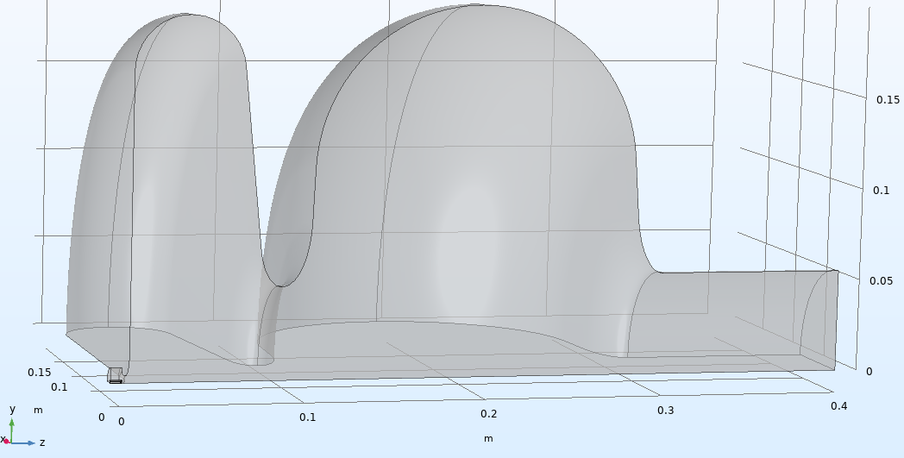
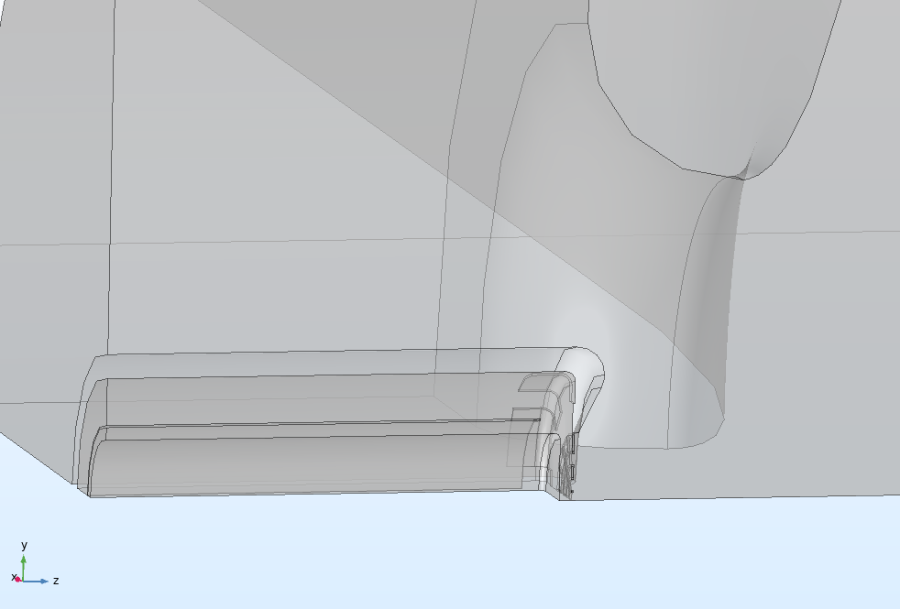
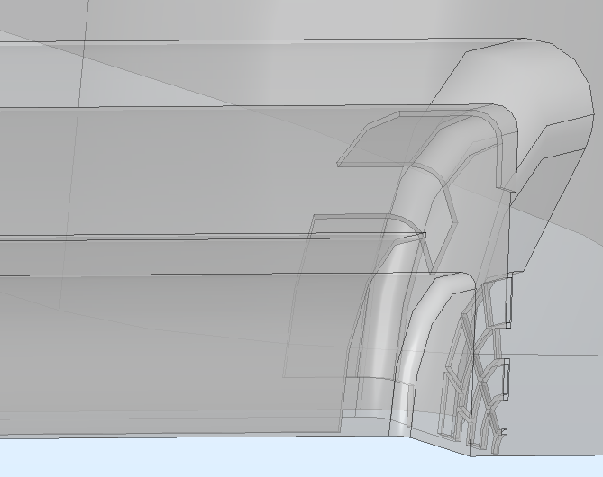
¼ of solid model for MICHELLE
$$R_{iris}$$
L

Slide 4
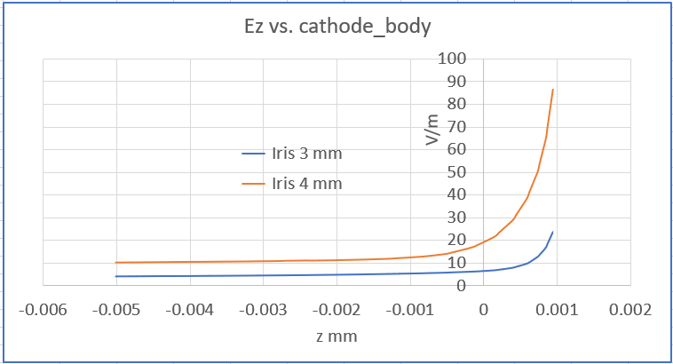
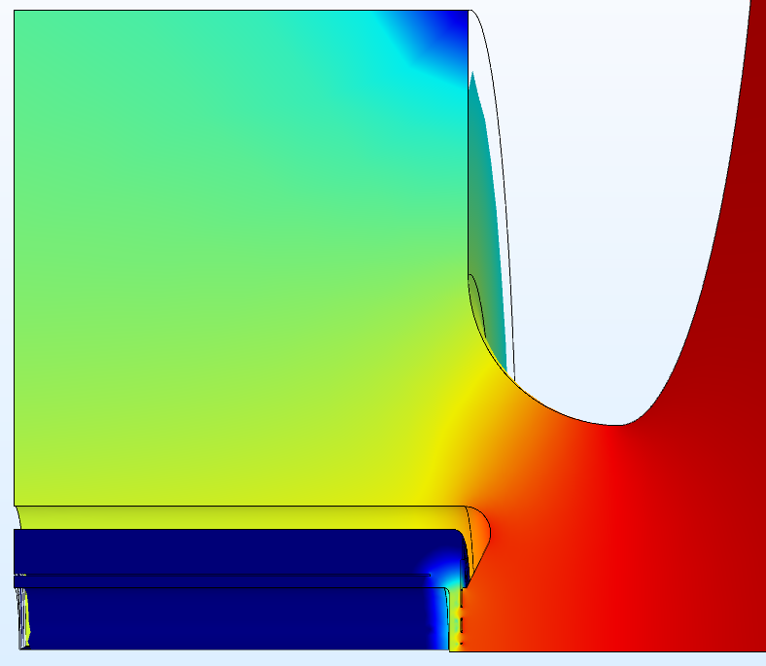
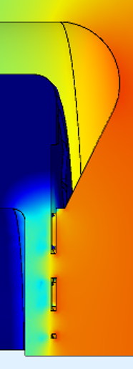
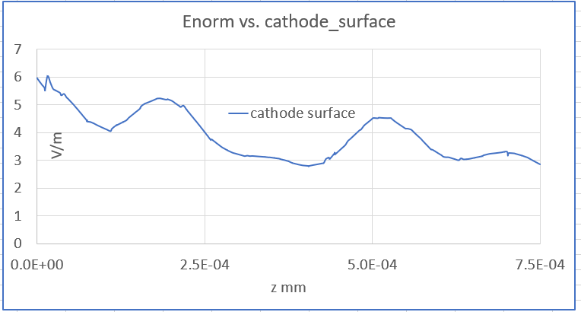
530 V/m
8.5 mm
10 V/m
4 V/m
Log scale of $E_{Field}$
Lumped port
$E_{out}=$1.6 MeV:
$E_{max}\sim 10 MV/m$, $U_{DC}$ = 300 V
4 V/m, d = 150 microns : V = 12 V
1.93 mm
$$R_{iris}$$
d = 150 microns

Slide 5
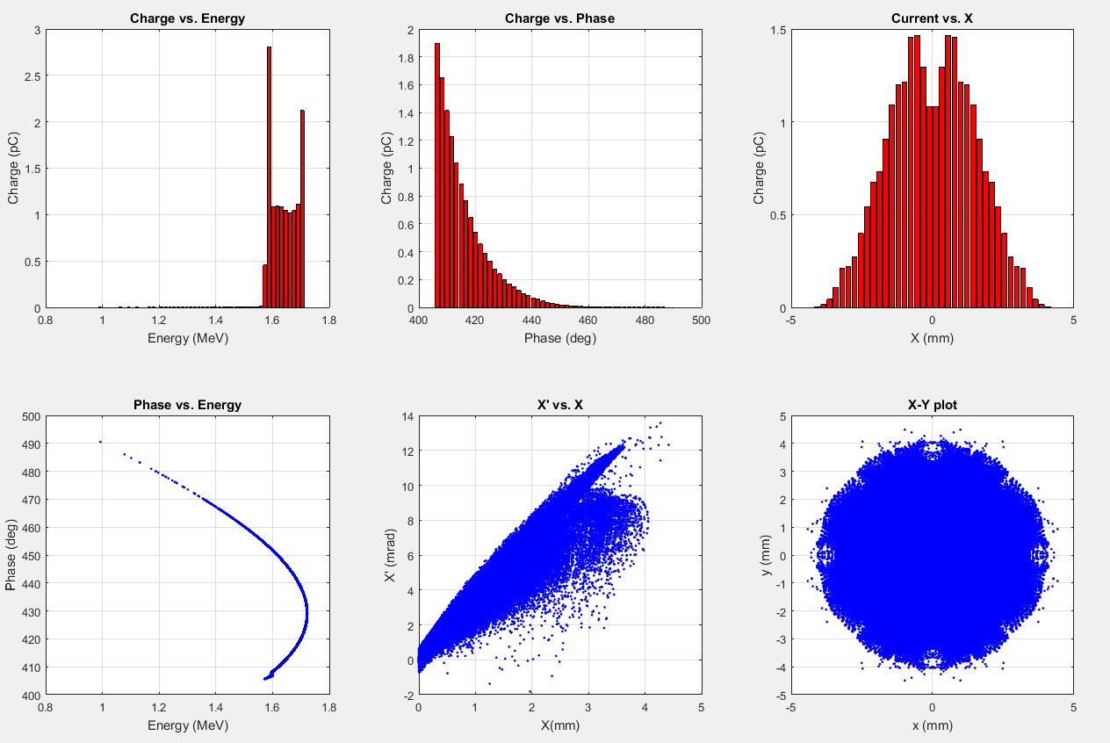
MICHELLE results. Not matched
$E_{average}=$1.65 MeV

