Slide 1
Accelerator Simulation Group
Eric G. Stern
AISP Department All-hands Meeting
3 Dec 2019

Slide 2
Accelerator Simulation Group
Formed in 2000 to develop numerical tools and expertise for beam and accelerator simulations with a special focus on High Performance Computing (HPC)
  Able to explore computing technologies that may be applied more broadly within SCD
    Spack, HDF5, Kokkos, …
Members: E. Stern (head), Q. Lu, T. Zolkin
Former members: P. Spentzouris (founder, now head of the Quantum Science Initiative), J. Amundson (now head of the Scientific Computing Division), D. Dechow, P. Lebrun, A. Macridin (now part of the Quantum Science Initiative), L. Michelotti, C. S. Park

Slide 3
Motivation
The Synergia project was begun in the early 2000s to take advantage of advances in HPC to address accelerator physics questions with detailed simulations.
High intensity proton beams (HEP community plan, 2014 P5 report)
  Need for beam simulation tools capable of addressing the specific challenges of the high intensity proton beams:
    Space-charge, longitudinal dynamics, injection, coherent instabilities, RF optimization, focusing optics, halo control, beam instrumentation, theory and modeling
  Developed and hosted in the Scientific Computing Division to take advantage of HPC expertise

Slide 4
Nonlinear dynamics in accelerators (T. Zolkin)
The Delivery Ring and extraction components for slow extraction delivery of protons to the Mu2e production target.

Slide 5
Characterization of high order behavior (T. Zolkin)
Tracking 4th order perturbation theory

Slide 6

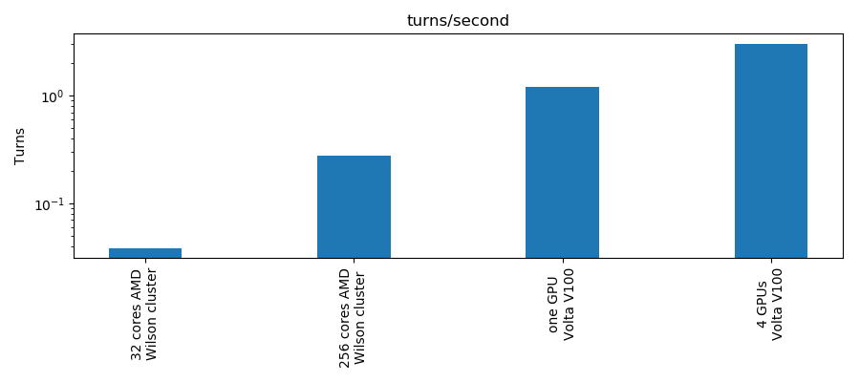
Speedup of Synergia on GPUs (Q. Lu)
Allows us to have the same code base that runs on CPUs and GPUS.
Data is abstracted as a view that can reside either on the Host or GPU
Kokkos provides primitive operations that execute on the data in parallel

Slide 7
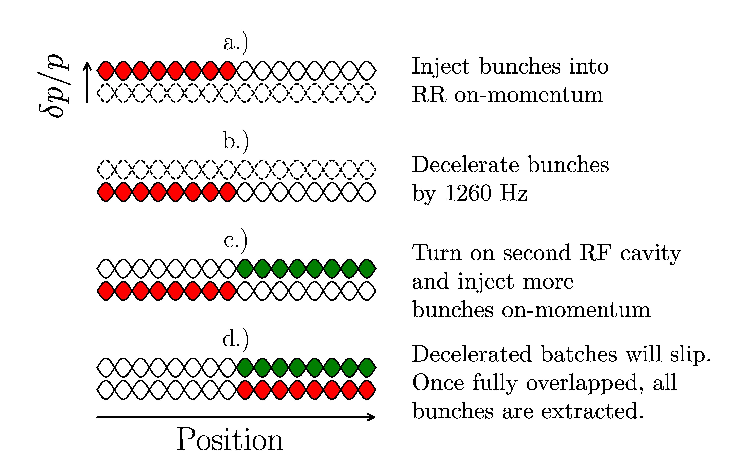
Simulation of slip-stacking with Synergia
Slip-stacking is a clever technique for increasing intensity.
  Pioneered at Fermilab, now used at CERN as well.
  Used in Recycler to double the number of protons per pulse.
  By the end of the cycle two bunches are added in the same bucket.
  Crucial for reaching 700 kW beam power.
Understanding slip-stacking is crucial for future high intensity machines.

Slide 8
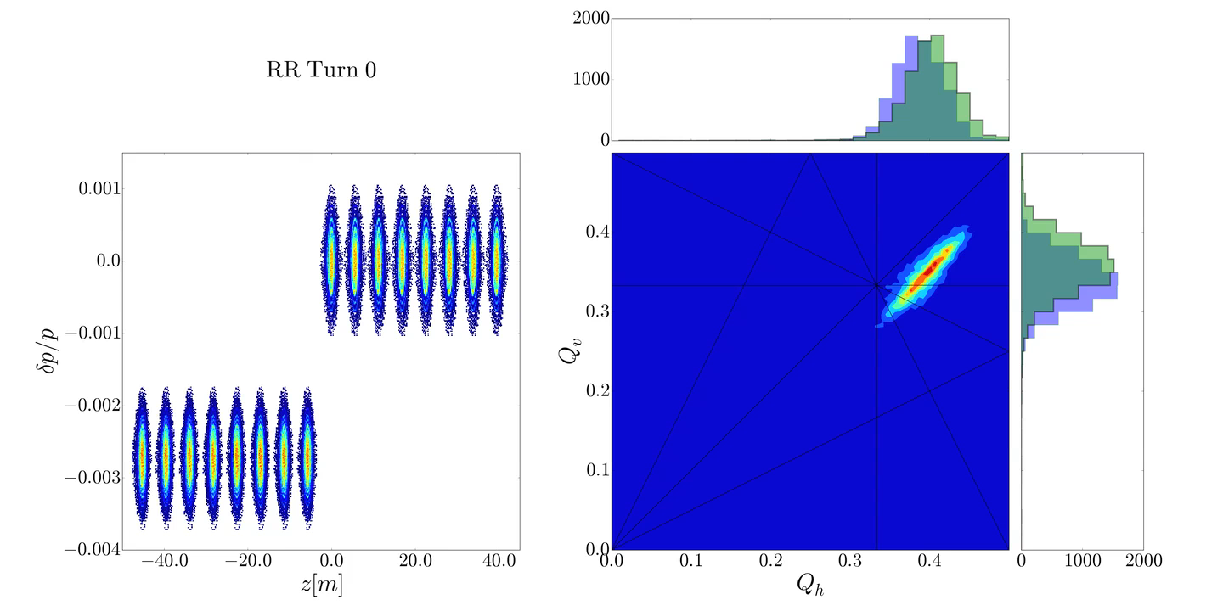
Animation of Synergia Slip-stacking simulation
R. Ainsworth, et al., Phys.Rev.Accel.Beams 22 (2019) no.2, 020404 .

Slide 9
Content Slide [22pt Bold]
Bullet points are optional. If preferred, only first level bullets can be used or bullets can be set to “NONE.” [18pt Regular]
First level bullet [18pt Regular]
  Second level bullet [16pt Regular]
    Third level bullet [15pt Regular]
      Fourth level bullet [14pt Regular]
        Fifth level bullet [14pt Regular]

Slide 10
Content Slide [22pt Bold]
Bullet points are optional. If preferred, only first level bullets can be used or bullets can be set to “NONE.” [18pt Regular]
First level bullet [18pt Regular]
  Second level bullet [16pt Regular]
    Third level bullet [15pt Regular]
      Fourth level bullet [14pt Regular]
        Fifth level bullet [14pt Regular]

Slide 11
Comparison Slide [22pt Bold]
First level bullet [18pt Reg]
  Second level bullet [16pt]
    Third level bullet [15pt]
      Fourth level bullet [14pt]
        Fifth level bullet [14pt]
First level bullet [18pt Reg]
  Second level bullet [16pt]
    Third level bullet [15pt]
      Fourth level bullet [14pt]
        Fifth level bullet [14pt]
Click to add caption text [13pt Bold]
Click to add caption text [13pt Bold]

Slide 12
Content and Caption Slide [22pt Bold]
Click to add caption text
[13pt Bold]
First level bullet [18pt Reg]
  Second level bullet [16pt]
    Third level bullet [15pt]
      Fourth level bullet [14pt]
        Fifth level bullet [14pt]

Slide 13
Picture and Caption Slide [22pt Bold]
Click to add caption text [13pt Bold]

Slide 15














Collaborations / Partnerships / Members [22pt Bold]

