Slide 1
Slow Extraction Working Group
Draft notes

Slide 2
Working group
Vladimir Nagaslaev
Vander Meulen
George Deinlein
Brian Drendel
Steve Werkema
Jerry Annala
Aakaash Narayanan

Slide 3
Interfaces
Infrastructure WG
Aperture improvements
Vacuum improvements
Instrumentation options
Installations
8 GeV Transport
Radiation and Loss Control
Later stage
Mu2e off-project → further upgrades?
Beam profilometer at the ESS
Ceramic pipes for tune quads
Air core quads
Regulation system
Beam Studies
RF?

Slide 4
Issues
[All interfaces]
Production delays
ESS
Regulation

Slide 5
Plan of Actions
Meetings bi-weekly, or in person with each interface
Machine studies - on opportunity, chances to schedule? Not discussed with George D.
Installation Met and discussed with Jim B.
Infrastructure Talking with Dave V. on occasions
Programming: start talking to who?
Guidance:
End of October: present the plan, group list
Starting November 1 - monthly reports [WBS, milestones, labor resources for the WG, justification if more than 6 months needed, ref to documentation]
January 31: Preliminary plan
March 2020: Full report

Slide 6
Milestones
Installations:
Septa HV supplies installed
Septa cabling complete
Shutdown 2020 installations complete
FC-40 circulation system complete
Spill Regulation system installed
Electrostatic Septa installed
Beam studies:
General studies complete
Dedicated studies complete
Application programming
Items #n complete
Instrumentation systems (each) ready for integration
Spill Regulation system is ready for integration
Slow Extraction systems integration complete
Slow Extraction commissioning start
Slow Extraction commissioning complete

Slide 7
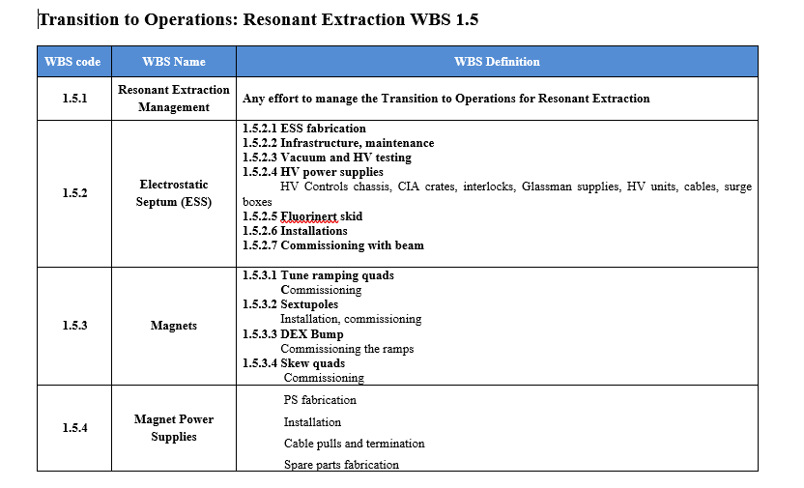
WBS-I

Slide 8
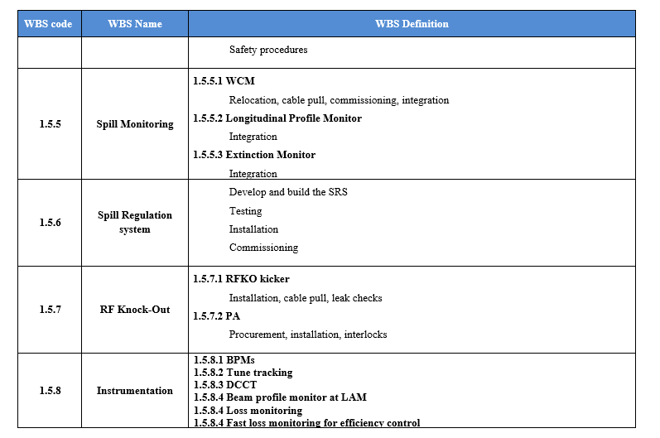
WBS-II

Slide 9
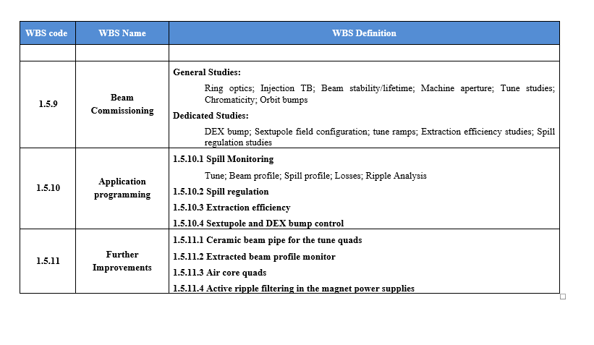
WBS-III

