Slide 1
CRYO ASIC readout system
Presenter: Dionisio
On behalf of SLAC team

Slide 2
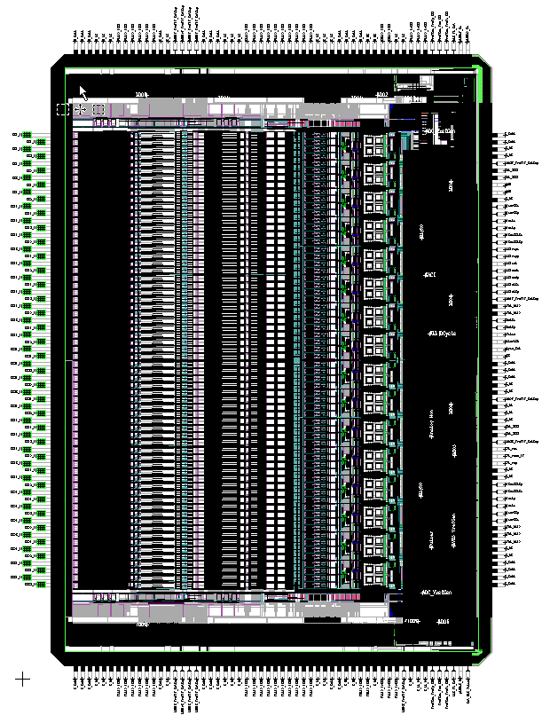
CRYO ASIC
CMOS process 0.13µm (1P8M)
Supply voltage 2.5V
Version v.0.2
Die size 6774 x 8948µm
Die size after cut 7236 x 9400 µm
Die thickness 250-300 µm
240
PinTop
185
Pin 1
184
PinLeft
PinRight
64
121
65
PinBottom
120

Slide 3
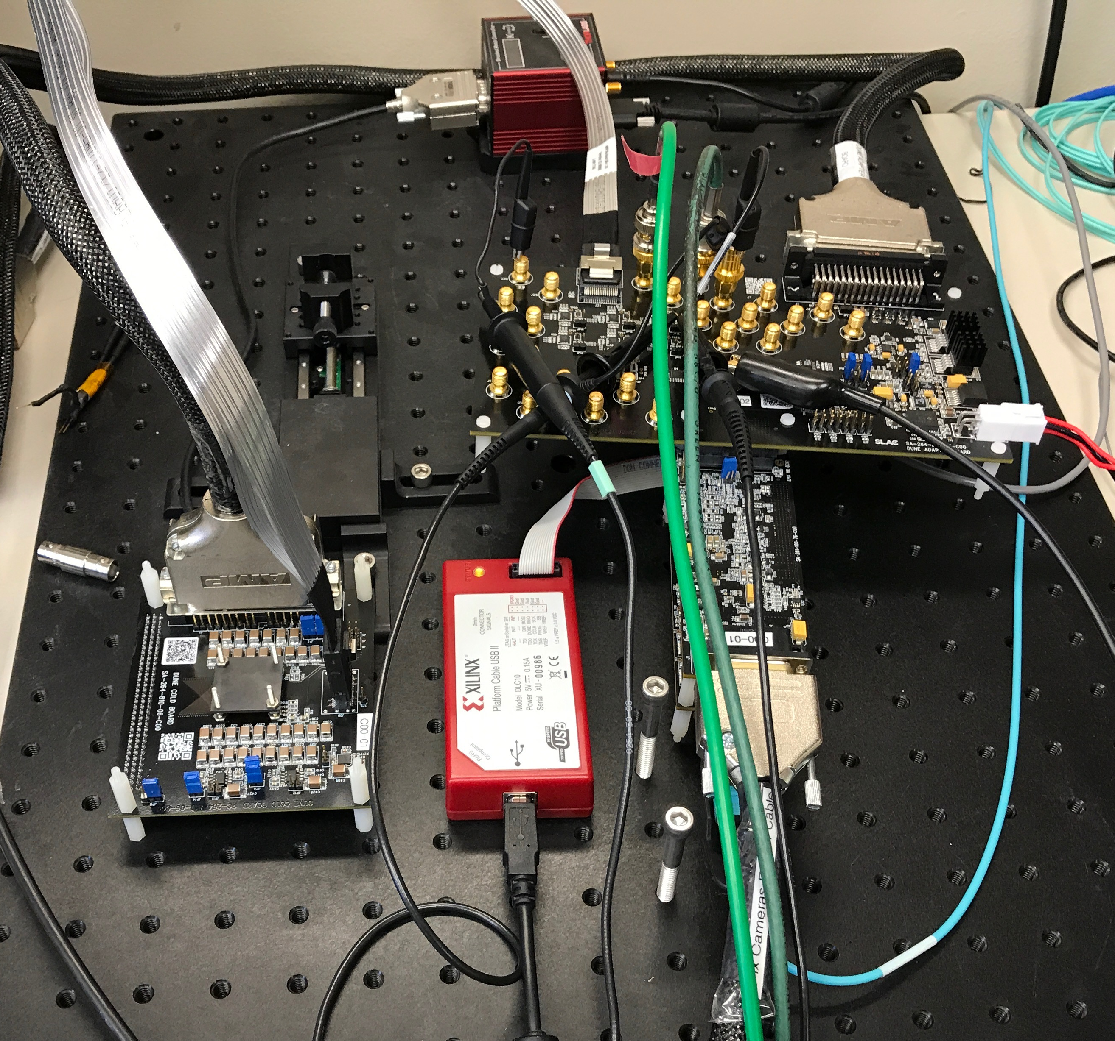
CRYO ASIC
CRYO ASIC (left)
CRYO ASIC wire-bonded to the cold board (center)
CRYO ASIC test system (right)

Slide 4
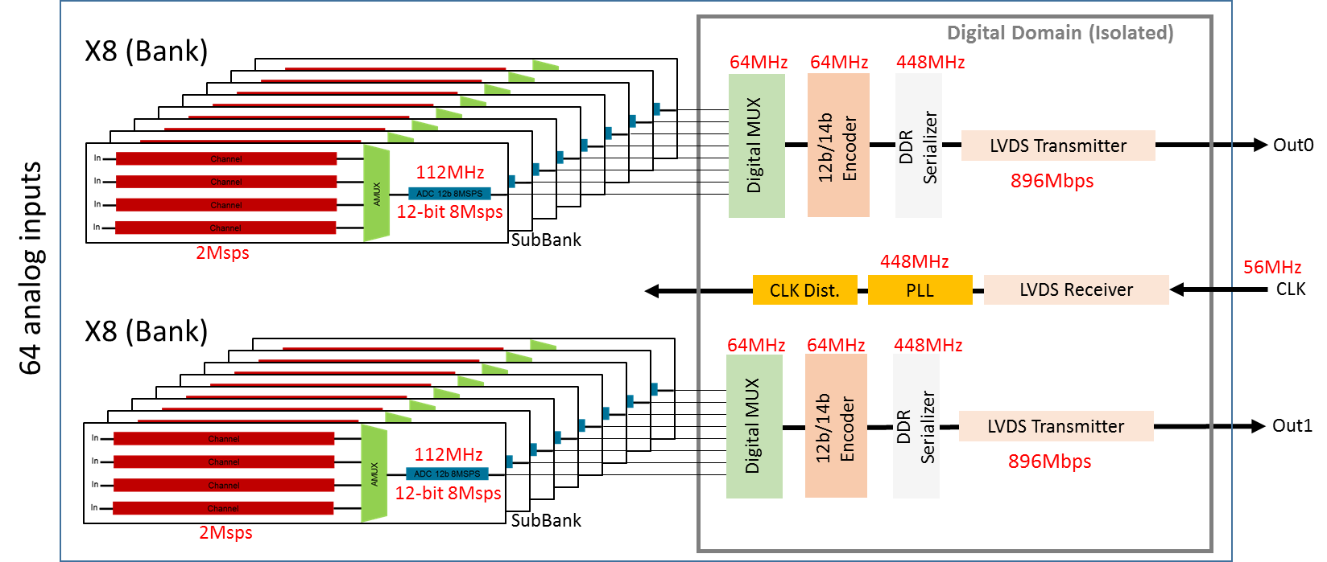
CRYO – Clock domains
Registers
SACI
All internal clocks are synchronized to the external input clock of 56MHz
Clocks at the SubBank level are generated when StartRO goes high (next slide)

Slide 5
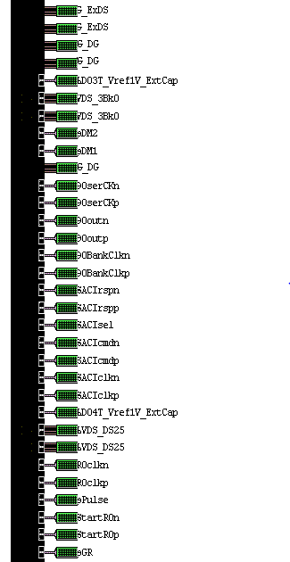
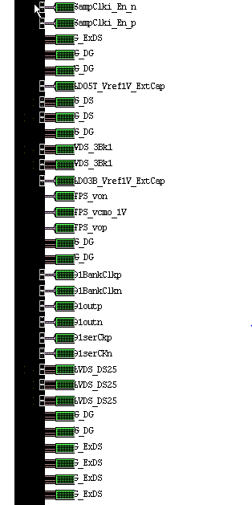
Signals to control 2 ASICs Based on CRYO (variant nExo or version 0.2)
184
Required signals
Signal name | Type | # of pins
4x Data Out (DO) | Differential | 8
CLK | Differential | 2
SACI (CLK, CMD, RESP) , SHClkEn and SRO* | Differential | 10 (multi drop)
SACI SEL(x2), GR, ACQ | SE | 4
 | Total pins | 24
*New connection needed when SR0 becomes differential
**ASIC Sync will be removed. ASIC pulse is used for the tests with internal pulse
Optional
Signal name | Type | # of pins
Digital monitoring | Single ended | 4
Analog monitoring | Analog | 6
External DAC S&H | Analog | 1
 | Total pins | 11
121

Slide 6
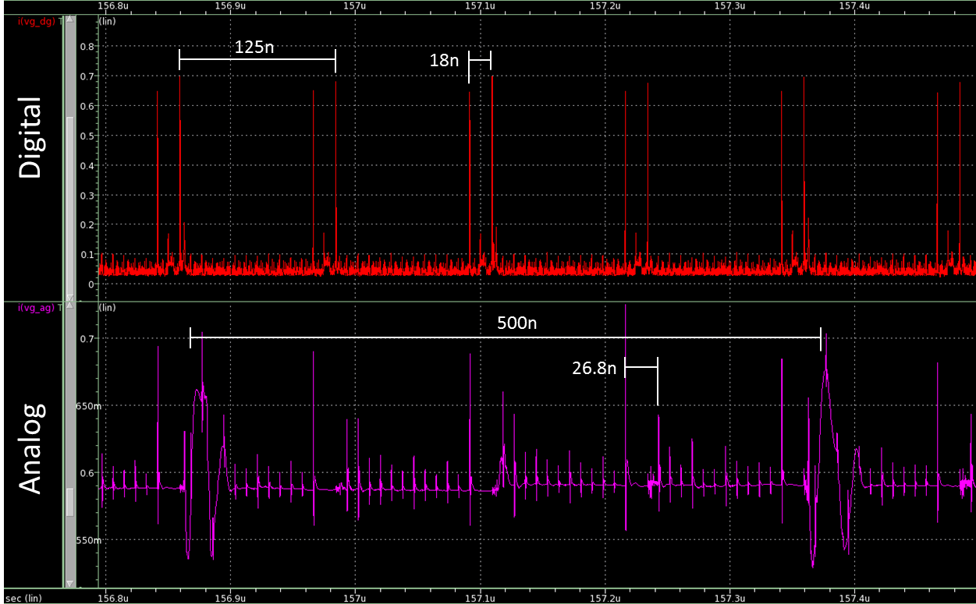
Cryo supply requirements
Power supplies
2x 2.5V digital
Current drawn: 0.1A/ASIC
Ripple accepted: <25mV
Must be regulated, using linear regulator
2x 2.5V analog
Current drawn: 0.65A/ASIC
Ripple accepted: <25mV
Must be regulated, using linear regulator
WIB
2 possible supplies
DC-DC + LDO (provides 2.5V direct to the ASICs)
DC-DC (provides 5V to COTS LDO in the FEMB)

Slide 7
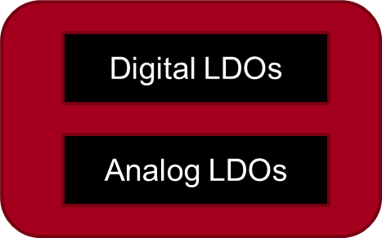
Possible current WIB power scheme
Data and control signals
Twin-ax
Ext.
LDO
cryo asic
Ext.
LDO
Front panel LDO voltage monitoring
Ext.
LDO
cryo asic
Ext.
LDO
DC-DC @ 5V
WIB
FEMB
Current carrying lines
Voltage monitoring line
FEMB does not include passive components.

Slide 8
Possible current WIB power scheme
Data and control signals
Twin-ax
cryo asic
Front panel LDO voltage monitoring
cryo asic
DC-DC+LDO @ 2.5V
WIB
FEMB
Current carrying lines
Voltage monitoring line
FEMB does not include passive components.

Slide 9
FIRMWARE
Slow control lines
Global reset
SACI
Fast control lines
SR0
SamClkEn
ACQ
Data and Clock lines
CLK (56MHz)
Data (896Mbps)
SACI (register)
Enable internal LDO
Enable PLL
Program channels (gain, filtering, bias and offsets)
CRYO specific fast commands
SR0En
SamClkEn
samplingCycleSync
chargeInjection (ACQ)
…

Slide 10
Initialization sequence
Global reset is always issued at the beginning of operation
SACI configures all ASIC registers
Including: Enable LDO and PLL, sets channel gain, filter, offsets …
SamClkEn signal (FPGA controlled synchronization signal)
After PLL is stable, SamClkEn signal control the exact moment when the internal clocks start
This enables precise control of sampling and hold moment
Associated with DUNE fast command structures it allows to synchronize the ASICs to +/- 56MHz clock pulse
Start of Readout signals (FPGA controlled synchronization signal)
Synchronize the ASIC data collection at the sample level
Associated with internal 8MHz clock
Concept waveform initialization sequence

Slide 11
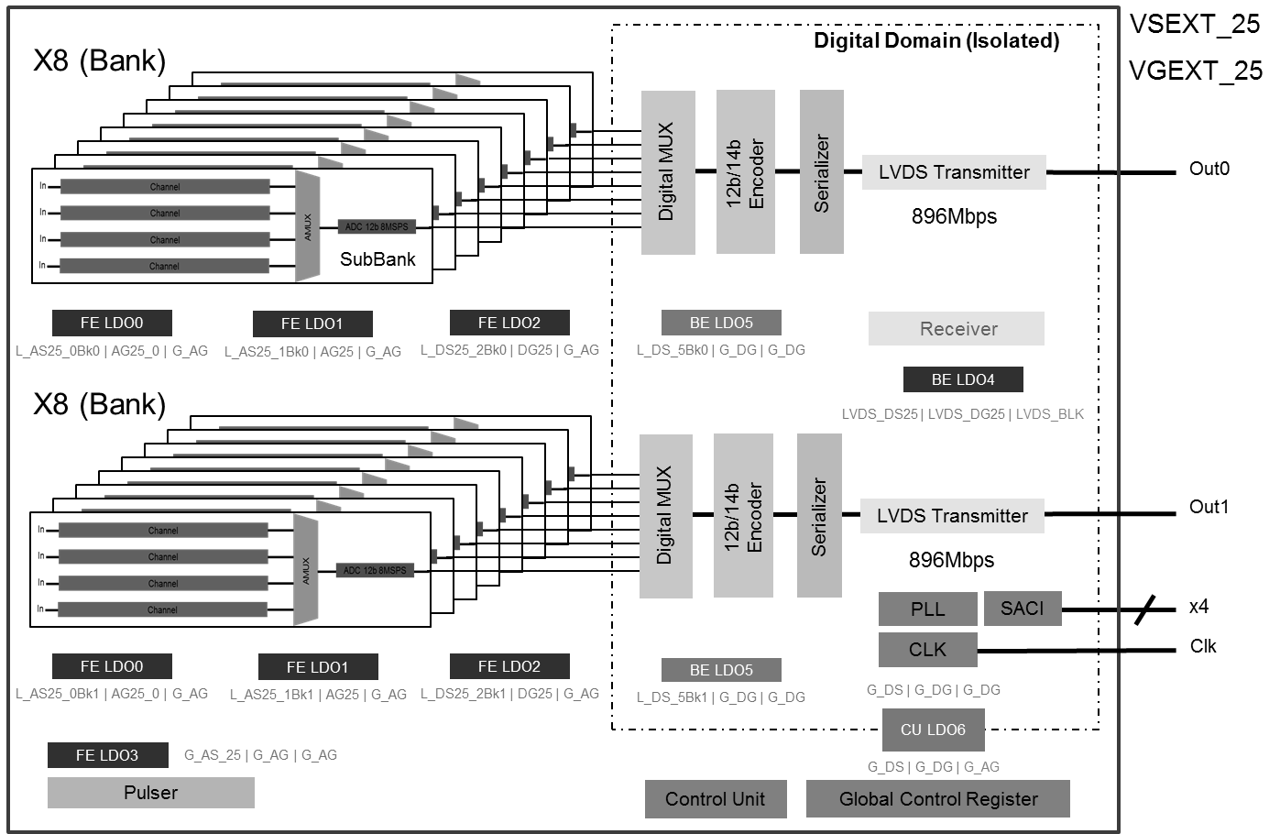
CRYO ASIC timing details (Sub-bank level) PRELIMINARY
‘StartRO’ latched with ‘sampCKi’

Slide 12
CRYO data format
CRYO ADC is 12 bit
Data in encoded as 12b14b (similar to 8b10b)
Data is DC balanced
SURF library (public) contains modules for decode data
https://github.com/slaclab/surf
Requires custom firmware to de-serialize the data
Already developed
Uses Xilinx specific features

Slide 13
Encoder description
Data encoding format
The 12B/14B line code is designed to provide a DC balanced encoding scheme for transmitting 12-bit data words over high speed serial links.
Encoding Algorithm
Like 8B/10B, the code table is split into two parts. The 7 least significant bits are encoded using a 7B/8B encoding table, and the 5 most significant bits are encoding using a 5B/6B table.
Also like 8B/10B, a running disparity is output with each code, and fed back to the input for use in selecting the next code.
The 7/8 encoding is considered first, along with a running disparity count. The code is looked up in the 7B/8B table. Then it is optionally inverted if doing so would bring would bring the running disparity closer to 0. Some codes naturally have 0 disparity (4 ones and 4 zeros), and these are never inverted.
Then the 5/6 encoding is considered. The code is looked up in the code table, and then optionally inverted according to the following rules
Attempt to balance the overall 14-bit code.
If the selected 8-bit code has positive disparity, invert the 6-bit code if needed to achieve negative disparity.
If the selected 8-bit code has negative disparity, invert the 6-bit code if needed to achieve positive disparity.
Attempt to balance the running disparity
If the selected 8-bit code has even disparity, invert by rules above based on the input running disparity rather than the selected 8-bit code disparity.

Slide 14
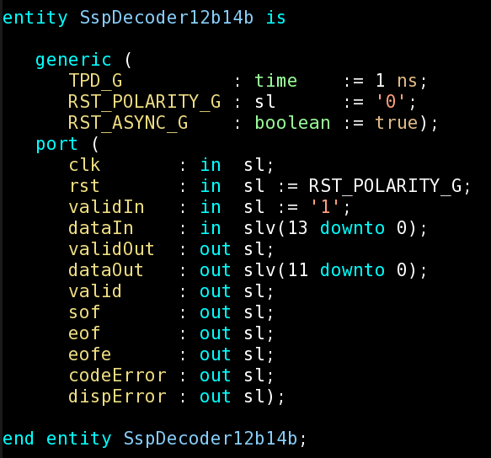
12b14b decoder
Deserializer converts streams at 896Mbps to 14b encoded data
12b14b decoder decodes the 14b data back to raw ADC (12b) data
Error detection
End of Frame error
Disparity errors
Encoding errors
Currently we have counters that enable us to track these errors if they happen

Slide 15
SLAC ASIC Control Interface (SACI)
Motivation
Need simple serial interface to ASICs for configuring registers and sending commands.
Standard Options Not a Great Fit
SPI: No backpressure. No way for ASIC to signal that it is done with a command or ready for new data. Requires polling.
I2C: Backpressure possible through clock stretching, but complex protocol and implementation.
Adoption
It is used by several ASICs, leveraging the platform design methodology adopted at SLAC

Slide 16
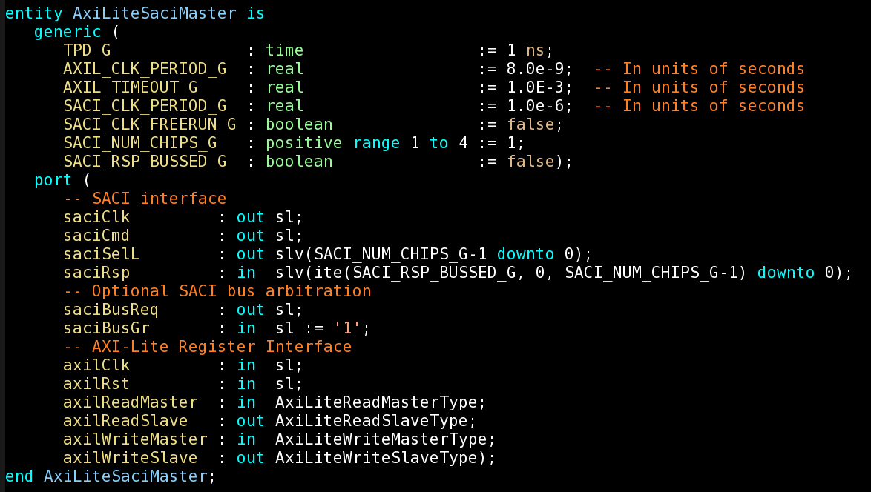
SACI Features
Master/Slave Serial Interface
4 Signals
3 shared: saciClk, saciCmd, saciRsp
1 dedicated select line per slave: saciSelL
Allows multiple slaves on same SACI bus. (Similar to SPI.)
Serial data transmitted on rising edge of clock and sampled on falling edge. MSB first.
Toggling saciSelL resets Slave state machine in case of lockup.

Slide 17
SACI Writes
Master lowers saciSelL
Master sends Start Bit, Write Bit, Command, Address and Data
Slave responds with Start Bit, Write bit, Command and Address
Master optionally raises saciSelL when done.

Slide 18
SACI Reads
Master lowers saciSelL
Master sends Start Bit, Read Bit, Command and Address
Slave responds with Start Bit, Write bit, Command, Address and Data
Master optionally raises saciSelL when done.

Slide 19
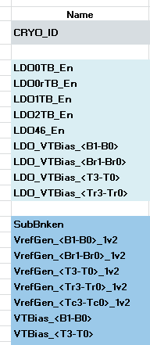
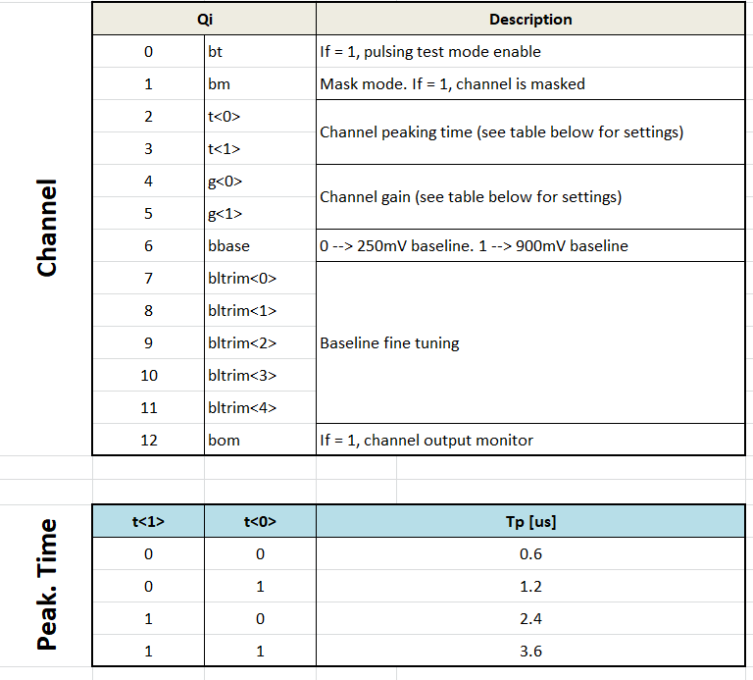
SACI Registers
Global registers
19 registers 16 bits
Examples
Channel registers

Slide 20
BACKUP

Slide 21
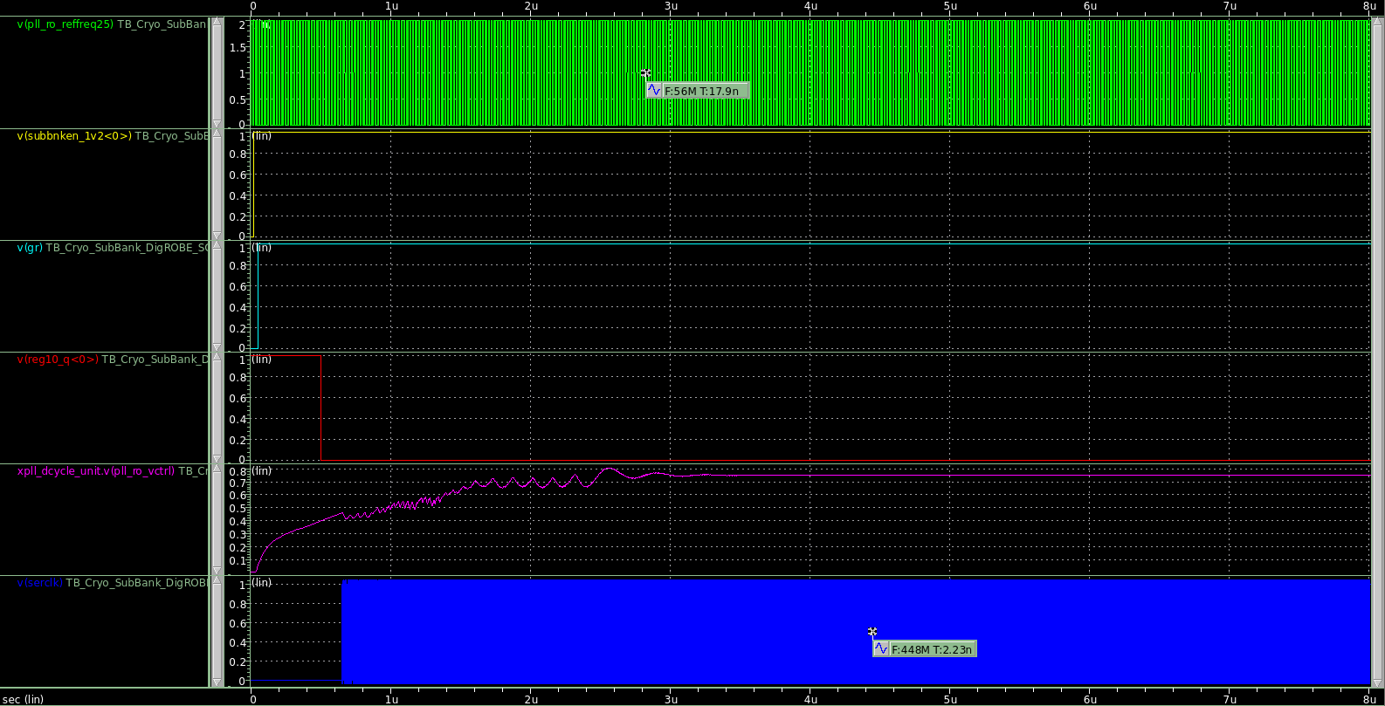
PLL settling
SubBank Enabled → GR at 50ns → PLL out of reset at 500ns
PLL settled already at 4us
56MHz
SubBankEn
Global Rst
PLL Rst
PLL Vcrtl
448MHz

