Slide 1
Magnets 302.2. Shipment Requirements and Execution
Maria Baldini - FNAL
HL-LHC AUP IPR DOE/SC Review – Jan. 14th–16th 2020

Slide 2
Outline
Requirements
Travelers and shipping plans
Shock data
Lesson learned: coil 206, humidity test
Summary
Lab
Logo

Slide 3
HL-LHC AUP shipments

Slide 4
Coil shipping Requirements
Coils
<500 microstrain = shocks <10 g (FEM analysis on Docdb 2478)
dedicated shipping fixtures
Provision against moisture
A minimum of 2 accelerometers on the LE and RE
5g and 10 g shock watches
Air ride dedicated truck
Notes:
FEM analysis confirmed that shocks up to 10 g are acceptable using the AUP MQXFA shipping fixture

Slide 5
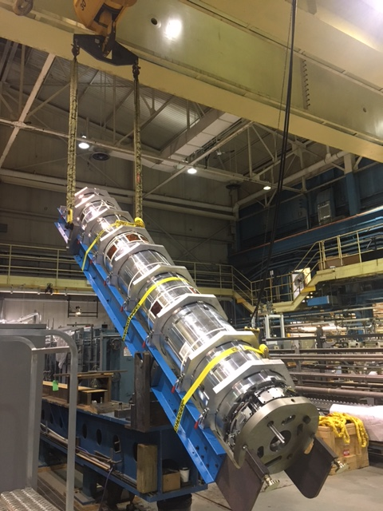
Magnet shipping Requirements
Magnets
conductor strain shall be <500 microstrain
the laminations shall always remain in contact during any MQXFA
4 point lifting and shocks < 5 g (FEM analysis in DocDb 838)
dedicated shipping fixtures
2 accelerometers on the LE and RE
5 g and 10 g shock watches
Air ride dedicated truck

Slide 6
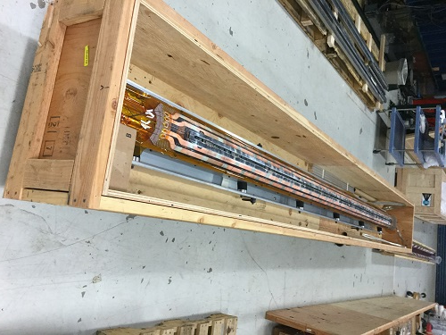
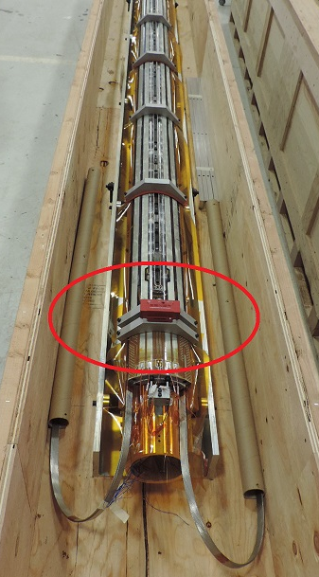
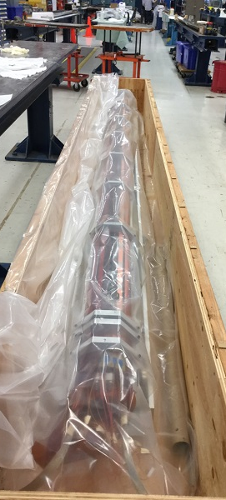
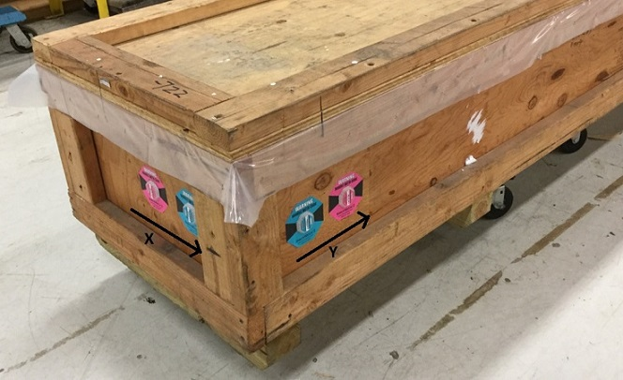
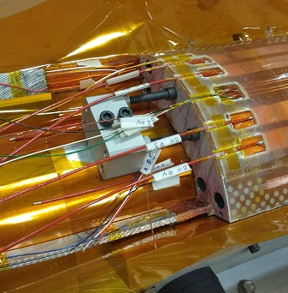
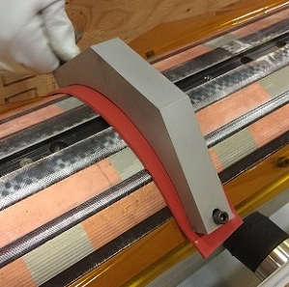
Coil QXFA Shipping travelers
Procedures are well defined by travelers in each lab.

Slide 7
Planning
Handling and shipping plan: US HiLumi Doc DB 1686
Coils shipped to LBNL from FNAL and BNL
fixture shipped back to BNL and FNAL from LBNL
At production peak: 6 shipping fixture (two spares)
Magnets shipped to BNL from LBNL
Magnets shipped to FNAL from BNL
At production peak: 4 shipping fixture (one spare)
LABS | Trips | # fixture/crates | Accelerometers | # batteries
FNAL coils | 50 | 2+ 1 spare | 4 (2 for each fixture) +1 spare to be returned with the empty crate | 200
BNL coils | 50 | 2+ 1 spare | 4 (2 for each fixture) +1 spare to be returned with the empty crate | 200
LBNL magnets | 25 | 3 crates + 1 spare | 6 (2 each) | 100
BNL magnets | 25 |  | keeps the ones received and use them for the shipment | 100

Slide 8
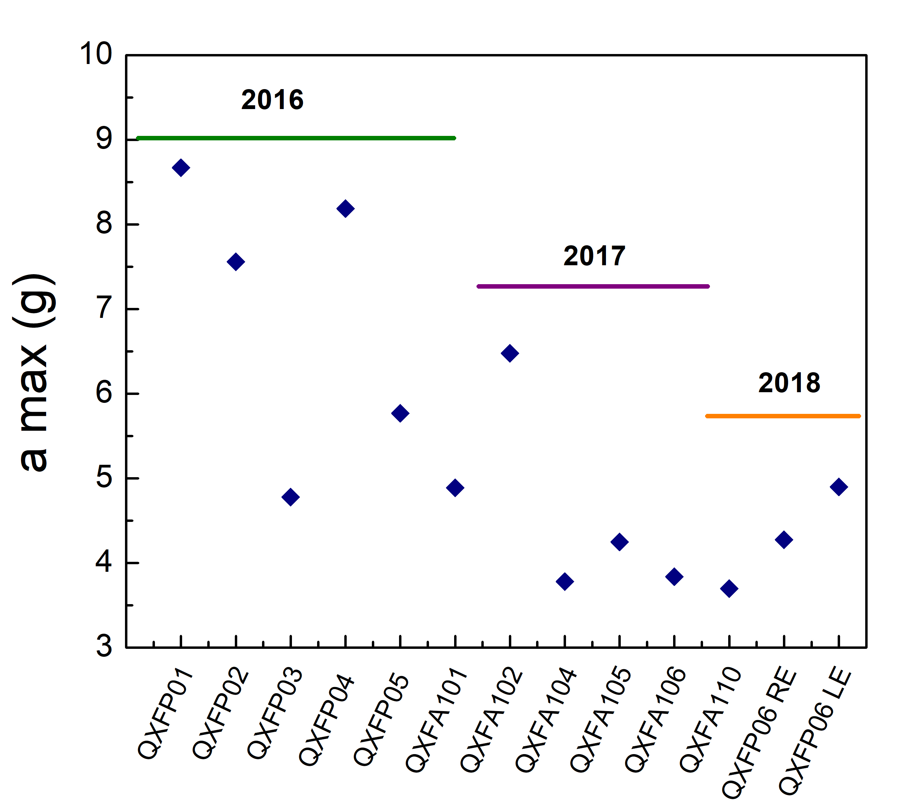
LARP Coil shipments summary (max shocks)
MQXFAP1
MQXFAP2

Slide 9
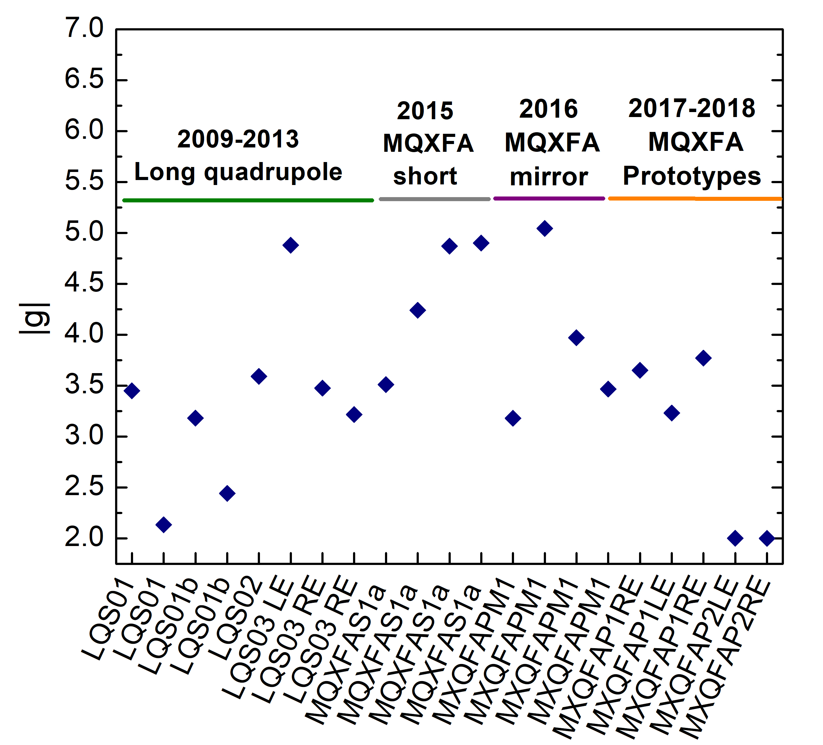
LARP Magnet shipments summary (max shocks)
loading/unloading
Accelerometer on the crate
HL-LHC AUP IPR DOE/SC Review– Jan 14-16, 2020
Notes:
Accelerometers on the crate for highest value after 2015
No info about accelerometers position before 2015

Slide 10
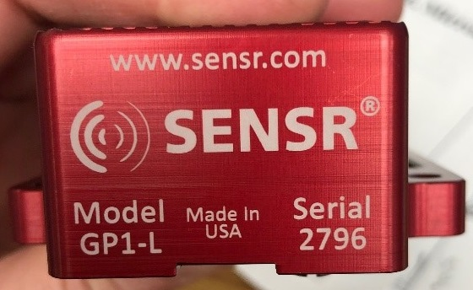
Shock measurements: accelerometers
SLAMSTICK X and C
g range up to 25 g and 16 g
Sample rate up 20 kHz or 3.2 kHz
Frequency response up to 2000 Hz or 500 Hz
Vibration spectral analysis
GP1L Senseware
g range up to 6.7 g
Sample rate 100 Hz
Frequency response 50 Hz
Event recorded if > 3g
From FNAL coil 115
From BNL coil 206
From magnet MQXFA03

Slide 11
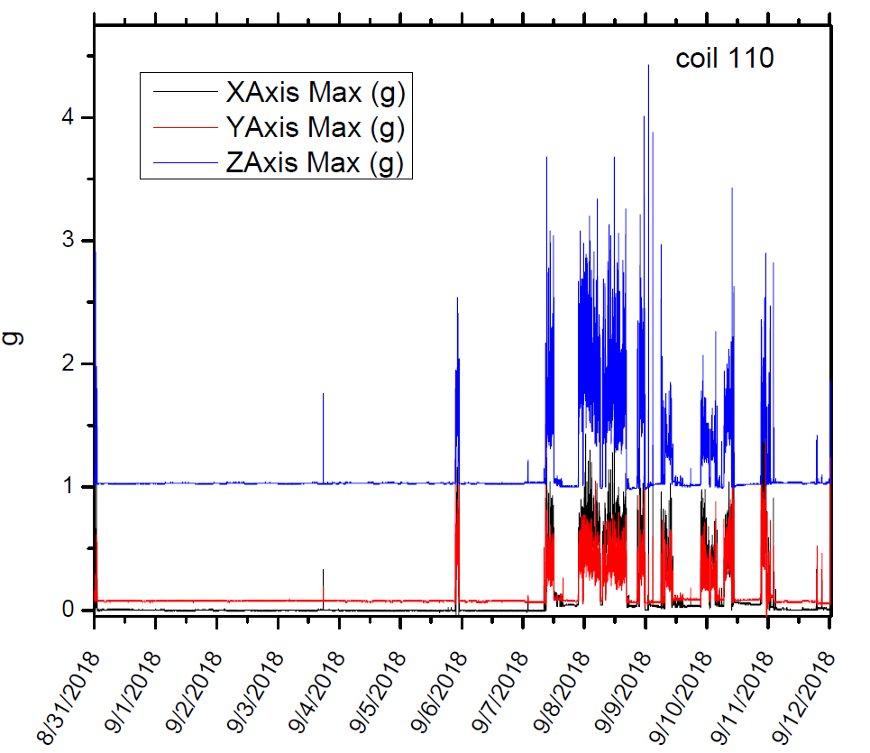
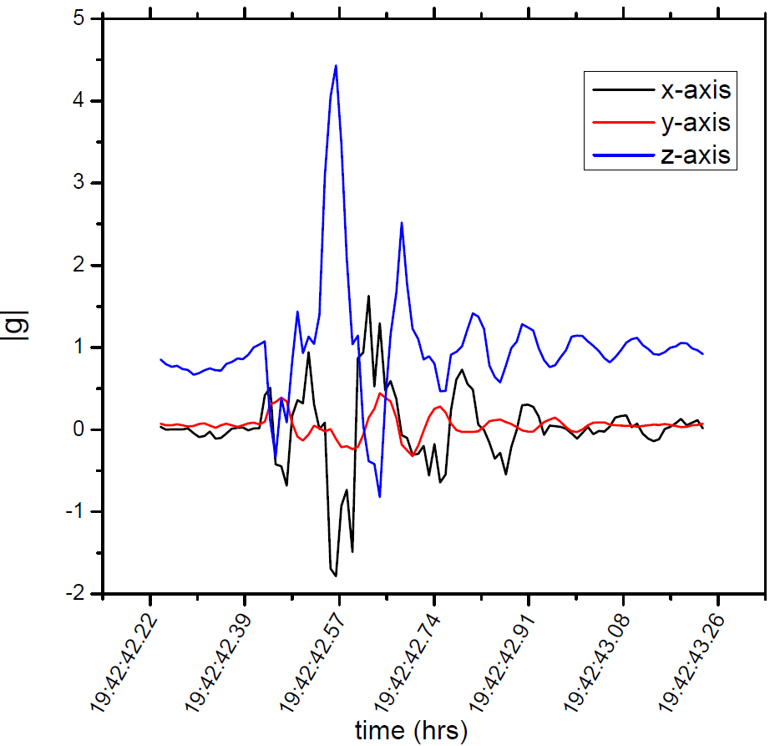
Accelerometers data set examples
GP1L: entire trip in a snapshot
GP1L: event >3g, 100 s

Slide 12
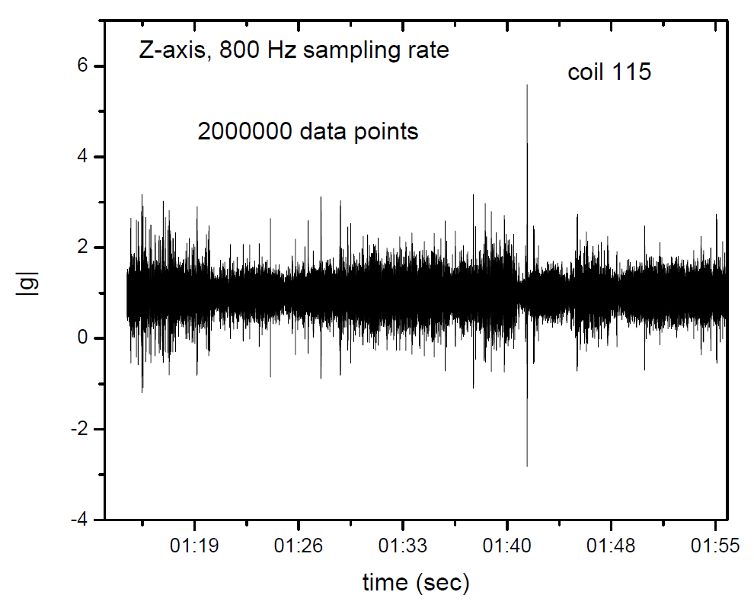
Accelerometers data set examples
Sept 21 2019
36 min of data

Slide 13
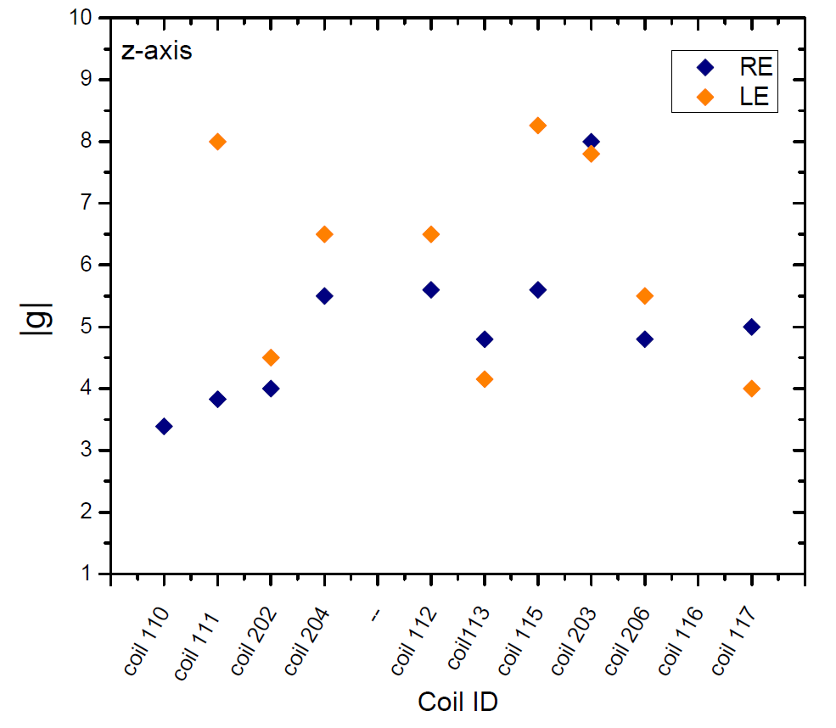
AUP Coil shipments summary (max shocks)
Max shocks are during loading/unloading
No shock > 10 g
MQXFA04
MQXFA03

Slide 14
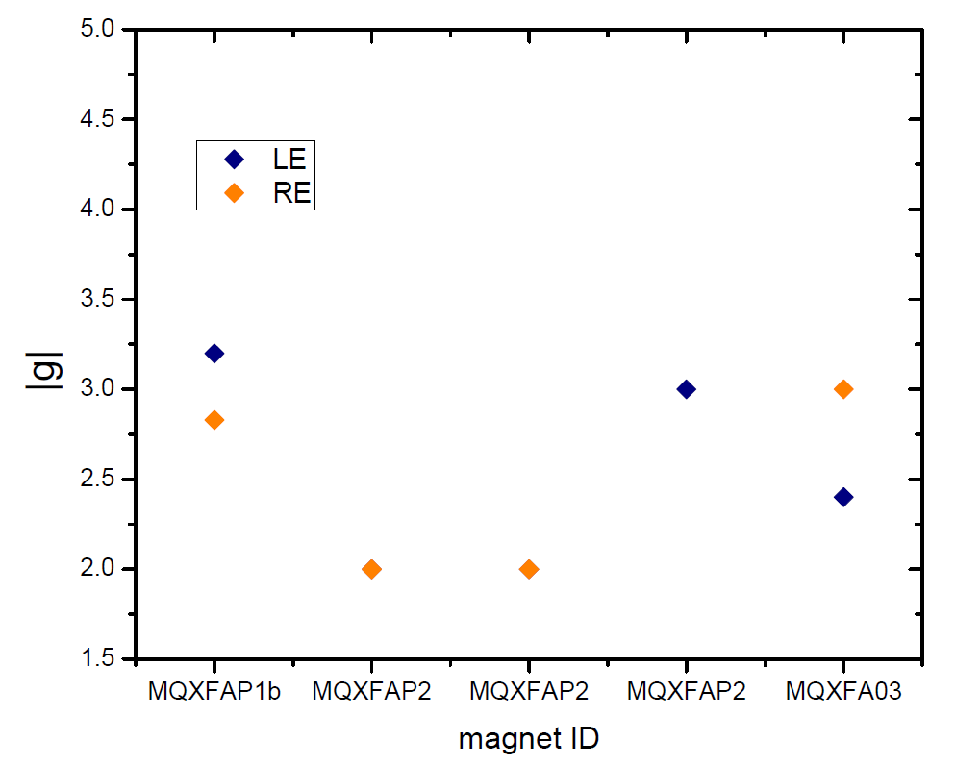
AUP magnet shipments summary (max shocks)
Z-axis
No shock > 5 g
After testing

Slide 15
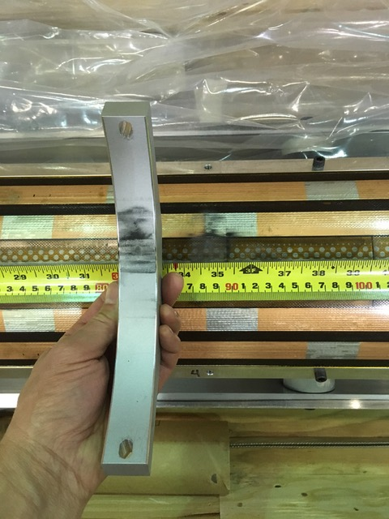
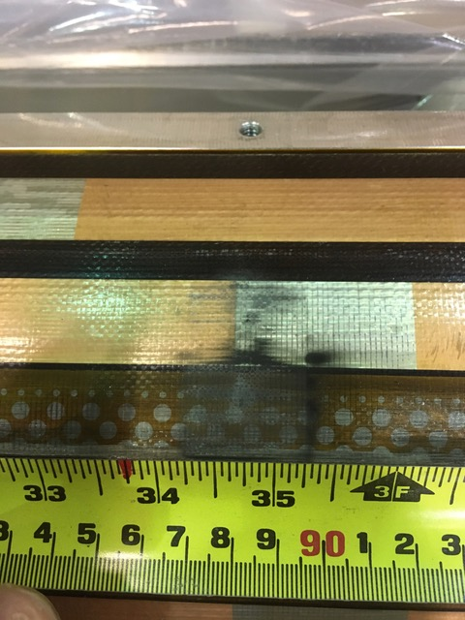
Lesson learned: Coil 206 DR
Example of marks under Clamping Rib 4

Slide 16
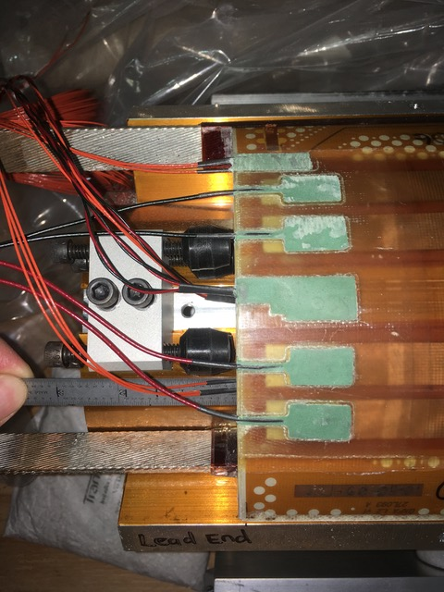
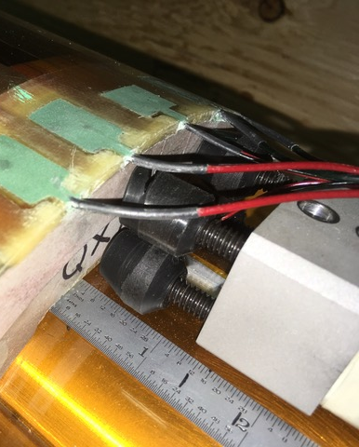
Coil 206 DR: Axial Restraints Not Engaged
HL-LHC AUP IPR DOE/SC Review– Jan 14-16, 2020

Slide 17
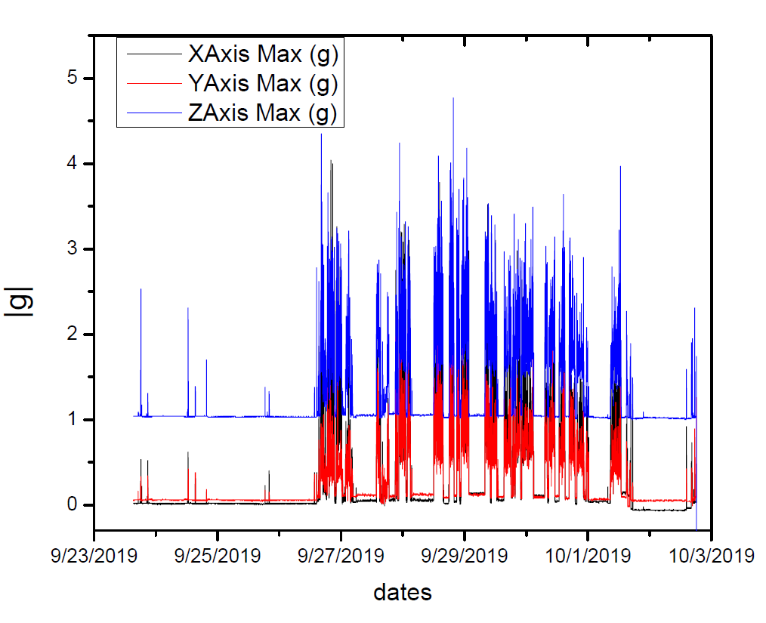
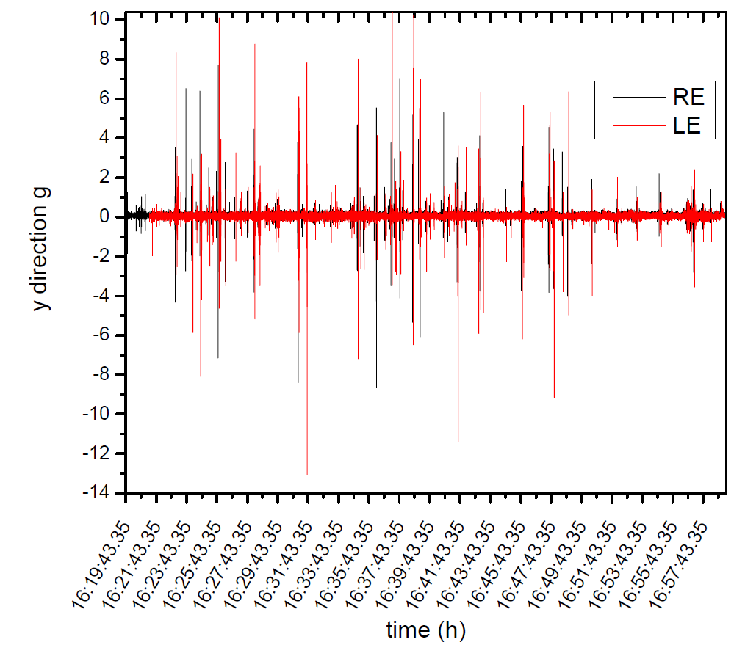
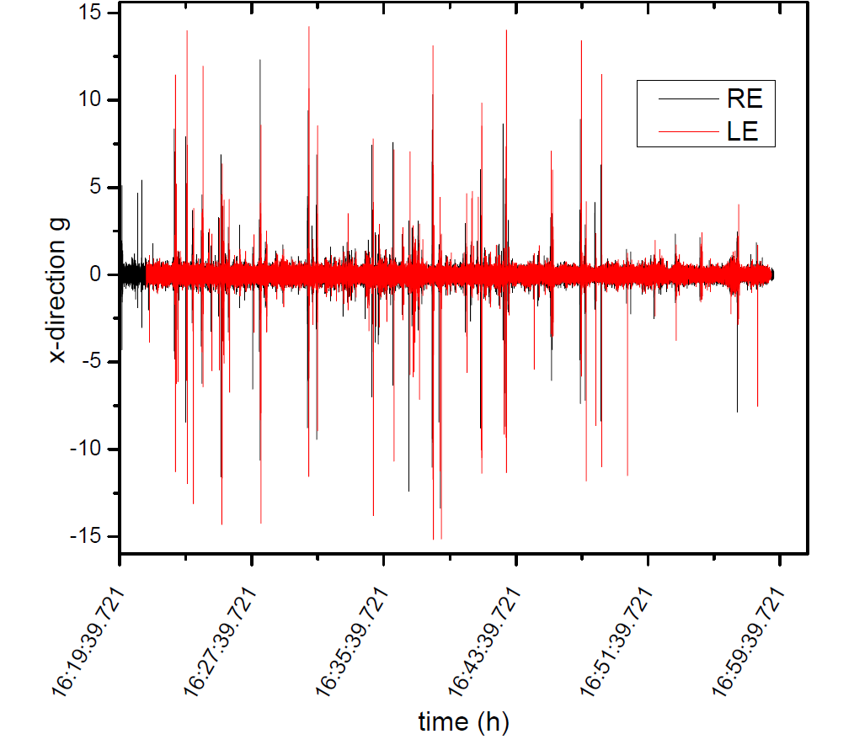
Accelerometer data for coil 206
GP1L: <5g
SLAMSTICK shocks > 10g along x and y axes
No shock > 10g along z-axes

Slide 18
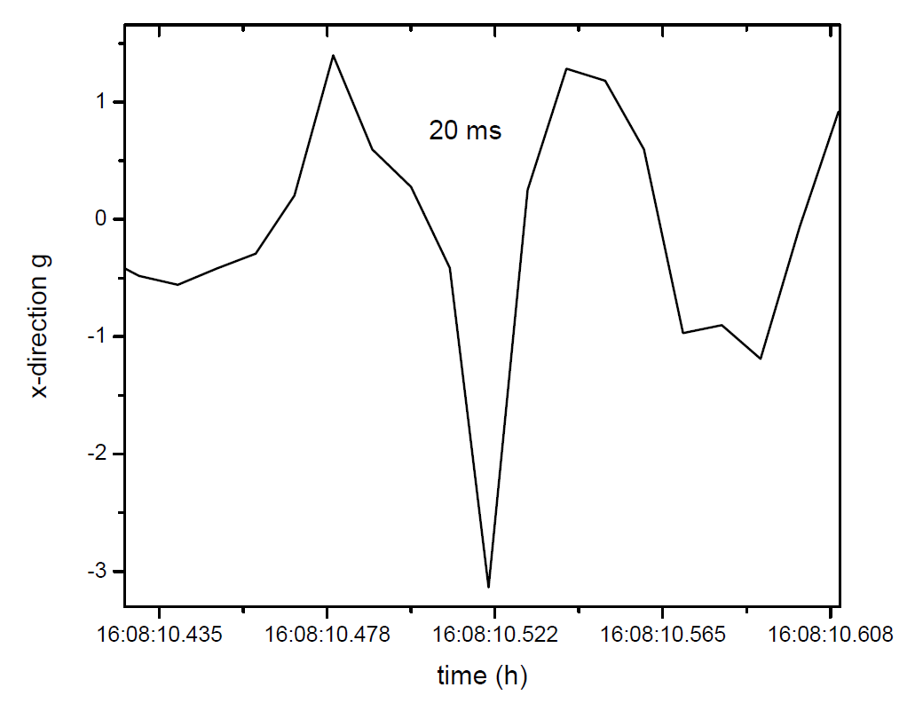
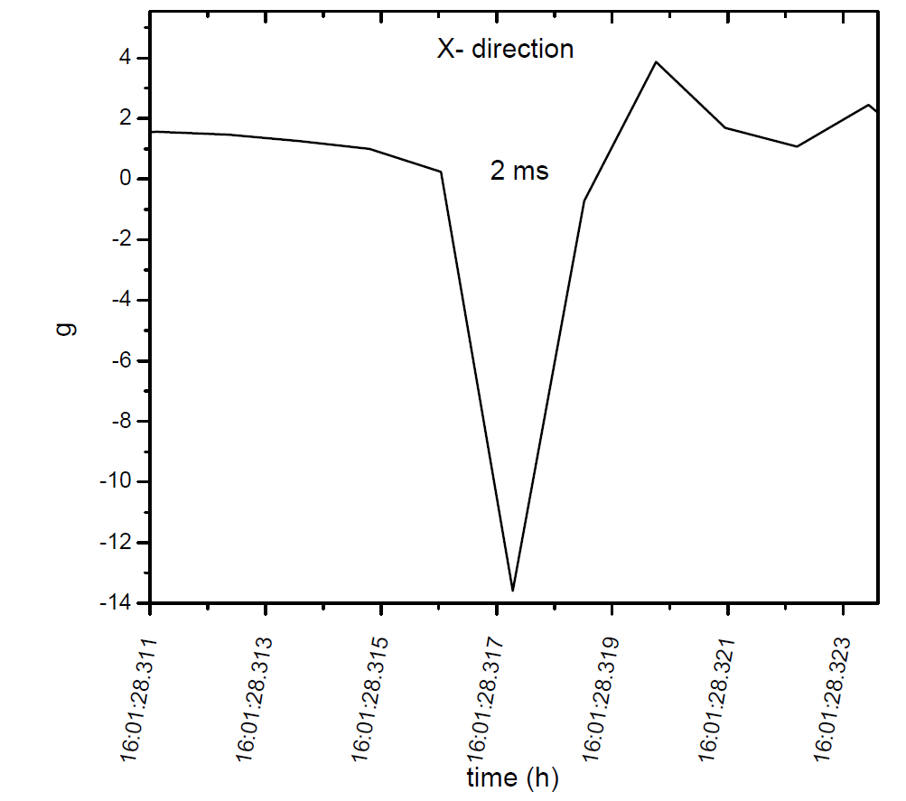
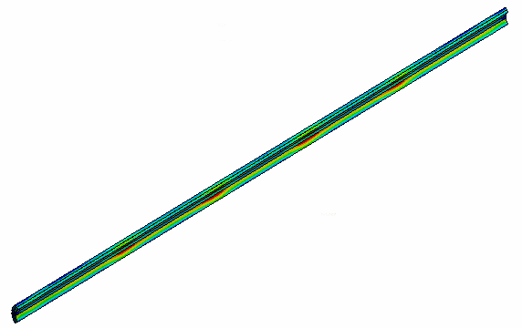
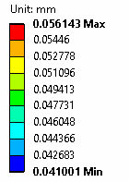
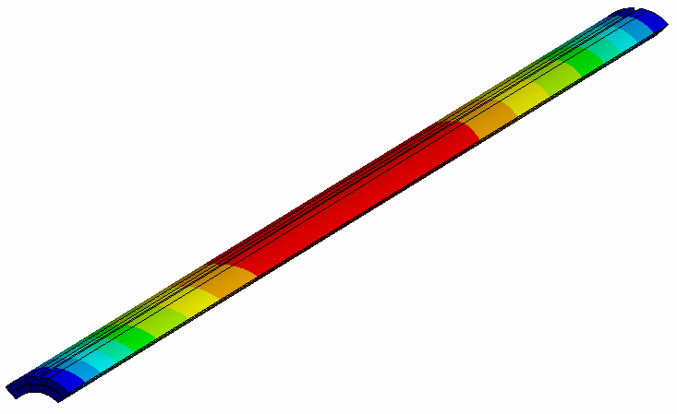
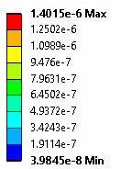
Accelerometer data for coil 206
GPL1 event time is 20 ms
SLAMSTICK event time is 2 ms
Very sharp shocks along x and y directions: coil is shaking because is not clamped well
FEM: 1g Vertical Inertial Load---upward on Coil Only
Coil deformation is ~56 (µm)
Coil Vertical Deflection (mm)
Coil Equivalent Strain,
Maximum strain is ~1.4 µε

Slide 19
Coil 206: lesson learned
Based on results and FEM analysis Coil 206 was accepted
Mitigations:
Add rubber material under the fixture clamps
Install locking nuts on axial restraints to prevent screws from backing out
Wrap coil in Kapton/Mylar around fixture
All those procedures have been specified in the coils shipping and handling requirements (Docdb 820)
Travelers have been updated and modified accordingly

Slide 20
Humidity and Temperature test
Data from Nov 11-14
Trip from FNAL to LBNL (Nov 8-Nov 14 2019)
Coil 117
80 units of desiccant in the crate
Empty crate
10 units of desiccant in the empty crate
FINDINGS
Relative humidity in the empty crate is around 10%-20% higher than in the coil 117 crate
During the trip: relative humidity never raises above 33 % for both crates.
Relative humidity values are well below 60%
Humidity will be measured from now on for each trip

Slide 21
302.2.: Summary
Requirements for QXFA coils and MQXFA magnets shipping and handling are established and well defined.
No shocks above 5g were observed for MQXFA magnet shipments
Shocks above 10g were observed only for 206 coil trip
Problems were identified and mitigated: Travelers and requirements were updated
Lab
Logo

Slide 22
Backup Slides
You should keep the pie-charts and tables from the CAM e-Toolbox as backup slides in case someone asks questions

Slide 23
Magnet MQXFA Shipping traveler @FNAL
FEM analysis confirmed that shocks up to 10 g are acceptable using the AUP MQXFA shipping fixture

Slide 24
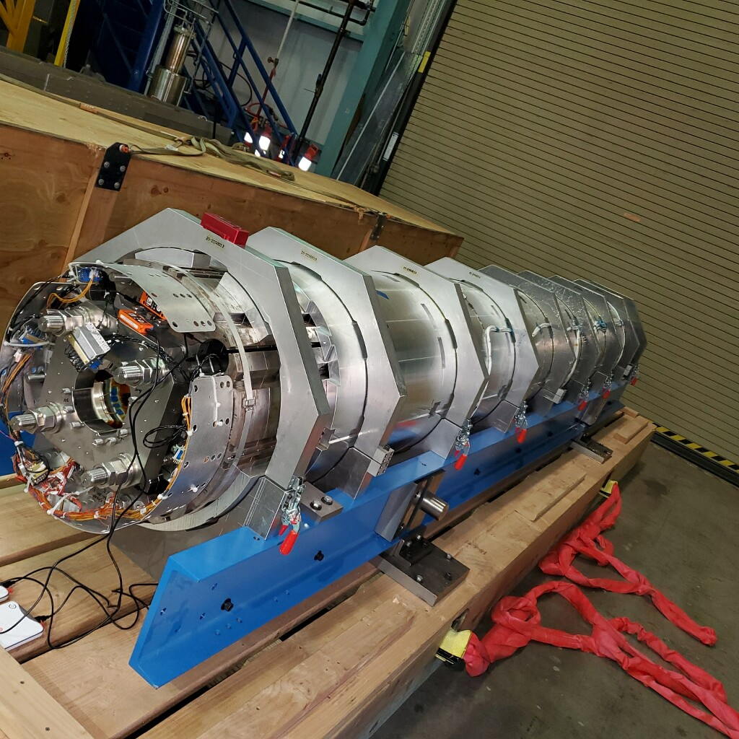
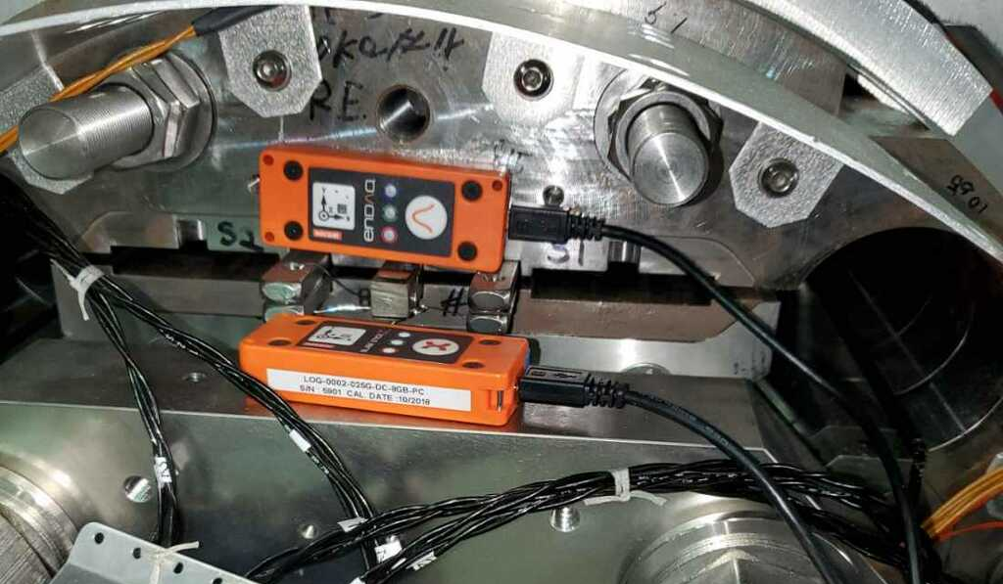
MQXFAP2 yoke and axial plate accelerometers

Slide 25
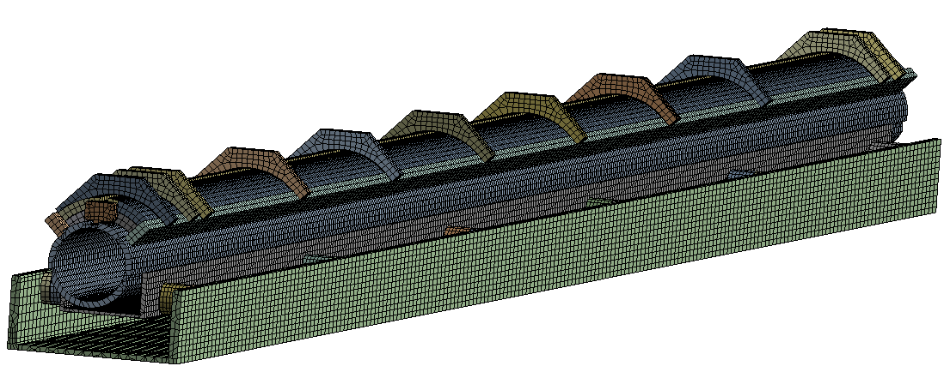
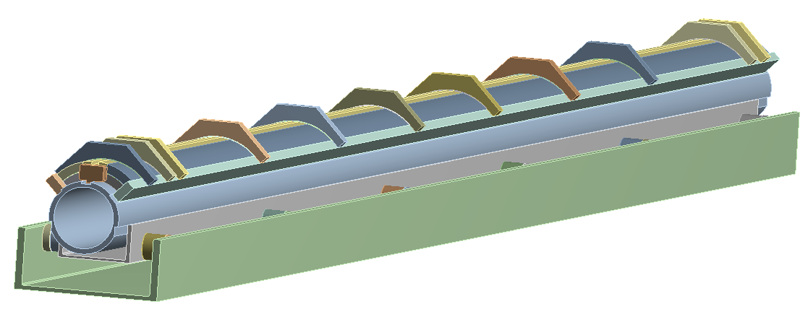
FE Model Overview
Coil Clamp
Rubber Isolator
Vertical inertial load
End Stopper
Base Channel
Side Rail
Fixed support on the bottom e surface
Support Tube
Support Channel
The material of the coil shipping fixture components is Aluminum 6061.
All components are in contact using contact elements
Contact174 --- 3D surface-surface contact element
Target170 --- Associated 3D target element
Friction coefficient is 0.2
Inside coil winding --- bonded
Between shipping fixture components --- bonded
Between coil and fixture --- frictional, mu=0.2
25

Slide 26
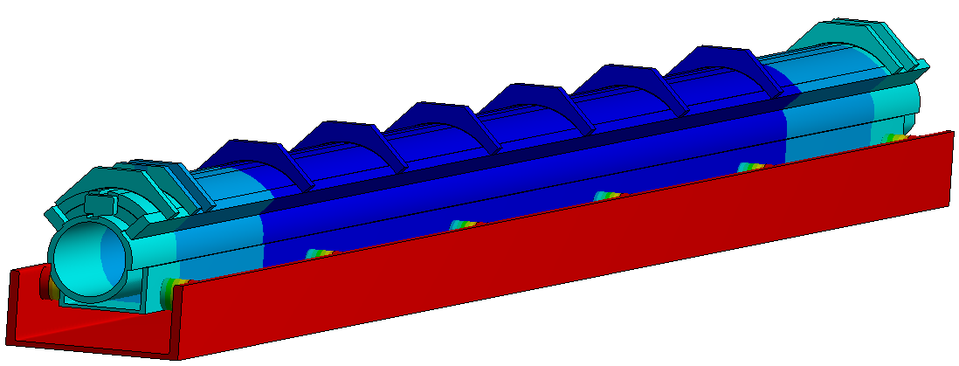
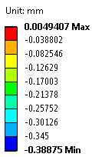
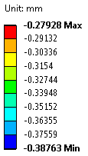
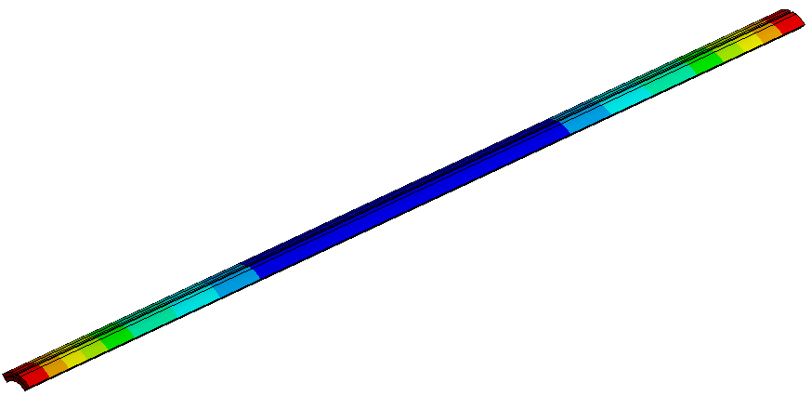
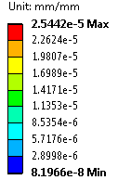
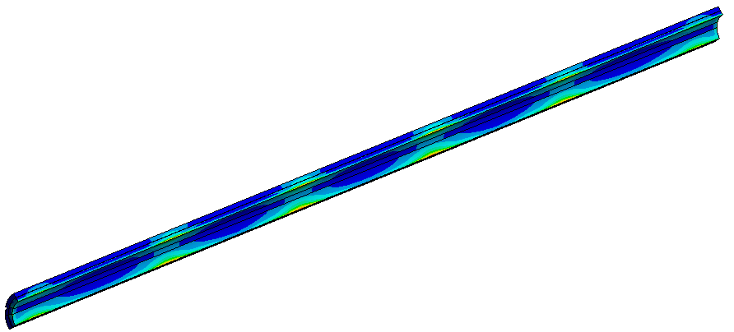
5g Vertical Inertial Load
0.5GPa Isolator modulus
0.39 mm
Vertical Deflection (mm)
Coil deformation is ~105 (µm)
Coil Equivalent Strain,
Maximum strain is ~25.4 µε
Coil Vertical Deflection (mm)

Slide 27
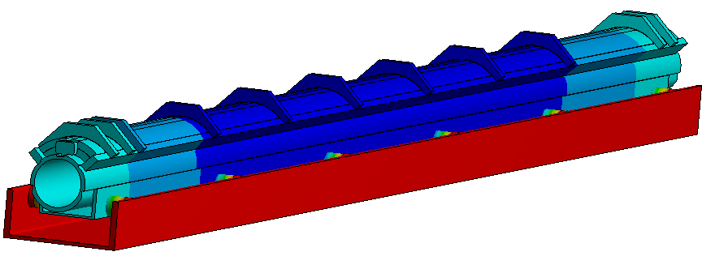
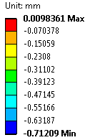
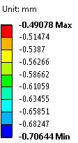
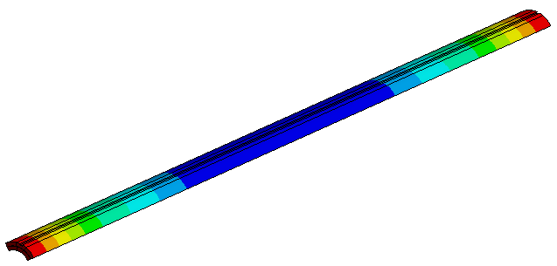
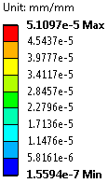
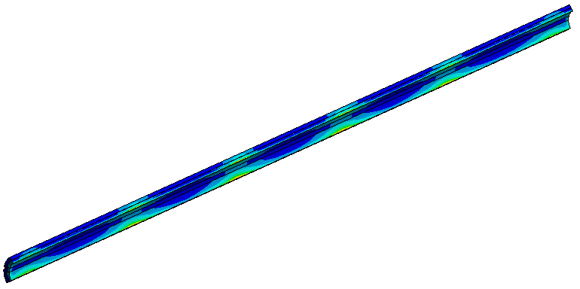
10g Vertical Inertial Load
0.5GPa Isolator modulus
0.71 mm
Vertical Deflection (mm)
Coil deformation is ~210(µm)
Coil Vertical Deflection (mm)
Coil Equivalent Strain,
Maximum strain is ~52 µε

Slide 28
Results with stiffer or softer isolators
Maximum vertical deflection (mm)
Coil deformation (mm)
Coil Strain (µε)
When the isolators are stiffer, the overall deflection and coil deformation become smaller.
The stiffer the fixture is, the larger safety factor we have.
Coil strain is much below the limit of 500 µε with the current fixture design under 5g and 10g loads.

Slide 29
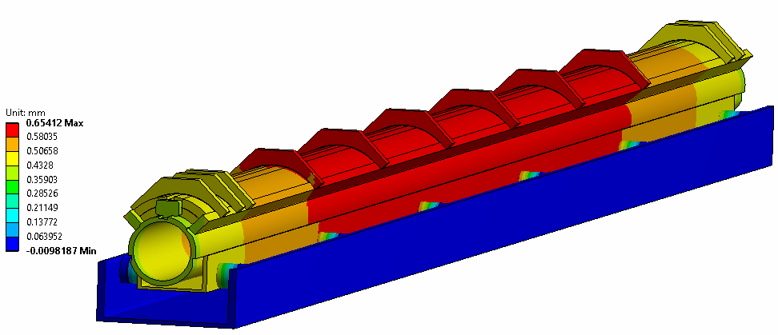
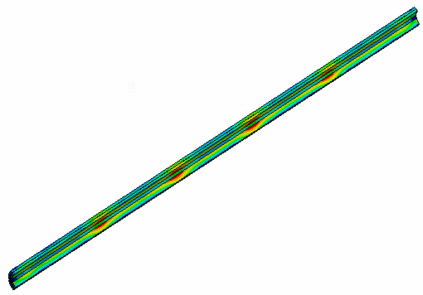
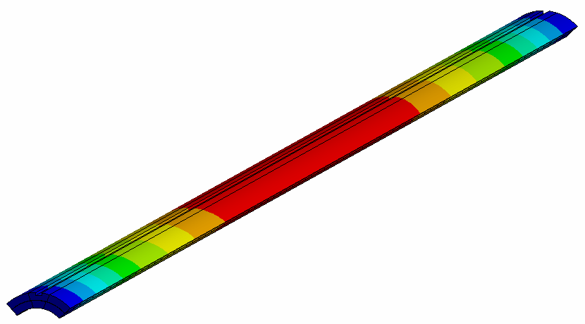
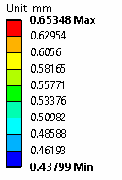
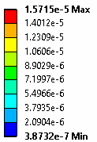
10g Vertical Inertial Load---upward (All parts)
0.65 mm
0.5GPa Isolator modulus
Vertical Deflection (mm)
Coil deformation is ~653 (µm)
Coil Equivalent Strain,
Maximum strain is ~16 µε
Coil Vertical Deflection (mm)
29

Slide 30
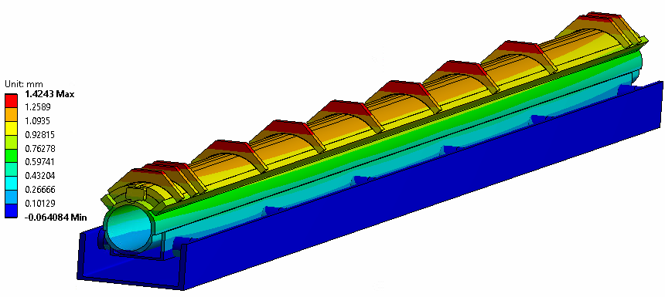
10g Inertial Load---Lateral (All parts)
0.5GPa Isolator modulus
Lateral inertial load
Horizontal deformation: 1.42 mm
Horizontal Deflection (mm)
Coil deformation (horizontal) is ~1.24 (mm)
Coil Equivalent Strain,
Maximum strain is ~95 µε
Coil Vertical Deflection (mm)
30

