Slide 1


Magnets 302.2.05
Coil Fabrication at FNAL
Fred Nobrega - Fermilab
HL-LHC AUP IPR DOE/SC Review – Jan. 14th–16th 2020

Slide 2

Outline
Scope and Interfaces
Organization
Technical Status and Progress
QA/QC
Approved BCRs
Schedule
Cost and Schedule Performance & VAR Reports
Estimate at Completion
Risks
ES&H
Plans for CD-3c
Summary
Lab
Logo

Slide 3
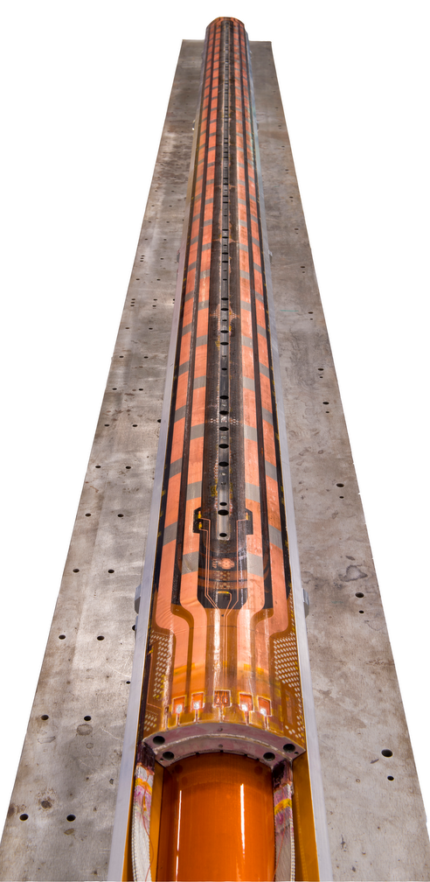
WBS 302.2.05 Scope
Charge #1
WBS Code | WBS Name | Control Account
302.2.05 | Coil Fabrication at FNAL | Yes
WBS Description
Scope of Work Fabricate 13 pre-series QXF coils and 36 production QXF coils at Fermilab. Fabrication steps include Winding and Curing, Reaction, and Impregnation. Includes shipping of accepted coil to LBNL for magnet assembly. Detailed description of QXF coil fabrication process provided by US-HiLumi-doc-95. Scope Assumptions/Exclusions One set of coil fabrication tooling is available from LARP, installed and fully functional in Fermilab Industrial Building 3 (IB3). This includes a winding machine with one mandrel, a curing press, a reaction oven and a reaction fixture, an impregnation station (in IB2) and an impregnation fixture. Coil witness sample testing is covered under the scope of WBS 302.2.02 Stand Procurement Coil production yield is assumed to be 87.5% (i.e., 1 coil out of 8 will be rejected and scrapped) WBS Deliverables A minimum of 43 accepted QXF coils with their corresponding QC reports
FNAL Coil Assy Drawing F10030927
CD-2 Scope
  Fabricate coils (15)
CD-3b Scope
  Fabricate coils (7)
CD-3c Scope
  Fabricate coils (27)
Total of 49 coils

Slide 4
WBS 302.2.05 Interfaces
Charge #3
Interface control documents (ICDs) detail the flow of materials and data from one WBS to another.
  Receive witness samples reaction for from WBS: Strand Procurement (send them back after reaction).
    WBS 302.2.02 → WBS 302.205 - Strand Procurement to Coil Fab (ICD: US-HiLumi-doc-279). Approved
  Receive insulated cable, coil parts, and additional reaction impregnation fixtures from WBS: Coil Parts, Materials, and Tooling.
    WBS 302.2.04 → WBS: 302.2.05 - Coil Parts, Materials, and Tooling to Coil Fabrication (ICD: US-HiLumi-doc-264). Approved
  Send completed coils to WBS: Structure Fabrication and Magnet Assembly at LBL.
    WBS 302.2.05 → WBS: 302.2.07 - Coil Fabrication to Structure Fabrication and Magnet Assembly (ICD: US-HiLumi-doc-252). Approved
US-HiLumi-doc-219

Slide 5
Organization Chart
Charge #2
Control Account
MQXFA Magnets
Fabrication
302.2
L2: G. Ambrosio
(M. Baldini)
Magnet Design, Integration and Coordination
302.2.01
L3/CAM: G. Ambrosio
(M. Baldini)
Strand Procurement and Testing
302.2.02
L3: L. Cooley (V. Lombardo)
CAM: V. Lombardo
Cable Fabrication
302.2.03
L3/CAM: I. Pong
Coil Parts, Materials, and
Tooling Procurement
302.2.04
L3/CAM: M. Yu
(A. Nobrega)
Coil Fabrication at FNAL
302.2.05
L3/CAM:
A. Nobrega
(M. Yu)
Coil Fabrication at BNL
302.2.06
L3/CAM: J. Schmalzle
(M. Anerella)
Structure Fabrication and
Magnets Assembly
302.2.07
L3/CAM: S. Prestemon
(D. Cheng)
Technical Support
Supervisor: M. Walls
A. Coons
B. Galan
P. Fox
L. Kaminskas
S. Ransom (C)
Tech-1
Tech-2
Tech-3
Tech-4
peak production

Slide 6
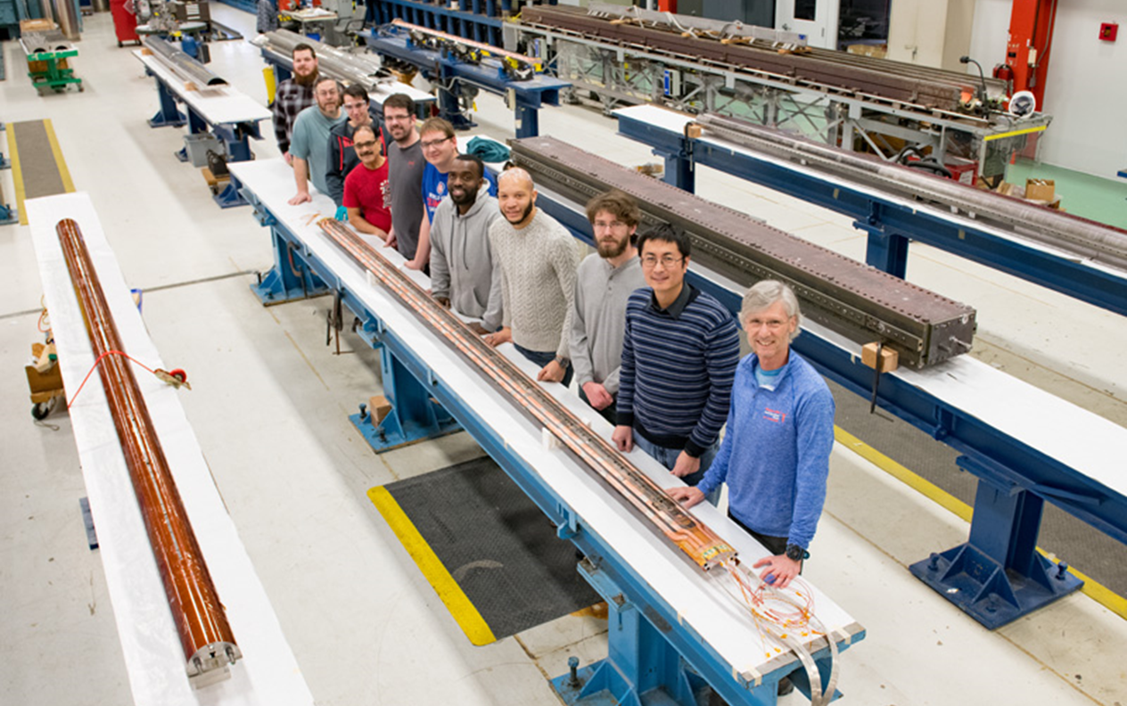
FNAL Coil Fabrication Team
Charge #2

Slide 7
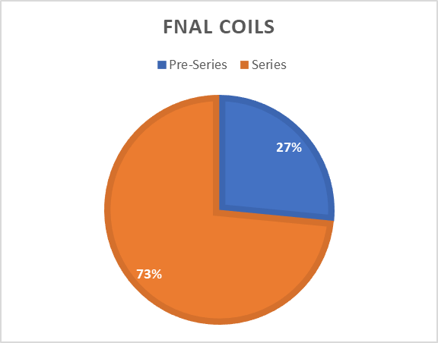
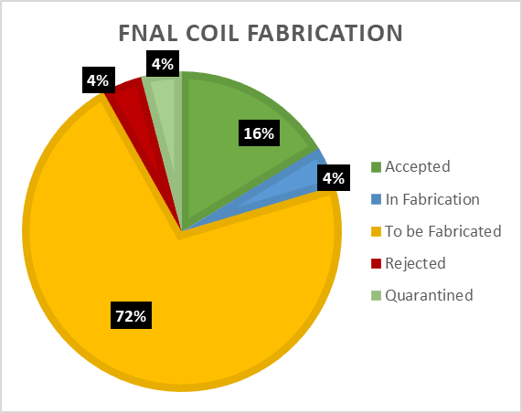
WBS 302.2.05 Technical Status & Progress
Charge #1
Dec. 1, 2019
Pre-series coil fabrication in process and nearly complete.
Coil production is on schedule.
Production Readiness Review: March 2020
Coil Fabrication Status
Accepted 8
In Fabrication 2
To be Fabricated 35
Rejected 2
Quarantined 2
Total 49

Slide 8
WBS 302.2.05 QA/QC
MIPs - FNAL Coil Status to CERN
Charge #1
As of Oct 31, 2019
AUP Quality Assurance Plan (US-HiLumi-doc-80).
  Coil Fabrication quality assurance plans include:
    Travelers (work plan) with in process electrical checks.
    CMM - Coil size measurements.
    Manufacturing & Inspection Plan (MIP) submitted to CERN.
    Data is saved to CERN Manufacturing & Test Folders (MTFs).
Rejected
Quarantine
QXFA109
QXFA114
Note: QXFA115 formally quarantined.

Slide 9
Causes & Corrective Action for
Rejected or Quarantined Coils
Rejected Coils:
  Coil 108 – electrical issue found after reaction.
    Cause: unknown. Possible cause is excess CTD-101 binder that pyrolyze and became conductive.
    Corrective action: revise application process of CTD-101 binder – Apply binder from the midplane up to the 3 turn from the pole.
    Coil was epoxy impregnated and used for coil various studies.
  Coil 118 – cable damaged during coil winding.
    Cause: winding machine boom height was in wrong position.
    Corrective action: revised process – added steps in traveler to inspect location of boom prior to each layer of coil winding.
    Coil dismantled; coil parts recovered.
Quarantined Coils:
  Coil 109 – electrical issue found during magnet assembly at LBNL.
    Cause: replacement of saddle end part after coil curing damaged cable insulation.
    Corrective action: changed saddle design & revised fabrication procedure – rounded saddle leg tips and added slits for flexibility – ended practice of swapping saddles after coil curing.
    Coil returned to FNAL – developing procedure to repair coil. If successful, use in a magnet.
  Coil 114 – fast epoxy fill rate during impregnation.
    Cause: unknown. Possible race tracking of epoxy during impregnation.
    Corrective action taken during impregnation: cycle between atmospheric pressure and vacuum – no change in epoxy level observed – completed cure cycle.
    Corrective action for future coils: none, cause unknown.
    Coil passed all electrical tests. Coil passed mechanical measurements including CMM. Coil quarantined for now.

Slide 10
WBS 302.2.05
Approved Baseline Change Requests
Charge #3
BCR#0078
  Remapping of coils due to number of rejections
  Impact: Cost -$194,056; Sched Days 0
BCR#0086
  Tg Testing on Coils QXFS08 and QXFP03 from MQXFAP1b
  Impact: Cost $43,975; Sched Days 0
BCR#0065 – mitigation of risk RT 02-2-01-017
  Short Coil Fabrication for QH Qualification Magnet Test (Short coil fabrication during long coil production.)
  Impact: Cost $299,388, Sched Days 0

Slide 11
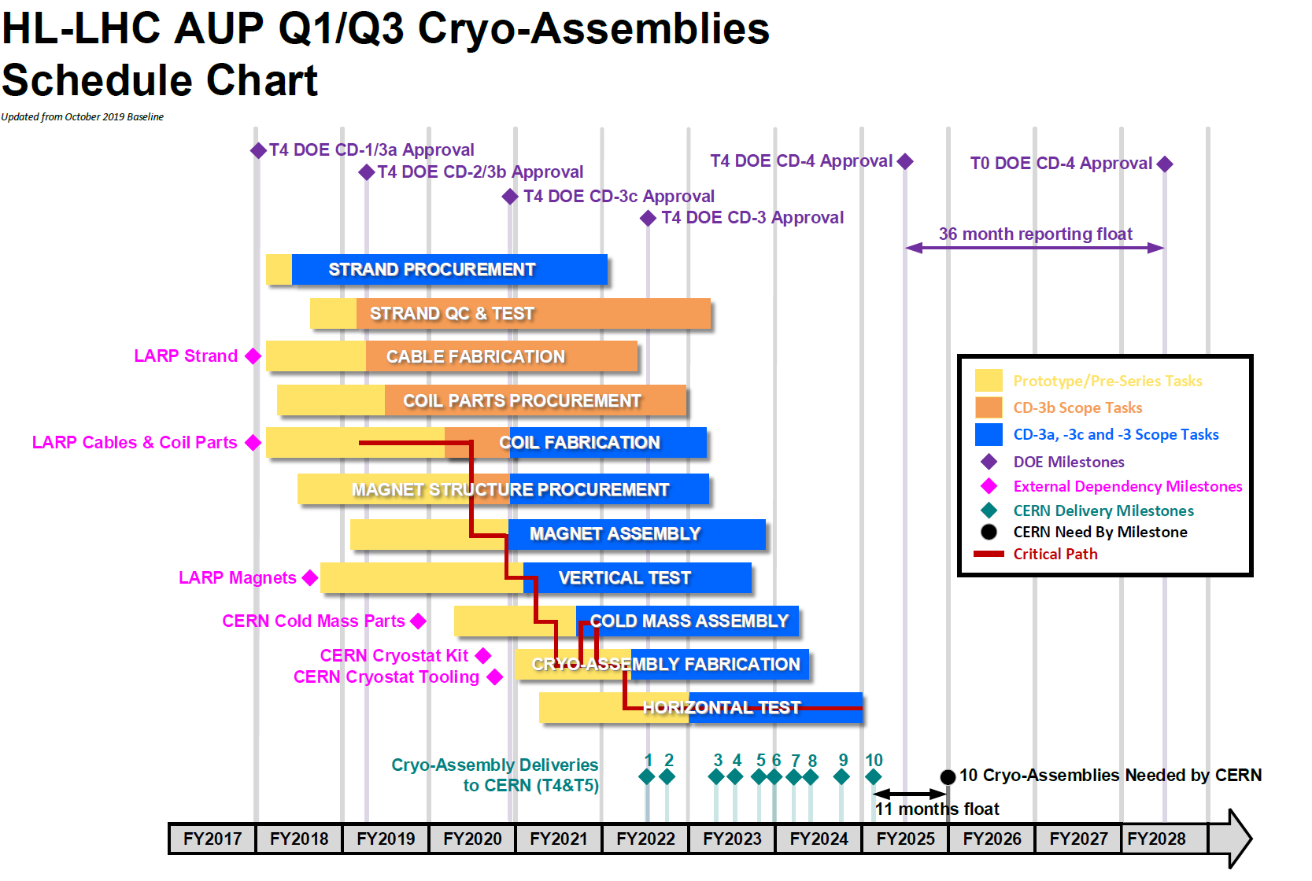
WBS 302.2.05 Schedule
Charge #2
302.2.05

Slide 12
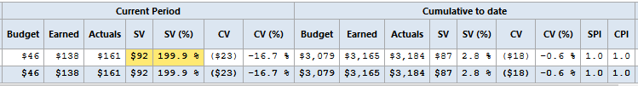
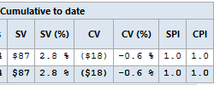
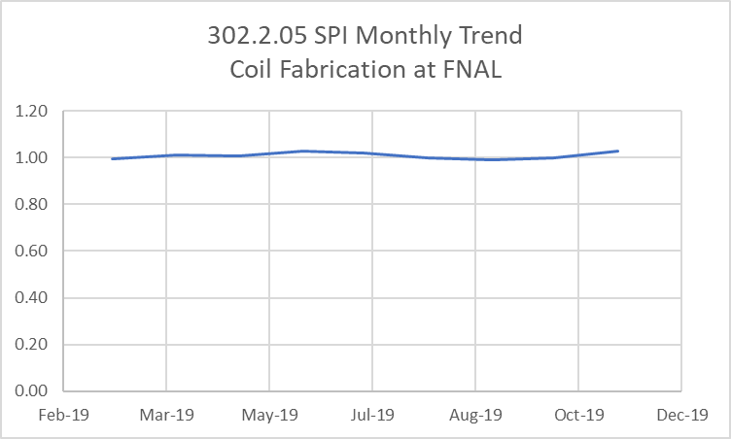
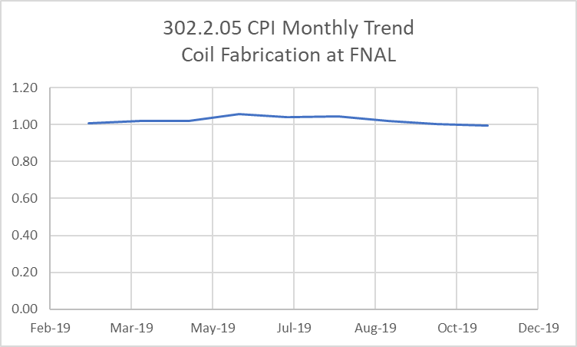
WBS 302.2.05 Cost and Schedule
Performance & VAR Reports
Charge #2
Current period schedule variance ahead of schedule.

Slide 13

WBS 302.2.05 Estimate at Completion
Charge #2
VAC due to failed coils
  Added $1.2M manual adjustment to EAC for rejected and/or quarantined coils to date.

Slide 14
Risk Assessment
Charge #6
ID Threats | Title | Risk Rank
RT-302-2-05-001 | FNAL Winding Machine Failure (MTBF 3 yrs) | Medium
RT-302-2-05-002 | FNAL Curing Press Failure | Medium
RT-302-2-05-003 | FNAL Reaction Oven Failure (MTBF 3 yrs) | Medium
RT-302-2-05-004 | FNAL Impregnation Station Failure | Medium
RT-302-2-05-005 | FNAL Impregnation Station Availability | Low
Coil fab risks included in risk register (US-HiLumi-doc-79).
  Equipment used have critical spare components in house.
  Risk of coil failure is addressed in WBS 302.2.01 (RT-302-2-01-002).
    Coil production yield is assumed to be 87.5% (ie 1 coil out of 8 rejected).

Slide 15
WBS 302.2.05 ES&H
Charge #5
All tasks are planned and performed to minimize the risk of injury to personnel and damage to equipment.
  Regular walkthroughs of fabrication area
  Engineers & tech’s attend required ES&H training courses
  Identify hazards and use appropriate PPE.
Hazards include:
  Electrical
  Chemicals (Boron Nitride, Mold release, Epoxy, Soldering flux).
  Hot surfaces from ovens, curing press, and soldering irons.
  Use of overhead cranes and lifting fixtures.
  Use of liquid argon
Hazard analysis
  Hazard Analysis Form: FESHM Chapter 2060
  AUP Hazard Analysis Report: US-HiLumi-doc-303

Slide 16
WBS 302.2.05 Plans for CD-3c
Project Execution Plan, US-HiLumi-doc-1341
CD‐3b Scope Items | Fiscal Year Obligations
 | FY19 | FY20 | FY21 | FY22 | FY23 | Total
302.2.05 Coil Fabrication at FNAL of 7 coils |  | $1,410,073 | $168,109 |  |  | $1,578,182
CD-3b Scope
  Fabricate coils (7)
CD-3c Scope
  Fabricate coils (27)

Slide 17
WBS 302.2.05 Summary
FNAL coil fabrication is proceeding according to the baseline plan.
SPI & CPI are nearly 1.0
Risks are identified and mitigated.
Coil production yield is lower than assumed.
All aspects of WBS 302.2.05, Coil Fabrication At Fermilab, are actively managed.

Slide 18
Backup Slides

Slide 19
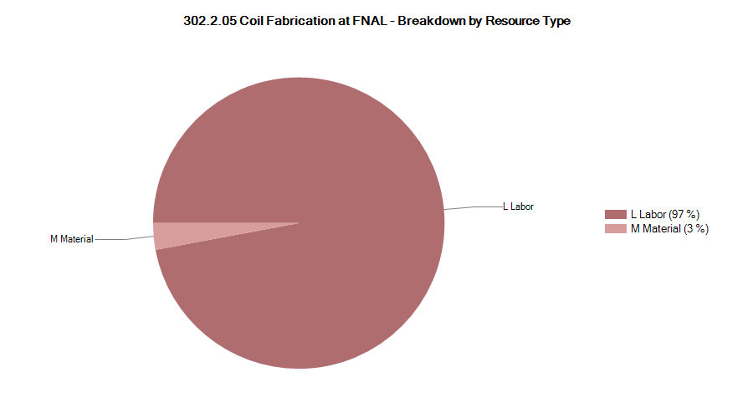

302.2.05 Resource Type Breakdown
97% labor, remaining 3% M&S is for coil shipping
Lab
Logo

Slide 20
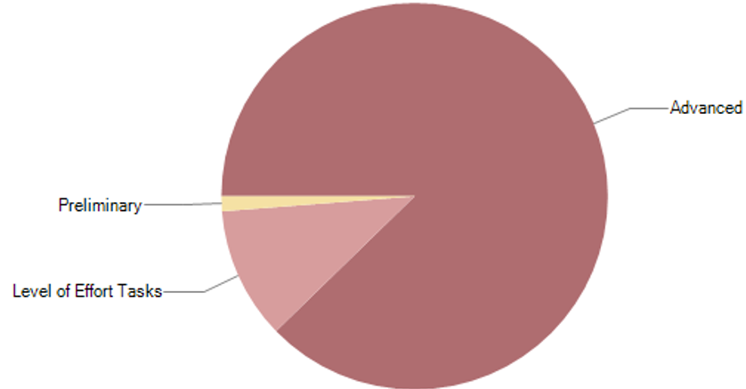

302.2.05 Estimate Quality
Preliminary is technician training effort
Lab
Logo

Slide 21
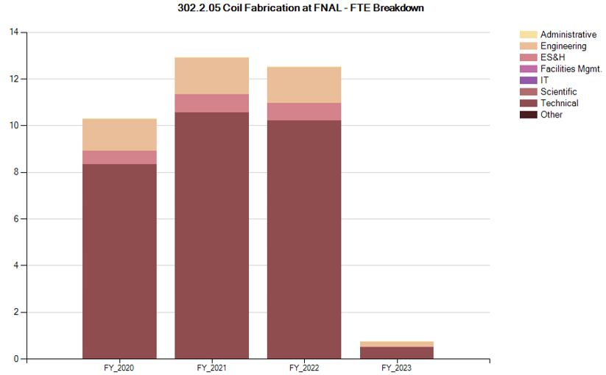
302.2.05 FTE Breakdown
From 5/31/18 forward
  Does not include FY18 Actuals
Lab
Logo

