Slide 1
Magnets 302.2.03 Cable Fabrication
Ian Pong – LBNL (L3 / CAM)
HL-LHC AUP IPR DOE/SC Review – Jan. 14th–16th 2019

Slide 2
General Outline
Scope and Deliverables
Interfaces
Technical Status and Progress
QA/QC
Approved BCRs
Schedule
Cost and Schedule Performance & VAR Reports
Estimate at Completion
Risks
ES&H
Summary

Slide 3
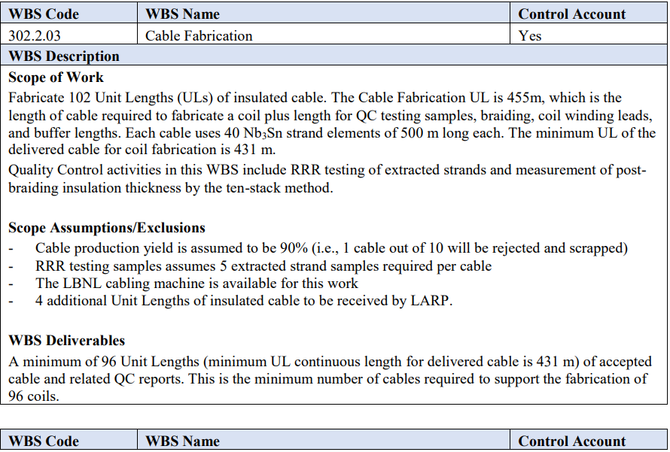
WBS 302.2.03: Scope and Deliverables
>50 QXFP and QXFA cables, only 1 failure so far
7 Fab DR
11 Braiding DR
US-HiLumi-doc-39

Slide 4
WBS 302.2.03: Scope and Deliverables
Deliver minimum of 96 insulated cables.
Scope includes:
Fabricate bare cables at LBNL
Insulation (braiding)
Extracted strand RRR QC

Slide 5
WBS 302.2.03: Interfaces
US-HiLumi-doc-219

Slide 6
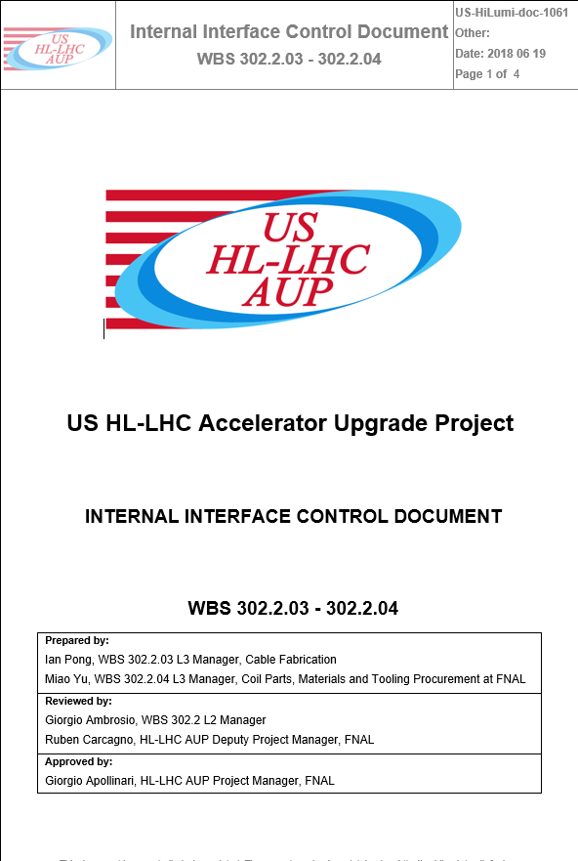
WBS 302.2.03: Interfaces
Interfaces controlled by US-HiLumi-doc-219 and references within
US-HiLumi-doc-282: Strand to Cable (302.2.02 to 03)
US-HiLumi-doc-1061: Cable to Coil (302.2.03 to 04)
ICD Review
Approved
Approved
Completed
US-HiLumi-doc-1061

Slide 7
WBS 302.2.03: Organization
US HL-LHC Accelerator Upgrade Project: 302.2 MQXFA Magnets Fabrication
Control Account
MQXFA Magnets
Fabrication
302.2
L2: G. Ambrosio
(M. Baldini)
US-HiLumi Document 104
Magnet Design, Integration and Coordination
302.2.01
L3/CAM: G. Ambrosio
(M. Baldini)
Strand Procurement and Testing
302.2.02
L3: L. Cooley (V. Lombardo)
CAM: V. Lombardo
Cable Fabrication
302.2.03
L3/CAM: I. Pong
(TBC)
Coil Parts, Materials, and
Tooling Procurement
302.2.04
L3/CAM: M. Yu
(A. Nobrega)
Coil Fabrication at FNAL
302.2.05
L3/CAM: A. Nobrega
(M. Yu)
Coil Fabrication at BNL
302.2.06
L3/CAM: J. Schmalzle
(M. Anerella)
Structure Fabrication and
Magnets Assembly
302.2.07
L3/CAM: S. Prestemon
(D. Cheng)

Slide 8
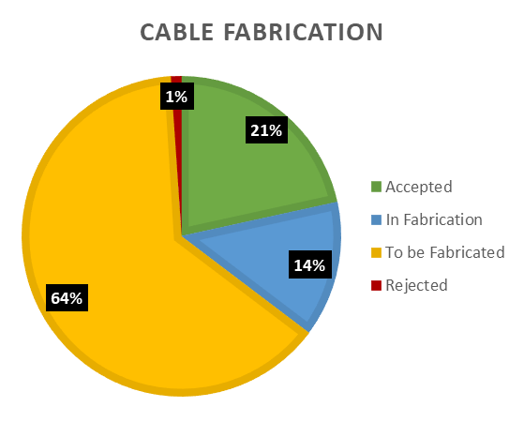
WBS 302.2.03: Technical Status and Progress
If applicable, include summary Fabrication Status Pie Chart from the “Parts Status” Excel file in FermiPoint (update as needed, information there is from July 2019. CAM is responsible for updating the numbers in Fermipoint, and keep using the same format).
CD-3b approved for full production
CDR, PDR, FDR, ICDR, PRR all completed
No outstanding actions (Doc 1322)
Assumed yield: 90%; Actual: ~98%!
Insulation Master Agreement (price locked down)
>35% complete (EV)

Slide 9
WBS 302.2.03: QA/QC
MIP approved by CERN (EDMS 1866230)
AUP Quality Plan (Doc 903)
1 failed cable – thoroughly investigated, improvements made, issue has not recurred
NCR (a.k.a. Deviation Reports in Vector)
Bare cable fabrication (Vector #464234): 7
Braiding (Vector #464342): 11
Mostly related to out-of-specification thickness, typically by a fraction of a micrometer

Slide 10
WBS 302.2.03: Approved Baseline Change Requests
No cabling task initiated BCR.

Slide 11
WBS 302.2.03: Schedule
Upcoming milestones:
April 2020 - T4 Milestone: Cable Fab 50% Complete
Free Float >3 months and clear of critical path

Slide 12
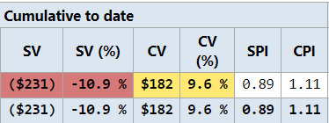
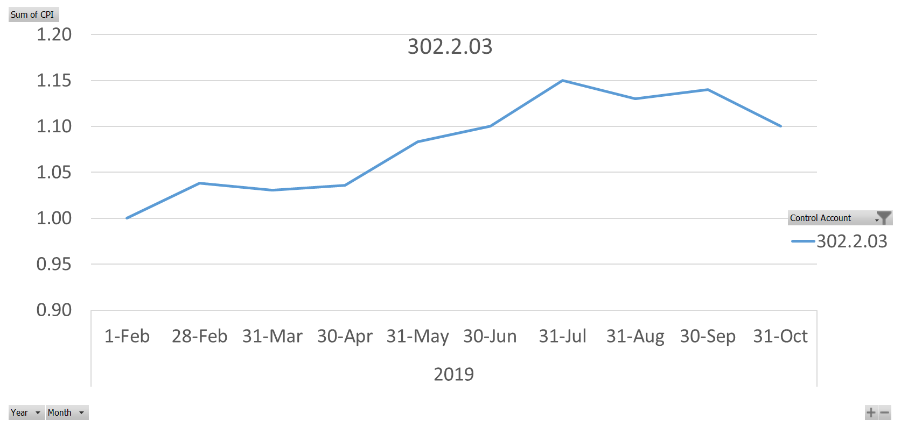
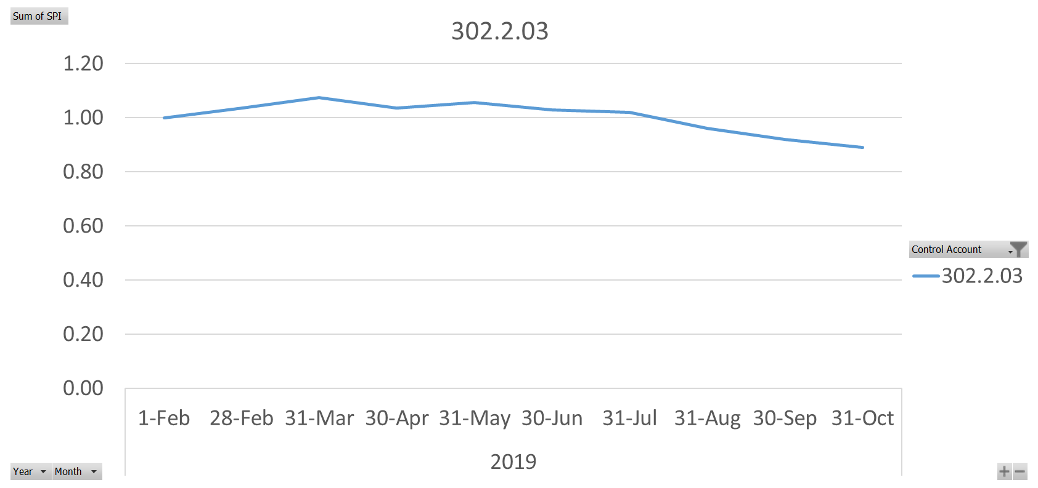
WBS 302.2.03: Cost and Schedule Performance & VAR Reports
CPI
SPI

Slide 13
WBS 302.2.03: Estimate at Completion
Minimal VAC.
SPI low due to L3 deputy departure, technician and engineer hiring issues, assistant sickness, etc. which are now all resolved. We are ~3 cables behind schedule, but we have also failed 3 fewer cables than planned.
CPI high due to L3 being a salary staff and overtime not costing the project.

Slide 14
WBS 302.2.03: Risks
Three threats
Number of cables fails to meet specification
Failure of insulation contractor to deliver on time
Significant breakdown of cabling machine
One opportunity
Mapping optimization allows leftover from wire spools to be converted to a cable UL

Slide 15
WBS 302.2.03: ES&H
Regular meetings at LBNL
Minutes, Roster kept in Windchill with version control
WPC, Procedures, HAR (9.1), etc. in place
We did have a sprinkler incident, and we took appropriate ESH&Q actions seriously and immediately, with prompt communications internally at LBNL and within AUP. HPI report being prepared.

Slide 16
WBS 302.2.03: Summary
Well defined WBS and interfaces
CD-3b approved full production
Major reviews all completed, MIP & QP in place
Actual yield ~98%! vs. assumed 90%
Had personnel shortage, but now full team
Maintained excellent progress, clear of critical path, cost well controlled
ESH&Q and Risks well managed
Lab
Logo

Slide 17
Backup Slides
Resource Type Breakdown
Estimate Quality
FTE Breakdown
Cost Performance Report

Slide 18
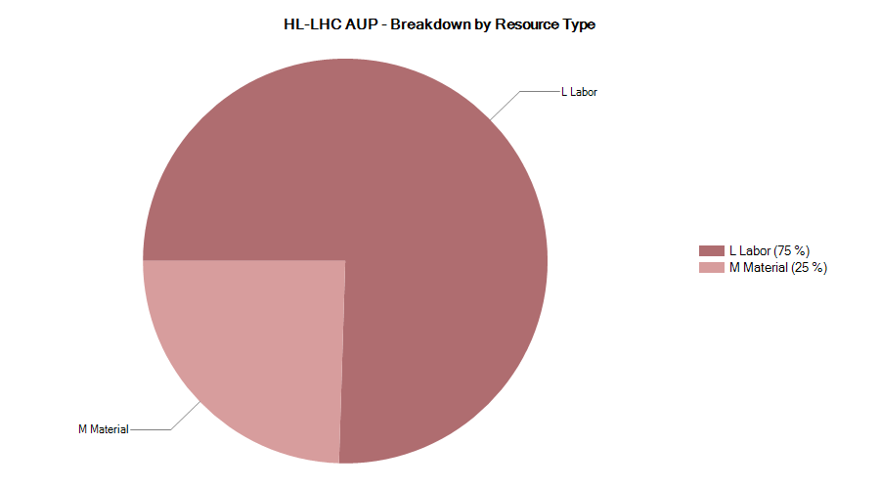
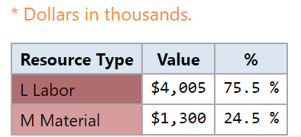
302.2.03 Resource Type Breakdown
75% Labor, 25% M&S
M&S Includes contractors (braiding vendor), travel, shipment, etc.

Slide 19
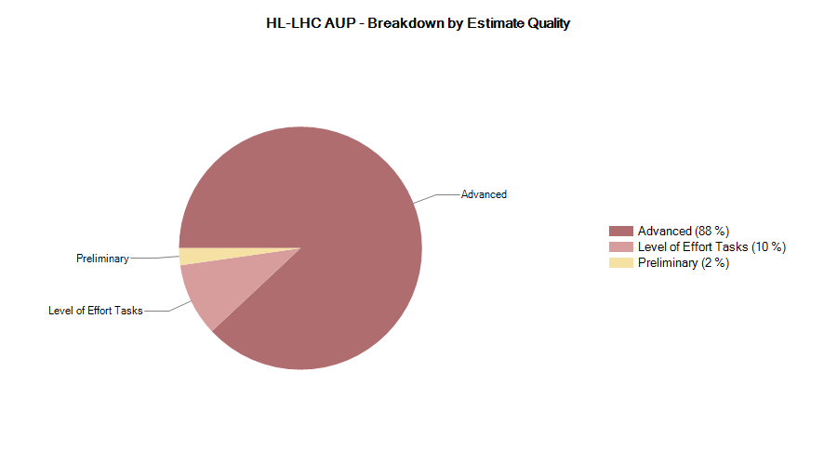
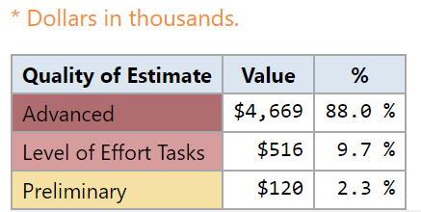
302.2.03 Estimate Quality

Slide 20
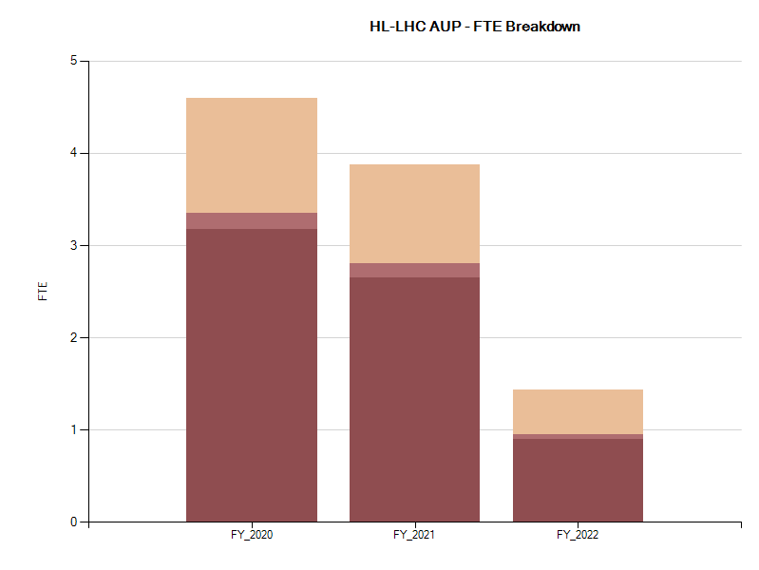
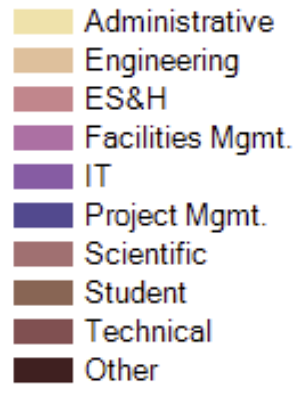
302.2.03 FTE Breakdown
Data set ID: 384 (AUP – Oct 2019)

Slide 21
302.2.03 Cost Performance Report
BAC = $5.306M
EAC = $5.287M
Cumulative SPI = 0.89, CPI = 1.11

