Slide 1
BTL Magnets
Bruce Hanna
BTL PDR
Dec 12 2019

Slide 2
Magnet Design parameters
Style | Quantity | Eff Length (m) | Field Integral | gap | Good field region | Uniformity | Operating temp | Comments
Transport line regular quads | 49 | 0.2 | 2 T | 52 mm | Ø24 mm | 0.1% | warm | Arc 1 and straight (18), beam dump line (4), Arc 2 (27)
Transport line large bore quads | 2 | 0.4 | 2 T | 80 | 150×10 mm² | 0.1% | warm | Located upstream of septum, 10s h&v sizes: 18.5&6.1 mm, max. beam separation – 55 mm
End of Booster line quads | 6 | 0.2 | 3T | 52 mm | Ø24 mm | 0.1% | warm
Tr. line one-plane dip. correctors | 56 | ~0.1 | ±10.0 mT∙m | 52 mm | Ø24 mm | 1% | warm | Arc 1 and straight (18), beam dump line (4), Arc 2 (33)
Transport line dipoles | 37 | 2.45 | 0.7 T∙m | 52 mm | Ø24 mm | 0.02% | warm | Arc 1 (8), Arc 2 (24), beam dump (5), B_{nominal} = 2.4 kG
End of transport line dipoles | 2 | 1.8 | 0.52 T∙m | 52 mm | Ø24 mm | 0.02% | warm | bend in vert. plane, connected serially, B_{nominal} = 2.47 kG
Fast dipole switch | 1 | 2 | 20 mT∙m | 45 mm | Ø24 mm | 1% | warm | Switching time ~20 ms, B=7.9 mT for 800 MeV
3-way septum magnet | 1 | 2.6 | 0.43 T∙m | 40×140 mm² | Ø30 mm | 0.2% | warm | Beam separation at the entrance – ±52 mm, 10s hor. size - 17 mm, septum thickness <17 mm (for each of 2 septa) B=0.139 T for 800 MeV
Beam dump sweep magnet | 1 | 0.5 | 0.05 T∙m | 52 mm | Ø24 mm | 1% | warm | Sweeping frequency – 60 Hz, sweeping radius – 5 cm, q = 10 mrad
Transport line magnet parameters from PDR, ED00100226
FRS’s and TRS’s have been written

Slide 3
Dipole design
A preliminary design was done by Miao Yu in April 2018.
There will be a total of 37 regular dipoles all powered in series and five abort line dipoles powered in series:
  First magnet will need to provide a beam tube to the straight ahead dump and a beam pipe towards the Booster
    Requires a special wide magnet
There are also two shorter versions that provide a vertical dogleg for Booster Injection
  They are each individually powered
Maximum field is .277 T for 1 GeV (.239 T for 800 MeV); this limit is to prevent excessive losses due to stripping
  800 MeV design field - .228 T

Slide 4
Dipole design (cont)
Technical specifications:
  Maximum Bending radius = 20.431 m
  Effective length = 2.45 m
  Maximum field integral = .71 T-m
  Magnet gap = 52 mm, beam pipe aperture = 46 mm
  Need to be able to ramp ➔ laminated magnet (dI/dt = 10 A.s)
    0-500 amps in 50 sec means a time constant of 10 sec so laminations about 2” thick would work
  Beam displacement in a dipole is 147 mm;
    Magnet with a sagitta of 36.9 mm
    Magnet with wide enough pole tips and wide beam pipe
      Requires a larger good field region
  Good field region= 24 mm diameter centered on the beam trajectory

Slide 5
Dipole design (cont)
Technical specifications (cont):
  Field uniformity (dB/B) = .02 %
  Water Flow velocity between 5 and 10 feet/sec
    This design has 7.7 ft/s flow with a 5 mm diameter water passage
    PIP-II working LCW pressure = 100 psid
Using the PD:
  Optics gives a nominal bend angle of .1146 rad
  Field integral at 800 MeV = .559 T-m
  For an effective length = 2.45 m then B=.228 T
  Needs a current of 393 amps

Slide 6
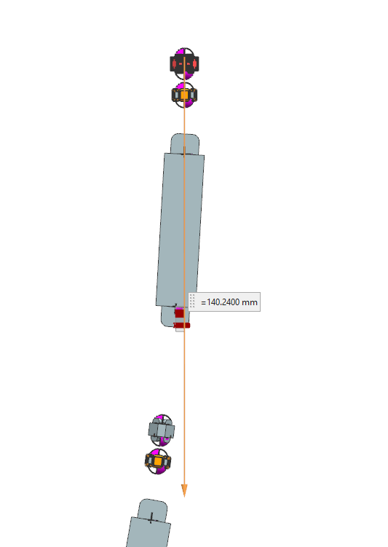
Issues with the First Dipole
-Should the first magnet be a wide
aperture magnet
would need pole tips of 165 mm
-One wide beam pipe or 2 beam pipes
-Second dipole is unaffected

Slide 7
Dipole design (cont)
Total of 24 turns.
Coil resistance is .026 ohms
Calculated water parameters(60 psi): velocity=7.7 ft/s, flow= .13 cfm

Slide 8
Dipole design (cont)

Slide 9
Dipole design (cont)

Slide 10
Dipole Summary
  Dipole design based on previous FNAL designs
    MLAW and MLG designs which are Lambertson magnet designs from 2015
  Available vendors and cost:
    Regular dipoles- Milhous: $1,705,000
    Booster Injection Dipoles- Milhous:$76,000

Slide 11
Quadrupole design
  49 regular transport line quad magnets
  6 End of Line Quads
  2 large aperture quads for the abort line
  Coils are water cooled and to keep the temperature rise below 10 degrees C
  The regular quads will be operated in strings:
    Arc 1 and straight section has:
      QD string with 11 magnets
      QF string with 10 magnets
    Arc 2 has:
      QD string with 11 magnets and 1 individual magnet (tuning)
      QD string with 11 magnets and 1 individual magnet (tuning)
    Abort line with 2 QD and 2 QF magnets run in series
  All EOL quads and large aperture quads will be individually powered

Slide 12
Quadrupole design parameters from Preliminary design by V Kashikhin
Parameter | Units | Regular Quads | EOL Quads
Pole tip radius | mm | 26 | 26
Integrated Gradient | T | 2 | 3
Effective Length | mm | 230 | 230
Center field gradient | T/m | 8.7 | 13
Pole Tip Field | T | .23 | .34
Amp-turns/pole | A | 2500 | 3600
Peak Current | A | 86 | 130
Coil copper conductor | mm | 8x8 | 8x8
# of turns/coil |  | 28 | 28
Yoke Length | mm | 200 | 200
Winding resistance | ohm | .042 | .042
Cooling hole diameter | mm | 5 | 5
Water Pressure Drop | MPa | .1 | .3
Water Temperature rise | C | 6.5 | 8.6

Slide 13
Quadrupole design parameters
  Additional Design parameters include:
    Good field region = 24 mm diameter
    Field uniformity = .1%
  Using this design for both the regular quads and the EOL quads and using the lattice values for the value of K:
    For regular quads, maximum value of K=-1.414 (1/m^2) which gives a maximum current of 66 amps
    Using the same design for the EOL quads, maximum K = 2.5 which gives a maximum current of 117 amps

Slide 14
100 amp Quadrupole Coil Design
Note that this design can also be used for the six EOL quads if we increase the maximum current to 150 amps

Slide 15
100 amp Quadrupole Field
Integrated field along the z-axis at the reference radius of 12 mm at 0, 30 and 45 degrees; non linearity is less than the requirements

Slide 16
Large Aperture Quadrupole design parameters
Parameter Units 2 Large Bore
Quadrupoles
Pole tip radius mm 40
Integrated gradient T 2
Effective length mm 400
Center field gradient T/m 5.0
Pole tip field T 0.2
Coil ampere-turns/pole A 3200
Coil peak current A 114
Coil copper conductor mm 8x8, dia. 5
Coil number of turns 28
Yoke length mm 400
Winding resistance Ohm 0.069
Magnet voltage V 8.2
Magnet power W 940
Number cooling circuits 1
Cooling hole diameter mm 5
Water pressure drop MPa 0.5
Water temperature rise C 11.9
Voltage for the string V 16.4
Total string power kW 1.88

Slide 17
Large Aperture Quadrupole Coil Design

Slide 18
Large Aperture Quadrupole Beam Pipe
Maximum displacement in these quads is 56.8 mm and the y 1 sigma beam size is .764 mm and the x 1 sigma beam size is 1.75 mm

Slide 19
Large Aperture Quadrupole Field
Field gradients in the mid plane along z-axis

Slide 20
Quadrupole Summary
  49 regular transport line quad magnets preliminary design is robust
  6 End of Line Quad :
    design relies on the regular quad design being capable of operating up to 150 amps
  2 large aperture quads for the abort line:
    Current preliminary design has larger than desired integrated field non linearity in the specified good field region
    Will need more work on pole profile
    Maximum displacement is 57.8 mm in the focusing quad
  Available vendors and cost:
    Regular quads- RadiaBeam: $870,000; Milhous: $922,000
    EOL Quads- Milhous: $160,000
    Large Aperture quads- Milhous:$74,000

Slide 21
Specialty Magnet design
  There are three different specialty magnets:
    3 way septum for switching between the abort line and Booster line
    Fast switch magnet for moving beam between the apertures of the septum magnet
    Beam sweep magnets to rotate beam on the dump face
  3 Way Septum magnetic design by Vladimir Kashikhin and mechanical design by Alexander Makarov
  3 Way Septum Specifications:
Effective Length (m) | 2.6
Field Integral (T-m) | .43
Nominal field (T) | .139
Maximum current (A) | 1350
Aperture (field-free region) (mm) | 34
Good field region (mm) | 30
Septum Thickness (mm) | <17 mm
Maximum allowed field in field free region (T) | 1e-5
Field uniformity (%) | .2
Maximum ramp rate (A/sec) | 20
Field uniformity | .2 %

Slide 22
3 Way Septum Magnet design
  3 Way Septum Results:
Integrated dipole field (T-m) | .43
Max effective length (m) | 2.6
Air gap (mm) | 40
Center magnetic field (T) | .165
Coil Amp-turns (Amp) | 5400
Coil conductor (mm) | 9x9, hole dia 5
Number of turns | 4
Coil current (amps) | 1350
Power dissipation (W) | 7400
Coil Resistance (Ohms) | .004
Total beam displacement (mm) | 82
Kick angle needed at 800 MeV is .074 rad which requires a current of 1085 amps

Slide 23
3 Way Septum Field Calculations
Magnetic flux lines

Slide 24
3 Way Septum Field Calculations
Fringe fields in the straight ahead line (field free)

Slide 25
3 Way Septum Field Calculations
Field homogeneity in the field region of the septum magnet

Slide 26
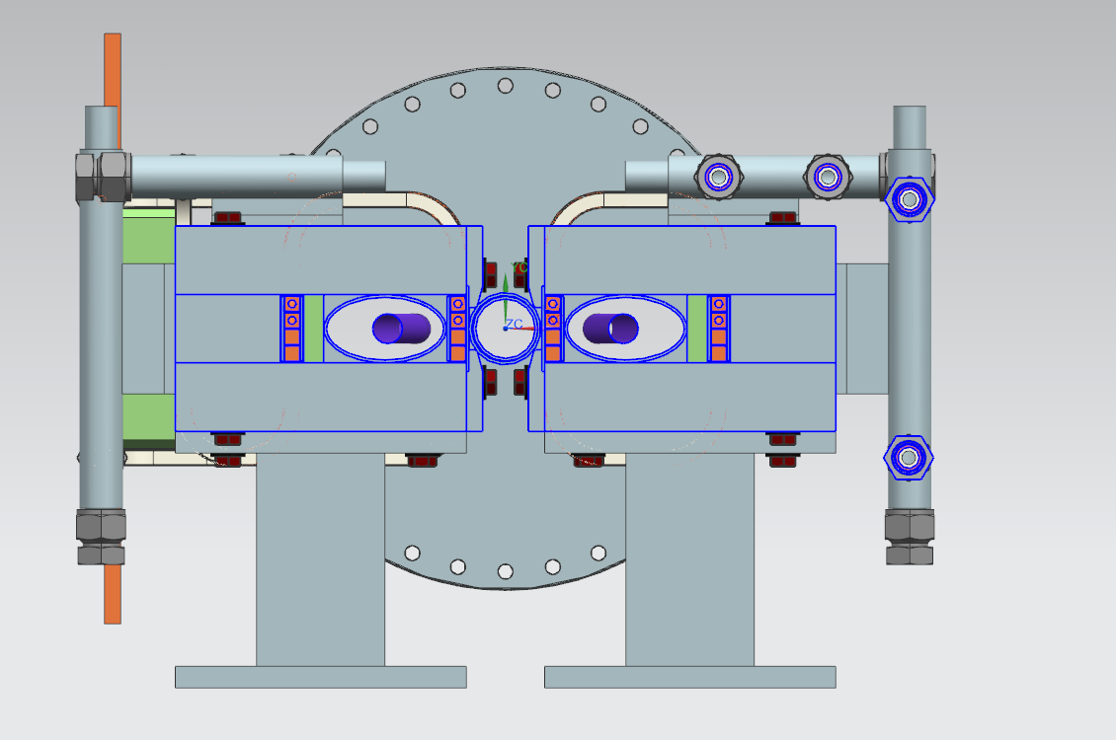
3 Way Septum Mechanical Design
Note that this shows two magnets; we will only install one

Slide 27
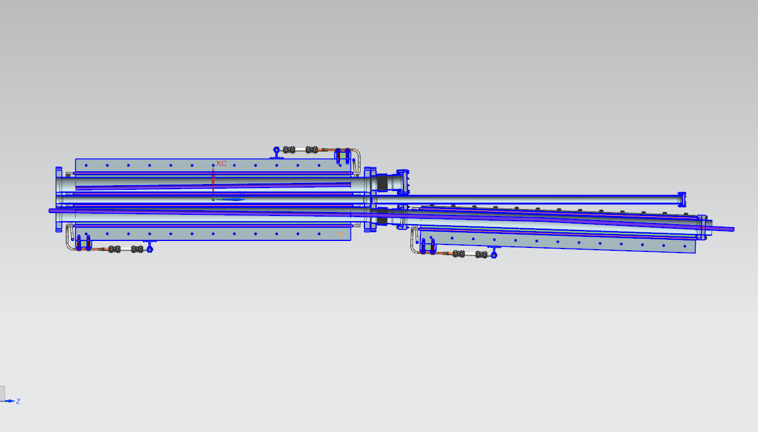
3 Way Septum Mechanical Design
3050
1485
1300
335
We would use two magnets to occupy the 2.6 m effective length. By aligning the second magnet at an angle of 2 degrees from the first we avoid the need for sagitta or excessive aperture.

Slide 28
Fast Dipole Switch Magnet
Requirements:
  Beam tube aperture = 46 mm
  Nominal Bend angle = .0035 rad
  Effective Length = 2 m
  Max Field integral = .02 T-m
  Rise time = 20 micro sec
  Flattop = 550 micro sec max
  Fall time can be many milli sec
  Rep rate = 20 Hz

Slide 29
Fast Dipole Switch Magnet
We currently are planning to use a refurbished Tevatron A0 Abort Kicker:
  Physical Length = 2.23 m
  Active Length = 1.92 m
  Magnetic field = 4.7 kG at current = 22.8 kA at 1 TeV
    We need a field integral of .017 T-m for 800 MeV so we need 409 amps
  Magnet Inductance = 3.15 uH
  Beam tube is a ceramic tube 78.5” long and a nominal ID = 1.875”= 47.6 mm
  Magnet is potted

Slide 30
Fast Dipole Switch Cross Section

Slide 31
Beam Sweep Magnet
Requirements:
  Beam tube aperture = 46 mm
  Maximum Bend angle = .01555 rad
  Effective Length = .5 m
  Nominal Field integral = .0759 T-m
  Operating Frequency = 11 Hz
  Magnet gap = 52 mm
  2 magnets required; one horizontal and one vertical
Current plan is to use existing EDTA magnets:
  Gap = 50.8 mm
  Steel length = 20 inches
  Transfer function (T-m/A) = .00276 (=>need 27.5 amp PS)

Slide 32
Beam Sweep Magnet
  Flange to flange length = 32 inches
  Magnet resistance = .127 ohms
  Beam pipe is rectangular roughly 1.5” by 2.5:
    Simulations indicate that with the design bend angles these apertures are fine.
  RMS current = 19.45 amps power = 48 watts
  Issues to investigate:
    Eddy currents
    Hysterisis heating of the core and beam tube

Slide 33
Beam Sweep Magnet
11 Hz operation at 20 amps

Slide 34
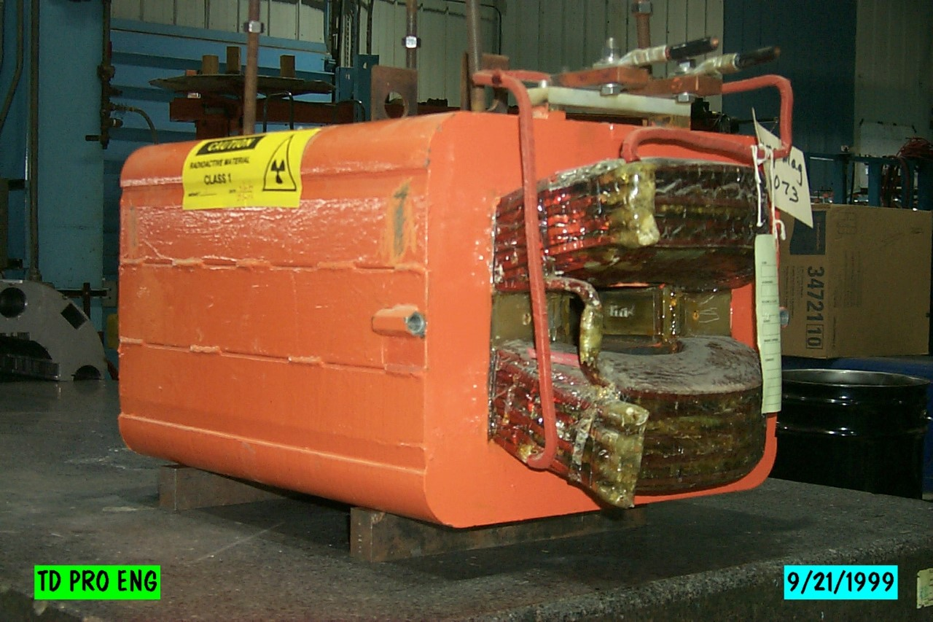
Beam Sweep Magnet

Slide 35
Safety and QC
Since all magnets will be fabricated by an outside vendor, all magnets will be QC’ed and magnetically tested by FNAL AP-STD division
  Travelers for each magnet will reside in Vector
All magnets will have appropriate provisions for rigging and for safe mounting to stands
  There will be discussions between the vendor, magnet designer, installation and mechanical engineers
All FNAL ES&H requirements will be meet
  Electrical grounding and NEC codes
  Piping systems
Where possible, power connections will be covered to prevent inadvertent contact

