Slide 1
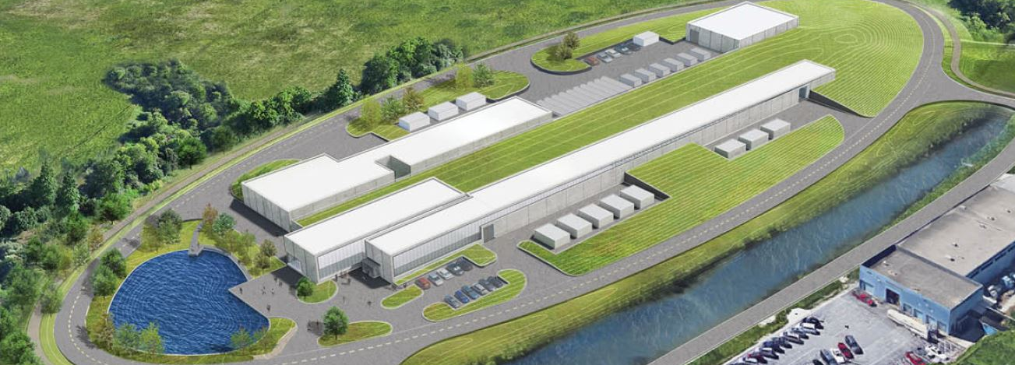
Introduction
Ioanis Kourbanis
PIP-II Beam Transfer Line PDR
12 December 2019

Slide 2
Outline
PIP-II Requirements
PIP-II Scope
Project KPPs
PIP-II Organization
Beam Transfer Line WBS Organization
Review Charge
Agenda

Slide 3
Global Requirement Document (GRD, #ED0001222) Defines Performance Expectations and Scope
Criteria for PIP-II are established on the basis of the P5 report and the approved Mission Need Statement as follows:
Deliver 1.2 MW of proton beam power from the Main Injector over the energy range 60 – 120 GeV, at the start of LBNF operations;
Support the current 8-GeV program at Fermilab including the Mu2e, g-2, and short-baseline neutrinos experiments;
Provide a platform for extension of beam power to LBNF to >2 MW;
Provide a path to increase the beam power to the Mu2e experiment to ~100 kW at 800 MeV, with a duty factor of up to 100%;
Provide a platform for extension of capability to flexible bunch pattern, high duty factor/higher beam power operations to multiple experiments simultaneously.
The above capabilities should be provided in a cost-effective manner.

Slide 4
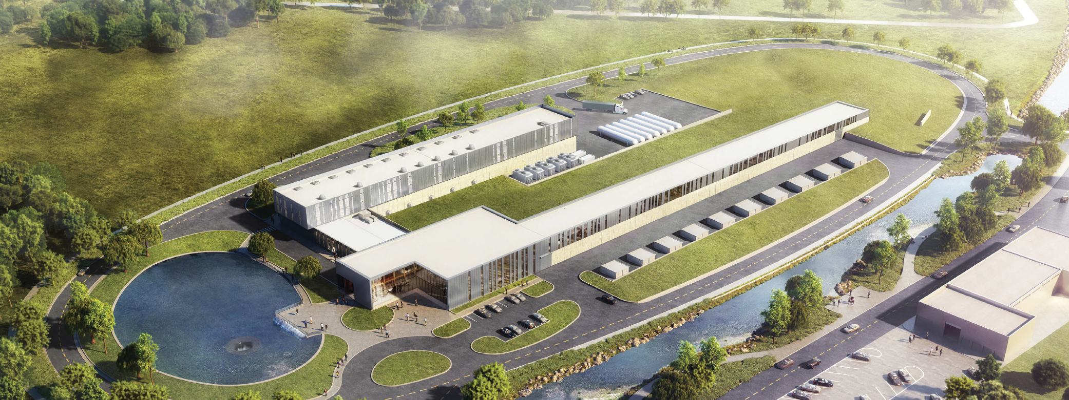
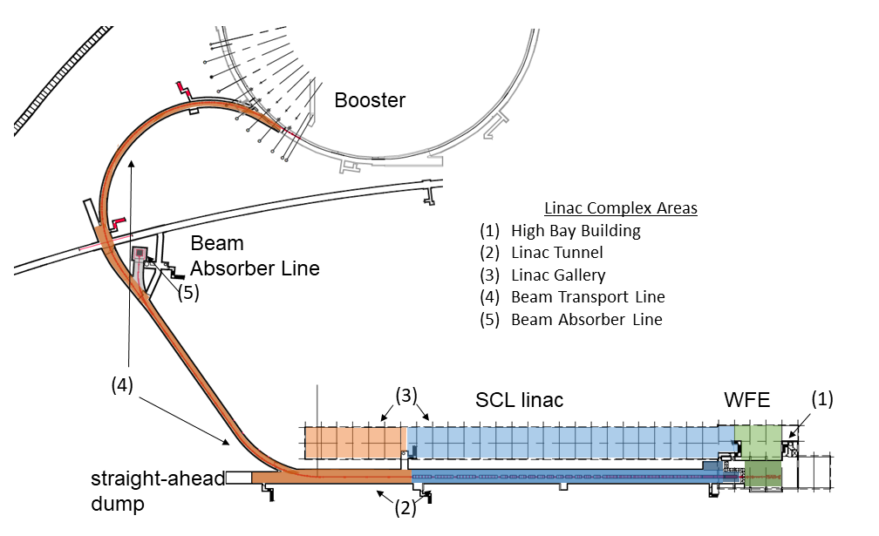
PIP-II Scope Driven by GRD Requirements
Charge #1
An 800-MeV superconducting H⁻, CW-compatible Linac
Beam transport of 800-MeV H⁻ from the SRF Linac to the Booster, beam dump capable of ~1% duty factor, and switch yard to the Muon Campus.
A new injection area in the Booster
Modifications to the Booster, Main Injector, and Recycler Ring to enable 1.2 MW power on LBNF target for 60-120 GeV.
Associated conventional facilities. The linac enclosure is compatible with upgrades.

Slide 5
Objective KPPs Define Project Commissioning Goals
Charge #1
# | Scope | Threshold KPPs | Objective KPPs
1 | Linac Beam Energy | Accelerate H- beam to 600 MeV | Accelerate H- beam to 700 MeV Linac systems required to accelerate beam to 800 MeV installed and tested
2 | Linac Beam Intensity | Beam delivered to Beam Dump at the end of Linac | Beam with intensity of 1.3E12 particles per pulse (H-) at 20 Hz delivered to Beam Line Dump
3 | Booster/ Recycler/ Main Injector upgrades | Booster, Recycler, and Main Injector Upgrades to support operations with beam power of 1.2 MW on the LBNF target are installed and tested without beam | Linac beam injected and circulated in Booster

Slide 6
PIP-II Project Management and Level 2 Systems/Managers
ADVISORY COMMITTEES
PIP-II Machine Advisory Committee H. Weise
PIP-II Project Management Group D. Glenzinski
PIP-II Strategic Project Advisory Committee J. Yeck
FNAL SUPPORT
ACCELERATOR DIV M. Lindgren
TECHNICAL DIV S. Belomestnykh
CFO OFFICE V. Peoples
WDRS K. Van Vreede
CSO OFFICE A. Kenney
COO OFFICE K. Gregory
CPO OFFICE D. Glenzinski
PIP-II Project
L. Merminga
PROJECT DIRECTOR
US TECHNICAL COORDINATOR
TECHNICAL DIRECTOR A. Klebaner
PROJECT MANAGER M. Kaducak
PROJECT SCIENTIST E. Pozdeyev
IN-KIND CONTRIBUTIONS MANAGER L. Lari
SPECIAL ADVISOR S. Holmes
ENVIRONMENTAL, SAFETY & HEALTH J. Anderson Jr.
DOCUMENT SYSTEM MANAGER T. Langford
EXECUTIVE ADMINISTRATION T. Langford
ADMINISTRATION SUPPORT TBD
TECHNICAL INTEGRATION
Technical Director - A. Klebaner
PROJECT ENGINEER A. Rowe
DEPUTY PROJ ENGINEER J. Steimel
IN-KIND TECHNICAL INTEGRATION A. Rowe
INTEGRATION COORDINATOR A. Martinez
SRF COORDINATOR J. Holzbauer
QUALITY ASSURANCE MGR (J. Adetunji)
Quality Engineer T. DiGrazia
Quality Engineer TBD
PROJECT SCIENTIST
E. Pozdeyev
PROJECT OFFICE
Project Manager - M. Kaducak
PROJECT CONTROLS MANAGER D. Leeb
Project Controls Specialists J. Randall
M. Bossert
A. Tomori
F. Leavell
C. Dolan
OPSS Consultant D. Hoffer
FINANCIAL MANAGER C. Jacobsen
PROCUREMENT MANAGER F. Minton
Procurement Administrator C. Rossman
RISK MANAGER L. Taylor
LOGISTICS MANAGER TBD
INTERNATIONAL COORDINATION
Technical Coordinators
IIFC-BARC S. Krishnagopal
IIFC-RRCAT P. Shrivastava
UK-UKRI P. McIntosh
ITALY-INFN TECH. C. Pagani
FRANCE-CEA O. Napoly
FRANCE-CNRS/IN2P3 D. Longuevergne
WBS 121.01
PROJECT MANAGEMENT
M. Kaducak
System Manager
WBS 121.02
SRF & CRYO SYSTEMS
G. Wu
System Manager
C. Boffo, Deputy Mgr.
WBS 121.03
ACCELERATOR SYSTEMS
E. Harms
System Manager
WBS 121.04
LINAC INSTALLATION & COMMISSIONING
F.G. Garcia
System Manager
WBS 121.05
ACCELERATOR COMPLEX UPGRADES
I. Kourbanis
System Manager
WBS 121.06
CONVENTIONAL FACILITIES
S. Dixon
System Manager

Slide 7
L3 Systems and Managers
WBS 121.01
PROJECT MANAGEMENT
M. Kaducak
System Manager
WBS 121.02
SRF & CRYO SYSTEMS
G. Wu
System Manager
WBS 121.03
ACCELERATOR SYSTEMS
E. Harms
System Manager
WBS 121.04
LINAC INSTALLATION & COMMISSIONING
F. G. Garcia
System Manager
WBS 121.05
ACCELERATOR COMPLEX UPGRADES
I. Kourbanis
System Manager
WBS 121.06
CONVENTIONAL FACILITIES
S. Dixon
System Manager
WBS 121.02.01
Project Management
G. Wu
WBS 121.03.01
Project Management
E. Harms
WBS 121.04.01
Project Management
F. G. Garcia
WBS 121.05.01 Project Management
I. Kourbanis
WBS 121.06.01
Project Management
S. Dixon
WBS 121.02.02
Half-wave Cryomodule
J. Ozelis
WBS 121.03.02
MPS
A. Warner
WBS 121.04.02
WFE
L. Prost
WBS 121.05.02
Transfer Line/Beam absorber
M. Xiao
WBS 121.06.02
Site Preparation
R. Wielgos
WBS 121.03.03
HPRF, RF distribution
J. Steimel
WBS 121.04.03
Test Infrastructure
J. Leibfritz
WBS 121.06.03
Cryoplant Building
S. Dixon (acting)
WBS 121.02.03
SSR Cryomodules
D. Passarelli
WBS 121.05.03
Beam Transfer Line Installation
D. Morris
WBS 121.03.04
LLRF
B. Chase
WBS 121.04.04
Building Infrastructure
J. Hunt
WBS 121.06.04
Utility Plant Building
E. Huedem
WBS 121.02.04
650 MHz Cryomodules
S. Chandrasekaran
WBS 121.05.04
Booster
D. Johnson
WBS 121.03.05
Magnets/PS
B. Hanna
WBS 121.04.05
Linac Installation
C. Baffes
WBS 121.06.05
Linac Complex
S. Dixon
WBS 121.05.05
MI/RR
J. Dey
WBS 121.02.05
Cryogenic Plant
B. Hansen
WBS 121.06.06
Booster Connection
R. Wielgos
WBS 121.03.06
Vacuum
R. Andrews
WBS 121.04.06
Beam Commissioning
E. Pozdeyev
WBS 121.02.06
Cryogenic Distribution
A. Dalesandro
WBS 121.03.07
Controls
J. Patrick
WBS 121.04.07
Accelerator Physics
E. Pozdeyev
WBS 121.03.08
Safety Systems
R. Zifko
WBS 121.03.09
Instrumentation
V. Scarpine

Slide 8
Scope/Deliverables (WBS 121.05.02,121.03.05)
WBS Dictionary Definition: 121.05.02 Beam Transfer Line and Beam Absorber
Define and maintain the Lattice of the Beam Transfer Line and the Beam Absorber Line. Specify the Beam Line components of both lines. Design, procurement, fabrication, and testing of Beam Transfer Line collimators and beam dumps. It includes a low power beam dump in line with the Linac and the main beam dump in the Beam Absorber line. It also includes the design, procurement and testing of a gamma-t jump system in MI.
WBS Dictionary Definition 121.03.05 Magnets and Power Supplies
Management, design, procurement, fabrication and testing of magnets and magnet power supplies. Includes quench protection monitors and power supplies (switchers) for HWR, SSR1, and SSR2 cryomodules, high voltage bias power supplies for cavity fundamental power couplers, power supplies for quads and correctors in the linac, and all types (dipoles, quads, correctors, special) of magnets and power supplies in the beam transfer line.

Slide 9
Beam Transfer Line Requirements
Transport the H- beam from the end of the PIP-II Linac to the Injection Point in the Booster.
Avoid Lorentz stripping of the H- beam.
Include a beam dump able to absorb the total power of the beam to Booster.
Allow for a transfer line from the PIP-II linac to the Mu2e target.

Slide 10
Review Charge Questions
Are the requirements documented, clear, complete and appropriate?
Is the proposed lattice design for the Beam Transfer Line likely to meet requirements? Explain any deficiencies or concerns.
Are the magnet designs likely to meet requirements? Explain any deficiencies or concerns.
Are there any features present (or absent) that threaten the intended function and performance of this design?
Have safety and environmental aspects been appropriately considered?
Have quality aspects been appropriately considered?

Slide 11
Review Agenda
Introduction: I. Kourbanis
Beam Transfer Line Lattice: M. Xiao
Break
Magnets: B. Hanna
Power Supplies: M. Kufer
Lunch
Closeout – Review Chair

Slide 12
END

