Slide 1
RF Gun
S. Kazakov
11/25/2019

Slide 2
File:
C:\CST_projects\ERDC\RF_gun\Coax_trans
Design is based at standard 7/8’’ coaxial line.
Coax_2_with_gun_no_potrt_eg_mode_2_materials
F = 655.8 MHz

Slide 3
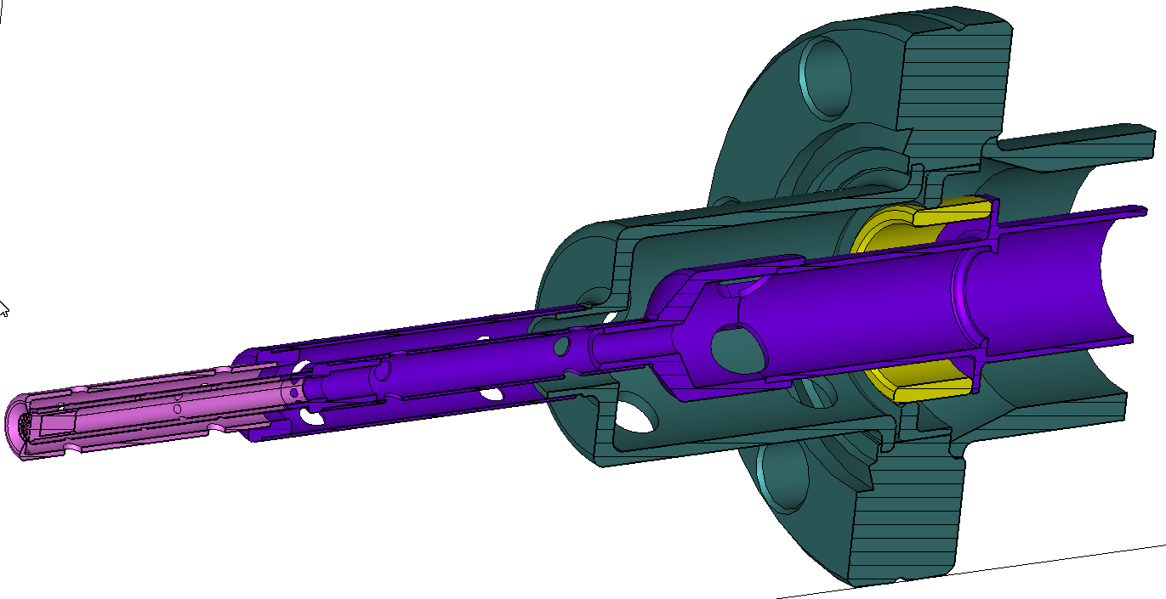
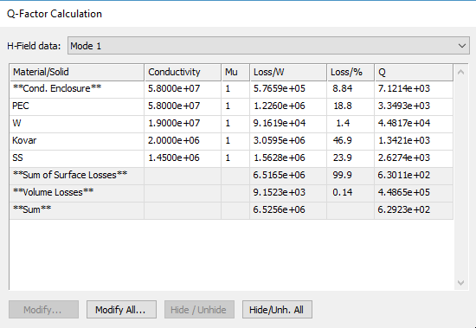
SS
Kovar
W
Material | σ, S/m | %
Copper | 5.8 $e^{7}$ | 27.7
SS 316 | 1.45 $e^{6}$ | 23.9
Kovar | 2 $e^{6}$ | 46.9
W | 1.9 $e^{7}$ | 1.4
Alumina | Loos tg = 3E-4 | 0.14
Alumina
Q = 629
File:
C:\CST_projects\ERDC\RF_gun\Coax_trans
Coax_2_with_gun_no_potrt_eg_mode_2_materials

Slide 4
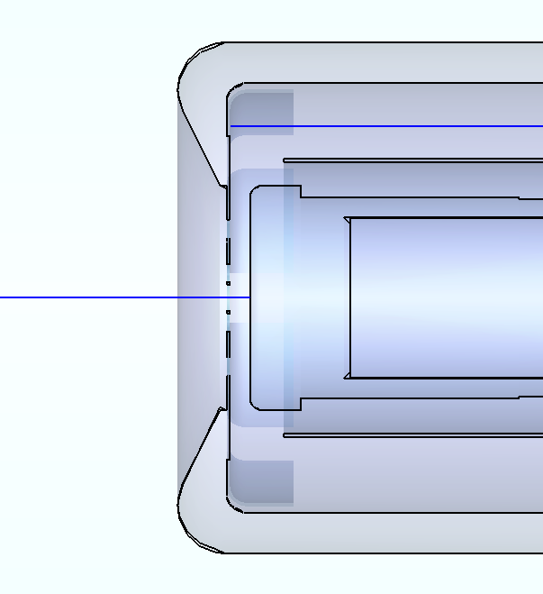
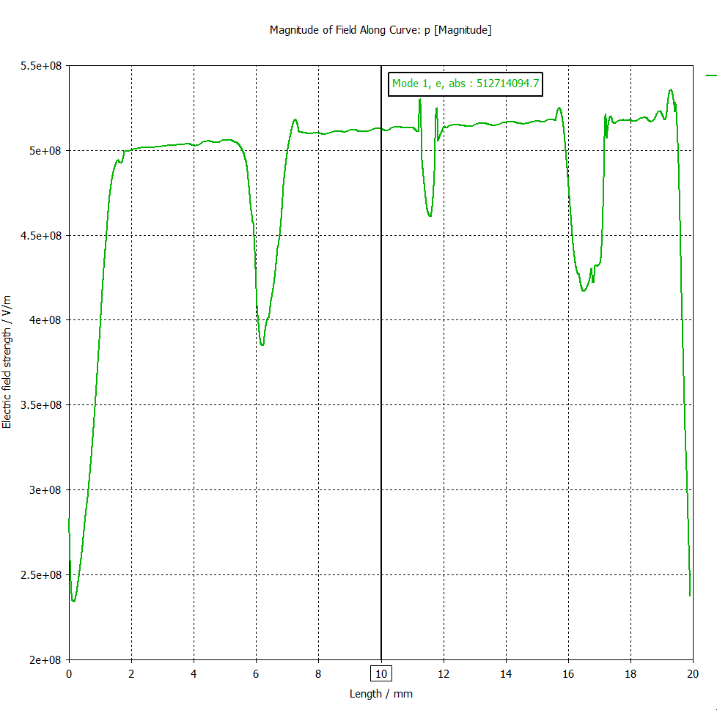
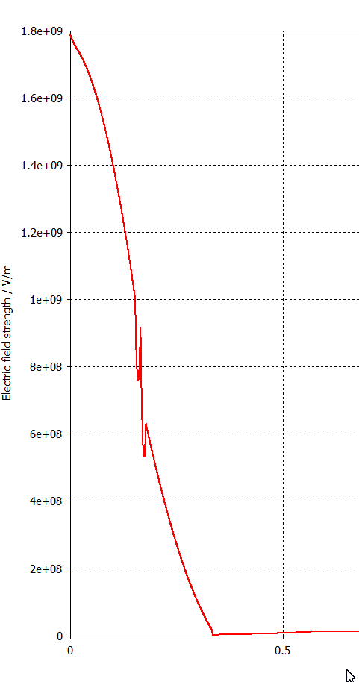
Curve 2
E-filed along curve 2
E-filed along curve 1
Curve 1
V = 2.9618E+5 V -> 1 J
V = 350 V -> 1.3964E-6 J
Q_total = 430
P_wall = 9.067
P_beam = 350 V x 12 mA = 4.2 W
Q_beam = 1338
P_total = 13.3 W

Slide 5
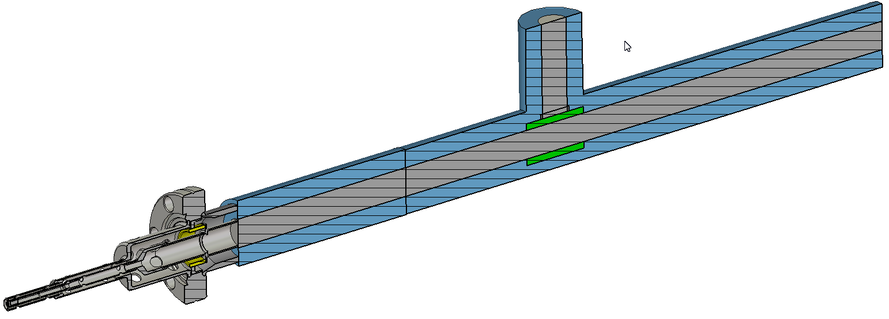
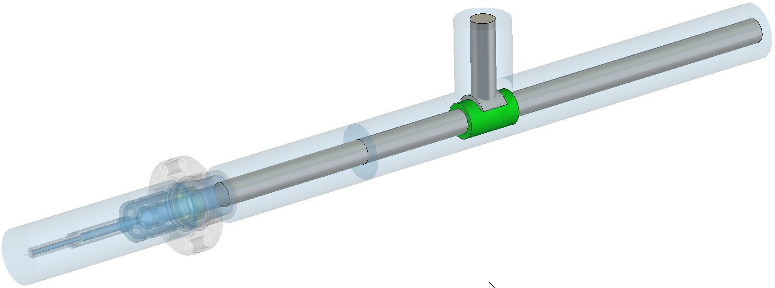
File:
C:\CST_projects\ERDC\RF_gun\Coax_trans\
Coax_2_with_gun_no_potrt_2_Q_cal_5

Slide 6
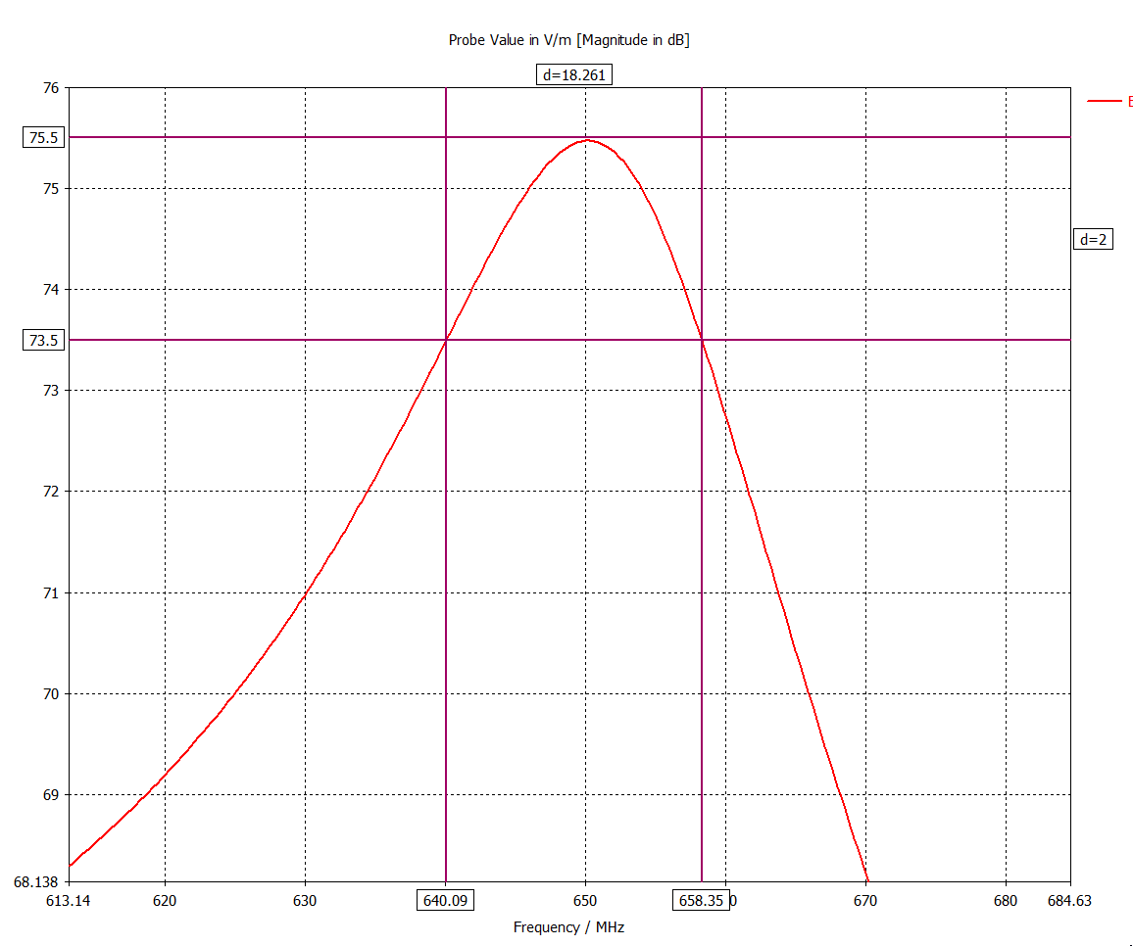
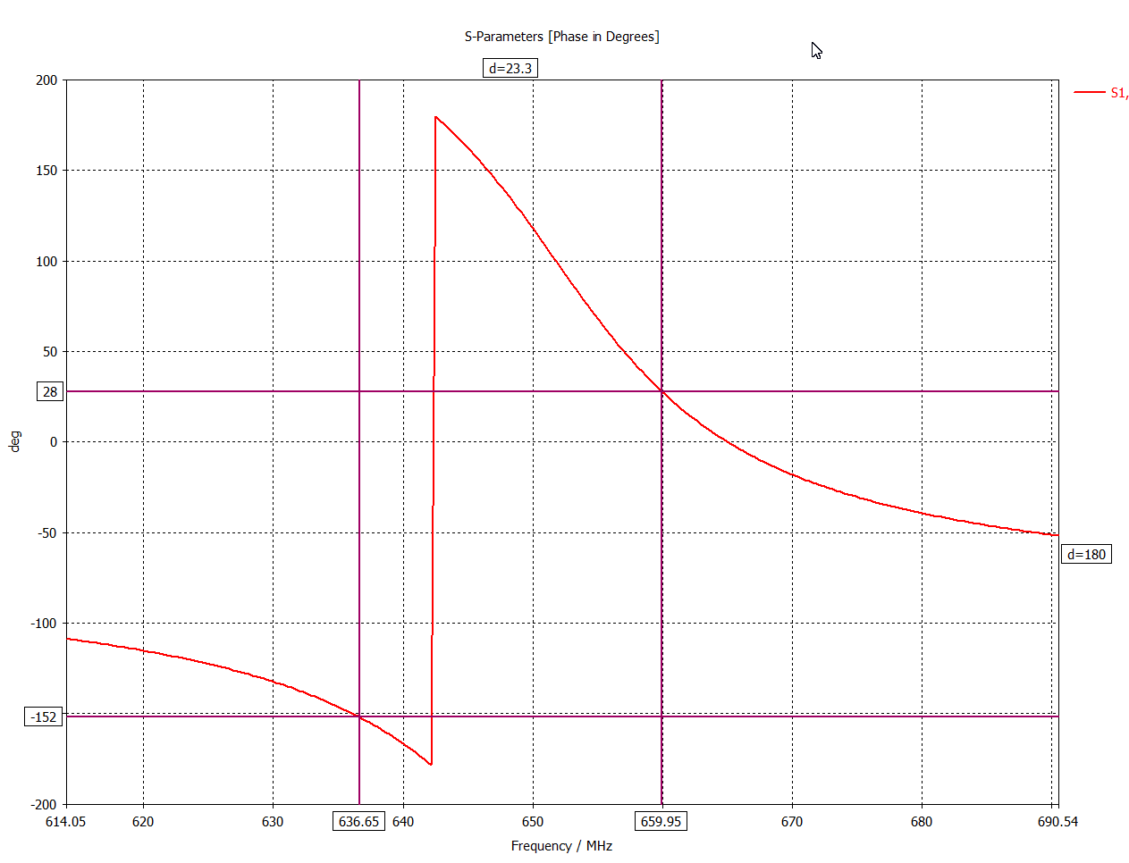
Qa = 36.6
Qb = 27.9
Qav = 32.3
Reflection G = (Qav – Q_total)/(Qav + Q_total) = 0.86
Power reflection = 0.74
Total power from source Ps = 13.3W / 0.26 = 51.2W

Slide 7
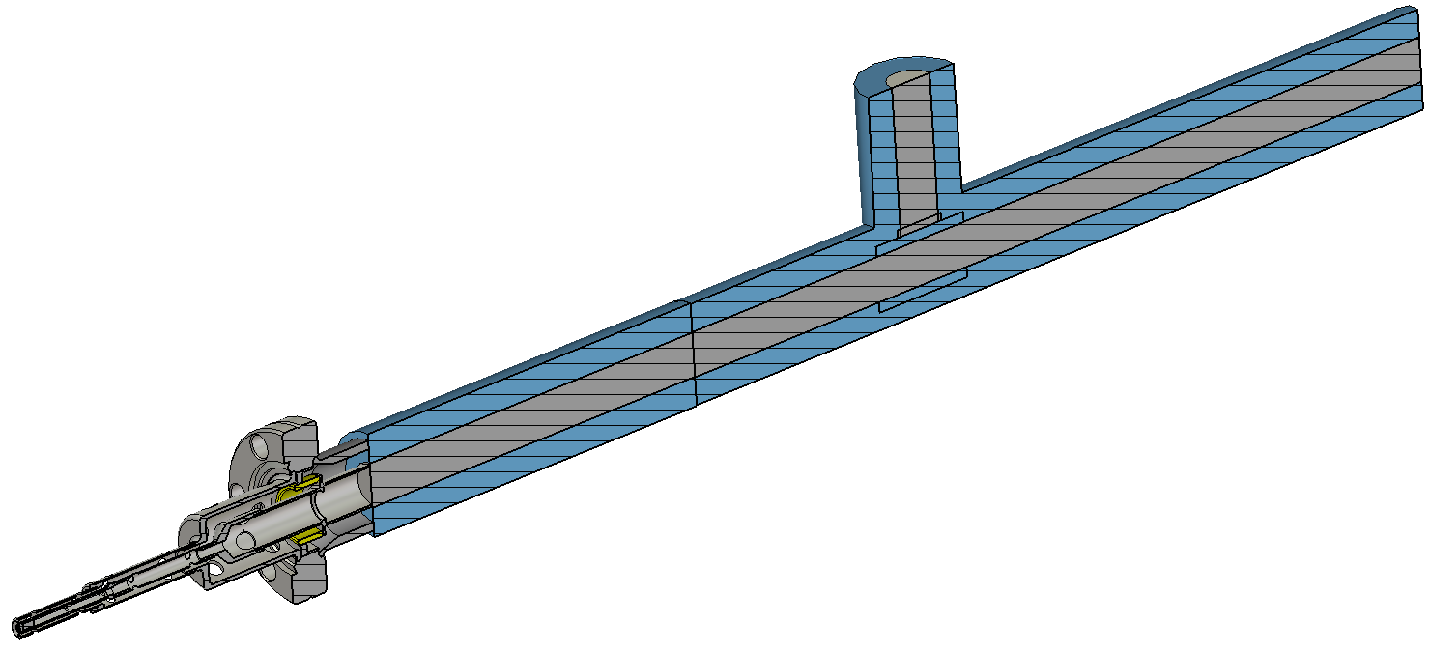
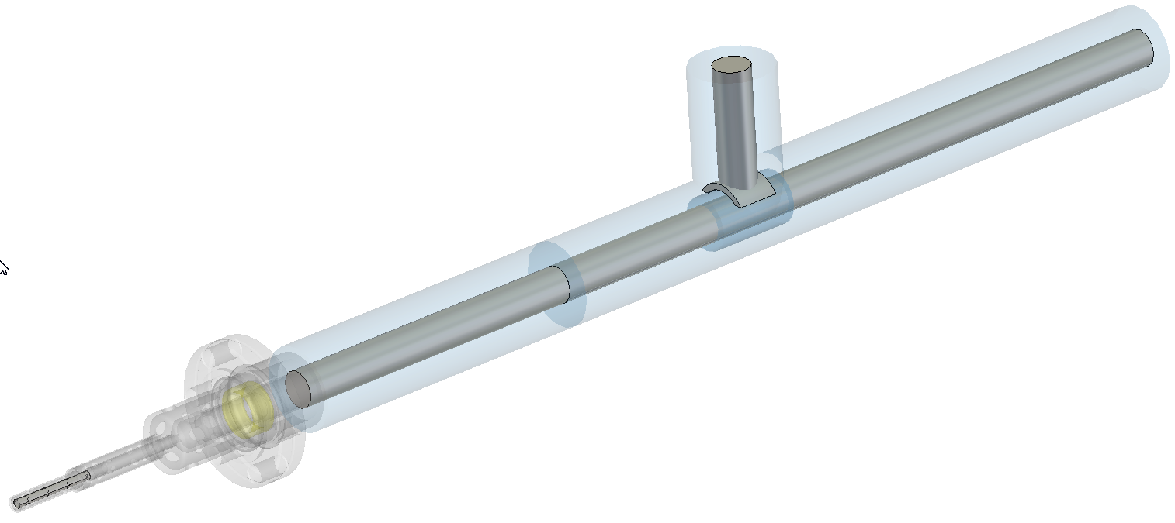
File:
C:\CST_projects\ERDC\RF_gun\Coax_trans\
Coax_2_with_gun_no_potrt_2_Q_cal_6

Slide 8
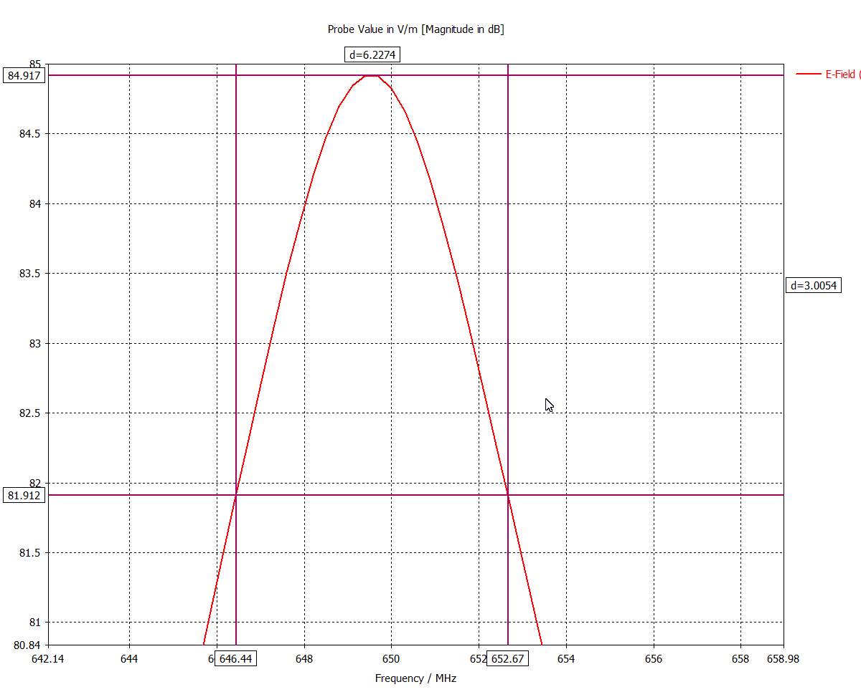
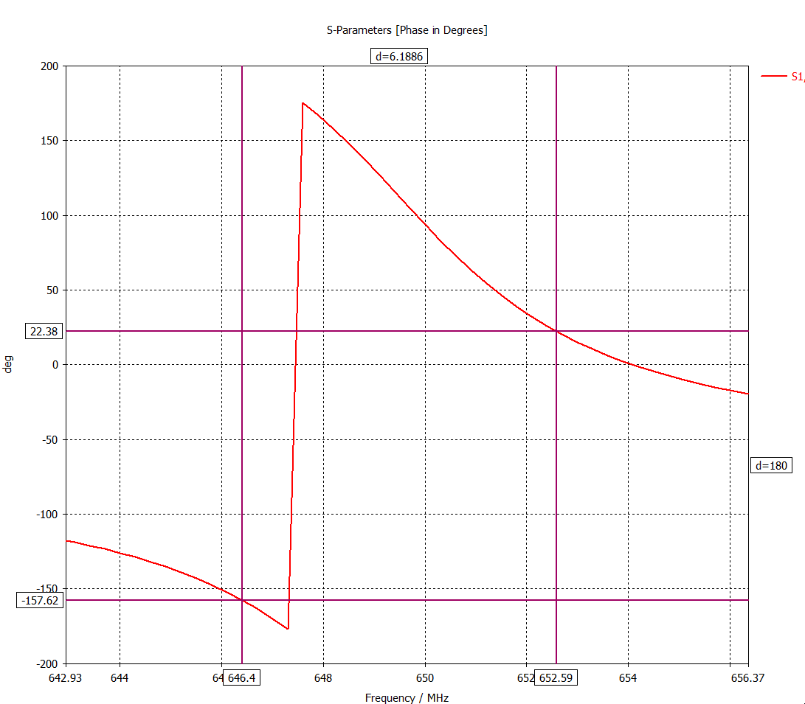
Qa = 103.
Qb = 105.
Qav = 104
Reflection G = (Qav – Q_total)/(Qav + Q_total) = 0.61
Power reflection = 0.37
Total power from source Ps = 13.3W / 0.26 = 21.2W

Slide 9
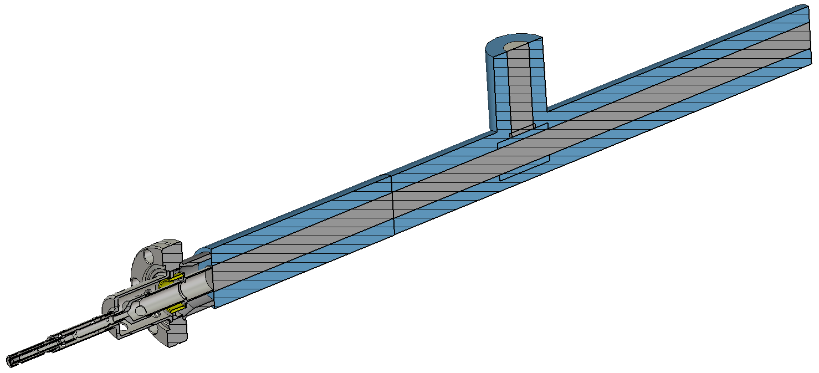
File:
C:\CST_projects\ERDC\RF_gun\Coax_trans\
Coax_2_with_gun_no_potrt_2_Q_cal_7

Slide 10
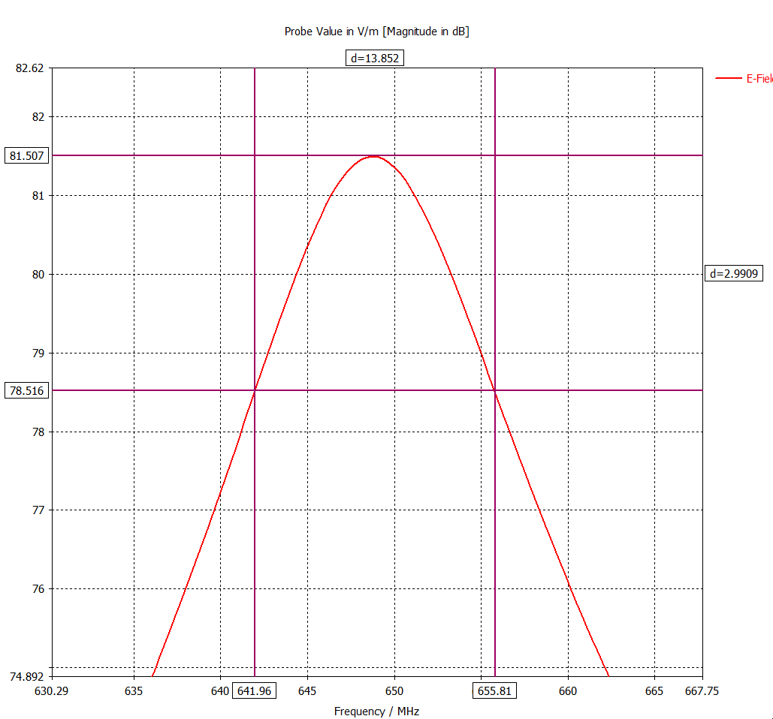
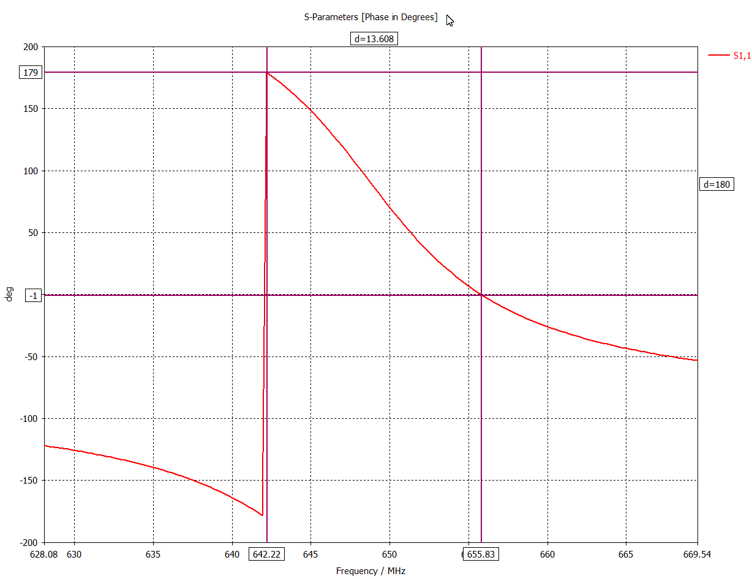
Qa = 46.9.
Qb = 47.8.
Qav = 47.4
Reflection G = (Qav – Q_total)/(Qav + Q_total) = 0.801
Power reflection = 0.642
Total power from source Ps = 13.3W / 0.26 = 37.2W

Slide 11
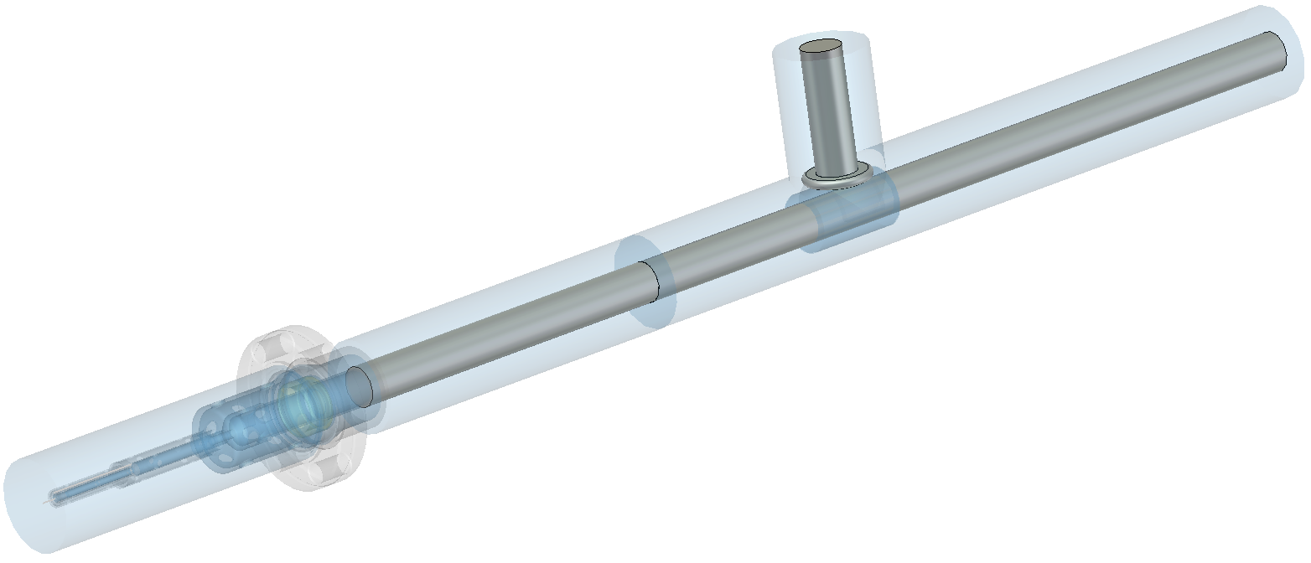
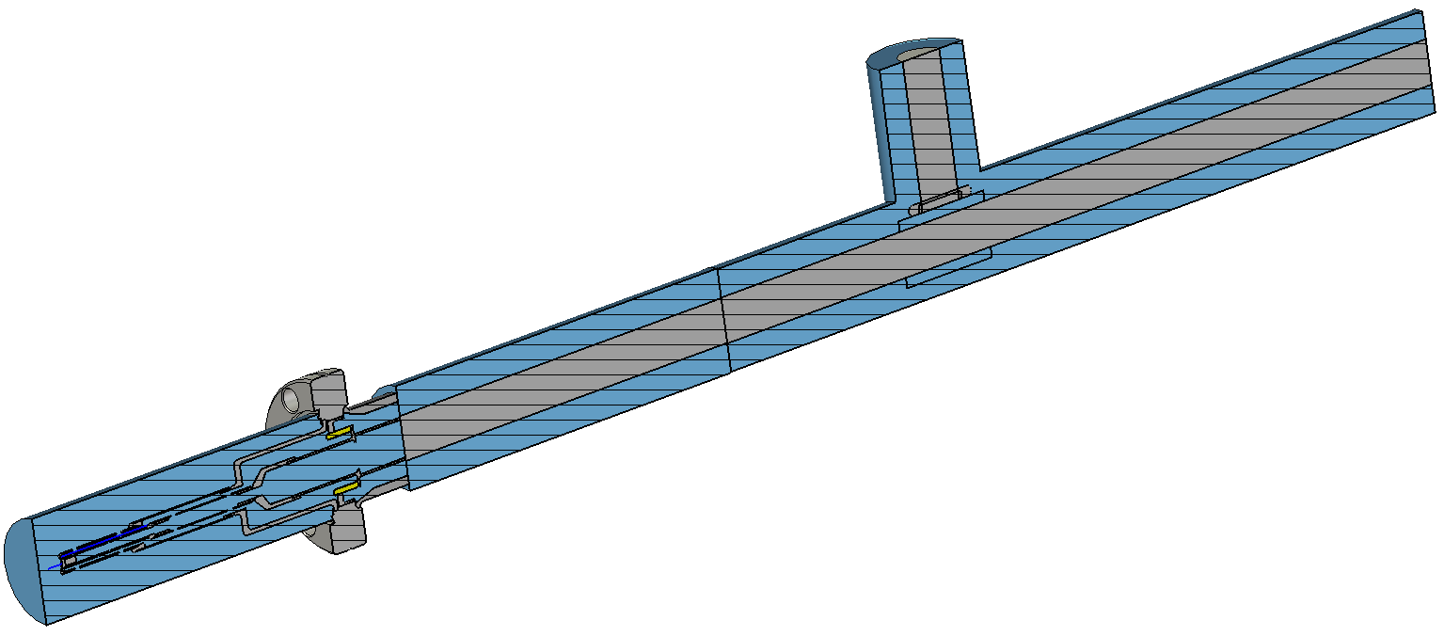
File:
C:\CST_projects\ERDC\RF_gun\Coax_trans\
Coax_2_with_gun_no_potrt_2_Q_cal_2

Slide 12
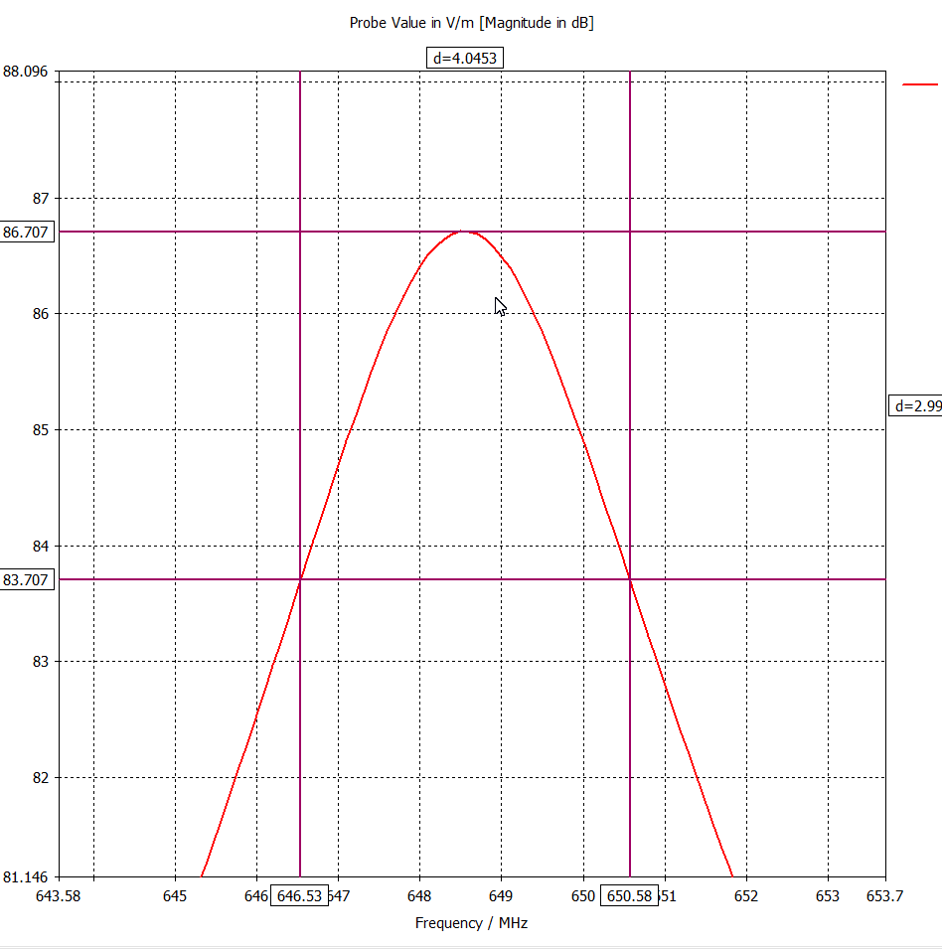
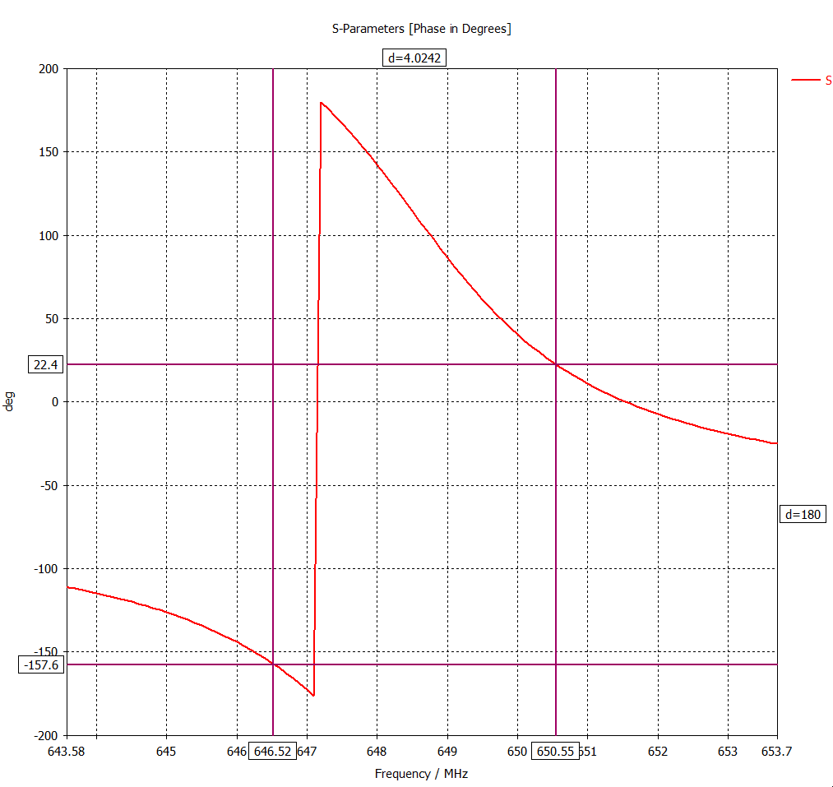
Qa = 160.4
Qb = 161.5
Qav = 161
Reflection G = (Qav – Q_total)/(Qav + Q_total) = 0.455
Power reflection = 0.207
Total power from source Ps = 13.3W / 0.793 = 16.8W

Slide 13
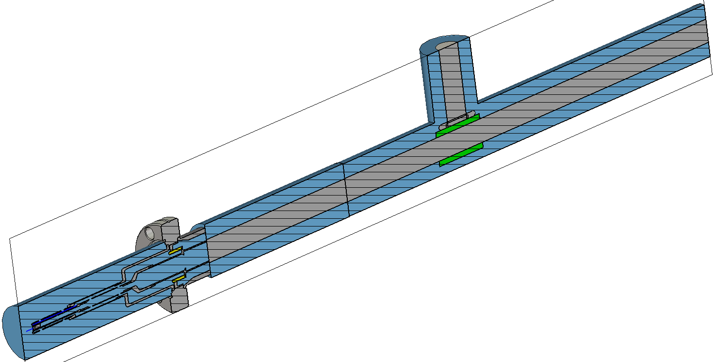
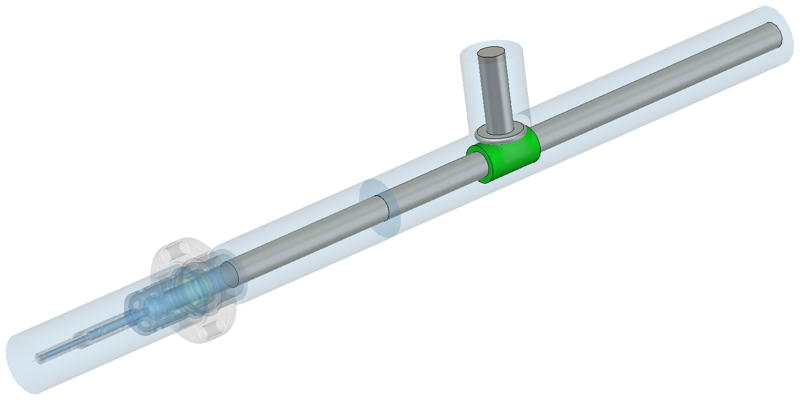
File:
Recommended geometry
C:\CST_projects\ERDC\RF_gun\Coax_trans\
Coax_2_with_gun_no_potrt_2_Q_cal_3

Slide 14
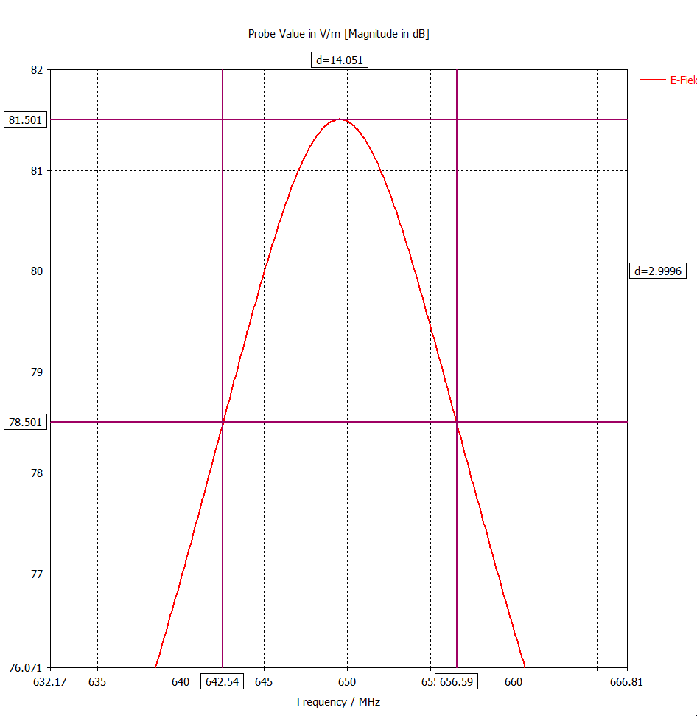
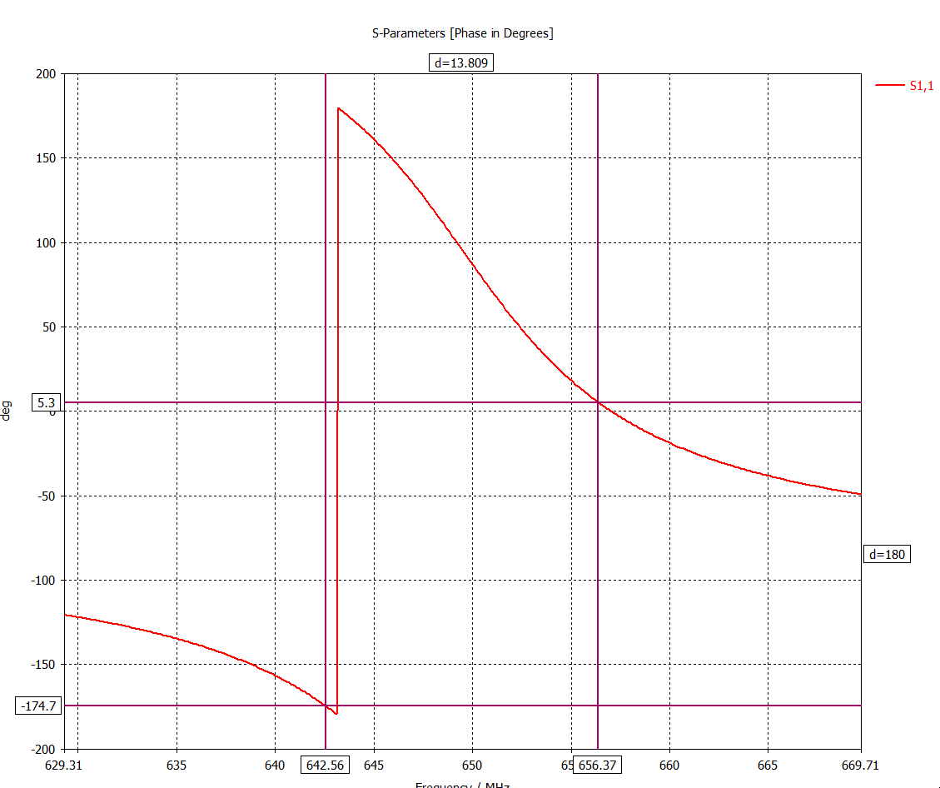
Qa = 46.2
Qb = 47.1
Qav = 46.7
Reflection G = (Qav – Q_total)/(Qav + Q_total) = 0.8
Power reflection = 0.64
Total power from source Ps = 13.3W / 0.36 = 37.0W
Recommended geometry

Slide 15
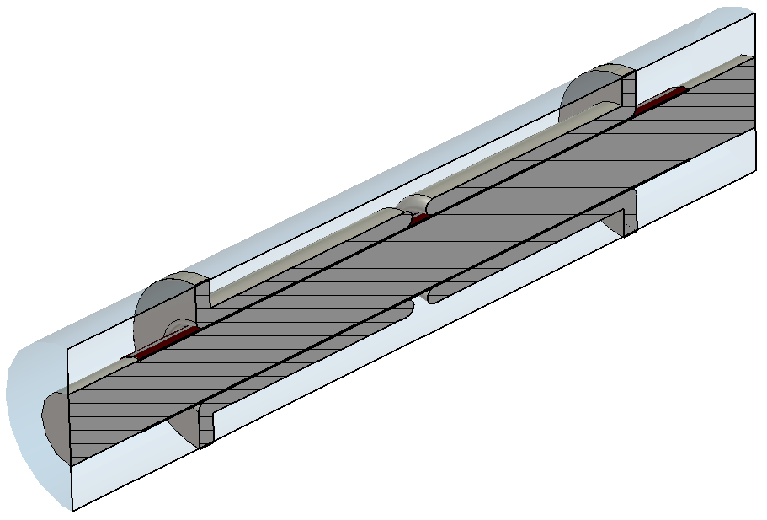
Capacitive
File:
C:\CST_projects\ERDC\RF_gun\Capacitive\
Cap_1_kapton_gap_rnd_3d_acc_2

Slide 16
File:
C:\CST_projects\ERDC\RF_gun\Coax_trans
Coax_2_with_gun_no_potrt_2_Q_cal_3_with_capacitive_2_ports
~ 20
~8.7
~128
~327

Slide 17
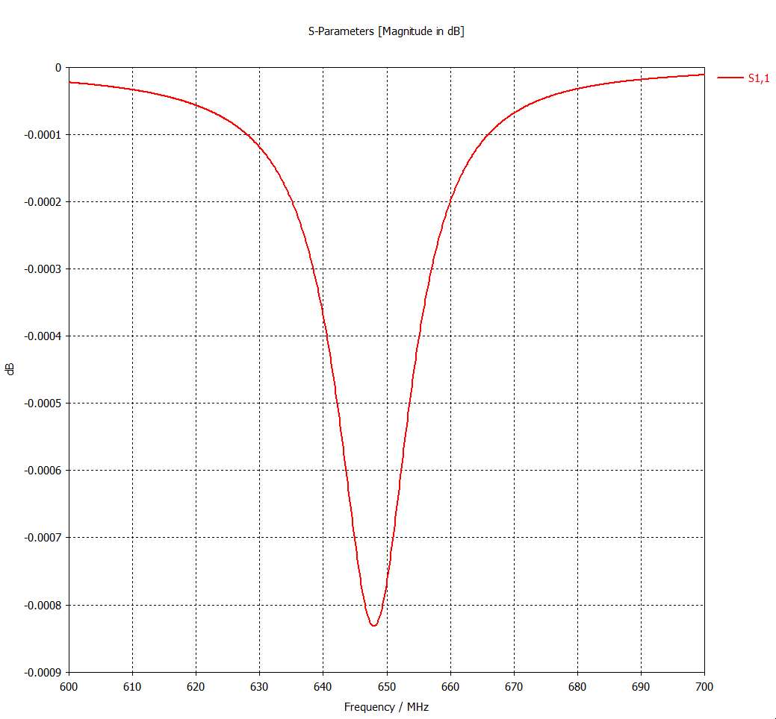
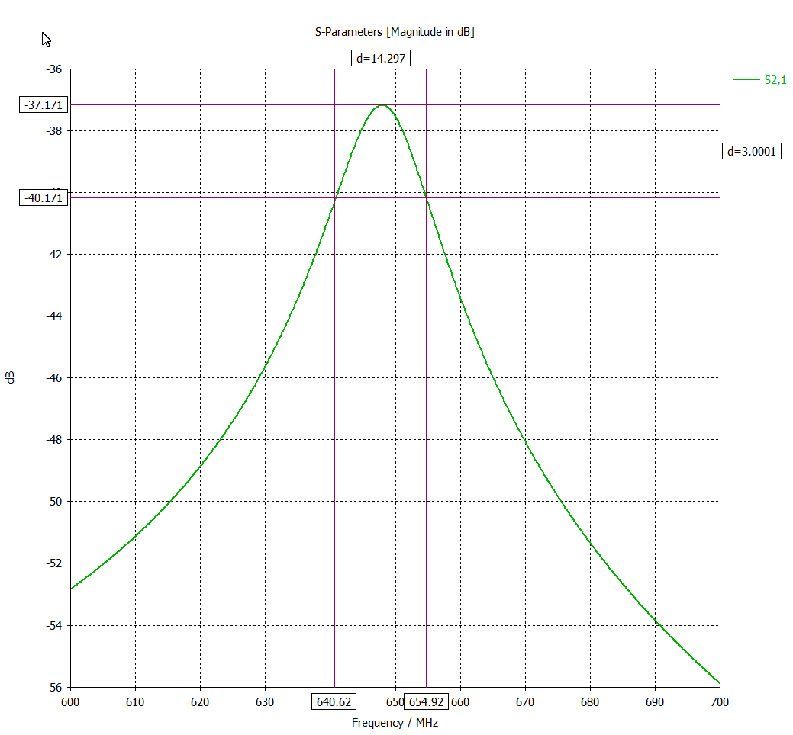
Radiation through port 2 is ~ -37 dB ( < 25 mW).
Q=45.5

