Slide 1
APA Production Schedule
Alberto Marchionni
23 January 2020

Slide 2
Pre-production APA
We always thought necessary to build a pre-production APA to test all interfaces with other Consortia, in particular CE and PDS
The pre-production APA would be tested in the cold box at CERN in advance of the APA Final Design review and would serve as input for the APA Final Design Review
If no additional modifications are needed, the pre-production APA would be installed in ProtoDUNE-II

Slide 3
APA Production for ProtoDUNE-II
From Eric’s e-mail of Nov. 2, 2019: “targeting installation by the end of 2021 based on the discussion at the meeting”
Initial proposal:
The 4 APAs should be identical to the DUNE APAs and possibly considered as spares for DUNE

Slide 4
Items to be finalized before production
Design completion
  Finalization of boards design (mechanical tolerances & voltage requirements)
  Addition of temperature sensors to APA frames
  Finalization of APA frame structural analysis
  Design of improved protection panels
  Support for cable grip of CE cables
  Validation of winder head with feedback control
  Decision on wire tension measurement method
  Design and FEA analysis of the APA transport frame
Manufacturing plan/pre-production tests
  Plan/pre-production for APA Boards
  Routing of PDS cables in APA frames
  Pre-production of APA frames
  Pre-production of slotted conduits

Slide 5
APA Production
Production of APAs
  6 winders in US (2 UChicago, 2 Yale, 2 PSL)
  4 winders in UK
Shown at I&I Oct. 2019
APA Production/year
Production Site | 2020 | 2021 | 2022 | 2023
Daresbury | 6 | 24 | 24 | 24
Yale |  | 2 | 9 | 13
Chicago |  | 2 | 9 | 13
PSL |  | 6 | 10 | 12
TOT | 6 | 34 | 52 | 62
?
  End of APA Production - detector module #1 September 2023
  End of APA Production - detector module #2 April 2026

Slide 6
TDR Reviews

Slide 7
TDR Milestones

Slide 8
Conclusions
Pre-production APA
  Who builds it? Do we need final boards for this?
ProtoDUNE-II APAs: we need a realistic schedule. It will be driven by the APA Final Design Review

Slide 9
Backup

Slide 10
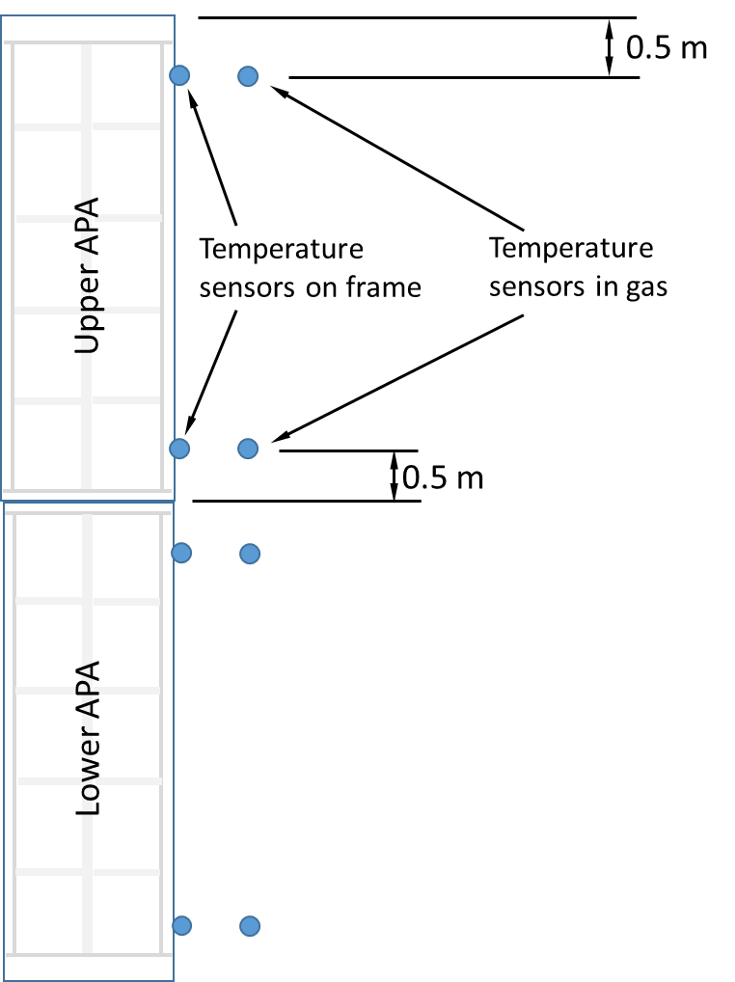
T sensors positioning
With eight sensors, the sensors should be divided into four pairs - with one of each pair in the gas and the other firmly in contact with the APA frame. This gives the temperature difference between frame and gas at four locations.
If we place a pair 0.5m from each end of each APA we will have a good idea of the temperature difference between the two foot tubes, the temperature gradient over each individual APA, and the temperature difference between the top of the APA stack and the bottom of the APA stack.
We will also have the frame/gas ΔT at these points.
Lee Greenler

