Slide 1
APA Workshop UK Factory
STFC Daresbury Laboratory
22nd January 2020

Slide 2
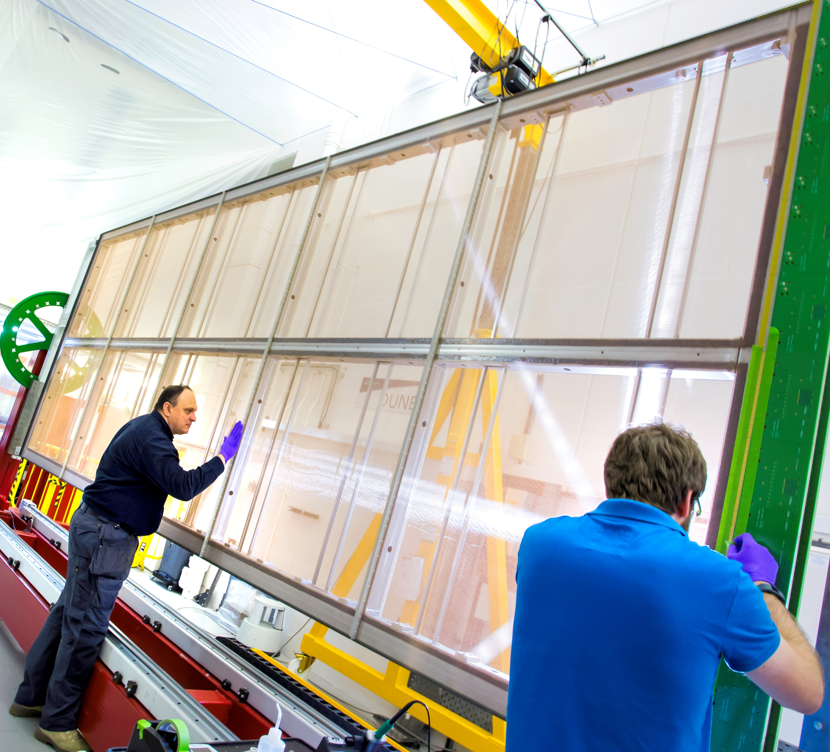
Overview
Factory layout
Progress on the Factory
Safety system
APA component status
APA production schedule

Slide 3
Daresbury Laboratory DUNE Factory
Inner hall site of the SRS accelerator identified as factory location
Purpose built factory room
Factory to have 4 winding machines, 10 process carts
Separate shipping area in renovated plant room
Dedicated swing arm pillar cranes for each winding machine

Slide 4
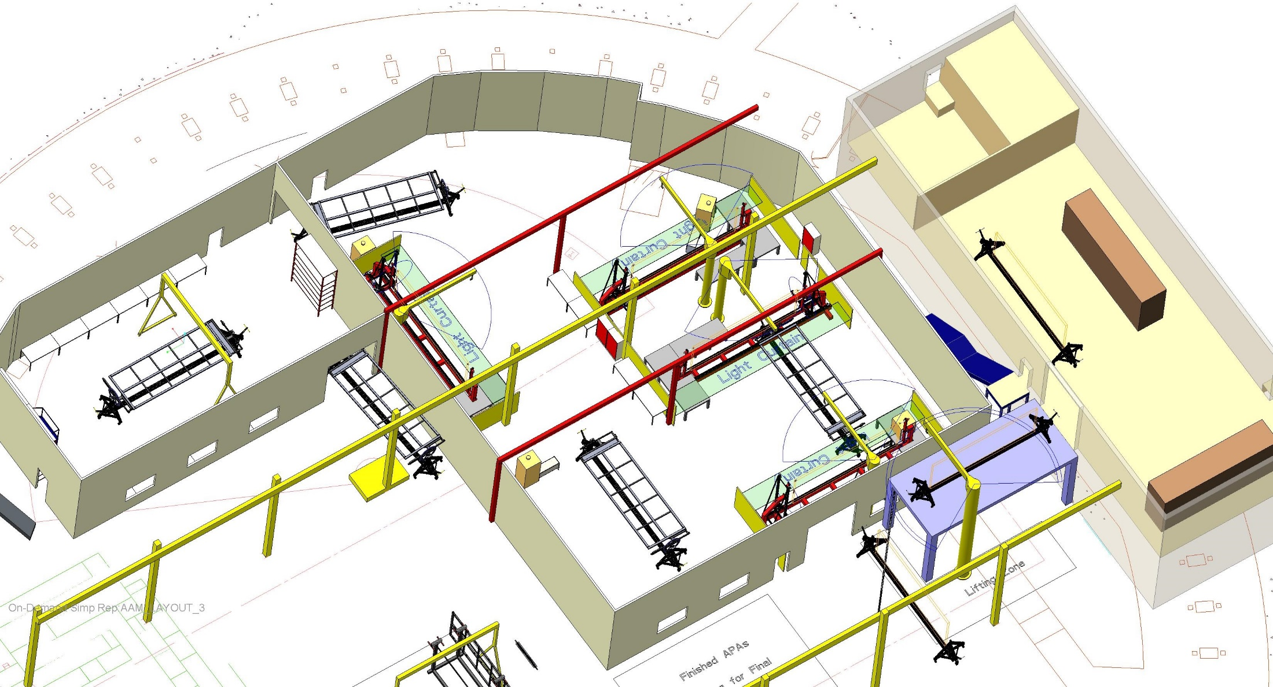
Daresbury Laboratory DUNE Factory Layout

Slide 5
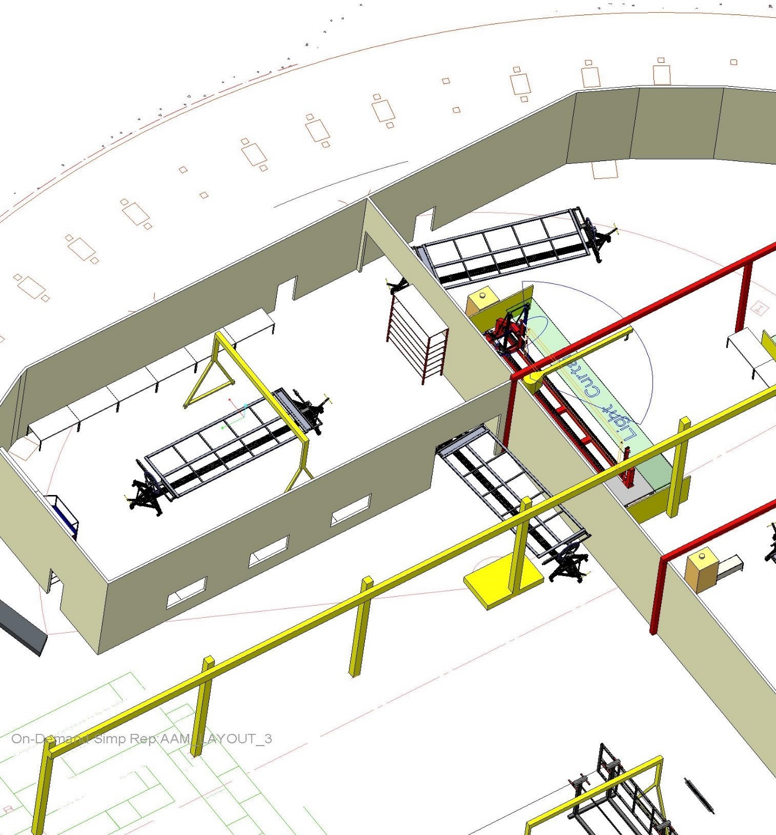
Pre Processing Area
Pre Processing Area – Comb bases & mesh panel fitting
Storage area for bare APA frames + large equipment.
APA frames loaded into process carts here.
Entrance into preparation area.

Slide 6
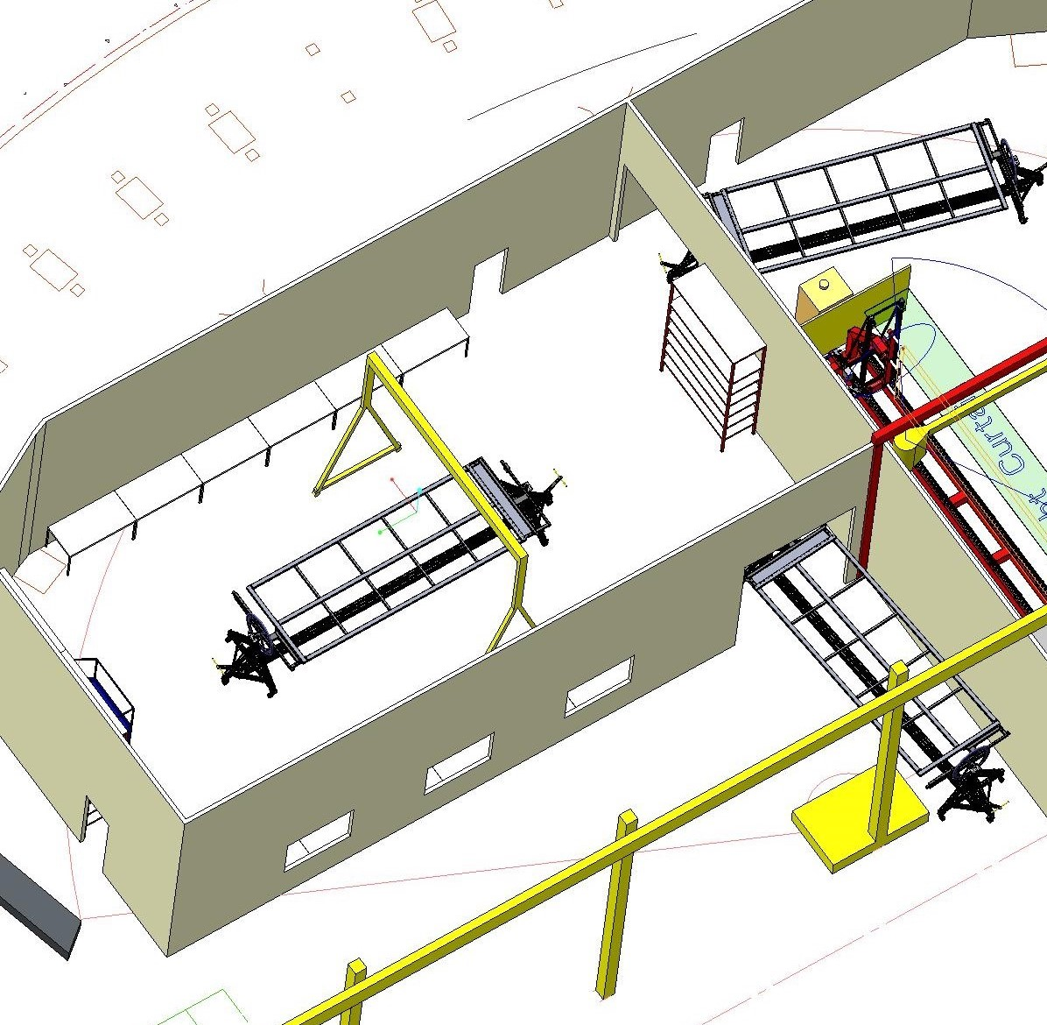
Pre Processing Area - cont
Access to
Winding
area
Small part / jig storage.
Prep area
210m^2
Small part assembly / general work area.
comb base and mesh panel fitting.
Emergency Exit
‘A’Frame
Ganrty
Crane

Slide 7
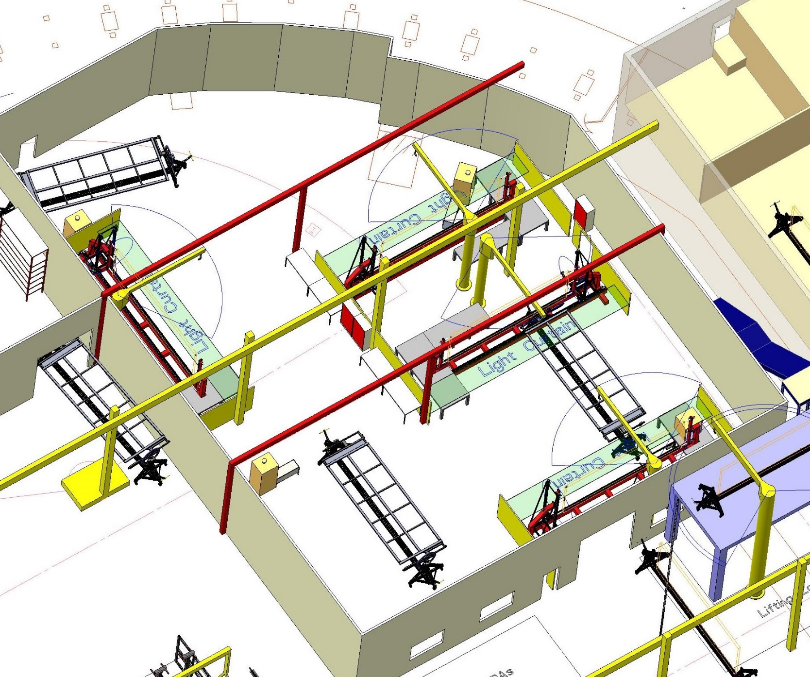
Factory Area Layout
Winder - 1
Winder - 2
Winder - 3
Emergency Exit
Plenty of wall space for off line prep work
Winder - 4
Parking for completed APA’s waiting for transfer to shipping area.
Winder area 638m^2
Door position shown incorrectly

Slide 8
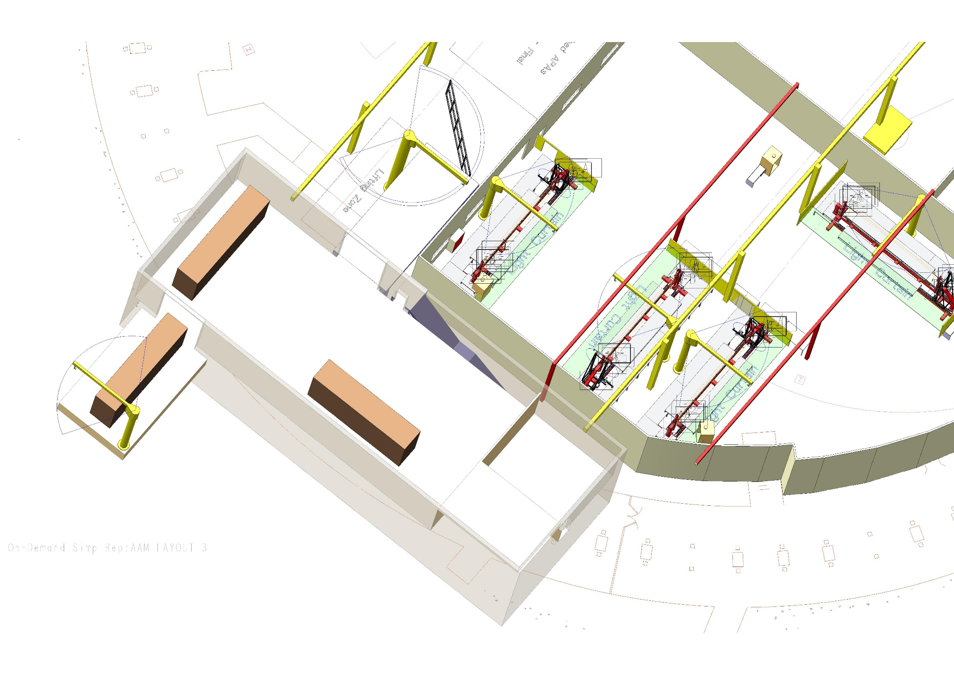
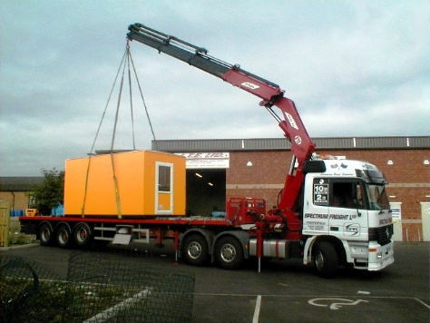
Packing & Shipping Area
Lifting zone to platform.
Fixed platform
Post processing / packing & shipping area. 237m^2
HIAB Truck for loading and shipping APA’s
Packing crate (size of existing PSL crate).
Overhead crane to cover this area.

Slide 9
Factory Progress
Factory Review Jan 2020
Crane installation & commissioning - Complete
Factory room build - Complete
Factory Room Services
Electrical services being installed includes all lighting, power and network systems…..expected completion end Jan 2020.
Heating and ventilation system filtered to class 100,000 ordered…..installation Feb 2020.
Shipping room refurbishment well advanced
Floor remedial work ongoing then electrical power distribution boards will be installed
Lighting installed
Heating and ventilation order placed
Platform
Installed - Complete

Slide 10
Factory Progress – Winding Machines
Plan to use updated existing winding machine in current position for development work and building of APA’s to meet schedule
Winding machine bases and pillars (3 off) – Delivered
Spines and bearing/shaft systems – Delivered
XYZ drives including spare z drives – expected delivery Jan 2020
Cable trays - Delivered

Slide 11
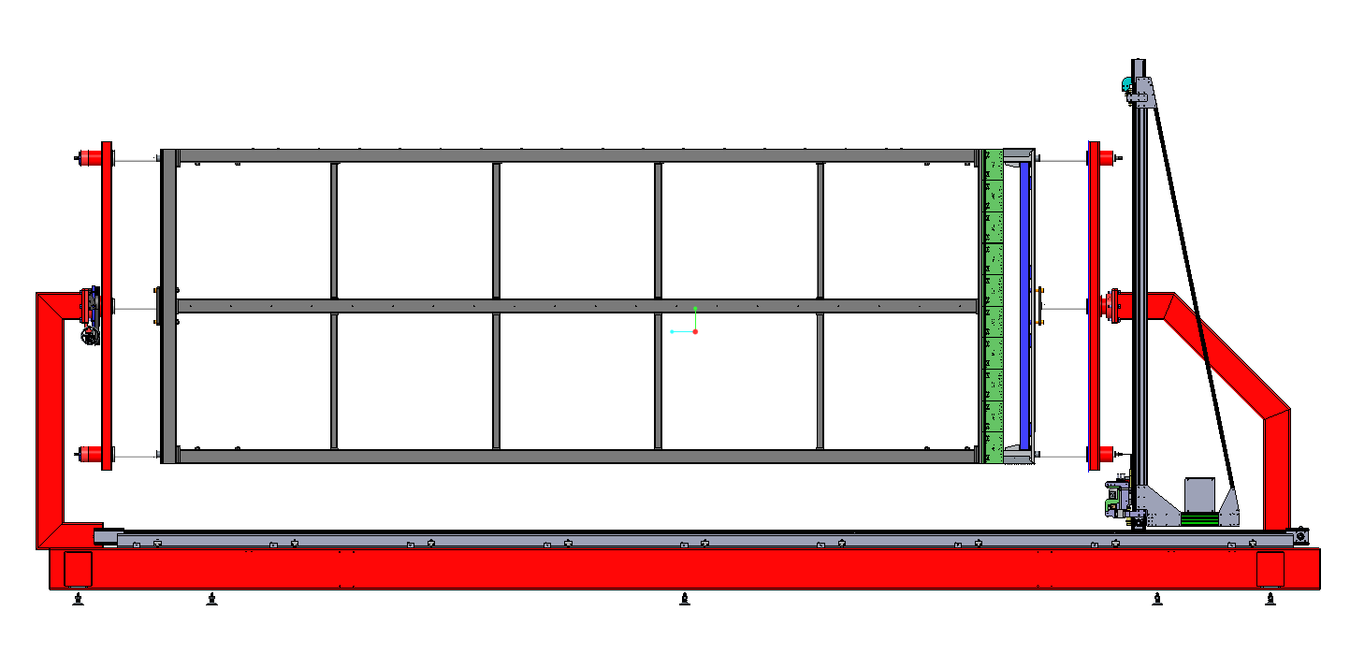
Winding Machines
Component Procurement in Progress
Bishop Wisecarver XY&Z drive stages
6 linear bearings,top centre & bottom

Slide 12
Safety System for Winding Machine
Development work being carried out on current winding machine.
Laser curtains in place
Fencing and access doors with breakout switches installed
Emergency off pull wire installed
Control system drgs complete
Commission control system in progress

Slide 13
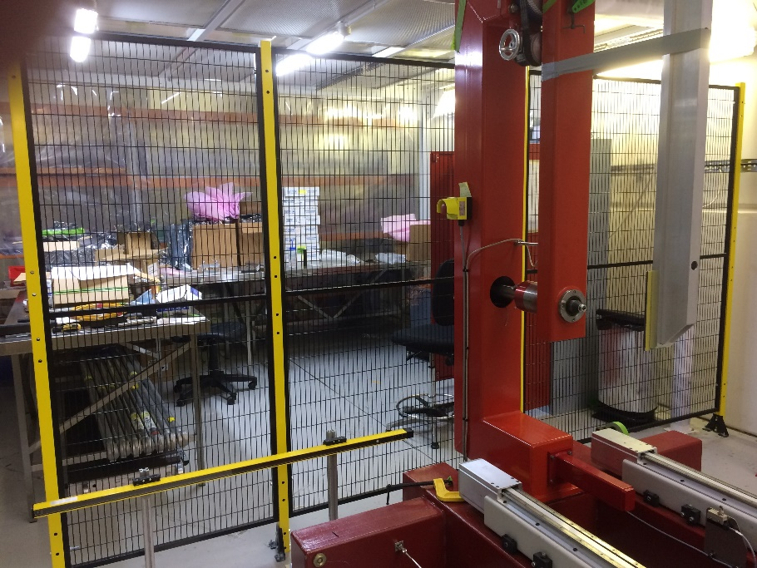
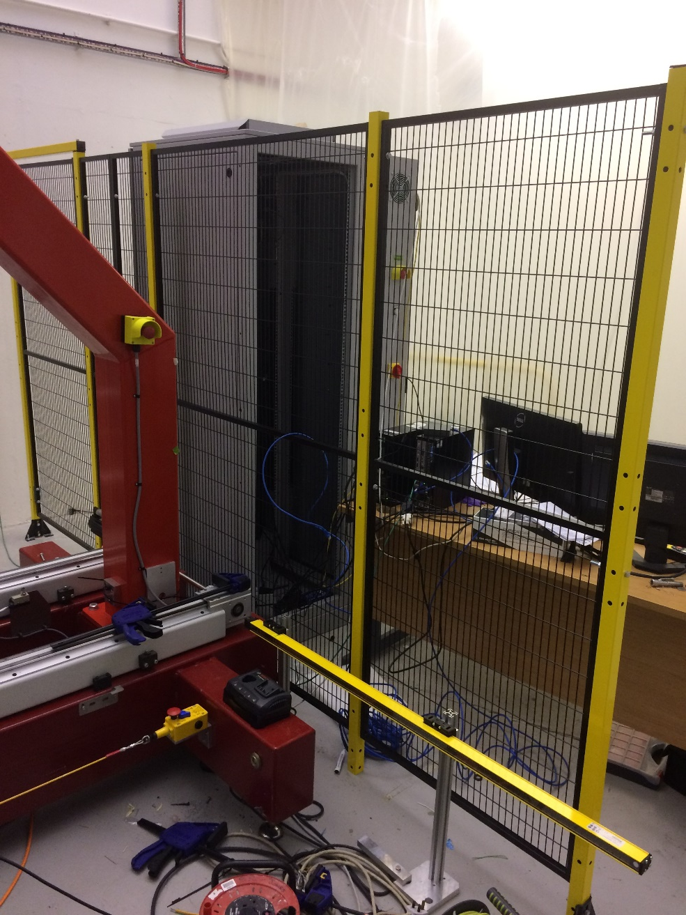
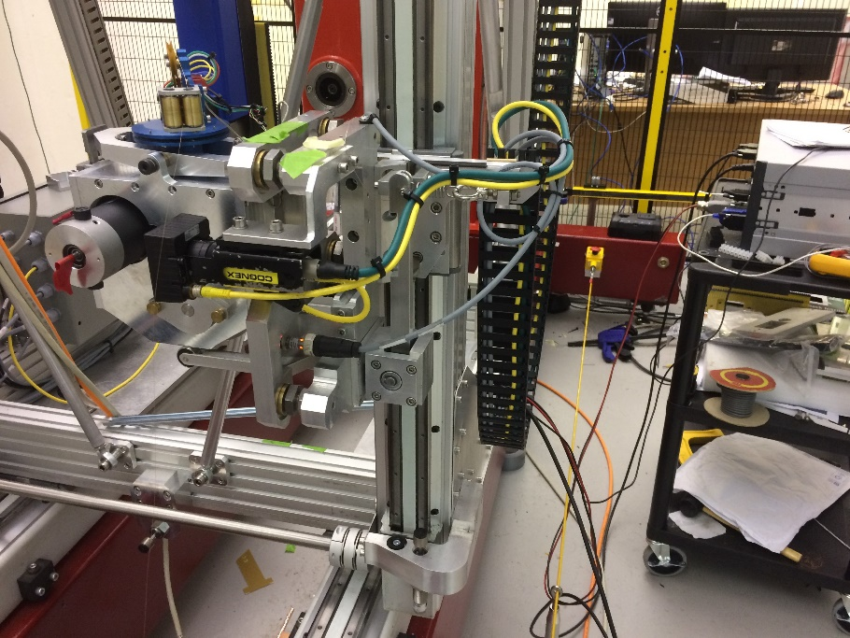
Safety System for Winding Machine
Laser light curtain
Interlock door for rear access
Laser light curtain
DC motor winder head tests in progress
Emergency interlocked pull wire

Slide 14
APA Component Status
Frames
3 frames ordered 2 from UK supplier 1 from PSL
Tender process for production required
Electronic Boards
60% Electronics review took place PSL November
Production delayed……sample boards will be supplied by PSL for winder commissioning
Suppliers need to be identified
Combs & Comb Bases
Suppliers identified
Order placed for comb bases,
Order placed for sample combs

Slide 15
APA Component Status
Winder Heads (active tension control) – 4off
1 existing…. Commissioned
4 currently being manufactured at University of Liverpool
Mesh – 10 rolls - Delivered
Currently manufacturing 40 mesh panels for 2 APA’s – expected delivery December 2019
Tender process for production is currently ongoing in UK

Slide 16
APA Component Status
Process Carts – 10 off
2 carts exist
Aluminium extrusion bases for 8 carts ordered
Support arms, gearboxes and bearing shafts ordered …….design review with PSL
Shipping Crates
Design review Jan 2020….Liverpool
Tender process for production required

Slide 17
APA Production
Production of APAs for Detector #1
US-APA production (76 APAs): Jan 4, 2021 – Dec 7, 2023
UK-APA production (76 APAs): Jul 6, 2020 – Nov 6, 2023
APA Production/year
Production Site | 2020 | 2021 | 2022 | 2023
Daresbury | 6 | 24 | 26 | 20
Yale |  | 10 | 13 | 7
Chicago |  | 10 | 13 | 7
PSL |  | 3 | 7 | 6
TOT | 6 | 47 | 59 | 40
Need to cold test 10% of APA production
Need to investigate options for local storage if early shipping to SD is not possible

Slide 18
APA Production
Factory to be manned and winding machines operated by Technician Staff from:-
Manchester, Liverpool, Sheffield, Lancaster & Daresbury

Slide 19
Thank you

