Slide 1
Winder / Head Modifications
STFC Daresbury Laboratory
22nd January 2020
DUNE APA Workshop

Slide 2
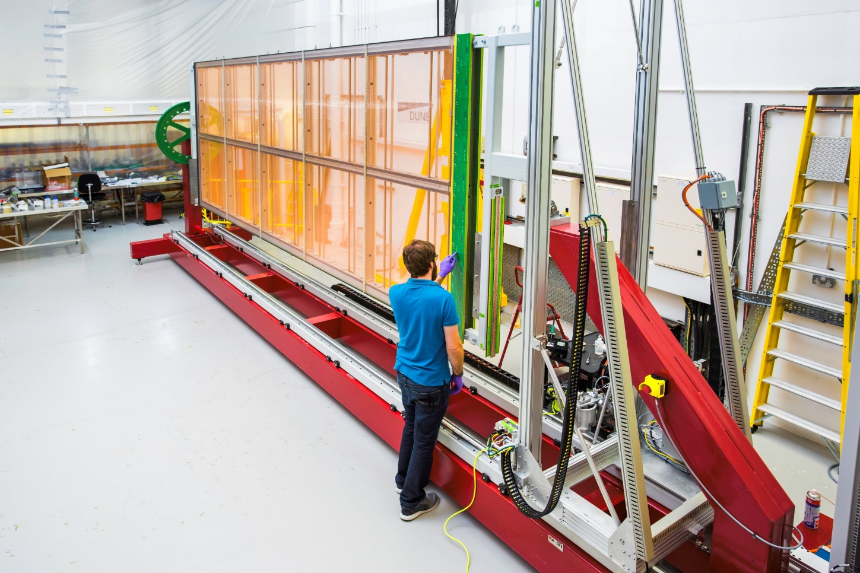
Old APA Support Method in the Winder
Previous mounting method used heavy interface frames.
Can wind only half a layer at a time.
Large changeover operations involving removal of the APA from the machine.
Very large risk of damage during changeover.
Rotation done by hand, heavy counter weights needed.
Large bending moment applied to the APA frame when horizontal.

Slide 3
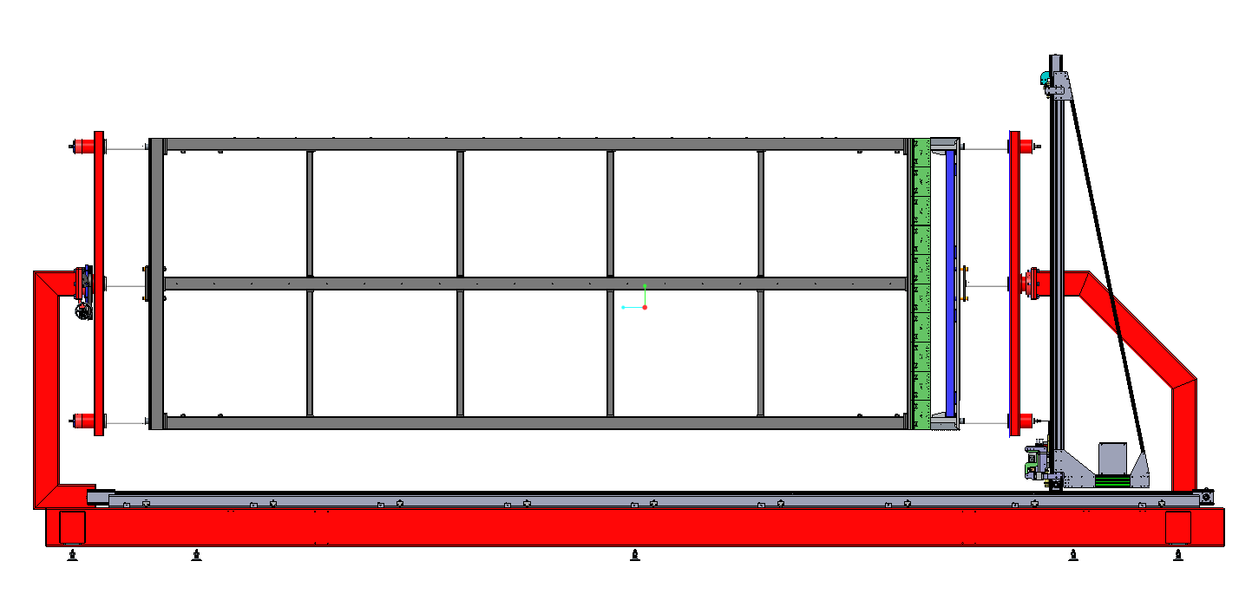
New APA Support Method in the Winder
Can wind all layers without removal from the winding machine.
Spherical bearings here reducing bending moment on the APA frame.
Manual rotation drive thro handwheel and gearbox.
6 linear bearings, top centre & bottom

Slide 4
Winder Head Tests

Slide 5
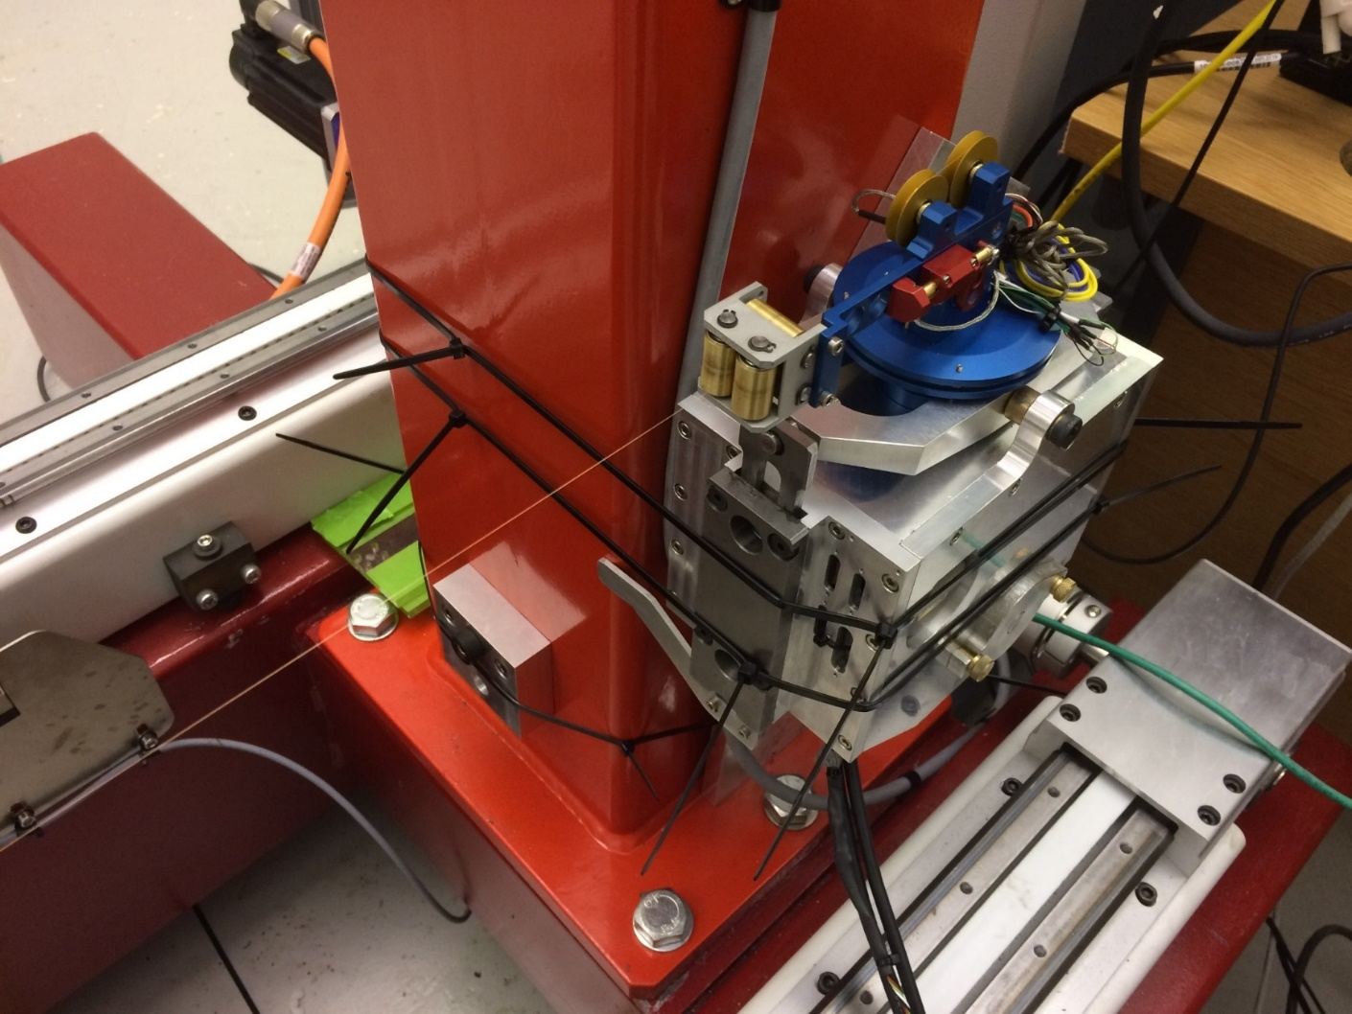
Previous Test Set-Up - AC Servo System
Slip ring
Head fixed for pull tests.

Slide 6
Previous Tests - AC Servo System
Following fixed pull tests the head was mounted on the winder. We did not have an APA frame so created a set up which enabled wire to be wound.
Carried out runs at half speed and nominal speed.
Experienced some problems with the slip ring device which maintains the signal feedback. Was better after a re-build.
As the head passes around the ends tension was lost due to a noticeable judder.
Tuning the system does not improve things.

Slide 7
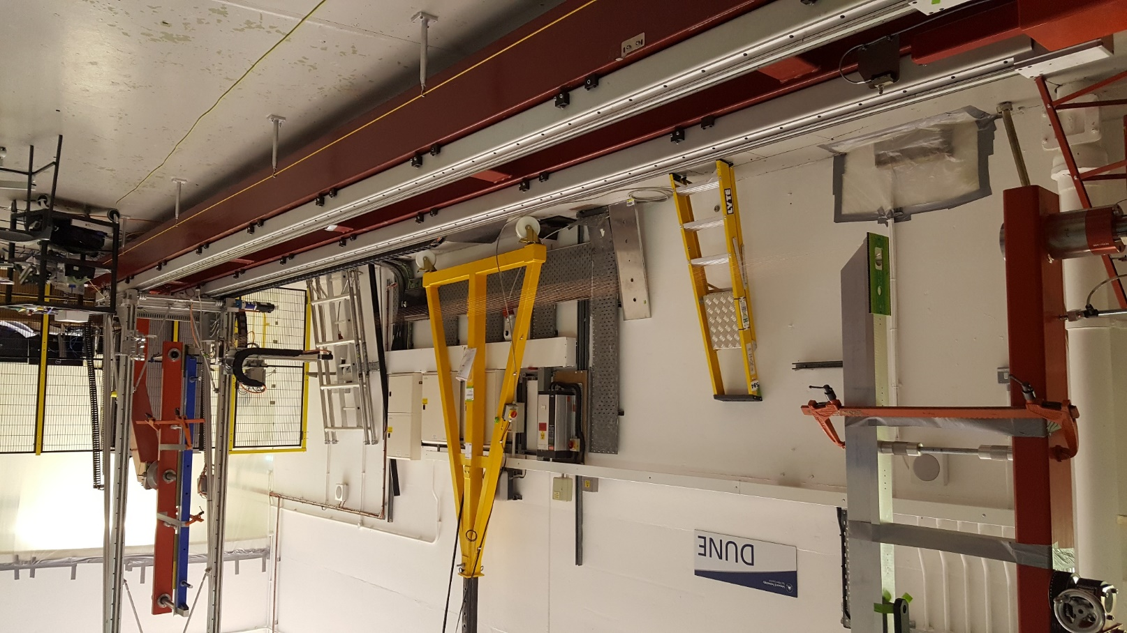
Winder Test Set Up
Wire
Head End PC Card
Foot End PC Card

Slide 8
Modified to a DC Servo System
The head was re-configured to use a DC servomotor and a new control system. This is a safer option as it operates at 36V and requires less cabling.
The dancer arm has been re-designed to remove the slip ring and make treading of the wire easier.

Slide 9
Removed slip ring – dancer arm now inside body
Internal Roller Assy
DC Motor
Belt Drive
Spool
Dancer Arm Assy

Slide 10
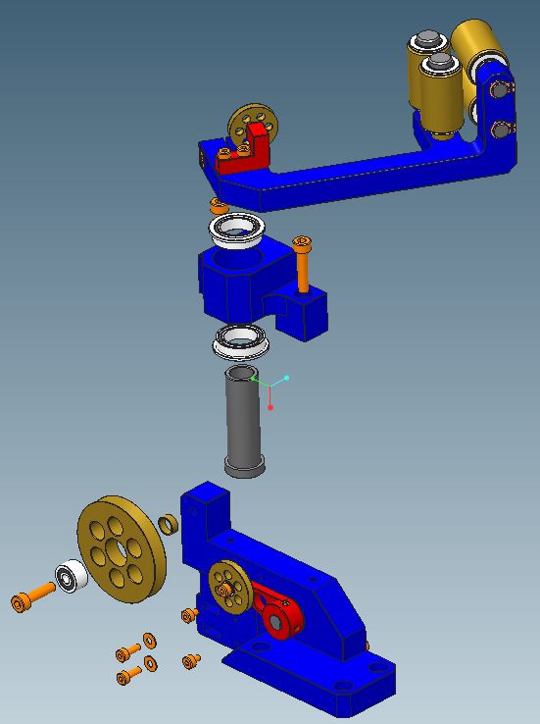
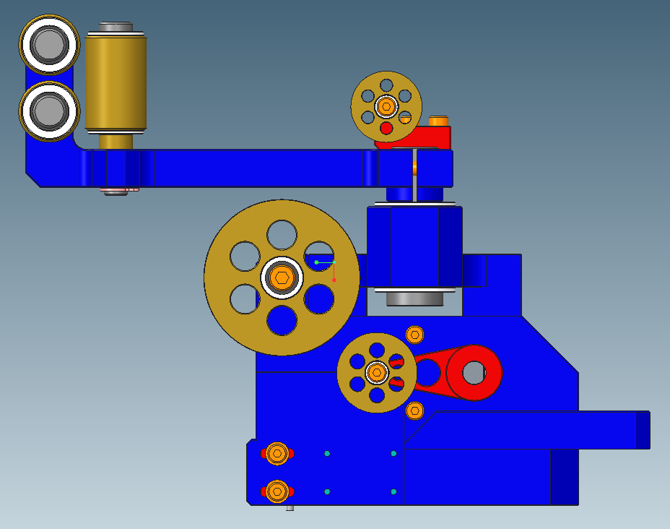
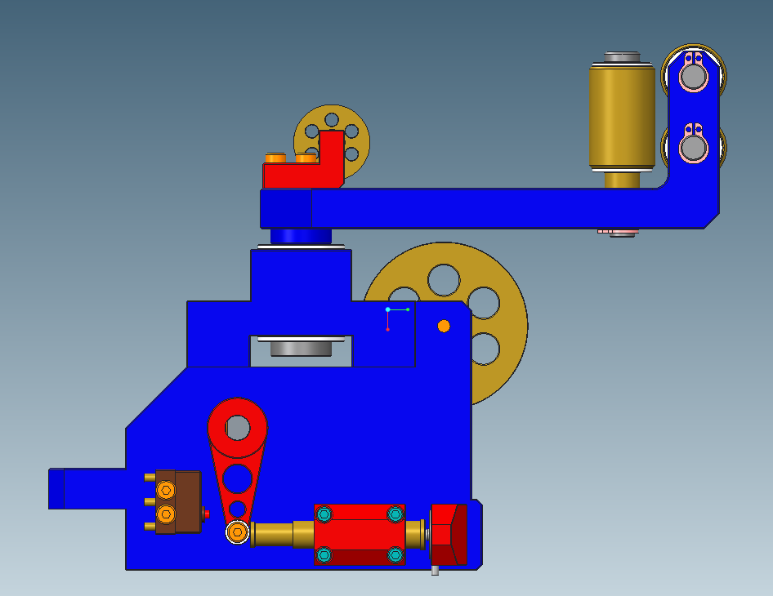
Exit Rollers
Wire Route
Housing
Bearings
Vertical Hollow Shaft

Slide 11
Wire Exit Rollers
Guide Roller
Guide Roller
Wire Break Kill Switch
Spring
Load Cell
Dancer Arm + Roller
Transfer Shaft + Bearings
Telescopic Tube
Adjustable Load Cell Housing

Slide 12
DC Servo System Tests
Bench tests went very well, took time to tune the motor and set up all the parameters.
Transferred the winder head to the winding machine. Clamped to the support post DC motor performed much better than the AC motor….able to maintain 6N tension forwards and backwards and very smooth in both directions.
Connected head to the 18m cable, needed to reset some parameters on the control system.
Wound wire round the end supports and it performed extremely well.
Tension measurement results 6.5N +- 0.5N.

Slide 13
Next Phase of Tests
The winding machine and head 3 point latching components are being fitted and aligned.
Electrical contact parts are being fitted and wired.
Winding tests will then be carried out using the full system.
Up to date control system components are being ordered and assembled. Components used so far are un-supported.

Slide 14
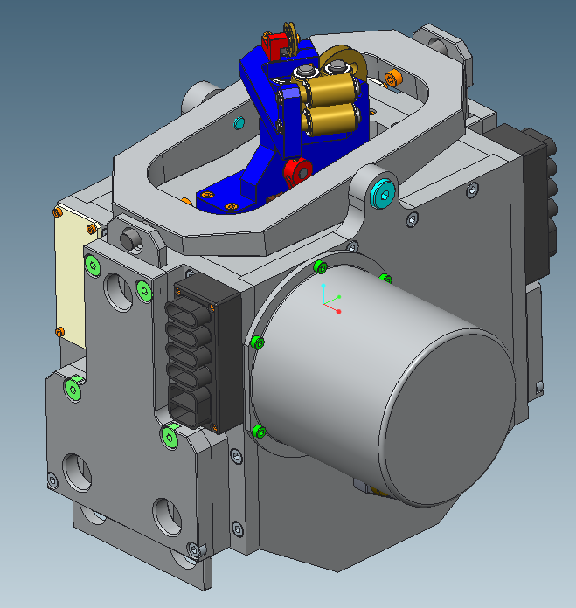
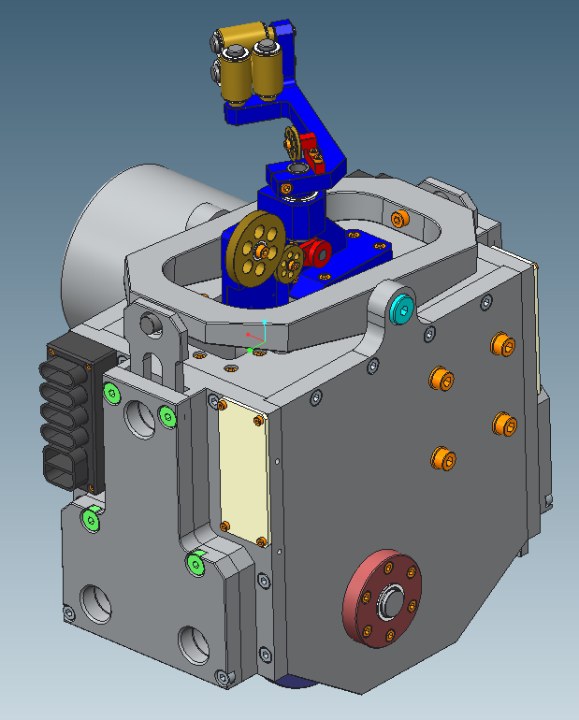
3 Pin Latch System
Latch Rocker
Electrical Contacts
Motor Can
3 Pin Latch

Slide 15
Winder Head Latching Components
Z Drive End
Compensator
Winder Head

Slide 16
Questions

