Slide 1
Correlation of MQXF Magnet Bow with Change in Center Observed during Cold Powering
J. DiMarco*
06Dec2019
*with help from X. Wang, P. Wanderer et al.

Slide 2
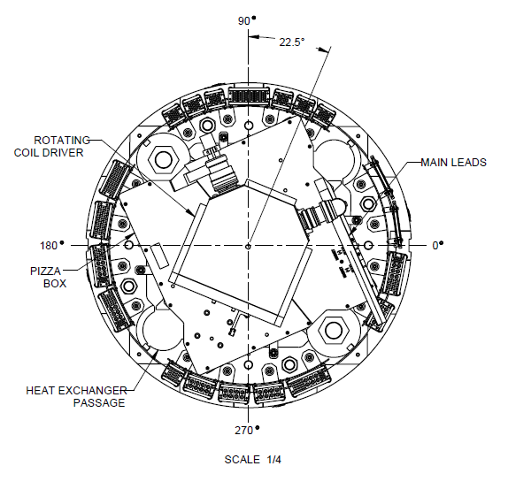
Angle between encoder 0 and magnet top is:
36.8° for AP2
22.5° for AP1b
18° for A03
Magnet top
For the BNL data, the measurements report dx, dy in the coordinate system of the encoder. For each magnet, these are reported here in the coordinate frame of the magnet
Plane of PCB
Change of magnet position wrt probe is measured during current loop or zscans at different currents.

Slide 3
Y’
“Feed-down” harmonics from measurement frame translation offset wrt magnet frame
Y
$$B_{n}^{′}+{iA}_{n}^{′}=\sum_{k=n}^{∞}{{(B}_{n}+iA_{n}) \frac{k!}{n!\left(k−n\right)!}} {\left(\frac{∆x+i∆y}{R_{ref}}\right)}^{k−n}$$
Magnet’
X’
$$∆z= ∆x+i∆y$$
X
For measured dipole (un-allowed harmonic) in quadrupole field,
To first order have:
Measurement
$∆z$ is the offset that the measurement system must move to be in the magnet frame, or equivalently, the magnet position wrt the probe
$$B_{1}^{′}+iA_{1}^{′}= {(B}_{1}+iA_{1})+ \frac{∆x+i∆y}{R_{ref}}{(B}_{2}+iA_{2})$$
Since $B_{1}^{′}+iA_{1}^{′} ≡0$,
$$∆z=−1∗ \frac{C_{1}}{C_{2}}∗R_{ref}$$
Note that “dz” is used throughout to represent the complex x, y, transverse offset (i.e. $∆z= ∆x+i∆y$), while “Z-position” represents the axial location

Slide 4
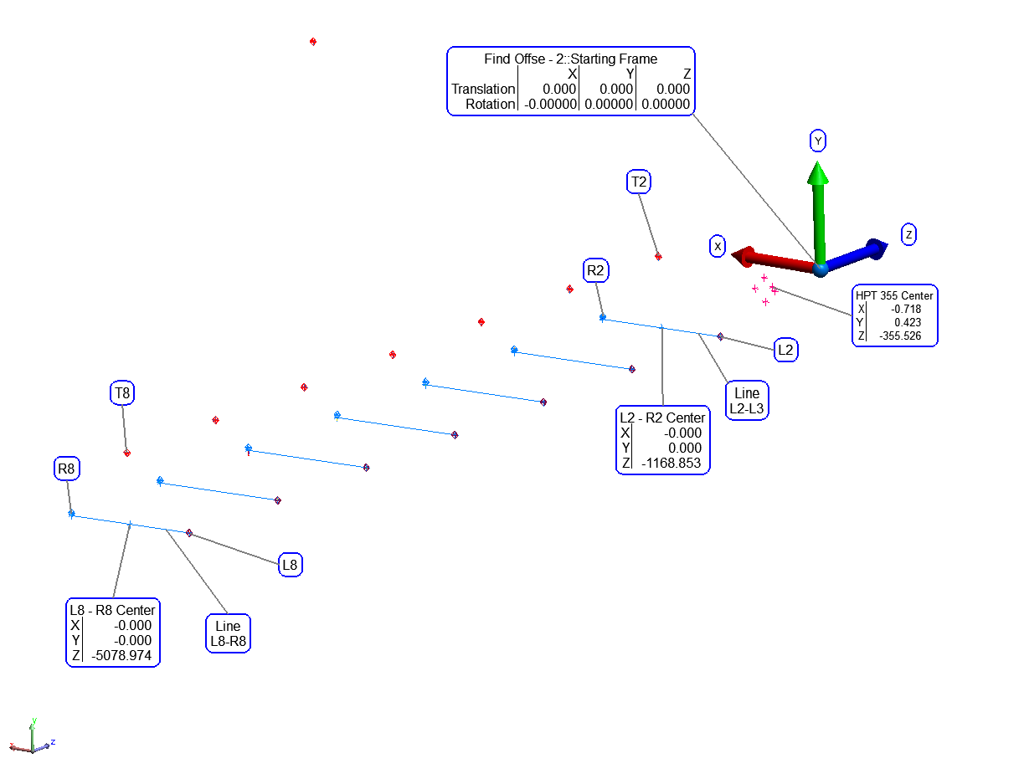
The survey data taken at LBL after magnet assembly is used to determine bow.
The L (left) and R (right) fiducials of the magnet keyway are averaged to determine xoffset.
The T (top) fiducials are used for the yoffset

Slide 5
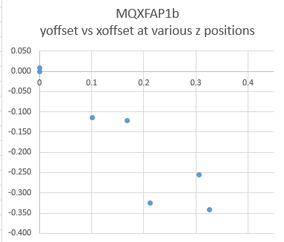
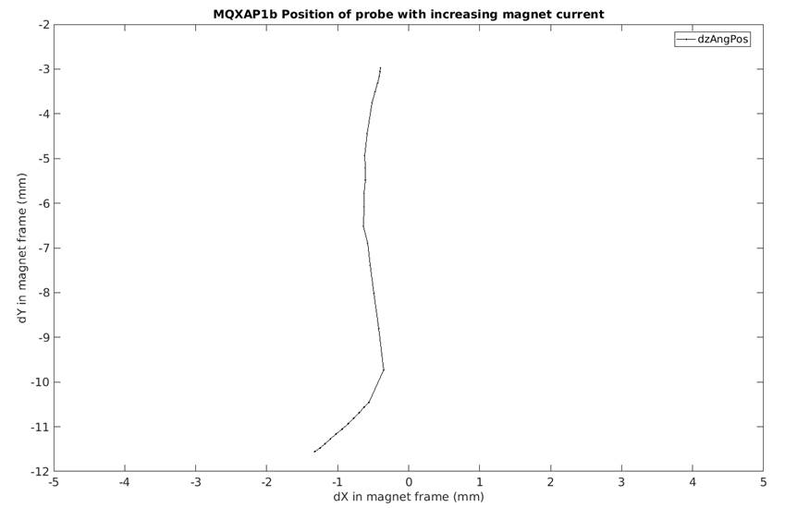
MQXFAP1b
Measurements at BNL
Survey at LBL
Low current
Survey after assembly with amplitude max at magnet center
High current
Current increasing to 16.5kA
(after quench training)
Change of ~ 7mm
Bow amplitude ~0.46mm

Slide 6
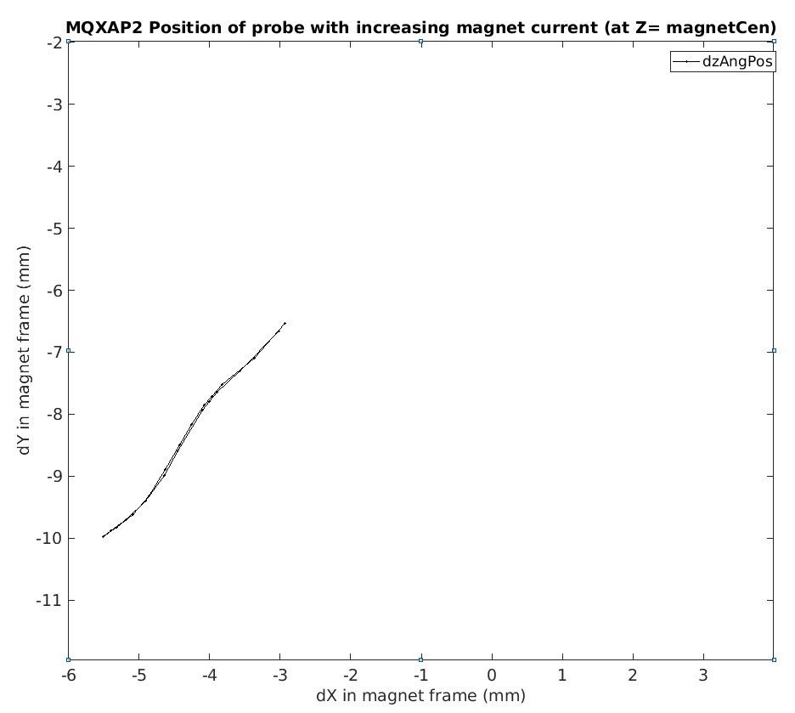
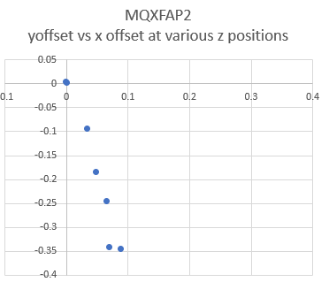
MQXFAP2
Measurements at BNL
Survey at LBL
Survey after assembly with amplitude max at magnet center
Low current
High current
Bow amplitude ~0.36mm
Current increasing to 10kA
(after quench training)
Change of ~ 4mm

Slide 7
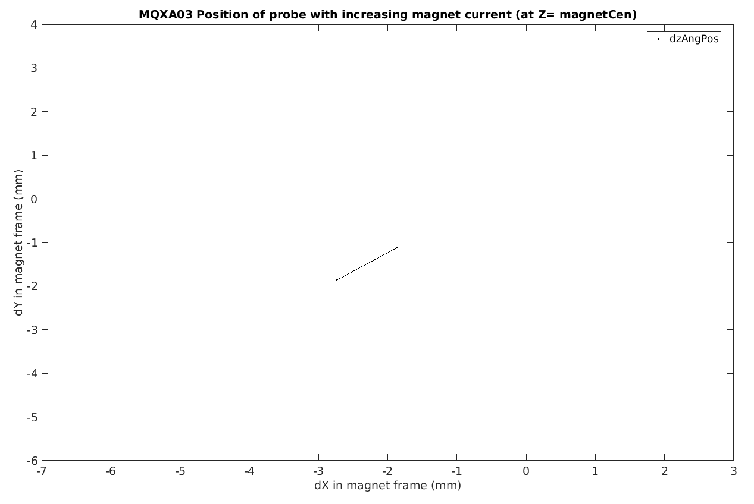
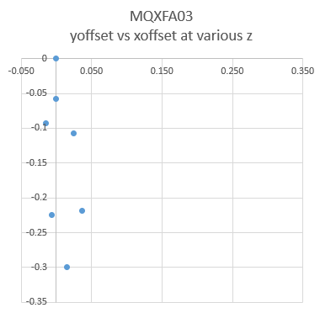
MQXFA03
Measurements at BNL
Survey at LBL
Survey after assembly with amplitude max at magnet center
Low current
High current
Bow amplitude ~0.3mm
Current increasing to 10kA
(before quench training)
Change of ~ 1.5mm

Slide 8
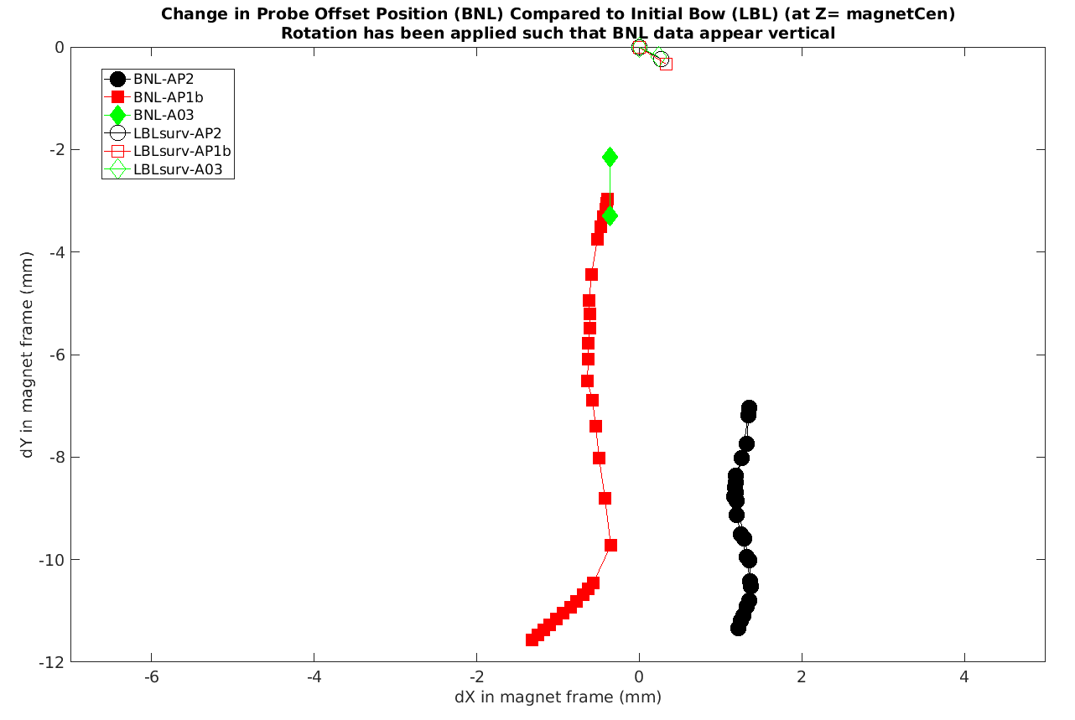
Bow data
Seems that as magnet is powered to high currents something related to the bow direction is affecting the XY offset (modulo some offset angle)
If rotate all the cold change data so that they lie in the same direction, and apply the same rotations to the bow data, find that the bow results also lie in the same direction
Angle between the cold change direction and bow is about 50 degrees

Slide 9
Summary:
There is a bow in the magnets as constructed – this tends to be ~0.35 - 0.4 mm in magnitude and with direction that varies by ~45 degrees.
The direction of the bow seems correlated with the change in probe offset wrt magnet center during powering to high currents, but with an angle of about 50 degrees wrt the bow direction.
Consider…
Bow acceptable? Can/should be reduced?
50 degree offset? Something to do with two mount points at 45 degrees to magnet XY ?
Check if A03 have change in offset amplitude after quench training?
Is there some lever arm that could magnify warm bore position change for a small change in magnet bow?

