Slide 1
200K, 100K Z-scans in AUP-MQXFAP_0003
Measurement dates: Nov. 8 and 12, 2019
Superconducting Magnet Division, Brookhaven National Laboratory
Reported by P. Wanderer

Slide 2
Measurement details (1)
Two readings at each Z-position: +I and –I,
Run 3: I(200K)=18A; Run 4: I(100K)=30A
Background subtracted by fitting a straight line to harmonics at +I and –I A.
Data centered at each Z-position to make the dipole term zero.
Data “pre-rotated” by 18 deg. to account for observed misalignment of magnet top with the rotating coil drive top.
Data taken with both 108.74 mm long and 217.872 mm long coils
Z-scan step size = 108.74 mm for full Z-range available
Can capture the lead end fully
Cannot capture the non-lead end region at all
No 27.185 mm steps in the lead end region.
Plots show only straight-section data.

Slide 3
Measurement details (2)
Axial positions:
The axial position of the transporter is recorded in inches, with z = 0 the home position at the nonlead end.
The CL of the 110 mm coil is 220.663 mm above the CL of the 220 mm coil.
To align the z axis 0 in the plots with the CL of the magnet, the transporter z was converted to mm and
For the 220 mm coil, 2177.923 mm were subtracted
For the 110 mm coil, 1957.320 mm were subtracted

Slide 4
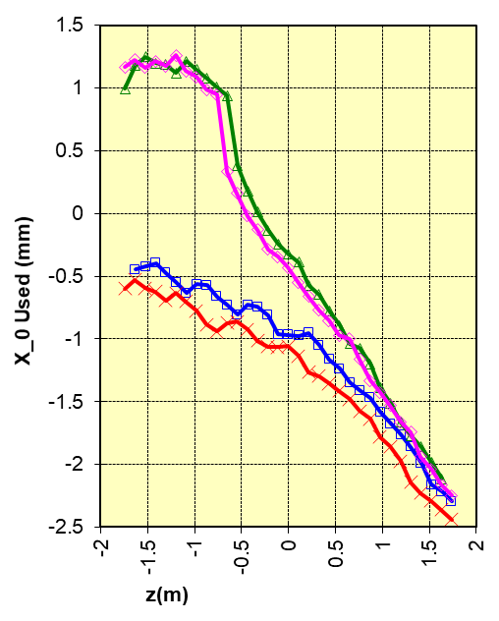
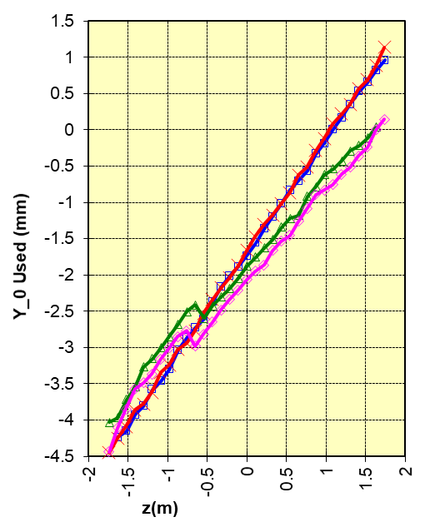
Measuring coil offsets

Slide 5
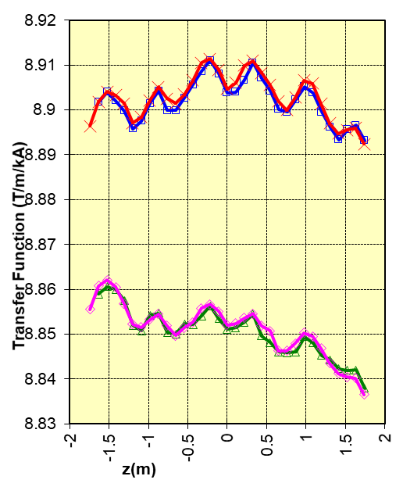
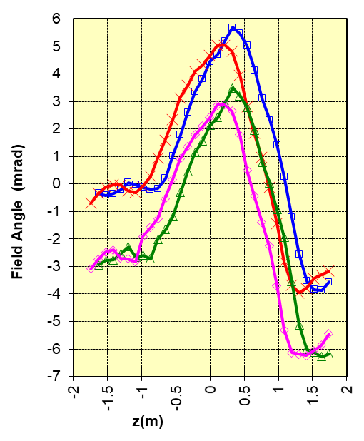
Transfer function and field angle variation

Slide 6
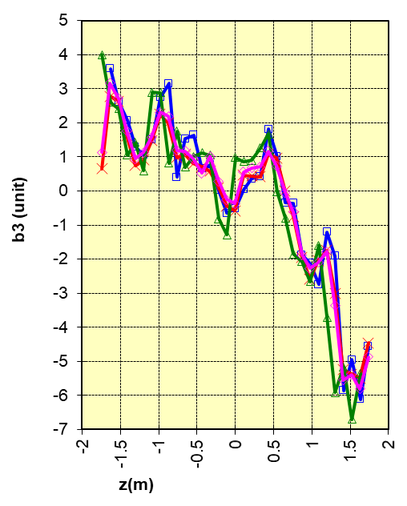
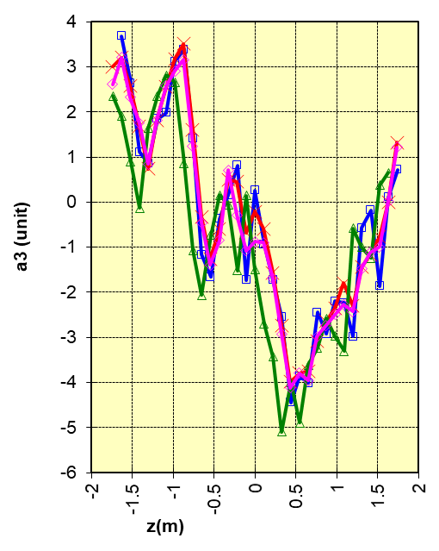
Sextupole terms

Slide 7
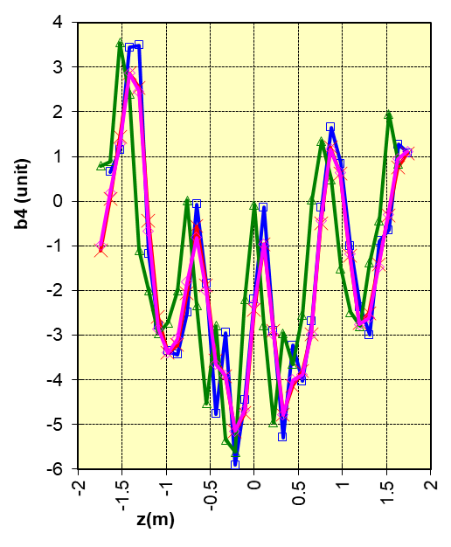
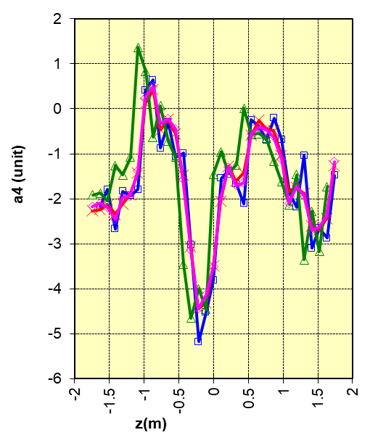
Octupole terms

Slide 8
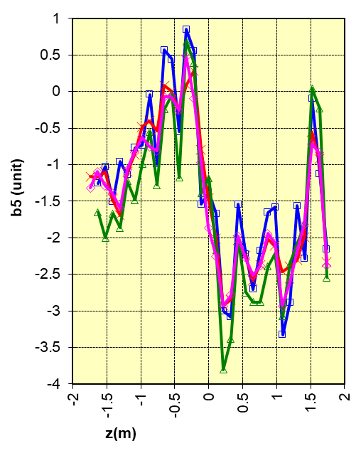
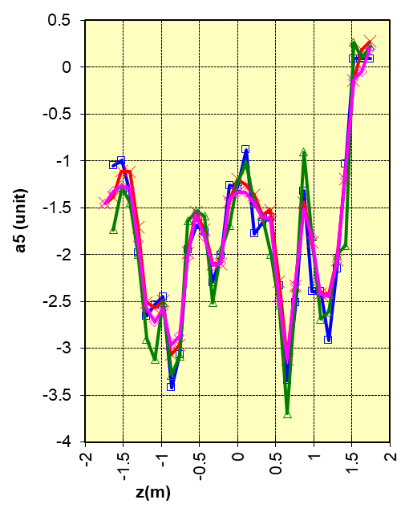
Decapole terms

Slide 9
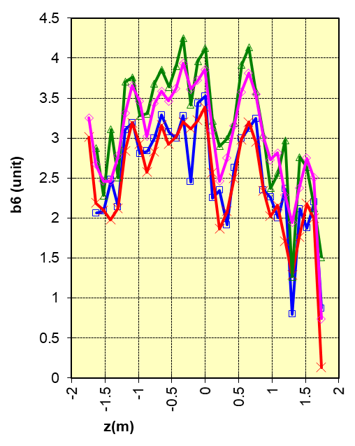
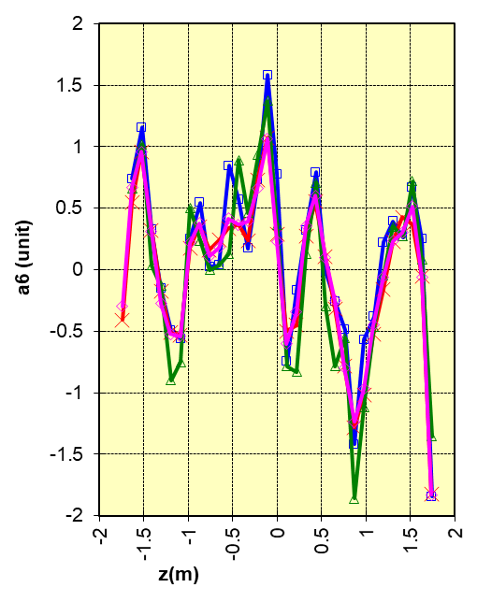
12-pole terms

Slide 10
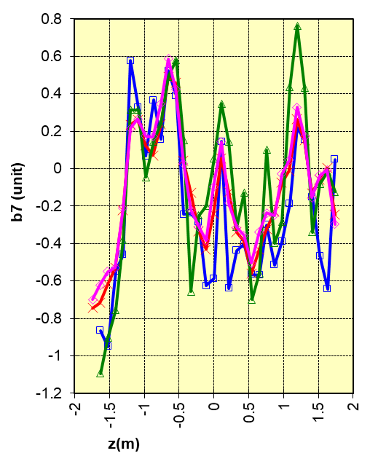
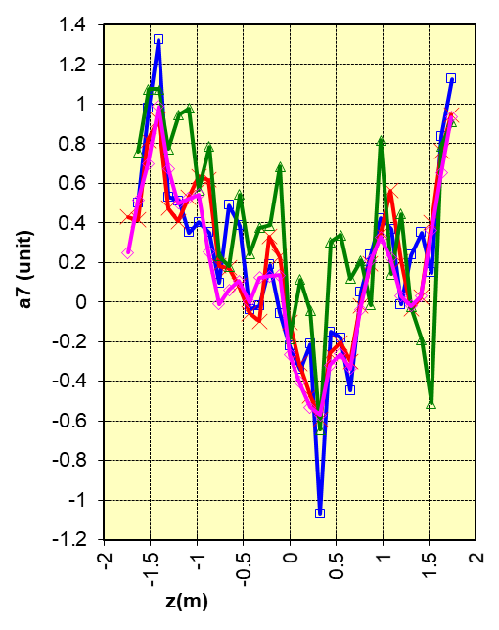
14-Pole terms

Slide 11
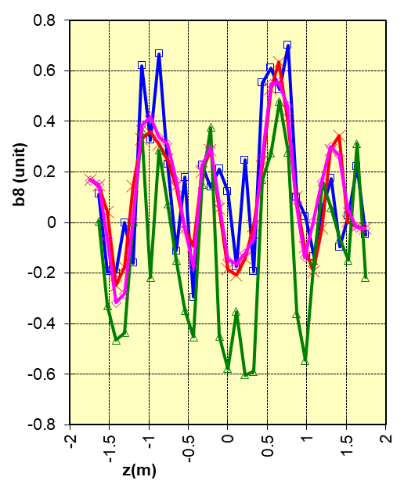
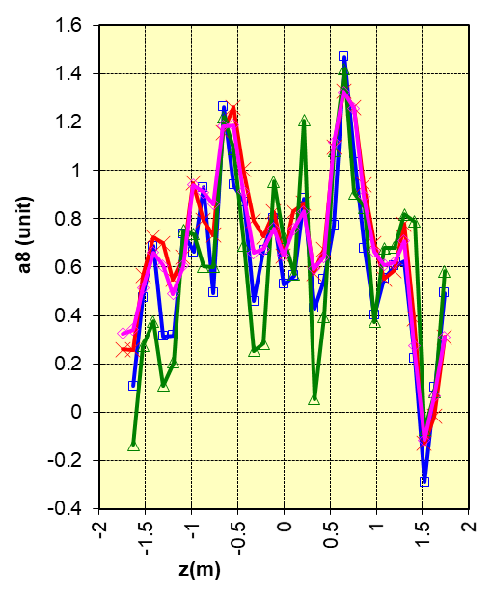
16-pole terms

Slide 12
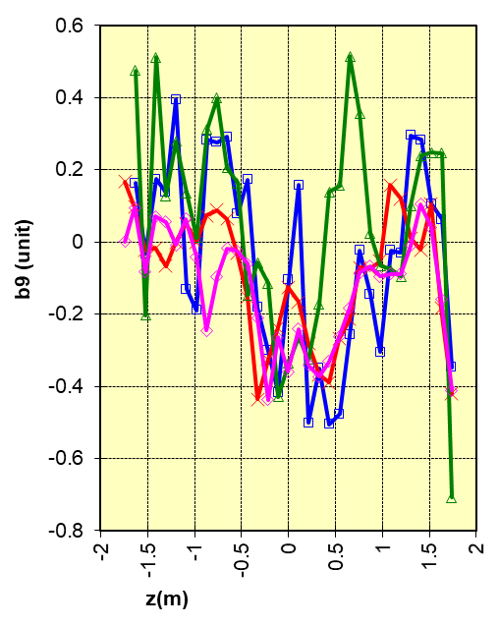
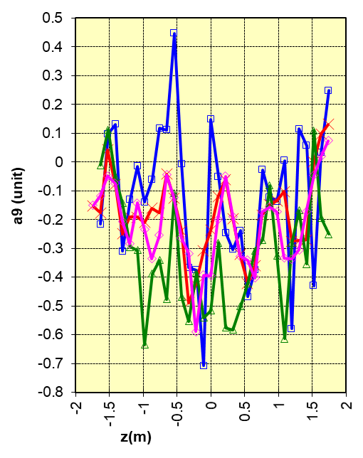
18-pole terms

Slide 13
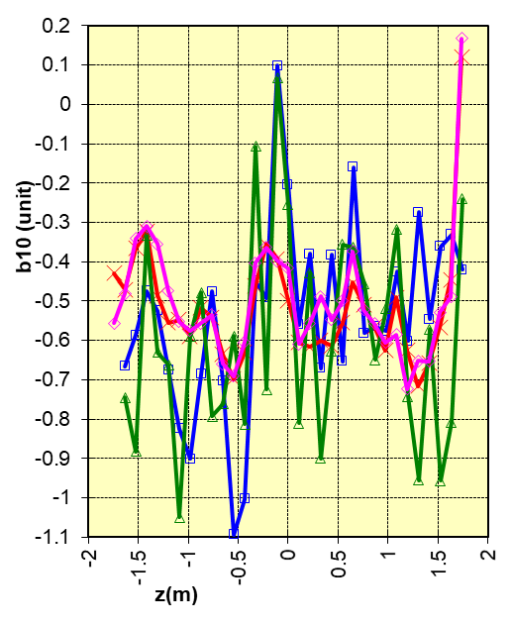
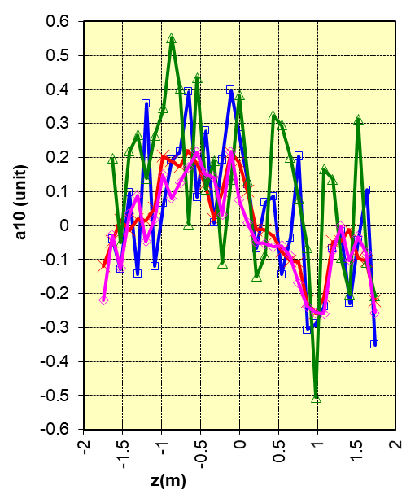
20-pole terms

Slide 14
Compare measuring coil offsets, warm and cool. Run 1 (warm measurements), courtesy A. Jain

Slide 15
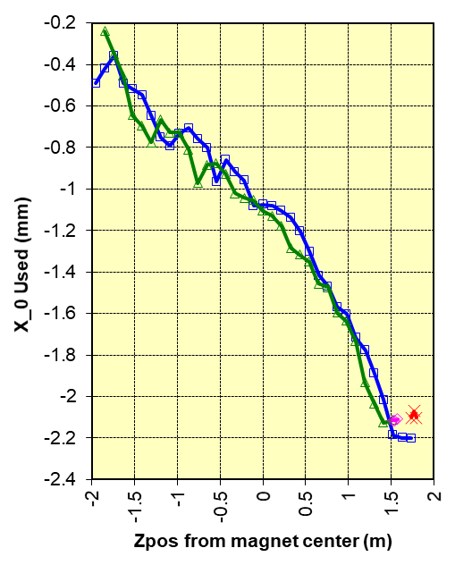
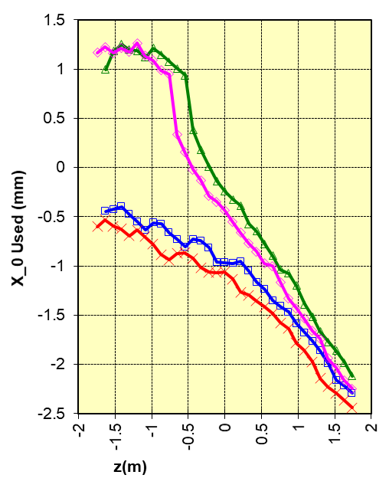
X_{o} offset, run 1 (warm) & Runs 2, 3 (cooldown)
200K / 18A
300K / 15A
100K / 30A
Warm – run 1
200K and 100K – runs 3 and 4

Slide 16
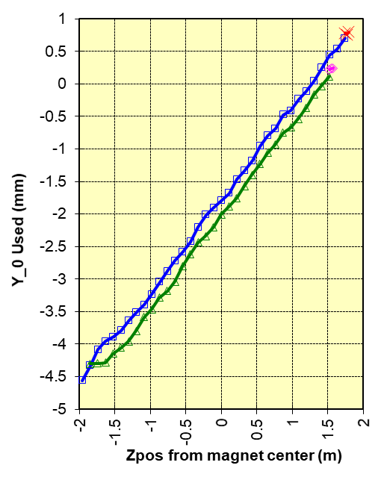
Y_{o} offset, run 1 (warm) & runs 2, 3 (cooldown)
100K / 30A
300K/15A
200K / 18A
Warm – run 1
200K and 100K – runs 3 and 4

