Slide 1
MQXFA03 Cold Z-SCAN and I-SCAN
Measurement dates: Nov. 26 and 27, 2019
Superconducting Magnet Division, Brookhaven National Laboratory
Reported by H. Song, P. Wanderer

Slide 2
Acknowledgment
BNL magnet testing team: J. Piyush, J. Muratore, M. Anerella, K. Amm, D. Sullivan, S. Dimaiuta, W. McKeon, et al.
LBNL: X. Wang, G. Sabbi
FNAL: J. DiMarco
Many others on coils, magnet assembly, testing, et al.

Slide 3
Measurement summary
Complete ISCAN
*There was a change in magnet center based on M Anerella’ s new drawings, checked by D. Sullivan and H. Song.

Slide 4
Magnetic measurement plan at 10 kA before quenching
Z scan at intermediate gradients
Goals:
Measure the field integral and magnetic length at intermediate gradient
Measure field quality and x-y offset variations along the magnet length
Conditions:
Magnet current at 1 kA and up to 10 kA
Data is acquired in parallel for both probes
Current ramp at center position to 10 kA (‘stair-step’ style)
Z-scans at 2 different currents 1 kA, 10 kA
220mm probe, 440mm z increment (~9 positions: 0, +/- 440, 880, 1320, 1760mm)
Straight part: [-1.67, 1.7] m, 3.37 m, X. Wang’s warm field data reported on 9/14/2019.

Slide 5
Measurement details
To report
Two Z-Scan at 960 A and 10 kA, 9 Z-positions, 440 mm around magnet center
One I-Scan, up to 10 kA, per test plan
Other processing detail
Data centered at each Z-position to make the dipole term zero.
Data “pre-rotated” by 18 deg. to account for observed misalignment of magnet top with the rotating coil drive top.
Data taken with both 108.74 mm long and 217.872 mm long coils
Axial positions:
The axial position of the transporter is recorded in inches, with z = 0 the home position at the nonlead end.
The CL of the 110 mm coil is 220.663 mm above the CL of the 220 mm coil.
To align the z axis 0 in the plots with the CL of the magnet, the transporter z was converted to mm and
For the 220 mm coil, 2215 mm were subtracted
For the 110 mm coil, 1994 mm were subtracted

Slide 6
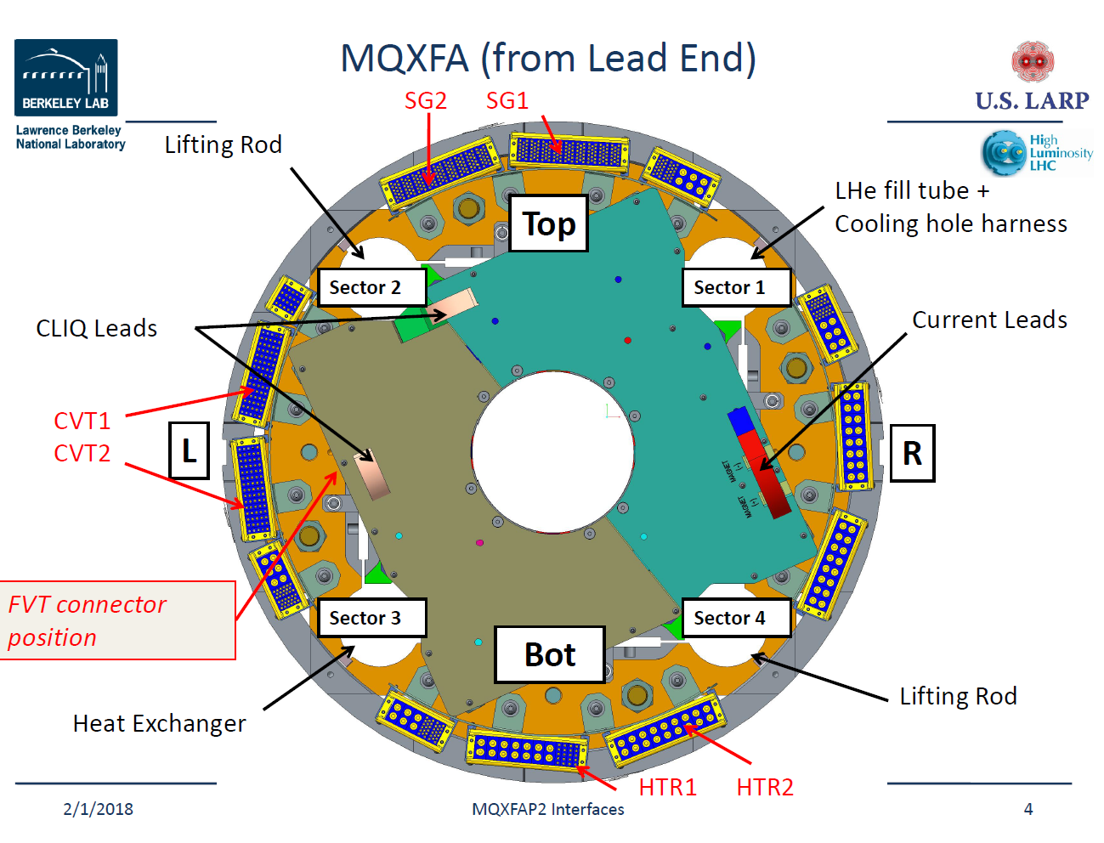
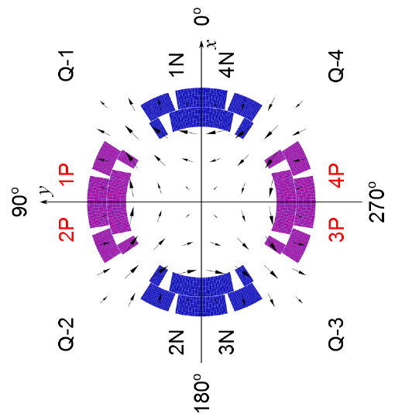
Magnet orientation and power convention
~18 degree
Q1 = P02
Q2 = P03
Q3 = P04
Q4 = P06
Negative normal quad
Pre-rotation by 18 degree

Slide 7
Measuring coil offsets
Both X₀ and Y₀ depends on currents. Higher current → larger offsets.
Max X₀ is about 3.2 mm, Max Y₀ is about 5 mm, towards non-lead end.
Long PCB 220 agrees with short PCB 110 data.

Slide 8
Transfer function and field angle variation
960 A
Warm TF, 8.84 T/m/kA
10 kA
1 mrad = 0.0573 degree, small angle
Pre-rotation by 18 degree, negative quadrupole
Similar to the measurements of MQXFAP2 and AP1b.

Slide 9
Sextupole terms (n = 3)
Normal harmonics, PCB 220 has long coil length, more averaging, less variation compared to PCB 110.

Slide 10
Octupole terms (n=4)

Slide 11
Decapole terms (n =5)

Slide 12
12-pole terms (n = 6)
960 A
10 kA
Allowed b₆, large at 960 A, and much smaller at 10 kA.
Even 4*440mm away from the magnet center, 12 pole terms start to change towards magnet ends.
Skew harmonics – nonallowed
Field errors for the same PCB coils though at 960 A and 10 kA current, seems to have good agreement.

Slide 13
14-Pole terms (n=7)
b₇ and a₇
Most of them less than 1 unit

Slide 14
16-pole terms (n = 8)
b₈ is ok, most of them less than 1 unit.
a₇ is a bit higher than the specification, summarized in later slides.

Slide 15
18-pole terms (n=9)
b₈ is ok, less than 0.4 unit.
a₇ is ok, less than 0.5 unit

Slide 16
20-pole terms (n =10)
Allowed harmonic b₁₀
Observed increase at/towards the magnet lead end, 4*440 mm away from the center.
The last point is taken out from the averaging analysis.

Slide 17
Field error table, averaged normal and skew harmonics (straight part) and RMS
BNL cold MM | Probe 220, 10 kA |  | Probe 220, 960 A
 | Average | RMS | Average | RMS
b3 | 0.798 | 2.062 | -2.579 | 3.320
a3 | -0.538 | 2.446 | -0.052 | 2.125
b4 | -1.481 | 2.758 | -1.457 | 2.371
a4 | -1.412 | 1.609 | -0.765 | 1.256
b5 | -1.699 | 1.840 | -1.167 | 1.235
a5 | -1.906 | 1.844 | -1.613 | 1.625
b6 | 2.167 | 2.254 | 15.490 | 15.502
a6 | -0.036 | 0.562 | 0.044 | 0.475
b7 | -0.198 | 0.353 | -0.500 | 0.601
a7 | 0.131 | 0.365 | -0.156 | 0.401
b8 | 0.076 | 0.230 | 0.160 | 0.326
a8 | 0.671 | 0.666 | 0.922 | 0.869
b9 | -0.060 | 0.157 | 0.105 | 0.204
a9 | -0.232 | 0.222 | -0.233 | 0.223
b10 | -0.623 | 0.632 | -3.197 | 3.199
a10 | 0.013 | 0.144 | -0.021 | 0.142
Allowed
Allowed

Slide 18
Averaged harmonics at straight sections, 960 A
Upper and lower bounds provided by Susana Izquierdo Bermudez according to the Triplet Field Quality Table version 4, May 20 2015.
Information further shared by Xiaorong Wang and GianLuca Sabbi.
Lower order terms (n < 6) close to the upper bound but still within the limits except for a₅
b₆ for 960 A is about 15 units, considerablely large, out of bound. Due to persistent current in the cables.
Two more terms out of bounds
a₈ 0.922 units above the upper bound
b₁₀ -3.197 units below the lower bound
BNL cold 960 A vs LBL warm MM
Comparison with triplet field quality table shows that field errors in straight part.

Slide 19
Averaged harmonics at straight sections, 10 kA
Comparison with the triplet field quality table, and LBL warm measurement data
The field errors in straight part are within the bound expect for a₈ 0.671 units, slightly above the bound.
b₆ for 10 kA is, becomes quite small, 2.167 units, within the bound. Impact of persistent current in the cables has been considerably reduced at higher current.
BNL cold 10 kA vs LBL warm MM

Slide 20
Conclusions on two Z-scans
Completed two Z-Scans at 960 A and 10 kA
Performed data analysis
To do
Data analysis, compare cold Z-scan to warm MM
Continue MM at higher currents – depending on quench progress
960 A, field errors are within the bound, except for large b6 due to persistent current, and a8 a10.
10 kA, field errors in the straight section are within the bound except for a8. b6 is considerably reduced from 15 units to 2 units within the bound.

Slide 21
Measurement offsets
PCB 220 is at the magnet center, 2215 mm away from the lowest position (Home).
X_0 max < 2 mm,

Slide 22
Transfer function and field angle for I-Scan (stair-step, DC Loop)
Agreement between PCB 220 and PCB 110 → Transfer function at straight section are consistent.
Field angle nearly constant during the current increasing,
Small field angle difference between PCB 220 and 110.

Slide 23
Sextupole terms (n=3)
Down ramping
Up ramping

Slide 24
Octupole terms (n=4)

Slide 25
Decapole terms (n =5)
Down ramping
Up ramping

Slide 26
12-pole terms (n =6)
Up ramping
Down ramping
Allowed b₆ is considerably large at around 1 kA, but decreases to small number in units when current is more than 8 kA
Large hysteresis loop due to persistent current in cables,
nonallowed a₆ is less than 0.7 units.

Slide 27
14 pole terms (n = 7)
Down ramping
Up ramping

Slide 28
20-pole terms (n =10)
Down ramping
Up ramping
Hysteresis loop observed in allowed normal b₁₀.
Start at -3.2039 units, and back at 1.6771 units at 960 A.

Slide 29
28-poles (n=14)
Up ramping
Down ramping
Hysteresis loop observed in allowed normal b₁₄.
Start with 0.8428 units, and back at -1.2178 units at 960 A.

Slide 30
Conclusions on I-Scan
Performed I-Scan from 960 A to 10 kA
Analyzed the harmonics
Observed hysteresis behaviors in allowed harmonics b6, b10, b14
To complete the I-Scan at high currents.

