Slide 1
IOTA Run-2 Commissioning Status, Plan and Priorities + RunCo Report
Alexander Valishev, Jamie Santucci
IOTA/FAST Meeting
December 6, 2019

Slide 2
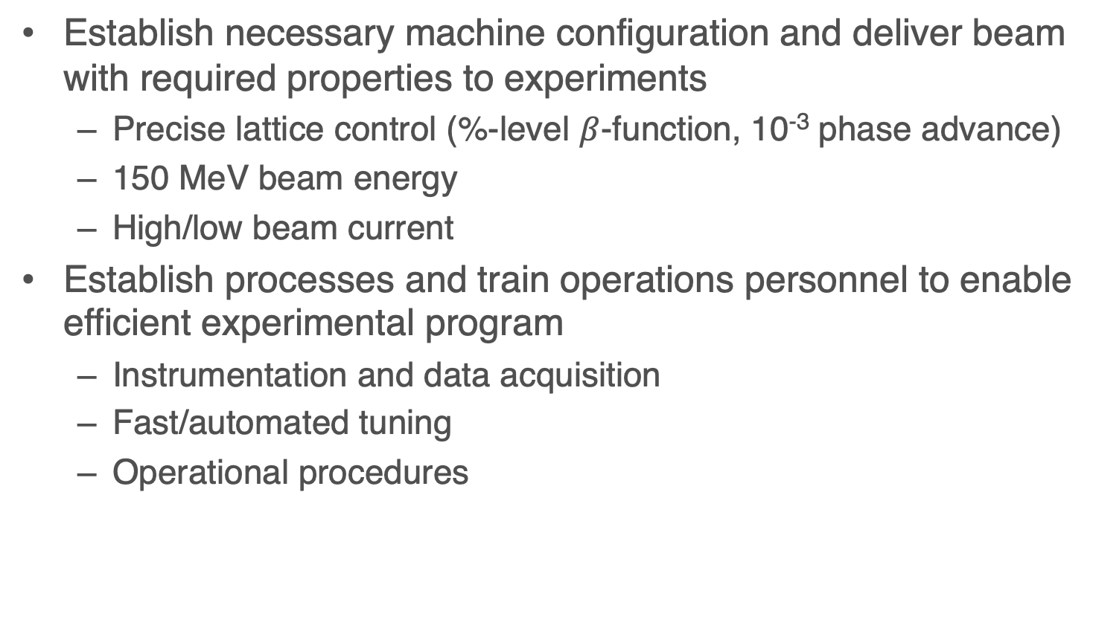
Commissioning Goals and Objectives
Establish necessary machine configuration and deliver beam with required properties to experiments
  Precise lattice control (%-level $β$-function, 10⁻³ phase advance)
  150 MeV beam energy
  High/low beam current
Establish processes and train operations personnel to enable efficient experimental program
  Instrumentation and data acquisition
  Fast/automated tuning
  Operational procedures

Slide 3
Main Commissioning Aspects
Linac/injector – no/minimal changes
  Plan to implement D600 NMR probe for energy calibration
  Increased number of BPMs
IOTA
  IBEND PS filter
  BPM system upgrade
  Main bending dipole edge field correctors
  Synclight automation upgrade
  Octupole string rebuild
  Undulator motion control automation
Combined
  New timing/synchronization

Slide 4
Status
11/26 Beam permit
11/27 Linac commissioning and operator re-training. 2 hours from turn-on to beam to IOTA!
  Need to update ‘Golden file’, the one in Sequencer is incorrect
Stopped for Thanksgiving holidays (personnel availability)
12/2-12/3 Cryo problems. Recovered 12/3 by 1800
12/3-12/5 Commissioning IOTA injection
  Work on new timing system
  Work on new BPM system
  Stable 0.5mA circulation on 12/5 by 1500 – about 23 hours of beam time since beginning

Slide 5
Accomplishments / lessons learned
New timing system commissioned
New BPM system – commissioned injection mode / first turns
  Must inject ~20pC/bunch to avoid pre-amp saturation
Good linac stability, both long- and short-term
IOTA mostly restored to Run-1 configuration
  Bending dipole trims restored to pre-shutdown configuration
  Orbit close but not quite the same
Followed previously outlined procedure https://indico.fnal.gov/event/21869/contribution/4/material/slides/0.docx - need to revise based on most recent experience.

Slide 6
RunCo Notes / Downtime
Linac recovery after shutdown went FAST
We now have betatron and synchrotron capture in IOTA
Use low intensity (20pC/b) for IOTA (for now)
DOWNTIME:
  Cryo: North Frige expander engine (34+ hrs)
  New IOTA BPM system (ongoing sporadically)
Outstanding jobs:
  Flux Capacitors installed
  Toroids calibrated
  Frick started up
  Experiments starting next week
Need operators to sign up for shifts in calendar
DOCUMENT EVERY CHANGE TO THE MACHINE

Slide 7
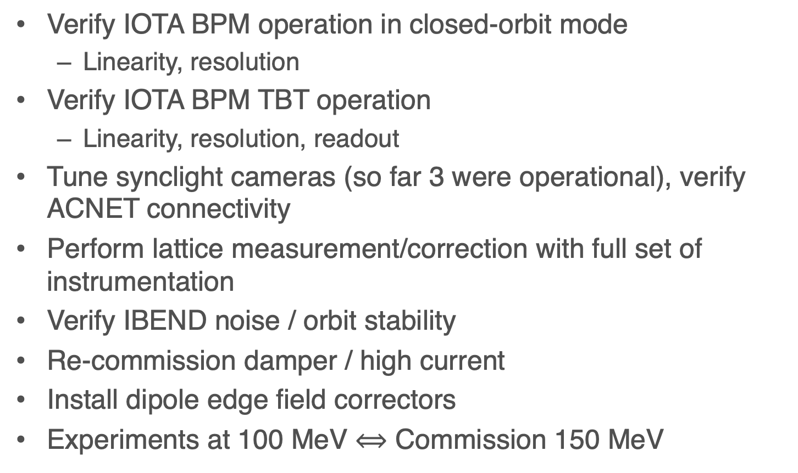
Next Steps / Priorities
Verify IOTA BPM operation in closed-orbit mode
  Linearity, resolution
Verify IOTA BPM TBT operation
  Linearity, resolution, readout
Tune synclight cameras (so far 3 were operational), verify ACNET connectivity
Perform lattice measurement/correction with full set of instrumentation
Verify IBEND noise / orbit stability
Re-commission damper / high current
Install dipole edge field correctors
Experiments at 100 MeV $⟺$ Commission 150 MeV

