Slide 1
IOTA Nonlinear Integrable Optics Experiments in Run 2
Alexander Valishev
IOTA/FAST Meeting
December 6, 2019

Slide 2
Personnel
PI - A.Valishev – experiment design, data acquisition, theory, modeling, analysis
N.Kuklev – octupole string, modeling/simulations, data acquisition, analysis
S.Szustkowski – nonlinear magnet, modeling/simulations, data acquisition, analysis
A.Romanov – lattice design, data acquisition, analysis

Slide 3
IOTA Accelerator and Beam Physics Roadmap
Complete the construction of IOTA/FAST facility
Install and commission IOTA proton injector 2020*
Conduct R&D in IOTA with the goal to develop enabling technologies for next-generation facilities
Nonlinear Integrable Optics (aim to improve beam stability / losses)
Phase I – e- beam 2018–2021
Phase II – p beam 2020–2022
Optical Stochastic Cooling (enable p-beam cooling at high energy)
Without optical amplifier 2019–2021
With optical amplifier 2021–2023
Space-charge Compensation (aim to reduce space-charge losses)
Using electron lens 2020–2023
Using electron column 2022–2023
Expand IOTA/FAST collaboration 2019–2023

Slide 4
Overall goal – experimental demonstration of NIO lattice in a practical accelerator
Phase I – research concentrates on the academic aspect of single-particle motion stability using electron beams
Demonstrate large amplitude-dependent detuning with conservation of dynamic aperture
Demonstrate practical machine tuning and limits of integrable optics stability in terms of imperfections, other nonlinearities, impact of longitudinal dynamics
Phase II – intense-beam studies with protons
Interplay between NIO and space-charge
Effect of NIO on halo formation, emittance growth and losses

Slide 5
IOTA NIO Variants
System with 1 invariant, aka Quasi-Integrable or Henon-Heiles Type
Implemented with Octupole string in BL straight
System with 2 invariants, aka Danilov-Nagaitsev or Elliptic potential
Implemented with special magnet (RadiaBeam) in BR straight

Slide 6
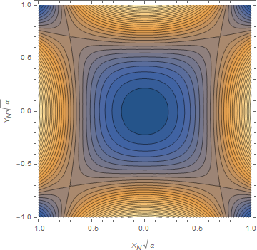
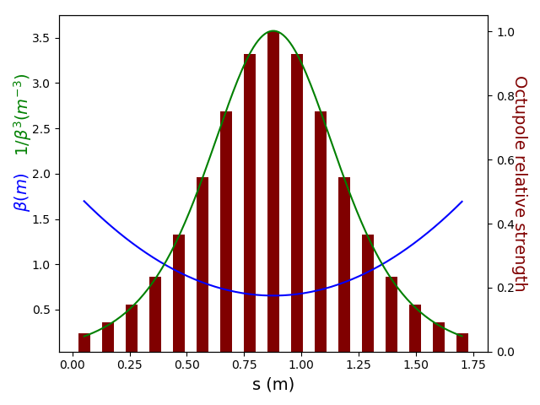
Henon-Heiles Type System with Octupoles (N.Kuklev, U.Chicago)
1 invariant of motion, ‘quasi-integrable’
Theoretical stability limit – $1/\sqrt{2α}$
(lower due to chaotic layer, $\sim 0.6/\sqrt{α}$)
Tune spread = 0.4
Implementation in IOTA with discrete elements
Imperfections complicate the dynamics
Performance predictions (at DA limit)
0.12 ideal case
0.08 for 18 octupoles
0.04 for 1 octupole

Slide 7
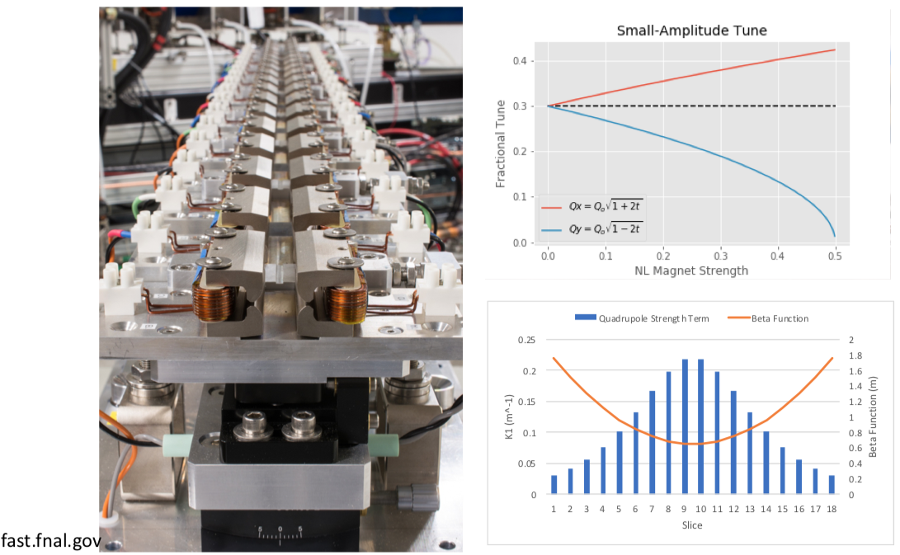
NIO with 2 Invariants of Motion – Special Magnet (S.Szustkowski, NIU)

Slide 8
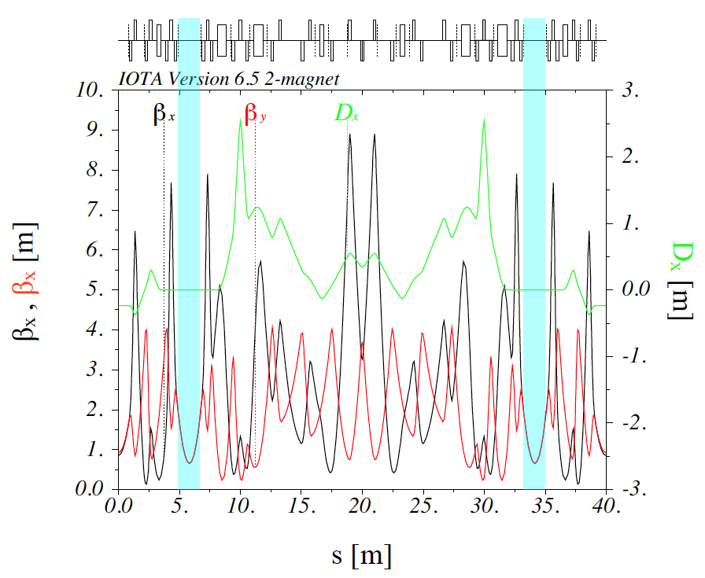
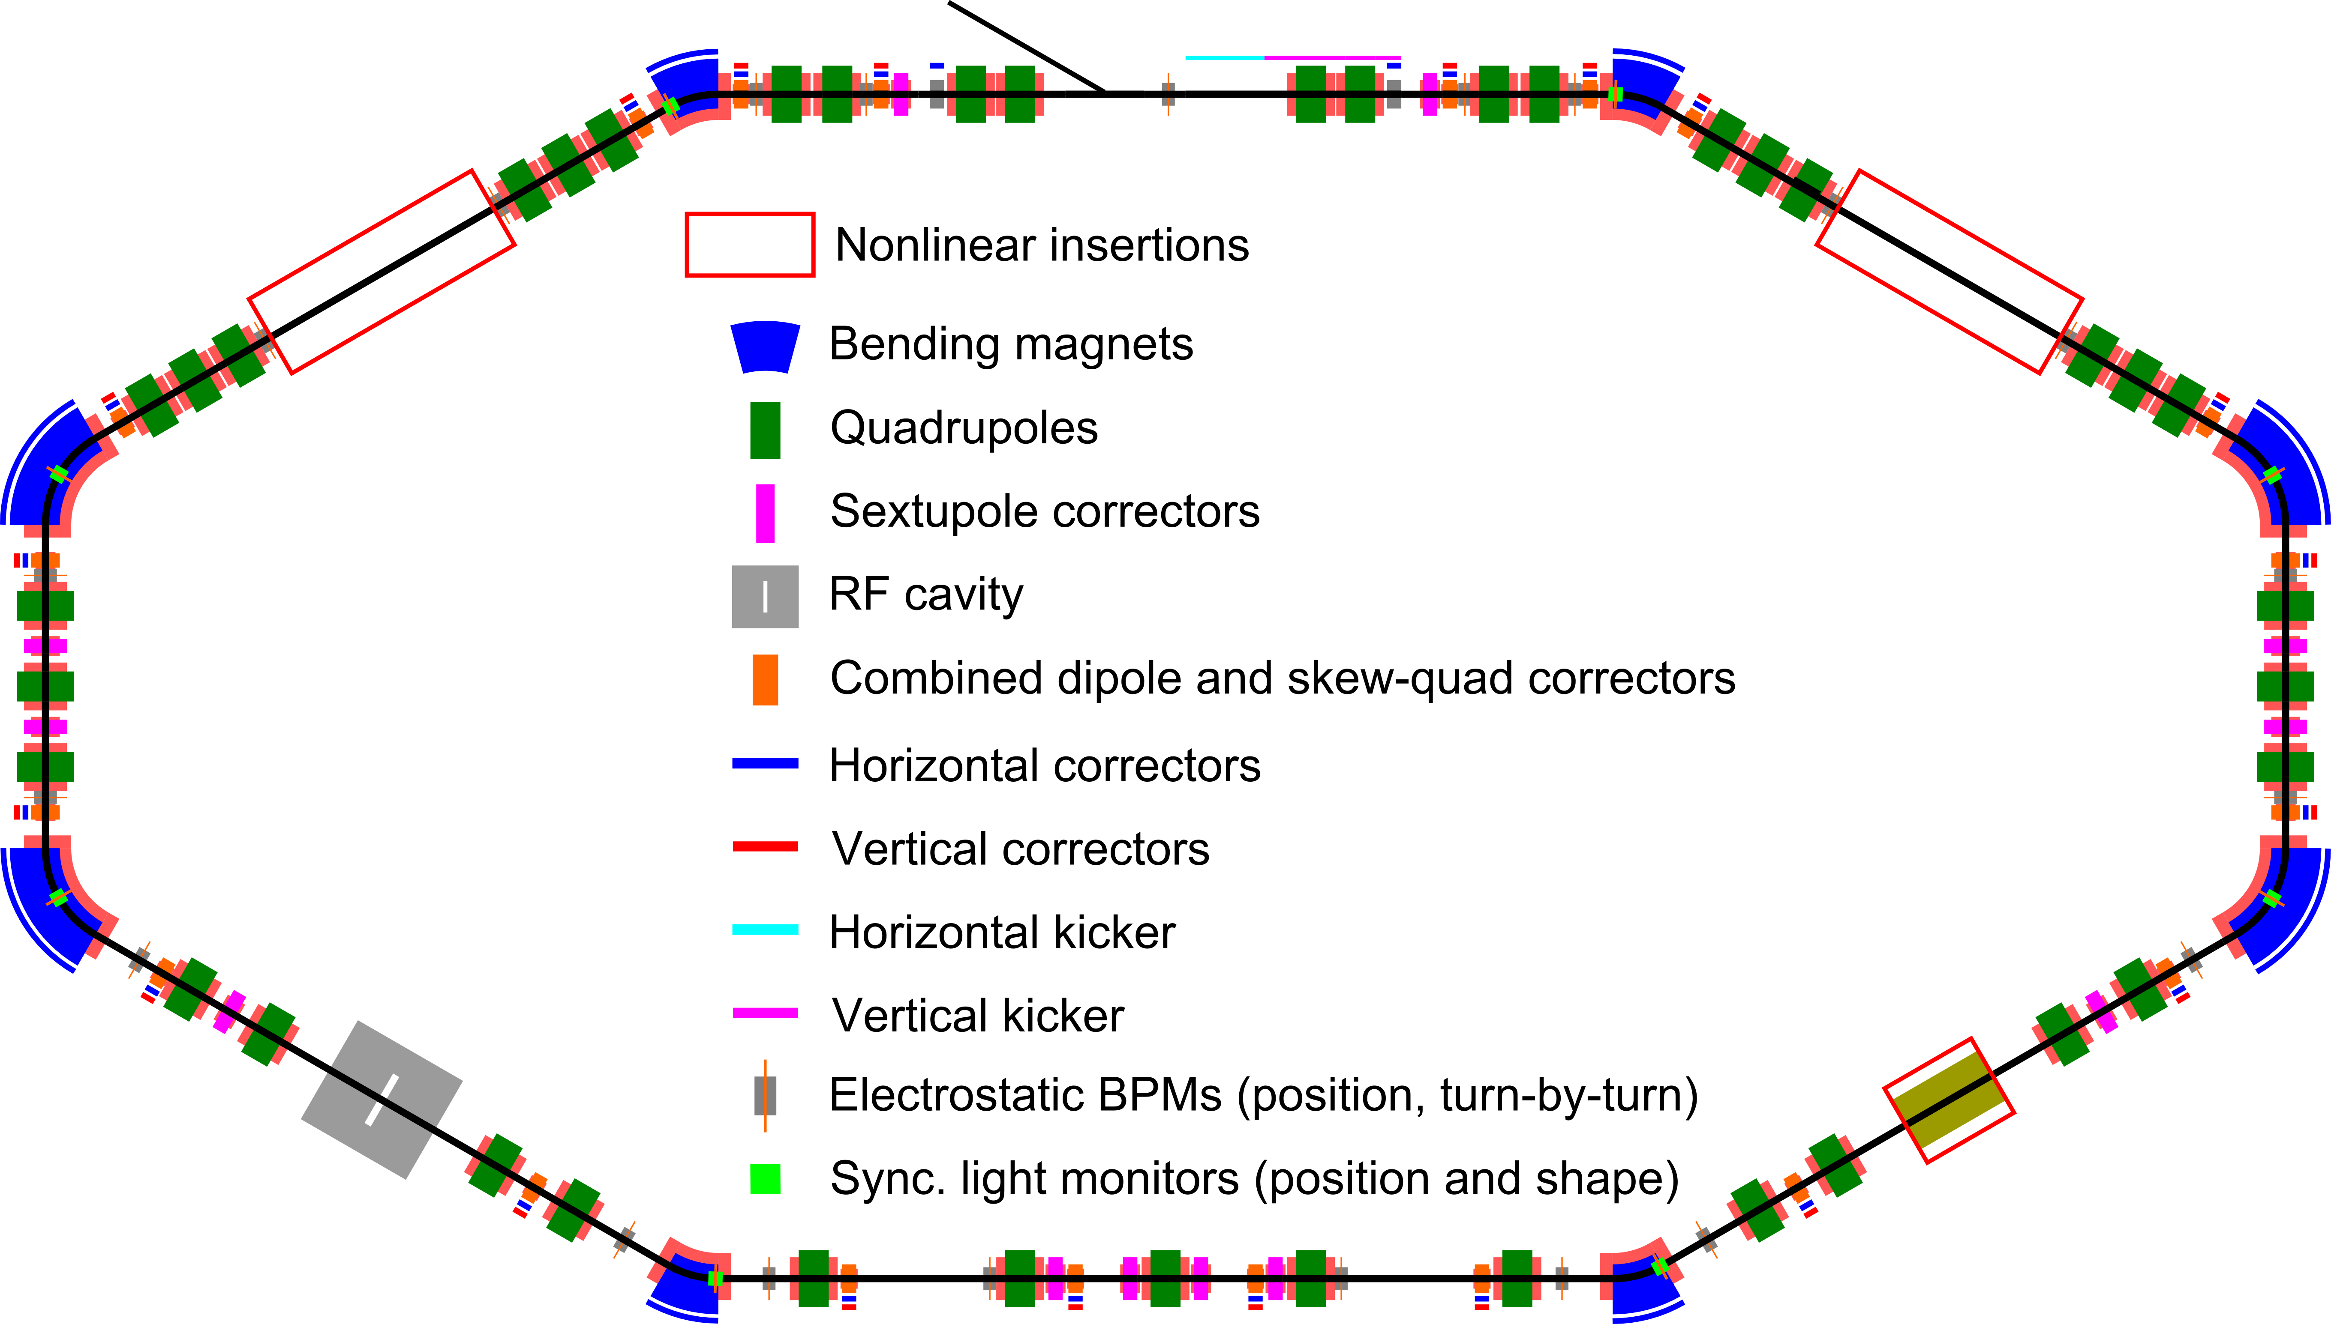
Implementation in IOTA
Practical requirements:
Round axially-symmetric linear lattice (FOFO)
2π x n phase advance
Drift with β_{x}=β_{y}, no dispersion

Slide 9
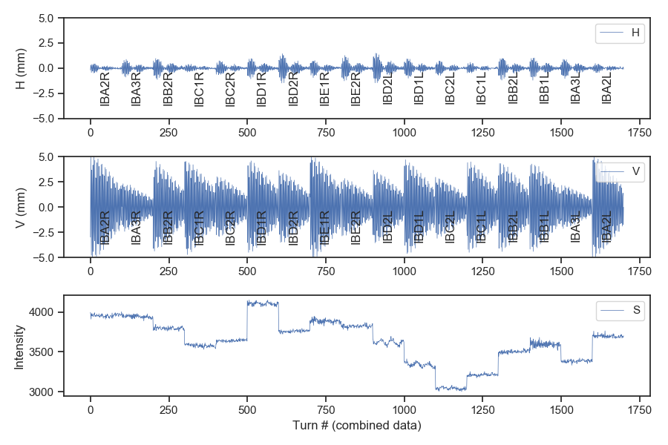
Experimental Method
Kick beam with V/H kicker to selected amplitude
Record BPM turn-by-turn positions and beam intensity
0.6kV Vkick
1A octupoles
100 turns

Slide 10
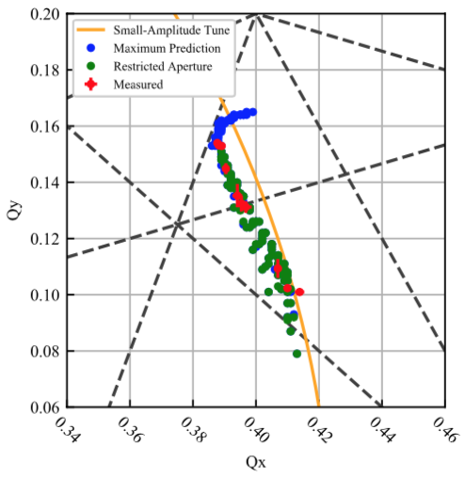
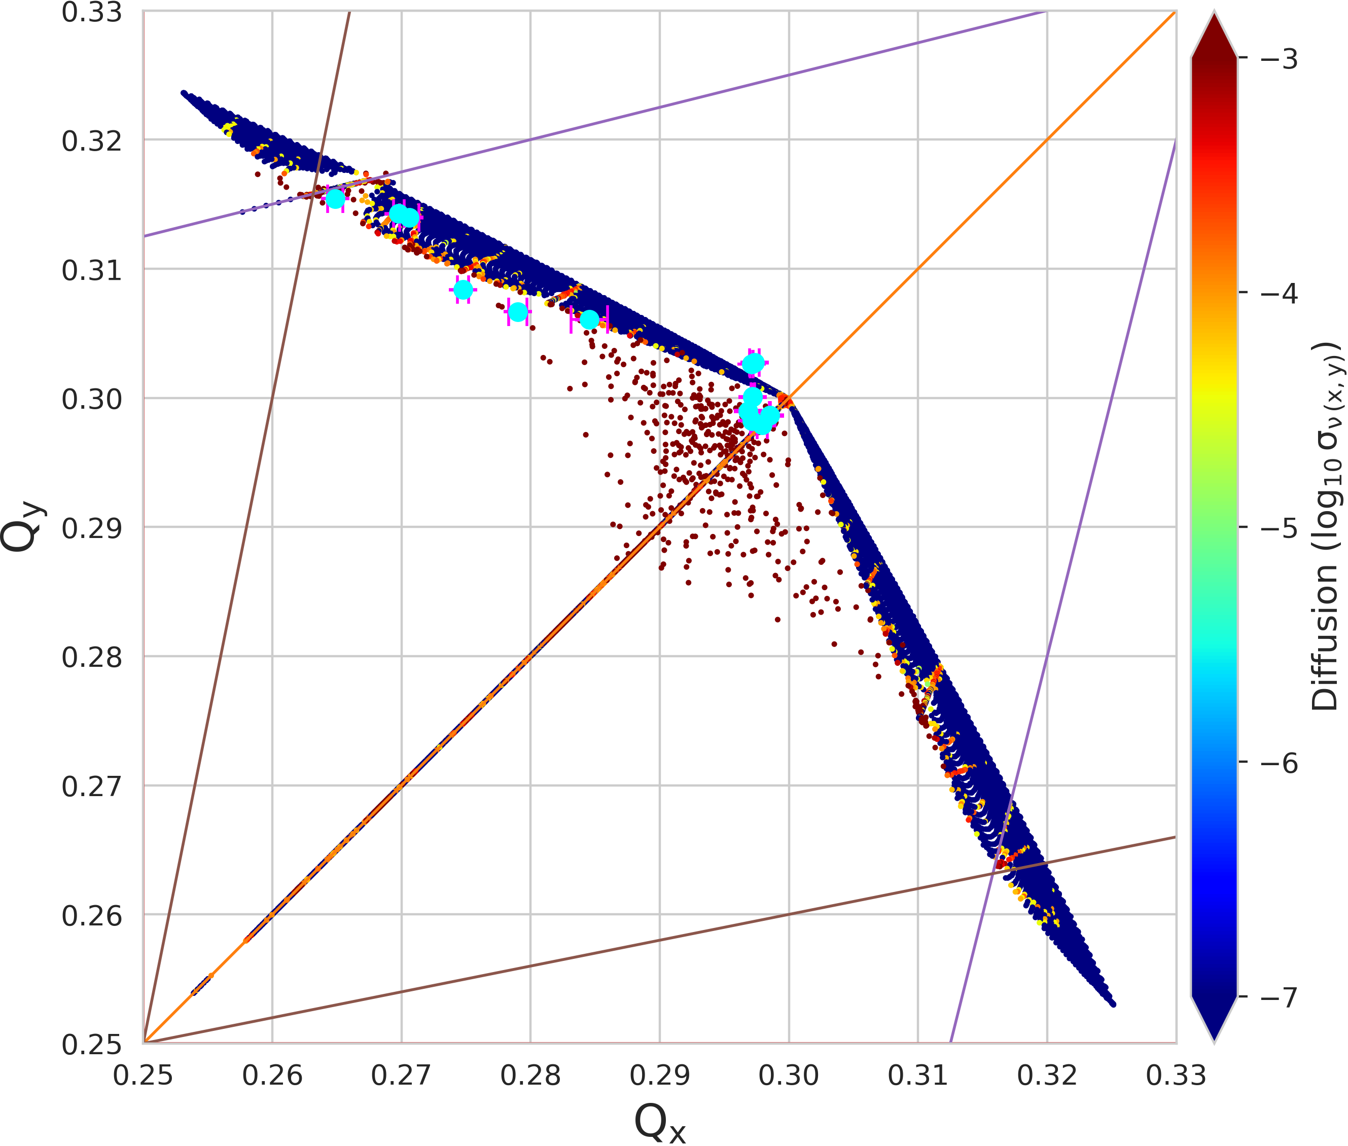
Run-1 Results – Amplitude-Dependent Tune Shift
~60-70% of ideal performance for both types of NIO
Clear improvement vs single octupole
Beam loss attributed to aperture restriction in DR
Limited machine tuning precision
Too fast decoherence for invariant reconstruction
N.Kuklev
S.Szustkowski

Slide 11
Run-2 Goals and Objectives
Demonstrate large (as predicted by modeling) nonlinear amplitude-dependent tune shift without reduction of dynamical aperture
For QI system as a function of Q₀ and strength = t
For DN system as a function of strength = t
Demonstrate conservation of dynamic invariants
Restore p,p_{x},y,p_{y} from TBT data
Systematic study of sensitivity of the NIO systems to imperfections
T-insert mismatch
Intrinsic resonances
Effect of sextupoles
Q₀=¼ with octupoles
Effect of integer resonance for DN system at high t

Slide 12
Requirements
Reassemble and Install Octupole string
Beam parameters
Smallest momentum spread for long decoherence time without sextupoles $→$ E=150 MeV, low beam current
Smallest transverse emittance $→$ low (<0.5mA ) beam current to avoid IBS
Lattice tuning and stability
All synclight cameras
Closed-orbit BPM with high resolution (<10$μ$m)
Kicker control
H and V controlled independently 0-1kV
Turn-by-turn coordinate measurement
Needs high beam current for best resolution, compromise with 1-b

Slide 13
Data collection and storage
Raw data collected in ACNET datalogger and shared Y drive
Processed data stored in Y drive and Redmine project page

Slide 14
Beam Time Requirements – 12 $×$8 hour shifts for research / data collection, commissioning of machine and systems extra!
Best model would be 8-hour shifts spaced by 1-2 days for data analysis and system interventions, if necessary
Goal 1 (amplitude-dependent tune shift) – 3 shifts
Orbit alignment through BL, BR, lattice tuning (1)
TBT data collection vs kick amplitude and t for QI and DN (2)
Goal 2 (conservation of invariants) – 3 shifts
TBT data collection vs kick amplitude, t and T-insert parameters
Goal 3 (systematic studies) – 6 shifts
Effect of sextupoles (2)
Q0=¼ with octupoles (2)
Effect of integer resonance for DN system at high t (2)

Slide 15
Backup

Slide 16
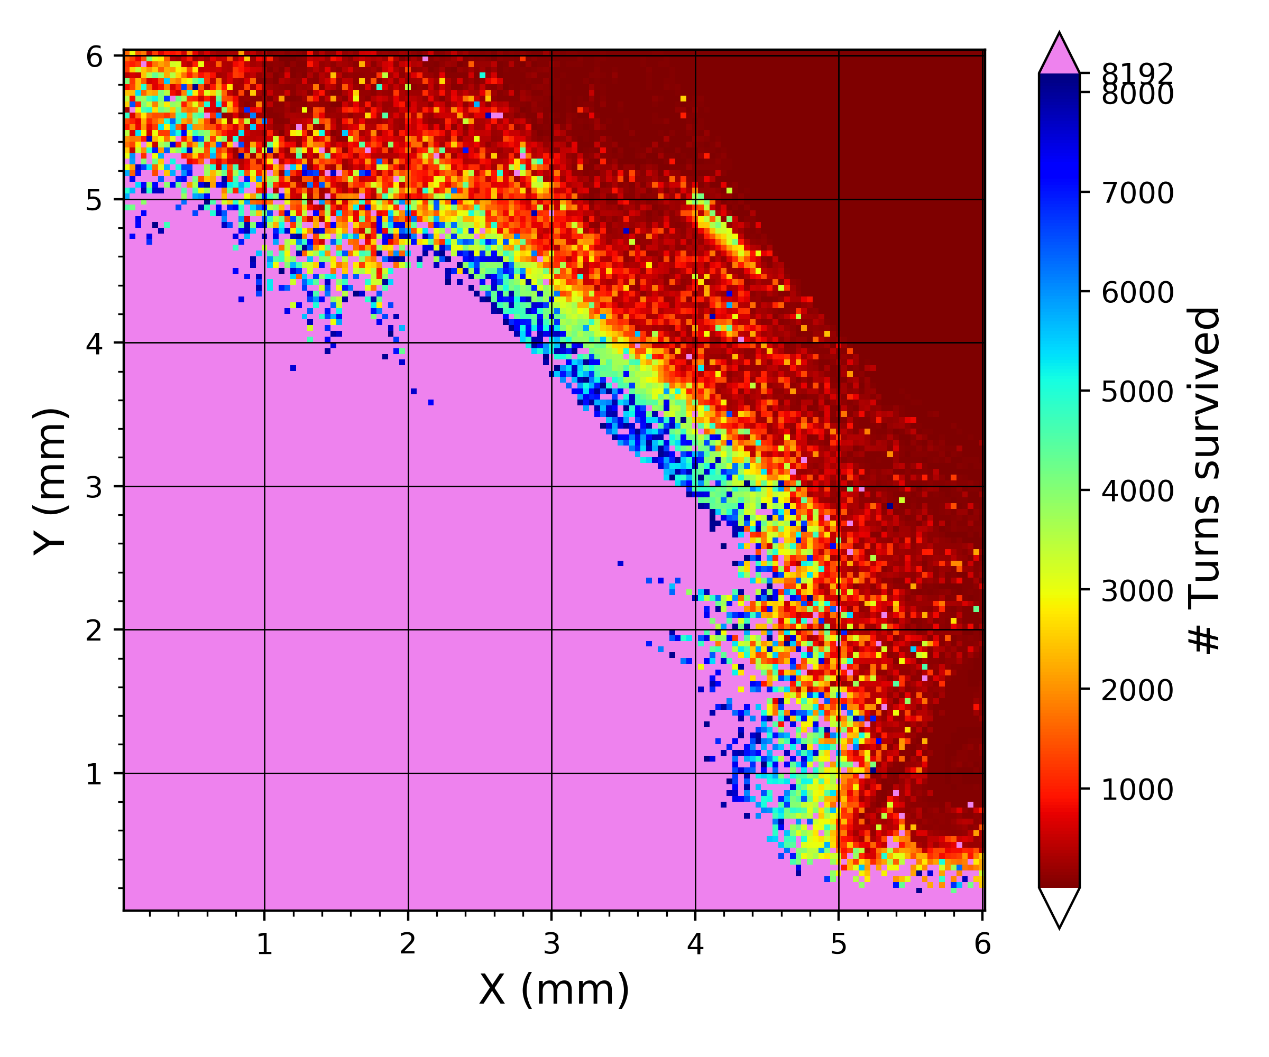
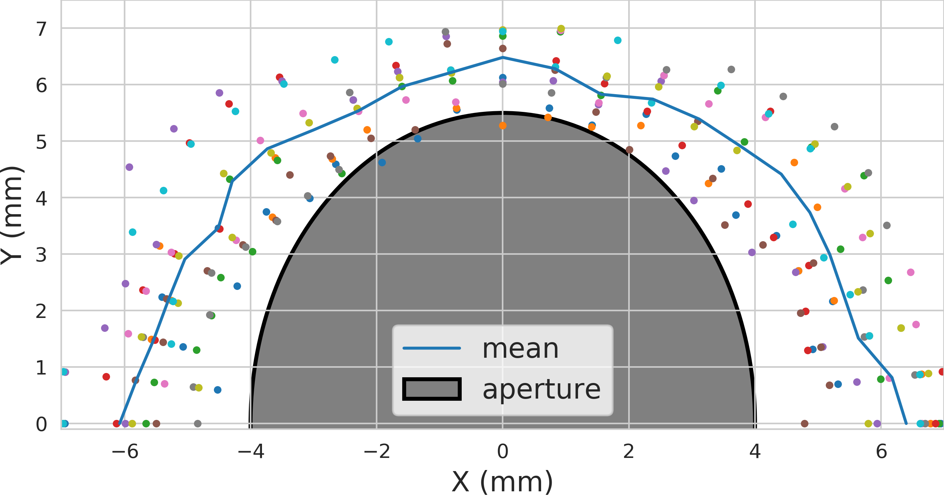
NIO-I Simulations (N.Kuklev)
Developed brand new code pipeline to interface with ‘elegant’

Slide 17
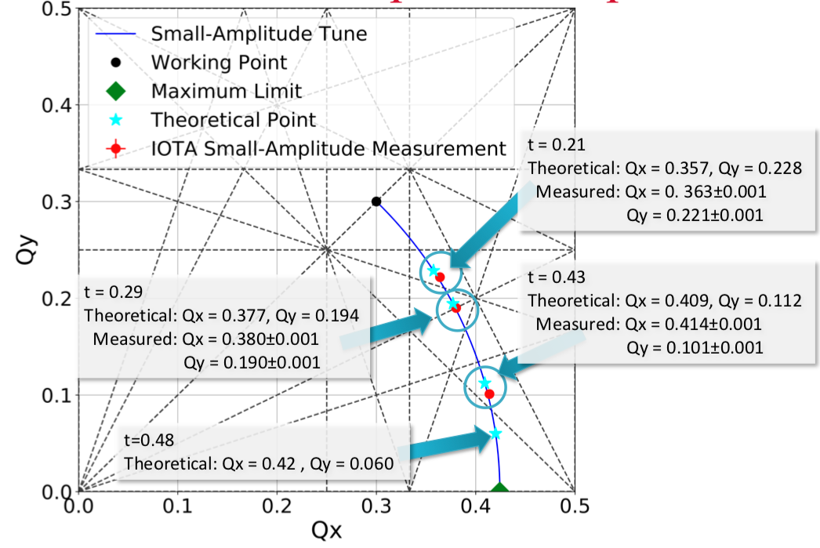
NIO-II Results – Small-Amplitude Tune
S.Szustkowski

Slide 18
NIO-II Simulations
S.Szustkowski

