Slide 1
Status of the ICARUS Experiment
Claudio Montanari
ICARUS Meeting
Jan 16, 2020

Slide 2
Outline
Current Technical Status progress since July 2019
Next activities
Summary and Outlook

Slide 3
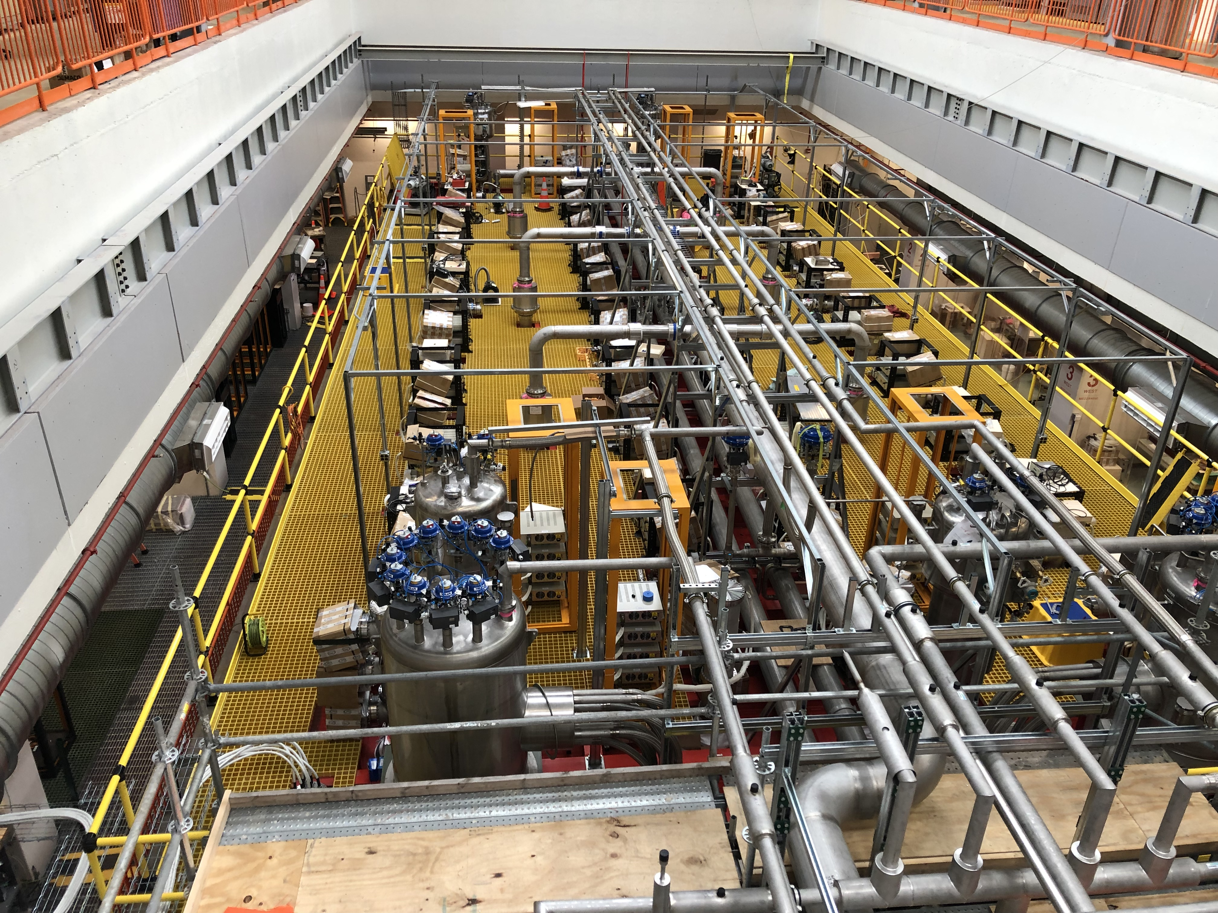
Technical status -1
June 2019
Progress since July 2019:
  TT-Link and wire bias cables have been installed. Connections to the minicrates will be done after the cryogenic commissioning to minimize risk of damage during the cryo pre-commissioning and commissioning.
  All Signal and HV cables for the PMTs have been installed and connected together with the optical fibers for calibration.
  The PMTs readout electronics and power supplies are installed, connected and ready to operate.
  The laser calibration system is installed and ready to operate.
  Optical fiber bundles for communication and DAQ are installed. Final connections to the minicrates are being installed.
  Servers for DAQ and networking both for the TPC and the PMTs are operational.

Slide 4
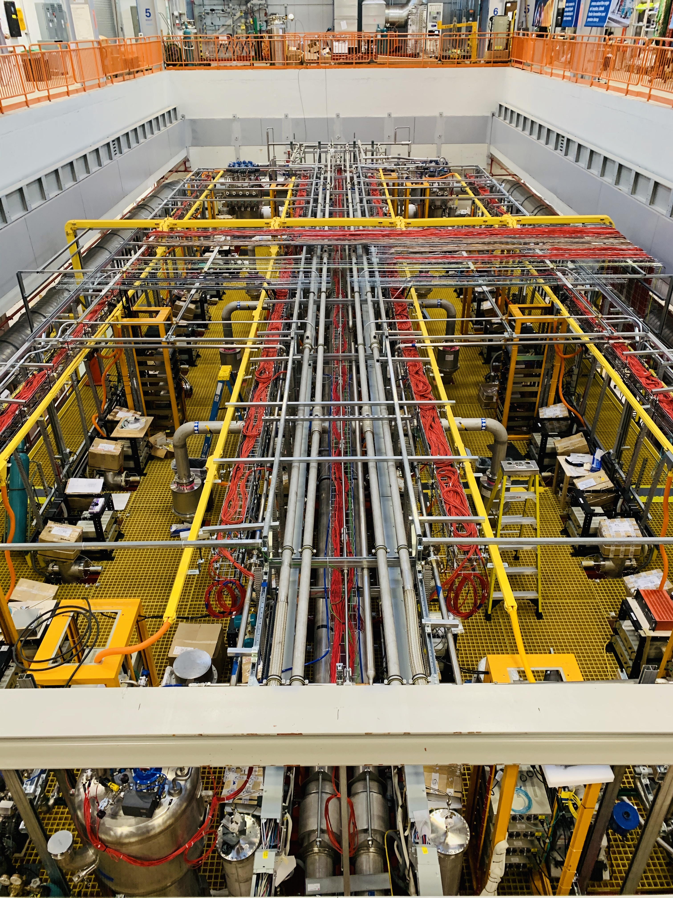
Technical status -2
December 2019
  HV Power Supply for the drift installed and connected.
  Readout for the North side of the CRT installed and operational.
  Tests of slow controls for the internal cryogenics, wires readout and PMTs in progress.
  Extensive tests of DAQ for the wires readout, PMTs and CRT are in progress since some months.
  Tests of data handling are in progress.
  The trigger logic is continuously developed. Electronics is installed and cabled. Tests are in progress.
  Preparation of the control room in ROC West in progress.
In blue are the common activities between ICARUS and SBND

Slide 5
Technical status - 3
December 2019
  Power distribution on top the the detector and on the mezzanine operational.
  Cryogenics hardware installation and cabling is complete.
  Tests of cryogenic controls in progress.
  ODH system ready to operate.
In blue are the common activities between ICARUS and SBND

Slide 6
ICARUS-T600: timeline
NO BEAM
CY 2019
CY 2020
Q1
Q2
Q3
Q4
Q1
Q2
Q3
Q4
Install Electronics Flanges
Proximity Cryogenics Installation
Install Cryo piping connections
Reinstall Vacuum System
Vacuum operation
Ready to Fill
Cold commissioning and LAr filling
Install Readout Hardware and pre-commissioning
ν
Install Cable Trays, T600 cabling
Ready to Readout
Transition to Operation
Overburden
Install Side CRTs
Install TOP CRTs

Slide 7
Foreseen next activities on TPC
Noise on 8 mini crates will be daily monitored during the cooling phase and Lar filling in order to trace the behavior of the wire chambers;
After LAr filling completion an extensive activity is foreseen on the TPC:
  The wire biasing cables will be plug-in on the flanges by flexible 30 cm extension cables mechanically constrained to mini-crate wall by nylon clips;
  The wires of TPC will be polarized maximizing the transparency on the first two induction plane to drift electrons and the signal collection on the last Collection plane. According to the previous ICARUS experience at Gran Sasso Lab. the voltage values -240 V, +10 V, +260 V will be initially applied to the Induction1, Induction2 and Collection respectively;
  First data taking will be devoted to optimize the TPC polarization, check the TPC performance in term of signal detection and noise by analyzing tracks in the collected events;
  The noise introduced by the different external sources will be investigated in order to be mitigated, in particular the grounding.

Slide 8
PMT activities before and after cooling down
Before cooling down:
  Test HV supply;
  PMT calibration of PMTs with the final electronics;
  Parameter settings (LVDS, baseline, threshold etc.);
  Test of DAQ with both PMTs and TPC;
  Set up of online monitoring of PMT DAQ system;
  Discussion and preparation of a plan about calibration.
After cooling down:
  Activation of PMTs and check the correct functioning;
  Perform a complete electronic check and debugging;
  Perform a full calibration campaign;
  Check of PMT DAQ system in view of data recording and trigger system activation;
  Start calibration routines;
  Perform the final calibration campaign with Laser, cosmic ray and random data.

Slide 9
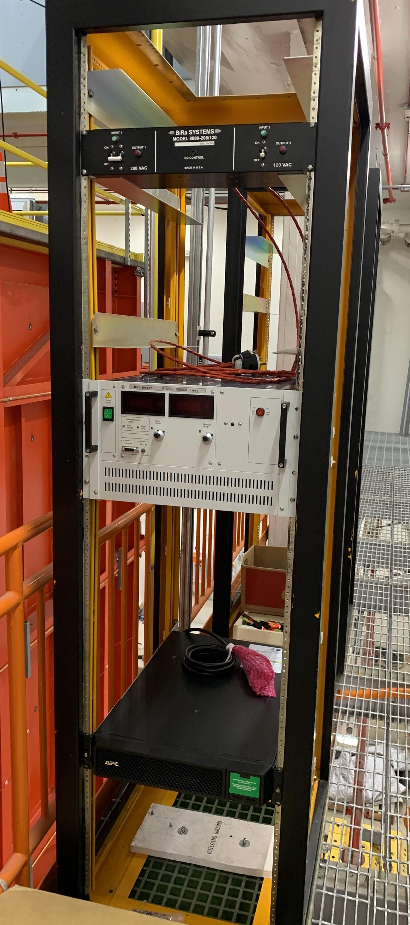
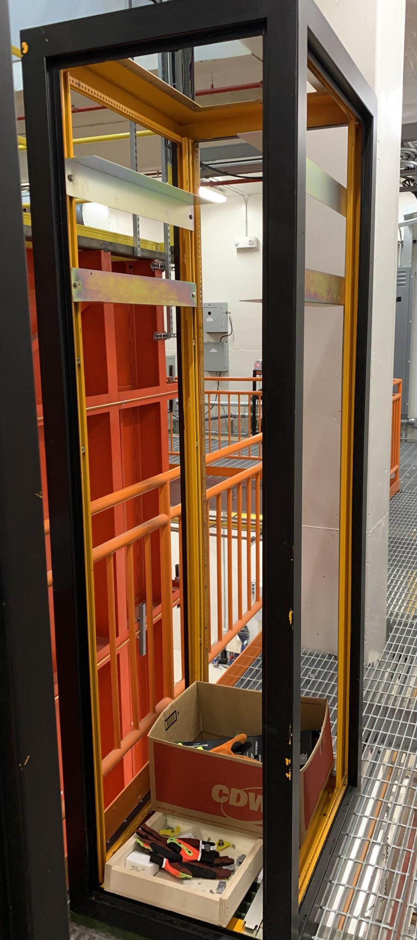
Installation of the Drift HV System
Current status of the rack installation is:
  120V Rack -> Shelving is in place for everything and now awaits the installation after the filling with liquid argon.
  208V Rack -> All components that are planned to be installed before the start of filling are in place for this rack except for the network port switch (this is the UPS, the spare Heinzinger Power Supply, and the AC Switch Box).
  The Splitter has been installed in the rack on top of the detector.
208V Rack
120V Rack

Slide 10
Next activities on DAQ system
Get prepared for 8 TPC+1 PMT crate DAQ during the period of cooling and LAr filling
Establish synchronization within each sub-system and among all the TPC, PMT, and CRT sub-system
Implement the interface/handshake between the DAQ and trigger systems
Improve error handing and monitoring metrics
Test the event building and define metadata
Deploy the data flow from the online clusters to tape
Stress test

Slide 11
Design architecture for trigger
White Rabbit network
CPU RT controller
Trig 0
BEAM ENABLE
PMT TRIG EAST
PMT TRIG WEST
PXIe 8135
7820R
7820R
7820R
7 lines in the backplane of the NI crate are used for bus communication among boards.
GLOBAL
TRIG
GATE ENABLE
SPEXI
Trig 6
TPC A2795
EAST
TPC A2795
WEST
PMT V1730
PMT V1730
PMT T300 EAST
PMT T300 WEST
Trigger laptop
SPEXI: synchronizes timing of whole detector, generates TT-Link signal for TPC readout Clock & Reset to PMT readout, handles beam extraction messages;
Two PMT trigger 7820 boards: generate a PMT Trigger & start pulse to digitizers for PMT activity recording in correspondence of interactions as detected by PMTs in each T300;
General Trigger 7820 board: combines PMT Trigger with SPEXI signal to generate a Global Trigger in coincidence with beam extraction (Early Warning).
RT controller: implements all features for communication with DAQ, monitoring of available buffer/veto generation;
One laptop to run the LabView Program: all connected to DAQ private network.

Slide 12
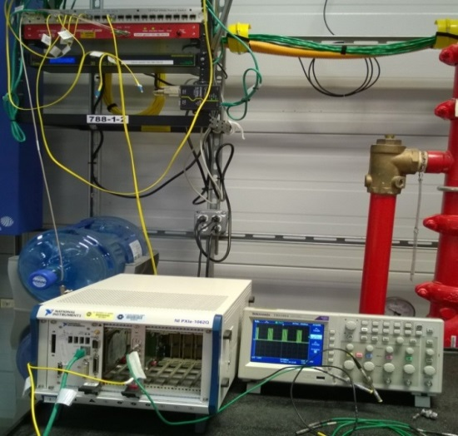
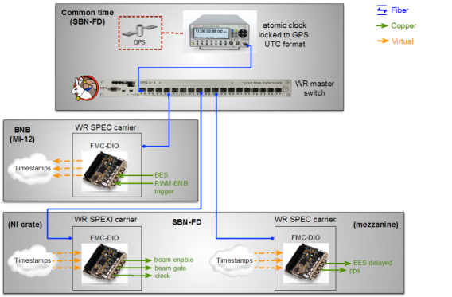
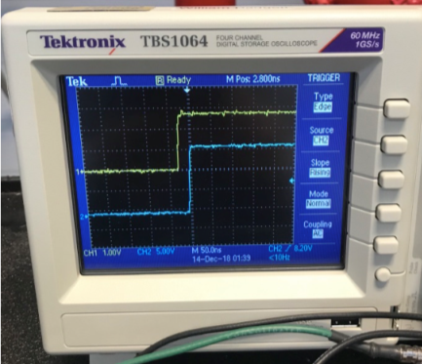
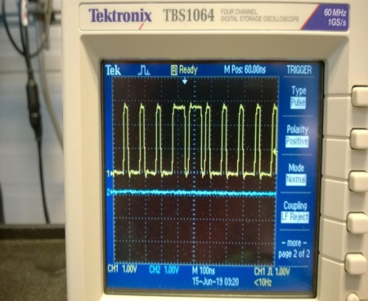
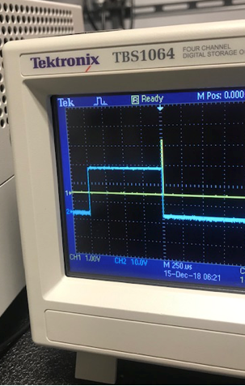
Trigger system status
  Present test setup at FNAL includes:
  SPEXI board in NI1062Q crate at ICARUS site connected to the WR (White Rabbit) master switch;
  SPEC board at MI-2 for sending beam signals to ICARUS Trigger system.
  Extensive tests in progress at ICARUS site:
  Phase locking of clocks to WR master 1 Hz pulse (pps) and the proper TTLink generation achieved/demonstrated consistently;
  Correctness of decoding of beam extraction signals and gate signal generation assessed.
  Issues of jittering of opened gates by 300 μs due to modification of gated-beam signal provided by Accelerator Division -> Proposal to modify signal broadcasting through WR network, to be study/implemented /tested end of Jan 2020.
  During December 2019 test of LabVIEW interface, unexpected issue with gate opening appeared: to be investigated thoroughly in Jan 2020.
  Final LabView code: for reading/displaying infos on trigger generation (timestamp of trigger, Early Warning packets…), setting up the parameters PMT majorities, gate width and delay...) and communicate with DAQ, expected by March 2020.

Slide 13
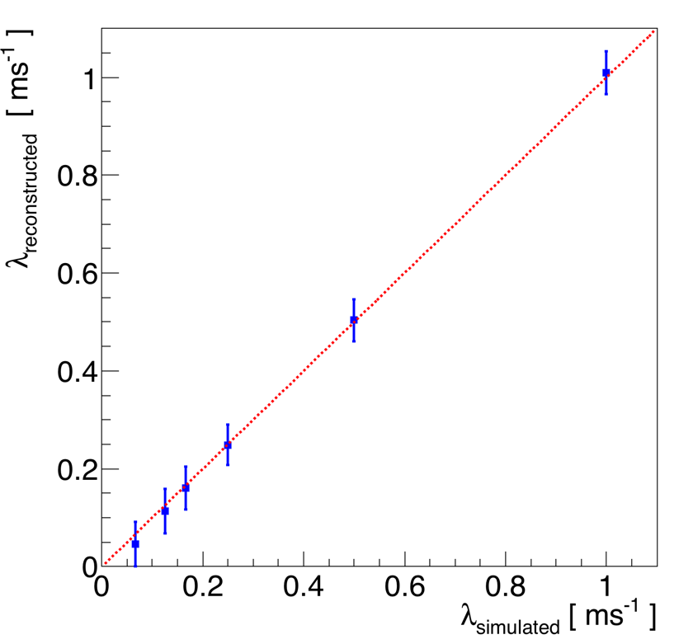
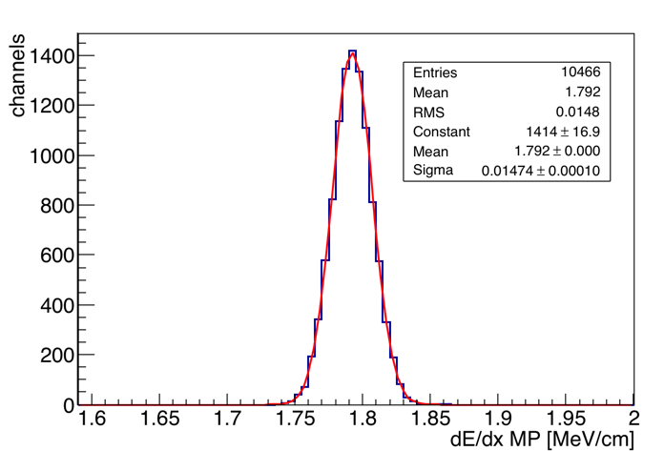
Calibration plans before the commissioning
In view of the commissioning phase, different tools to extract information for calibration purposes directly from the cosmic events are under preparation:
  An “online - quick” method for the purity measurement is ready and can be applied on the first events collected (even if we acquire only a reduced fraction of the Coll. wires)
  A tool for the equalization/calibration of the TPC wires based on the muon dE/dx measurements in each TPC channel is under finalization: a 1-2% resolution on the channel equalization can be reached using the muon tracks selected in 5k cosmic events (the acquisition of the full detector is required)
  A procedure for the PMT calibration (gain and timing) using the laser calibration system and the tools for the calibration based on the collected events is under development
  Possible procedures for the CRT calibration are also under discussion
ONLINE method: measurements on 40 events
2 ms
1 ms
8 ms
4 ms
6 ms
15 ms
dE/dx MP value evaluated in different TPC wires

Slide 14
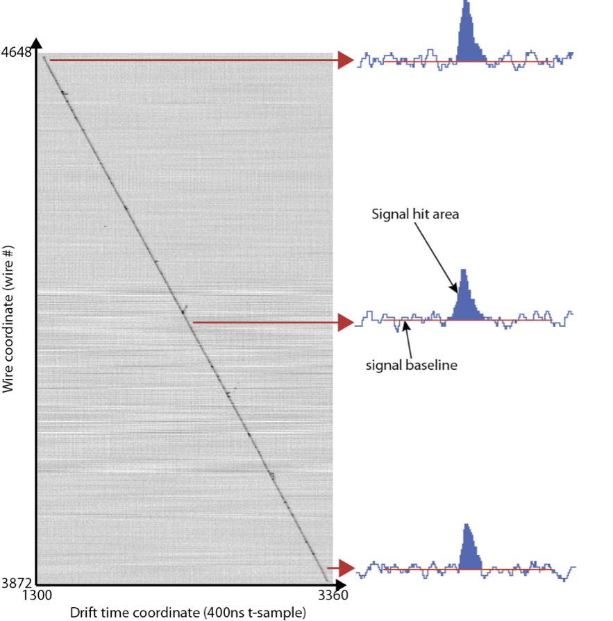
Calibration plans during the commissioning - TPC
During the commissioning phase the events collected will be first of all used to have a continuous monitoring of the Liquid Argon purity and to provide a first rough calibration of the TPC wires:
  In order to provide a fast evaluation, the developed “online purity method” doesn’t use all the available reconstruction tools (for example for the noise filtering): the code will then be tuned directly on the events collected to take into account of the observed noise conditions
  Additional tests will be also performed to study the possible impacts of the observed noise conditions and of the space charge effect on the purity evaluation and on the provided resolution for the TPC wires equalization

Slide 15
Calibration plans during the commissioning - PMT
For PMT calibration purposes we will use first of all the laser system:
  A dedicated procedure is under discussion within the PMT and the Calibration WG:
    the basic idea is to inject the laser pulse to the groups of 10 PMTs and the PMT signals (only PMT waveforms, TPC signals not needed) will be collected and used to extract timing/gain information;
    The procedure will be used to have a precise calibration during the commissioning phase and then periodically;
    A similar procedure, collecting a reduced number number of waveforms for each PMT, can be also foreseen to have a continuous monitoring of the PMT calibration;
The calibration from the laser system will be combined with the study of the events collected:
  The information on the light collected from through-going muons will help providing the absolute calibration and inter-calibration between the different groups of 10 PMTs
  Dedicated trigger sources are under discussion (in particular random triggers)

Slide 16
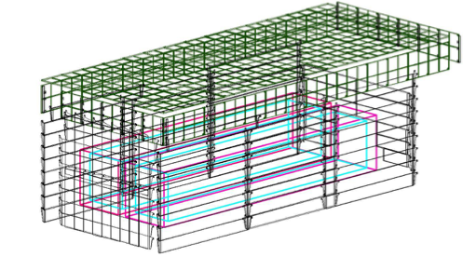
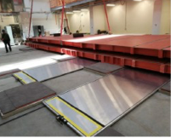
Overview of the SBN-FD CRT
Top CRT flat plane: module assembly is on going at Frascati Italy, near completion
Top CRT vertical planes
Side CRT planes: One wall installed, remaining modules ready to be installed
Bottom CRT planes: installed and tested
Setting the DAQ interface

Slide 17
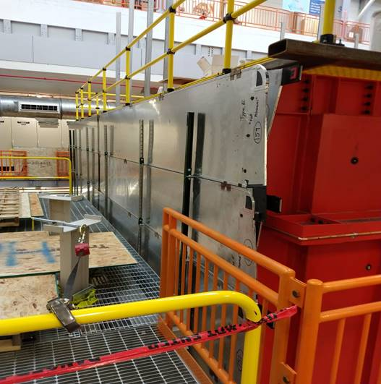
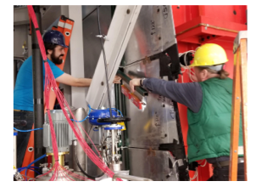
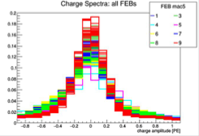
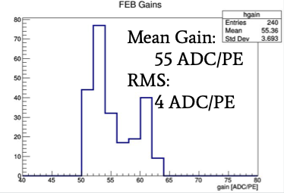
Starting the commissioning of side CRT
North wall side CRT was installed at the beginning of the year
Readout electronics have been installed this fall
  Reading 240 channels (8 FEBs)
Commissioning of the north wall is ongoing, taking data with 8 FEBs
Exercising the DAQ and analyzing the data collected
Optimizing configurations (thresholds as well as equalizing the gains, etc.)
First data from the CRT!
Pedestal for each FEB after calibration
Gains with all channels using the same bias setting

Slide 18
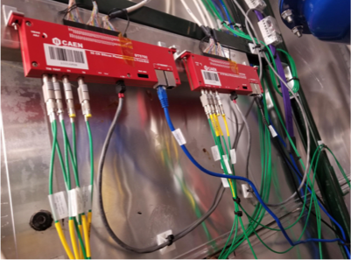
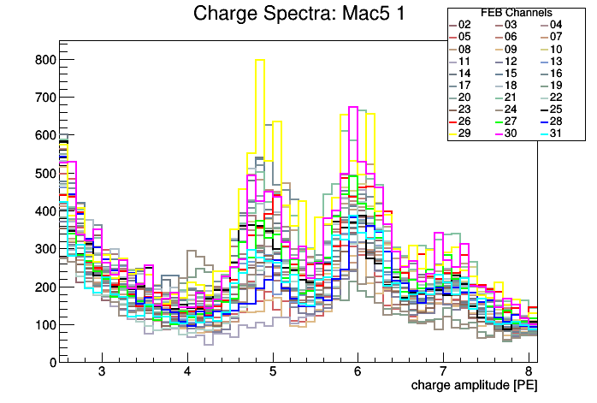
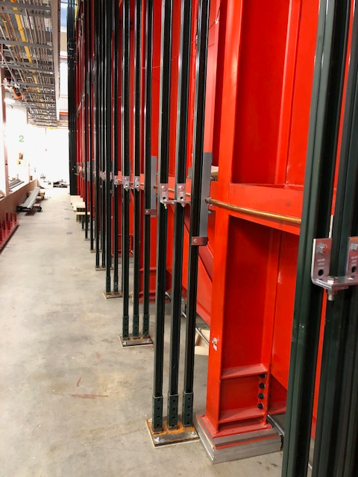
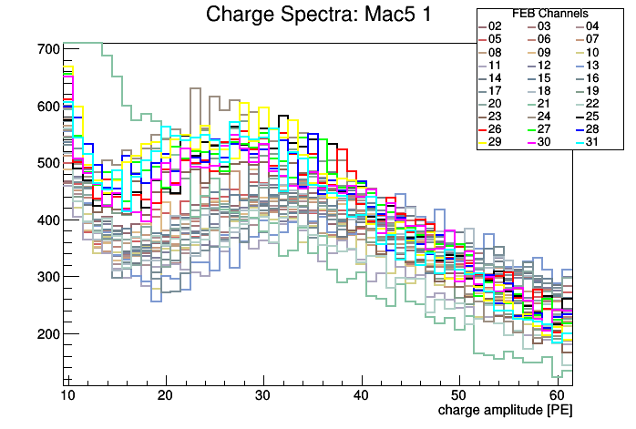
SBN-FD CRT Updates
ADC spectral overlays calibrated in PE for one FEB
Cosmic ray signals
Installing the support for the remaining side CRT installation
Modules for the top CRT to be shipped to Fermilab on February 2020
Full side CRT and top CRT to be installed after filling

Slide 19
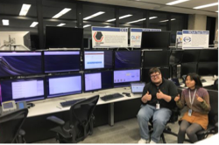
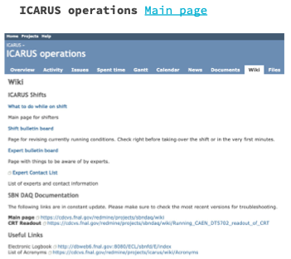
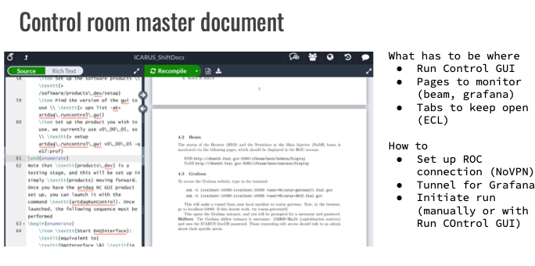
SBN Control Room
Control room for the SBN-FD is setup in ROC-West
Software for running the DAQ and network connections is in place
Have run DAQ, run control GUI, ECL and several of the monitoring tools from the control room machines since November 21
Writeup of the documentation for shifters in progress
Starting tests with off-site remote control room
  Testing to date has been done at CSU

Slide 20
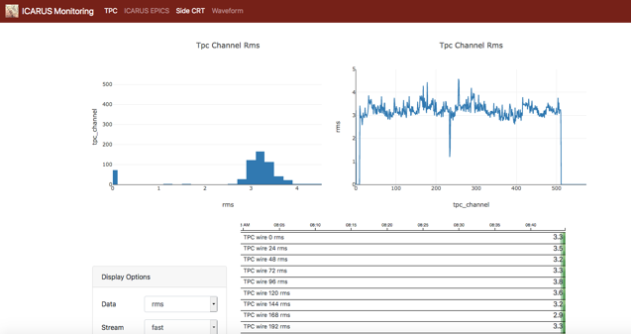
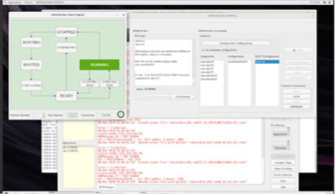
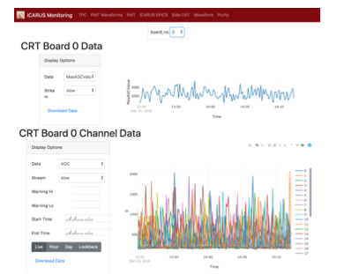
Ongoing Activities at SBN-FD Control Room
Exercising the DAQ and online monitoring from the control room
  Running ICARUS vertical slice test (TPC and PMT ) and side CRT (north wall)
Run Control GUI
TPC Monitoring
CRT Monitoring
PMT Monitoring

Slide 21
Slow Control Architecture
EPICS is the core software for SBN-FD, SBND, and microBoone.
EPICS Extensions
Control System Studio – user interfaces
Archiver
Alarm handler
Hardware and external data sources
Power supplies
GPS
Cryogenics (IFIX)
Beam
Computer status
DAQ status
Environment
EPICS
SBN Tools
Web displays
Databases
Management: Geoff Savage

Slide 22
Integration Into Slow Controls
ICARUS specific:
Inside cryostat
  Liquid argon temperatures
  Liquid argon levels
TPC
  Wire bias power supply
  Readout crate power supply
PMT
  HV power supply
  HV distribution
  VME crate power supply
  Calibration system
Drift (cathode) HV
CRT
  Readout power supplies
  HV power supplies
SBN Common:
GPS
Impedance monitor
Cryogenics
Beam
Computer status
DAQ status
Environment
Underscore indicates tested with a user interface
All other items are in progress

Slide 23
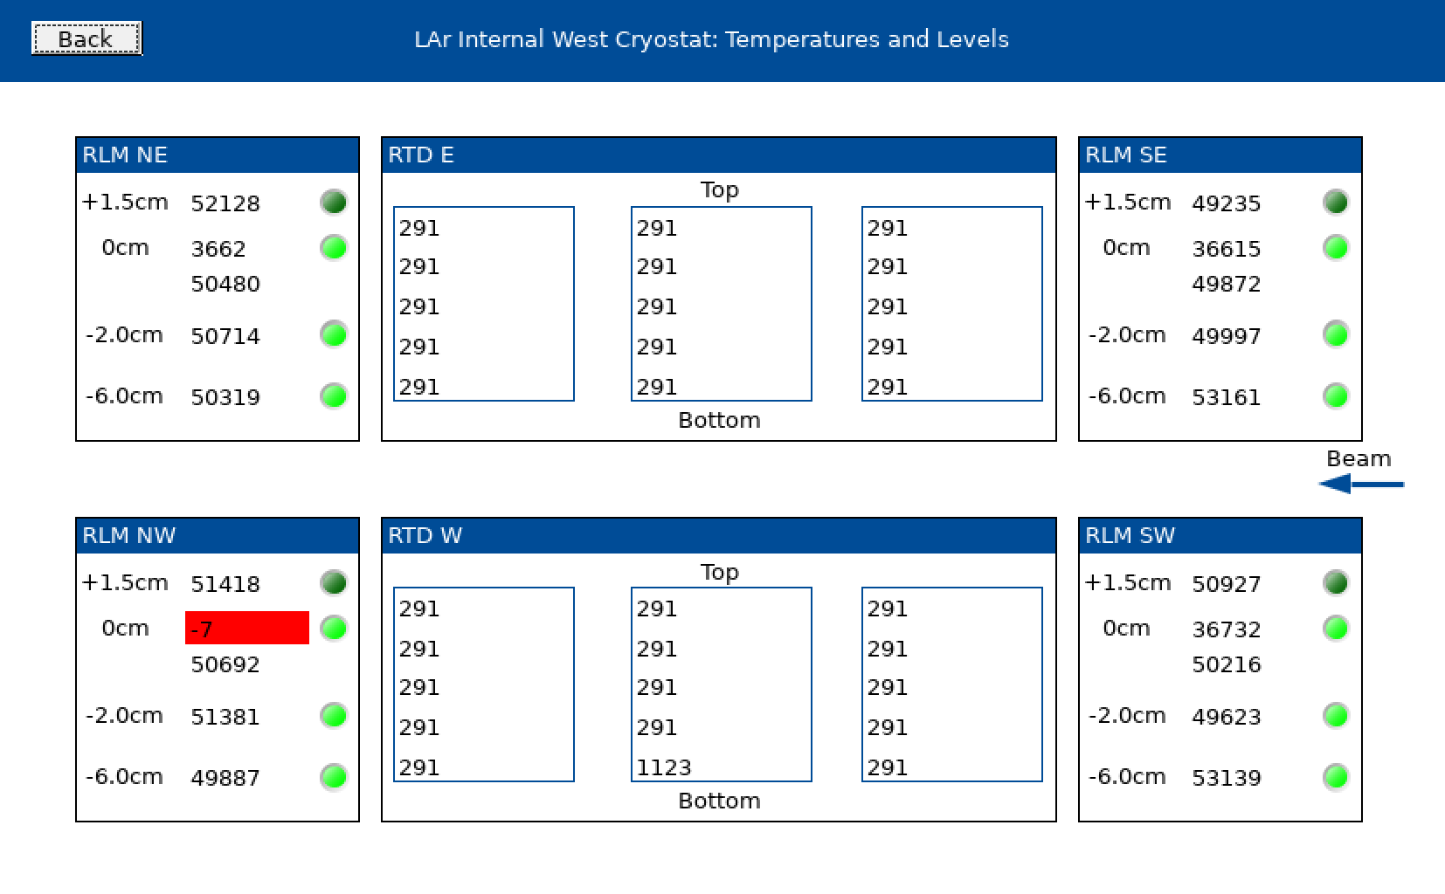
Temperatures and Levels in Cryostat
OPC
Server
IFIX
readout
Sensors in cryostat
PLC
EPICS
Archiver
Database
CSS
Display

Slide 24
Slow Controls: Remaining DCS Items
TPC
  Wire bias power supply
  Readout crate power supply
PMT
  Calibration system
Drift (cathode) HV
CRT
  Readout power supplies
  HV power supplies
SBN Common
  Computer status
  DAQ status
  Environment
Control room GUIs (CSS – Control System Studio)
Archiver
Alarms
Cameras
Integration
Lots of work remaining: additional people support is required urgently

Slide 25
Slow Controls: Other Computing Items
Computer with SPEC card
  Move SPEC card to Icarus-clk01 from Icarus-daq02
  Icarus-daq02 needs to be retired
PMT computers
  Installed 7 computers for PMT
  Only need 3 computers + 1 spare
    First allocation of communication cards was one per computer
    Settled on 2 communication cards (A3818) per computer
  Reallocate 3 PMT computers?
    Run control
    Monitoring
    DCS – only one computer assigned to DCS
    No need to physically move the computers
Lots of work remaining: additional people support is required urgently

Slide 26
Electrical Working Group: Scope
Responsible for Detector AC Power Distribution and Ground Monitoring system.
Generate electronics rack build specifications and graphics.
Provide design documentation for all custom designed equipment.
Generate AC and DC power distribution schematics for installation and safety reviews.
Assist with Operational Readiness Clearance documentation and participate in Reviews.

Slide 27
Electrical Working Group: Accomplishments
Low-noise Detector AC Power installed.
  Ground Monitoring system successfully used to indicate ground shorts between the detector and building ground systems.
  Numerous sources identified and removed throughout the year.
  Next available opportunity to resolve current ground short is April.
Electronics rack builds completed for all equipment.
  Provided a mechanism for keeping track of power consumption.
  Provided a plan for equipment positioning and infrastructure needs.
Design documentation for all systems has been collected and available in the SBN DocDB.
Completed 11 partial Operational Readiness Clearance reviews.
  In progress: HV Drift, Trigger, Laser, Wire Bias/TT-Link, CRT, Heaters, DAQ

Slide 28
Electrical Working Group: Plans
Resolve ground short in April.
Complete remaining 7 pORCs in preparation for final walkthrough.

Slide 29
Conclusions (I)
We are about to start the cryogenic commissioning and this requires the start of 24/7 shifts.
  The control room is ready
  The assignment of the shifts is ready to be circulated to the Collaboration
Several activities are still going on, mainly about DAQ, Trigger, Slow controls and networking.
  None of these is on the critical path for the cryogenic commissioning
Immediately after the cryogenic commissioning the short(s) between the detector ground and the building ground has to be resolved (two weeks available for the search, during the cryogenic stabilization phase).
Immediately after the cryogenic stabilization the detector commissioning will take place and this includes:
  Final connection of TT-Links, wires bias and DAQ optical fibers
  HV activation
  PMTs activation
  Purity measurements
  Calibrations
  Trigger setup
  Finalization of the Slow Control System
  DAQ operation with the full detector
  Training of experts
  Finalization of the setup for operation (Shifts, Manuals, Run Coordination)

Slide 30
Conclusions (II)
The remaining installation activities concern, in order:
  The installation of the side CRT;
  The installation of venting and fire protection systems on top of the detector;
  The installation of the Top CRT
  The installation of the Overburden.
The detector commissioning (previous slide) and the remaining installation activities have to take place before the start of the neutrino beam, in October.
  This implies a maximal presence of the Collaboration onsite during the period between May and October, this year. The estimate is a continuous presence of about 20 persons during this period, including a technical support of at least 3 technicians for the remaining installation activities and 3 persons on shift.
A support of additional 2 persons for the setup of the Slow Control System is urgently needed
Additional support (2 persons) is also required for the DAQ setup and testing

Slide 31
THANK YOU!

Slide 32
Backups

Slide 33
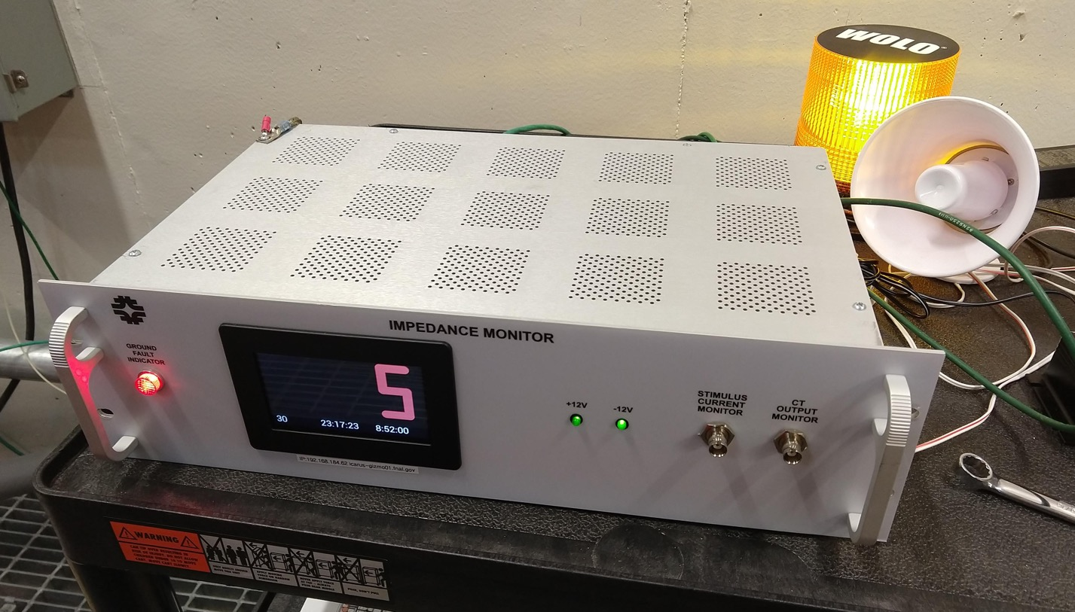
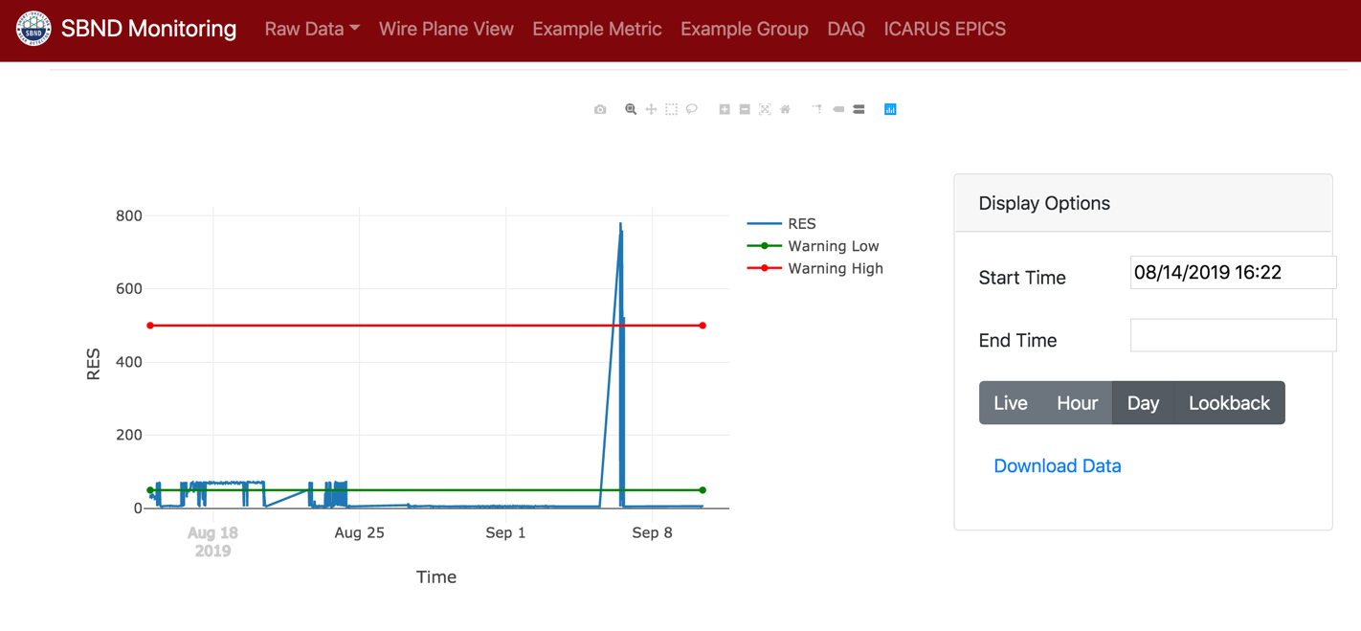
Impedance Monitoring (GIZMO)
GIZMO
readout
GIZMO
EPICS
Archiver
Web
Display
Database
Monitor Impedance between detector and building ground
Tells you if you have a “short”

Slide 34
Ongoing Activities at SBN-FD Control Room
  Adding information with the current running conditions

Slide 35
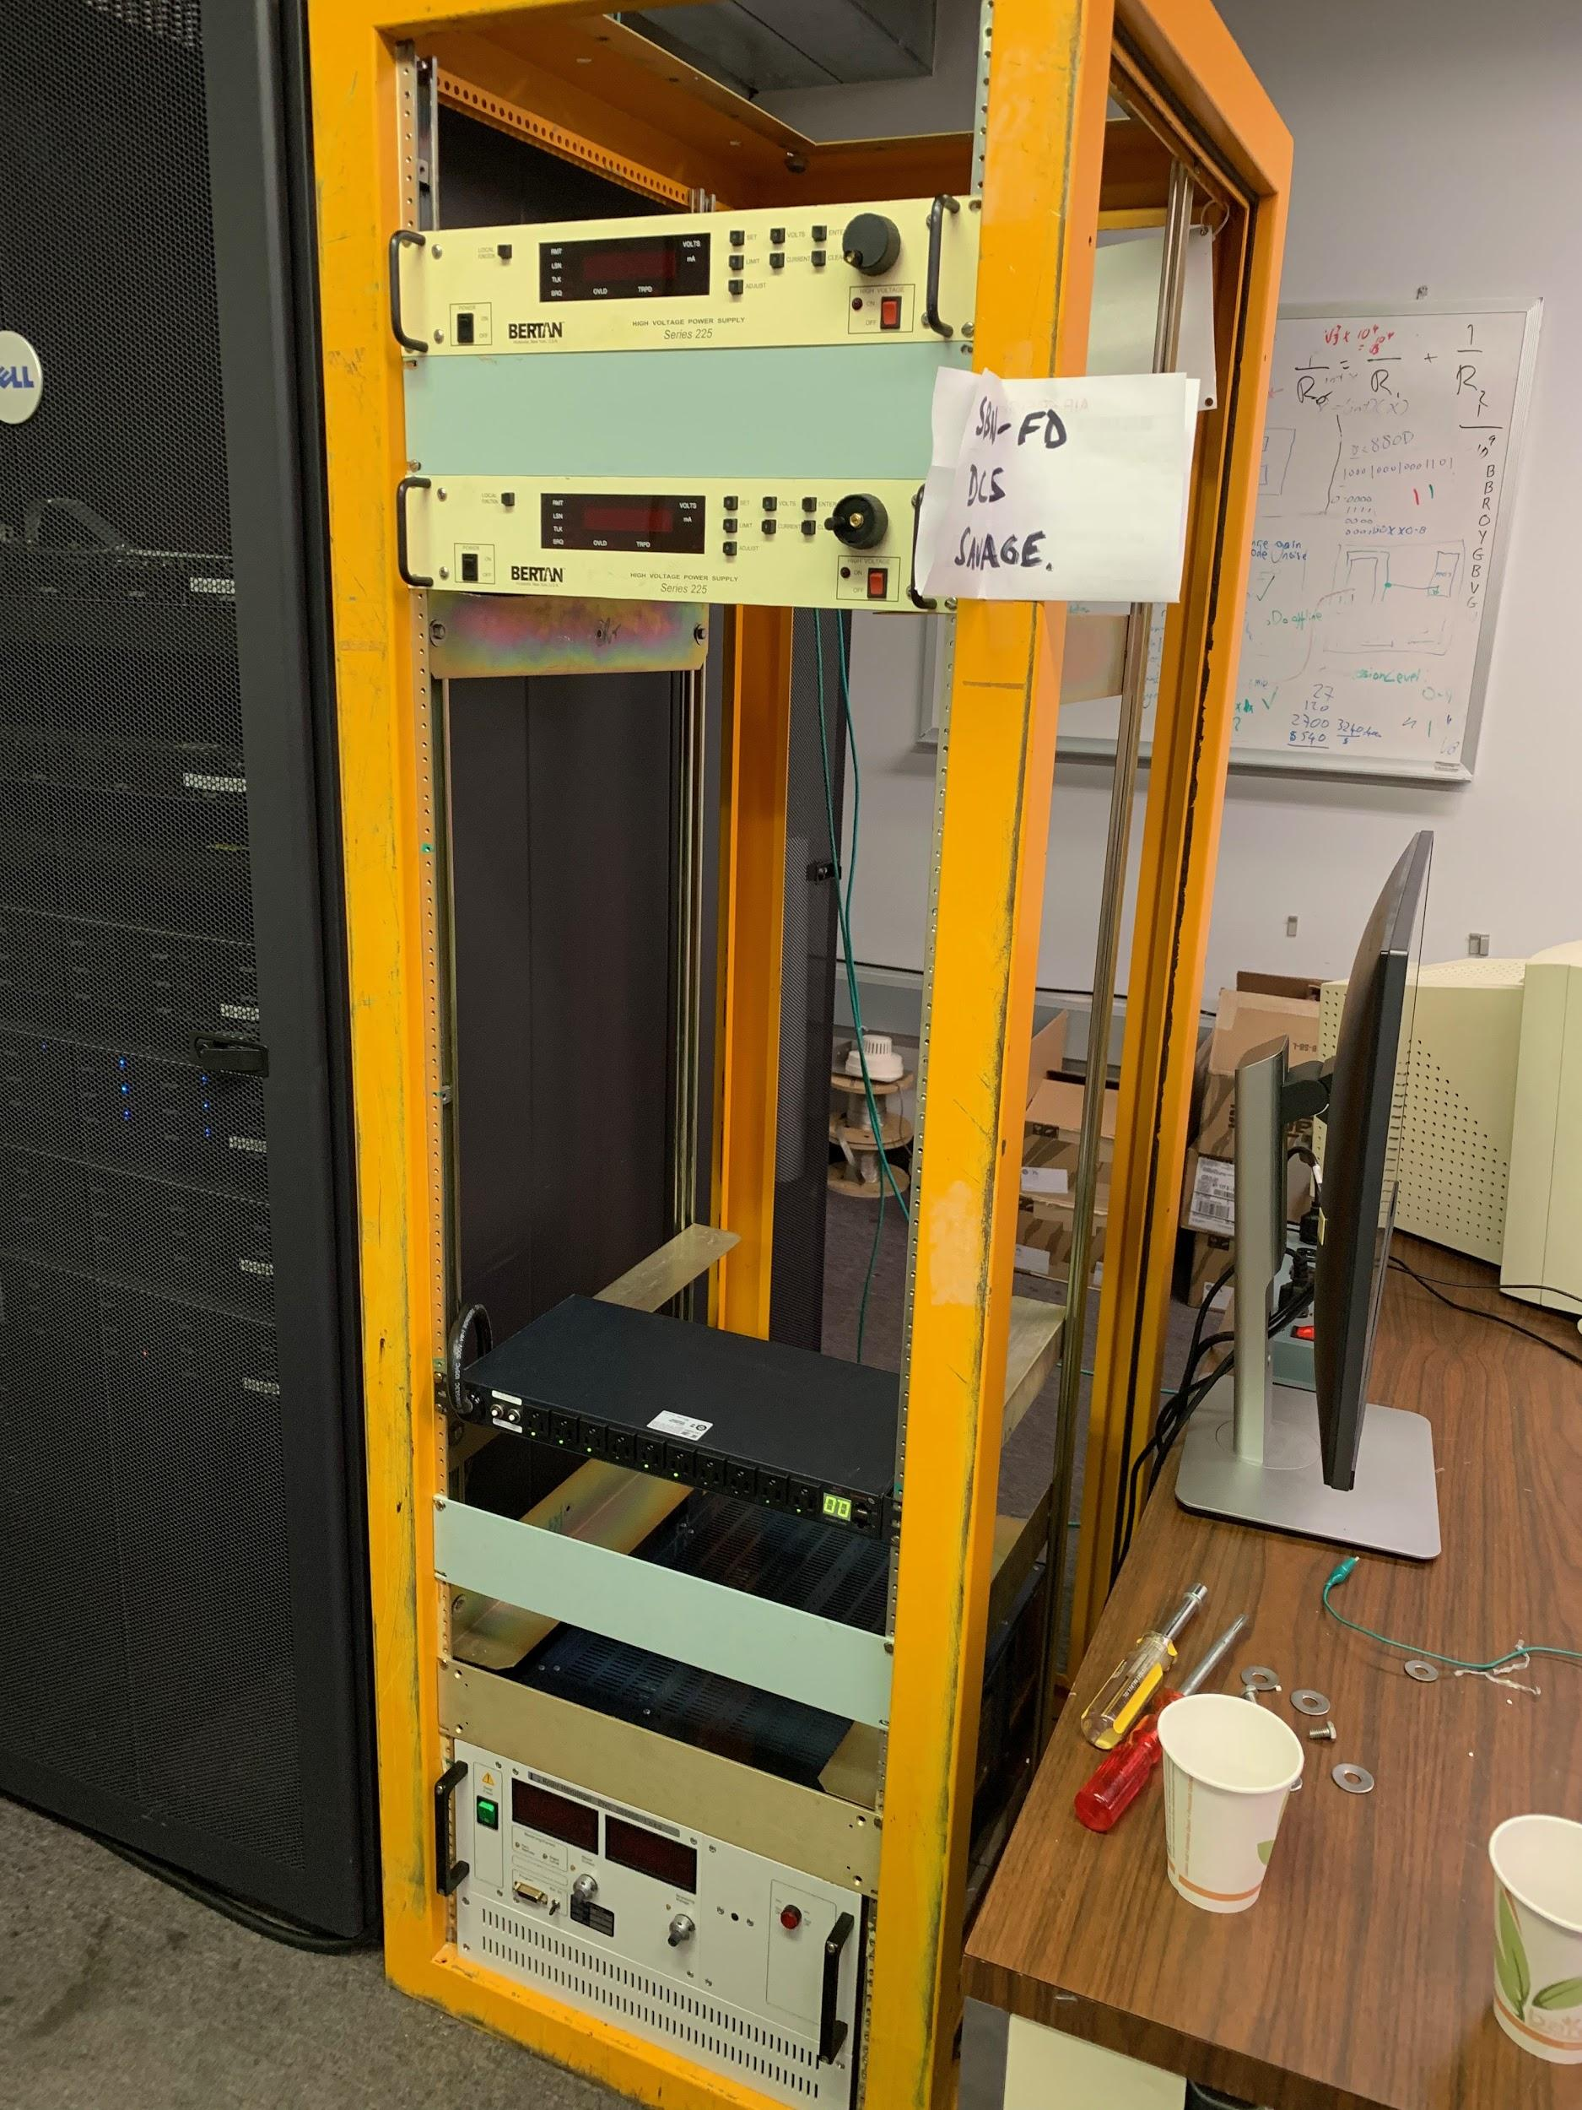
Drift HV system: Slow Controls Test Stand at DAB
A test stand has been assembled at DAB with the purpose of being able to work on the development of the slow controls of the Drift HV System, as well as testing the Monitor Chassis.
Further work on the slow controls of the Drift HV System will continue during the filling process as well as the implementation of the controls in the control room for the Drift HV System.

Slide 36
ICARUS Trigger system
ICARUS Trigger exploits the recognition of PMT signals inside BNB/NuMI proton beam extraction gates, the White Rabbit network providing a time alignment at 50 ps level.
The signals from the Cosmic Ray Tagger system and the bunched structure of proton beams will be added later to improve cosmic rays rejection.
The trigger system would provide also the common general start of data acquisition and the common synchronization of all sub-detector systems, i.e. PMTs, TPCs.
An atomic clock locked to GPS provides a 1 Hz synchronization signal (pps) to ICARUS and to the Beam Monitor detectors at beams extraction locations used for Early Warning signals (35 ms, 730 ms in advance of protons on target at BNB, NuMI) and Extraction Signals generation.
Target: 0.3 Hz in-spill physical events rate dominated by cosmic rays are expected:
  BNB - 5 10¹² pot/spill in ~1.6 µs, 5 Hz rate: ~1 ν/180 spill (0.03 Hz)
  NuMI - 6 10¹³ pot/spill in ~9.5 µs, 0.75 Hz rate: ~1 ν/53 spill (0.01 Hz).
The Trigger system deployment involves different technical aspects in the programming the electronic boards as well as dedicated studies/analysis of MC events with the participation from PMT, TPC, DAQ and Software Working Groups.
Technical status reports on the ICARUS-T600 trigger system are released on the ICARUS Doc-DB repository.

Slide 37
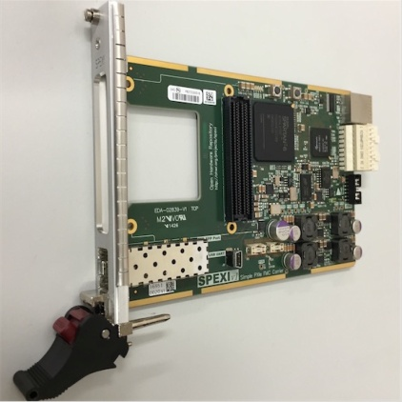
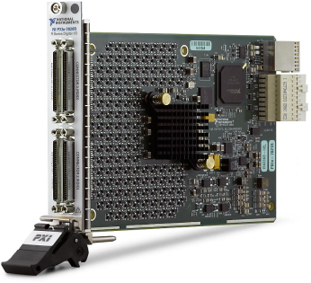
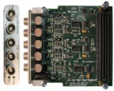
ICARUS trigger system layout
Based on NI PXIe instrumentation: PXIe-8135 RT (Real Time) controller, SPEXI board by INCAA Computers and 3 PXIe-7820R boards for PMT Trigger and General Trigger are used:
RT controller: implements all features for communication with DAQ, monitoring of available buffer/veto generation;
SPEXI: VHDL programmed - synchronizes timing of whole detector, generates TT-Link signal for TPC readout Clock & Reset to PMT readout, handles beam extraction messages;
2 PMT trigger 7820 boards: LabView programmed - generate a PMT Trigger & start pulse to digitizers for PMT activity recording in correspondence of interactions in LAr as detected by PMTs in each T300;
General Trigger 7820 board: combines PMT Trigger with SPEXI signal to generate a Global Trigger in coincidence with beam extraction (Early Warning signal).
ICARUS Trigger NI crate configuration
8
1
3
5
RT
Controller
SPEXI
7
8
2
0
R
General
Trigger
7
8
2
0
R
PMT
Trigger
7
8
2
0
R
PMT
Trigger
All modules already tested: now installed at FNAL ICARUS site.

Slide 38
PMT activities after filling and cryogenic stabilization
  Activation of PMTs at cryogenic temperature and check the correct operation. Status: to be done after the detector cool down in 1 week.
  Perform a complete electronic check and debugging – Status: to be done after the detector cool down in 1 week.
  Perform a full calibration campaign with PMT DAQ and electronics – Status: to be done after the detector cool down in 2 weeks.
  Check of PMT DAQ system in view of data recording and trigger system activation. Status: to be done after the detector cool down in 3 weeks together with the DAQ and trigger WGs.
  Practice a calibration routine as defined together with the calibration WG – Status: to be done after the previous calibration campaign.
  Perform the final calibration campaign with Laser and cosmic ray data. Perform tests taking data with random triggers. Status: need trigger system and TPC functioning with DAQ to be ready by that time.

Slide 39
Next activities on TPC
Noise on 6 mini crates will be daily monitored during the cooling phase and Lar filling in order to trace the behavior of the wire chambers and to intercept as early as possible sources of noise due to the operation of cryogenic equipment;
After LAr filling completion an extensive activity is foreseen on the TPC:
  The wire biasing cables will be plug-in on the flanges by flexible 30 cm extension cables mechanically constrained to mini-crate wall by nylon clips;
  All TT-Link cables will be connected to the mini-crates;
  All optical fibers for DAQ and networking will be connected to the minicrates and to the power supplies;
  The wires of TPC will be polarized maximizing the transparency on the first two induction plane to drift electrons and the signal collection on the last Collection plane. According to the previous ICARUS experience at Gran Sasso Lab. the voltage values -240 V, +10 V, +260 V will be initially applied to the Induction1, Induction2 and Collection respectively;
  First data taking will be devoted to optimize the TPC polarization, check the TPC performance in term of signal detection and noise by analyzing tracks in the collected events;
  The noise introduced by the different external sources will be investigated in order to be mitigated, in particular the grounding.

Slide 40
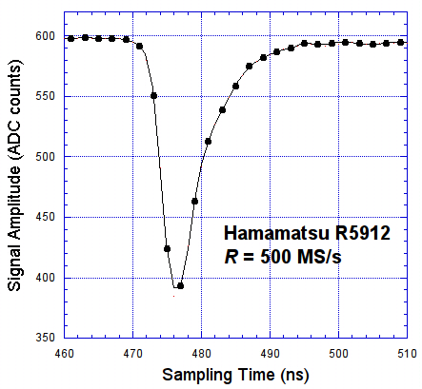
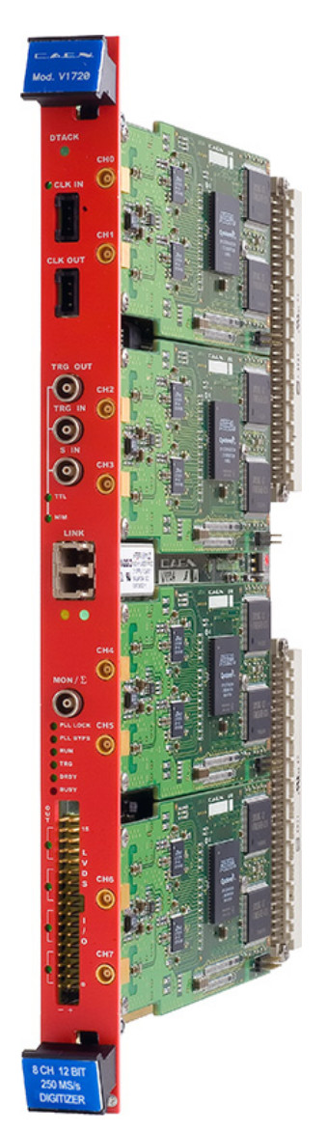
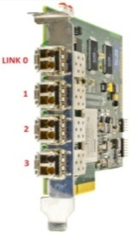
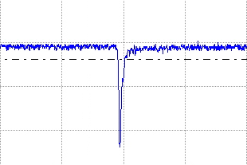
Light Detection System Overview
The T600 light collection system consists of 360 PMTs 8‘’ HAMAMATSU R5912-MOD, each coated with ~200 μg/cm² of Tetra-Phenyl-Butadiene (TPB) to detect the λ=128 nm LAr scintillation.
For each PMT, a 50 μm optical fiber allows the illumination of the surface by means of light pulses from an external Laser source (λ=405nm, FWHM<100ps).
The readout structure is equivalent to an oscilloscope channel for each PMT: it allows the recording of the light signal shape with ns time resolution as requested for the timing.
This is performed by means of CAEN V1730B (500MS/s, 14-bit) boards. Recorded signals are then dispatched through optical links (A3818 board).
Moreover the V1730B boards will generate a set of discriminated output signals (LVDS) which are used for triggering purposes.
V1730
PMT Trigger
General Trigger
PMT
Trigger
Logic
Optical
Link
LVDS
A3818
Data Recording
(10 µs)

Slide 41
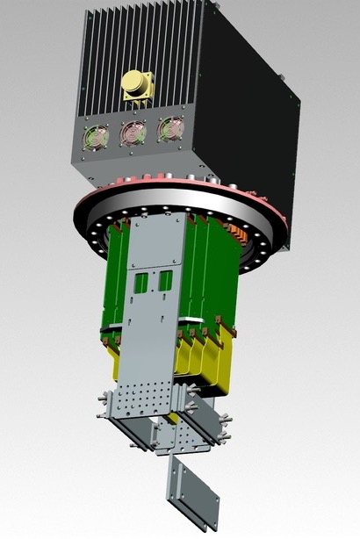
ICARUS TPC Read-out System Overview
The new ‘’warm’’ ICARUS TPC electronics includes:
      A front-end based on analogue low noise/charge sensitive pre-amplifier - same for Induction/Collection wires;
      A serial 12 bit ADC system, one per channel with 400 ns sync. sampling;
        A serial bus architecture with optical links for Gigabit/s transmission.
Both analogue/digital electronics hosted in a single board directly mounted on a signal feedthrough flange. External side of flange acts as backplane for a custom mini-crate where 9 boards (576 ch) are housed:
    64 pre-Amps/ADC per board, 0-3.3V rail to rail, FPGA, optical link
    Backplanes of mini-crates distribute power supply/local control signals
    Wire signals decoupled from HV bias by DBB boards are installed on the internal side of the flanges.
H.V. (<±500 V)
Backplane connector
Liquid argon
Gas
REG
REG
Trigger
Sense wires
(4-9m, 20pF/m)
Twisted pair cables
(~1.8-6.2 m, 50pF/m)
TT-link
ADC
Induction (32ch)
…
…
FPGA
optical
link
Fibers
ADC
Collection (32ch)
RAM
Test IN
JINST 13 (2018) P12007
Decoupling board
UHV
Feed-through
(18x32ch)
Front-end ampl
(64/board)
12bit serial ADC
400ns sampling

Slide 42
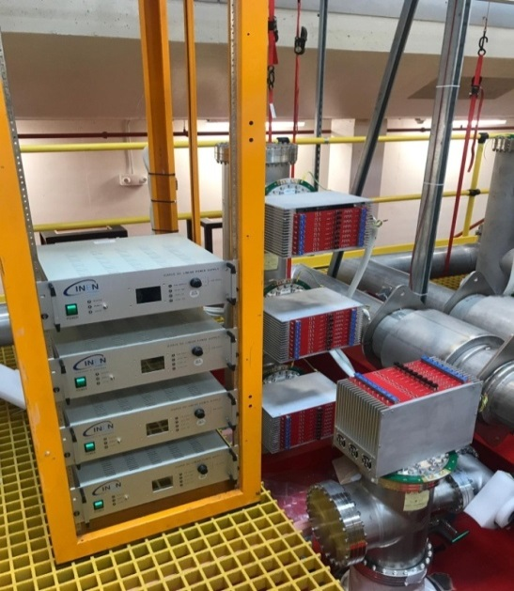
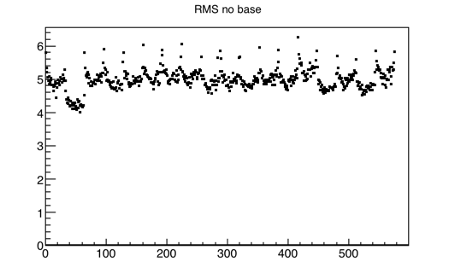
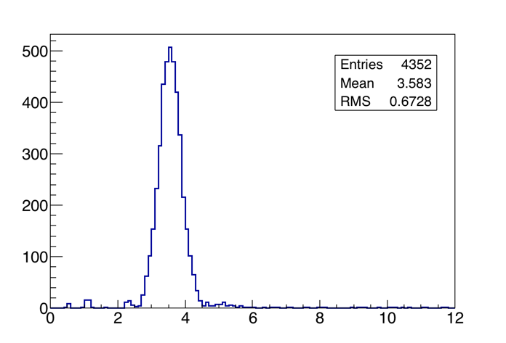
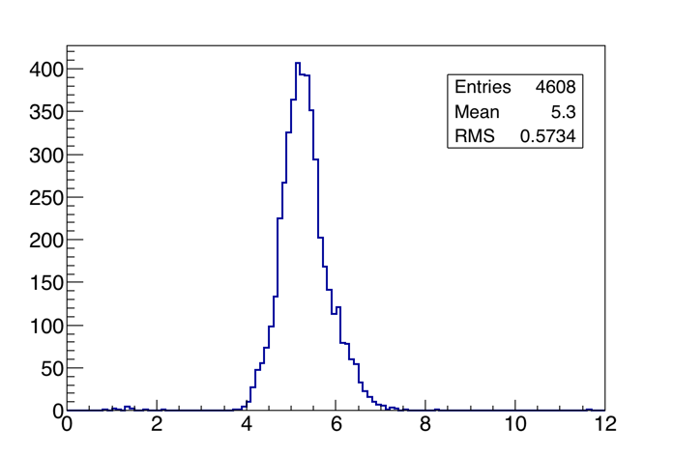
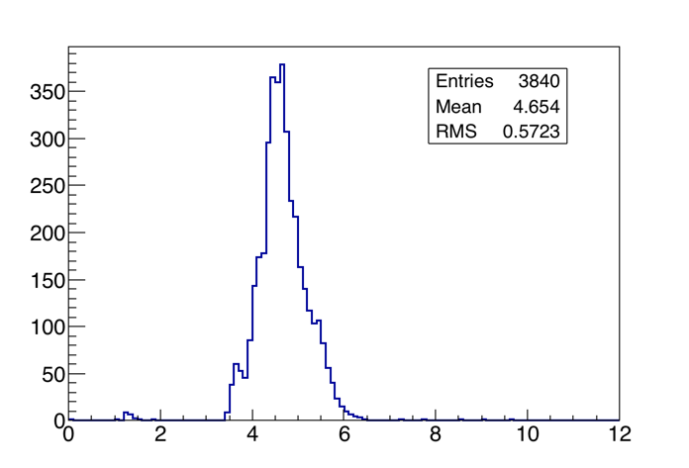
Vertical Slice Test (VST): 24 flanges on 8 corner chimneys
Similar VST were performed on the 24 corner flanges which refer to horizontal Induction1 wires, shortest Induction 2 and Collection wires;
  A higher noise level on these crates (~ 4.5 - 5 #ADC) compared to the standard crates has been observed, due to the longer wires (9 m vs 3.8 m), to the longer internal flat cables and to the external noise related to the installation activities;
RMS (#ADC)
(1 ADC:550 e-)
channel
Bottom crates: Induction2/Collection wires, channels RMS distribution
Middle crates: Induction1 wires, channels RMS distribution
Top crates: Induction1 wires, channels RMS distribution
RMS (#ADC)
RMS (#ADC)
RMS (#ADC)

Slide 43



SBNFD (NP01) –Status of Cryogenic Installation, Dec 2018
Designed, procured,
partially installed
Installed, tested,
await cooldown
Installed, tested,
await cooldown
Warm Proximity:
procured by CERN,
will be installed by Fermi
Additional filter
Partially installed,
await wiring and
software
Cold Proximity:
delivered to Fermilab,
install in 2019
Designed, procured,
partially installed
Await modification
Built, await
fill w/gas
Warm vessel:
exceptional vessel
w/ purge
Designed, wait
procurement
ODH
Installed, tested
Proximity platform – installed
Supports – designed, awaiting
procurement and installation
Integration and Controls:
Safety documentation per FESHM 4240, 5031, 5031.1, 5051.5, 5033, 5032 (~ 80 Eng. Notes)
CERN EDMS No. 1549951

Slide 44
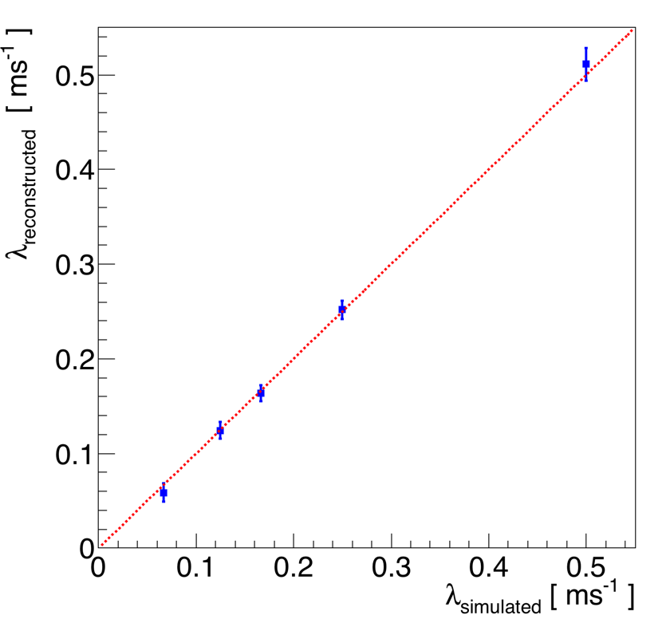
Testing Purity Measurement with MC Events
2 ms
2 ms
1 ms
4 ms
6 ms
8 ms
4 ms
6 ms
8 ms
15 ms
15 ms
  Using MC events, the methodology has been tested and shown to be adequate for ICARUS monitoring/calibration needs
  Current plan is to study dependence of measurement on both collection wire noise level and space charge effects.

Slide 45
TPC Channel Gain Calibration
In order to utilize the TPC for energy measurements, TPC channel gain (ADC → energy) must be measured; this is done on a per-channel basis.
Result: set of calibration constants that enforce uniformity of channel gain across the TPC; measure (and monitor) constants using dE/dx of cosmic muon tracks throughout TPC
  By accumulating the values of muon dE/dx in each channel, we extract the most-probable (MP) value and from this the required calibration constant
Resolution of 1-2% requires ~5000 cosmic muon tracks
Planning to study impact of purity, noise level and space charge effects on measurement
Also implementing monitoring of calibration constants over time
dE/dx MP value evaluated in different TPC channels

Slide 46
PMT Calibration studies
Measurements of the PMTs gain and dark count rates has been performed at room temperature
  Half of PMTs tested in air with a large input light intensity from laser calibration system (current light source LED, waiting for laser safety review approval): mean number of photoelectrons (p.e.) measured: ~ 10;
  Other half of PMTs have been tested under vacuum at 2x10⁻⁴ mbar with a low input light intensity, to measure the single p.e. spectrum;
Calibration/monitoring of PMT gain and timing to be done w/ multiple approaches:
  Laser calibration system for relative timing, gain
  Cosmic events for absolute gain and timing (with CRT)
PMT voltage distribution w/ 10⁷ gain
Gain vs Voltage for a PMT

Slide 47
PMT activities before cooling down
Test HV supply – Status: in progress (manual check ok, use of slow control software to be tested) expected to be done by Jan 2020.
Calibration of PMTs with the final electronics (HV/digitizer/laser) at room temperature – Status: in progress, expected to be done by mid. Jan 2020.
Understanding of parameter settings (LVDS, baseline, threshold etc.) with calibration data, preparation for cryogenic operation – Status: to be completed by end of Jan 2020.
Test of DAQ with both PMTs and TPC – Status: work to be coordinated with TPC WG in Jan 2020.
Online monitoring of PMT DAQ system - Status: in progress, expected to be completed by mid Jan 2020.
Discussion and preparation of a plan about calibration during detector operation; propose the necessary trigger scheme; prepare configuration files for final regular and special calibrations - Status: work in progress with trigger and calibration WGs, needs to be ready right after the detector cool down.

Slide 48
Plans
Get prepared for 8 TPC+1 PMT crate DAQ during the period of cooling and LAr filling
Establish synchronization within each sub-system and among all the TPC, PMT, and CRT sub-system
Implement the interface/handshake between the DAQ and trigger systems
Improve error handing and monitoring metrics
Test the event building and define metadata
Deploy the data flow from the online clusters to tape
Stress test

