Slide 1
HNL Discussion Group
ADR/CERN

Slide 2
HNL Discussion Group
Kevin J. Kelly, Albert De Roeck, Haifa Rejeb Sfar, Pilar Coloma, Josu Hernández García, Georgios Christodoulou, Patrick J Fox, Athanasios Hatzikoutelis
Meetings: Normally Thursday 9:00 CT (bi-weekly)
3 meetings so far

Slide 3
First Goal ND CDR results
Based on results from Haifa Sfar (+GC, ADR) presented at the last collaboration meeting by Georgios
Implementation in the ND CDR
https://www.overleaf.com/7871472922bfcbjqvfgnsb
More or less ready for this round
What the latest time schedule for the CDR??
Next steps (backgrounds, detector simulation, optimized selections…)
Tests on the effect of the kinematics/implement the correct one
Update the fluxes accordingly
Detector simulation
SM Neutrino and other backgrounds

Slide 4
ND CDR preparation contribution
Contribution is in the overleaf. Comments still welcome!
Figure based on the work presented in September, using zero mass kinematics in the decays
Included these curves on a more ‘world results and projections plot’
Possible to add still
More discussion on expected results of searches coming up
Microboone results have been released a week ago
Comment on using the proper kinematics (Kevin et al., Enrique et al.). Make a test eg mu-pi or e-pi decay channel with/without kinematic correction to discuss the impact on the result
Done but qualitatively
…

Slide 5
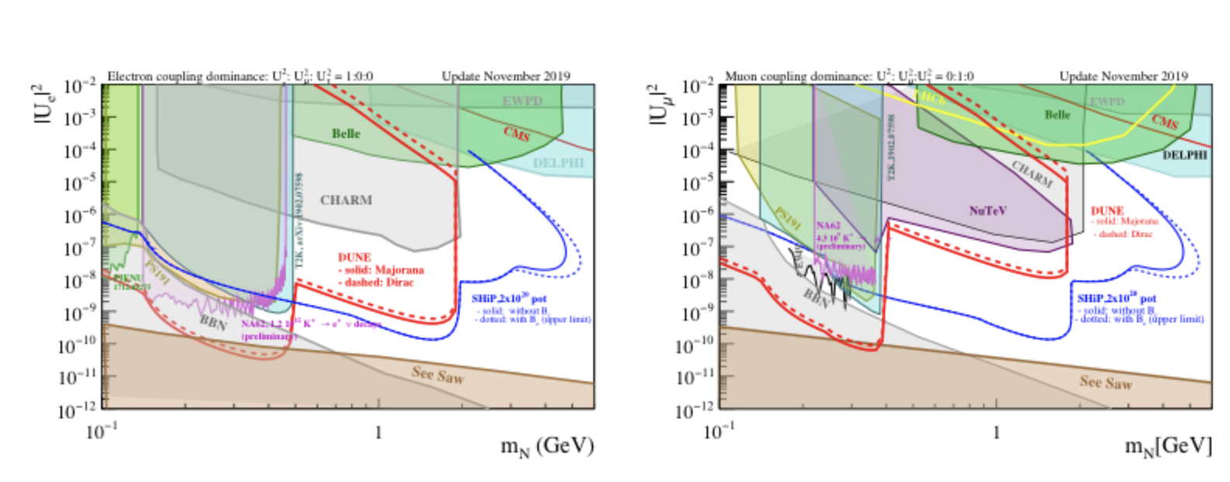

Slide 6
Background estimation from neutrino interactions in the near detector
A first production for neutrino interactions in the multi purpose detector (MPD) is available
High pressure gas TPC geometry (TPC + ECal + Magnet) + pseudo-reconstruction
Will start to estimate the backgrounds from neutrino interactions
ArgonCube simulation less clear, probably will still take some time
Starting with the MPD detector simulation

Slide 7
Next Steps
Improved kinematics: Cross checks between the different tools in preparation by the different groups. More discussion by Kevin and /or Enrique today
Agreed on a bench mark to test and compare. New flux files will be used by Haifa to check the sensitivity change.
Caveat: we need also to adapt the ND acceptance weight function in the flux files
Study of the backgrounds.
Expected effects of the different know channels, will be different for the LarTPC and the HPgTPC. Can we use TOF timing? (-> timing workshop last month)
Simulation studies
What is the status of the ND simulations? We can use MPD one and we will
look at that early next year
Other
Comparison MadrGraph/Genie formats
…

