Slide 1
MQXFA04 Structure & Shims Review
Introduction & Charge
Giorgio Ambrosio
Magnets L2
U.S. HL-LHC Accelerator Upgrade Project
MQXFA04 Structure & Shims Review
December 12, 2019

Slide 2
Outline
MQXFA Magnet documentation
Review Goals
Charge

Slide 3
MQXFA Magnet Functional Requirement Spec
Approved by CERN
Accepted by AUP
  EDMS# 1535430
  Updated to match the Acceptance Criteria approved by CERN before AUP CD-2/3b review
US-HiLumi-doc-36

Slide 4

Structural Design Criteria
Graded approach
Address use of materials with K_{1c} < 100
US-HiLumi-doc-909

Slide 5
Review of the MQXFAP2 Al- Shell Issue and Lessons Learned
Assessment of:
Understanding MQXFAP2 issue
Analysis method (FAD)
Margin

Slide 6

Review Goals
The HL-LHC AUP project is starting the assembly of MQXFA04 magnet. MQXFA04 is the second pre-series of the MQXFA low beta quadrupoles to be used in Q1 and Q3 for the High Luminosity LHC. If MQXFA04 meets MQXFA requirements [1] it will be used in the first Q1/Q3 cryo-assembly to be installed in the HL-LHC.
MQXFA04 coils were reviewed on October 30, 2019 [2].
MQXFA Functional Requirements Specification, US-HiLumi-doc-36.
Report of the MQXFA04 Coils Acceptance Review, US-HiLumi-doc-2432.
MQXFA03 pre-load targets and pre-loading sequence, US-HiLumi-doc-2496.
MQXFA Structural Design Criteria, US-HiLumi-doc-909.
MQXFA Magnet Interface Specification, US-HiLumi-doc-1674.
- Report of the Review of the MQXFAP2 Al-Shell Issue and Lessons Learned, US-HiLumi-doc-2192;
- MQXFA03 Structure & Loading Review, US-HiLumi-doc-2260.

Slide 7
Review Goals
MQXFA pre-load targets and pre-loading sequence for MQXFA03 and following magnets were approved by AUP Technical Board on July 5, 2019 [3].
The goal of this review is to evaluate the MQXFA04 structure and shim plan. The reviewers are requested to assess that the MQXFA04 structure meets the MQXFA Structural Design Criteria [4], that non-conformities have been adequately processed, and that structure and shims will allow MQXFA04 to meet MQXFA requirements [1].
MQXFA Functional Requirements Specification, US-HiLumi-doc-36.
Report of the MQXFA04 Coils Acceptance Review, US-HiLumi-doc-2432.
MQXFA03 pre-load targets and pre-loading sequence, US-HiLumi-doc-2496.
MQXFA Structural Design Criteria, US-HiLumi-doc-909.
MQXFA Magnet Interface Specification, US-HiLumi-doc-1674.
- Report of the Review of the MQXFAP2 Al-Shell Issue and Lessons Learned, US-HiLumi-doc-2192;
- MQXFA03 Structure & Loading Review, US-HiLumi-doc-2260.

Slide 8
CHARGE Questions
The committee is requested to answer the following questions:
Does the MQXFA04 structure meet the MQXFA Structural Design Criteria [4]?
Are there major non-conformities? If answer is yes, have they been adequately documented and processed?
Are the proposed shims adequate for allowing MQXFA04 to meet MQXFA requirements [1]?
Is MQXFA04 going to meet the MQXFA Interface Specification [5]?
Have all recommendations from previous relevant reviews [6] been adequately addressed?
Do you have any other comment or recommendation to assure MQXFA04 is going to meet requirements?
MQXFA Functional Requirements Specification, US-HiLumi-doc-36.
Report of the MQXFA04 Coils Acceptance Review, US-HiLumi-doc-2432.
MQXFA03 pre-load targets and pre-loading sequence, US-HiLumi-doc-2496.
MQXFA Structural Design Criteria, US-HiLumi-doc-909.
MQXFA Magnet Interface Specification, US-HiLumi-doc-1674.
- Report of the Review of the MQXFAP2 Al-Shell Issue and Lessons Learned, US-HiLumi-doc-2192;
- MQXFA03 Structure & Loading Review, US-HiLumi-doc-2260.

Slide 9
Schedule
Today:
  Talks
  Q&A
Following days:
  Closed session(s) by Zoom or phone calls
Report by email or Zoom mtg
  By January 3rd

Slide 10
Back up Slides

Slide 11
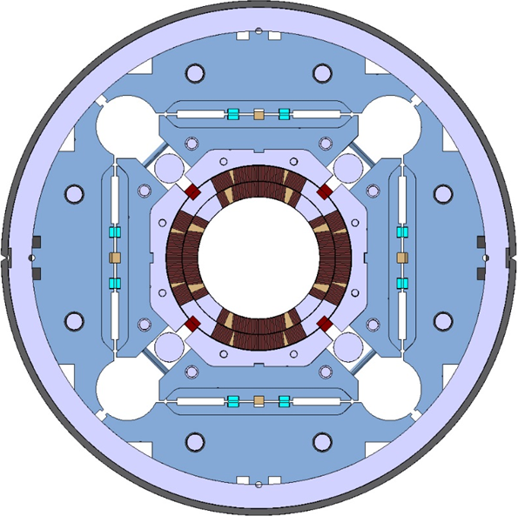
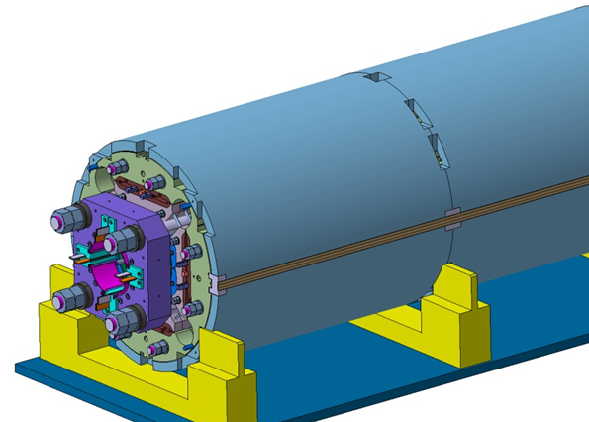
MQXFA/B Main Parameters
Parameter | Unit | MQXFA/B
Coil aperture | mm | 150
Magnetic length | m | 4.2/7.15
N. of layers |  | 2
N. of turns Inner-Outer layer |  | 22-28
Operation temperature | K | 1.9
Nominal gradient | T/m | 132.6
Nominal current | kA | 16.5
Peak field at nom. current | T | 11.4
Stored energy at nom. curr. | MJ/m | 1.2
Diff. inductance | mH/m | 8.2
Strand diameter | mm | 0.85
Strand number |  | 40
Cable width | mm | 18.15
Cable mid thickness | mm | 1.525
Keystone angle |  | 0.4
P. Ferracin et al., “Development of MQXF, the Nb₃Sn Low-β Quadrupole for the HiLumi LHC ” IEEE Trans App. Supercond. Vol. 26, no. 4, 4000207
G. Ambrosio et al., “MQXFS1 Quadrupole Design Report” LARP DocDB 1074

Slide 12
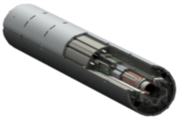
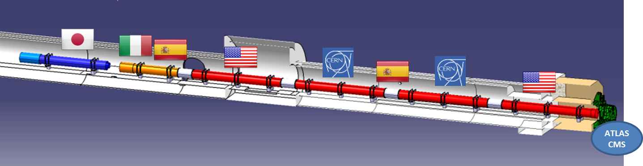
US Contribution to HL-LHC Inner Triplets
10 Q1/Q3 Cryo-assemblies
  20 Magnets (MQXFA) with 4.2 m magnetic length
  Two magnets in each cold mass
Q2 cold masses by CERN
  Magnetic length: 7.15 m (MQXFB)
Magnet
(MQXFA)
US cold mass

