Slide 1
Magnet Fabrication Travelers, Non-Conformities and Resolution
Katherine Ray – LBNL (QA)
Mike Solis – LBNL (Procurement Technical Contact)
December 12, 2019 – MQXFA04 Structure and Loading Review

Slide 2
Overview
State of the Magnet Fabrication Travelers
Part Inspection Plan
Non-Conformances on MQXFA04

Slide 3
Magnet Fabrication Travelers Overview
# | Title | Revision | ID
1 | Coil Acceptance WI | A | SU-1011-5294
2 | Yoke Pre-Stack WI | B | SU-1008-8072
3 | Yoke Half Stack WI | C | SU-1009-7829
4 | Shell Instrumentation WI | C | SU-1009-3745
5 | Shell-Yoke Assy WI | B | SU-1008-2169
6 | Loadpad Pre-Stack WI | B | SU-1008-8075
7 | Dressed Coil WI | D | SU-1008-8073
8 | Pad-Collar Assy WI | A | SU-1010-1610
9 | Coil Pack Subassy WI | B | SU-1008-8074
10 | Magnet Electrical QA at LBNL | C | SU-1010-1903
11 | Magnetic Measurements | Not released | SU-1010-2018
12 | Integration and Loading WI (based on 2 other WI, both @ Rev B) | Not released | SU-1011-5294
13 | Axial Rods Instrumented WI | B | SU-1008-8069
14 | Splice Box WI | A | SU-1008-8067
15 | Magnet Shipping WI | A | SU-1011-3284

Slide 4
Magnet Fabrication Travelers Overview
# | Title | Revision | ID
1 | Coil Acceptance WI | A | SU-1011-5294
2 | Yoke Pre-Stack WI | B | SU-1008-8072
3 | Yoke Half Stack WI | C | SU-1009-7829
4 | Shell Instrumentation WI | C | SU-1009-3745
5 | Shell-Yoke Assy WI | B | SU-1008-2169
6 | Loadpad Pre-Stack WI | B | SU-1008-8075
7 | Dressed Coil WI | D | SU-1008-8073
8 | Pad-Collar Assy WI | A | SU-1010-1610
9 | Coil Pack Subassy WI | B | SU-1008-8074
10 | Magnet Electrical QA at LBNL | C | SU-1010-1903
11 | Magnetic Measurements | Not released | SU-1010-2018
12 | Integration and Loading WI (based on 2 other WI, both @ Rev B) | Not released | SU-1011-5294
13 | Axial Rods Instrumented WI | B | SU-1008-8069
14 | Splice Box WI | A | SU-1008-8067
15 | Magnet Shipping WI | A | SU-1011-3284
Lessons Learned from A03 have been integrated into the first 10 travelers.
We are working on the next 5 travelers now.

Slide 5
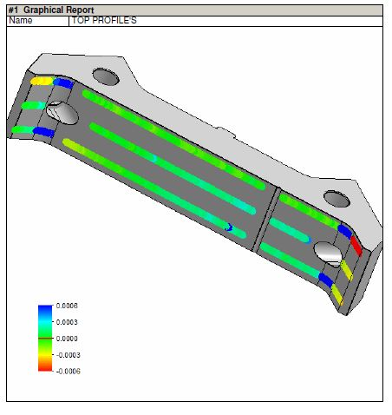
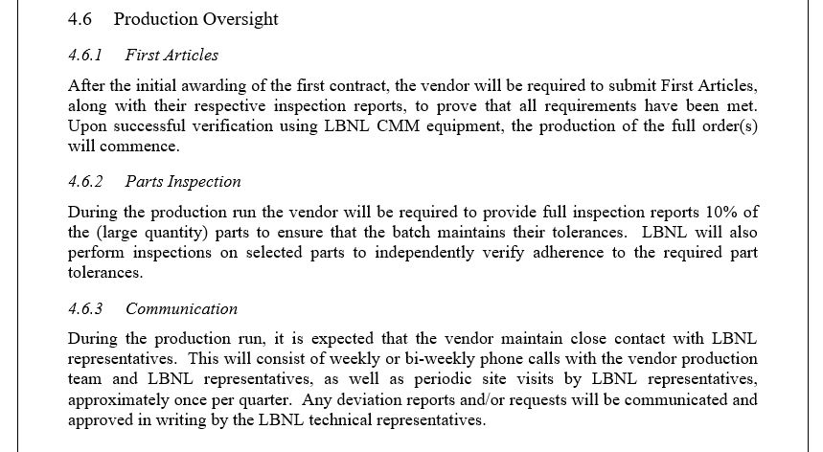
Part Inspection Plans
Our overall inspection plan is set out in the Advanced Acquisition Plan (docDB #962)
Includes first article inspection, 10% inspection of yokes/loadpads/collars, inspection at LBNL

Slide 6
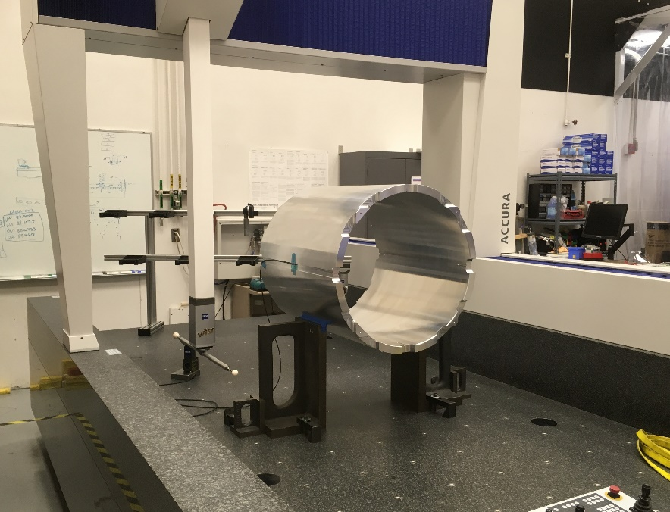
Shell Inspection Plans
100% of shells are inspected both at the vendor and at LBNL
Fluourescent (Dye) Penetrant Inspection (FPI) required
Ultrasonic inspection to class AA required

Slide 7
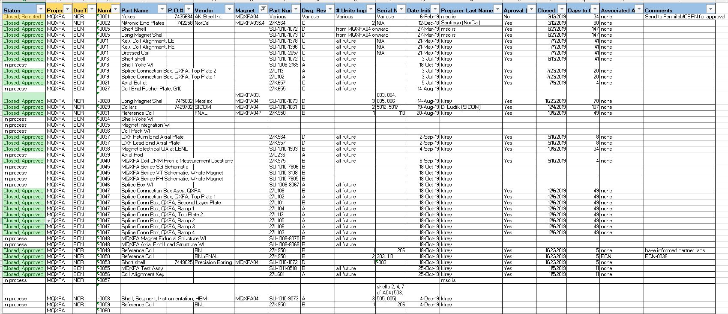
Change Records
We are tracking Non-Conformances, Deviations and Engineering Changes in one spreadsheet
These are currently communicated to Fermilab L2 on a monthly basis

Slide 8
MQXFA04 Change Records
The NCRs on A04 thus far include:
(#28) Ultrasonic testing to grade A instead of AA for 3 long shells
(#29) Wrong serial number on 2 collars
(#31) Coil 113 had a short (retested and passed)
(#49, 59) Coil 206 shifted during shipment, then saw a bubble under the GPI (passed electrical tests)
(#50) 203 and 113 were hipoted to 4600V instead of 3680V
(#53) Short shell -003 had a 0.006” deep, ¼” long gouge in it
(#58) Shell strain gauges wires were swapped (wrong length)

Slide 9
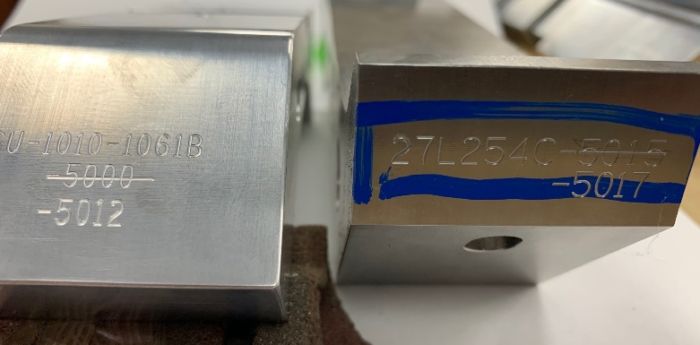
MQXFA04 Change Records
The NCRs on A04 thus far include:
(#28) Ultrasonic testing to grade A instead of AA for 3 long shells
(#29) Wrong serial number on 2 collars
(#31) Coil 113 had a short (retested and passed)
(#49, 59) Coil 206 shifted during shipment, then saw a bubble under the GPI (passed electrical tests)
(#50) 203 and 113 were hipoted to 4600V instead of 3680V
(#53) Short shell -003 had a 0.006” deep, ¼” long gouge in it
(#58) Shell strain gauges wires were swapped (wrong length)
Discussed during Coil Selection
Indico Pages:
https://indico.fnal.gov/event/22009/
https://indico.fnal.gov/event/22526/
https://indico.fnal.gov/event/22659/
Rewired

Slide 10
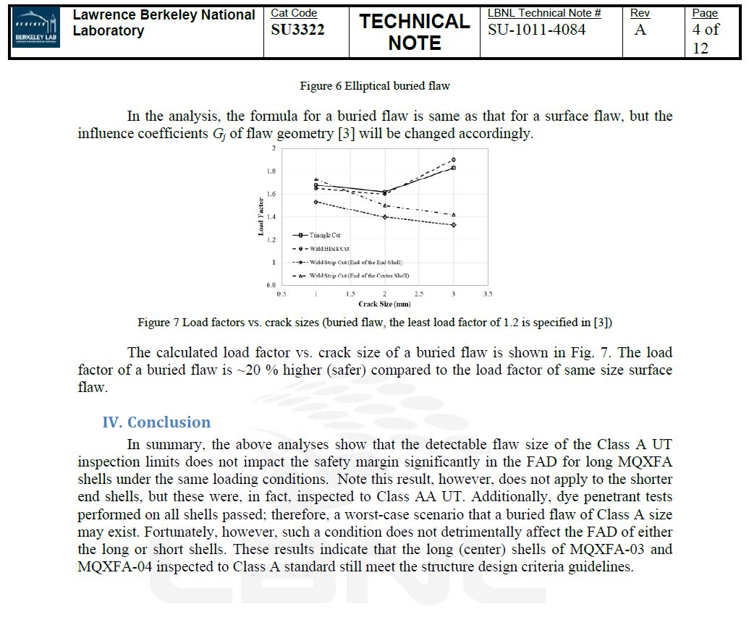
NCR-0028, Ultrasonic testing to Grade A
Ultrasonic testing was only performed to Grade A, not AA (3mm flaw, not 2mm)
Performed analysis available in Tech Note SU-1011-4084
Analysis showed the shells still meet the design criteria
Approved by L2
Have communicated with vendor so that future shells will be tested to Grade AA

Slide 11
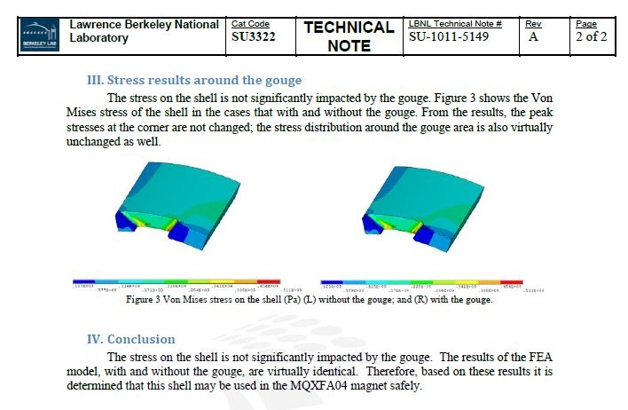
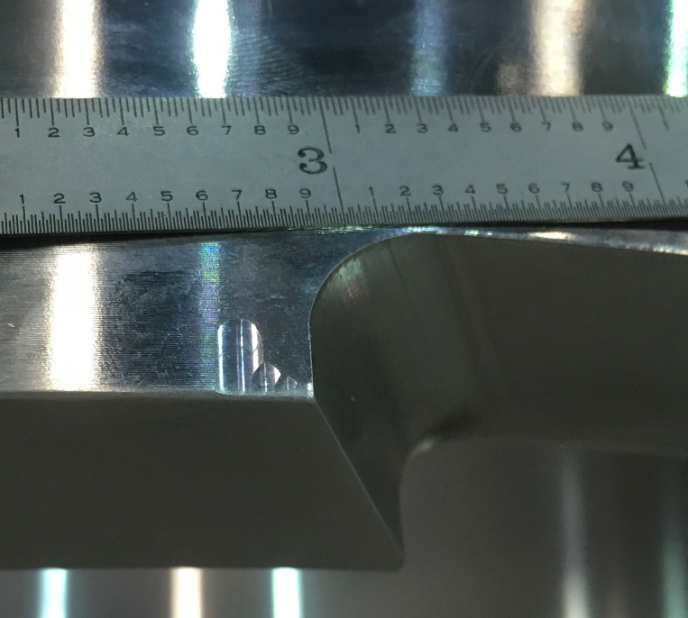
NCR-0053, Gouge in Shell
The 0.006” x 0.125” x 0.25” gouge was modeled.
Analysis available in Tech Note SU-1011-5149
The stress on the shell is not significantly impacted by the gouge, and the shell was accepted at the L2 level

Slide 12
Summary
The travelers continue to be updated with Lessons Learned from the A03 magnet
We are following a part inspection plan that includes full inspection of the shells and 10% inspection of the laminations
There were 2 possible issues with the A04 shells which were analyzed and determined to be acceptable

