Slide 1
Ionization Laser Update
Laser WG meeting 12/12/2019
Jan Boissevain - LANL

Slide 2
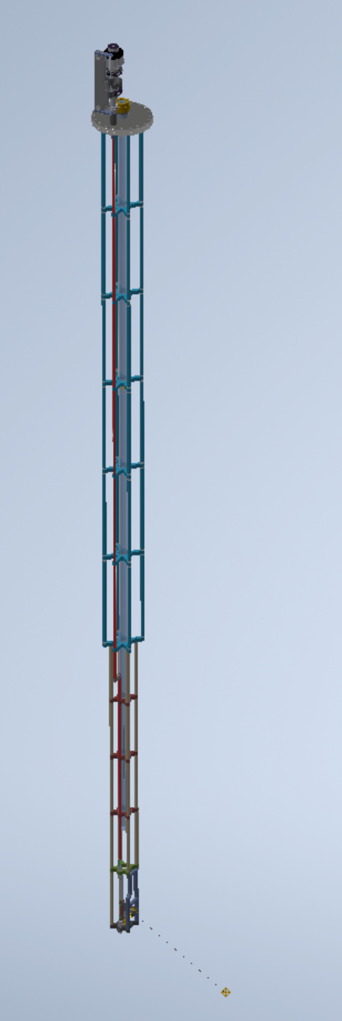
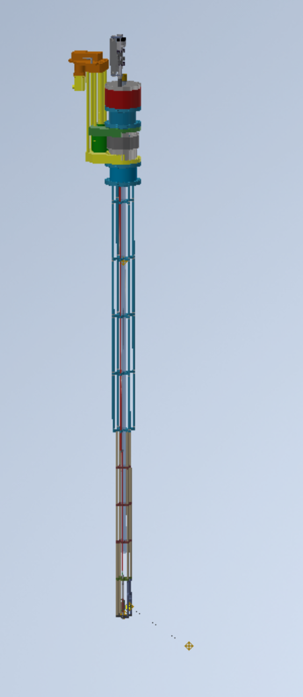
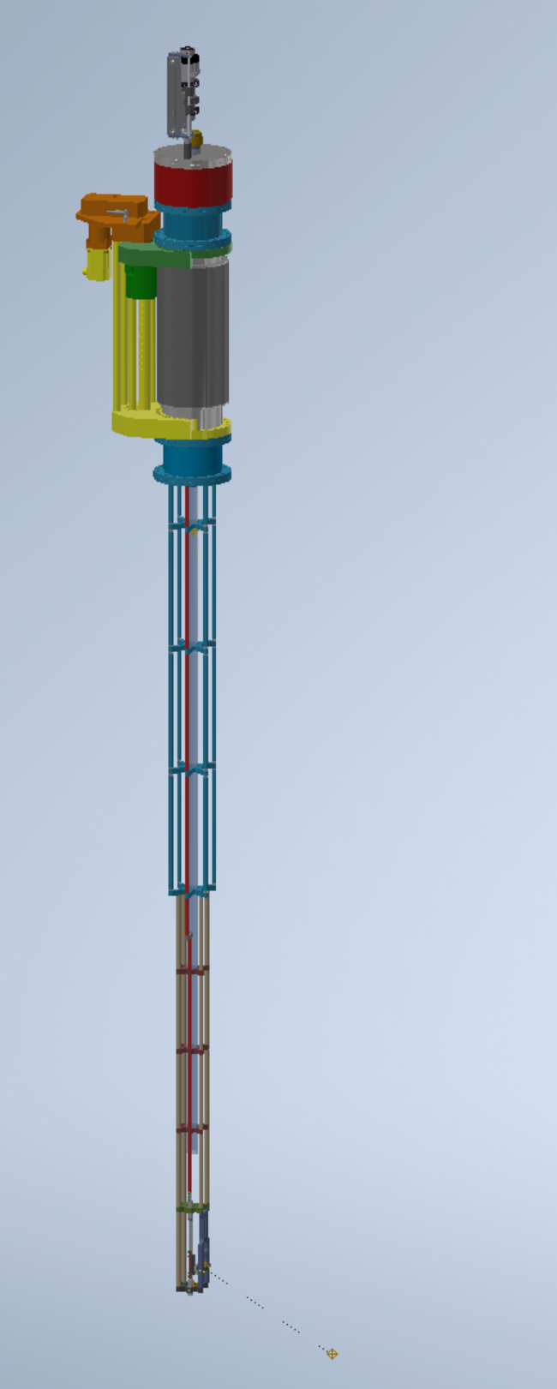
Laser Periscope
Laser Periscope w translation and rotation
Rotation module placeholder – in discussions with Ferrotec
Candidate translation module (UHV Design HLSM150-300) shown fully compressed
3m
Candidate translation module shown fully extended (300mm travel)
SS Support Structure

Slide 3
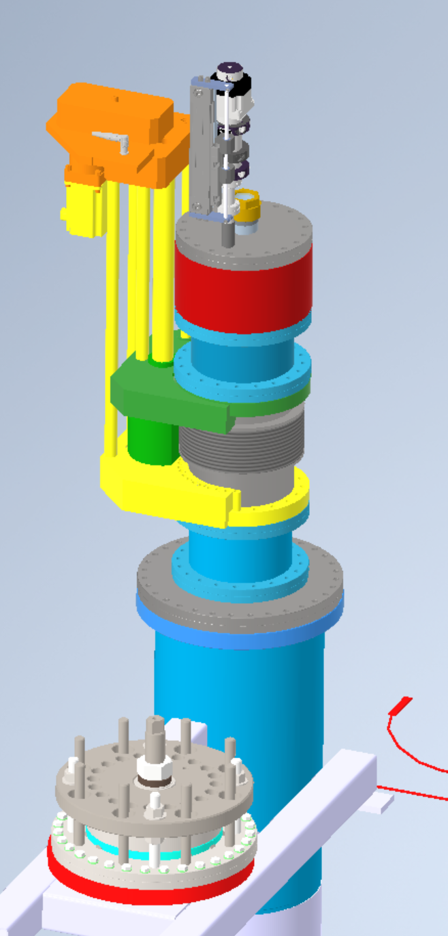
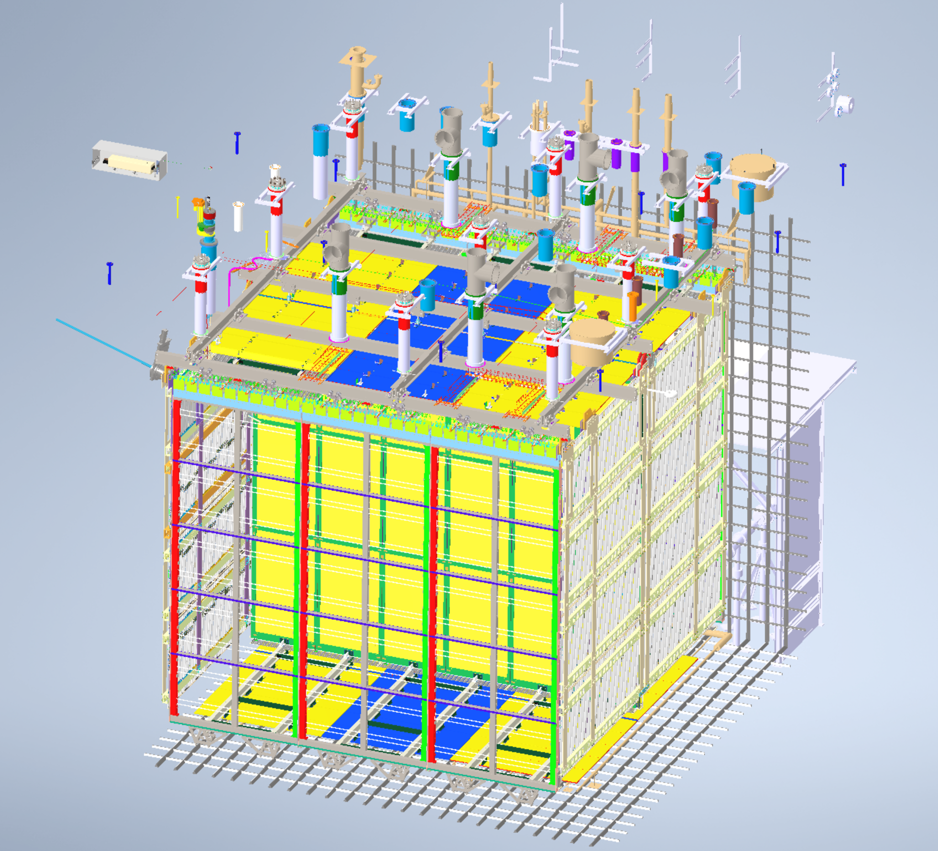
Laser
Laser Periscope
Linear Translation Module shown in compressed position

Slide 4
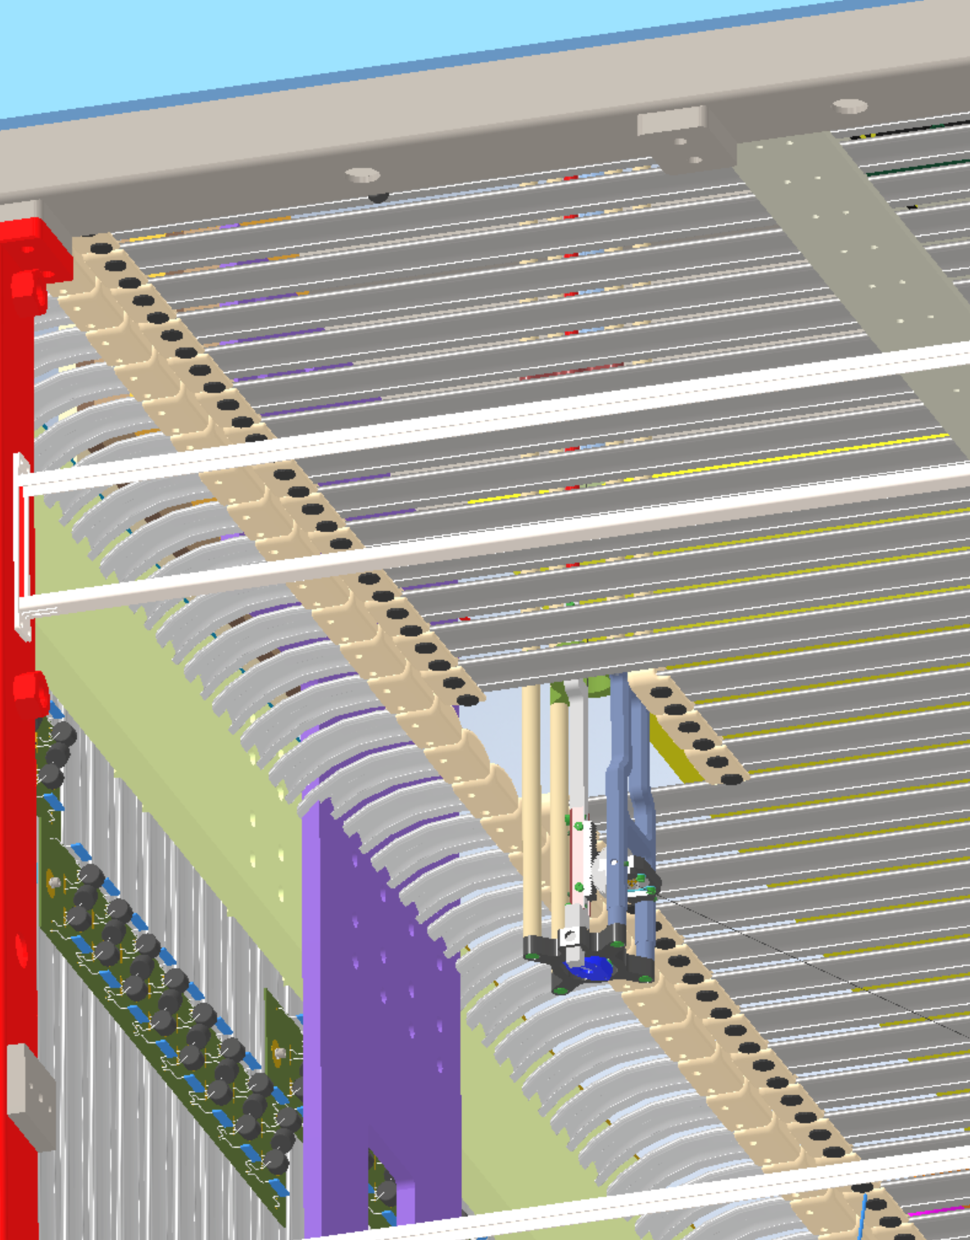
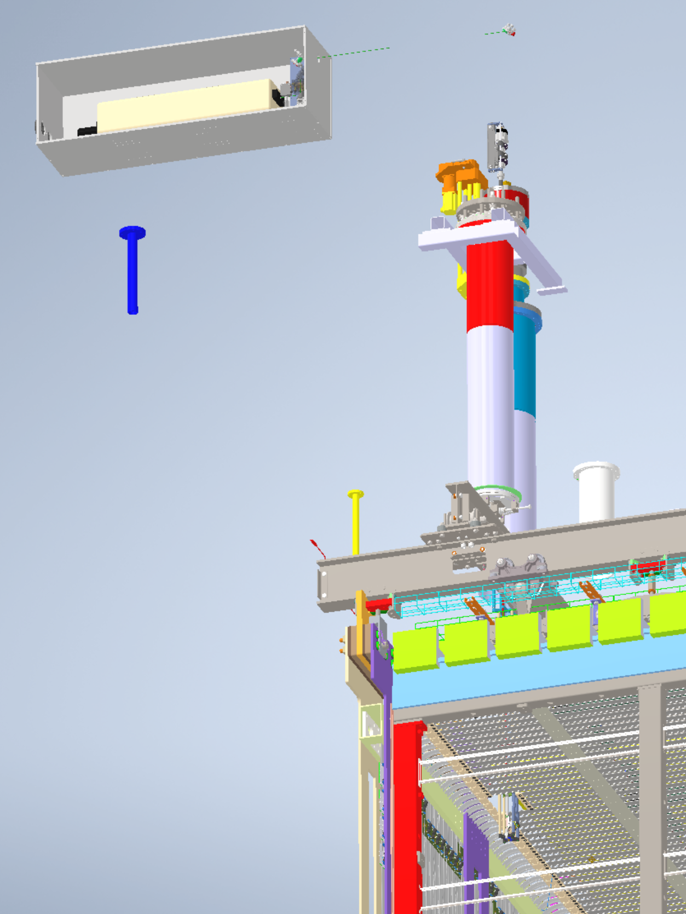
Laser Periscope shown in deployed position

Slide 5
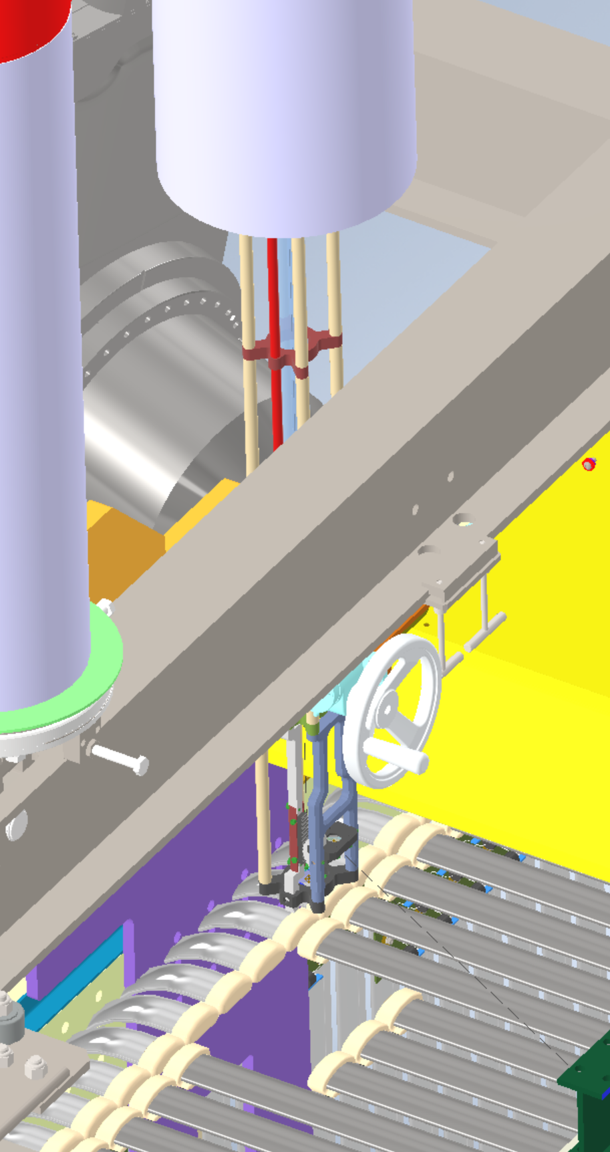
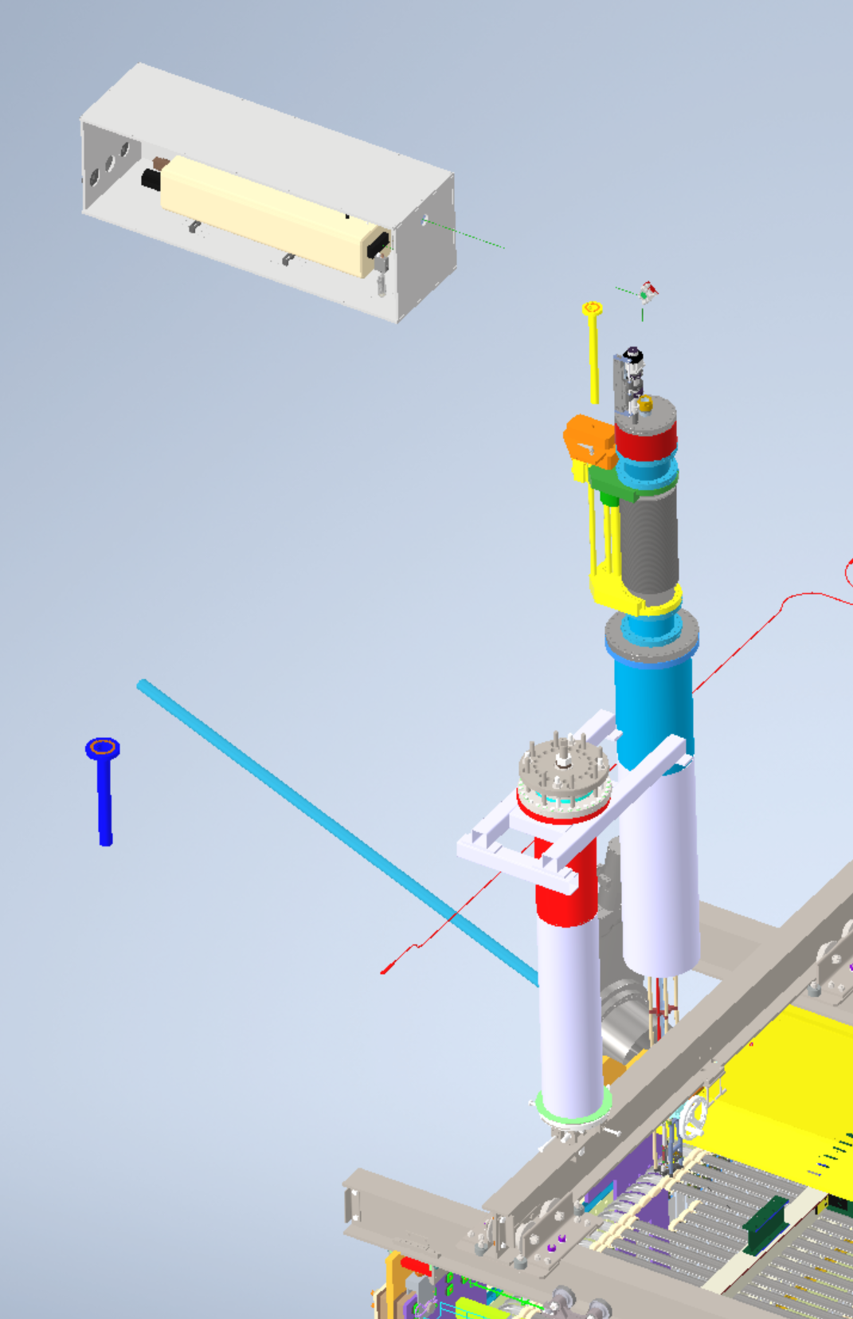
Laser Periscope in retracted position

Slide 6
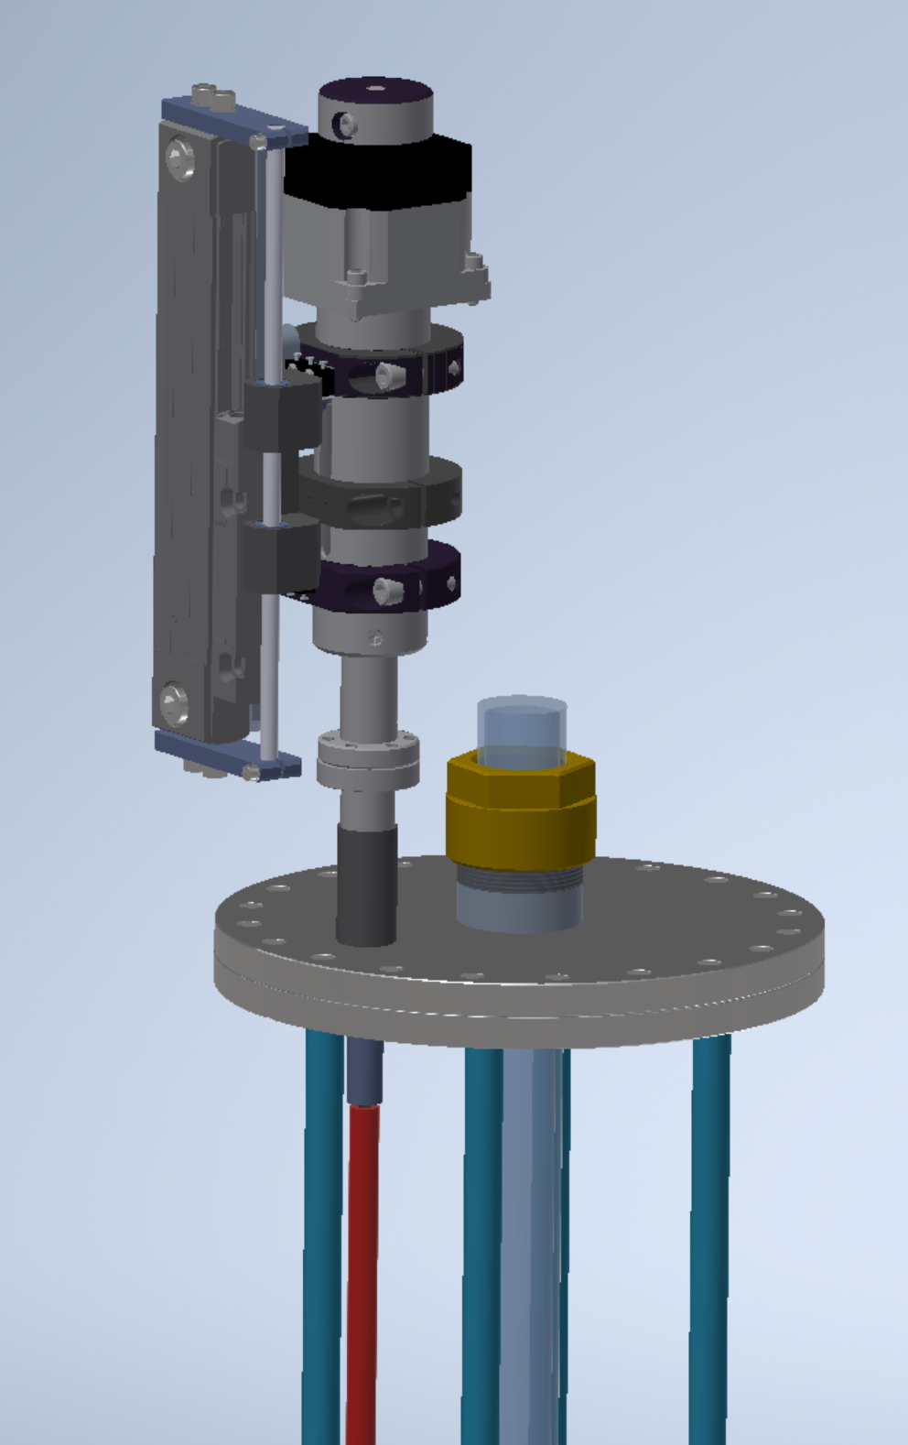
Linear Actuator for mirror
8” OD Conflat Flange
Mirror Actuator Tube

Slide 7
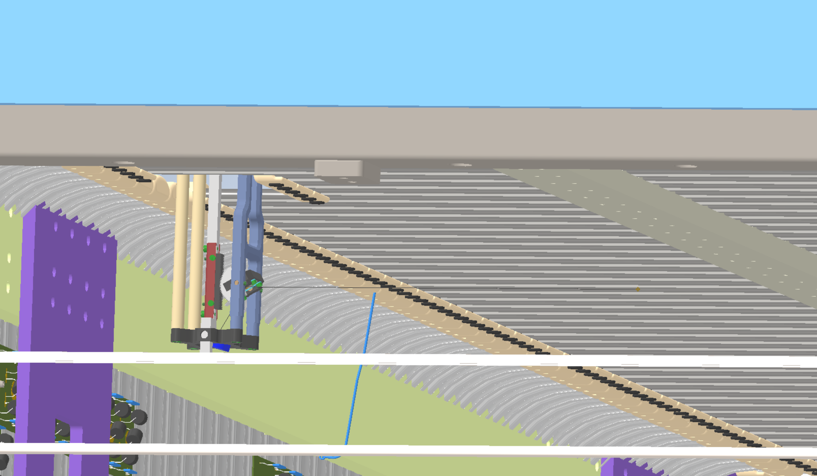
60mm
Horizontal laser vector

