Slide 1
Updated Single Phase Profile Divider Design
Cristobal Garces
UTA HEP
Dec. 17, 2019

Slide 2
Profile Divider
Purpose of the divider is to separate the aluminum profiles during assembly.
Divider must not damage the profiles during assembly.
Divider must also minimally interfere with the profiles during lifting.

Slide 3
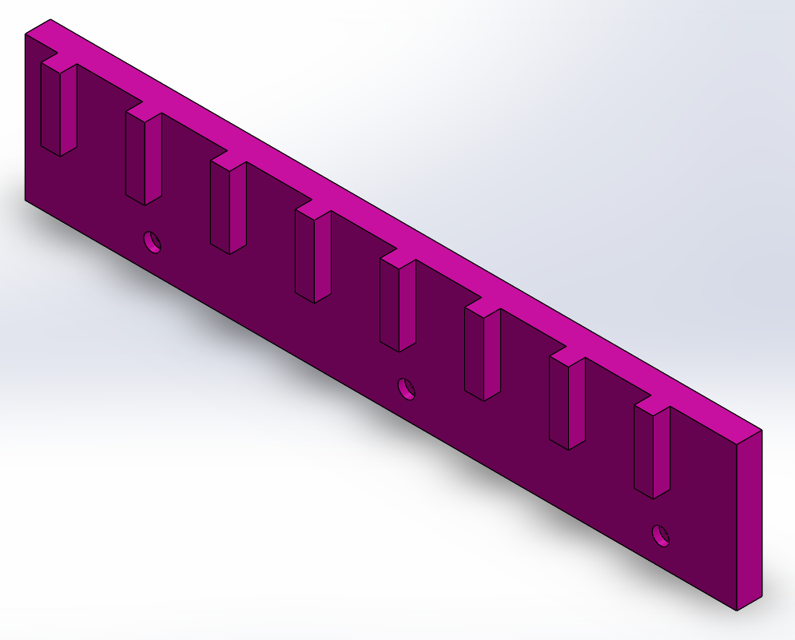
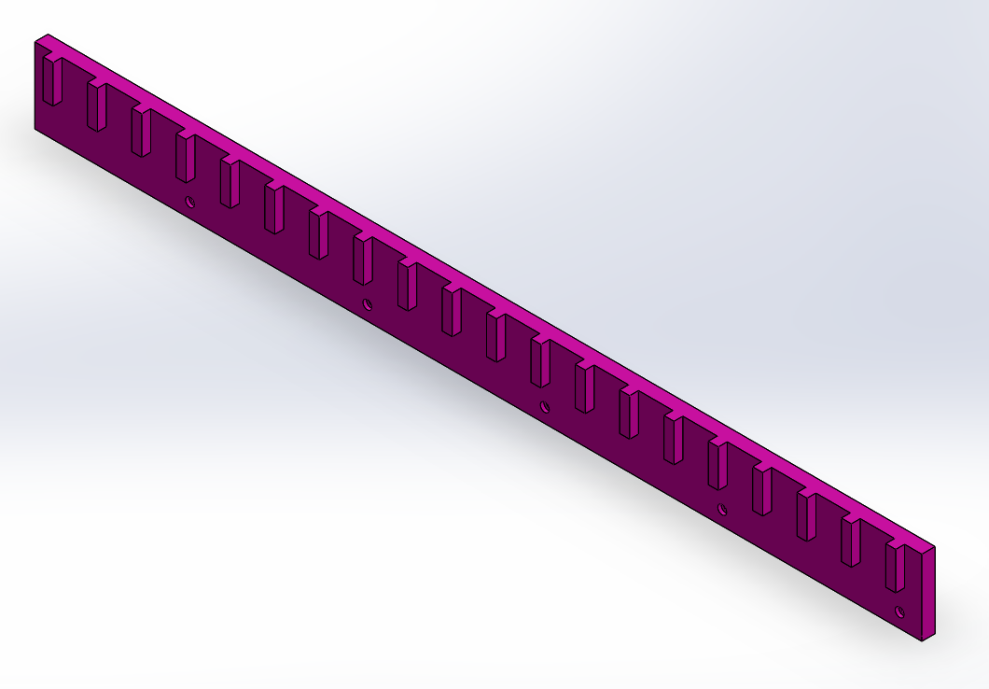
Previous Profile Dividers

Slide 4
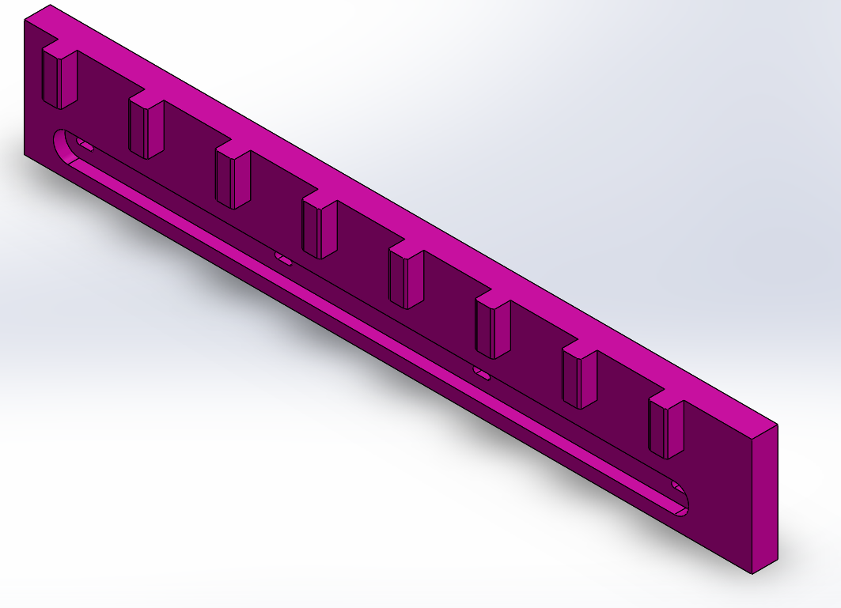
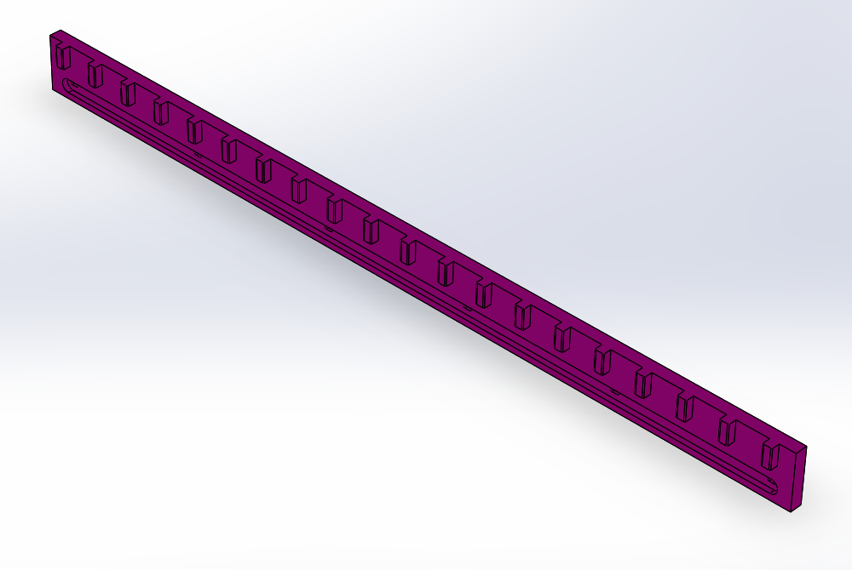
Updated Profile Dividers

Slide 5
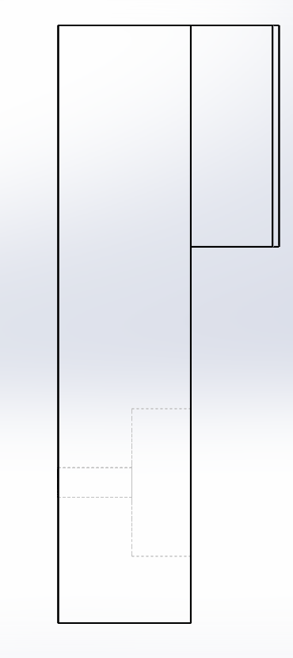
Updated Design
One row has one short divider and two long dividers.
Blind holes replaced with a slot across entire length of the divider.
A large steel plate will be inserted into the slot.
Screw holes are now also slots.
Teeth length has been reduced by 2 cm.
Teeth are now chamfered to allow release of profiles without resistance during lifting.

Slide 6
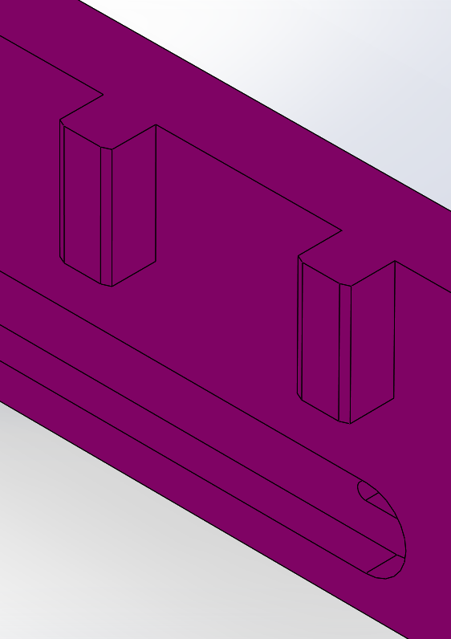
Chamfer on Teeth

Slide 7
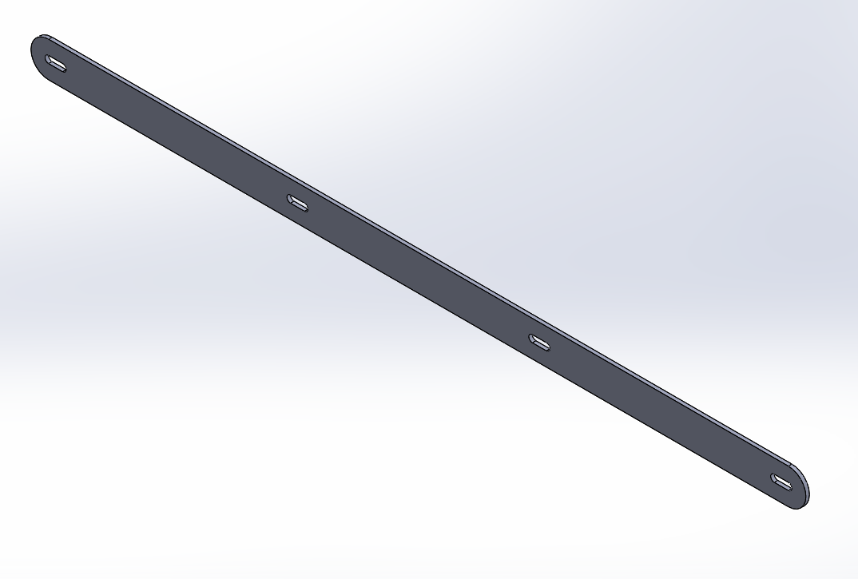
Pinning Plate
2 mm stainless steel plate designed to fit inside slot.
Slots are coincident to the slots on the divider.
Purpose is to assist in holding the divider in place.

Slide 8
