Slide 1
Compact SRF Accelerator Status
Michael Geelhoed

Slide 2
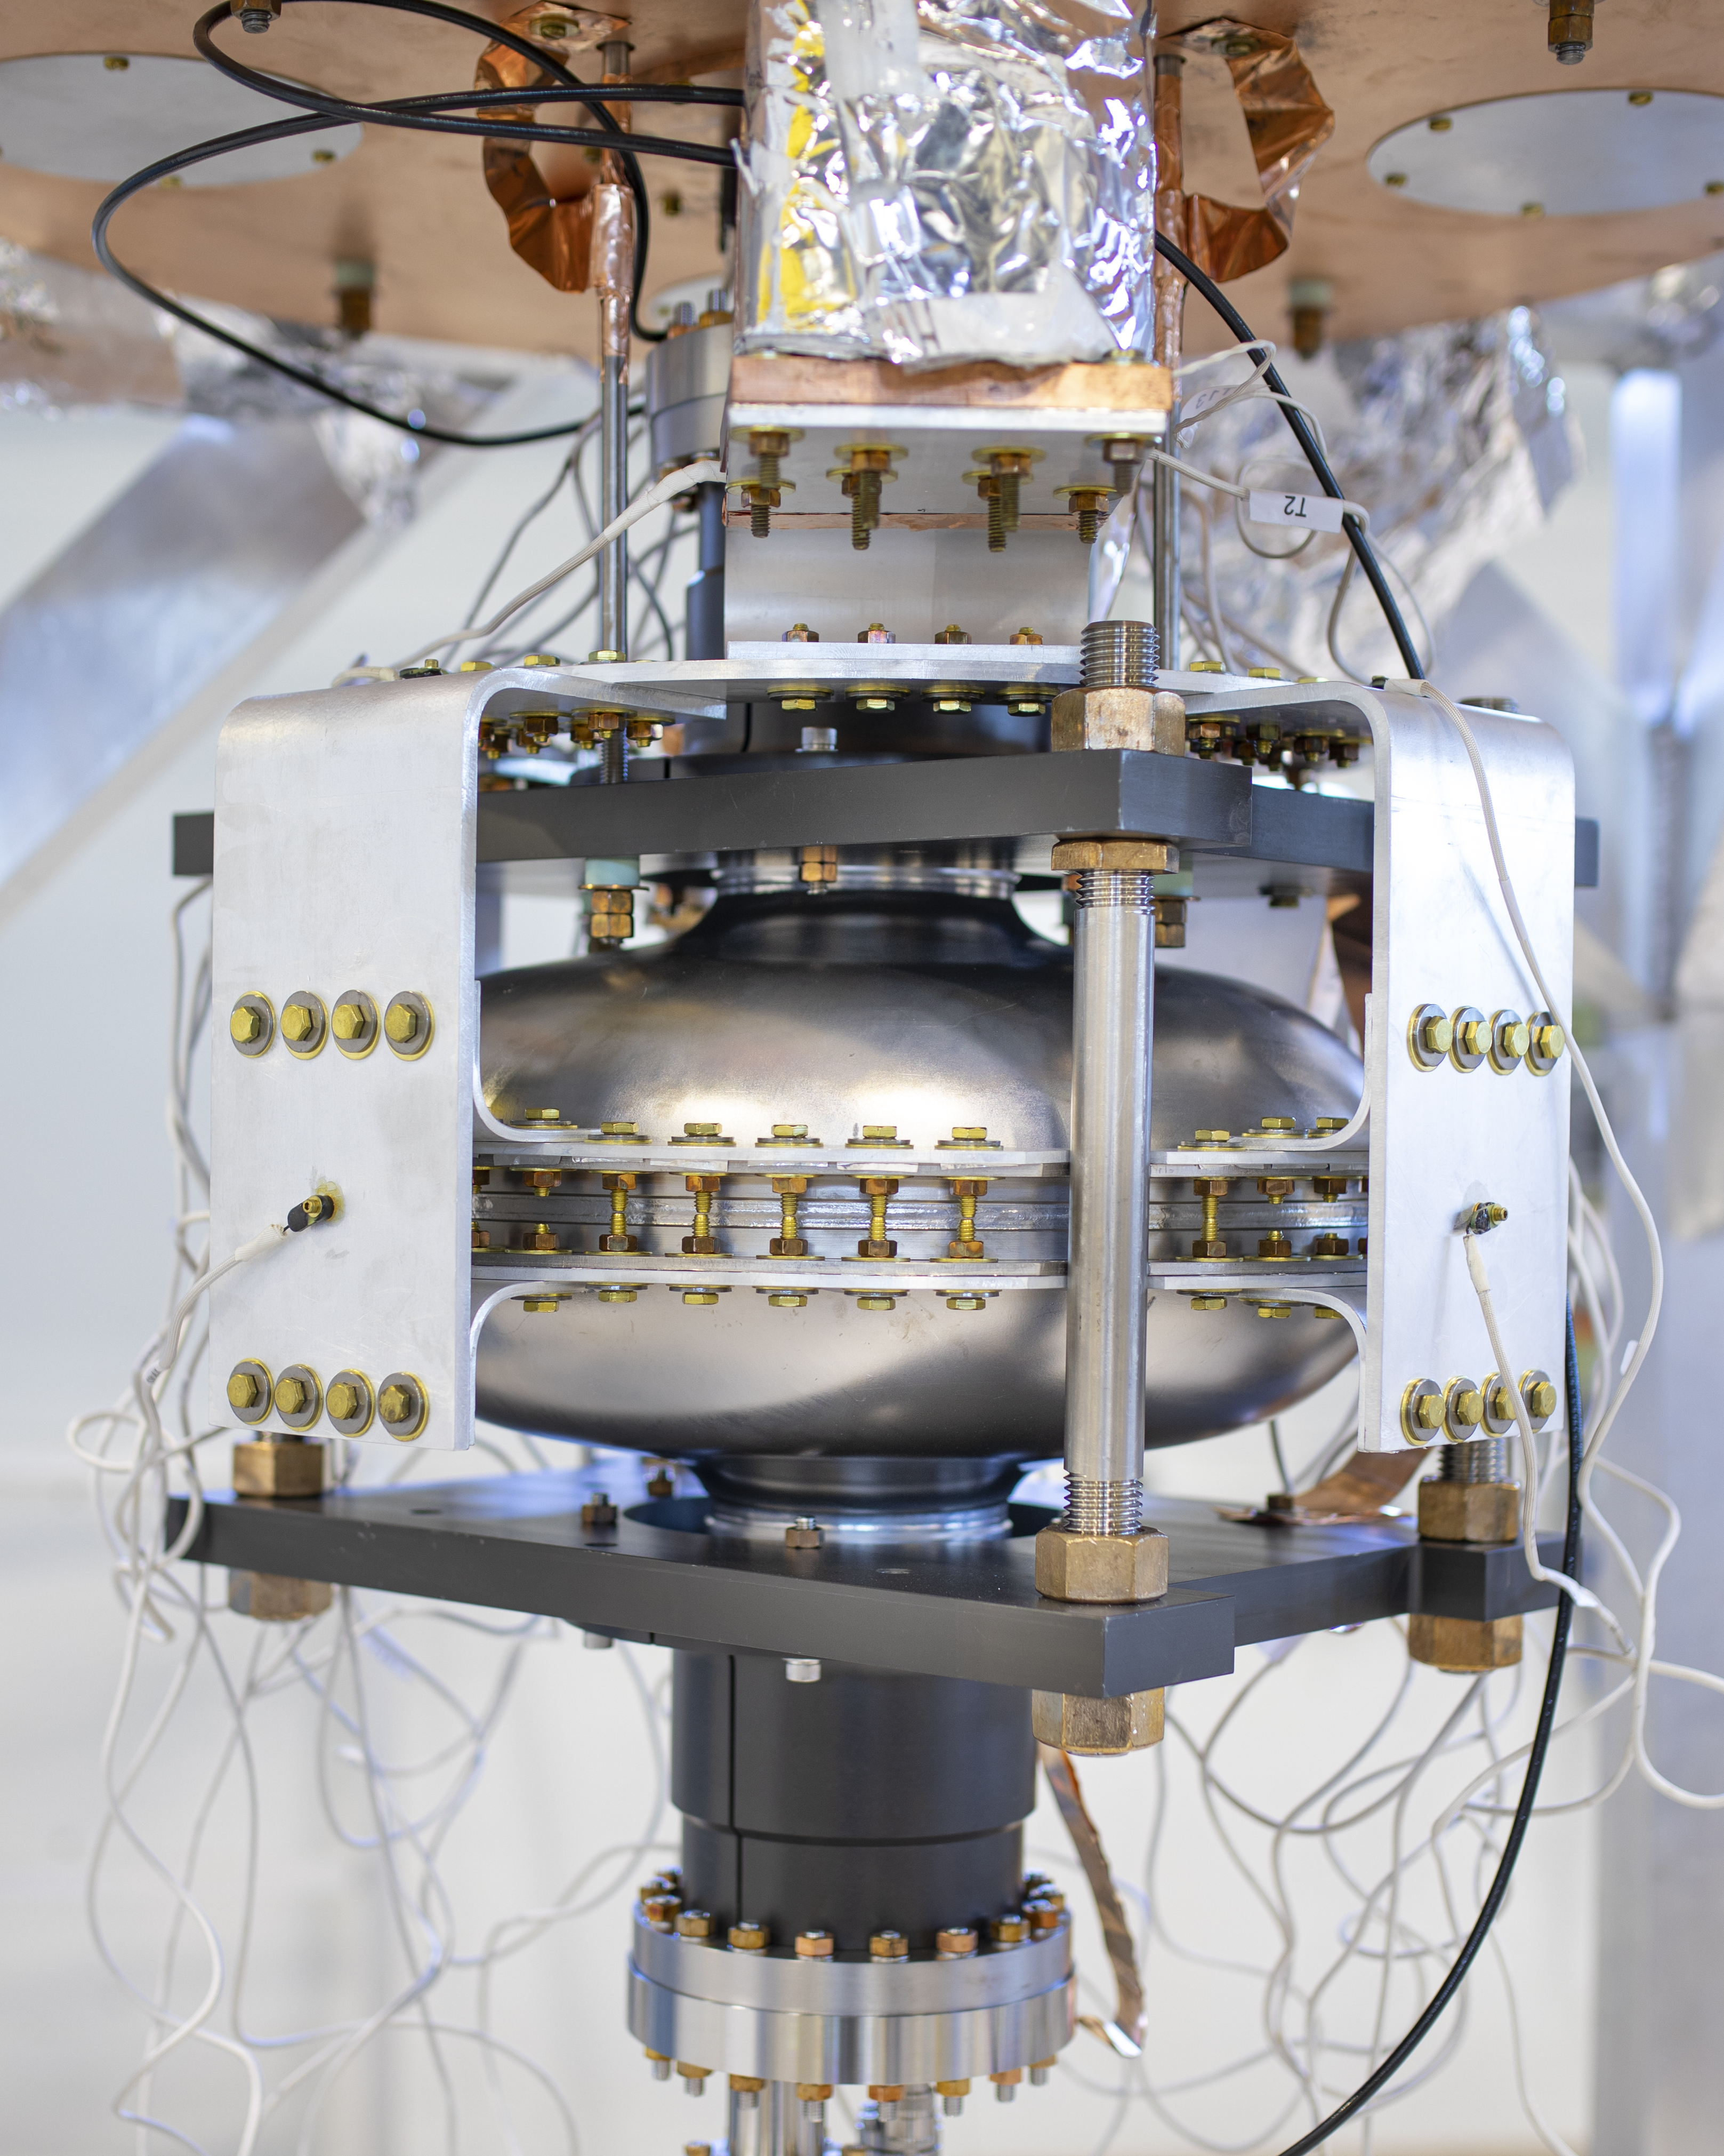
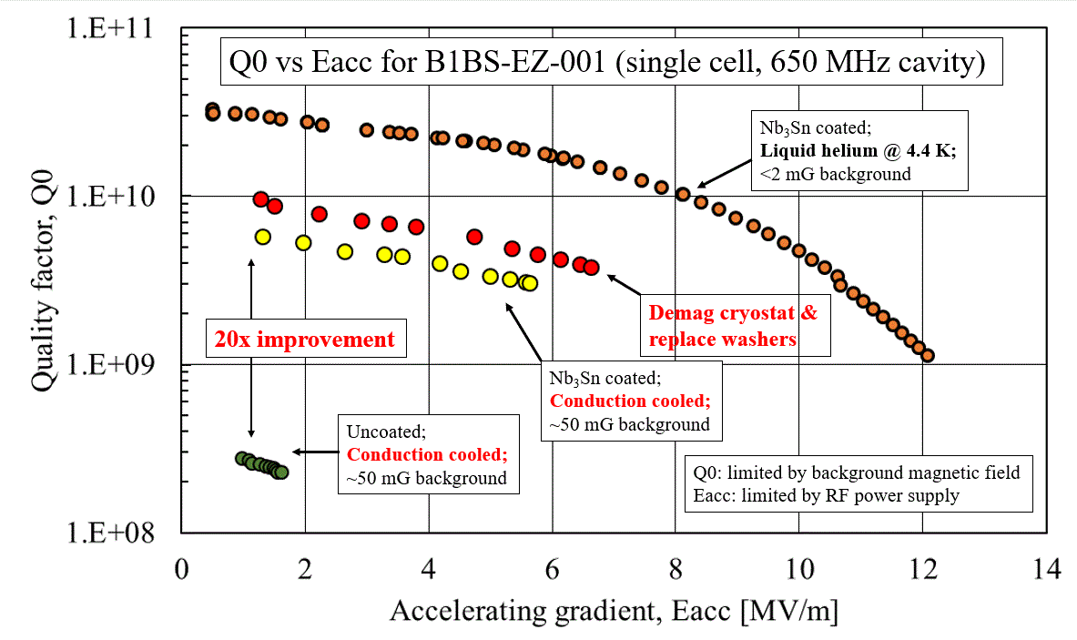
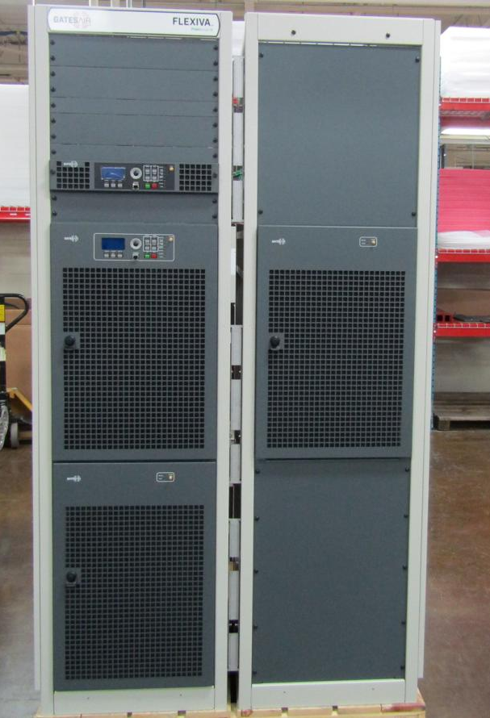
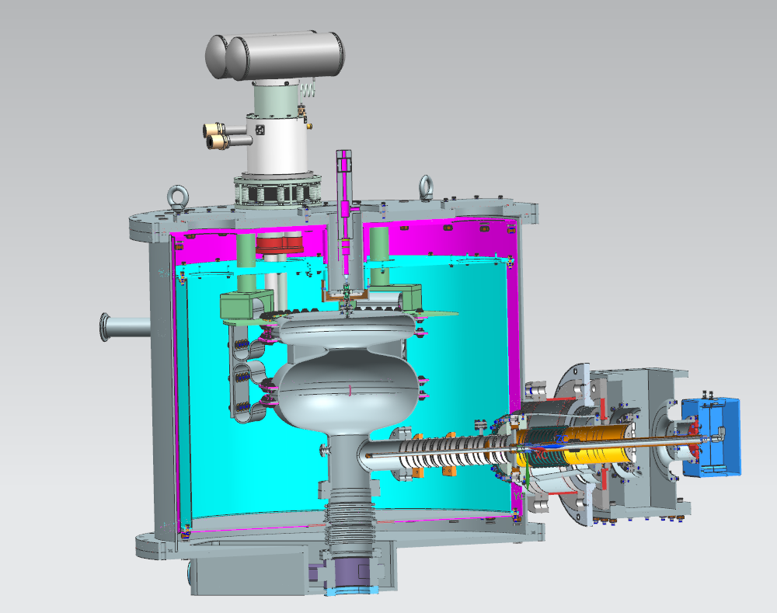
Accelerator High Level Progress
Experimental Setup and Year 1 Results
Capital Assets
20 kW RF Power Source
Cryo Coolers
Raw Nb Material for 1.5 cell
 | Spent | Need
M&S | ~$1M | $1.4M
Labor | $0.8M | $1.3M
}
~$3M
over 2 yrs

Slide 3
Accelerator Subsystems Labor
Sub system | Status | Direct Cost ($k) | $ Amount for the knowns
Coupler | Defined PIP-II style coupler will work for dissipated heat load | 22.3 | $20k Air/Vac Couplers Testing
RF Power | RF Source 20 kW purchase review process | 6 | $50k Circulator & Waveguide Assembly
Cryocooler & Cryostat | Preliminary design of VJ, MS, and TS for Cryostat | 105 | $10k Assembly Cryostat
Gun | Integration of Gun with cavity & cryomodule | 126 | $30k SRF Gun Testing
SRF Cavity | Design of 1.5 cell complete | 48.8 | $250k for Chemical Processing $20k IB1 VTS
Nb₃Sn | ECA funds progressing Found Coating “Recipe” | 117.7 | $150k Coating $20k IB1 VTS
LLRF & Interlocks | N/A | 0.00 | $50k Interlock Programming
Integration | Preliminary design of VTS Testing to be completed at HAB | 5.4 | $75k Assembly
$431.2k $675k

Slide 4
Accelerator Subsystems M&S
Sub system | Status | Direct Cost ($k) | $ Amount for the knowns
Coupler | Ready for PIP-II style Coupler 2 Sides Air/Vac | 0.0 | $65k for a set of Air/Vac Couplers
RF Power | RF Source 20 kW purchase Still requires Circulator, Coaxial Cable, etc. | 167.7 (+196.5) | $100k for circulator $50k for Misc RF Components (waveguide)
Cryocooler & Cryostat | 3 PT420s available on site | 126.7 | $160k Design $150k Procurement
Gun | Heatwave PO for fabrication of Cathode Grid | 83.2 | $110k to Heat Wave
SRF Cavity | Nb material procured for 1.5 cell fabrication | 98.3 | $150k for manufacturing $20k for additional Nb
Nb₃Sn | Cradle and Fork Completed Found “Recipe” via IB1 VTS | 82.5 | $6k cradle for coating $25k for IB1 VTS Hardware
LLRF & Interlocks | In hand Euclid 650 MHz LLRF | 0.0 | $150k for Interlocks
Integration | Electrical plugs and hardware for CC & RF Source | 10.0 | $50k for Platform $20k Hardware
$764.9k $1.056M

Slide 5
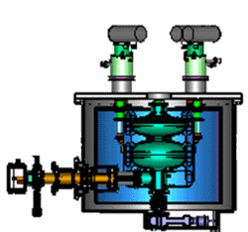
Accelerator Actual Parameters for Prototype
Parameter | Value
Cells | 1.5
Amps | 12.5 mA
Voltage | 1.6 MeV
Power | 20 kW
RF | CW
Material | Nb₃Sn Coated Cavity

