Slide 1
FEA of NuMI Megawatt Decay Pipe US Window and Beam Absorber
Yun He, present Zhijing Tang’s FEA work
TSD Topical Meeting
Dec. 19, 2019

Slide 2
Outline
Decay pipe upstream window
  by Zhijing Tang
Hadron beam absorber
  by Zhijing Tang
Target downstream Be window
  by Kavin Ammigan
  previously presented at NBI 2019 in Oct. 24, 2019

Slide 3
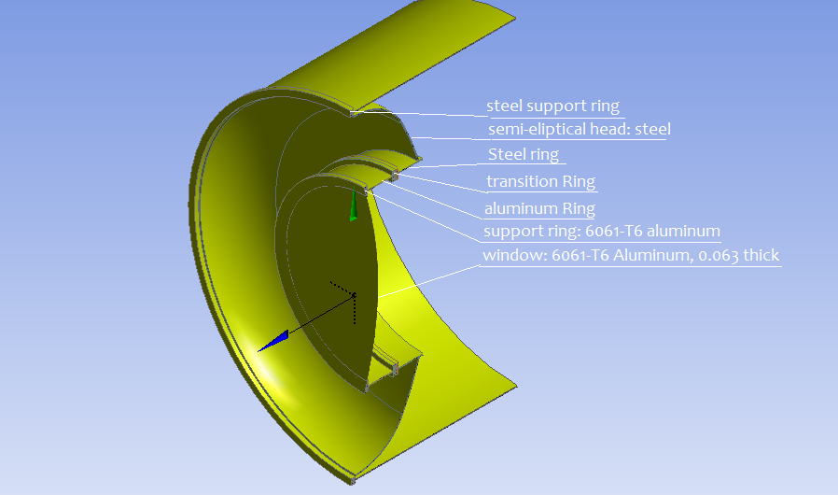
Decay Pipe Upstream Window
Evaluate possible solutions in event window needs to be repaired
Repair mechanism concept developed
A patch scheme was proposed in case the window fails. Weld repair patch (Al 5083 or 5052) over failed section (Al 6061) Repair mechanism concept developed (by Mike Campbell) Robot laser ablation welding testing Samples, welding, testing & characterize properties recommended Al 5086 for the repair patch material, which provides a good welding quality and the 1/16” thickness is commercially available. FEA thermo-structural analysis
Suspected corrosion was found on the window at beam spot center in 2007
Since then, decay pipe was filled helium gas
Boundary conditions
Outside is air of 1 atmospheric pressure and inside is helium with 0.9 atmospheric pressure.
Both sides have 5 W/m²-C film coefficient for natural convection cooling.
Assuming ambient temperature of 22C.

Slide 4
Decay Pipe Patched Window FEA
This work used the new set of MARS data that Igor has provided, with the following changes in the model (compared to the FEA work that Zhijing Tang did in Feb. 2018):
Target core with 4 winged fins at upstream;
With target DS Be window cooling loop/water in the model;
Decay pipe window repair patch (Al 5086).
Two set of data were provided:
Beam normal 1 MW operation;
Beam 6 mm-off center accidental condition
Here are the complete MARS data, images, notes
If it works for patched window, it will also work for the original window, because aluminum 6061 has better thermal conductivity than Al 5086 (125 W/m-C) (167 W/m-C for Al 6061)
Conclusions: temperature, displacement and stress all look acceptable.
Future plans: look at the Aluminum material property degradation due to extended radiation exposure:
  DPA data
  H/He gas production.

Slide 5
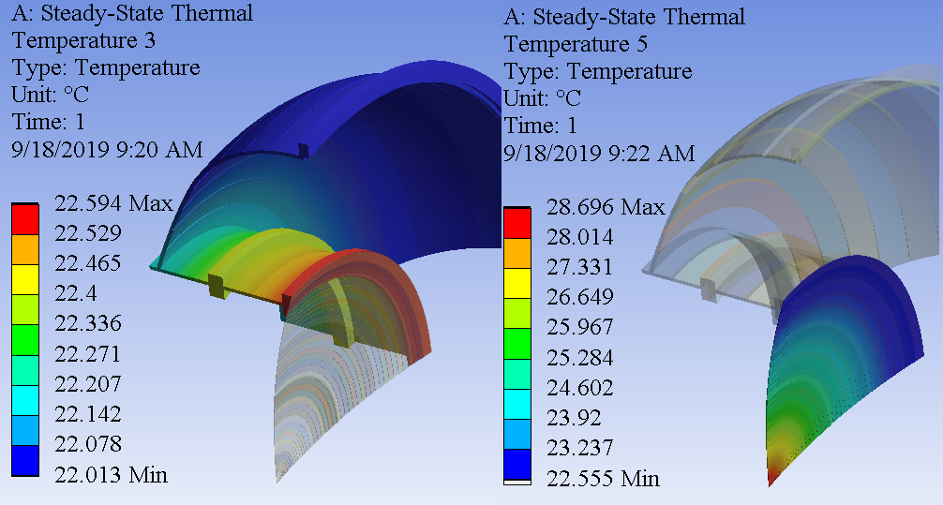
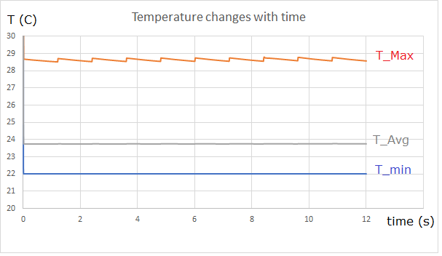
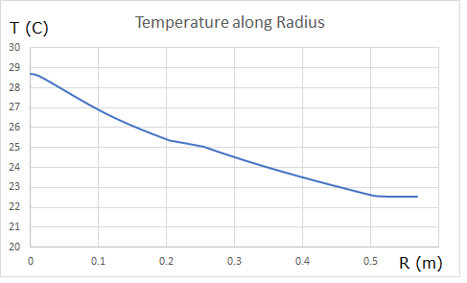
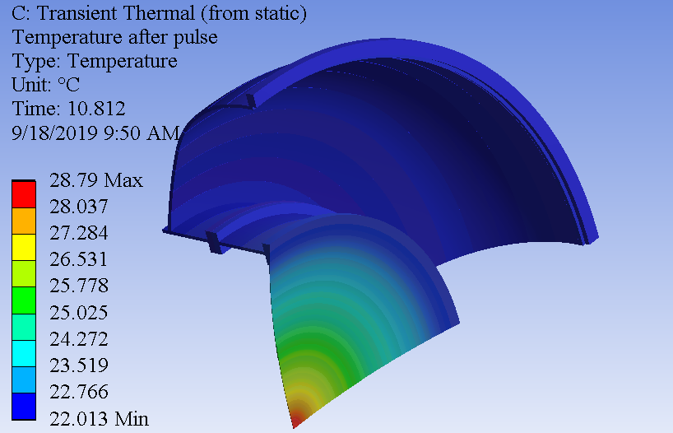
Temperature Solutions
Static temperature max.: 29 ºC
Temperature fluctuation: 0.2 ºC

Slide 6
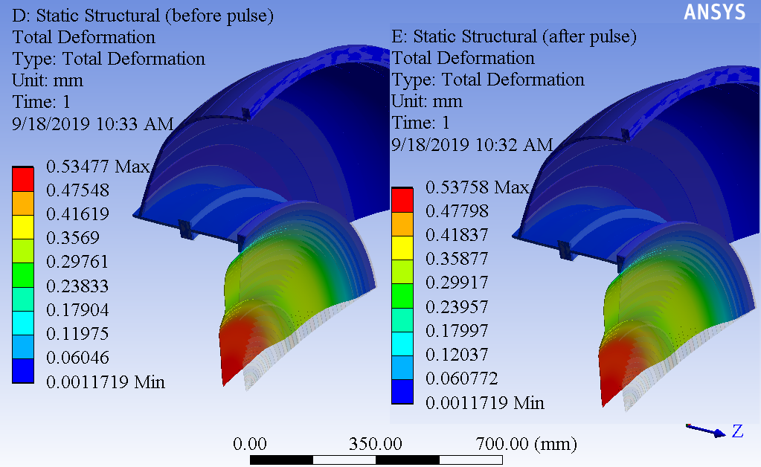
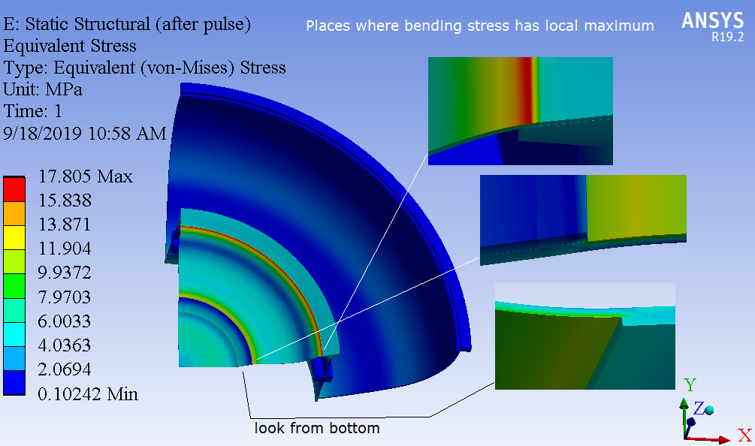
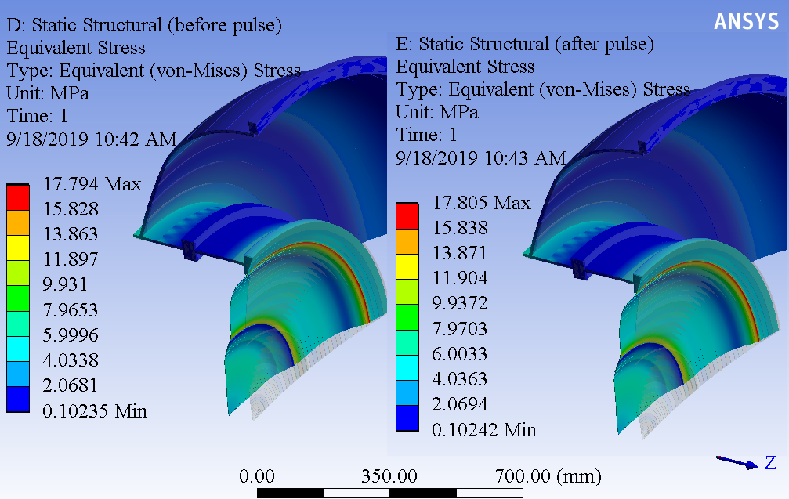
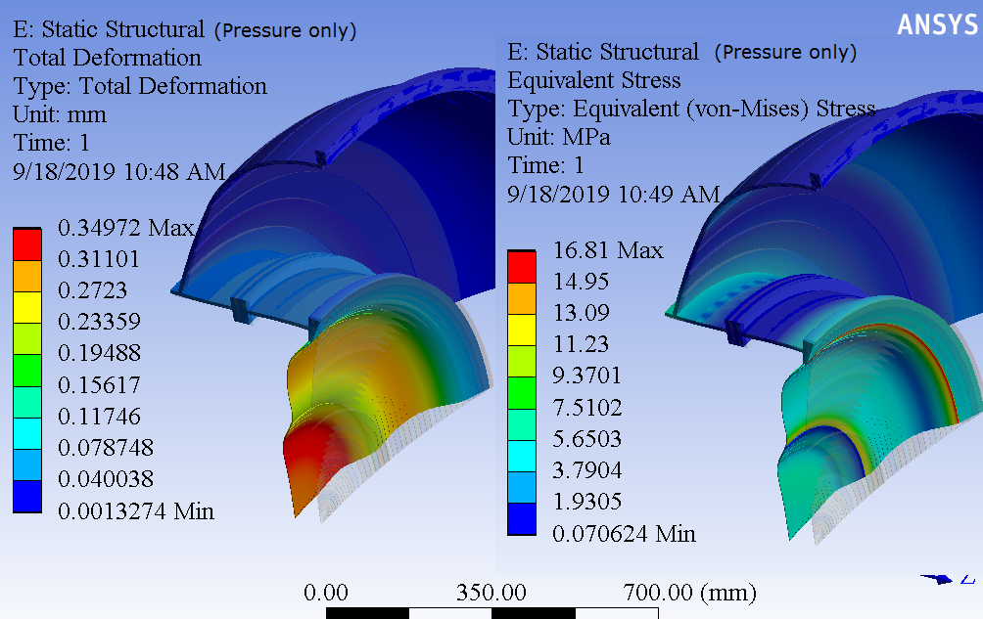
Structural Analysis
Displacement max: 0.54 mm
Detailed stress distribution near max stress
Equivalent stress max: 17.8 MPa
With pressure load only – main contributor

Slide 7
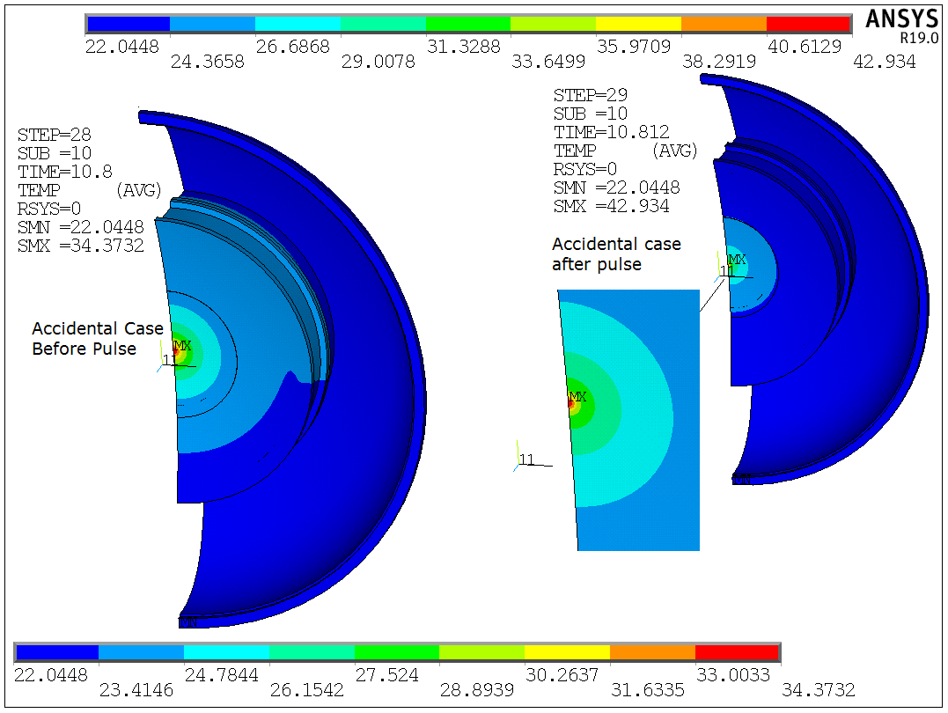
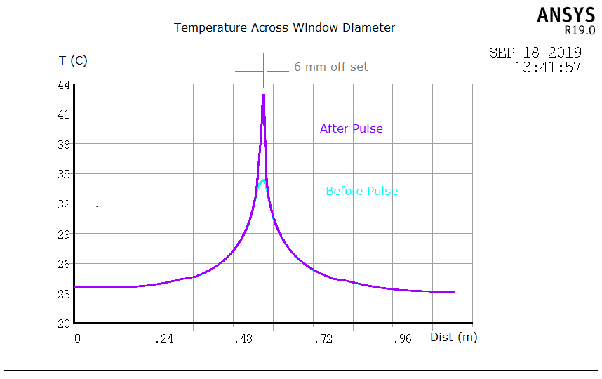
Under Accidental Condition
Temperature before and after pulse
Temperature distribution cross window along its diameter, max 8.5 ºC mostly limited within hot-spot

Slide 8
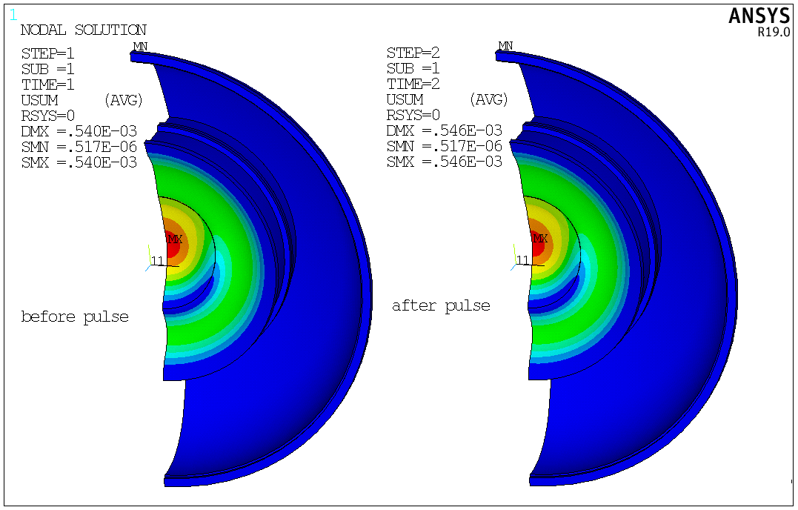
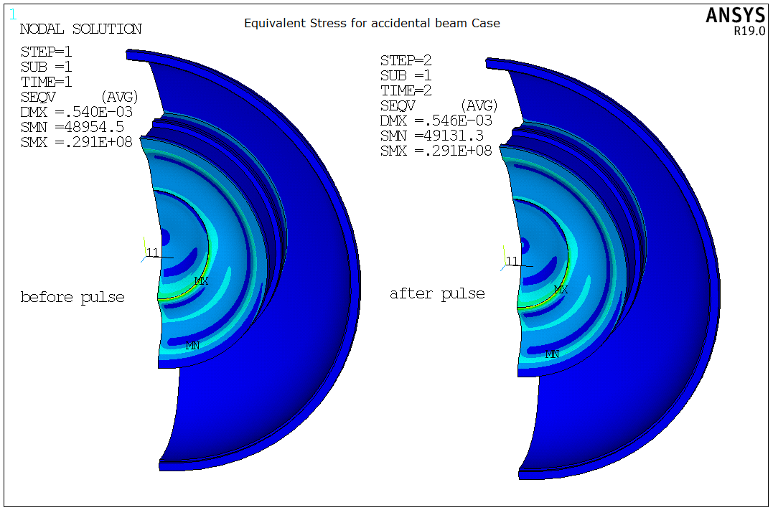
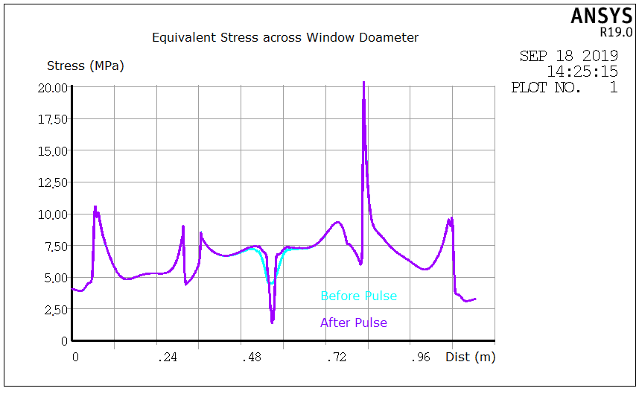
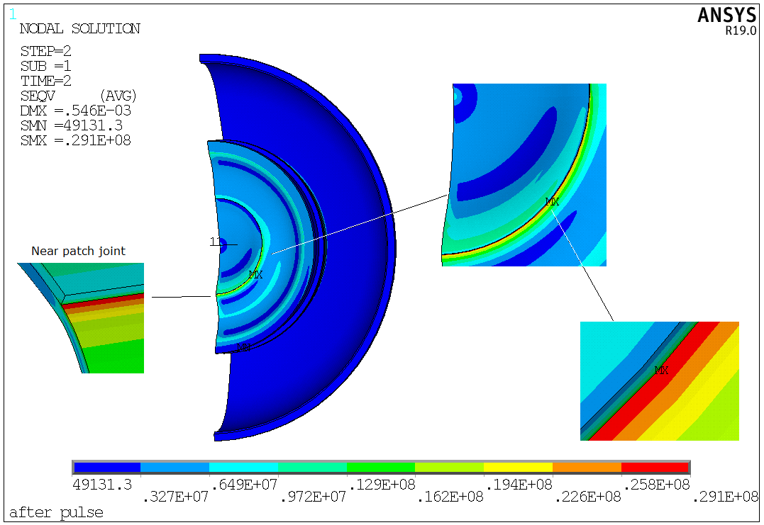
Under Accidental Condition
Displacement: no noticeable difference before and after pulse, except center spot
Equivalent stress: no noticeable difference before and after pulse, except center spot

Slide 9
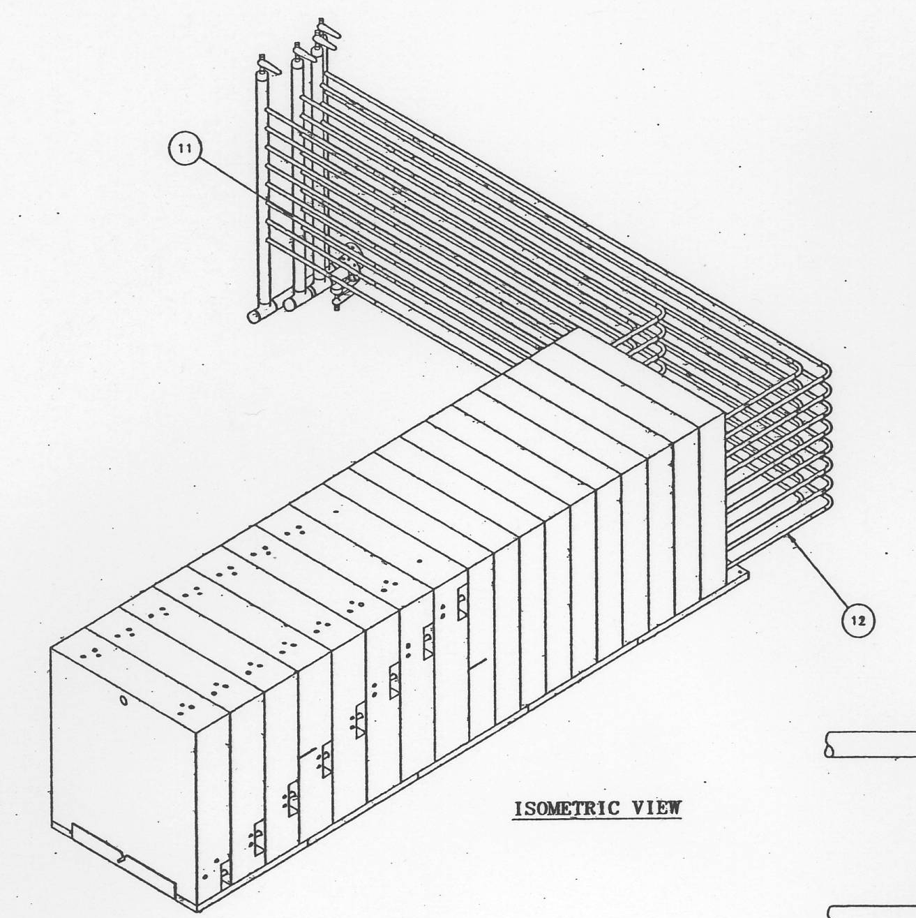
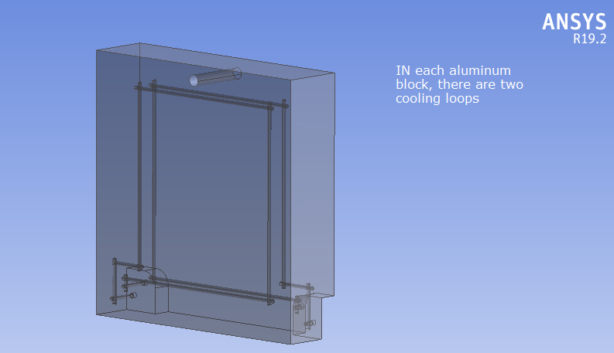
Hadron Beam Absorber
NuMI beam absorber core:
8 water cooled aluminum blocks, cooled by the NuMI absorber RAW cooling system.
10 steel blocks, not water cooled.
RAW cooling parameters provided by Des.
RAW Cooling Parameter | Values | Units
Total flow to absorber | 80 | Gpm
Cooling loops per aluminum block | 2
Number of aluminum blocks | 8
Average flow per block | 10 | Gpm
Average flow per loop per block | 5 | Gpm
ID of the gun drilled channel | 0.75 | in.
Avg.velocity in gun drilled channel | 3.59 | ft s^-1
Avg.velocity in gun drilled channel | 1.09 | m s^-1
Density of water at inlet temperature | 998 | kg m^-3
Inlet water temperature | 27 | C
Cooling channel D = 19.05 mm, circumference = 0.059847 m, length = 0.95 m, cooling surface = 0.056855 m². Each block has 2*4 = 8 channels, total cooling surface = 0.4548 m². Average heat flux is (assume normal operation, consider aluminum blocks only) 43066/0.4548 = 94692 W/m².
Water density = 998 kg/m³, specific heat = 4181 J/kg-K. Total cooling water flow is 80 GPM = 5.0472e-3 m³/s = 5.037 kg/s. Its cooling capacity is 5.037*4181 = 21060 W/K. For heat load of 43066 W, the temperature rise will be 2.045 K. The inlet water temperature is 27 C, we assume average cooling water temperature to be 28 C.

Slide 10
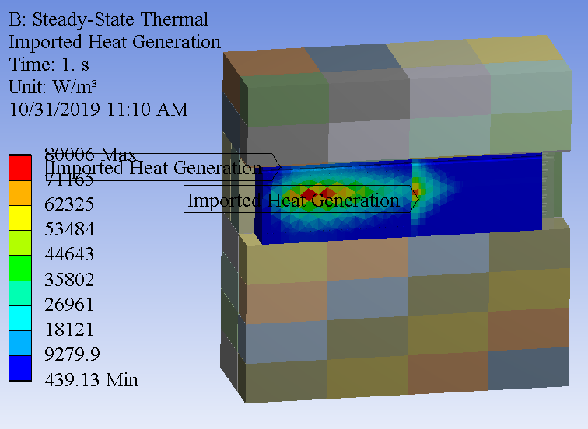
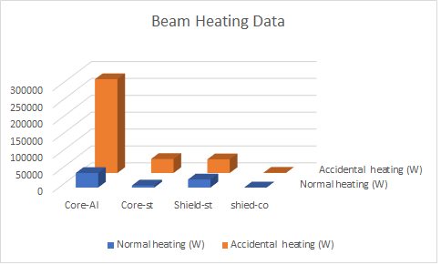
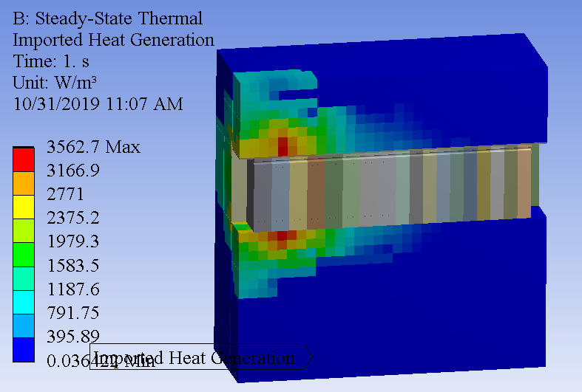
Beam Heating Loads
Normal Operation | Core |  | shielding |  | Total
 | Aluminum | Steel | steel | concrete
Total ED (GeV/proton) | 4.9691 | 0.694 | 2.7362 | 0.0314 | 8.4307
Normal heating (W) | 43066 | 6015 | 23714 | 272 | 73067
Accidental Case | Core |  | shielding
 | Aluminum | Steel | steel | concrete | Total
Total ED (GeV/proton) | 32.0188 | 4.7946 | 4.6678 | 0.084 | 41.5652
Accidental heating (W) | 277496 | 41553 | 40455 | 728 | 360232

Slide 11
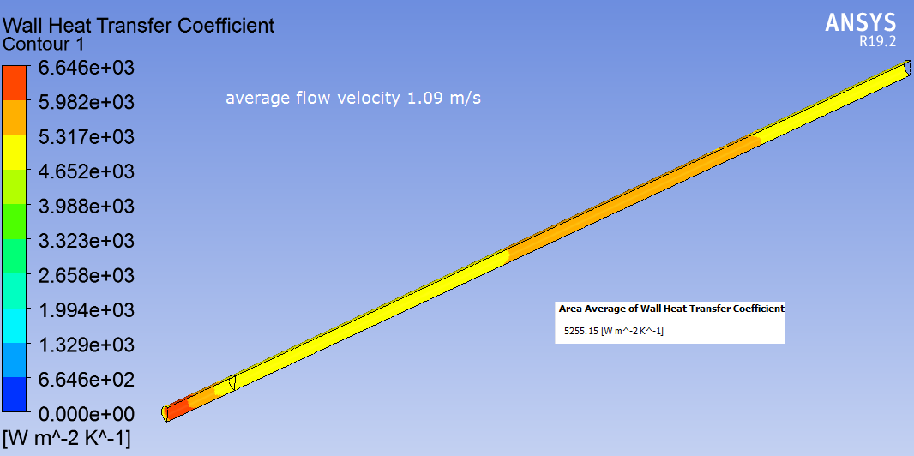
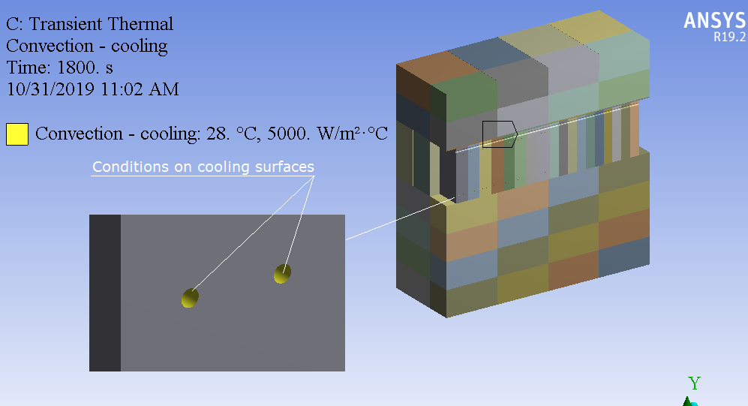
FEA Model Boundary Conditions
All the blocks (blocks in core and shielding blocks) are in direct contact, except those between core and shielding blocks in horizontal direction, there is a gap about 1/2 inch. For simplicity, we model this gap as a conduction layer with thermal conductivity of 0.05 W/m-K.
Since there is no specification about the outside surfaces, we have to make some assumptions. On the outer surface of the steel shielding blocks (top, bottom and side), we assume two kinds of boundary conditions.
  First is to assume boundary is insulated, there is no heat flux going in or out.
  Second is to assume boundary has the temperature of 50 C.
For both cases, we run a static thermal calculation to determine the temperature for normal operation.
Then run a transient calculation (start from the static solution) to see how fast the temperature rises when accidental case occurs.

Slide 12
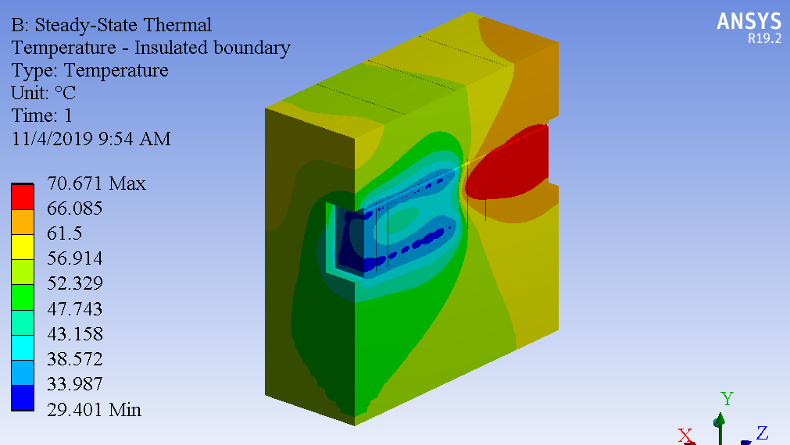
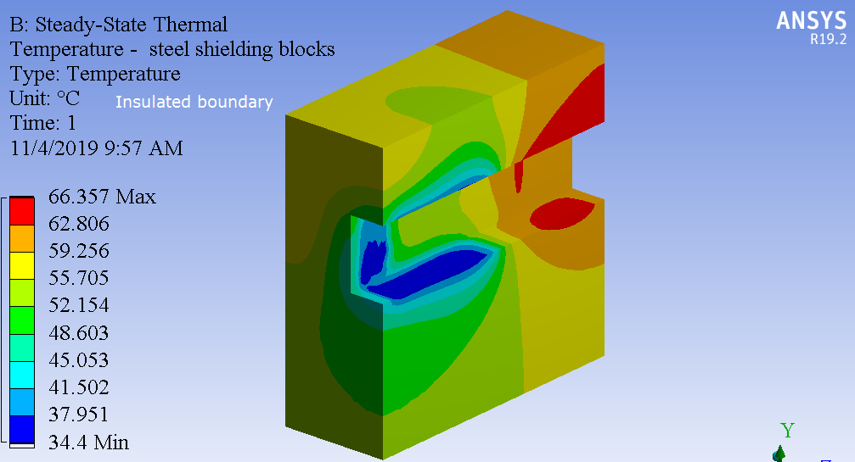
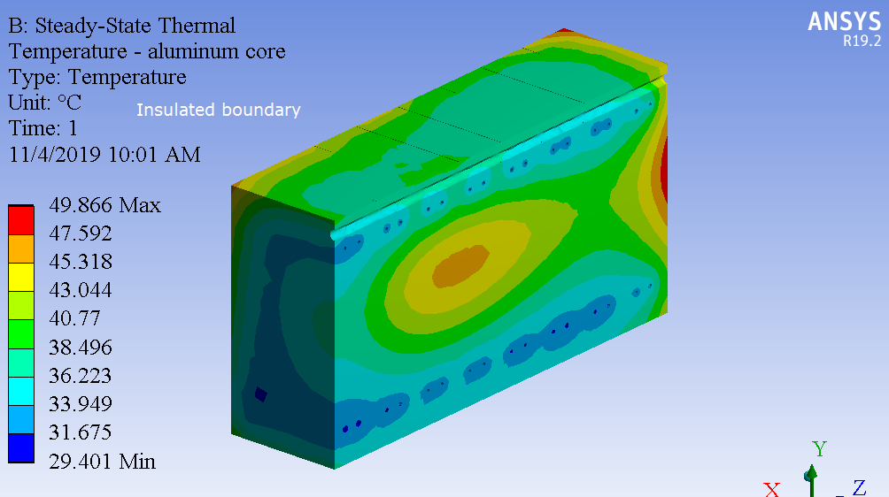
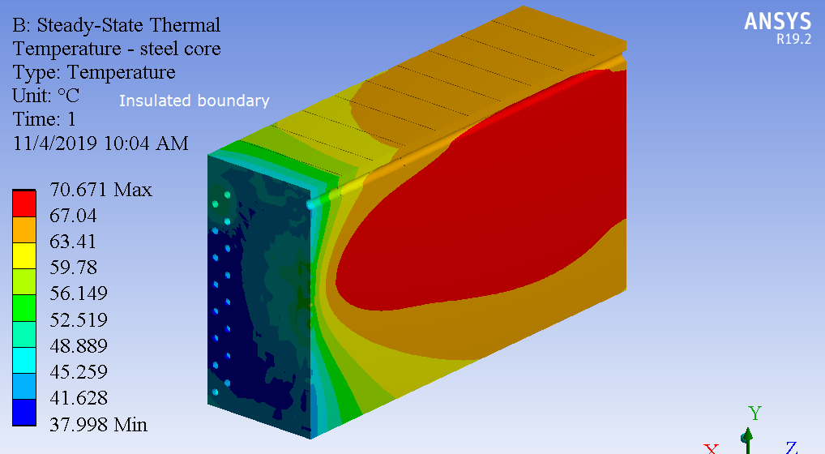
Temperatures – Assume Boundary Insulated
Static temperature max.: 71 ºC in Steel core

Slide 13
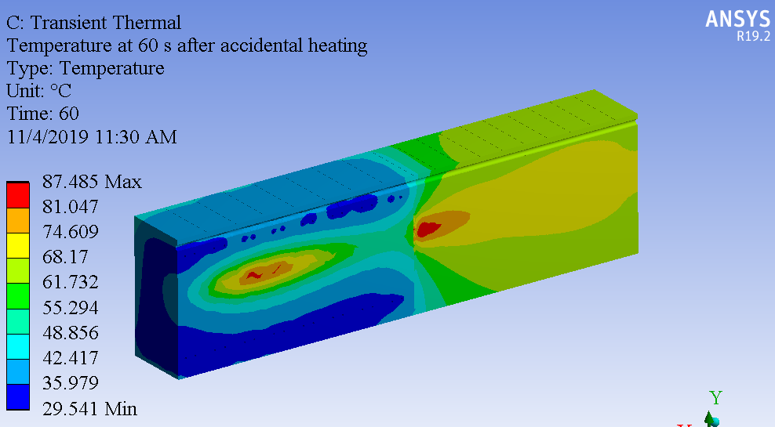
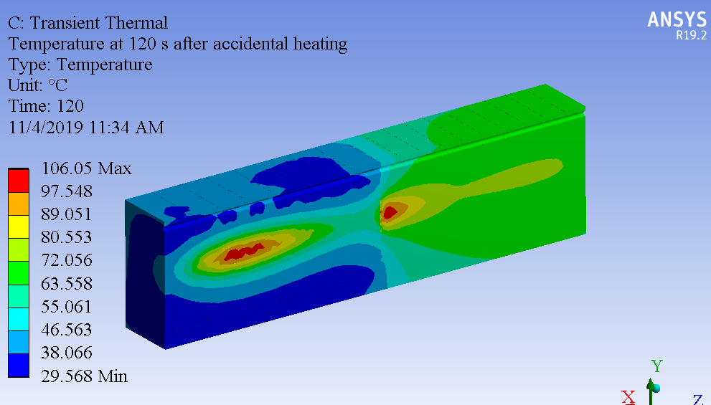
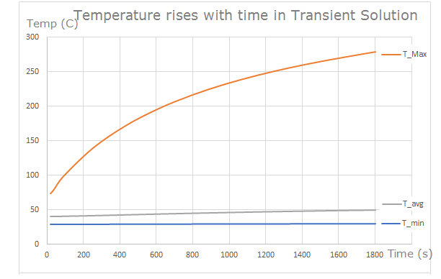
Temperatures after Accidental Heating Turned on
Although at the accidental condition, the temperature reaches high after a certain time, we know it would be just a single pulse with the machine protection in place.

Slide 14
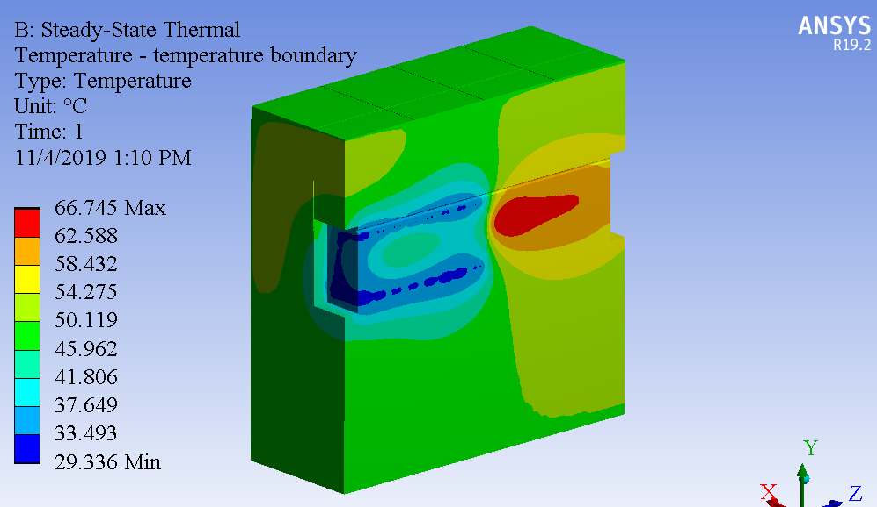
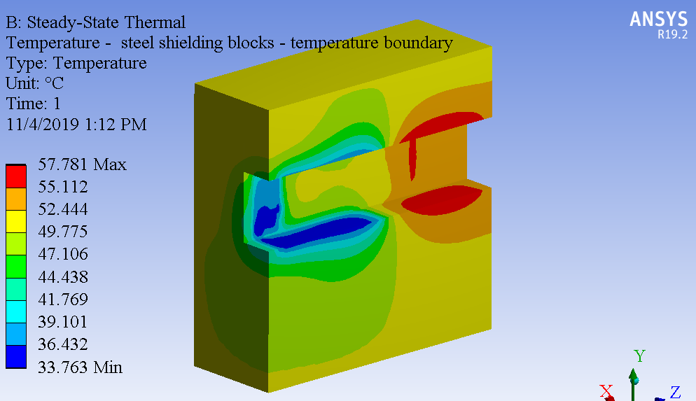
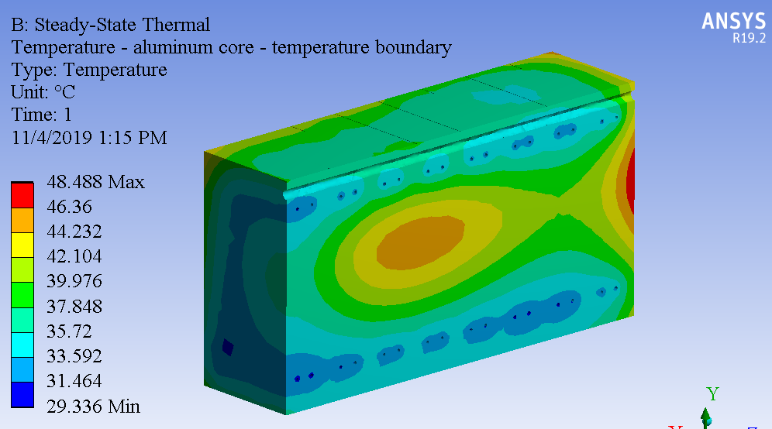
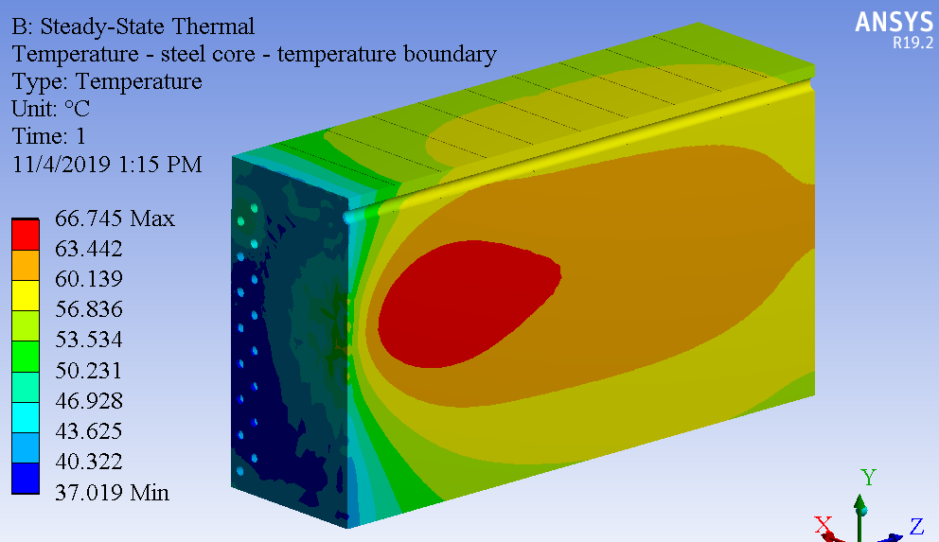
Temperatures – Assume Boundary at 50 ºC
Static temperature max.: 67 ºC in Steel core, The heat flux going out is 2335 W for this half model. That is 6.4% of the total heat load.

Slide 15
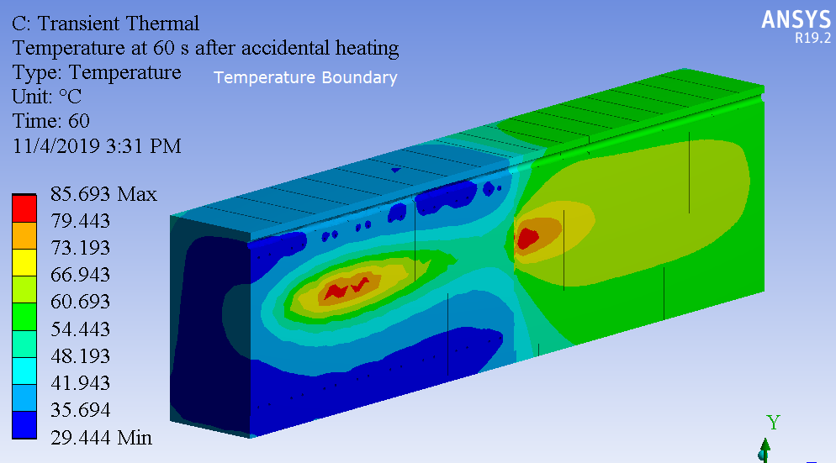
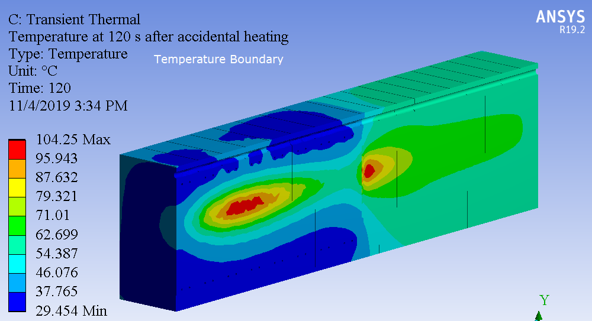
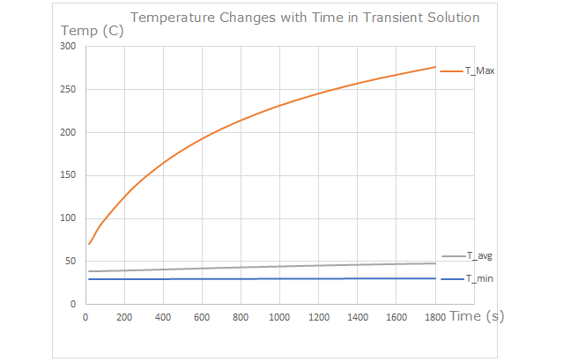
Temperatures after Accidental Heating Turned on
Summary:
The maximum temperature is about 67~71 C, in steel core blocks.
Transient temperature solution is calculated when accidental beam heating is turned on. The maximum temperature (both in aluminum core and steel core) can rise to 104~106 C within 2 minutes
Conclusion:
Temperature at the normal operations will be acceptable.
Although at the accidental condition, the temperature reaches high after a certain time, we know it would be just a single pulse with the machine protection in place.
Future plans:
Asses aging issues of RAW system
Install instrumentation for monitoring the absorber temperature

