Slide 1
IOTA Run-2 RunCo Report
Jamie Santucci
IOTA/FAST Meeting
December 20, 2019

Slide 2
Past week major accomplishments
All upgrades have been implemented
IOTA design current reached again: 1 mA
IOTA Flux Compensators fixed circumference issues
  Was 45mm short, now only 6mm short
Commissioning instrumentation and tools continues
  BPMs, Toroids, and Wall Current monitor
  Sync-Light: scientific cameras and PMTs
Prague noise filter for IOTA bend PS working
  Noise levels still need to be quantified
Approved experiments have started taking data
  Wakefield Effects on Beam Dynamics (FNAL/SLAC)
No significant downtime to report

Slide 3
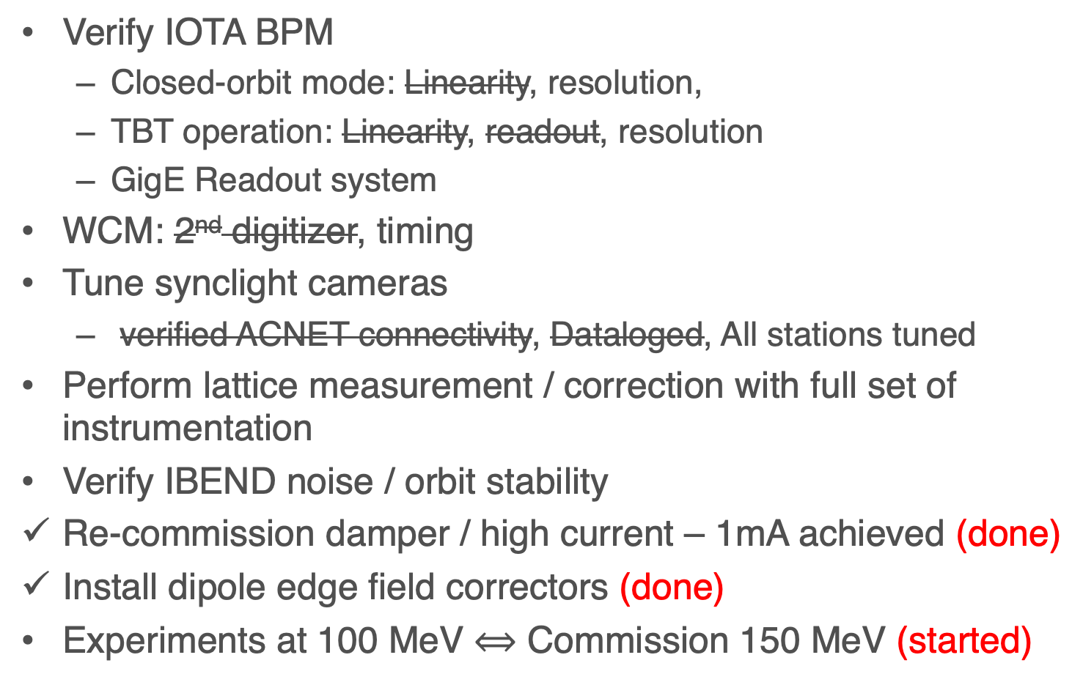
Next Steps / Priorities
Verify IOTA BPM
  Closed-orbit mode: Linearity, resolution,
  TBT operation: Linearity, readout, resolution
  GigE Readout system
WCM: 2nd digitizer, timing
Tune synclight cameras
  verified ACNET connectivity, Dataloged, All stations tuned
Perform lattice measurement / correction with full set of instrumentation
Verify IBEND noise / orbit stability
Re-commission damper / high current – 1mA achieved (done)
Install dipole edge field correctors (done)
Experiments at 100 MeV $⟺$ Commission 150 MeV (started)

Slide 4
Schedule for the rest of Run 2
Thursday 12/19: IOTA Beam commissioning
Friday 12/20: IOTA Beam commissioning
Saturday 12/21: Start of Octopole Shutdown
Wednesday 01/01: Last Day of Octopole Shutdown
Thursday 01/02: Start up and shake-down
  Day: Beam to HEA and IOTA
  Evening: IOTA Beam Studies
01/03 to 01/31 Shifts? First come first served!
Still need operators to sign up for shifts in the calendar
Remember to document EVERY change to the machine
Many January shifts available for experiments
  Sign up with the RunCo.

