Slide 1
ArgonCube 2x2 Bern Visit: Feb. 4-7, 2020
Linda Bagby
ArgonCube Electronics
February 20, 2020

Slide 2
Outline
Detector Power Configuration Options
Noise Scan
Cryostat Isolation Study
Summary

Slide 3
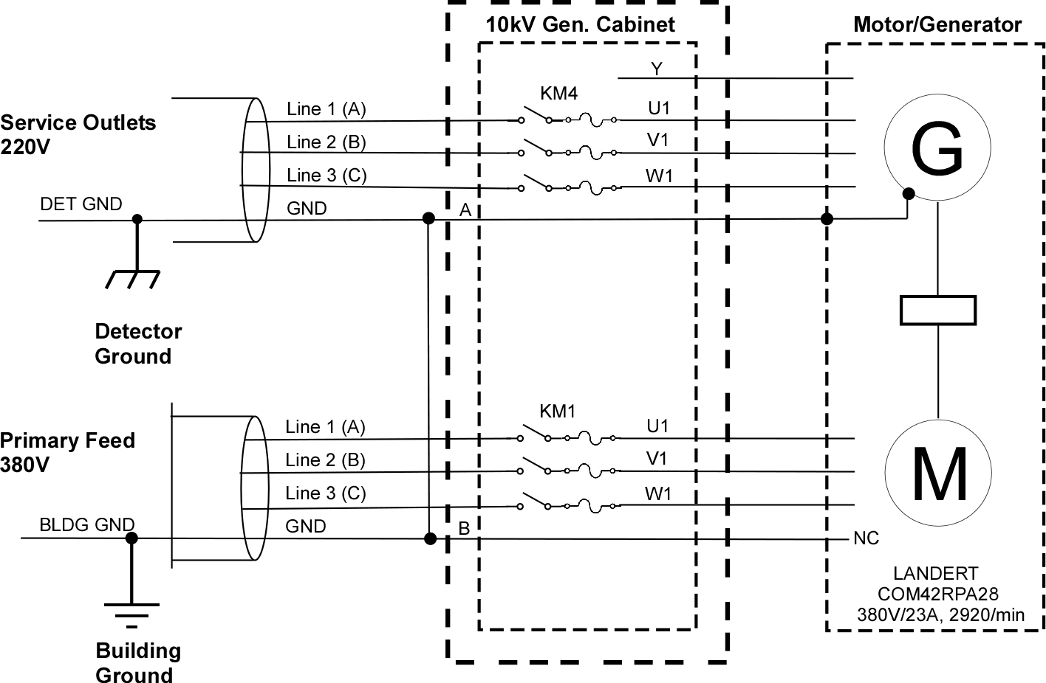
Current Configuration

Slide 4
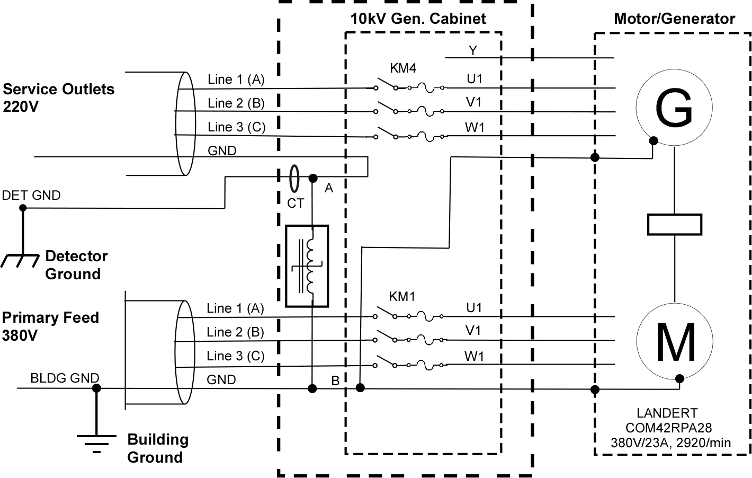
Proposed Configuration

Slide 5
System Comments
The body responsible for electrical safety should review and approve the changes to the system before implementation.
To monitor shorts as they occur, a current transformer (Pearson 2100, ~$500) and Impedance Monitor chassis (~$1500/parts) are required.
The Detector power distribution circuit outlets are housed in conductive enclosures. According to our NEC code, the ground wire must be electrically attached to the PDU housing. If the Swiss electrical code is the same, the enclosures need to be isolated from the railing and concrete floor.

Slide 6
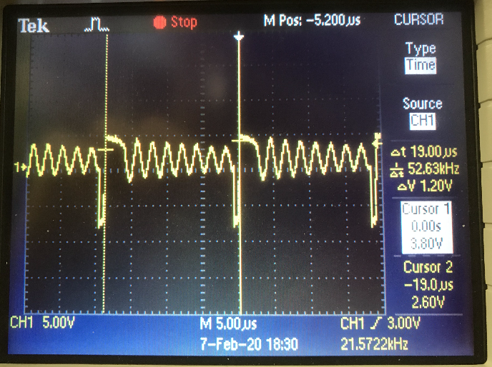
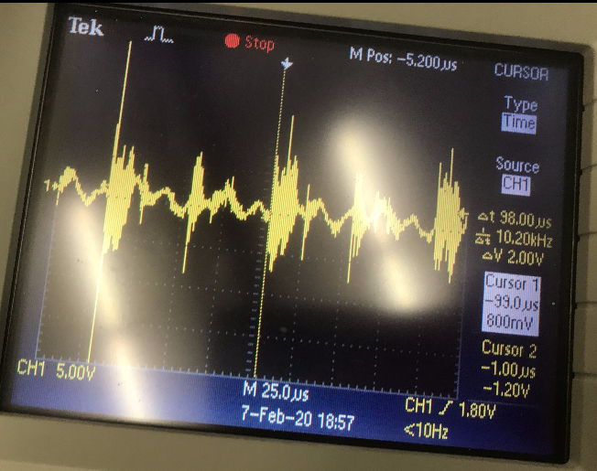
Noise Scan
Francesco and I performed a noise scan using a capacitive pick up probe and Spectrum Analyzer.
Measured EMI from pump VFDs and 10kHz throughout building.
VFD
10kHz

Slide 7
Cryostat Isolation
Francesco and I verified the cryostat is isolated by removing the internal pump AC power cord.
A 10K resistor was attached between the building ground and the cryostat to prevent charge buildup on the cryostat.

Slide 8
Summary
A proposed schematic for adding the saturable inductor and current transformer is provided.
A noise scan indicates a 10kHz noise signature—source unknown.
The cryostat is isolated and referenced to the building with a 10K ohm resistor.

Slide 9
Back Ups

Slide 10
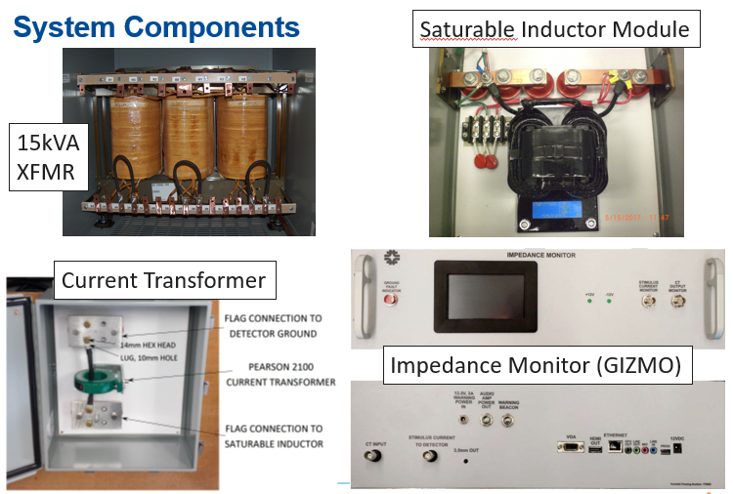

Slide 11
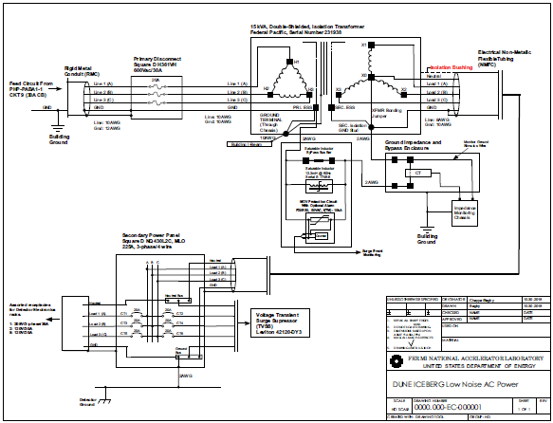
Example: AC Schematic for Detector electronics

Slide 12
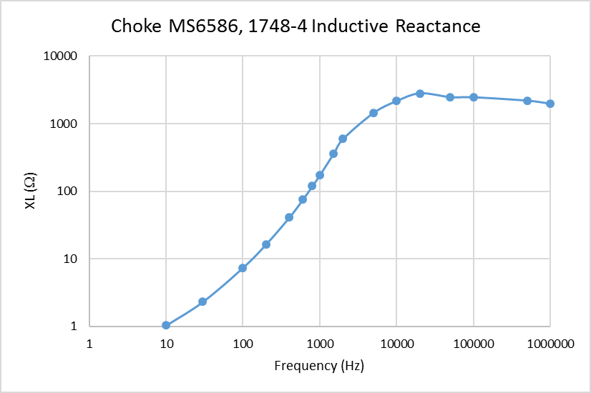
Saturable Inductor Reactance

Slide 13
Grounding Rules
Dielectric breaks on all cryogenic piping.
Detector electronics powered from ‘low-noise’ power.
Galvanic, or preferably, optical isolation required between equipment powered across the ground boundary.
Cable tray for copper cables between electronics rack and cryostat is isolated from building ground, connected to detector ground.
Identify Charge Readout grounding rules for
  Pixel Board
  Electronics
  HV Drift
Identify Light Readout grounding rules for
  Electronics
  Bias
Instrumentation
Signal and power cabling/shield treatments should be reviewed.

